Slide 1
Telco Customer Churn Prediction Project

Slide 2
1. Project Overview
- Objective: Predict which telecom customers are likely to churn.
- Business Value: Retain high-risk customers and reduce revenue loss.
- Dataset: Telco Customer Churn (7,000+ customers, 21 features).

Slide 3
2. Data Understanding
- Customer Demographics: Gender, SeniorCitizen, Partner, Dependents
- Service Details: PhoneService, InternetService, StreamingTV
- Account Info: Tenure, Contract, PaymentMethod
- Financials: MonthlyCharges, TotalCharges
- Target Variable: Churn (Yes/No)

Slide 4
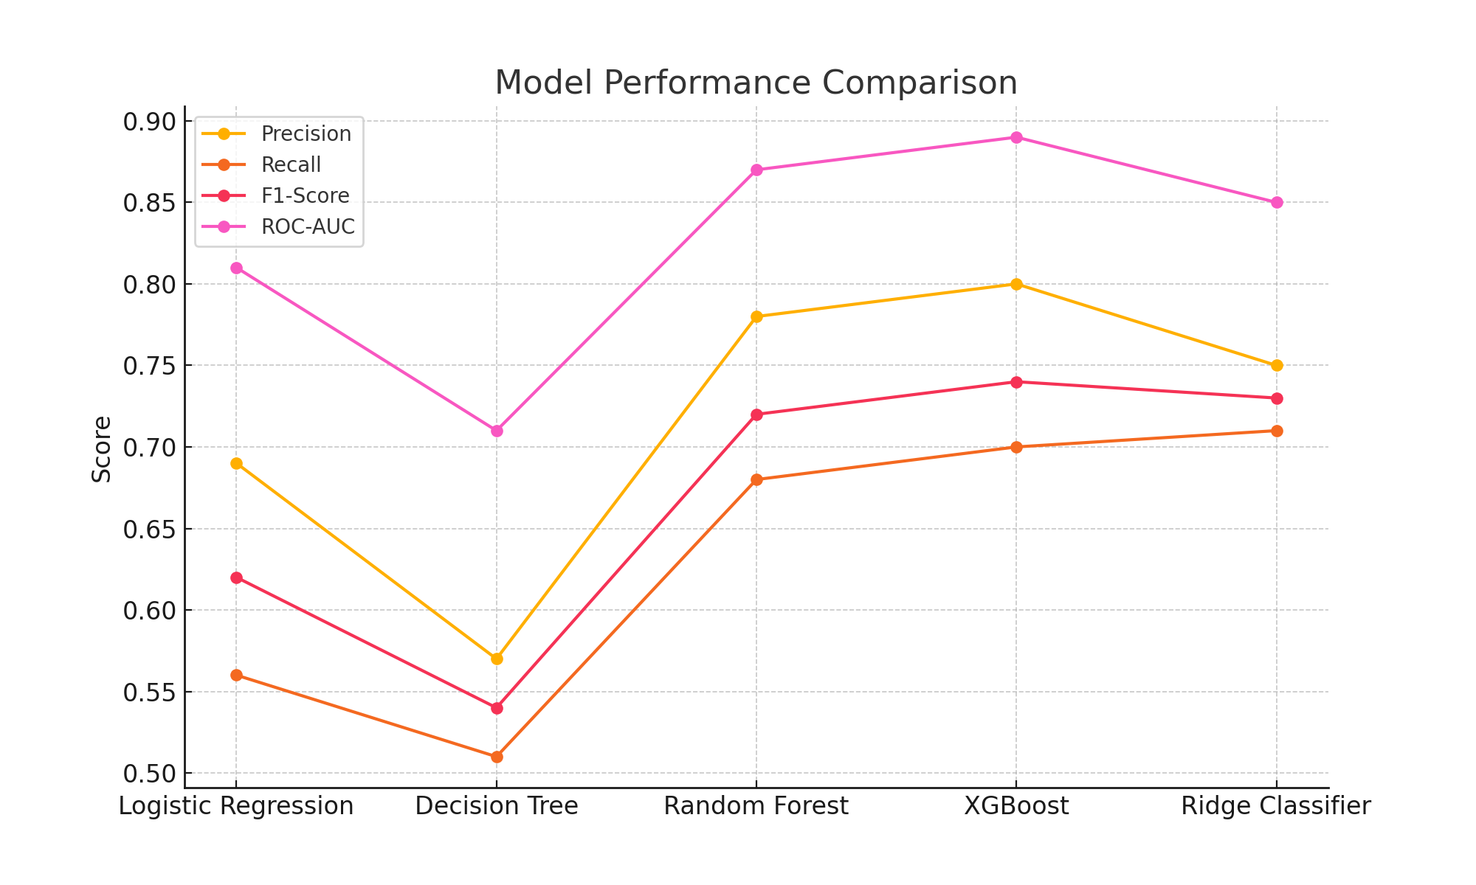
3. Model Performance

Slide 5
4. Feature Importance
- Contract_Month-to-month: High churn risk
- Tenure: Short tenure = higher risk
- PaymentMethod_Electronic check: Higher churn
- MonthlyCharges: Higher charges = higher churn

Slide 6
5. Recommendations
- Target month-to-month customers for retention.
- Offer discounts to high-risk customers (short tenure, high charges).
- Monitor model performance monthly.

