Slide 1
Human Computer Interaction
Section - 1
Group 20 - Bug Smashers
AU1940028 Moksh Doshi
AU1940120 Jaimik Patel
AU1940130 Nandish Patel

Slide 2
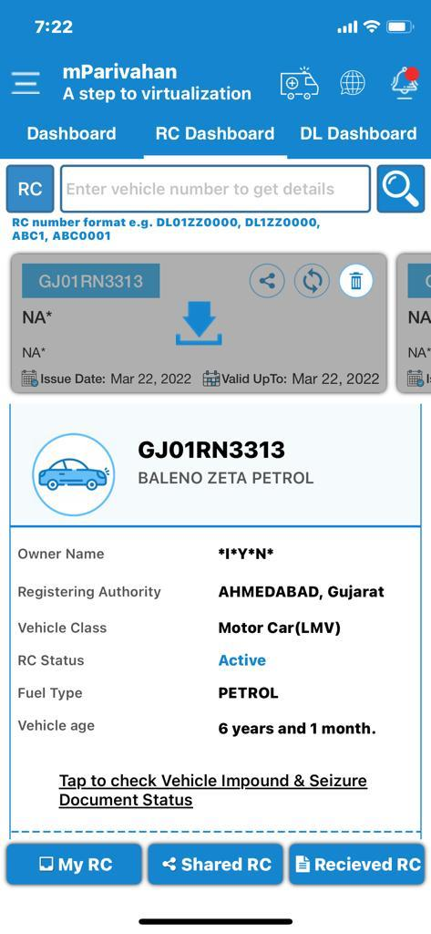
Motivation
Segregated services provided by the government
M-Parivahan - Save and view the registration certificate & licence details
Parivahan Sewa - Book slots, apply for licences, etc
Pay Ahmedabad Challan - To pay the e-challan of registered vehicles
Problems
Users are not aware of the websites
Hard to navigate user interface
Exploitation of system due to corruption
Solution
“DigiWheels” mobile app to provide a user friendly interface along with an integrated interface to carry out all the tasks related to on-road vehicles

Slide 3
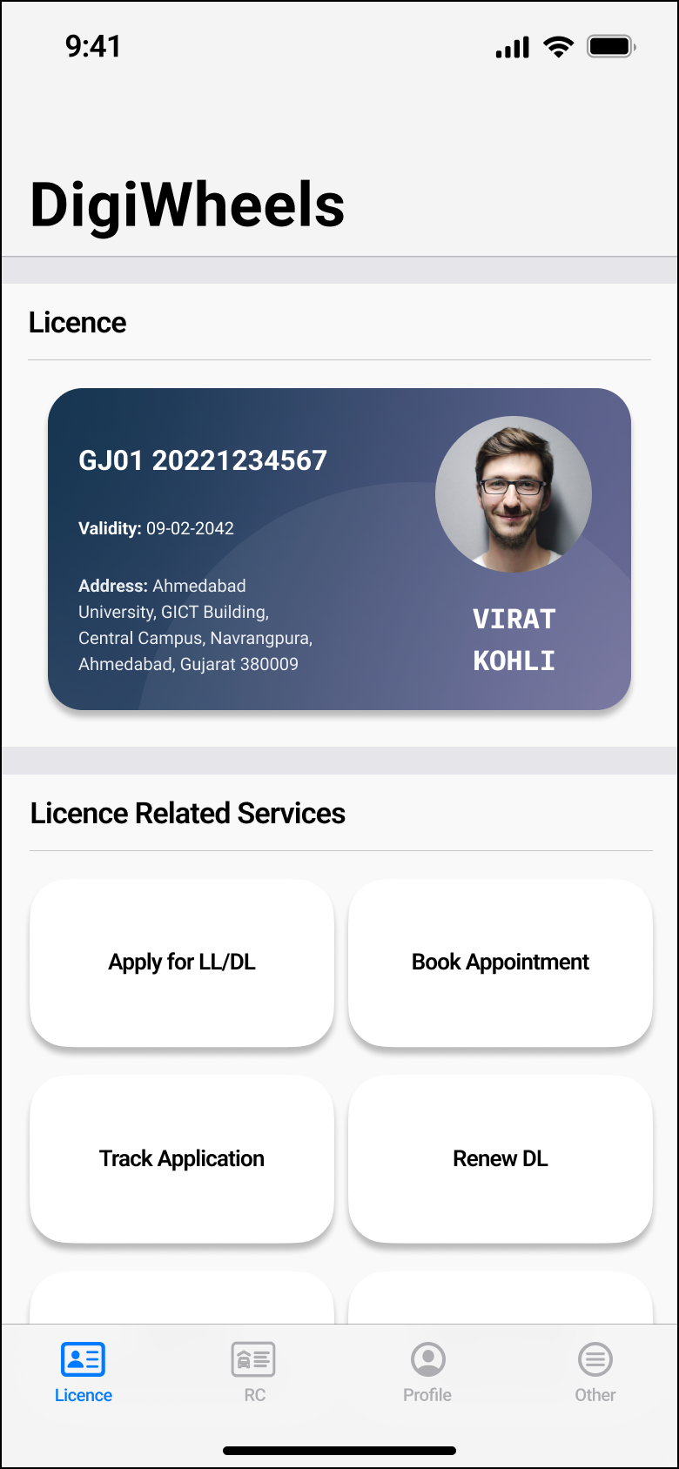
Project Overview
DigiWheels app provides users with effortless access to the transport information along with supplementary functionality such as licence application and other transport-related documents
The application will help user to:
Apply for a new learner/permanent licence
Save and view his/her driving licence
View details of vehicles registered to his/her name
View and pay traffic violation fines with his/her payment method of choice i.e. credit cards, UPI, wallets, net banking, etc
See if he/she is compliant with various traffic regulations such as a compulsory FASTag, valid PUC certificate and take necessary actions in case he is not

Slide 4
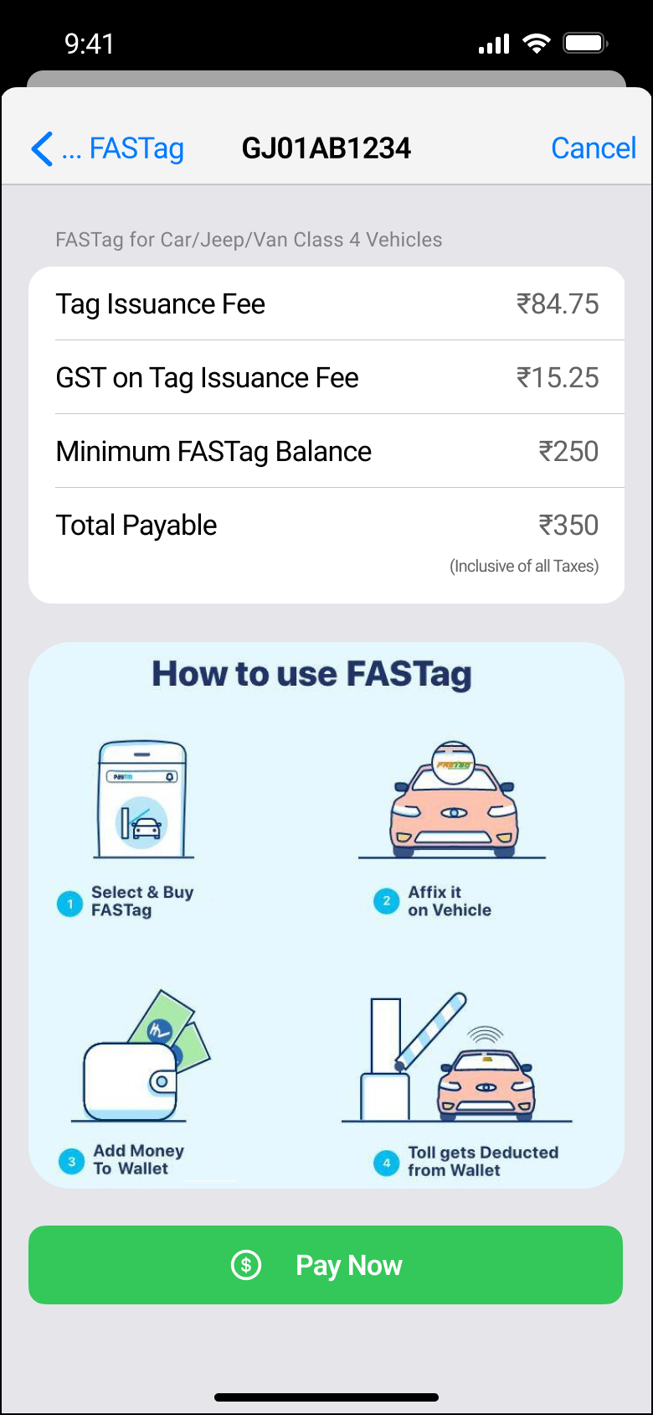
1 - Manage FASTag
Functionality
Purchase FASTag for registered vehicles
View FASTag balance
Recharge FASTag wallet
Universal Usability
Diverse Cognitive and Perceptual Abilities
By selecting a valid RC and making required payment FASTag can be purchased. A virtual FASTag is created linked to the Registration number by fetching all other data automatically from the system.

Slide 5
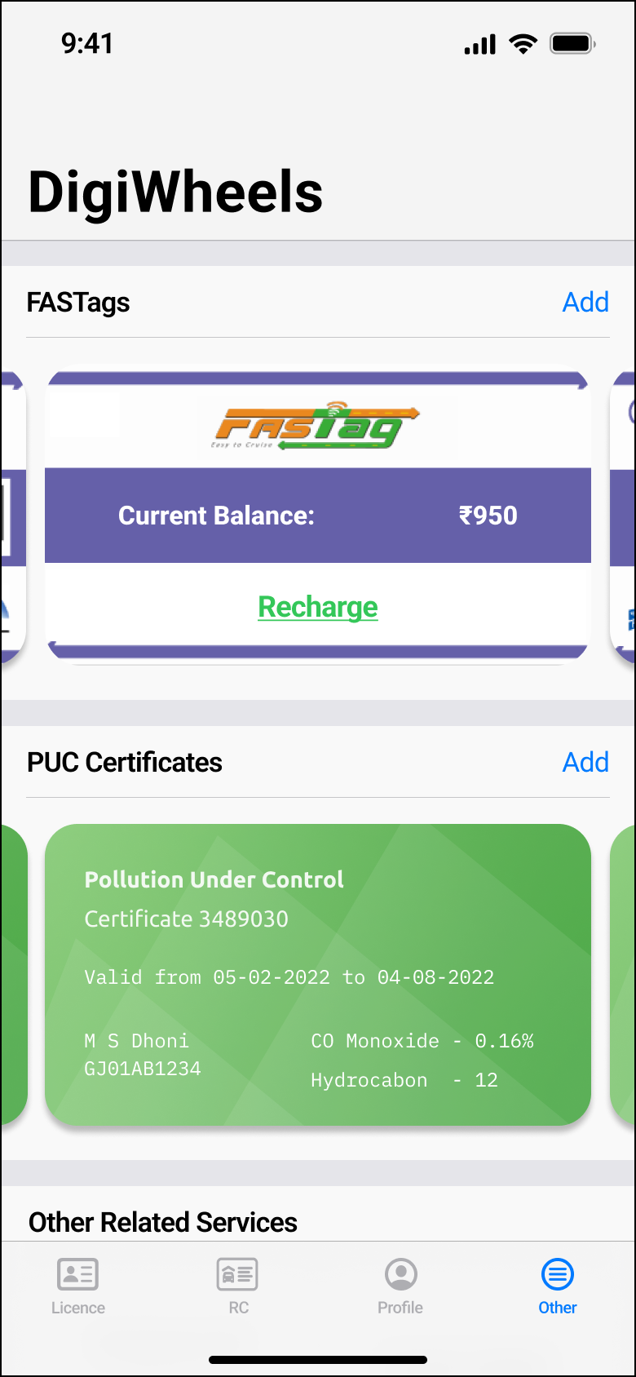
1 - Manage FASTag
Design Principles
Prevent Errors
Data is automatically fetched from the server. No need to enter and check whether the vehicle details are correct or not every time
Interaction Style
Form Fill In
Fill RC details and click on pay now option to recharge FASTag

Slide 6
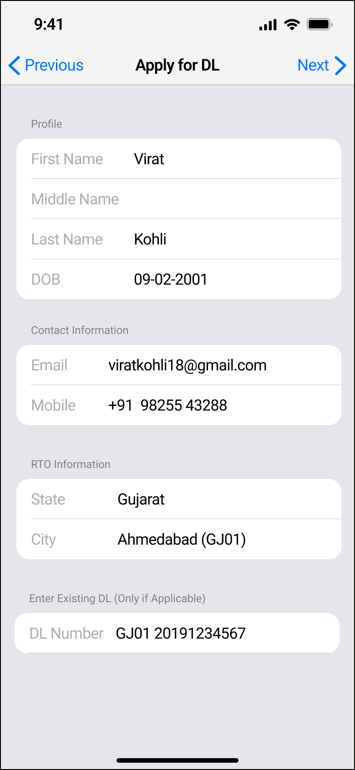
2 - Apply for Licence
Functionality
Fill details like name, age, gender, date of birth, email & more
Upload any government authorised ID like Aadhar, Pan, etc.
Take a selfie or upload a photo; e-signature for cross verification
Universal Usability
Diverse Cognitive and Perceptual Abilities: OTP will be fetched from the messages along with suggestion in the numeric keypad
Cultural and International Diversity: Data is validated by the system i.e., for numeric data, only T9 keypad is shown, for single option radio buttons are shown, etc

Slide 7
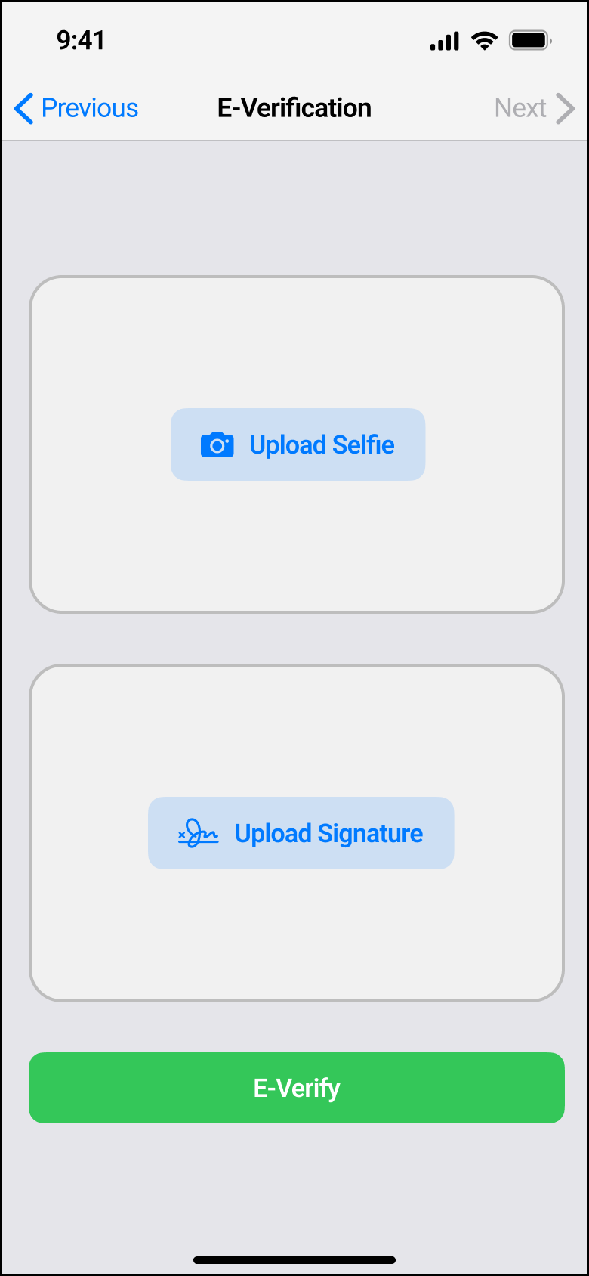
2 - Apply for Licence
Design Principles
Consistency: Similar fields are provided in the same font style and size, green colour is used for primary and secondary action elements
Reduce Short Term Memory Load: OTP is automatically fetched from the messages
Interaction Style
Form Fill-in: Form fill-in is required to enter the full name, email id, mobile number, etc in order to apply for licence
Menu Selection: User can select one or more options from the different vehicle checkboxes like MCWG, MCWOG, LMV, etc

Slide 8
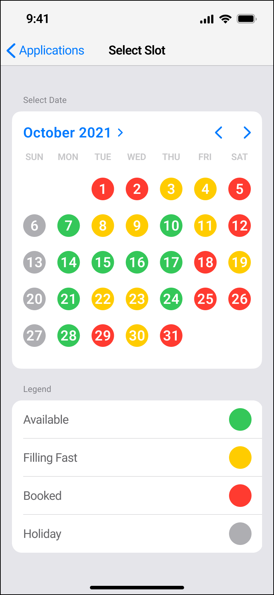
3 - Book slot for Driving test
Functionality
User is required to just select the date he want to book from the given available dates and then user is required to choose the time slot
After successfully selecting the slot user is required to pay the fee for the applied driving test through debit card/credit card
Universal Usability
Diverse Cognitive and Perceptual Abilities: Different colour coding for better visualization and help make a decision quickly
Cultural and International Diversity: Date and time of the booked slot is displayed in different formats

Slide 9
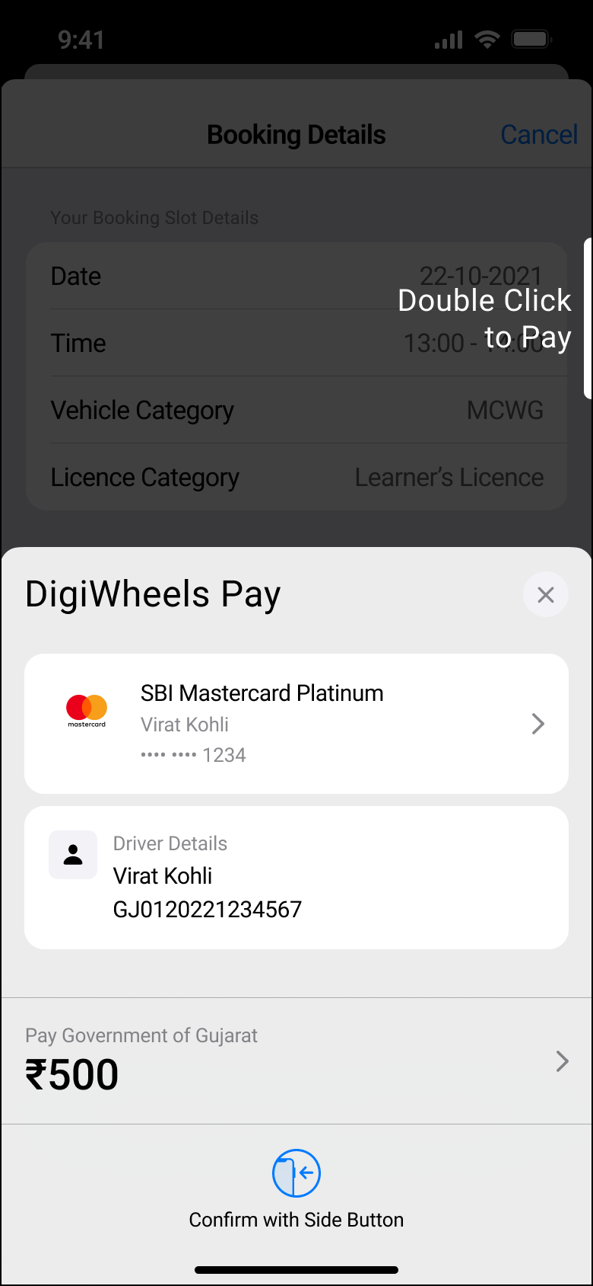
3 - Book slot for Driving test
Design Principles
Permit Easy Reversal of Actions : Multi level confirm dialogs and physical actions to prevent mistakes
Visibility: Dates displayed in different colours for quick inference according to their availability of the time slot
Prevent Errors: Colour is used to display error and blocking actions prevent further progress until the error is rectified
Interaction Style
Menu Selection: Selecting time slot slot; Selecting payment method

Slide 10
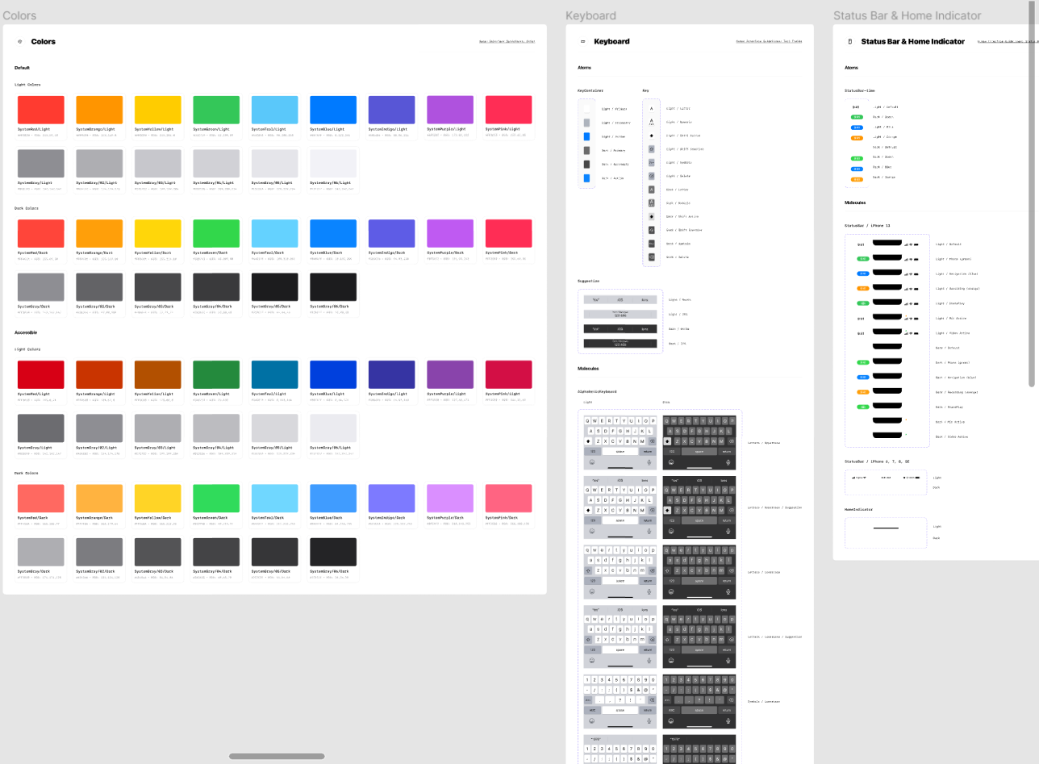
Difficulties Encountered
1. Finding pre-made components
2. Learning new design software
3. Maintaining consistency within different screens

Slide 11

Real Life Implementation and Challenges
Problems encountered:
Mobile platform consistency
Government approval is difficult to obtain as sensitive data is to be accessed
Proposed solutions:
Develop a consistent interface for iOS and Android
Use the existing mParivahan backend

Slide 12
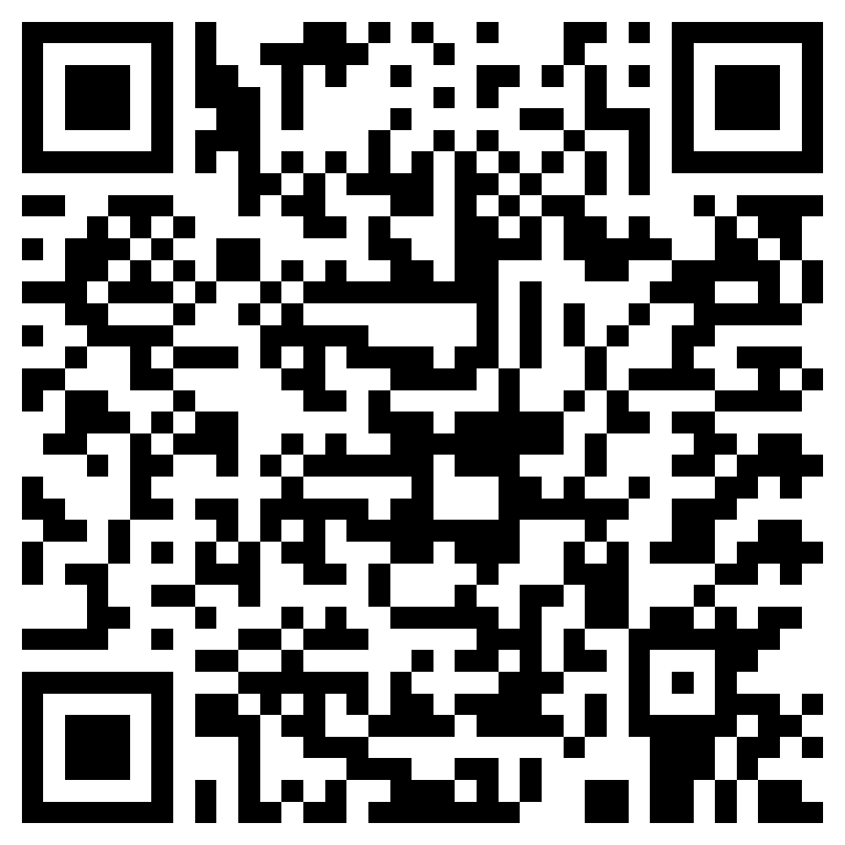
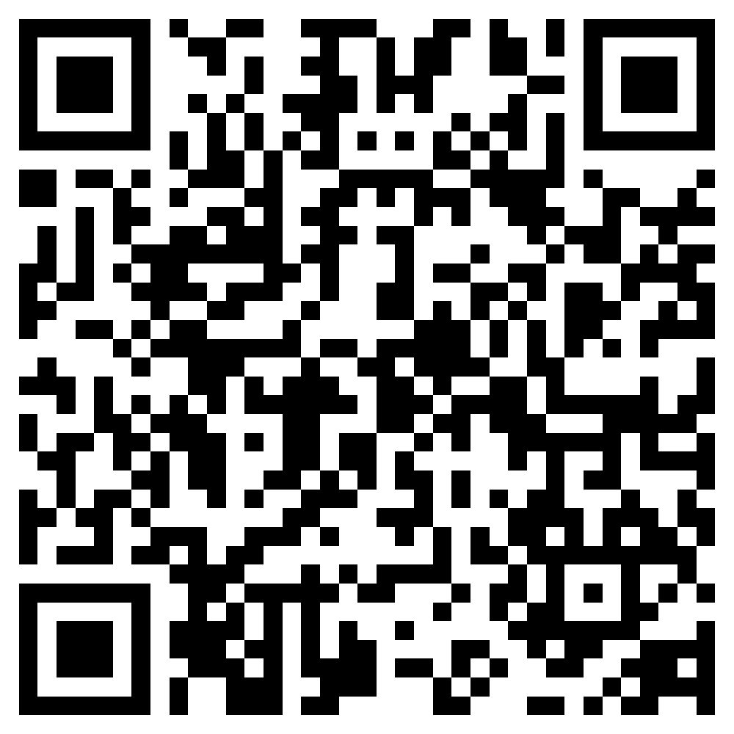
Demonstration
Figma: https://www.figma.com/file/F7DCzEMGs17EA10IySuPza/HCI-Project?node-id=135%3A165
Video: https://drive.google.com/file/d/1GHhnIvqvs5iwlPoguNeIvIALop8_qm1s/view?usp=sharing

Slide 13
Learning Outcomes
Learnt the process of creating user-friendly, easily navigable and minimalist interfaces keeping in light HCI theories, terms, principles, and methods
Compared and appraised various distinct designs to gain a thorough knowledge on interface from an HCI biased view
Constructed conceptual basis to design HCI that includes: problems, goals, user interaction style, as well as user-centric interface design
Got acquainted with tools and technologies in order to prototype and visualize the end-user design
Effective and efficient collaboration in teams

Slide 14
Thank You

