Slide 1
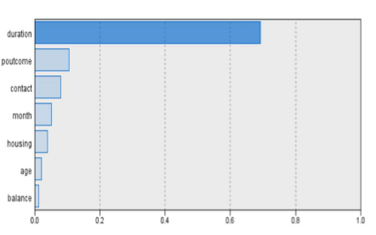
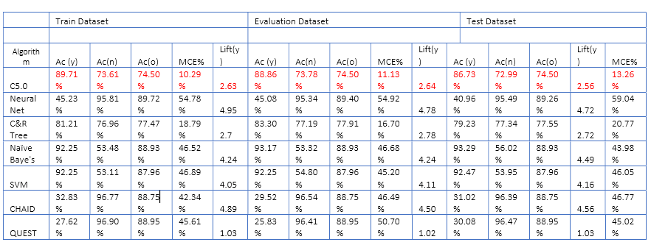
BANK MARKETING WITH DATA MINING BAROONA
INTRODUCTION
A financial institution is an organization which deals with monetary transactions like deposits, investments, loans and currency exchange. It has dedicated and remarkable resources with great business acumen. This poster is based on the data set of a Portuguese financial institution which conducted a tele-marketing campaign to attract potential clients by requesting them to subscribe to a term deposit in their bank. A term deposit is a transaction where monetary investments are carried out with a reasonable rate of interest over a fixed term.
CLASSIFICATION
The sample data was divided into three parts Training(13498 obs, 60%), Evaluation(4555obs, 20%) and Testing(4553obs, 20%). Various modelling algorithms like C5.0, Nnet, C&RT, Naïve bayes, SVM, CHAID, and QUEST were applied where term_deposit_subscribed was a response variable.
BEST MODEL SELECTION: The best model is C5.0 with 30% pruning severity, 500 minimum nodes in child branch, with global pruning, with cost ratio of 9:1, with overall accuracy of 74.5%, with 73% accuracy and lift 1.11 for class ‘no’ and with 89% accuracy and lift 2.6 for class ‘yes’. We wanted to correctly identify ‘yes’ labels so we compromised the overall accuracy and class ’no’ accuracy.
CONCLUSION
The C5.0 Decision Tree was the most suitable model for this data. The duration of the call had the highest impact on the subscription procedure i.e., higher duration yielded successful subscriptions and vice-versa. Also, the previous marketing campaign’s result had a fair influence on the target viz, poutcome’s success ensured that the client opted to invest again for 90% of the times. Among the small percentage of investments, most of them were after the end of a financial year (May-August). During this period, dedicated communication centres aid in better customer interaction through various channels like the telephone (wired/mobile) and digital (state-of-the-art). This model works quite efficiently on a new dataset in this domain.
FUTURE RESEARCH: we suggest that latest data should be used to yield a better model, ideally, by adding several characteristics which are not associated to the contact execution such as demographics of the client (eg: place of residence, annual income etc).
DATA PREPROCESSING
A 50% sample from the original bank marketing dataset was taken as a subset and analyzed. The new dataset contained 22606 observations and 16 predictor variables. It required feature engineering to ensure consistency.
The variable Age (continuous) was divided into three categories: Youth (18-35 years), Workforce (36- 59 years) and Retired (> 60 years).
For the poutcome feature, the "other" observations (900) were merged with "unknown" as they belonged to the same hierarchy.
Lastly, the target variable “y” which indicates if the term deposit was subscribed to or not was renamed as “term_deposit _subscribed”.
RESULTS
The main 3 key features that are responsible for subscription of term deposit were call duration, outcomes of previous campaign and medium of contact. The results of decision tree generated by model depicted that more a client spent time on conversation especially through telephone were more likely to subscribe in future.
In addition, if client previously subscribed for term deposit and is in contact on frequent basis then s/he is more likely to subscribe in future also. The outcome of the previous campaign creates a massive impact on the result. If the previous outcome is success, a client is 90% likely to opt for the term deposit again.
The ideal months for contacting a client is during the mid-year (May to August). During these months, 71% of the people have subscribed for term deposit.

