Slide 1


COMP8851 – Industry based Internship(Part-time) Session / Year – Session 2 / 2020 Student ID – 45539510
BY – Nandish Patel

Slide 2
Table of Contents
1. Background Information of trUUth
2. Position and Responsibilities
3. Skills developed
4. Conclusion and Future work

Slide 3
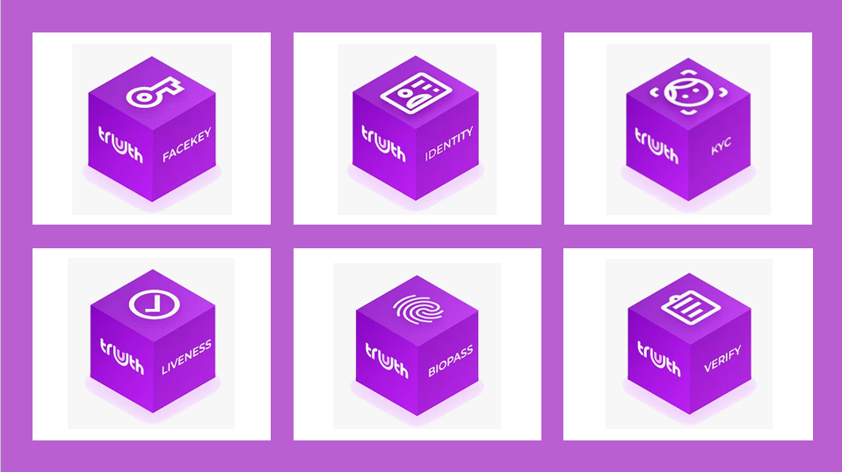
1. Background Information
Recognized identity is the first right we get as a person. It is the key to several rights and services. Identity theft has been evolved with the evolution of technology.
A goal of providing a safe and secure cyber world was set by the people at trUUth. trUUth is a Sydney-based software development start-up. At trUUth, our mission is to provide the world's most secure, accurate and user-friendly digital identity service.
To tackle the issues faced in the cyber world and to provide passwordless authentication, fraud detection, digital onboarding and other identity services, trUUth developed “trUUth Suite”.
UU in trUUth stands for Universal Unit – a new global data currency.
trUUth Suite

Slide 4
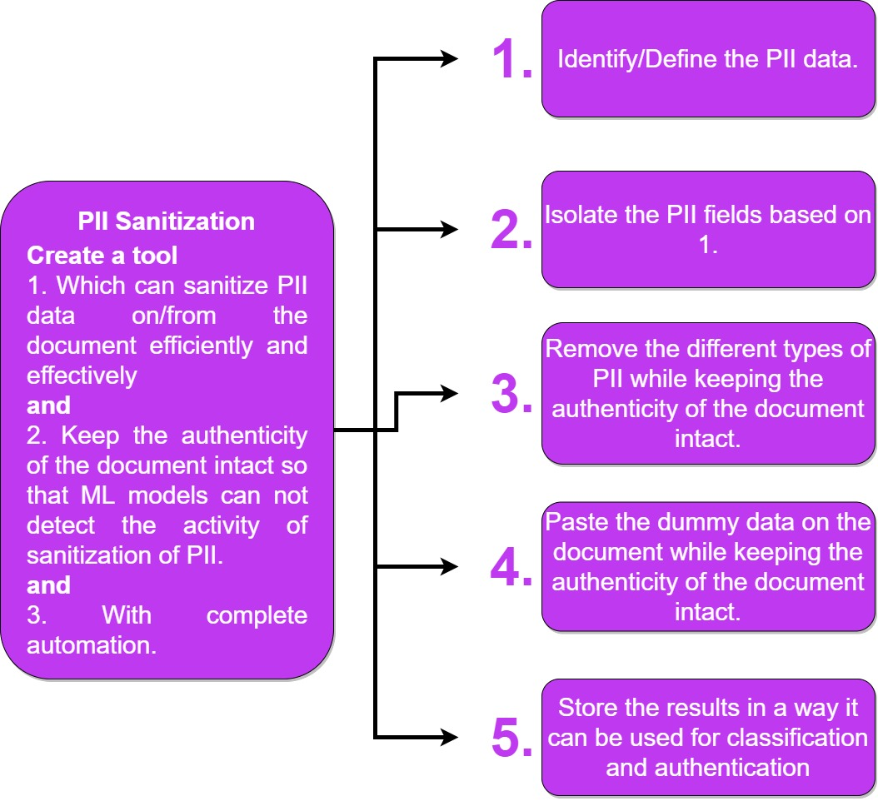
2. Position and Responsibility
I am working in the Documentation stream under R&D department as a Data Science Intern. The primary objective of my internship was tailored to the task ID Document Classification but later it was shifted to the task of PII(Personally Identifiable Information) sanitization.
The problem statement is “To formulate an algorithm which can sanitize PII data from the ID document efficiently and effectively while keeping the authenticity of the document intact without any human intervention”.
Problem Statement

Slide 5
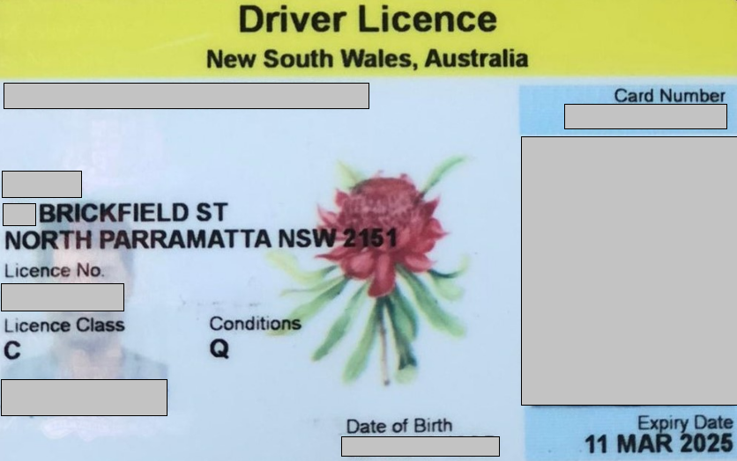
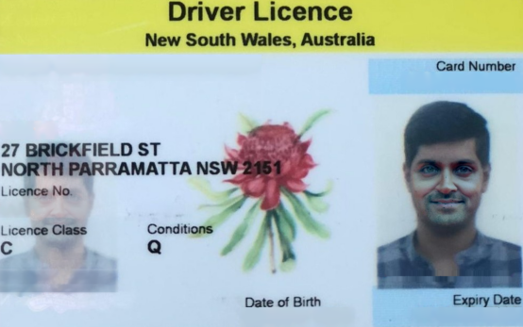
Work Sample
Source Document
Altered Document

Slide 6




3. Skills developed – Soft Skills
 | Academic Research Skills – As a data science novice, I was always too excited to jump into data modelling. But while working at trUUth I have learnt that literature review is a crucial part in any data science project, and It could really help laying a strong foundation.
 | Documentation Skills – Documenting the progress of the stream is also as important as implementation of the stream objectives. The presence of documentation helps keep track of all aspects of the stream and it improves on the quality of the stream. The primary use of the documentation is knowledge transfer.
 | Collaborative Skills – It’s not about one-man army. Every team member has a unique skill set which can be utilized for better results.
 | Big Picture Thinking Skills – One of the most important skill I have acquired while working at trUUth was to be able to address the problem while keeping the future requirements in mind.

Slide 7

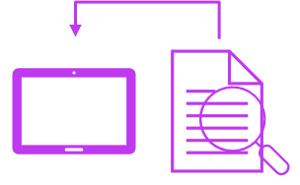


3. Skills developed – Technical Skills
 | Data Modelling – By fitting variety of ML(Machine Learning) and DL(Deep Learning) models to achieve the task of ID Document Classification, I have been able to grasp a deep understanding of widely used supervised & unsupervised ML models along with a few DL models. After struggling with large image datasets, I have acquired the skills to undertake the analysis and modelling of the large datasets.
 | Optical Character Recognition – I was able to get hands-on experience of widely used OCR tools such as Google Vision and Amazon Textract.
 | Computer Vision(CV) – The primary focus of my internship was based on images of the ID documents. I have created various solutions for PII sanitization and in doing so I have acquired the advance level expertise in CV libraries, packages and functions in various programming languages. I also possess the deep knowledge of a few state-of-the-art concepts in the field of CV.
 | Programming Skills – Upon building most of the solutions in Python, I have developed the knowledge of advanced concepts in Python. Moreover, I have learnt to write code with higher reusability and interpretability. In addition to that, I have developed the skill of code documentation.

Slide 8
4. Conclusion and Future work
My journey with trUUth has been a brilliant span of time. With no prior professional experience, I stepped into this startup and it was absolutely worth it. I acquired new skills and embraced the opportunity of picking the minds of vastly experienced leadership. One of the major takeaways from trUUth was to be able to cultivate a mental model that drives achievement and motivation. All in all, I feel that I have headed an inch closer to my goal of becoming a reliable data scientist.
I will reinvent myself by leveraging the skills acquired at trUUth and I would love to continue working at trUUth if given an opportunity to if not I will continue the journey of becoming a great data scientist.

Slide 9
Thank You

