Slide 1
RETAIL PROJECT
E-COMMERCE WEBSITE

Slide 2
Table of contents
Team members
1
RETAIL
Sprint 1
2
Sprint 2
3

Slide 3
01
TEAM MEMBERS
RETAIL

Slide 4
1.Mahfooza
2.Meghna
3.Nandita
4.Prerana
5.Mithali
6.Naija
7.Gowri
8.Keerthana
9.kusum
Team Memebers

Slide 5
02
SPRINT 1
RETAIL

Slide 6
Sprint-1
Planning Activities​
Planning-User stories in Jira​
Work allocation- For test design to team members- Jira tasks​
Test design process:
-Scenarios- categorised based on business risks​
-Test cases​
-Pre-conditions and specification for data creation​
Test design techniques applied where ever necessary ​
Review process and baseline of testcases​

Slide 7
Sprint-1
Functionality​
USER END:
1.Registration
2.Login
3.Search
4.Add to cart
5.wishList
6.Checkout
7.My account
8.Home page Navigation
​
ADMIN END:
1.Dashboard
2.Navigation
3.Product catalog
4.Sales
5.Customer
6.Marketing
7.Report

Slide 8
Sprint-1
Test Execution
Preparation of test data​
Smoke test including pre-condition check​
Start of Test execution​
Defect logging if any –2 cycles​
Follow ups​
Bug allocation to development team​
Updation of issue log​
​

Slide 9
Sprint-1
Test Metrics​
Modules wise No. Of test cases written-​
Defect age ​
Category wise defect analysis based on priority,seviority,status ​
Causal analysis using fishbone diagram and 5 why analysis​
Pareto chart 80-20 graph based on defect causes​

Slide 10
Pivot Chart
RETAIL

Slide 11
Defects Table
RETAIL
Functionality | Issue type | Issue description | detected on
User_Registration | Reuirement | Under registration the Drop down list does not contain all the states corresponding to the country in the user end. | 3/09/21
User_HomePageNavigation | Requirement | In the home page navigation the shop had no categories listing down | 3/0921
User_SearchFunctionality | Requirement | The user cannot search based on the category in the search bar | 3/09/21
User_ItemDetail_Navigation | UI/UX | On clickin the item it navigates to wrong item detail page in user end | 3/09/21
User_Payment | Requirement | Online Payment option not avaiable So user cannot checkoutitem online | 3/09/21
User_MyOrder | Requirement | Tracking order functionality Missing | 3/09/21
User_Checkdelivery | UI/UX | Check delivery button is missing | 4/09/12
Admin_Catalog_Categories | Requirement | On deleting categories it will not give any sort of warning message if that perticular item likend to any product or not in the admin end. | 4/09/21

Slide 12
Sprint-1
Post Execution Activities​
Like to have features in application communicated to developers
On going issues discussed during the pre-production move of release 1
Review of acceptance criteria
Planning for regression test cases using manual/automation approach

Slide 13
Sprint-1
Process of sprint 1
Started by doing walkthrough of the website
Analised the functionality
Started writing test case by Preparing the scenario first
Then checked for postive and negative test cases and given the expected output
After completing writing the test cases asigned one of the team mate to prepare review checklist for the test cases
Once Test case is approved Started doing manual testing and marked wether passed or failed along with the risk for each test cases

Slide 14
03
SPRINT 2
RETAIL

Slide 15
Sprint-2
Planning Activities​
selection of test cases for automation under​
Smoke test​
Sanity test​
Regression test​
Task allocation for automation test cases to automation testers​
Techniques followed -Selenium , Java ,maven, testNG, PageObjectModel, frameworks selected for the automation ​

Slide 16
Sprint-2
​
REGRESSION TEST:
1.User_Registration
2.User_Login
3.User_search
4.User_AddtoCart
5.User_WishList
​
SANITY TEST:
1.Admin_Products
2.Admin_review
3.Admin_Review
4.Admin_Returns
5.Asmin_Customer
6.Admin_Marketing
7.Admin_report_ProductViewList
8.Admin_Report_CustomerSearch
9.User_CustomerSearchAppearing
in_adminend
10.User_MyOrder
11.User_MyAccount
12.User_Checkout
SMOKE TEST:
1.Admin_Home_page
2.Admin_Dashboard
3.Admin_Categories
4.Admin_Product_
purchase_List
Functionality​

Slide 17
Sprint-2
Process of Sprint 2​
1.Smoke Test
​
Smoke test is done using SeleniumIDE
Created project in selenium ide
gave the url of the website
started recording
asserted the destination element
stopped recording
Script will be generated
finally Ran the script

Slide 18
Sprint-2
Process of Sprint 2​
2.Regression Test
Regression test is done using EclipseIDE Using java
Created separate package for Page class and Test case class
In page class the reference to the WebElement is given
Using id/xpath/cssSelector/linkText
Functions to login the page and to wish list the product is given
In Testcase class the function within the page class are called
The expected output is given within Assert satement.
TestNG report and Extent Report are created

Slide 19
Sprint-2
Process of Sprint 2​
1.Sanity Test
Regression test is done using EclipseIDE Using java
Created separate package for Page class and Test case class
In page class the reference to the WebElement is given
Using id/xpath/cssSelector/linkText
Functions to login the page and to Ad,Delete,Filter the product is given
In Testcase class the function within the page class are called
The sendKeys values are passed through data provider method using excel sheet
The expected output is given within Assert satement.
TestNG report and Extent Report are created
Screenshot method is implemented to capture the image after the execution

Slide 20
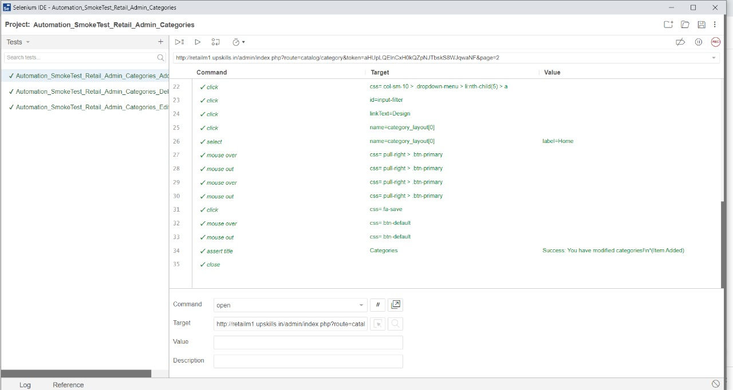
SMOKE TEST

Slide 21
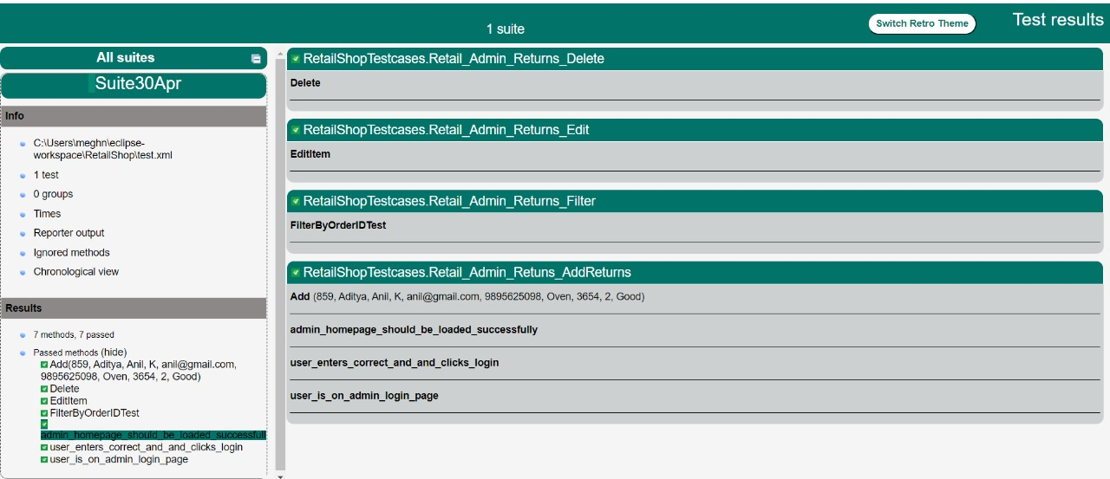
TestNG Report

Slide 22
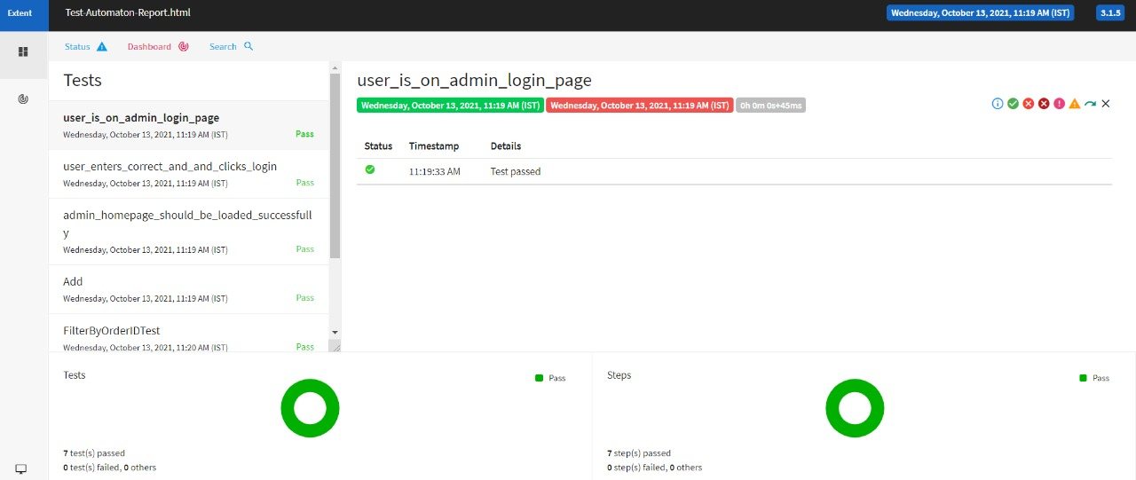
Extent Report

Slide 23
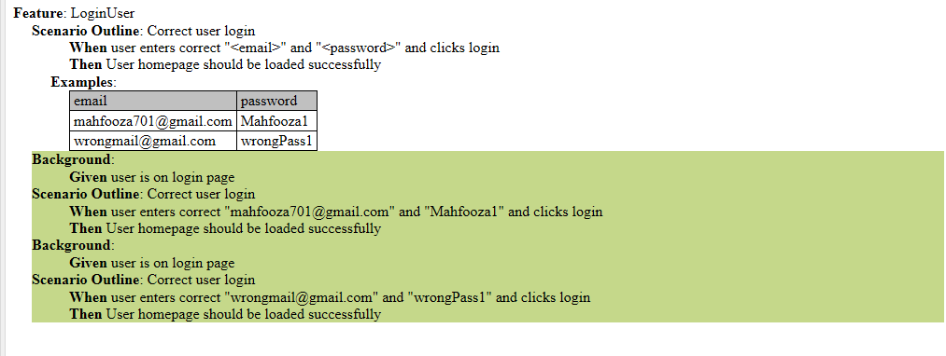
Sprint-2
Implementation of Cucumber Framework
User Login verification Cumber Report

Slide 24
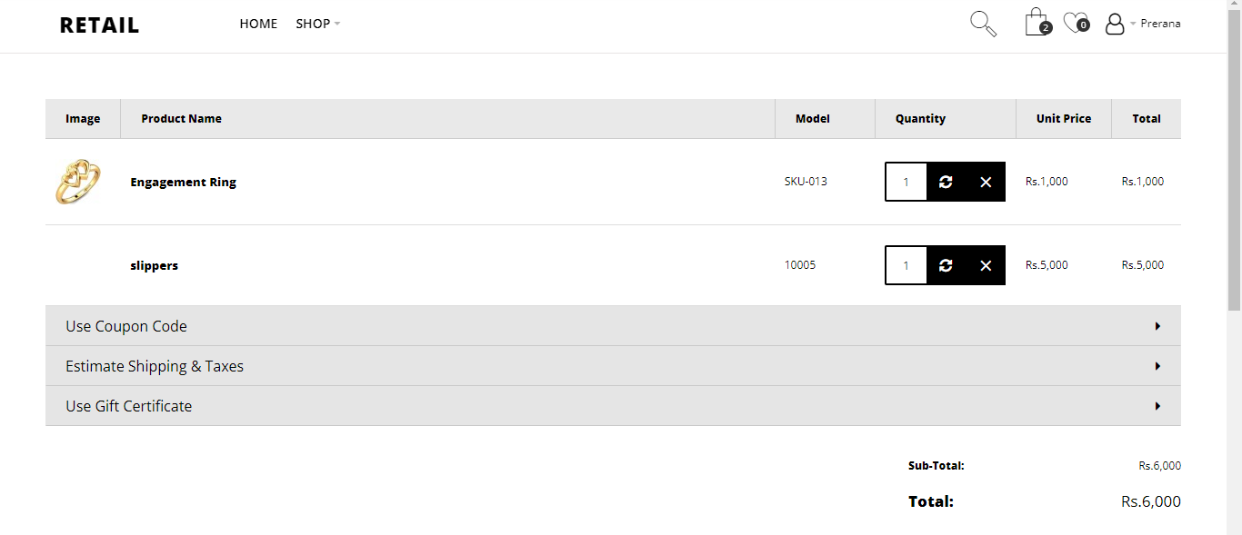
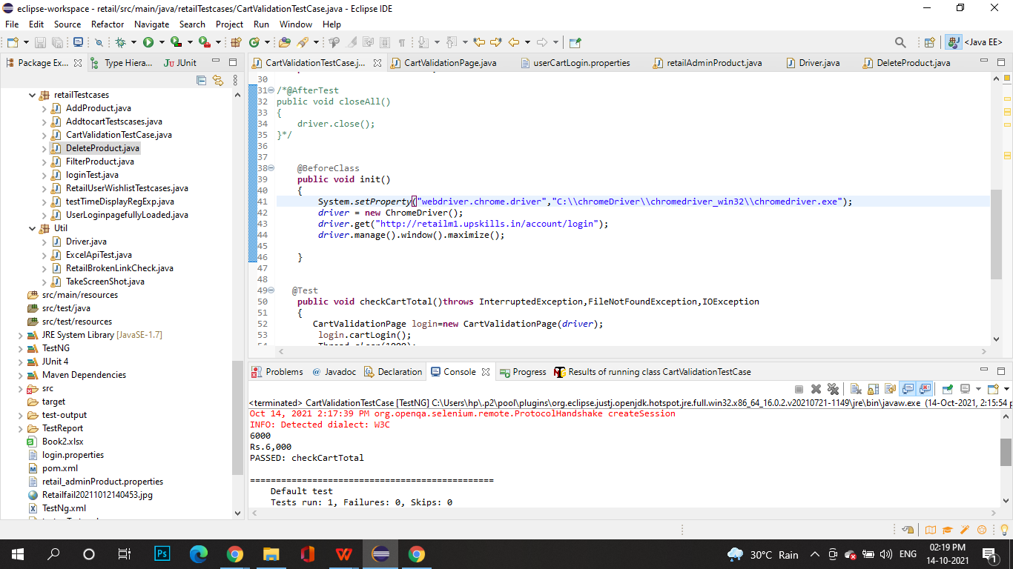
Sprint-2
End to End testing
Validation of the Cart Total

Slide 25
THANKYOU

