Slide 1
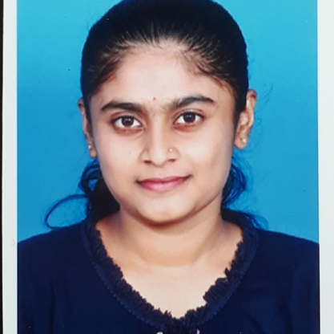



Nandita V Hiremath
Analyst/Software Engineer
Bachelor of Engineering
Computer Science : 2017 - 2021
Skills
Java 8 /J2EE | Java Basics, OOPS, Generics, Collections, Arrays, Loops, Lambda Exp, Stream API Junit, Mockito, Servlets
Spring core | IOC & Dependency Injection, Autowire
Spring REST | REST controllers, Implementation of GET, POST, PUT & DELETE, Bean Validation & Exception Handling, Testing Services, Controller & Repository layer
Spring Data JPA | Implement DAO layer using spring Data repositories, Transaction Management
Spring Boot Microservices | Spring Boot Starters, annotations, Messaging Service, Sync/Async comms, Swagger API documents
Spring Cloud | Eureka, Netflix Ribbon, Feign Client, Netflix Hystrix, Netflix Zuul & Config Server
React | Components, Hooks, Event handling, Redux, Reducers, Testing using Jasmin & Karma
Angular | Components, Services, Modules, Routing, Forms & Validation, Testing using Jasmine & Karma
Database | MongoDB No Sql Basics My SQL RDS Basics
UI Tech | HTML 5 & CSS 3,JavaScript, ES6 & TypeScript Reusable templates, Optimized UI Designed
Tools | Git, Postman, Maven, IDE
Devops | CI/CD, Jenkins configuration, Build Pipelines, notifications, quality gate understanding
Add On skills | Communications, Team management. Peer learning
Bangalore
nandita-v.hiremath@capgemini.com
+91 6362098781
A4
Full Stack Developer
Hands on experience in creating microservices with Springboot, Spring Security, Spring Cloud API Gateway, Eureka server.
Proficient in creating Single page Web Application in React .
React developer with working knowledge on ReactJS with react hooks,reactive forms,routing and Material UI.
Experience in creating documentation with Java docs and swagger and in unit testing using Junit, Mockito including code quality compliance .
Development experience using Eclipse,intellij,VS Code, pgAdmin for postgreas, postman Api connection and MangoDB by Atlas.
Flight management System
Completed case study of Flight management system along with JWT authentication, Swagger and with payment feature, responsive UI for user interface.
Online banking system
Completed group case study on Online banking system using Layered Architecture using spring boot with Swagger documentation, spring security with hibernate responsive UI with ReactJS.
AWS Cloud practitioner certified.
Check out my work on GitHub & Video Profile

