Slide 1
Singing Phoneme Ergonomic LabeLer - Milestone 4
Avinash Persaud, Nandith Narayan, Carlos Cepeda

Slide 2
Data Structure Testing
Separate module added
Checks basic functionality (add, delete, get, insert, move, set)
Notes:
Avinash

Slide 3
Timeline Widget
Presents a graphical representation of the labels to the user
Since we support multiple types of labels (phonemes, syllables, and custom labels), multiple timelines can be added to a project.
Notes:
Nandith

Slide 4
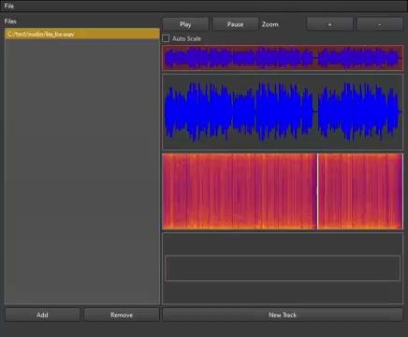
Timeline Demo
Notes:
Nandith

Slide 5
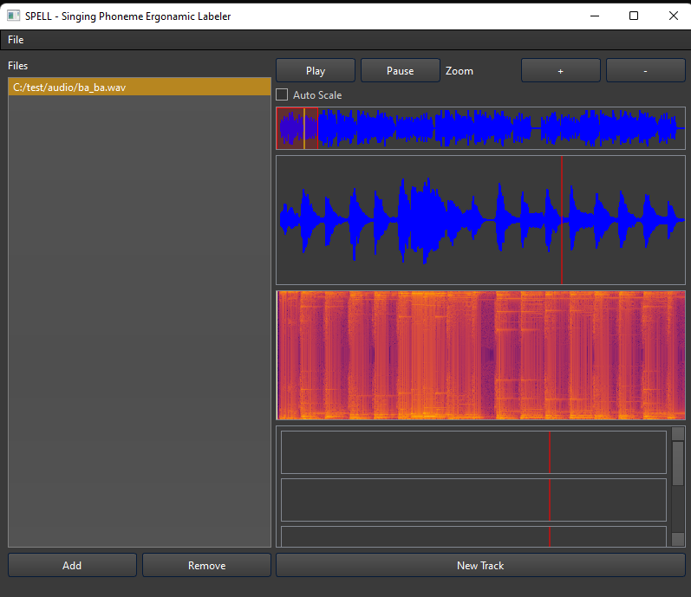
UI updates
Zoom controls
Draggable waveform window
Synchronized cursors across widgets
Scroll bars appear when widgets get too large
Notes:
Nandith

Slide 6
Refactoring
Separated core functionalities into widgets and sub-widgets
Allows mouse input virtual functions to be used
Took advantage of Qt’s Signals & Slots to keep everything in sync
Reduced calling of update functions
Notes:
Avinash

Slide 7
Timeline Data Structure
Created an abstract class to represent generic labels
Created concrete classes for every label type
Created an interface between the data structure and UI
Integrated the timeline data structure with the UI
Notes:
Avinash

Slide 8
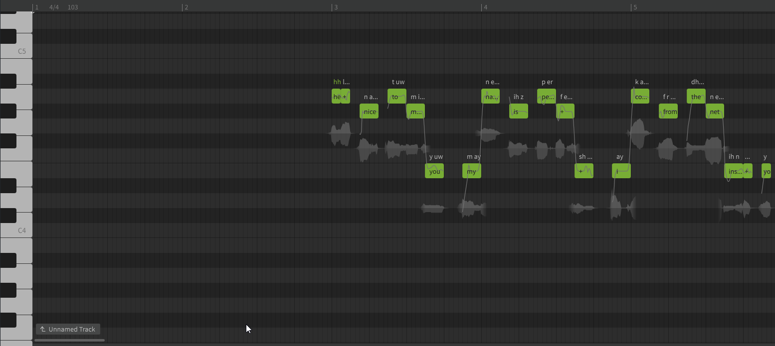
Tasks For Milestone 5
Generate the output file (HTS)
Integrate phoneme classification network
Create note view UI element
Screenshot of piano roll feature present in SynthesizerV
Notes:
Carlos +Avinash for img

Slide 9
Generate the Output File (Milestone 5)
This includes:
Interweaving all the overlapping feature tracks such as:
Notes
Phonemes
Syllables
Formatting every label, and writing the data to a file
With better understanding of the HTS singing label format, we have overcome one of the technical challenges.
Notes:
Carlos

Slide 10
Integrate Phoneme Classification Network (Milestone 5)
Integrate learning libraries such as TensorFlow and Keras
Computational power is a problem, but we have 2 solutions:
Run the models on a different thread
Implement loading bar for feedback
Notes:
Carlos

Slide 11
Note View (Milestone 5)
Assign a note to each syllable/assign syllables to notes
Enter music score related data
Tempo
Key Signature
Offset and quantize notes
Notes should not be aligned to syllable start
Natural singing tends to start before the note
Notes:
Carlos

