Slide 1



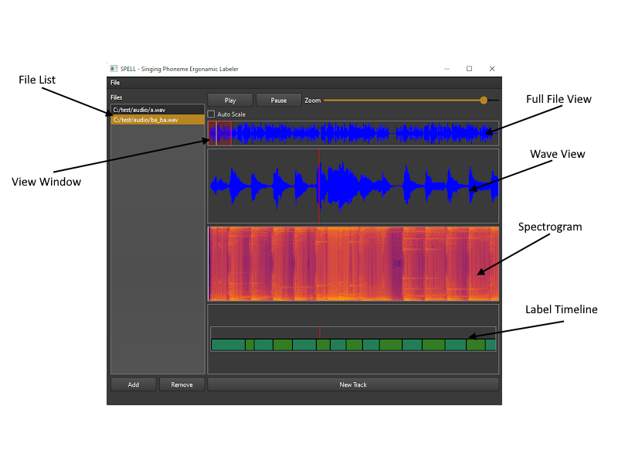
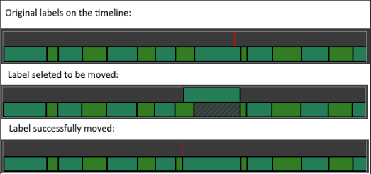
Singing Data Labeling Tool
Avinash Persaud, Nandith Narayan, Carlos Cepeda
Faculty Advisor(s): Dr. William D. Shoaff, Dept. of Computer Science, Florida Institute of Technology
Motivation:
Currently, labeling singing/audio data requires the use of multiple tools. These tools are often clunky to use and contain difficult to navigate user interfaces.
Goal:
Our goal is to create a multi-platform tool that will combine the functionalities of multiple current tools with an easy to navigate and fluid graphical user interface.
Full File View:
The full file view widget displays the waveform of the entire audio file. It also contains a draggable window. This window represents the section of audio that is currently displayed by the wave view and the spectrogram. To modify the window, the user can either click and drag to move it, or change its size by changing the zoom level. It also contains a cursor to indicate what part of the audio is currently selected.
Core Functionalities:
Easy to navigate graphical user interface
Quick access keyboard shortcuts for important tasks
Automatic detection and classification of the phonemes present in the audio
Exportable label data in the HTS label format
User Interface:
Spectrogram View:
The spectrogram view widget displays the spectrogram of the section of audio currently selected. By using the fourier transform, the spectrogram is able to display the frequencies present in the audio over time. The Y-axis represents frequency while the X-axis represents time. The color represents intensity.
GUI Widgets
We separated the GUI elements into sections called widgets. Each widget has its own purpose. Our tool contains the following widgets:
Wave View
Full File View
Spectrogram
TImeline
File List
Toolbar
Wave View:
The wave view widget displays the waveform of a section of the audio. This section can be shrunk or grown by adjusting the zoom level via the zoom slider or keyboard and mouse shortcuts. An Issue other tools have is that sometimes the audio volume can be relatively quiet thus, making the waveform too small for the user to view. We solved this problem by including an auto-scale feature. When the auto-scale checkbox is selected, the waveform is automatically scaled to fill up the entire view.
TImeline View
The timeline view widget displays labels that the user has created. We support multiple types of labels, namely: phonemes, syllables, notes, and words. Labels can be added by clicking on the wave view. When the user clicks on the wave view, a label is added to the timeline at the exact location that the user clicked on. Labels can be moved by left clicking on them and clicking on the new position of the label
Hierarchical Phoneme Classification
We trained a convolutional neural network to automatically classify the phonemes present in the audio. To do this, we take a section of audio and convert it into an image using the MEL spectrogram. By converting the audio into an image, we can drastically reduce the data size as well as use image-based machine-learning models. In the english language, there are 44 phonemes, classifying phonemes into 44 classes at once proved to be a hard task for our networks to learn. To solve this, we used a hierarchical classification model where we first classify if a given phoneme is a vowel or consonant. Then, if it’s a vowel, we use a vowel classifying network. If it’s a consonant, we use a consonant classification network. This allows our vowel and consonant networks to be smaller and run faster.
Intermediate Data Structure:
In order to store the data created by the user, we created a data structure that could handle all the types of data the user will throw at it. This includes storing raw audio signals, spectrograms, user preferences, and of course labels. We designed the intermediate data structure to handle multiple label types including phonemes, syllables, notes, and words along with timestamps and duration values.
Acknowledgements:
Dr. William D. Shoaff, Dept. of Computer Science, Florida Institute of Technology.
Caleb Matthew Long, Appalachian State University.

