Slide 1

Design And Analysis of Algorithm

Slide 2
Course Details
Course Code: AD43/AI43
Course Title : Design and Analysis of Algorithms
Course Credits : 3:0:0
CIE : 50 Marks
SEE : 50 Marks
Total No of Theory / Tutorial / Lab Hours : 42/0/0

Slide 3
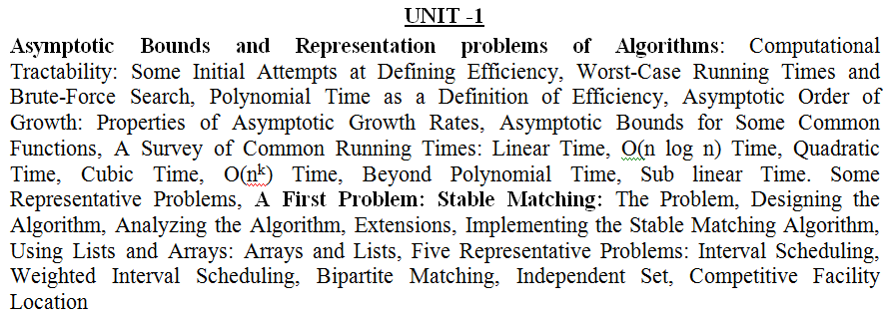
Syllabus
Prerequisites: Data Structures & Programming Language

Slide 4
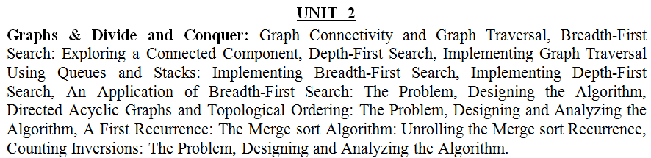
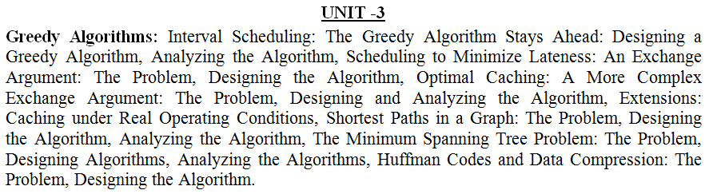
Syllabus

Slide 5
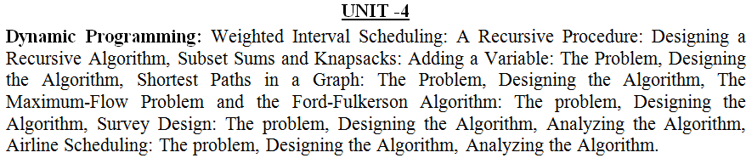
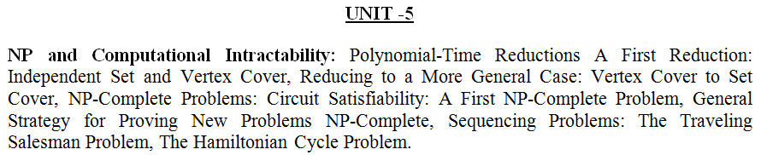
Syllabus

Slide 6
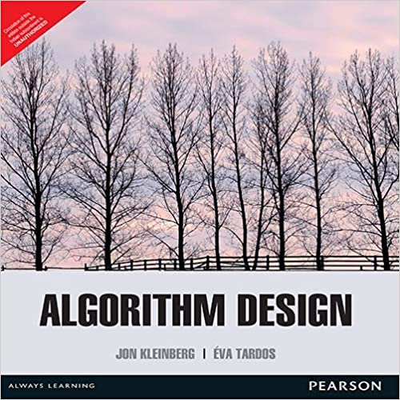
Syllabus
Text Book
“Algorithm Design” - Jon Kleinberg and Eva Tardos, Pearson ,1st Edition (2013).

Slide 7
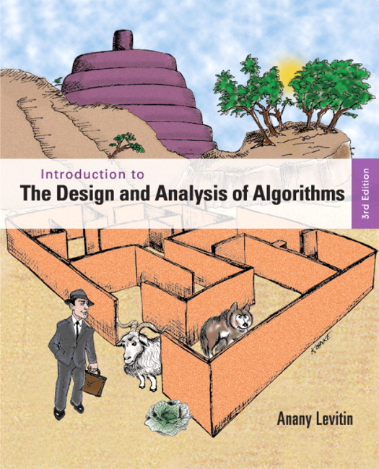
Syllabus
Reference Book
Anany Levitin: Introduction to The Design & Analysis of Algorithms, 3rd Edition, Pearson Education, 2012.

Slide 8
ALGORITHM
An algorithm is a finite set of instructions that, if followed, accomplishes a particular task.
Algorithm Criteria
Input: Zero or more inputs.
Output: At least one output.
Definiteness: Each instruction must be clear and unambiguous.
Ex: Add 6 or 7 to x
Finiteness: Should terminate after finite number of steps and time.
Effectiveness: Every instruction must be very basic.

Slide 9
Write a program to compute sum of n natural numbers
#include<stdio.h>
int main()
{
int n,sum=0;
printf(“Enter the value of n”);
scanf(“%d”,&n);
for(i=1;i<=n;i++)
{
sum = sum + i;
}
printf(“%d”,sum);
}
#include<stdio.h>
int main()
{
int n,sum=0;
printf(“Enter the value of n”);
scanf(“%d”,&n);
n= n(n+1)/2
printf(“%d”, n);
}

Slide 10
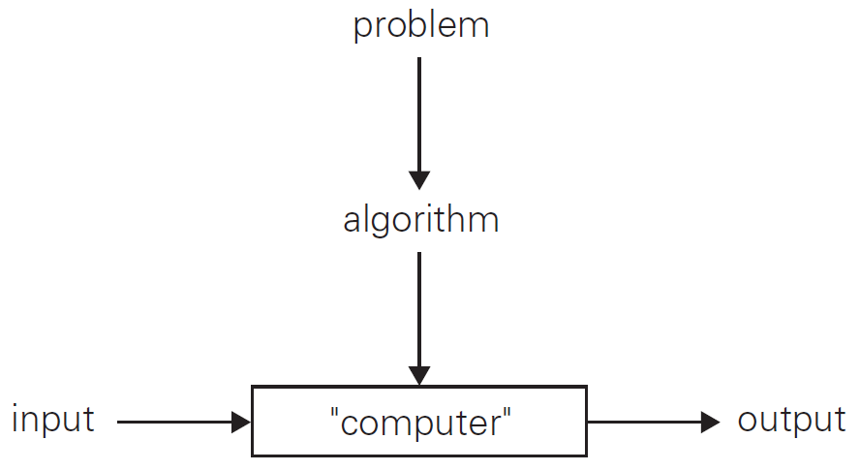
The Notion of the Algorithm

Slide 11
Euclid’s Algorithm
Euclid’s algorithm for computing gcd(m,n)
Step 1: If n = 0, return the value of m as the answer and stop; otherwise, proceed to Step 2.
Step 2: Divide m by n and assign the value of the remainder to r.
Step 3: Assign the value of n to m and the value of r to n. Go to Step 1.

Slide 12
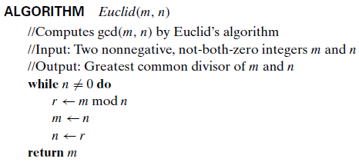
Euclid’s Algorithm

Slide 13
Exercise
Find gcd (320, 110) by applying Euclid’s algorithm.
Find gcd (555, 25) by applying Euclid’s algorithm.
Find gcd (31415, 14142) by applying Euclid’s algorithm.

Slide 14
Exercise
Find gcd (31415, 14142) by applying Euclid’s algorithm.
Solution:
gcd(31415, 14142) = gcd(14142, 3131) = gcd(3131, 1618) = gcd(1618, 1513) = gcd(1513, 105) = gcd(1513, 105) = gcd(105, 43) = gcd(43, 19) = gcd(19, 5) = gcd(5, 4) = gcd(4, 1) = gcd(1, 0) = 1.

Slide 15
Course Details
Course Code: CS42
Course Title : Design and Analysis of Algorithms
Course Credits : 3:0:0
CIE : 50 Marks
SEE : 50 Marks
Total No of Theory / Tutorial / Lab Hours : 42/0/0

Slide 16
Syllabus
Prerequisites: Data Structures & Programming Language

Slide 17
Syllabus

Slide 18
ASYMPTOTIC NOTATION

Slide 19
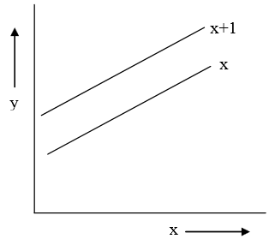
ASYMPTOTE
An asymptote is a line or curve that a graph approaches but does not intersect.
An asymptote of a curve is a line in such a way that distance between curve and line approaches zero towards large values or infinity.
Ex: x is asymptotic to x+1 and these two lines in the graph will never intersect

Slide 20
The concept of asymptote will help in understanding the behavior of an algorithm for large value of input.
Bounds
Bounds will be useful to understand the asymptotic notations.
Lower Bound: A non empty set A and its subset B is given with relation ≤. An element a A is called lower bound of B if a ≤ x ᵾ x Ԑ B (read as if a is less than equal to x for all x belongs to set B).
Example: A non empty set A and its subset B is given as A={1,2,3,4,5,6} and B={2,3}. The lower bound of B= 1, 2 as 1, 2 in the set A is less than or equal to all element of B.
Upper Bound: An element a A is called upper bound of B if x≤a ᵾ x Ԑ B.
For example a non empty set A and its subset B is given as A={1,2,3,4,5,6} and B={2,3}.
The upper bound of B= 3,4,5,6 as 3,4,5,6 in the set A is greater than or equal to all element of B.

Slide 21
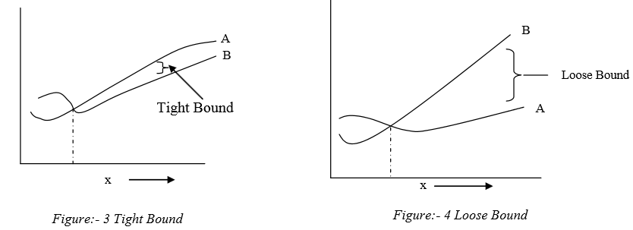
In figure 3, distance between lines A and B is less as B ≤ A. For large value of x, B will approach to A as it is less than or equal to A.
In Figure 4, A < B i.e. distance between A and B is large. For example A < B, there will be distance between A and B even for large value of x as it is strictly less than only.

Slide 22
Big Oh (O)

Slide 23
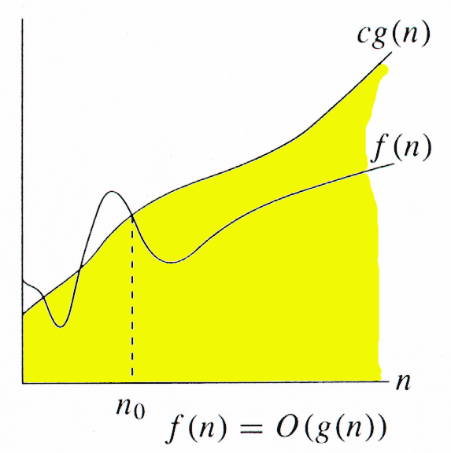
Big Oh (O) Notation This notation provides upper bound for a given function.
Definition f(n) = O(g(n)) iff there exist positive constants c and n₀ such that f(n) ≤ cg(n) for all n, n ≥ n₀.
O(g(n)) = {f(n) : ∃ positive constants c and n_{0,} such that ∀n ≥ n₀, we have 0 ≤ f(n) ≤ cg(n) }
Intuitively: Set of all functions whose rate of growth is the same as or lower than that of g(n).

Slide 24
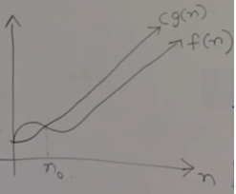
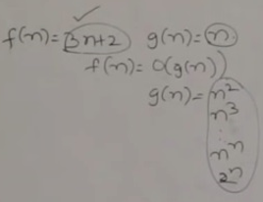
f(n)=3n + 2
f(n)=3n +2 g(n) = n
f(n)<= O(g(n))
f(n)<=c. g(n) ʉ c>0 & n0 >=1
3n+2 <= c. g(n)
C=4
3(2)+2 <= 4. (2)
8<=8 (T) ʉ c>=4 & no=2
3n +2 <= 4n ʉ no >=2
f(n)= O(g(n)).

Slide 25
scanf(“%d”,&n);
printf(“Enter elements to an array”);
for(i=1;i<=n;i++)
scanf(“%d”,&a[i]);
1+n+1+n= 2n+3
f(n) = 2n+3.
f(n)= c. g(n)
g(n)= n2
= n3
= n pow n
= 2 pow n

Slide 26

BIG OMEGA ( )

Slide 27
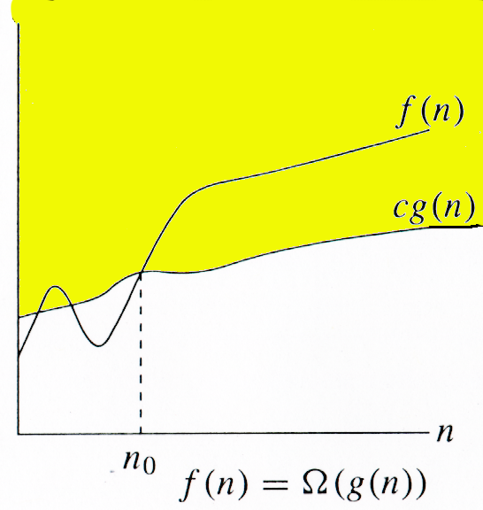
Omega (Ω) notation provides a lower-bound .
Definition: mean ‘order at least' i.e minimum time required to execute the algorithm or have lower bound .
f(n) = Ω (g(n)) iff there exist positive constants c and n₀ such that f(n) ≥ c g(n) for all n, n ≥ n₀.
Ω(g(n)) = {f(n) : ∃ positive constants c and n_{0,} such that ∀n ≥ n₀, we have 0 ≤ cg(n) ≤ f(n)}
Intuitively: Set of all functions whose rate of growth is the same as or higher than that of g(n).

Slide 28
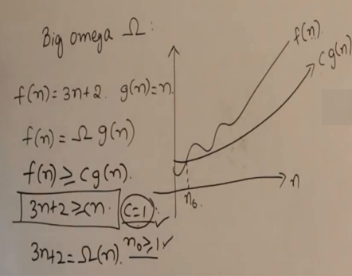
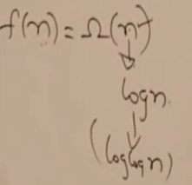

Slide 29
THETA NOTATION (Θ)

Slide 30
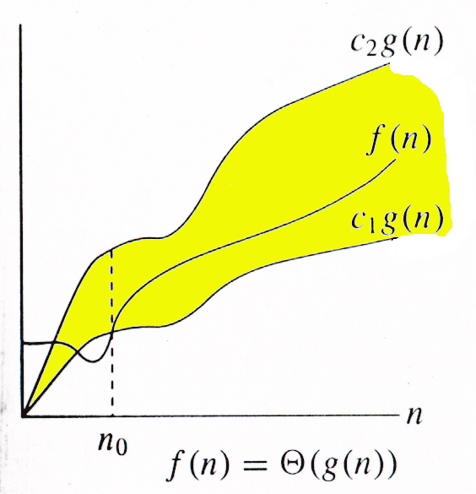
It provides both upper and lower bounds (tight bound) for a given function.
(Theta) Notation: means `order exactly'. Order exactly implies a function is bounded above and bounded below both. This notation provides both minimum and maximum value for a function.
Let g(n) be given function. f(n) be the set of function defined as
Θ(g(n)) = {f(n): if there exist positive constant c1,c2 and n0 such that
0≤c1g(n)≤f(n) ≤c2g(n) for all n, n >= n0}
Θ(g(n)) = {f(n) : ∃ positive constants c₁, c₂, and n₀, such that ∀n ≥ n₀, 0 ≤ c₁g(n) ≤ f(n) ≤ c₂g(n)}
f(n) and g(n) are nonnegative, for large n.

Slide 31
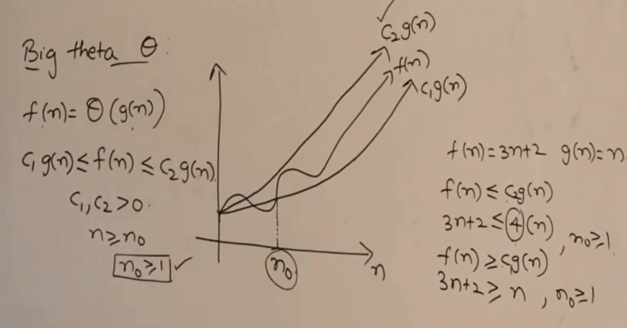

Slide 32
f(n) = 3n+3 g(n)=n
f(n)<=c.g(n)
3n+3<= c.g(n)
3n+3<=3n
c=3,4,5.
3n+3<=6n c=6 and n0 =1.
f(n)>=c.g(n)
3n+3>=n c=1 and n0 =1.
n <= 3n+3 <= 6n ʉ n0 >=1
f(n) = Θ(g(n))

Slide 33
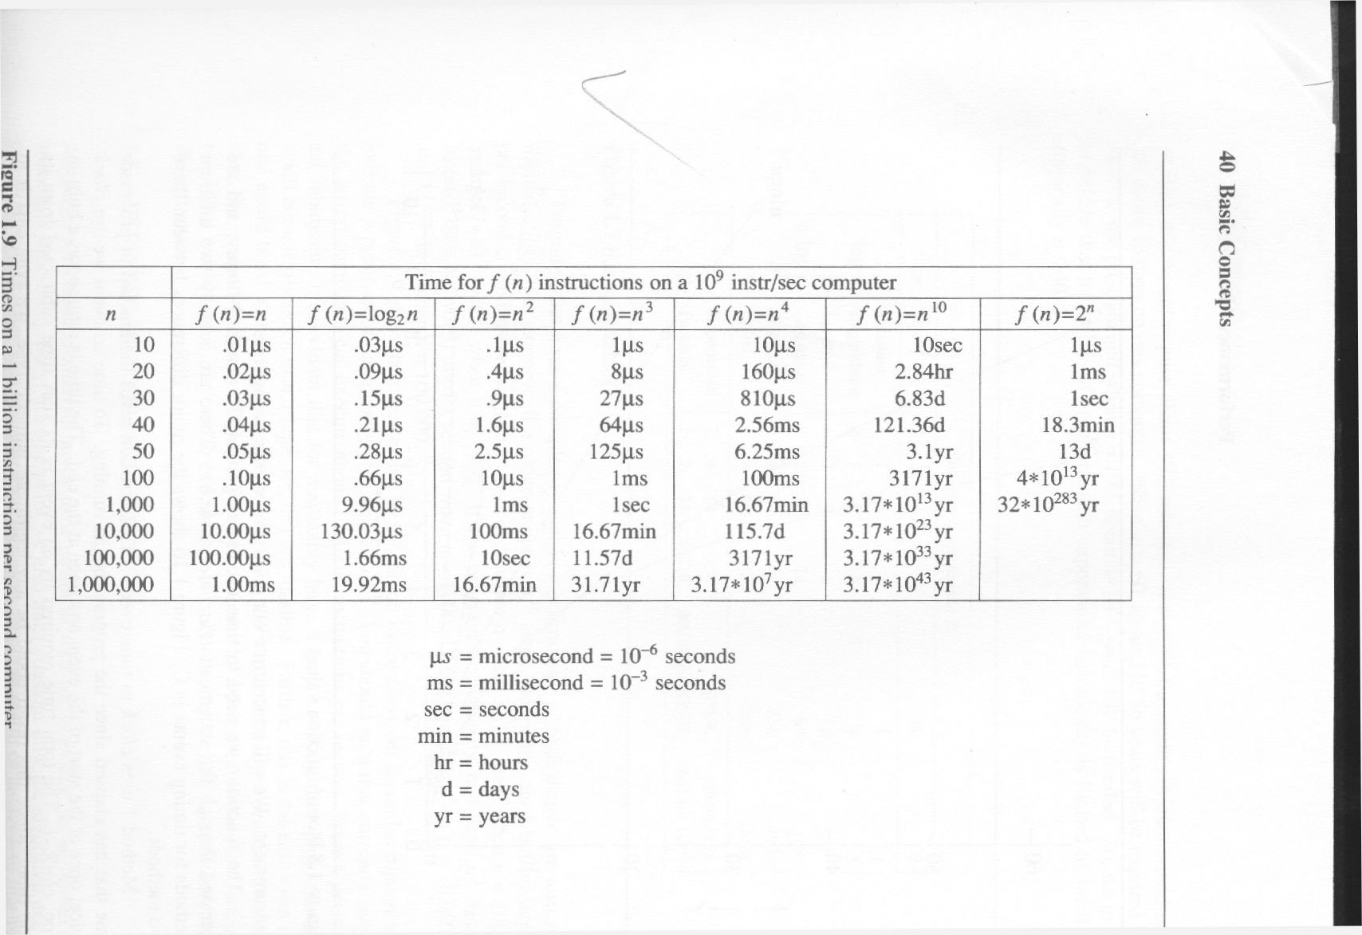

Slide 34
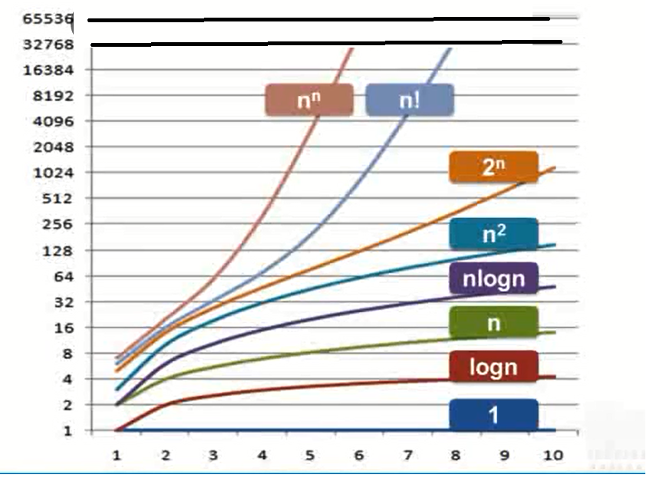

Slide 35

THANK YOU
Notes:
Select the text of font seogo print
Text animation is fade animation (In animate)
Select automatically after 0.5
Select drop down of title 1 option and select effect options, in animate text select by letter. And delay 100%
12*0.5 =6
For pen: go to motion path and select custom path
trace the text and double click.
Start with previous.
Go to effect options for pen pic and remove smooth start and end.

Slide 36
EXAMPLES
3n+2=O(n) /* 3n+2 <= 4n for n >= 2 */
3n+3=O(n) /* 3n+3<=4n for n>=3 */
100n+6=O(n) /* 100n+6<=101n for n>=10 */
10n2+4n+2=O(n2) /* 10n2+4n+2<=11n2 for n>=5 */
6*2n+n2=O(2n) /* 6*2n+n2 <=7*2n for n>=4 */

