Slide 1
Theory of computation (ToC) AI44 / AD44
Credits: 03
Alias course names: FLAT / FAFL / ATC / TFCS
BY: Vinay t r

Slide 2
Text Books
John E. Hopcroft, Rajeev Motwani, Jeffrey D.Ullman: Introduction to Automata Theory, Languages and Computation, 3rd Edition, Pearson Education, 2007. (Chapters: 1.1, 1.5, 2.2 to 2.5, 3.1 to 3.3, 4, 5, 6, 7, 8.1 to
8.4, 8.6, 9.1, 9.2, 9.4.1, 9.5)
K.L.P. Mishra: Theory of Computer Science, Automata, Languages, and Computation, 3rd Edition, PHI Learning, 2009.
John C Martin: Introduction to Languages and Automata Theory, 3rd Edition, Tata McGraw-Hill, 2007
Automata Theory by Ellian Rich ******* (GATE)
NPTEL Online Video Tutorials, VTU e – Learning Videos.

Slide 3
SYLLABUS
UNIT 1 : Introduction to Finite Automata
UNIT 2: Regular Expressions and Equivalence of automata
UNIT 3: Context Free Grammars, Pushdown Automata
UNIT 4: Deterministic Pushdown Automata and properties of CFL’s
UNIT 5: The Turing Machine and language of Recursively enumerable

Slide 4
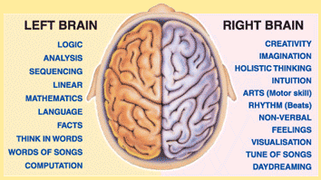
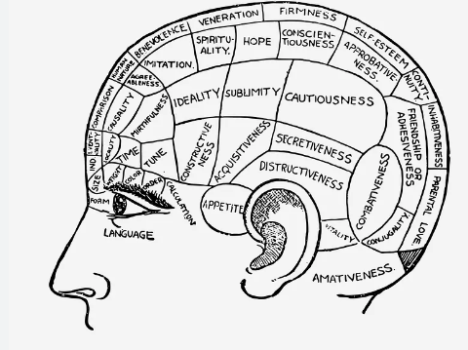

Slide 5
Guidelines
Slow down. The more you understand, the less you have to memorize.
Do the exercises. Write your own notes. (Unruled book)
Drink water. Lots of it.
Practice more Problems (Question papers)

Slide 6
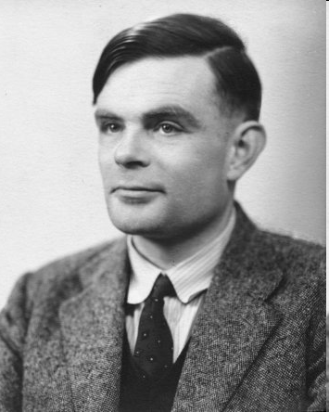
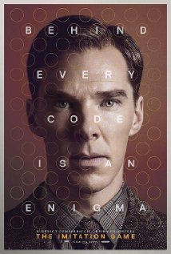
What is Automata Theory
Pioneer of automata theory
Alan Turing (1912-1954)
Father of Modern Computer Science
English mathematician
Studied abstract machines called Turing machines even before computers existed
Heard of the Turing test?

Slide 7
Why study the theory of computation
Defn: Automata is an abstract machine for modelling computations.
Why Abstract machines?
Abstract machine allows us to model the essential parameters, and ignore the non-essential parameters.
What is computability?
It is very difficult to define, but Our notion of computation: Examples are
Add 2 numbers
Find the roots of a quadratic equation
Multiply 2 matrices
And so on…..
Important to note that: all the above have algorithms

Slide 8
What is not computable: Example-
•Halting problem of a program:
simply write a program that examines other programs to determine if they halt or loop forever. Obviously whether or not a program halts depends on the data it is fed so in this case we mean program to be code plus the data it operates on.
Why it not computable:
simple answer – No algorithm exists
Some computations take lot of time to be meaning full: Example
Travelling salesman problem
When computations are not finished within a reasonable time, such computations are useless, also known as NP-problem(non-deterministic polynomial problems)

Slide 9
Tractable/Intractable Problems:
Tractable Problem: a problem that is solvable by a polynomial-time algorithm. The upper bound is polynomial. Examples: Quick sort(O(nlogn)
Intractable Problem: a problem that cannot be solved by a polynomial-time algorithm. The lower bound is exponential. Examples: Travelling Salesman problem
Computation vs Complexity ******
Solvable or not vs Easier or harder to solve

Slide 10
Why study theory of Computation ?
Implementations come and go
Assembly language -> Job Control Lang -> Java -> …
Mathematical Properties (problems & algorithms) having nothing to do with current technology or languages. (Natural Languages)

Slide 11
It is useful in 2 key ways ***
It Provides a set of abstract structures that are useful for solving certain classes or problems.
It defines provable limits to what can be computed , regardless of processor speed or memory size.

Slide 12
Goals
Study Principles of Problems themselves
Does a solution exist?
If not, is there a restricted variation?
Can solution be implemented in fixed memory?
Is Solution efficient?
Growth of time & memory with problem size?
Are there equivalent groups of problems?

Slide 13
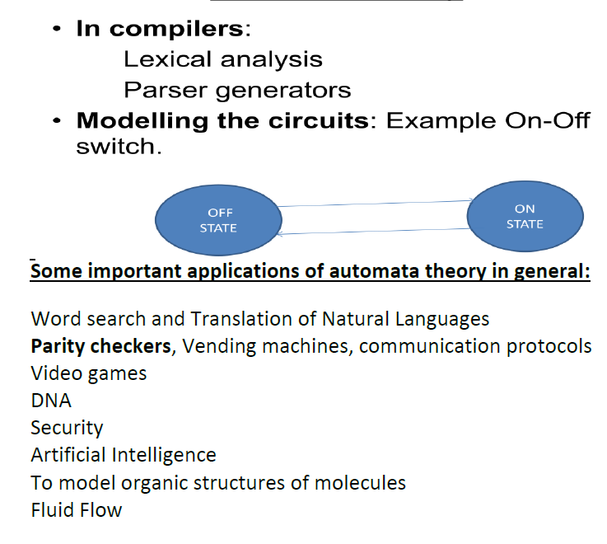
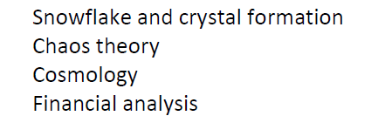
Applications of automata theory

Slide 14
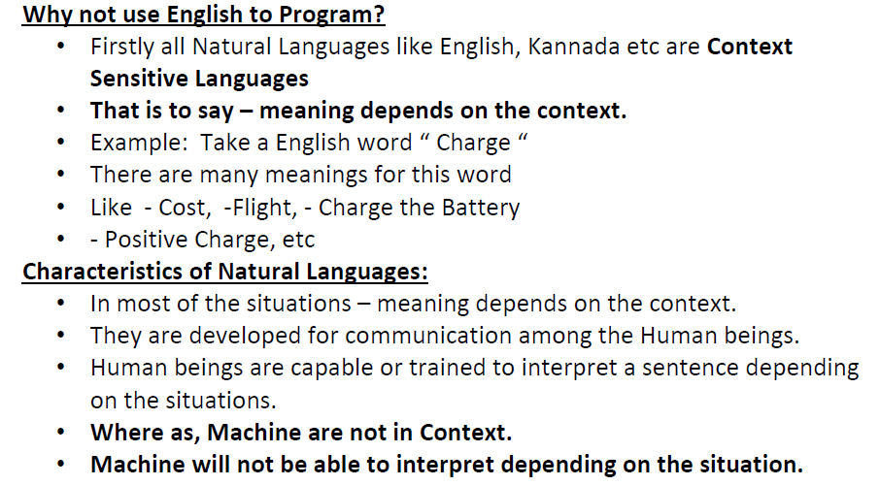
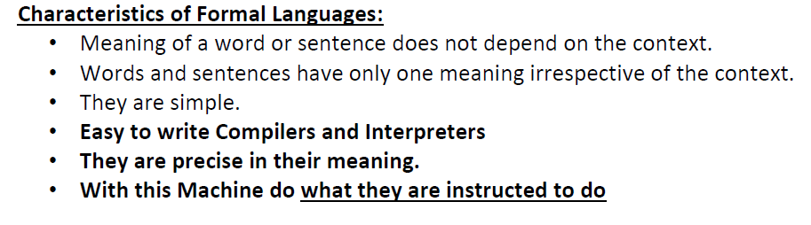

Slide 15
Some devices we will see
finite automata | Devices with a finite amount of memory. Used to model “small” computers.
push-down automata | Devices with infinite memory that can be accessed in a restricted way. Used to model parsers, etc.
Turing Machines | Devices with infinite memory. Used to model any computer.
time-bounded Turing Machines | Infinite memory, but bounded running time. Used to model any computer program that runs in a “reasonable” amount of time.

Slide 16
Some highlights of the course
Finite automata
We will understand what kinds of things a device with finite memory can do, and what it cannot do
Introduce simulation: the ability of one device to “imitate” another device
Introduce nondeterminism: the ability of a device to make arbitrary choices
Push-down automata
These devices are related to grammars, which describe the structure of programming (and natural) languages

Slide 17
Some highlights of the course
Turing Machines
This is a general model of a computer, capturing anything we could ever hope to compute
Surprisingly, there are many things that we cannot compute, for example:
It seems that you should be able to tell just by looking at the program, but it is impossible to do!
Write a program that, given the code of another program in C, tells if this program ever outputs the word “hello”

Slide 18
How to study:
Subject is mathematical and lot of logical thinking is required.
There are number of Theorems and proofs.
Understand the definition – mathematically i.e. Examples are not substitute for definitions.
Examples are only to make the definition clear.
Work out number of problems from various other books.
Key to understanding this subject – attempt to work harder problems even if you are not able get answers.
If you plan to take up - Gate examination for PG studies – you must understand it thoroughly.

