Slide 1
What is automata theory
Automata theory is the study of abstract computational devices
Abstract devices are (simplified) models of real computations
Computations happen everywhere: On your laptop, on your cell phone, in nature, …
Why do we need abstract models?

Slide 2
A simple computer
SWITCH
BATTERY
input: switch
output: light bulb
actions: flip switch
states: on, off
Note: ODD no. of times – , Even no. of Times --

Slide 3
A simple “computer”
SWITCH
f
BATTERY
start
on
off
f
input: switch
output: light bulb
actions: f for “flip switch”
states: on, off
bulb is on if and only if there was an odd number of flips

Slide 4
Another “computer”
1
1
start
off
off
1
BATTERY
2
2
2
2
1
2
off
on
1
inputs: switches 1 and 2
actions: 1 for “flip switch 1”
actions: 2 for “flip switch 2”
states: on, off
bulb is on if and only if both switches were flipped an odd number of times

Slide 5
A design problem
1
?
4
5
BATTERY
2
3
Can you design a circuit where the light is on if and only if all the switches were flipped exactly the same number of times?

Slide 6
A design problem
Such devices are difficult to reason about, because they can be designed in an infinite number of ways
By representing them as abstract computational devices, or automata, we will learn how to answer such questions

Slide 7
Central Concepts of Automata Theory
Alphabet
Strings
Languages

Slide 8
Alphabet - Σ
An alphabet is a non-empty, finite set of characters/symbols
Use Σ to denote an alphabet
Examples
= { a, b }
= { 0, 1, 2 }
= { a, b, c,…z, A, B, … Z }
= { #, $, *, @, & }

Slide 9
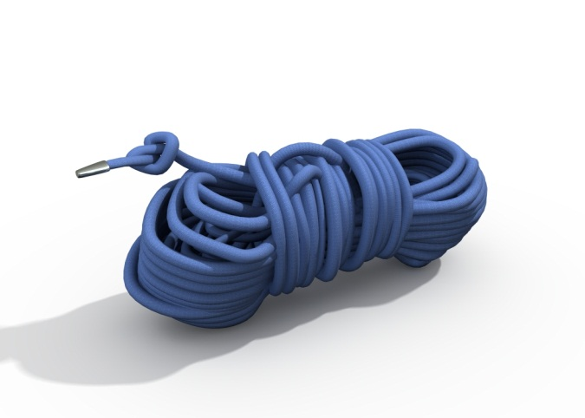
Strings
A string is a finite sequence, possibly empty, of characters drawn from some alphabet Σ.
ε is the empty string
• Σ* is the set of all possible strings over an alphabet Σ.

Slide 10
Example Alphabets & Strings
Alphabet name | Alphabet symbols | Example strings
The lower case English alphabet | {a, b, c, …, z} | ε, aabbcg, aaaaa
The binary alphabet | {0, 1} | ε, 0, 001100,11
A star alphabet | { , ☺ , 😐 , , , } | ε, ☺☺, 
A music Alphabet Classical

Slide 11
Functions on Strings
Length:
|s| is the length of string s
|s| is the number of characters in string s.
|ε| = 0
|1001101| = 7
#_{c}(s) is defined as the number of times that c occurs in s.
#_{a}(abbaaa) = 4.

Slide 12
More Functions on Strings
Concatenation: the concatenation of 2 strings s and t is the string formed by appending t to s; written as s||t or more commonly, st
Example:
If x = good and y = bye, then xy = goodbye
and yx = byegood
Note that |xy| = |x| + |y| -- Is it always??
ε is the identity for concatenation of strings. So,
∀x (x ε = ε x = x)
Concatenation is associative. So,
∀s, t, w ((st)w = s(tw))

Slide 13
More Functions on Strings
Reverse: For each string w, w ^{R} is defined as:
if |w| = 0 then w ^{R} = w = ε
if |w| = 1 then w ^{R} = w
if |w| > 1 then:
∃a ∈ Σ (∃u ∈ Σ* (w = ua))
So define w ^{R} = a u ^{R}
^{OR}
if |w| > 1 then:
∃a ∈ Σ & ∃u ∈ Σ* ϶ w = ua
So define w ^{R} = a u ^{R}
^{Example:}
Proof is by simple induction

Slide 14
Defining a Language
A language is a (finite or infinite) set of strings over a (finite) alphabet Σ.
Examples: Let Σ = {a, b}
Some languages over Σ:
∅ = { } // the empty language, no strings
{ε} // language contains only the empty string
{a, b}
{ε, a, aa, aaa, aaaa, aaaaa}

Slide 15
Defining a Language
Two ways to define a language via a Machine = Automaton
AKA – Computer Program
Recognizer
Generator
Which do we want? Why?

Slide 16
Σ*
Σ* is defined as the set of all possible strings that can be formed from the alphabet Σ*
Σ* is a language
Σ* contains an infinite number of strings
Σ* is countably infinite

Slide 17
Σ* Example
Let Σ = {a, b}
Σ* = {ε, a, b,aa,ab,ba,bb,aaa,aab,… }
Later, we will spend some more time studying Σ*.

Slide 18
Example Language Definitions
Let Σ = {a, b}
L = { w ∈ Σ* : |w| < 5}
L = { w ∈ Σ* | w begins with b}
L = { w ∈ Σ* | #_{b}(w) = 2}
L = { w ∈ Σ* | each a is followed by exactly 2 b’s} ****
L = { w ∈ Σ* | w does not begin with a}
Note: Identify which are valid/invalid strings

Slide 19
More Examples
What strings are in the following languages?
L = {a^{n} : n ≥ 0}
L = {ba^{2n} : n ≥ 0}
L = {b^{n}a^{n} : n ≥ 0}

Slide 20
Enumeration
Enumeration: to list all strings in a language (set)
• Arbitrary order
• More useful: lexicographic order
Shortest first
Within a length, dictionary order
Define linear order of arbitrary symbols

Slide 21
Lexicographic Enumeration
{w ∈ {a, b}* : |w| is even}
{ε, aa, ab, bb, aaaa, aaab, …}
What string is next?
How many strings of length 4?
How many strings of length 6?

Slide 22
Cardinality of a Language
Cardinality of a Language: the number of strings in the language
| L |
Smallest language over any Σ is ∅, with cardinality 0.
The largest is Σ*.
Is this true?
How big is it?
Can a language be uncountable?

Slide 23
Functions on Languages
Set (Language) functions
Have the traditional meaning
Union
Intersection
Complement
Difference
Operations on Languages
• Concatenation
• Kleene star
Reverse

Slide 24
Concatenation of Languages
If L₁ and L₂ are languages over Σ:
L₁L₂ = {w : ∃s ∈ L₁ & ∃t ∈ L₂ ϶ w = st }
Examples:
L₁ = {cat, dog}
L₂ = {apple, pear}
L₁ L₂ = {catapple, catpear, dogapple, dogpear}
L₂ L₁ ={applecat,appledog,pearcat,peardog}

Slide 25
Concatenation of Languages
{ε} is the identity for concatenation:
L{ε} = {ε}L = L
∅ is a zero for concatenation:
L ∅ = ∅ L = ∅

Slide 26
Kleene Star
*
L* - language consisting of 0 or more concatenations of strings from L
L* = {ε} ∪ {w ∈ Σ* : w = w₁ w₂ … w_{k,} k ≥ 1 &
w₁, w₂, … w_{k} ∈ L}
Examples:
L = {dog, cat, fish}
L* = {ε, dog, cat, fish, dogdog, dogcat,
dogfish,fishcatfish,fishdogdogfishcat, …}
~~~~~~~~~~~~
L₁ = a* L₂ = b*
What is a*? b*?
L₁ L₂ =
L₂ L₁ =
L₁ L₁ =

Slide 27
The Operator
+
L⁺ = language consisting of 1 or more concatenations of strings from L
L⁺ = L L*
L⁺ = L* - {ε} iff ε ∉ L

Slide 28
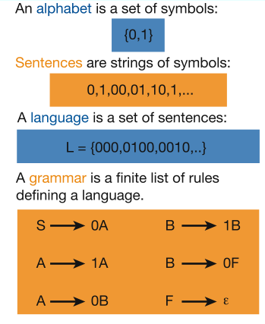
Languages & Grammars
Languages: “A language is a collection of sentences of finite length all constructed from a finite alphabet of symbols”
Grammars: “A grammar can be regarded as a device that enumerates the sentences of a language” - nothing more, nothing less
N. Chomsky, Information and Control, Vol 2, 1959

Slide 29
The Chomsky Hierarchy
A containment hierarchy of classes of formal languages
Recursively- enumerable (TM)+
Context- sensitive (LBA)
Context- free
(PDA)
Regular
(DFA)

Slide 30
Finite Automata

Slide 31
Example of a finite automaton
f
off
on
f
There are states off and on, the automaton starts in off and tries to reach the “good state” on
What sequences of fs lead to the good state?
Answer: {f, fff, fffff, …} = {f ^{n}: n is odd}
This is an example of a deterministic finite automaton over alphabet {f}

Slide 32
Deterministic finite automata
A deterministic finite automaton (DFA) is a 5-tuple (Q, Σ, δ, q₀, F) where
Q is a finite set of states
Σ is an alphabet
δ: Q × Σ → Q is a transition function
q₀ ∈ Q is the initial state
F ⊆ Q is a set of accepting states (or final states).
In diagrams, the accepting states will be denoted by double loops

Slide 33
Example
0
1
0,1
q₀
1
q₁
0
q₂
alphabet Σ = {0, 1}
start state Q = {q₀, q₁, q₂}
initial state q₀
accepting states F = {q₀, q₁}
transition function δ:
inputs
0
1
q₀
q₀
q₁
states
q₁
q₂
q₁
q₂
q₂
q₂

Slide 34
Language of a DFA
The language of a DFA (Q, Σ, δ, q₀, F) is the set of all strings over Σ that, starting from q₀ and following the transitions as the string is read left to right, will reach some accepting state.
f
M:
off
on
f
Language of M is {f, fff, fffff, …} = {f ^{n}: n is odd}

Slide 35
Examples
0
0
1
q₀
q₁
1
0
1
1
q₀
q₁
0
0
1
0,1
q₀
1
q₁
0
q₂
What are the languages of these DFAs?

Slide 36
Examples
Construct a DFA that accepts the language
L = {010, 1}
( Σ = {0, 1} )

Slide 37
Examples
Construct a DFA that accepts the language
Answer
L = {010, 1}
( Σ = {0, 1} )
q₀
1
q₀₁
0
q₀₁₀
0
0
1
q_{ε}
0, 1
1
q₁
0, 1
q_{die}
0, 1

Slide 38
Examples
Construct a DFA over alphabet {0, 1} that accepts all strings that end in 101

Slide 39
Examples
Construct a DFA over alphabet {0, 1} that accepts all strings that end in 101
Hint: The DFA must “remember” the last 3 bits of the string it is reading

Slide 40
Examples
Construct a DFA over alphabet {0, 1} that accepts all strings that end in 101
Sketch of answer:
0
0
q₀₀₀
0
q₀₀
1
1
q₀₀₁
q₀
0
1
…
q₀₁
…
q_{ε}
q₁₀
1
q₁₀₁
0
…
1
q₁
1
…
q₁₁
1
q₁₁₁
1

