Slide 1
Jenkins
Skill enhancement Lab
Jenkins installation and setup, explore the environment and Demonstrate continuous integration and development using Jenkins
Notes:
https://www.youtube.com/watch?v=89yWXXIOisk

Slide 2
Jenkins
It is a java application, so platform independent
It is used for continuous integration and continuous delivery
Step 1: Download Jenkin
Step 2: place the war file on any location on your system
Step 3: go to command prompt/terminal
-go to folder where jenkin.war file is placed
- java-jar jenkins.war OR java -jar jenkins.war --enable-future-java --httpPort=8080
- copy the password from the info given
Step 4: go to browser- localhost:8080
-jenkin will get open and ask for password
- select plugins to download
- select the suggested plugins and install
Jenkins is been started create new user or continue as admin
In systems “Users” folder “.jenkin” folder will be generated
Notes:
Password:
c39c8d370acc423c864b6ab83bf0cc0d

Slide 3
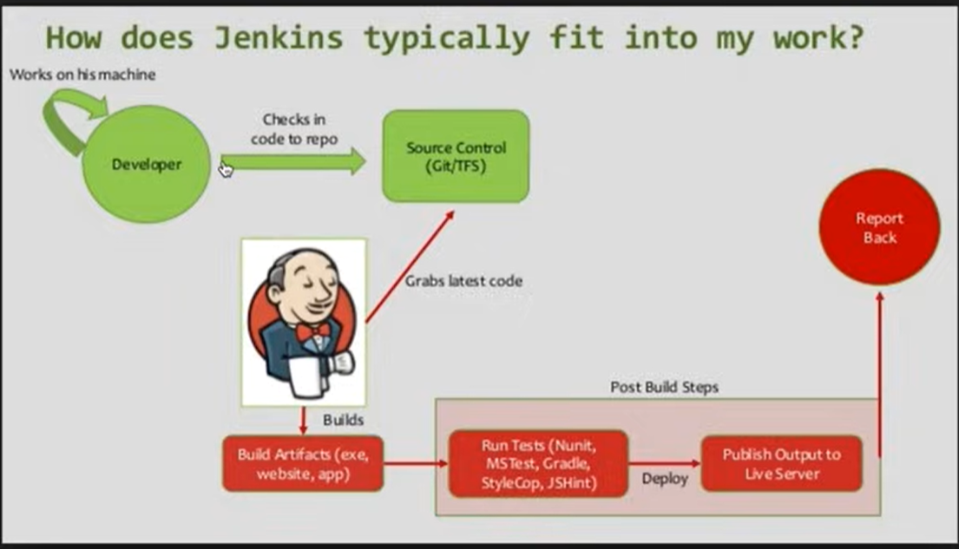

Slide 4
Setup jenkins on tomcat
pre-requisite→
tomcat 5 or above
java 7 or above has to available
step 1: download tomcat 8- binary distribution-> click on zip file
step 2: unzip it and place it on any location.
step 3: copy and paste jenkins.war file inside tomcat/webapps folder
step 4: go to command prompt
go to tomcat/bin directory
make all files executable: chmod +x *.sh
step 5: start tomcat( you have to be in bin folder)
./startup.sh
step 6: verify tomcat started- go to browser localhost:8080
localhost:8080/jenkins
login with admin username and password
jenkins is not running as standalone but working with tomcat
Notes:
https://www.youtube.com/watch?v=Fi9pgrMlQZY
we can start all our application on single server. for most of the web applications we do use tomcat, so it is easier to use jenkins with tomcat.

Slide 5
if we want to start jenkins standalone also then
-go to command prompt, go to the path where jenkins is placed
- by default jenkins standalone starts on port 8080 but right now our tomcat/ jenkins is working on 8080
- so give command java -jar jenkins.war –httpPort=9090
- this will start jenkins standalone
- go to browser and check localhost:9090
#create a testjob on standalone port 9090.
#create a testjob2 on tomcat which is there on port 8080
#go to command prompt and start the standalone jenkins again
#shutdown tomcat by command ./shutdown.sh and start again by ./startup.sh
# go to browser and refresh both the pages of standalone and tomcat jenkins pages
# we can see both the jenkins with both the jobs created.

Slide 6
CI/CD Pipeline
devOps is a software development approach involving continuous development, testing, integration, deployment and monitoring throughout the development lifecycle.
create multiple jobs for multiple stages
samplebuildJob-freestyle project(GUI will be available)
sampledeployJob-pipeline(script will be available)
sampleTestJob
sampleReleaseJob

Slide 7
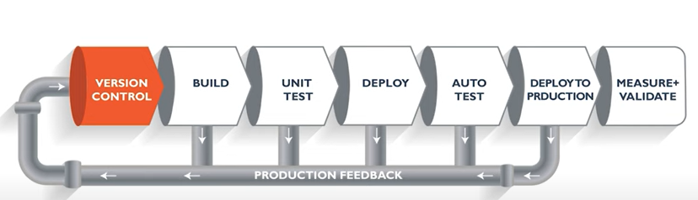
what is CI and CD?

Slide 8
create new item->select pipeline->give name-> select hello world script(if code starting with pipeline keyword then it is scripted pipeline/declarative pipeline and if it starts with node then it is groovy scripting)-> apply->save
build now(execute)->open build number-check status as success
#jenkin backup we can take by using thin backup plugin

Slide 9
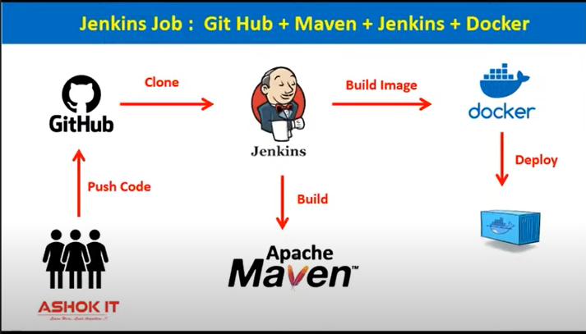
4 stage project on jenkins

Slide 10
Script
pipeline{
agent any —(not executing on any particular machine)
stages{
stage{(‘git clone’){
steps{
git ‘url’ —(this is same as git cloning)
}
}
stage{(‘mvn build’){
steps{
sh ‘mvn clean package’
}
}
stage{(‘docker image’){
steps{
sh ‘docker build -t img .’
}
}
stage{(‘deployment’){
steps{
sh ‘docker run -d -p 9090:8080 img’
}
}
}
}

Slide 11
go to gitHub-> copy url of college registration form project
go to jenkin-create item-pipeline-name- description-pipeline-copy git clone stage code(if we dont know the syntax-> go to pipeline syntax-select git:pipeline->give cloning url->branch name-master->public repository->generate script-> copy it and paste it in stage code of jenkin->build now->jenkin console output
configure-pipeline-add next stage of maven-copy code-apply-save-build now-build failed( setup maven on linux or configure maven as a plugin
(manage jenkins->tools->maven installation->add maven->
add scriptbefore stages-as
tools{
maven ‘m3’
}
build again

