Slide 1

MACHINE INTELLIGENCE
Dr. N MEHALA
Department of Computer Science and Engineering

Slide 2

MACHINE INTELLIGENCE
Module 4 [Unsupervised Learning]
Dr. N MEHALA
Department of Computer Science and Engineering

Slide 3
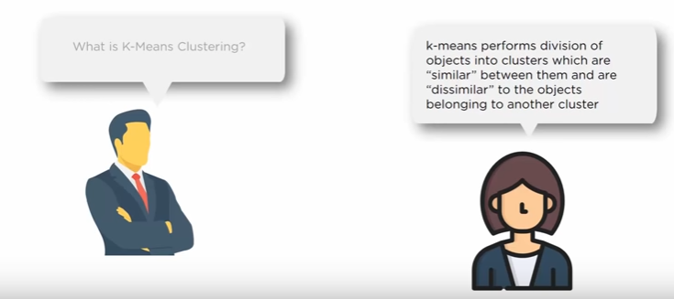
MACHINE INTELLIGENCE
K-Means Clustering Algorithm

Slide 4
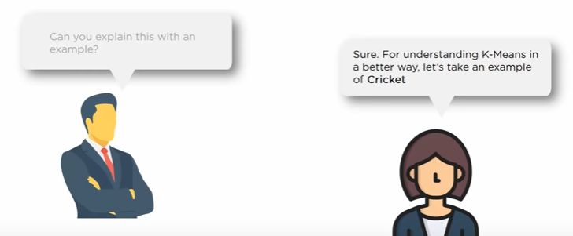
MACHINE INTELLIGENCE
K-Means Clustering Algorithm

Slide 5
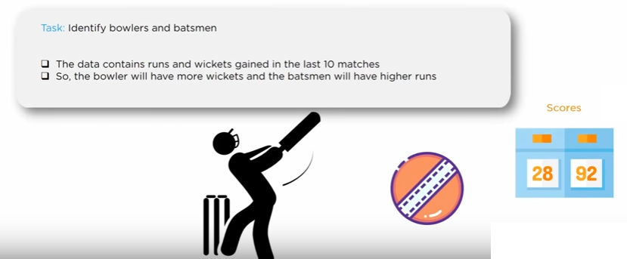
MACHINE INTELLIGENCE
K-Means Clustering Algorithm

Slide 6
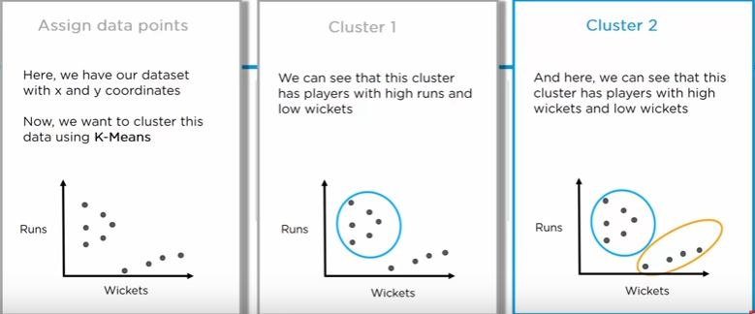
MACHINE INTELLIGENCE
K-Means Clustering Algorithm

Slide 7
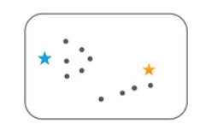
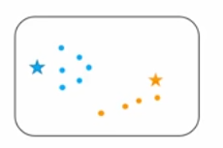
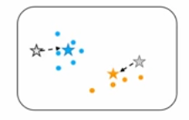
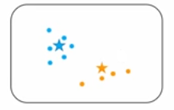
MACHINE INTELLIGENCE
K-Means Clustering Algorithm
Process will be repeated until our centroids becomes static

Slide 8
MACHINE INTELLIGENCE
K-Means Clustering Algorithm
Partitional clustering approach
Each cluster is associated with a centroid (center point)
Each point is assigned to the cluster with the closest centroid
Number of clusters, K, must be specified
The basic algorithm is very simple

Slide 9
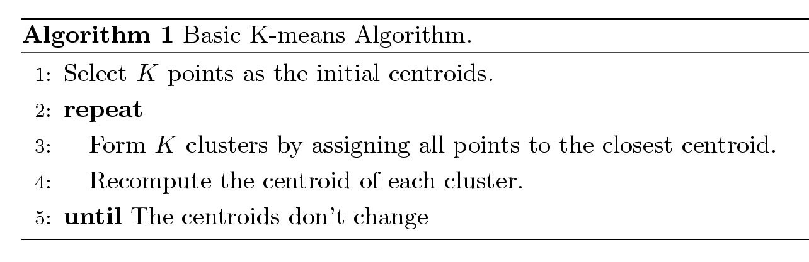
MACHINE INTELLIGENCE
K-Means Clustering Algorithm

Slide 10

MACHINE INTELLIGENCE
K-Means Clustering Algorithm : Applications

Slide 11
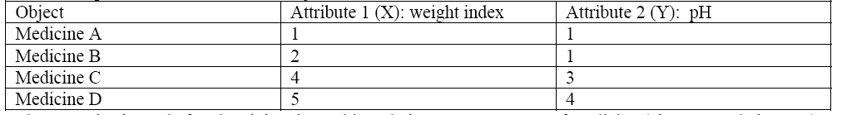
MACHINE INTELLIGENCE
K-Means Clustering: Example
Suppose we have several objects (4 types of medicines) and each object have two attributes or features as shown in the table. Our goal is to group these objects into K=2 group of medicine based on the two features (pH and weight index).

Slide 12
MACHINE INTELLIGENCE
K-Means Clustering: Example
Step1. Initial value of centroids: Suppose we use medicine A and medicine B as the first centroids. Let c1 and c2 denote the coordinate of the centroids, then c1 = (1,1) and c2 = (2,1)

Slide 13
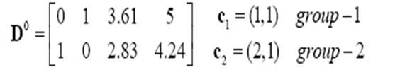
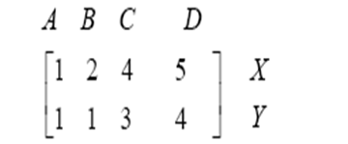
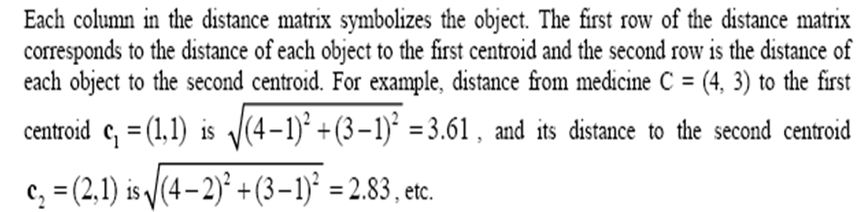
MACHINE INTELLIGENCE
K-Means Clustering: Example
Step2a. Objects-Centroids distance: we calculate the distance between cluster centroid to each object.
Let us use Euclidean distance, then we have distance matrix at iteration 0 is

Slide 14
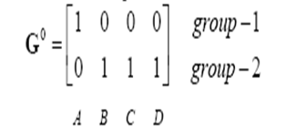
MACHINE INTELLIGENCE
K-Means Clustering: Example
Step2b. Objects clustering: we assign each object based on minimum distance. Thus medicineA is assigned to group1, medicineB is assigned to group2, medicineC is assigned to group2 and medicineD is assigned to group2. The element of Group matrix is 1 if and only if the object is assigned to that group.

Slide 15
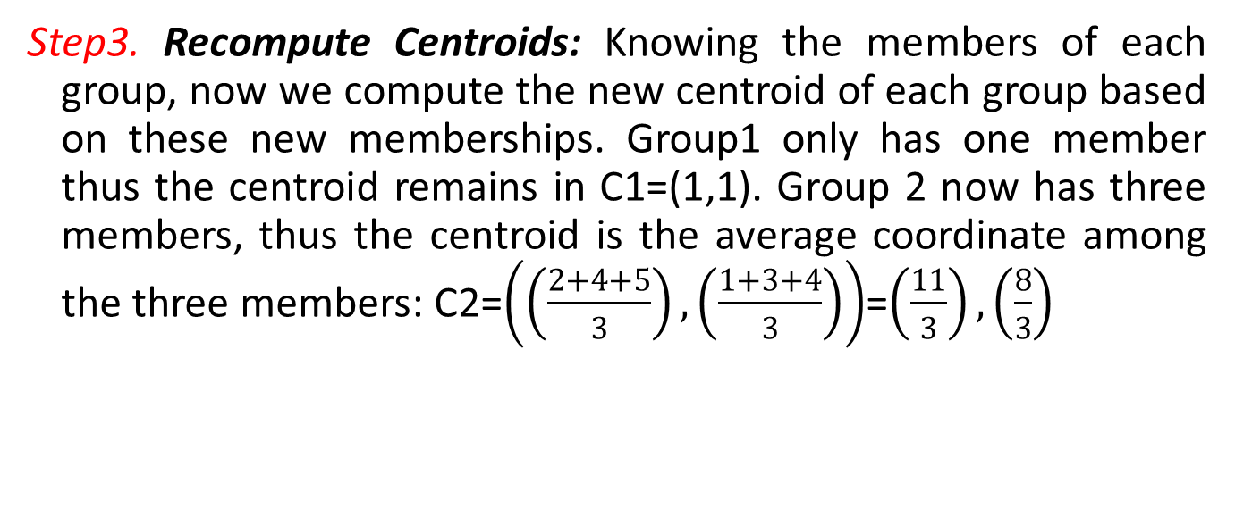
MACHINE INTELLIGENCE
K-Means Clustering: Example
Step3. Recompute Centroids: Knowing the members of each group, now we compute the new centroid of each group based on these new memberships. Group1 only has one member thus the centroid remains in C1=(1,1). Group 2 now has three members, thus the centroid is the average coordinate among the three members: C2=$\left(\left(\frac{2+4+5}{3}\right),\left(\frac{1+3+4}{3}\right)\right)$=$\left(\frac{11}{3}\right),\left(\frac{8}{3}\right)$

Slide 16
MACHINE INTELLIGENCE
K-Means Clustering: Example (Iteration1)

Slide 17



MACHINE INTELLIGENCE
K-Means Clustering: Example (Iteration1)
Step2a. Objects-Centroids distance
Step2b. Objects clustering
Step3. Recompute Centroids

Slide 18


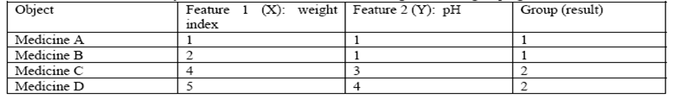
MACHINE INTELLIGENCE
K-Means Clustering: Example (Iteration2)
Step2a. Objects-Centroids distance
Step2b. Objects clustering

Slide 19
MACHINE INTELLIGENCE
K-Means Clustering: Evaluation
Most common measure is Sum of Squared Error (SSE)
For each point, the error is the distance to the nearest cluster
To get SSE, we square these errors and sum them.
x is a data point in cluster C_{i} and m_{i} is the representative point for cluster C_{i}
can show that m_{i} corresponds to the center (mean) of the cluster
Given two clusters, we can choose the one with the smallest error
One easy way to reduce SSE is to increase K, the number of clusters
A good clustering with smaller K can have a lower SSE than a poor clustering with higher K

Slide 20
MACHINE INTELLIGENCE
K-Means Clustering: Summary
Pros: Easy to implement
Cons: Can converge at local minima; slow on very large datasets
Works with: Numeric values

Slide 21
MACHINE INTELLIGENCE
K-Means Clustering: Summary
General approach to k-means clustering
Collect: Any method.
Prepare: Numeric values are needed for a distance calculation, and nominal values can be mapped into binary values for distance calculations.
Analyze: Any method.
Train: Doesn’t apply to unsupervised learning.
Test: Apply the clustering algorithm and inspect the results. Quantitative error measurements such as sum of squared error (introduced later) can be used.
Use: Anything you wish. Often, the clusters centers can be treated as representative data of the whole cluster to make decisions

Slide 22
MACHINE INTELLIGENCE
K-Means Clustering: Summary
Initial centroids are often chosen randomly
Clusters produced vary from one run to another
The centroid is (typically) the mean of the points in the cluster.
‘Closeness’ is measured by Euclidean distance, cosine similarity, correlation etc.
Most of the convergence happens in the first few iterations
Often the stopping condition is changed to ‘Until relatively few points change clusters’
Complexity is O( n * K * I * d )
n = number of points, K = number of clusters, I = number of iterations, d = number of attributes

Slide 23
MACHINE INTELLIGENCE
K-Means Clustering: Summary
Initial centroids are often chosen randomly
Clusters produced vary from one run to another
The centroid is (typically) the mean of the points in the cluster.
‘Closeness’ is measured by Euclidean distance, cosine similarity, correlation etc.
Most of the convergence happens in the first few iterations
Often the stopping condition is changed to ‘Until relatively few points change clusters’
Complexity is O( n * K * I * d )
n = number of points, K = number of clusters, I = number of iterations, d = number of attributes

Slide 24
MACHINE INTELLIGENCE
Summary
K-Means Clustering (Partitional Clustering)
Example: K-Means Clustering
K-Means Clustering: Evaluation

Slide 25
MACHINE INTELLIGENCE
Resources
http://www2.ift.ulaval.ca/~chaib/IFT-4102-7025/public_html/Fichiers/Machine_Learning_in_Action.pdf
http://wwwusers.cs.umn.edu/~kumar/dmbook/.
ftp://ftp.aw.com/cseng/authors/tan
http://web.ccsu.edu/datamining/resources.html

Slide 26
THANK YOU
Dr. N MEHALA
Department of Computer Science and Engineering
mehala@pes.edu

