Slide 1
Foresight: Visual Produce-Spoilage Estimation
Review 3 — trained models, integrated web application, evaluation and deployment readiness
Notes:
Introduce the team and the goal of Review 3: show real models running inside the application, compare models, show XAI, and report test results.

Slide 2
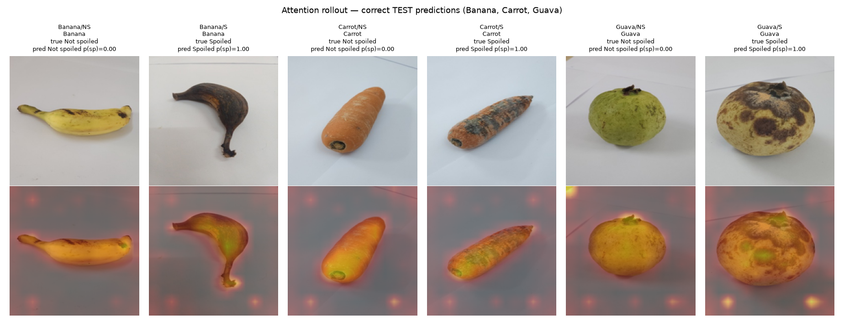
From one photo to an actionable freshness estimate
Post-harvest loss is high for perishable fruit and vegetables in Indian supply chains
Foresight takes one phone-style photo of a single item and returns: produce type, spoilage estimate, visible-decay check, decay mask, proxy shelf-life and an explanation heat-map
Six produce types: banana, carrot, guava, Indian gooseberry, mango, tomato
Research prototype — a visual estimate, not a food-safety guarantee
Real test images with the model's attention rollout

Slide 3
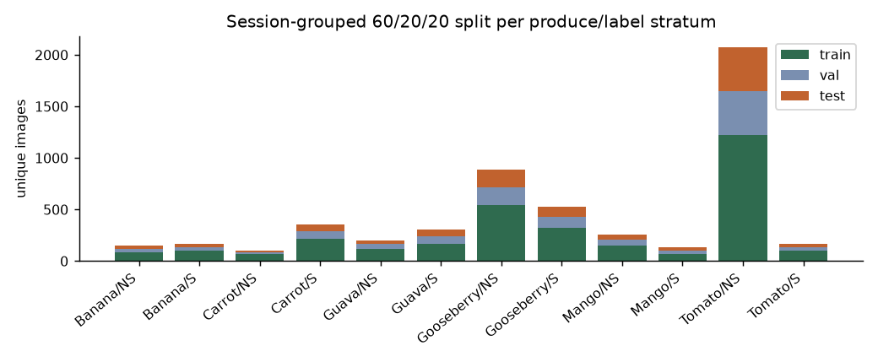
TR-6 audited: duplicates and conflicts removed
21,653
10,776
170
5,335
files audited (19.8 GiB)
unique images (Classified = copy of Normal)
contents with conflicting labels — excluded
eligible sRGB images used
60/20/20 split by capture session: 3177 / 1087 / 1071
0 duplicate images and 0 sessions shared across splits
A random split would put an exact copy of ~60% of test images into training

Slide 4
Architecture: React UI, FastAPI, models, SQLite
React + Vite UI
upload, results, history, dashboard
FastAPI
validation, errors, CORS
Inference
ViT-B/16 + add-on models
Result composer
warnings, overlays
SQLite history
no images stored
1
2
3
4
5
ViT-B/16 classifier
produce type + spoilage
Visible-decay check
probe trained on human labels
Pilot U-Net
fruit + decay mask, coverage %
Proxy shelf-life
days until 'Spoiled' label
Attention rollout
XAI heat-map
Every response carries the model version, warnings and a disclaimer; mock mode is off by default and labelled DEMO MOCK DATA if ever enabled.

Slide 5
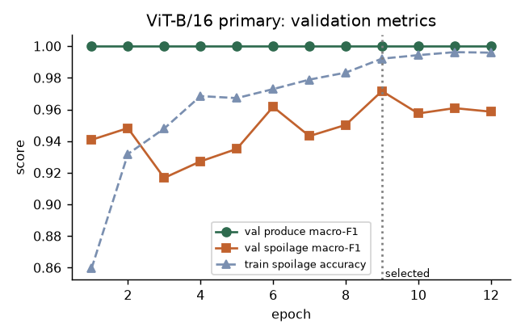
Primary model: pretrained ViT-B/16 with two heads
Backbone | ViT-B/16 (ImageNet-21k → 1k), fine-tuned
Heads | produce type (6) + spoilage (2)
Loss | CE(type) + CE(spoilage)
Optimiser / LR | AdamW, 0.00002 backbone, 0.0002 heads
Batch / epochs | 16 / 12, best epoch 9 (validation)
Augmentation | crop, flips, ±15° rotation, brightness/contrast
Training time | 54.7 min on Apple M5 (MPS)
Validation macro-F1 per epoch; checkpoint selected on validation only

Slide 6
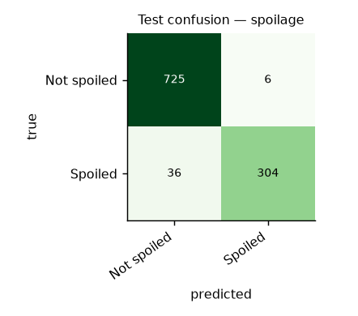
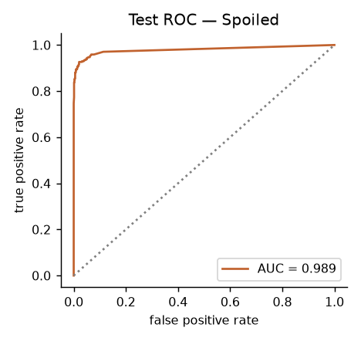
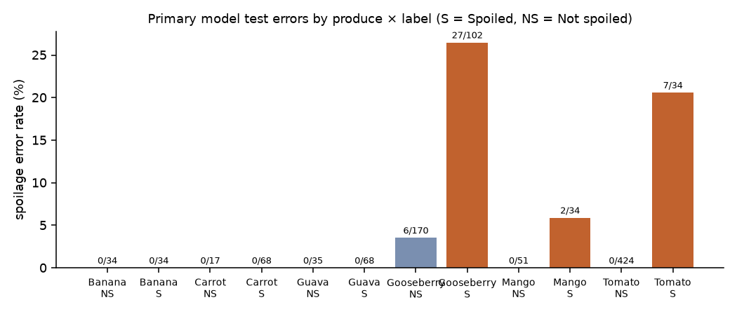
Held-out test results (1,071 images, scored once)
0.954
96.1%
spoilage macro-F1
spoilage accuracy
0.989
100%
spoilage ROC-AUC
produce-type accuracy
Session-bootstrap 95% CI for macro-F1: 0.903–0.988. Weak spot: Spoiled recall 0.894 (mostly gooseberry and tomato).

Slide 7
Model comparison: fine-tuned ViT-B/16 is best
Fine-tuning beats frozen features by 0.038
Conventional augmentation: +0.013, positive on all 3 seeds
GAN images: -0.009, not consistent across seeds — no benefit
Same split, same untouched test set for every model

Slide 8
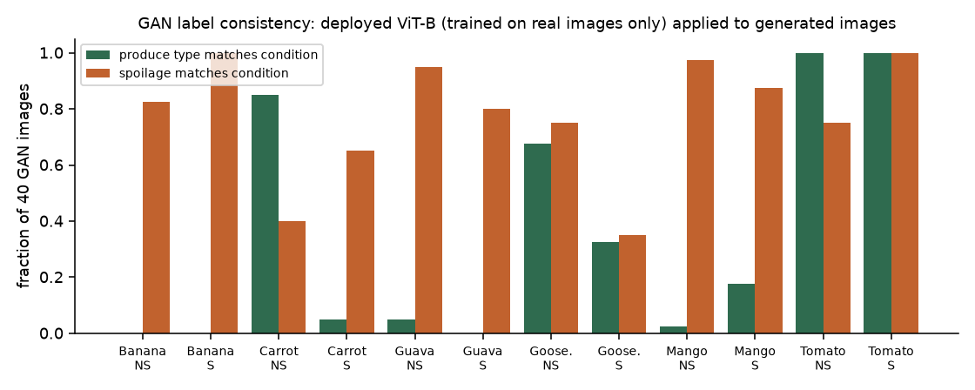
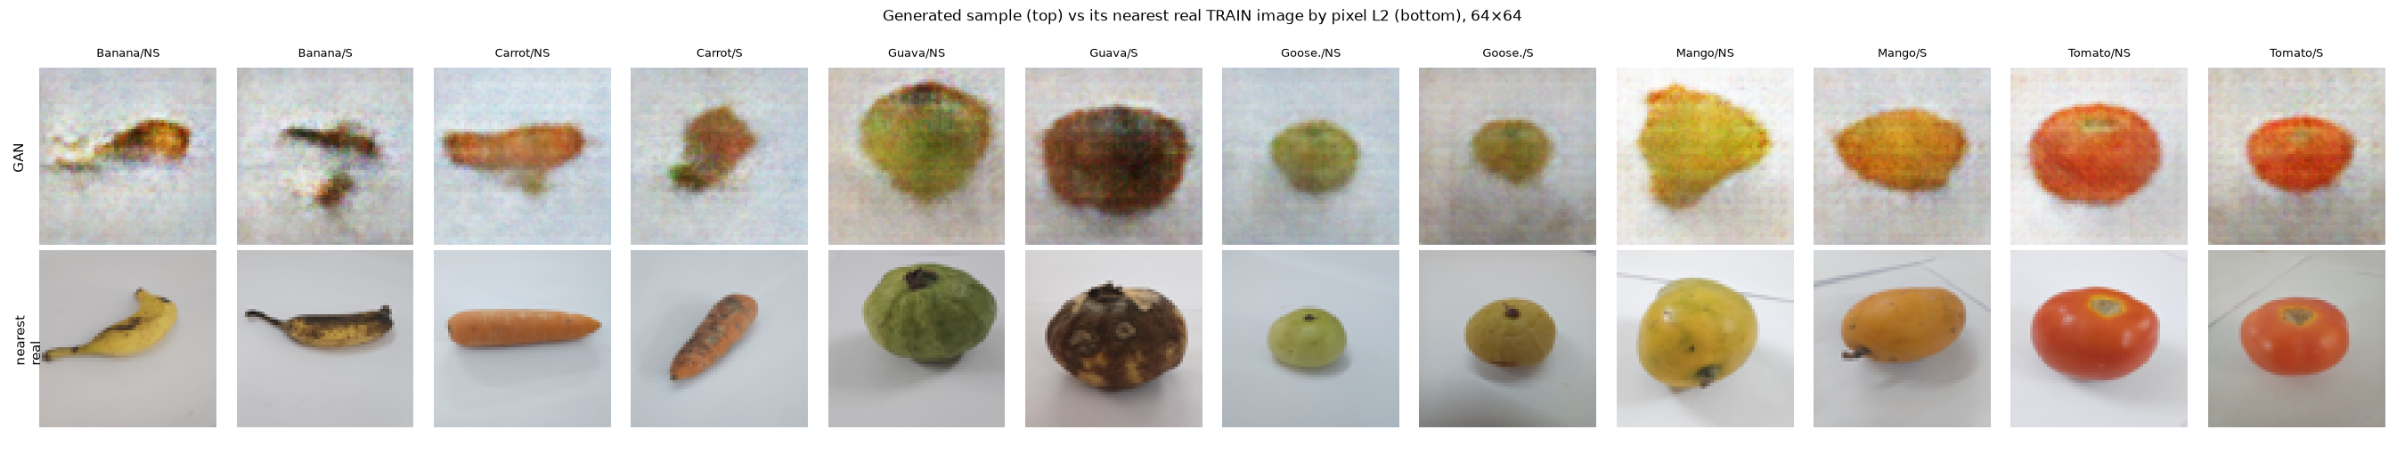
GAN augmentation: tested, no measurable gain
Conditional DCGAN, 64×64, 12 classes, trained on the training split only
480 synthetic images; real-data ViT recognises the intended produce in only 34.6%
No memorisation: generated images are farther from training images than real images are from each other
3-seed ViT-S result: 0.919 with GAN vs 0.928 without

Slide 9
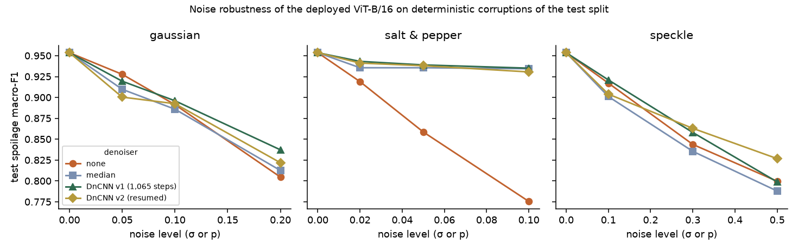
Ablations: split design and noise matter most
Unseen-days test: 0.830 vs 0.928 (−0.098, 3 seeds)
Strong noise lowers spoilage macro-F1 to ~0.78–0.80; produce type stays ≥0.96
3×3 median filter repairs salt-and-pepper noise; DnCNN helps under heavy noise only
Real TR-6 sensor noise (σ≈0.003) is far below these stress levels
Split scheme | Test images with same-day image in train
Random (raw files) | 100.0% (+ 60% exact duplicates)
Session-grouped (used) | 76.2%
Day-grouped (sensitivity) | 1.5%

Slide 10
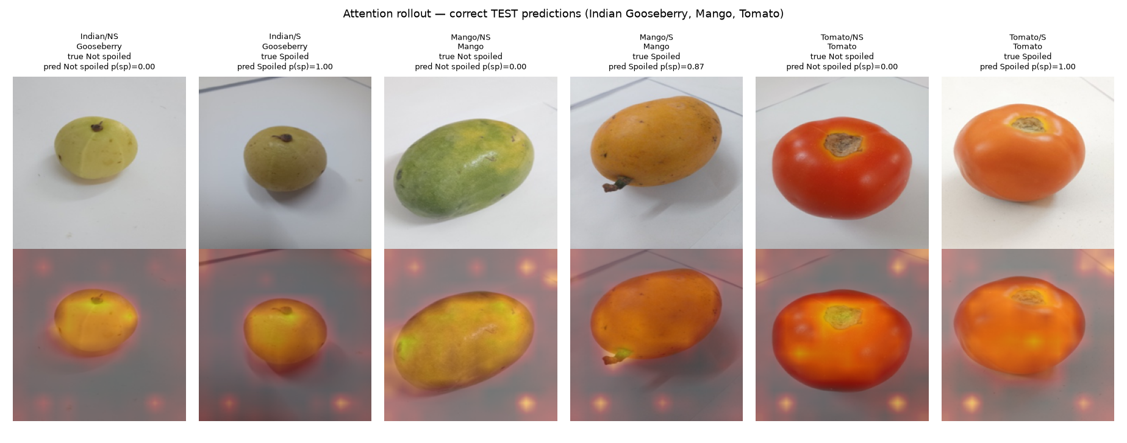
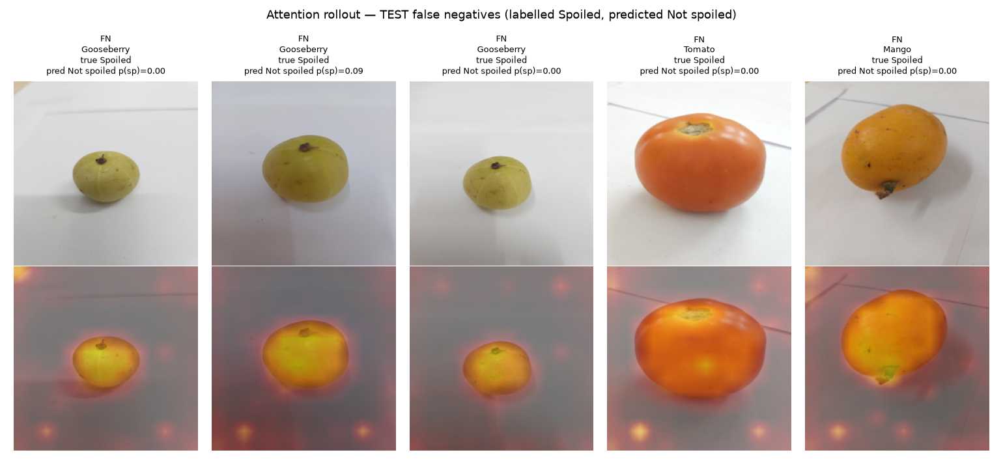
XAI: attention rollout shows the model looks at the fruit
10×
0.95
larger confidence drop when highlighted patches are masked vs random
map stability under flip (Spearman ρ)
Missed 'Spoiled' gooseberries look fresh, and attention is on the fruit — the date-based label precedes visible decay
Bright background dots are a known ViT artefact, not evidence of background use
Explanations are diagnostic, not proof of correctness

Slide 11
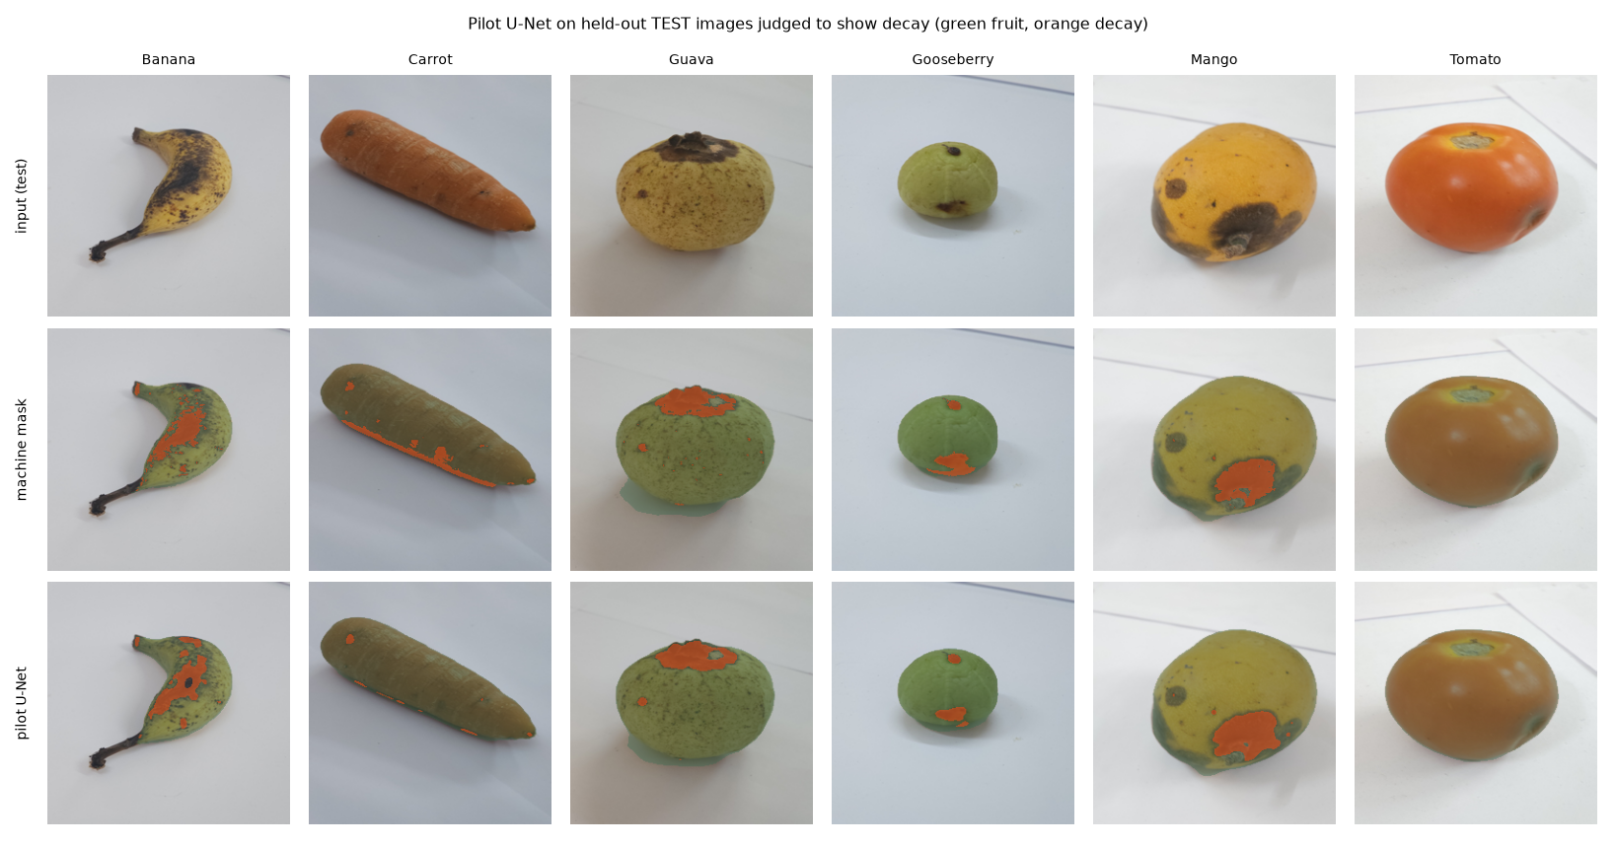
Added: visible-decay check, pilot U-Net, proxy shelf-life
Component | Held-out result | Trained on
Visible-decay check | 0.931 accuracy (n=29) | 165 human labels
Pilot U-Net | fruit Dice 0.98, decay Dice 0.59 | machine masks (pilot)
Proxy shelf-life | MAE 4.3 days, R² 0.89 | days to 'Spoiled' label
Human annotation of 180 images: TR-6 'Spoiled' images showed visible decay in only 72/109. The U-Net is a pilot (machine-generated masks) and shelf-life is a proxy — both labelled as such in the UI.
Pilot U-Net on held-out test images: input / machine mask / prediction

Slide 12
Live integration with the trained models
1
Upload photo (JPG/PNG/WEBP ≤15 MB)
60/60
57/60
2
Validate, decode, EXIF-correct, resize
produce correct via live API (held-out originals)
spoilage correct via live API
3
ViT-B/16 + visible-decay + U-Net + shelf-life
48 ms
44/44
median end-to-end latency
UI fields present in real responses
4
Card: type, spoilage, decay %, shelf-life, heat-map
Errors handled: wrong type (415), corrupt (400), too large (413), model missing (503) — all shown clearly in the UI.
5
Saved to SQLite history and dashboard

Slide 13
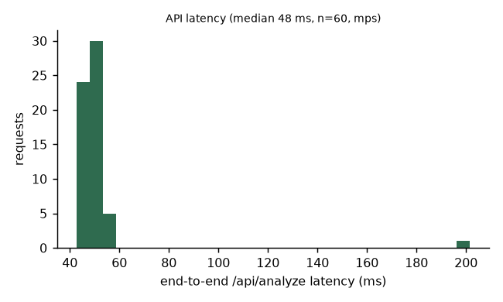
Testing: automated, end-to-end and in the browser
37
7
11/11
0
pytest: API, real model, data integrity
Vitest: frontend API client + components
live end-to-end checks passed
duplicate / session leakage across splits
Missing checkpoint fails clearly (503) — no fabricated predictions
Mock mode off by default and labelled DEMO MOCK DATA
Source dataset re-hashed: unchanged
CORS restricted to the configured frontend origin
Preprocessing parity: API vs training cache

Slide 14
Limitations and next steps
Limitations
Next steps
Same physical fruits appear in train and test (no specimen IDs)
Spoilage labels are date-based; some 'Spoiled' fruit looks fresh
Lab photos on plain backgrounds; real phone photos untested
U-Net is a pilot; shelf-life is a proxy
Human-drawn decay polygons → validated U-Net
Real-world photo test set
Confidence calibration
Third-party deployment (backend ~1.5 GB RAM)
IEEE DataPort submission of TR-6+

Slide 15
A real, tested and explainable produce-spoilage prototype
ViT-B/16 test spoilage macro-F1 0.954 · integrated FastAPI + React app · GAN, XAI, ablation and robustness evaluated · thank you — questions?

