Slide 1

Employee Attrition Analysis
By
Nanditha Sirigiri

Slide 2
Project
The leading BPO company is assessing the employee attrition rate which is critical to the health and success of the organization.
Business problem:
To analyze the attrition rate of the BPO company. The maintained dataset for the attrition analysis containing the records of Retain_Indicator, Sex_Indicator, Relocation_Indicator, Marital Status and Employee ID.
Business Solution:
Logistic Regression algorithm is built to analyze the employee attrition rate which can enable the company to employ a more targeted approach towards their employee retention strategies.

Slide 3

Interpretation
Analysis : Frequency of churn
Initially the frequency of the number of employees retaining and leaving the company are analyzed. The dependent variable is the Retain_indicator.
The analysis explains the frequency that 56% of the employee of the company has churn which is high.

Slide 4
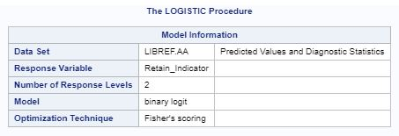
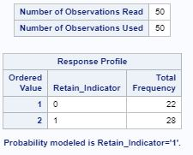
Model
Model: Logistic Regression algorithm
Application of Logistic Regression enables organizations to employ a more targeted approach towards their employee retention strategies in business performance.
Dependent Variable: Retain_Indicator.
Independent Variables: Sex_Indicator, Relocation_Indicator, Marital Status and Employee ID

Slide 5

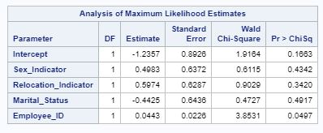
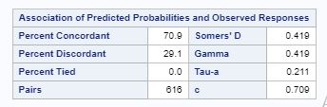
Model results and interpretations
Model: Logistic Regression algorithm
The relative gradient convergence criterion of the model is satisfied indicating the good fit of the model.
The model output resulted in the P-Value for the Employee Id variable is 0.0497(<0.05) and rest of the variables has P-value>0.05.
The C-Statistic is 0.709 or 70.9% which indicates the model is good.

Slide 6
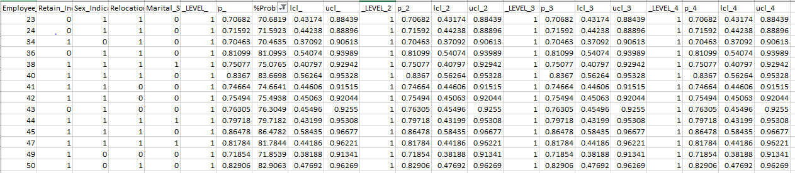
Conclusions:
The result of the attrition rate from the implemented algorithm is categorized as High, Medium and low attrition rate of the employees of the company as shown.
14 employees are in high risk of leaving the company, 25 employees are in between leaving or not leaving and the rest 11 employees will retain in the company
High risk(>70% probability)

Slide 7
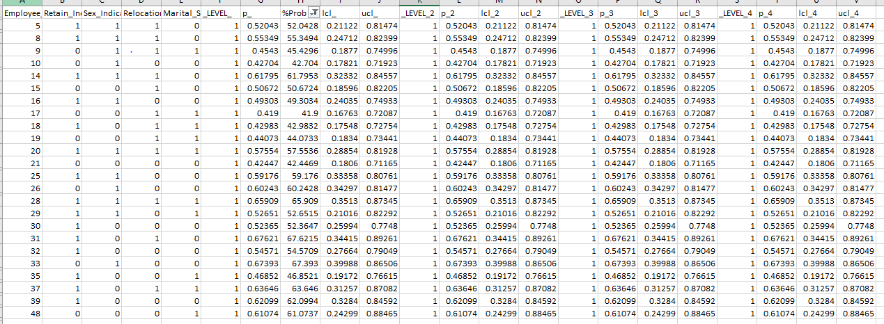
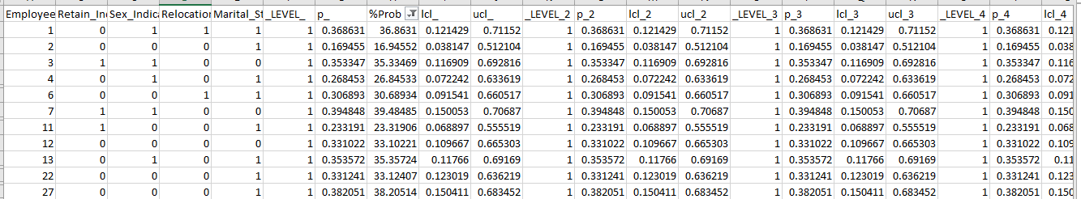
Medium risk (probability between 40% and 69%)
Low risk(<40%)

