Slide 1

TOMATO PRICE FORECASTING USING MACHINE LEARNING MODELS
Tomato Price Prediction | Group 12|Rakshitha R AMB2206
Nanditha V AMB2149
Purushotham G S AMB2190

Slide 2
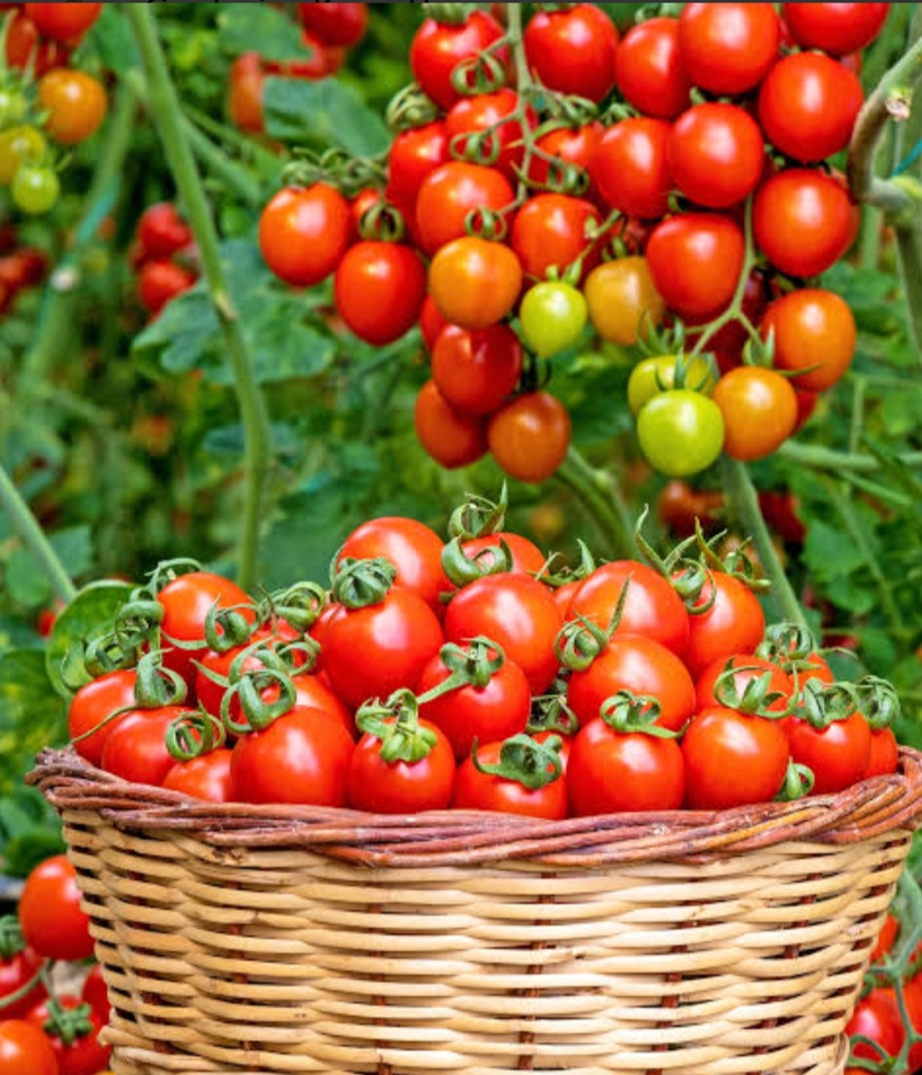
CONTENT
Introduction
Problem Statement
Motivation
Objectives
Review of Literature
Data overview
Methodology
Model Evaluation Metrics
Tools and Technologies used
Result
Conclusion

Slide 3
INTODUCTION
Agriculture is a crucial sector in India, contributing significantly to the economy and livelihood of millions of farmers. Tomato is one of the most widely cultivated and consumed vegetables, but its market price is highly volatile. Tomato price fluctuation is one of the major challenges faced by farmers in India. Due to the lack of predictive insights, farmers often suffer losses despite good production. In this project, we use machine learning techniques to analyze historical market data and build a predictive model that helps forecast tomato prices, enabling better decision-making and reducing uncertainty.”

Slide 4
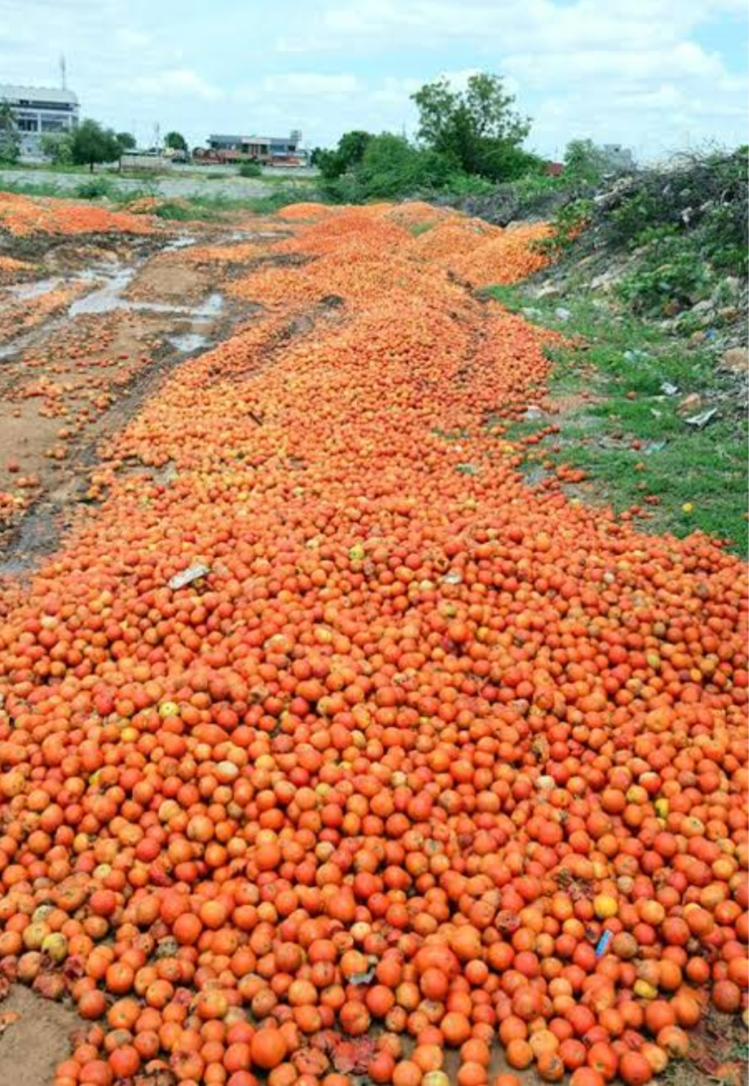
PROBLEM STATEMENT
Tomato prices are highly volatile and unpredictable, causing financial uncertainty for farmers. Farmers often lack data-driven tools to decide the right time to sell their produce.
Price fluctuations are influenced by factors like seasonality, supply-demand imbalance, and market conditions.
Traditional methods rely on guesswork, leading to losses even after good yield.
There is a need for an accurate and reliable prediction system to forecast tomato prices in advance.

Slide 5
MOTIVATION
Sudden price drops can cause significant losses to farmers
Lack of timely insights leads to poor decision-making in harvesting and selling
Middlemen often benefit more due to information asymmetry
There is a need for a system that provides reliable and timely price forecasts
With the availability of historical data, Machine Learning can uncover hidden patterns in pricing

Slide 6
OBJECTIVES
To develop a machine learning model for predicting tomato prices.To analyze historical agricultural data such as price, quantity, and date
To perform data preprocessing and feature extraction (year, month, day)
To implement and compare models like: Linear Regression, Random Forest and Decision Tree
To identify the most accurate model for price prediction
To visualize trends using graphs and charts
To assist farmers and stakeholders in better decision-making
To evaluate model performance using metrics: MAE, MSE, RMSE & R² score

Slide 7
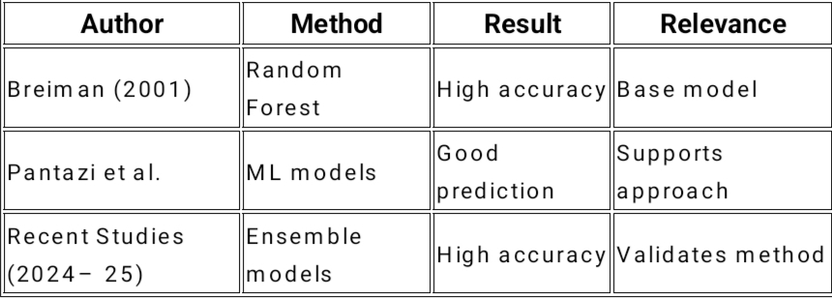
Review of Literature

Slide 8
DATASET OVERVIEW
Dataset obtained from Kaggle
Contains historical data related to tomato prices and market trends from 1/1/2018 to 14/04/2021
Dataset used in this project contains 1201 daily price records.

Slide 9
DATA FEATURES
Arrivals - Quantity of tomatoes arriving in the market
Temperature - Daily temperature
Rainfall - Rainfall level
Time data
Price Target variable (tomato price)

Slide 10
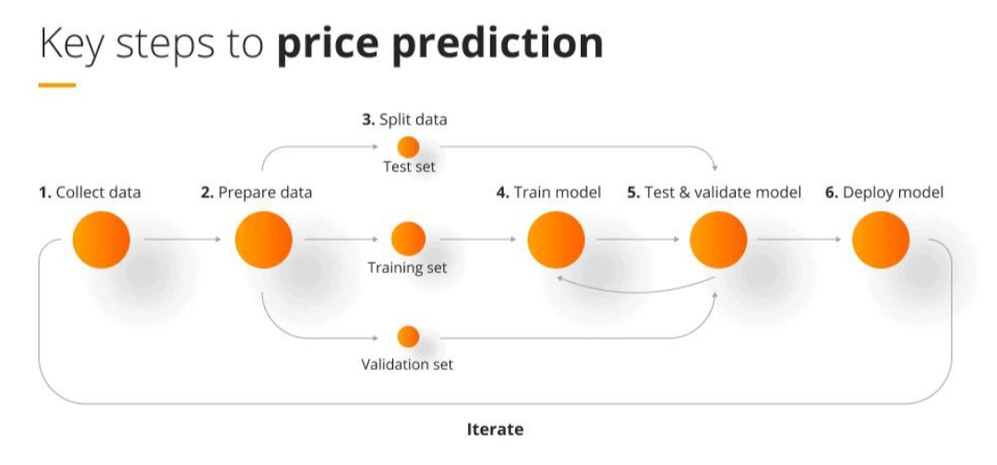
METHODOLOGY
Data collection & preprocessing
Apply Linear Regression & Random Forest
Train-test split
Evaluate using RMSE, R²
Predict future prices

Slide 11
Three machine models were implemented:
1.Linear regression
Assumes linear relationship between input features and target
Simple and fast model
2.Decision Tree
Splits data into branches based on feature values
Captures non linear relationships
3.Random forest
Assemble of multiple decision trees
Reduces overfitting
Provides high accuracy

Slide 12
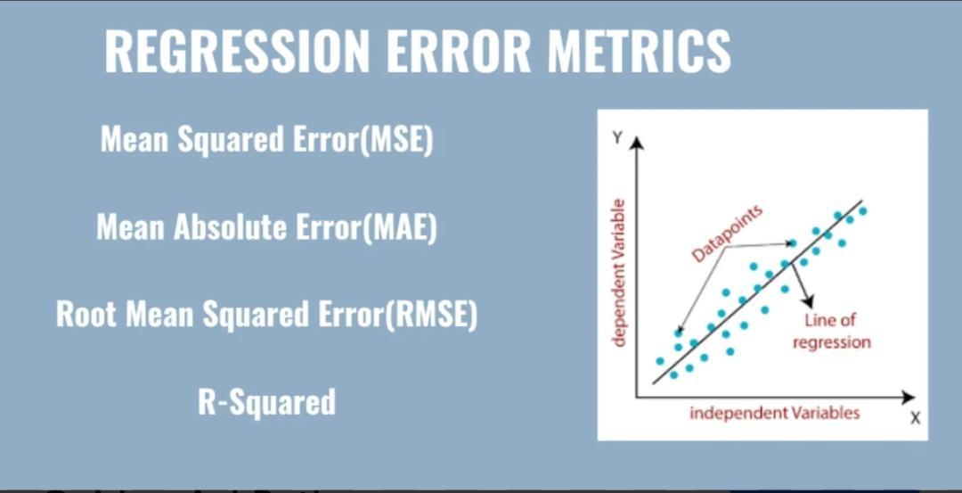
Model Evaluation Metrics
The models were evaluated using:
1.R2 Score (Coefficient of Determination)
Measures accuracy of prediction
O Higher value = better model
2.RMSE (Root Mean Squared Error)
Measures prediction error
3. MAE(Mean Absolute Error)
4.MSE(Mean Squared Error)

Slide 13
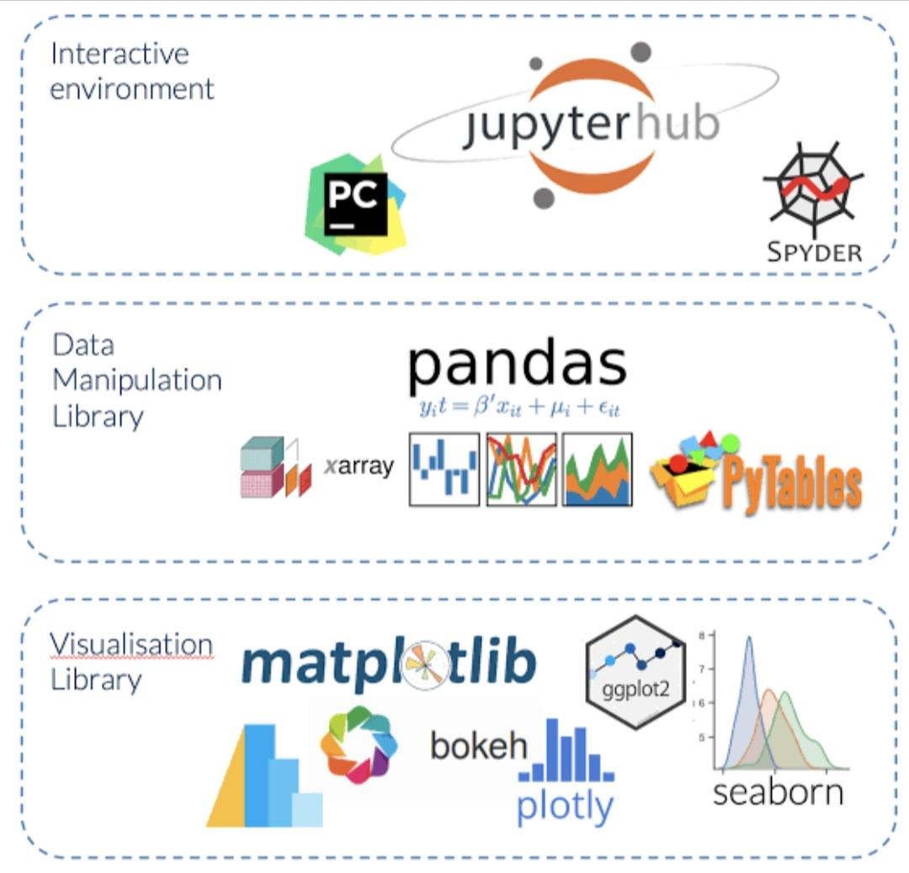

TOOLS AND TECHCHNOLOGY
*LIBRARIES USED:
Pandas
Numpy
Matplotlib
*DEVELOPMENT ENVIRONMENT : Google Colab
*DATA HANDLING AND STORAGE: csv files

Slide 14
RESULT
MODEL | MAE | MSE | RMSE | R^2
LINEAR REGRESSION | 34.38 | 1909.27 | 43.71 | 0.7834
DECESION TREE | 20.54 | 659.00 | 25.67 | 0.9253
RANDOM FOREST | 13.98 | 305.53 | 17.48 | 0.9653
TUNED RANDOM FOREST | 10.54 | 269.31 | 15.52 | 0.9657

Slide 15
R² COMPARISION GRAPH

Slide 16

CONCLUSION
Machine Learning models were successfully applied to predict tomato prices. Random Forest and Tuned Random Forest achieved the best performance with highest R² and lowest errors. The project shows that data-driven approaches improve prediction accuracy compared to traditional methods. This model can support better decision-making for farmers and stakeholders.

Slide 17


