Slide 1

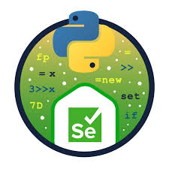
Web Automation using Selenium with Python
Capstone Project Presentation
Website: StackDemo
Presented by: Nandivada Prasad
Course/Internship: Python Automation
Date: 11/03/26

Slide 2
Problem Statement
Testing of Web Application by Manually takes more time process and repeating process.
Application Websites require testing of some features like Login with credentials, Search for products, Checking cart and Giving Address process.
This Project testing all these functions Automatically by using Selenium with python.

Slide 3
Project Objectives
The main goal of this project is to automate testing of the website using Selenium.
In this project :
Automated the website features like login, product selection, cart, checkout, and logout
By using Python, Selenium and Page Object Model to perform web automation
Used Excel file to run with different data and credentials
For Execution using Pytest framework and generated reports to view test results
To Run multiple tests at the same time by using Parallel Execution

Slide 4
Tools and Technologies Used
ChromeDriver - for browser
Python - Programming language for scripts
Selenium - used to automate web browser actions
Pytest - For test Framework
OpenPyXL - used to read data from excel

Slide 5
Automation Framework Architecture
Page Objects
Test Data
Test Scripts
Utilities
Report
Login Page
Product Page
Checkout Page
Address Page
Receipt Page
Logout Page
Excel Data
Test Stack
Excel Utility
Logger
HTML Report
Conftest

Slide 6
Project Workflow
Start
Open Browser
Login with Excel Data
Search and add Product to cart
Checkout & Shipping Details
Place Order & Verify Confirmation
Receipt Download
Logout
End

Slide 7
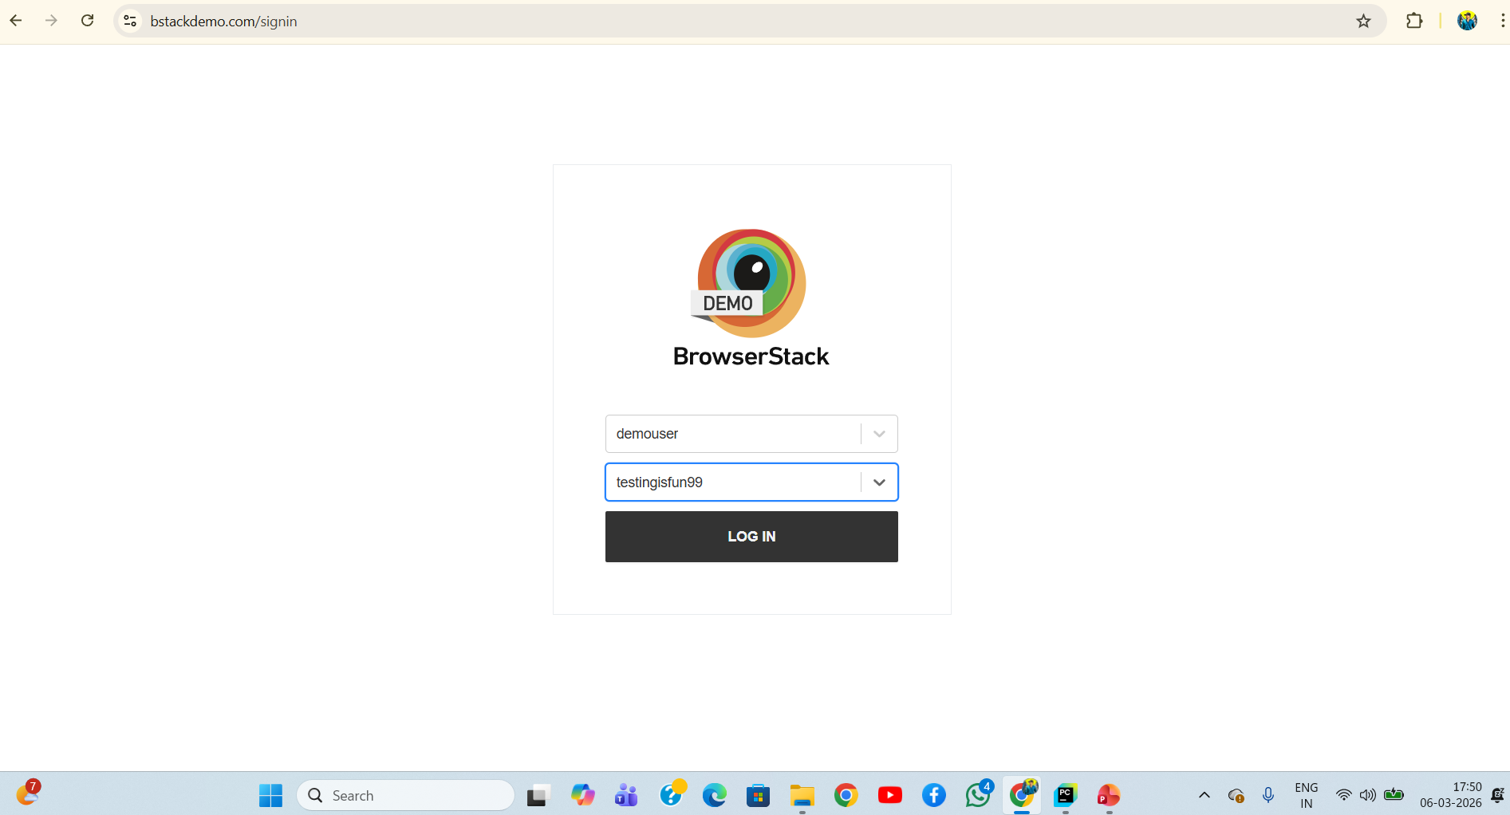
Project Test Output - Screen shots
Login Page :

Slide 8
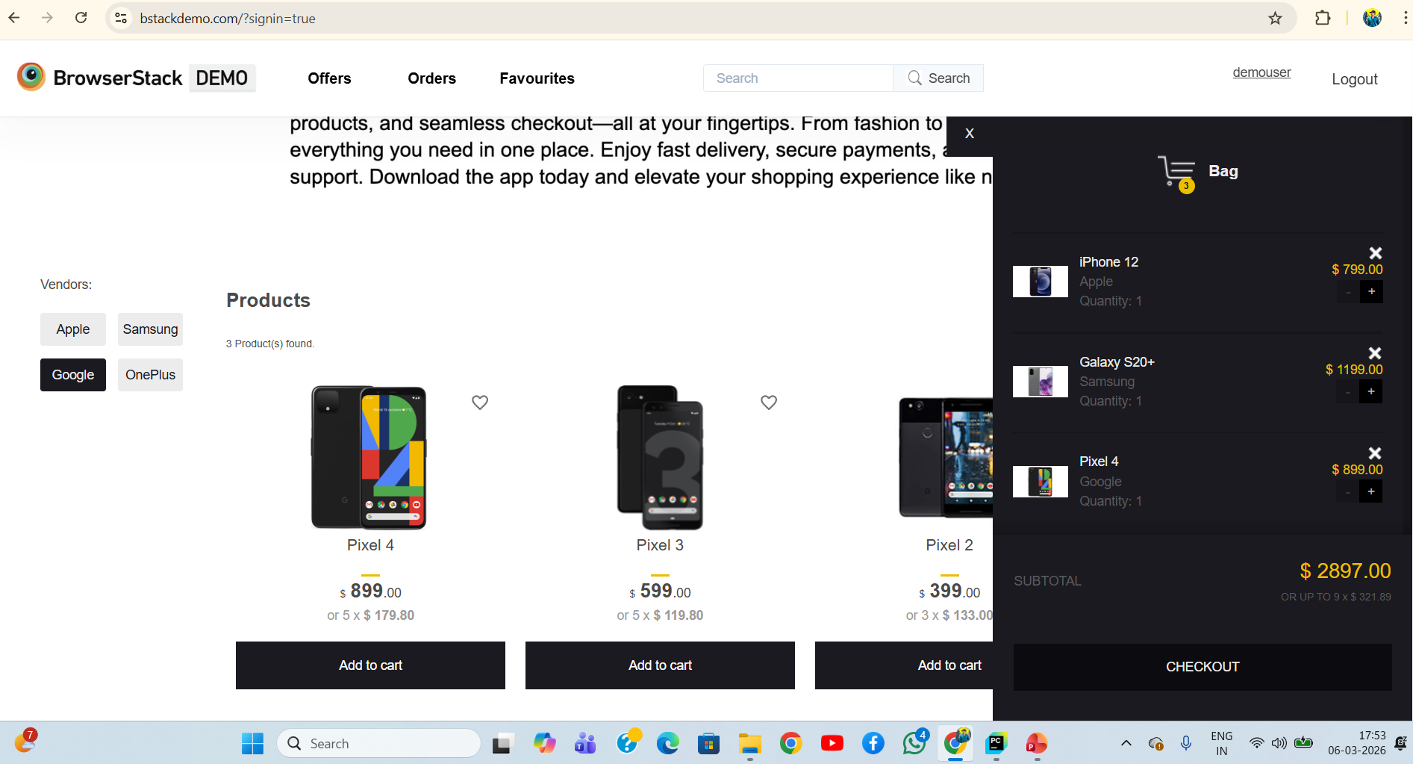
Product & Cart Page :

Slide 9
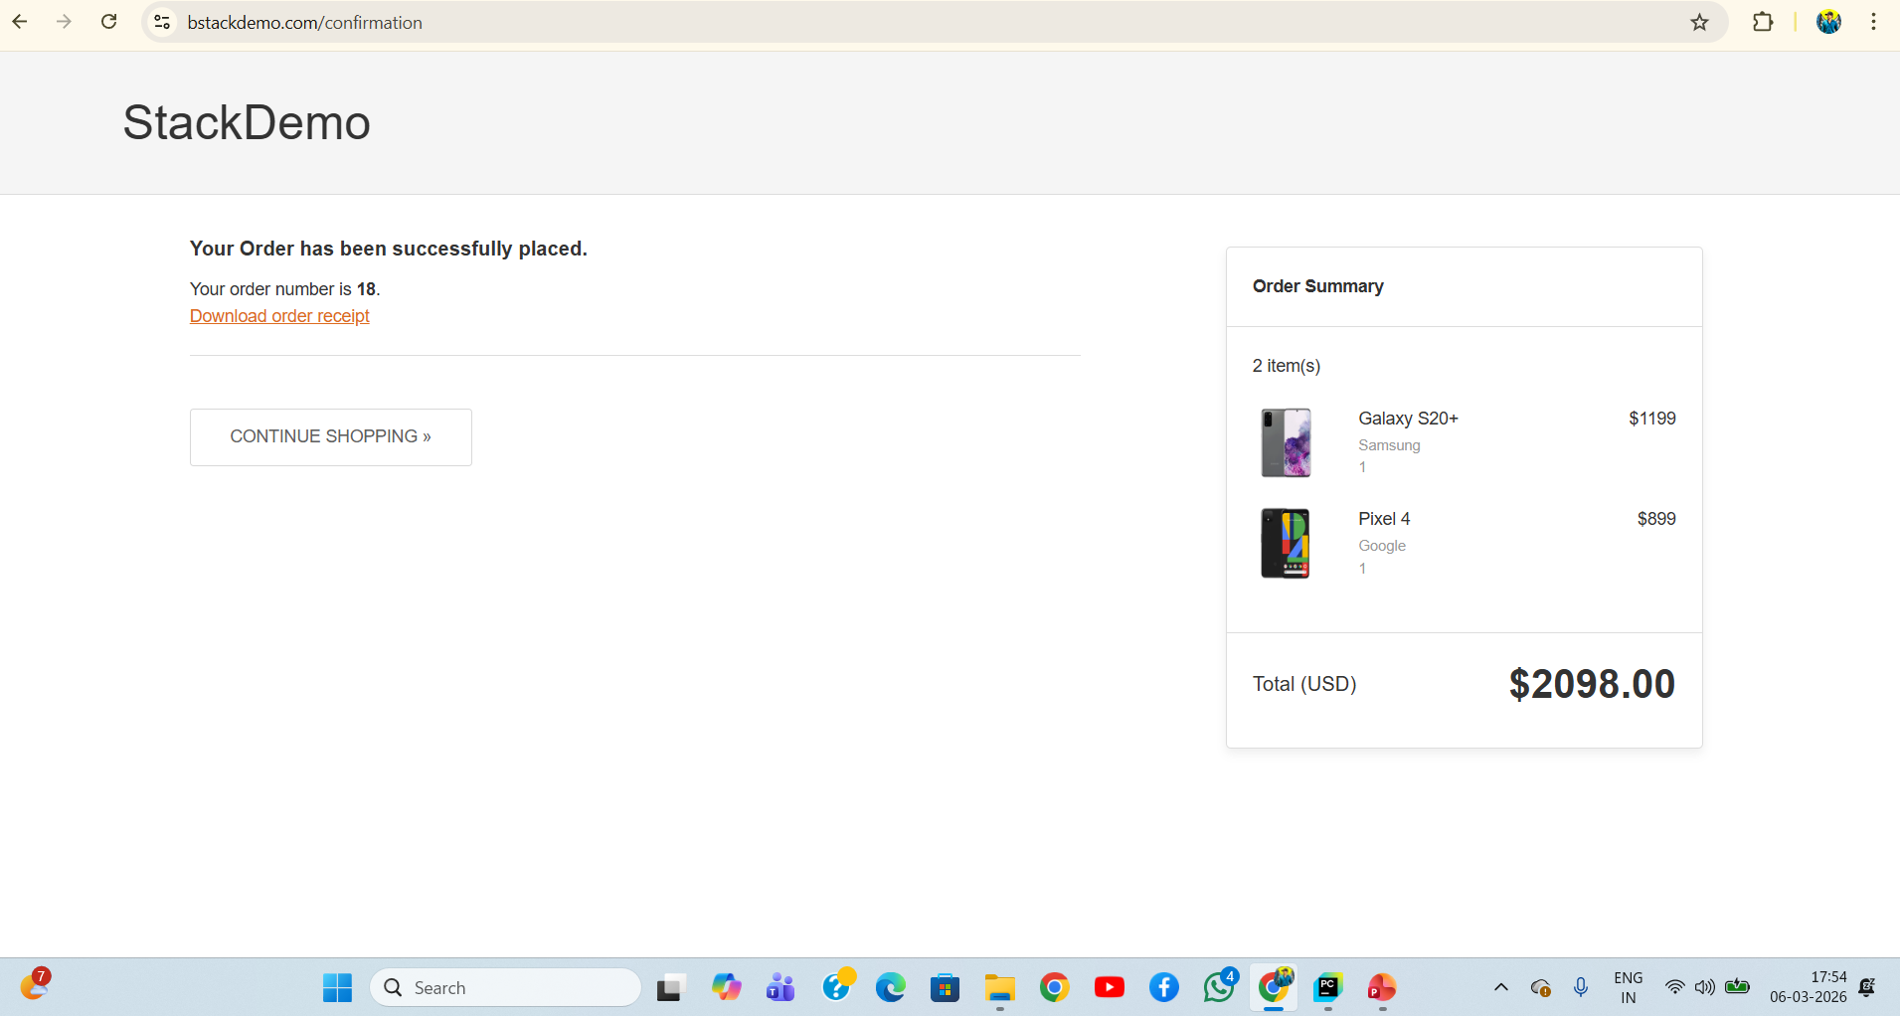
Verification & Receipt Page :

Slide 10
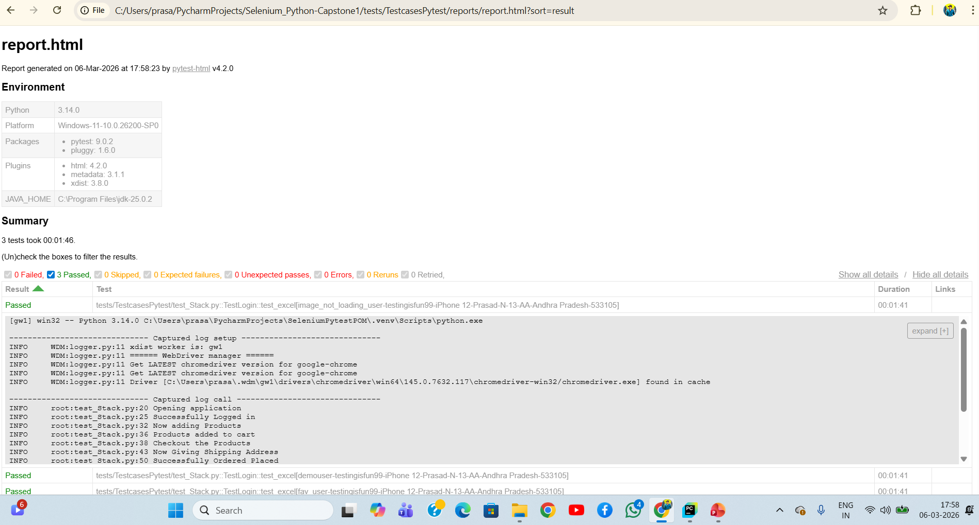
Report Page :

Slide 11
Challenges Faced
Challenges which I faced during this Project :
When implement the Page Object Model and Frameworks for Automation.
When handling Dynamic elements and Xpath.
For test data to give Multiple data information in Excel.
In the time of Parallel Execution using Data Driven Testing.
Waiting for page and elements loading.

Slide 12
Future Enhancements
Improve the report portion so that test results can be understood more clearly.
I want to add more tests to increase the test of the application.
Adding more techniques for test data to done parallel execution in different browsers.

Slide 13
Conclusion
From this project, I was able to understand how Selenium Automation works in real-time applications or websites.
I learned POM method and Data Driven testing .
I gained more experience on Selenium with Python while doing End to End Automation.
Successfully complete the login, add products, checkout and logout process by automation testing.

