Slide 1



Bank Loan Report
View in Power BI
Last data refresh:
29/09/2025 05:09:59 UTC
Downloaded at:
03/10/2025 11:21:50 UTC

Slide 2
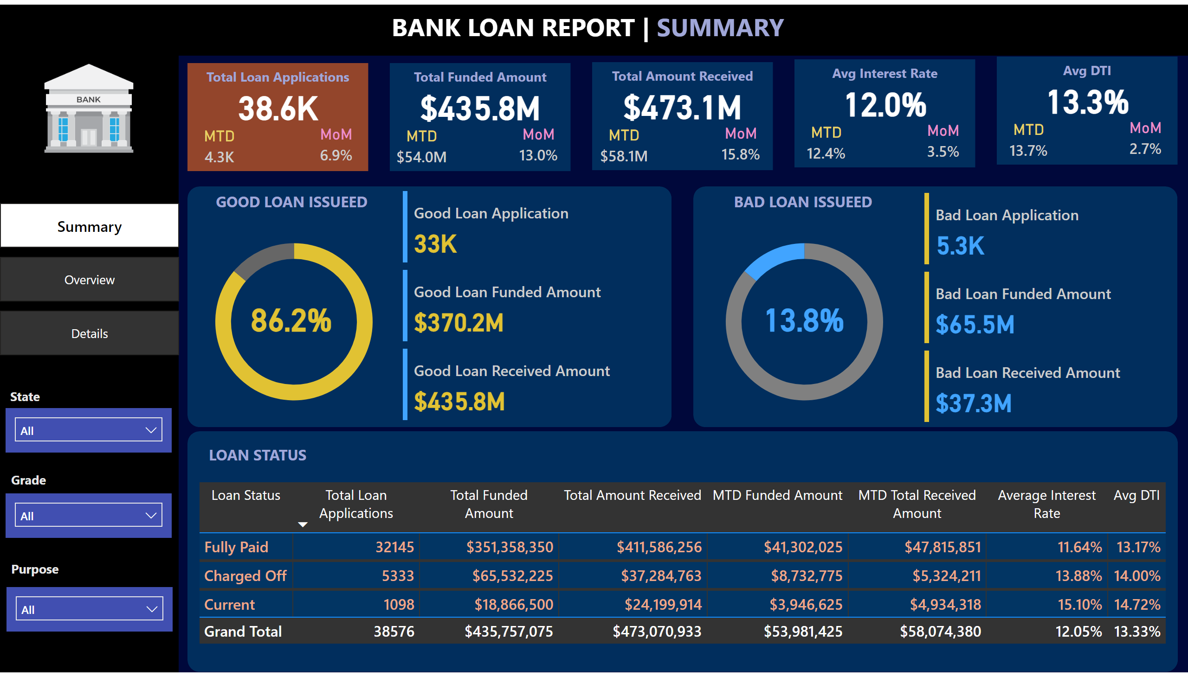
Summary
Notes:
shape
No alt text provided
shape
No alt text provided
textbox
No alt text provided
MTD
No alt text provided
card
No alt text provided
textbox
No alt text provided
MoM
No alt text provided
shape
No alt text provided
MTD
No alt text provided
card
No alt text provided
textbox
No alt text provided
MoM
No alt text provided
shape
No alt text provided
MTD
No alt text provided
card
No alt text provided
textbox
No alt text provided
MoM
No alt text provided
shape
No alt text provided
MTD
No alt text provided
card
No alt text provided
textbox
No alt text provided
MoM
No alt text provided
shape
No alt text provided
MTD
No alt text provided
card
No alt text provided
textbox
No alt text provided
MoM
No alt text provided
shape
No alt text provided
shape
No alt text provided
shape
No alt text provided
donutChart
No alt text provided
card
No alt text provided
textbox
No alt text provided
cardVisual
No alt text provided
donutChart
No alt text provided
textbox
No alt text provided
card
No alt text provided
cardVisual
No alt text provided
tableEx
No alt text provided
shape
No alt text provided
textbox
No alt text provided
slicer
No alt text provided
textbox
No alt text provided
slicer
No alt text provided
textbox
No alt text provided
slicer
No alt text provided
textbox
No alt text provided
image
No alt text provided
pageNavigator
No alt text provided

Slide 3
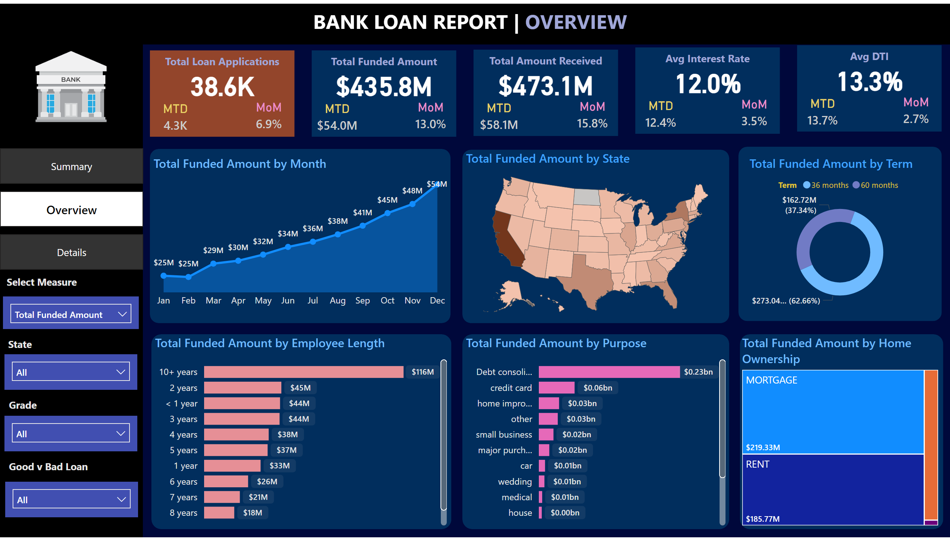
Overview
Notes:
shape
No alt text provided
shape
No alt text provided
textbox
No alt text provided
MTD
No alt text provided
card
No alt text provided
textbox
No alt text provided
MoM
No alt text provided
shape
No alt text provided
MTD
No alt text provided
card
No alt text provided
textbox
No alt text provided
MoM
No alt text provided
shape
No alt text provided
MTD
No alt text provided
card
No alt text provided
textbox
No alt text provided
MoM
No alt text provided
shape
No alt text provided
MTD
No alt text provided
card
No alt text provided
textbox
No alt text provided
MoM
No alt text provided
shape
No alt text provided
MTD
No alt text provided
card
No alt text provided
textbox
No alt text provided
MoM
No alt text provided
shape
No alt text provided
shape
No alt text provided
slicer
No alt text provided
textbox
No alt text provided
slicer
No alt text provided
textbox
No alt text provided
slicer
No alt text provided
textbox
No alt text provided
areaChart
No alt text provided
slicer
No alt text provided
textbox
No alt text provided
shape
No alt text provided
shapeMap
No alt text provided
shape
No alt text provided
donutChart
No alt text provided
shape
No alt text provided
barChart
No alt text provided
shape
No alt text provided
barChart
No alt text provided
shape
No alt text provided
treemap
No alt text provided
pageNavigator
No alt text provided
image
No alt text provided

Slide 4
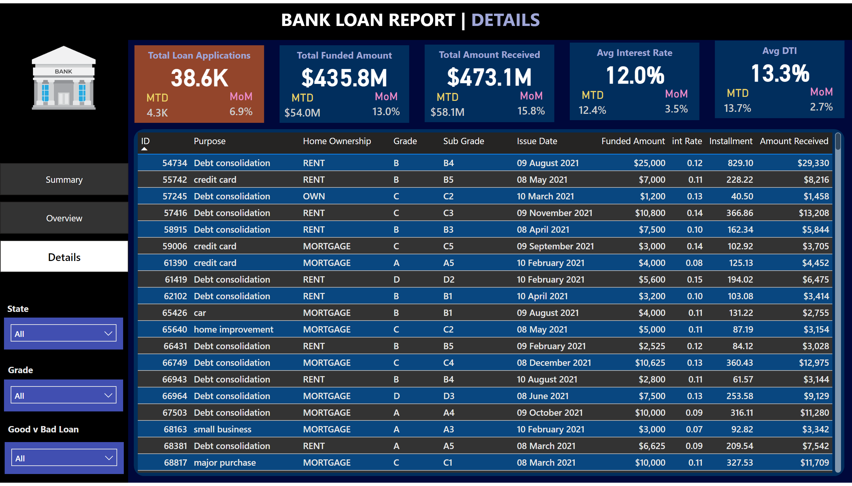
Details
Notes:
shape
No alt text provided
shape
No alt text provided
textbox
No alt text provided
MTD
No alt text provided
card
No alt text provided
textbox
No alt text provided
MoM
No alt text provided
shape
No alt text provided
MTD
No alt text provided
card
No alt text provided
textbox
No alt text provided
MoM
No alt text provided
shape
No alt text provided
MTD
No alt text provided
card
No alt text provided
textbox
No alt text provided
MoM
No alt text provided
shape
No alt text provided
MTD
No alt text provided
card
No alt text provided
textbox
No alt text provided
MoM
No alt text provided
shape
No alt text provided
MTD
No alt text provided
card
No alt text provided
textbox
No alt text provided
MoM
No alt text provided
shape
No alt text provided
slicer
No alt text provided
textbox
No alt text provided
slicer
No alt text provided
textbox
No alt text provided
slicer
No alt text provided
textbox
No alt text provided
shape
No alt text provided
tableEx
No alt text provided
pageNavigator
No alt text provided
image
No alt text provided

