Slide 1


“Make it Stick”- Study Strategies for Retention
Project IMPACT Workshop Series

Slide 2
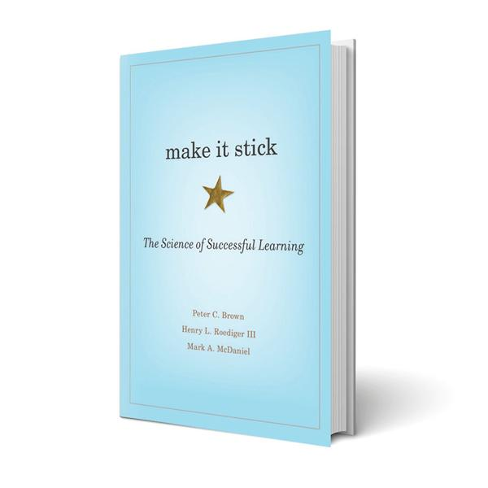
Make it Stick
Make it Stick: The Science of Successful Learning challenges a lot of what we previously thought about learning. Drawing on recent discoveries in cognitive psychology and other disciplines, the authors offer concrete techniques for becoming more productive learners.

Slide 3


What does NOT work
Many of the most common study strategies are not effective for retaining information.
Underlining: Draws too much focus on small details
Rereading notes: Creates familiarity with subject, but does not lead to mastery.
Rewriting notes: Better than just rereading, but still does not give you a chance to see how well you learned something

Slide 4
To start, you need to know 2 things about studying...
Embrace the challenging moments of studying
The harder it is to recall something from memory, the better you will remember it!
Learn the difference between familiarity and mastery.

Slide 5
Three things that DO work
Retrieval Practice
Self quizzing
Spaced Studying
Leaving large gaps between your study sessions
Interleaving
Mixing up your study topics

Slide 6
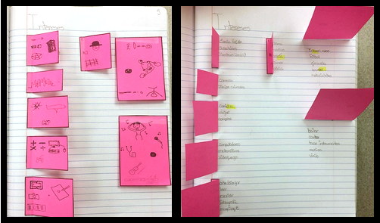
Retrieval Practice
Self-quizzing
Retrieval practice involves trying to recall facts or details from memory, without looking at the answers
This is what you do on the exam
The more you practice the skill before hand, the easier it is to do it in the exam
Many ways to quiz yourself
What do you use to test yourself when studying?

Slide 7

Spaced Studying
It may sound counter-intuitive, but leaving gaps between your study sessions leads to stronger retention of material
“Spacing” your study sessions gives the brain time to forget the answer. The process of working hard to recall the fact actually leads to stronger memories
It also is important in transferring information from short term memory to long term memory

Slide 8

Interleaving
Interleaving involves mixing up the topics you are studying
For example, in your retrieval practice, you may ask yourself a question from chapter 1, then chapter 4, then chapter 1.
This is much harder than going in order! But it leads to mastery quicker
It also replicates the exam scenario more realistically. Tests rarely follow a sequential order.

Slide 9
Strategies you can try
Use memory cues
Mnemonics, visual mnemonics
Elaborate
Expand on the concepts you study
Generate
Try to solve problems before you know how to

Slide 10
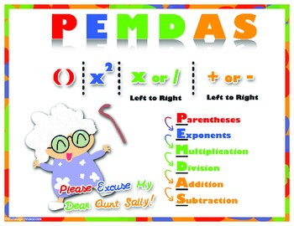
Use Memory Cues
Memory cues help us condense lots of information into smaller bits.
Traditional mnemonics
Visual mnemonics
You could also try songs, or a color coding system

Slide 11

Elaborate
Make it your goal to find new layers of meaning in the material you study
Explain ideas in your own words
Draw connections between concepts
Create your own examples
Think of “adding branches” to each concept you study
Try doing venn diagrams comparing and contrasting two concepts you study to see them in new ways

Slide 12

Generate
Try and solve a problem BEFORE being taught how to!
Try to figure out what makes sense and guess how you would go about solving it
Rely on your logic
Even if you don't figure it out, when you review how to solve the problem, it may make more sense and will likely stick better
Example: finding the area of a circle, hands on equations
Works outside of math too!

Slide 13
Other findings
Go beyond learning styles
There are many types of intelligences & explore multimodal learning
Reflect
Check in with yourself
Calibrate
Abby Author, NYC

Slide 14
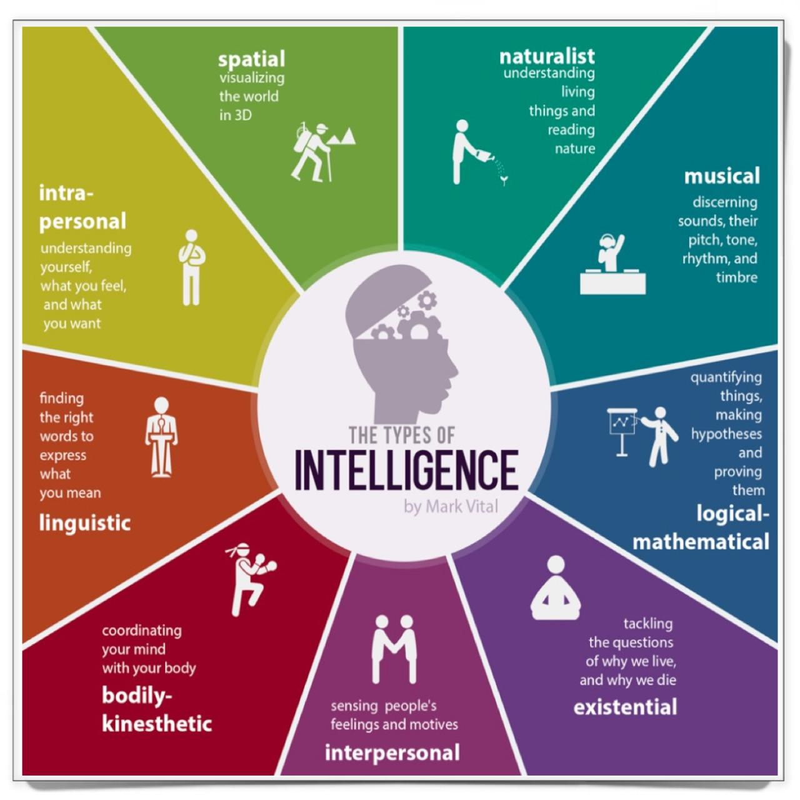
Go beyond learning styles
Learning preferences are helpful, but can be relied on too much
Multimodal approach to learning most effective
There are other aspects of you as a learner to take into account
Theory of multiple intelligences by Howard Gardner (1983)

Slide 15
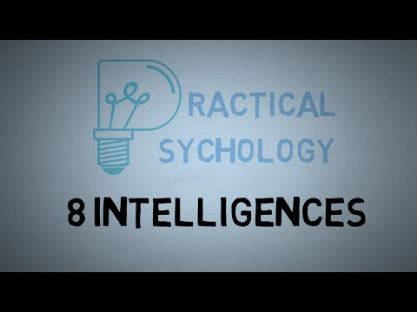
Multiple Intelligences
https://www.youtube.com/watch?v=s2Edujr0vA

Slide 16
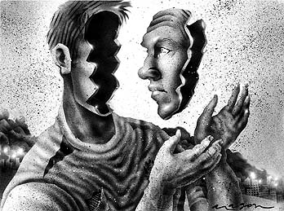
Reflect
Check in with yourself
How well is my retrieval practice going?
Am I mastering the concepts or am I vaguely familiar with them?
Am I able to elaborate on these concepts?
Am I able to generate answers before reviewing the material?
Am I using my learning strengths when studying?

Slide 17

Metacognition
https://youtu.be/7CVssaGGPDM

Slide 18

Calibrate
Use objective measures to accurately judge your studying and learning
Tests, quizzes, feedback, sample tests, study guides you quiz yourself on
Then, adjust your studying accordingly
This may involve focusing more or less on certain topics, or changing the type of questions you use in your retrieval practice

Slide 19

Wrap up.
Two things to know
When it's harder, real learning is happening
Mastery, not familiarity
What doesn’t work
Three things that do work
Retrieval practice
Spaced studying
Interleaving
Strategies you can try
Memory cues
Elaboration
Generate
Other findings
Go beyond learning preferences
Reflect
Calibrate

