Slide 1
Systems of Linear Equations
Session 01-02
Course : MATH6030001 - Linear Algebra
Effective Period : February 2022

Slide 2
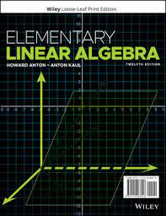
Acknowledgement
These slides have been adapted from:
Anton, Howard, and Chris Rorres. Elementary linear algebra: applications version. John Wiley & Sons, 2019.

Slide 3

LO 1 : Solve systems of linear equations using various methods.
Learning Objectives
Students will be able to represent real problems in systems of linear equations.
Students will be able to use appropriate methods to solve a system of linear equations.

Slide 4
Contents
1
1
System of linear equations
2
2
Solution
3
3
4
Gaussian and Gauss-Jordan Elimination
4
Homogeneous System
of Linear Equations

Slide 5
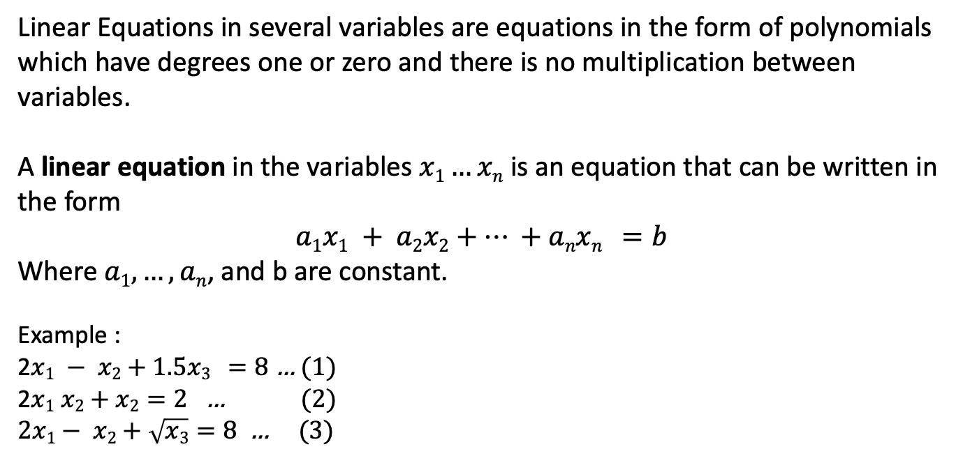
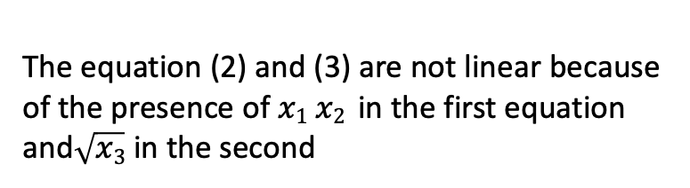
Definition
Linear Equations in several variables are equations in the form of polynomials which have degrees one or zero and there is no multiplication between variables.
A linear equation in the variables $x1…xn$ is an equation that can be written in the form
$$a1x1 + a2x2+… +anxn =b$$
Where$a1, …,an$, and b are constant.
Example :
2$x1 − x2+1.5x3 =8$ … (1)
2$x1 x2+x2=2$ … (2)
$2x1− x2+\sqrt{x3}=8$ … (3)
The equation (2) and (3) are not linear because of the presence of $x1 x2$ in the first equation and$\sqrt{x3}$ in the second

Slide 6
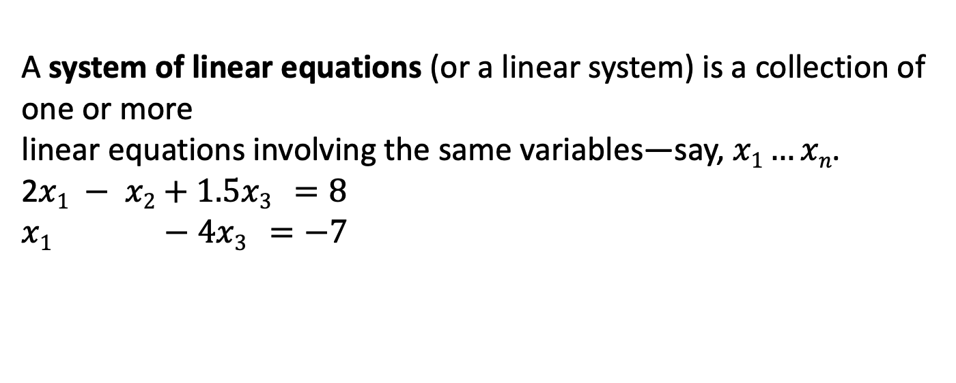
Definition
A system of linear equations (or a linear system) is a collection of one or more
linear equations involving the same variables—say, $x1…xn$.
2$x1 − x2+1.5x3 =8$
$$x1 −4x3 =−7$$

Slide 7
Solution

Slide 8
A solution of a linear system in n unknowns$x1,x2,…,xn$ is is a sequence of n numbers
$s1,s2,…,sn$ for which the substitution
$x1$= $s1$,$x2$=$s2$,… $xn$= $sn$
Example : Determine solution for system of linear equations as follows :
$$5x+y = 3$$
$$2x−y = 4$$
Solution : the system has the solution $x =1 , y = −2$
A system of linear equations has
  1. no solution, or
  2. exactly one solution, or
  3. infinitely many solutions.
A system of linear equations is said to be consistent if it has either one solution or
infinitely many solutions; a system is inconsistent if it has no solution.

Slide 9
Linear Systems with Two Unknown
Linear systems in two unknowns arise in connection with intersections of lines. For example, consider the linear system
$$a1x +b1y=c1$$
$$a2x +b2y=c2$$
Each solution (x, y) of this system corresponds to a point of intersection of the lines, so there are three possibilities :
  1. no solution, if the lines may be parallel and distinct,
  2. exactly one solution, if the lines may intersect at only one point.
  3. infinitely many solutions, if the lines may coincide, in which case there are infinitely many points of intersection.

Slide 10
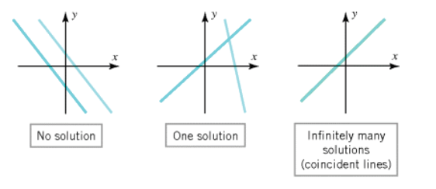
Linear Systems with Two Unknown
Example :
A Linear System with No Solutions
$$x+y =4$$
$$3x+3y =6$$
A Linear System with Infinitely Many solution
$$4x−2y =1$$
$$16x−8y = 4$$
A Linear System with one Solutions
$$5x+y = 3$$
$$2x−y = 4$$

Slide 11
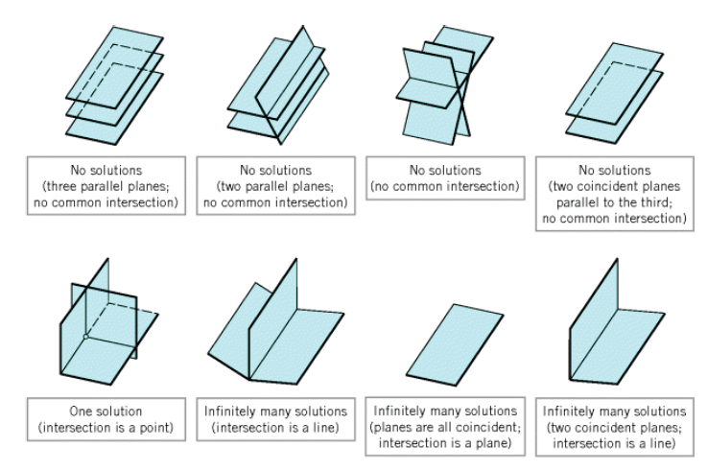

Linear Systems with
Three Unknowns
Similarly, for a linear system of three equations in three unknowns:
in which the graphs of the equations are planes, the solutions of the system, if any, correspond to points where all three planes intersect. So again we see that there are only three possibilities : no solutions, one solution, or infinitely many solutions
Ilustration

Slide 12
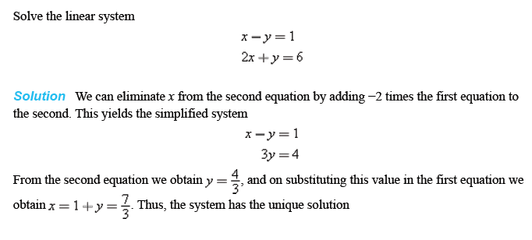
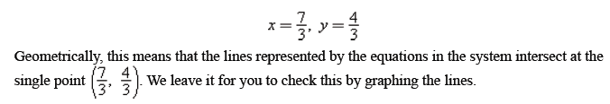
A Linear System with One Solution

Slide 13
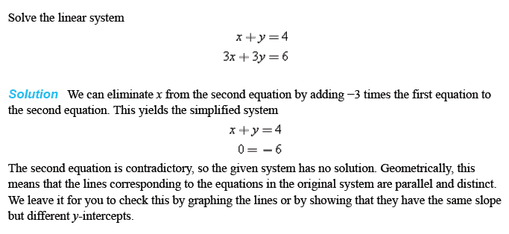
A Linear System with No Solutions

Slide 14

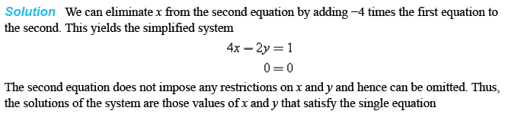
A Linear System with
Infinitely Many Solutions

Slide 15
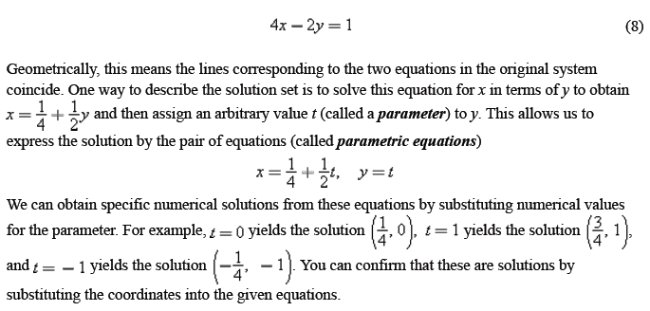
A Linear System with
Infinitely Many Solutions (2)

Slide 16
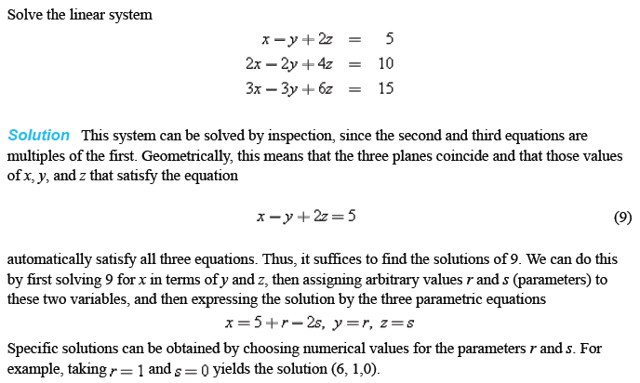
A Linear System with
Infinitely Many Solutions (3)

Slide 17
Gaussian and Gauss-Jordan Elimination
Methods of solving systems of linear equations

Slide 18
System of linear equation can be represented as matrix.
This is called the augmented matrix for the system
a₁₁x₁ + a₁₂x₂ + $⋯$+ a_{1n}x_{n} = b₁
a₂₁x₁ + a₂₂x₂ + $⋯$+ a_{2n}x_{n} = b₂
$⋮$ $⋮$
a_{m1}x₁ + a_{m2}x₂ + $⋯$+ a_{mn}x_{n} = b_{m}$.$
$$\left(\begin{matrix}\text{a}\text{11} & \begin{matrix}\text{a}\text{12} & ⋯ & \text{a}\text{1}\text{n}\end{matrix} & \text{b}\text{1} \\ \begin{matrix}\text{a}\text{21} \\ \end{matrix} & \begin{matrix}\text{a}\text{22} & ⋯ & \text{a}\text{2}\text{n} \\ ⋮ & & ⋮\end{matrix} & \begin{matrix}\text{b}\text{2} \\ ⋮\end{matrix} \\ \text{a}\text{m}\text{1} & \begin{matrix}\text{a}\text{m}\text{2} & ⋯ & \text{a}\text{mn}\end{matrix} & \text{b}\text{m}. \end{matrix}\right)$$
Example : Find the matrix from System of linear equation
x₁ + x₂ + 2x₃ = 9
2x₁ - 3x₃ = 1
3x₁ + 6x₂ - 5x₃ = 0
$$\left(\begin{matrix}1 & 1 & \begin{matrix}2 & 9\end{matrix} \\ 2 & 4 & \begin{matrix}−3 & 1\end{matrix} \\ 3 & 6 & \begin{matrix}−5 & 0\end{matrix}\end{matrix}\right)$$

Slide 19
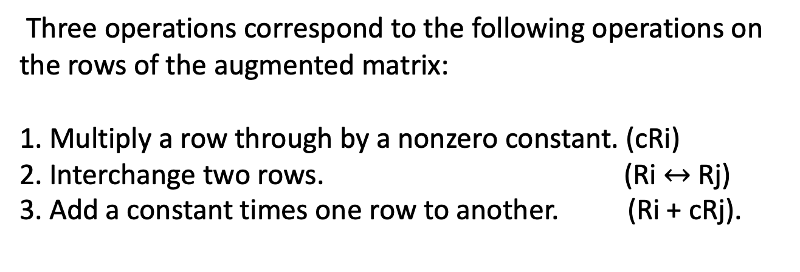
Elementary row operations on a matrix
Three operations correspond to the following operations on the rows of the augmented matrix:
1. Multiply a row through by a nonzero constant. (cRi)
2. Interchange two rows. (Ri $↔$ Rj)
3. Add a constant times one row to another. (Ri + cRj).

Slide 20
Gauss-Jordan elimination.
The following properties to form a reduced row echelon.
1. If a row does not consist entirely of zeros, then the first nonzero number in the row is a 1.
We call this a leading 1.
2. If there are any rows that consist entirely of zeros, then they are grouped together at the bottom of the matrix.
3. In any two successive rows that do not consist entirely of zeros, the leading 1 in the lower row occurs farther to the
right than the leading 1 in the higher row.
4. Each column that contains a leading 1 has zeros everywhere else in that column.
A matrix that has the first three properties is said to be in row echelon form
The procedure (or algorithm) for reducing a matrix to reduced row echelon form
is called Gauss-Jordan elimination. If only the forward phase is used, then the procedure
produces a row echelon form only and is called Gaussian elimination.

Slide 21
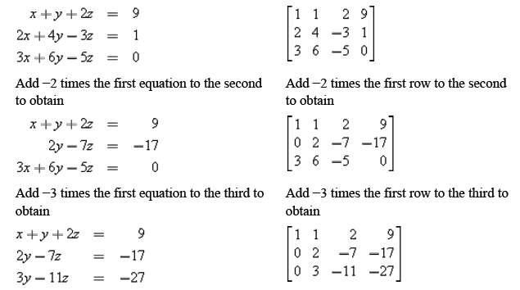
Example 1 : Solve by Gauss elimination.
In the left column we solve a system of linear equations by operating on the equations in the system, and in the right column we solve the same system by operating on the rows of the augmented matrix.

Slide 22
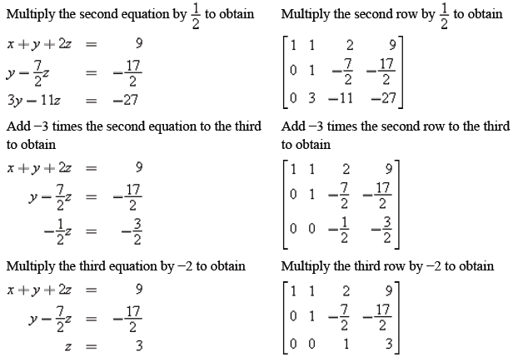
Example 1 : Solve by Gauss elimination.

Slide 23
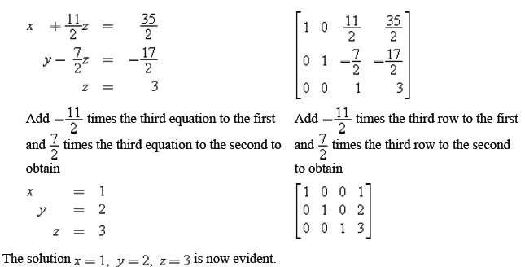
Example 1 : Solve by Gauss elimination.

Slide 24
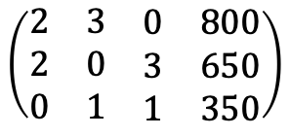
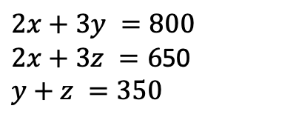
Example 2 : Solve by Gauss-Jordan elimination.
Find the solution of the system of linear equation
$$2x+3y =800$$
$2x+3z =6$50
$$y+z =350$$
Solution : Determine the augmented matrix from the system
$$\left(\begin{matrix}2 & 3 & \begin{matrix}0 & 800\end{matrix} \\ 2 & 0 & \begin{matrix}3 & 650\end{matrix} \\ 0 & 1 & \begin{matrix}1 & 350\end{matrix}\end{matrix}\right)$$

Slide 25
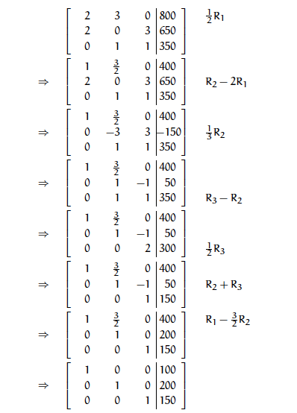
By using Gauss-Jordan elimination Procedure
The solution of the system, $x =100, y =200$, and $z = 150$

Slide 26

Homogeneous System of Linear Equations
A system of linear equations is said to be homogeneous if the constant terms are all zero; that is, the system has the form
Every homogeneous system of linear equations is consistent because all such systems have x₁=0, x₂=0, …, x_{n}=0 as a solution. This solution is called the trivial solution; if there are other solutions, they are called nontrivial solutions.

Slide 27

Homogeneous System of Linear Equations
Because a homogeneous linear system always has the trivial solution, there are only two possibilities for its solutions:
The system has only the trivial solution.
The system has infinitely many solutions in addition to the trivial solution.
In the special case of a homogeneous linear system of two equations in two unknowns, say
the graphs of the equations are lines through the origin, and the trivial solution corresponds to the point of intersection at the origin.

Slide 28
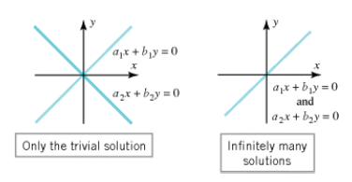
Illustration
There is one case in which a homogeneous system is assured of having nontrivial solutions : whenever the system involves more unknowns than equations.

Slide 29
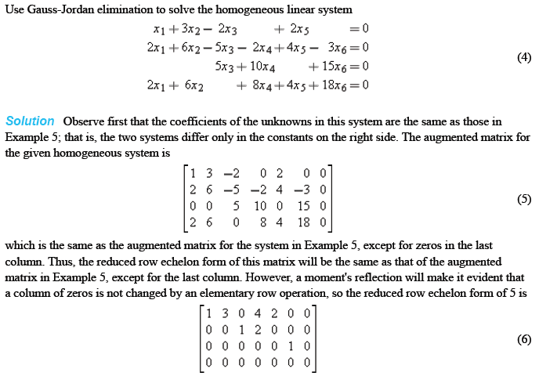
Example : Solving the homogeneous linear system

Slide 30
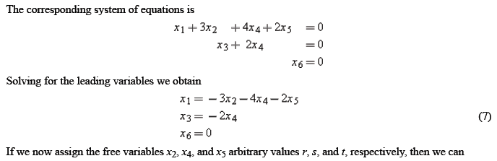

Example (Cont.)

Slide 31

Thank You

