Slide 1
Linear Algebra
Session 1-2

Slide 2
Systems of Linear Equations

Slide 3
These slides have been adapted from:
Anton, H. and Rorres, C. (2010). Elementary Linear Algebra : Applications Version. 10th Edition. John Wiley & Sons. New Jersey.
Chapter 1
Acknowledgement

Slide 4
LO 1 : Solve systems of linear equations using various methods.
Learning Objectives
Students will be able to represent real problems in systems of linear equations.
Students will be able to use appropriate methods to solve a system of linear equations.

Slide 5
Systems of Linear Equations
Contents
Introduction to Systems of Linear Equations
Elementary Row Operations
Gaussian and Gauss-Jordan Eliminations

Slide 6
Introduction to Systems of Linear Equations

Slide 7
Linear Equations
A linear equation in the n variables x₁, x₂, ..., x_{n} is an equation that can be expressed in the form :
a₁x₁ + a₂x₂ + ... + a_{n}x_{n} = b,
where a₁, a₂, ..., a_{n} and b are constants, and the a’s are not
all zero.
In the special cases when n=2 or n=3, we will often use variables without subscripts and write linear equations as :
a₁x + a₂y = b (a₁, a₂ not both 0)
a₁x + a₂y + a₃z = b (a₁, a₂, a₃ not all 0)
In the special case where b=0, the equation has the form :
a₁x₁ + a₂x₂ + ... + a_{n}x_{n} = 0,
which is called a homogeneous linear equation in the variables
x₁, x₂, ..., x_{n}.

Slide 8


Examples
Observe that a linear equation does not involve any products or roots of variables. All variables occur only to the first power and do not appear, for example, as arguments of trigonometric, logarithmic, or exponential functions. The following are linear equations:
The following are not linear equations:

Slide 9
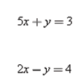
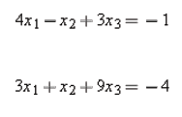
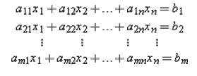
Systems of Linear Equations
A finite set of linear equations is called a system of linear equations or, more briefly, a linear system. The variables are called unknowns. For example :
(linear system in x and y) (linear system
in x₁, x₂ and x₃)
A general linear system of m equations in the n unknowns x₁, x₂, ..., x_{n} can be written as

Slide 10
Solutions of Linear Systems
A solution of a linear system in n unknowns x₁, x₂, ..., x_{n} is a sequence of n numbers s₁, s₂, ..., s_{n} for which the substitution
x₁=s₁, x₂=s₂, ..., x_{n}=s_{n}
makes each equation a true statement.
The solution of a linear system in n unknowns can be written as (s₁, s₂, ..., s_{n})
which is called an ordered n-tuple.
In general, we say that a linear system is consistent if it has at least one solution and inconsistent if it has no solutions.

Slide 11
Examples
This linear system :
has x=1, y=-2 as the solution
This linear system :
has x₁=1, x₂=2 and x₃=-1 as a solution

Slide 12
Linear Systems with
Two Unknowns
Linear systems in two unknowns arise in connection with intersections of lines. For example, consider the linear system in which the graphs of the equations are lines in the xy-plane. Each solution (x, y) of this system corresponds to a point of intersection of the lines, so there are three possibilities :
The lines may be parallel and distinct, in which case there is no intersection and consequently no solution.
The lines may intersect at only one point, in which case the system has exactly one solution.
The lines may coincide, in which case there are infinitely many points of intersection (the points on the common line) and consequently infinitely many solutions.

Slide 13
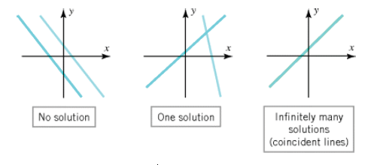
Illustration

Slide 14

Linear Systems with
Three Unknowns
Similarly, for a linear system of three equations in three unknowns:
in which the graphs of the equations are planes, the solutions of the system, if any, correspond to points where all three planes intersect. So again we see that there are only three possibilities : no solutions, one solution, or infinitely many solutions

Slide 15
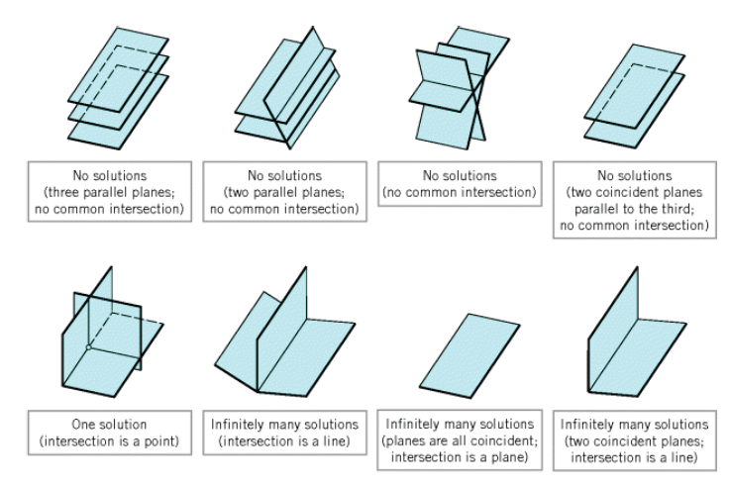
Illustration

Slide 16
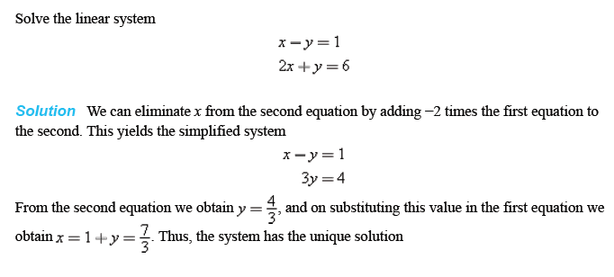
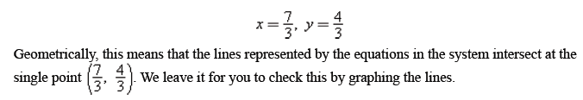
A Linear System with One Solution

Slide 17
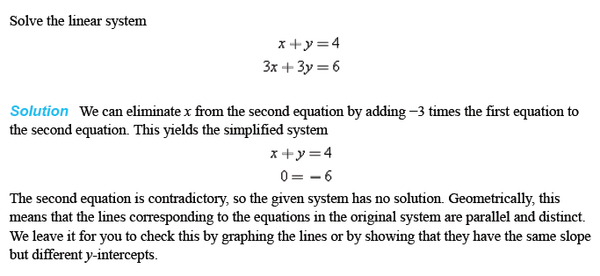
A Linear System with No Solutions

Slide 18

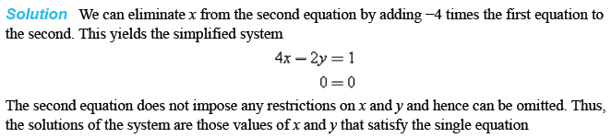
A Linear System with
Infinitely Many Solutions (1)

Slide 19
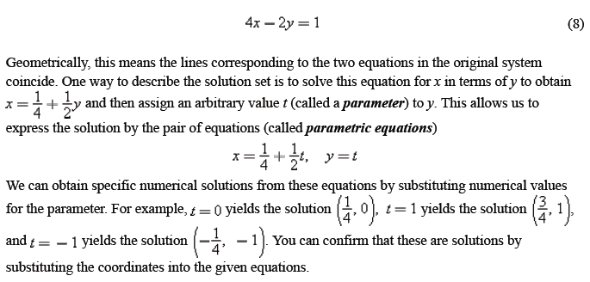
A Linear System with
Infinitely Many Solutions (2)

Slide 20
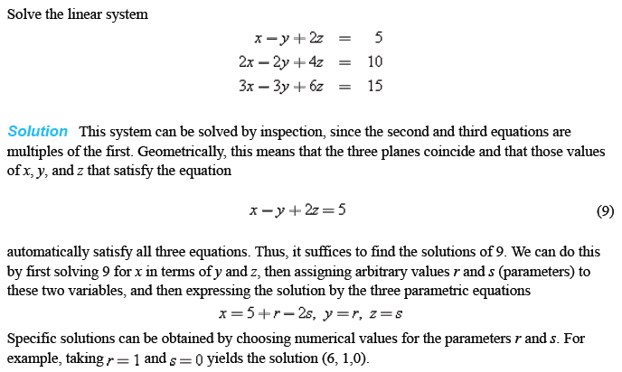
A Linear System with
Infinitely Many Solutions (3)

Slide 21
Elementary Row Operations

Slide 22
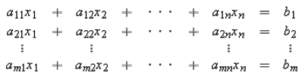
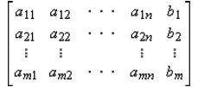
Augmented Matrix
As the number of equations and unknowns in a linear system increases, so does the complexity of the algebra involved in finding solutions. The required computations can be made more manageable by simplifying notation and standardizing procedures. For example, by mentally keeping track of the location of the +'s, the x's, and the ='s in the linear system :
we can abbreviate the system by writing only the rectangular array of numbers

Slide 23


Augmented Matrix (Cont.)
This is called the augmented matrix for the system. For example, the augmented matrix for the system of equations
is

Slide 24
Elementary Row Operations
The basic method for solving a linear system is to perform appropriate algebraic operations on the system that do not alter the solution set and that produce a succession of increasingly simpler systems, until a point is reached where it can be ascertained whether the system is consistent, and if so, what its solutions are. Typically, the algebraic operations are as follows:
Multiply an equation through by a nonzero constant.
Interchange two equations.
Add a constant times one equation to another.
Since the rows (horizontal lines) of an augmented matrix correspond to the equations in the associated system, these three operations correspond to the following operations on the rows of the augmented matrix:
Multiply a row through by a nonzero constant.
Interchange two rows.
Add a constant times one row to another.
These are called elementary row operations on a matrix.

Slide 25
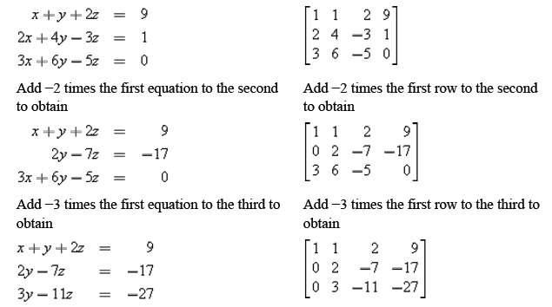
Example (1/3)
In the left column we solve a system of linear equations by operating on the equations in the system, and in the right column we solve the same system by operating on the rows of the augmented matrix.

Slide 26
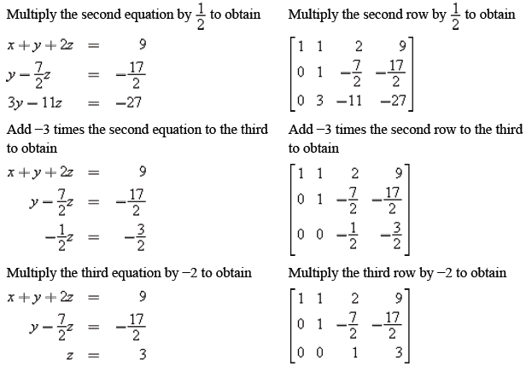
Example (2/3)

Slide 27
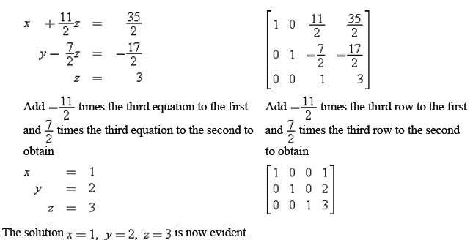
Example (3/3)

Slide 28
Gaussian and Gauss-Jordan Elimination

Slide 29

Row Echelon Forms
In the example of the last section, we solved a linear system in the unknowns x, y, and z by reducing the augmented matrix to the form :
from which the solution x=1, y=2, z=3 became evident. This is an example of a matrix that is in reduced row echelon form. To be of this form, a matrix must have the following properties:
If a row does not consist entirely of zeros, then the first nonzero number in the row is a 1. We call this a leading 1.
If there are any rows that consist entirely of zeros, then they are grouped together at the bottom of the matrix.
In any two successive rows that do not consist entirely of zeros, the leading 1 in the lower row occurs farther to the right than the leading 1 in the higher row.
Each column that contains a leading 1 has zeros everywhere else in that column.
A matrix that has the first three properties is said to be in row echelon form.

Slide 30


Example
Thus, a matrix in reduced row echelon form is of necessity in row echelon form, but not conversely.
The following matrices are in reduced row echelon form.
The following matrices are in row echelon form but not reduced row echelon form.

Slide 31
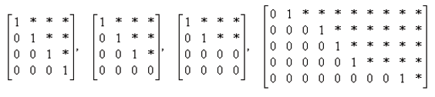
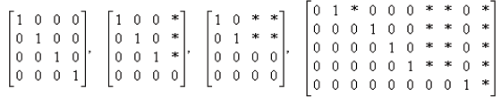
More Examples
As previous examples illustrate, a matrix in row echelon form has zeros below each leading 1, whereas a matrix in reduced row echelon form has zeros below and above each leading 1. Thus, with any real numbers substituted for the *'s, all matrices of the following types are in row echelon form:
All matrices of the following types are in reduced row echelon form:

Slide 32
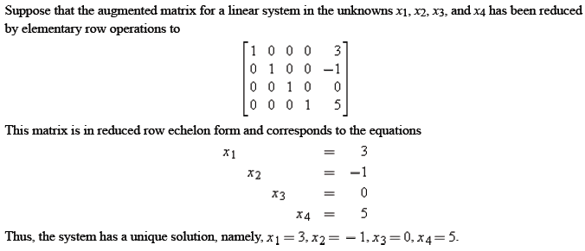
System with Unique Solution

Slide 33
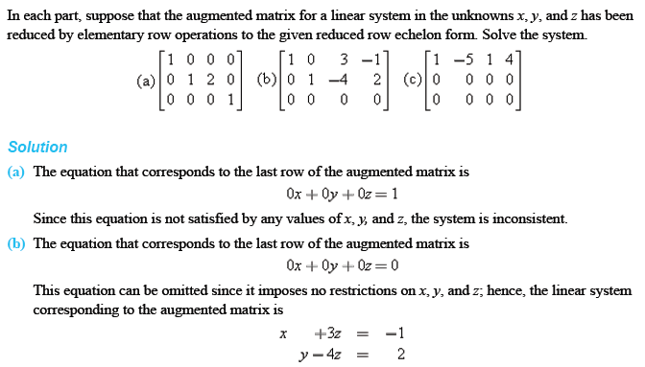
System with No or
Infinitely Many Solutions

Slide 34
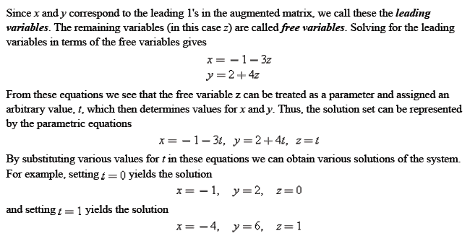
System with No or
Infinitely Many Solutions

Slide 35
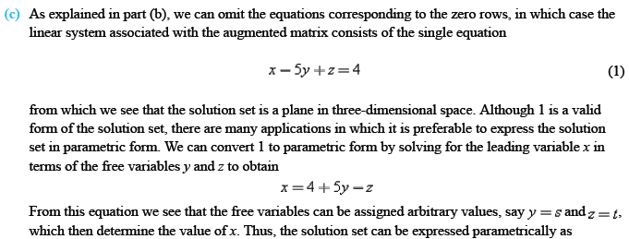

System with No or
Infinitely Many Solutions

Slide 36
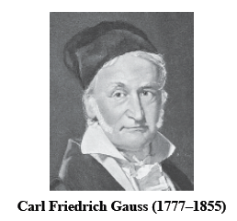
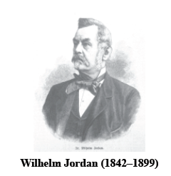
Gaussian and Gauss-Jordan Elimination
The procedure (or algorithm) for reducing a matrix to reduced row echelon form is called Gauss-Jordan elimination. This algorithm consists of two parts, a forward phase in which zeros are introduced below the leading 1's and then a backward phase in which zeros are introduced above the leading 1's. If only the forward phase is used, then the procedure produces a row echelon form only and is called Gaussian elimination.

Slide 37
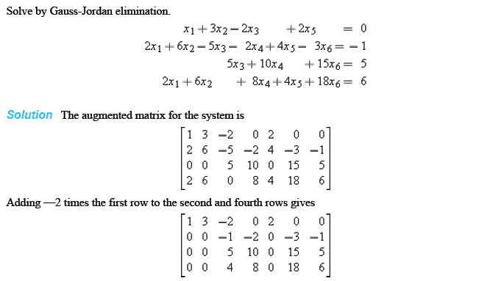
Example of Gauss-Jordan
Elimination (1/3)

Slide 38
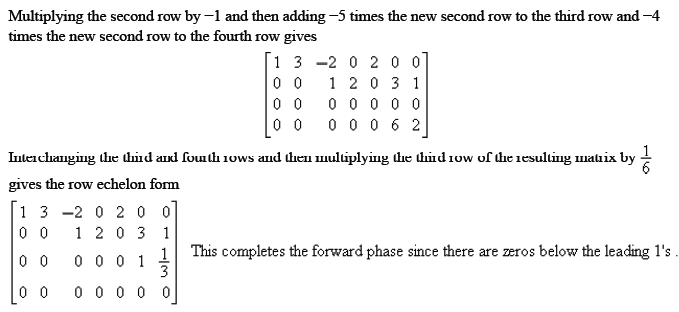
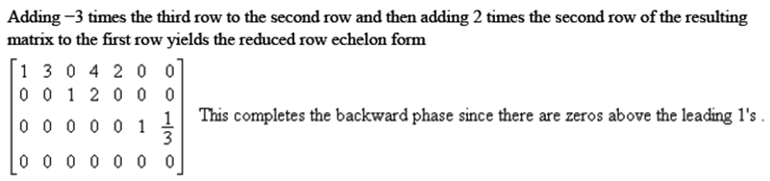
Example of Gauss-Jordan
Elimination (2/3)

Slide 39

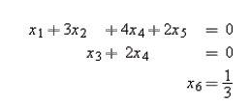
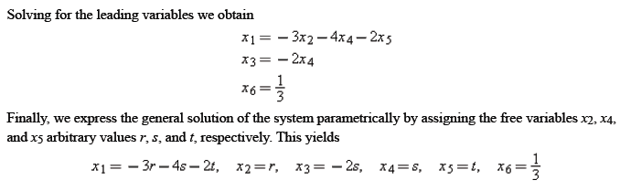
Example of Gauss-Jordan
Elimination (3/3)

Slide 40
Gaussian Elimination and Back Substitution
For small linear systems that are solved by hand (such as most of those in this text), Gauss-Jordan elimination (reduction to reduced row echelon form) is a good procedure to use.
However, for large linear systems that require a computer solution, it is generally more efficient to use Gaussian elimination (reduction to row echelon form) followed by a technique known as back-substitution to complete the process of solving the system.

Slide 41
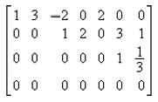
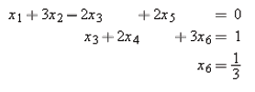
Example of Gaussian Elimination and Back Substitution (1/3)
In the previous example, a row echelon form of the augmented matrix is
which has the corresponding system of equations :

Slide 42
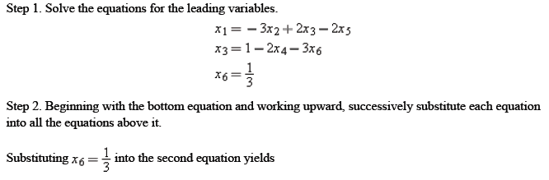

Example of Gaussian Elimination and Back Substitution (2/3)

Slide 43
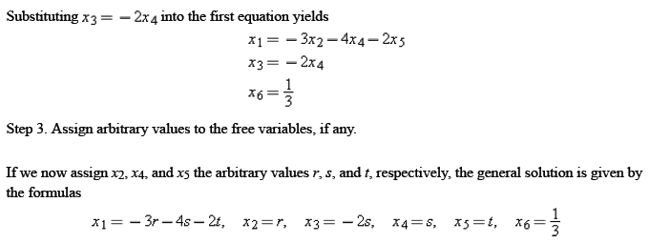
Example of Gaussian Elimination and Back Substitution (3/3)
The solution is same with the previous example using Gauss-Jordan elimination.

Slide 44
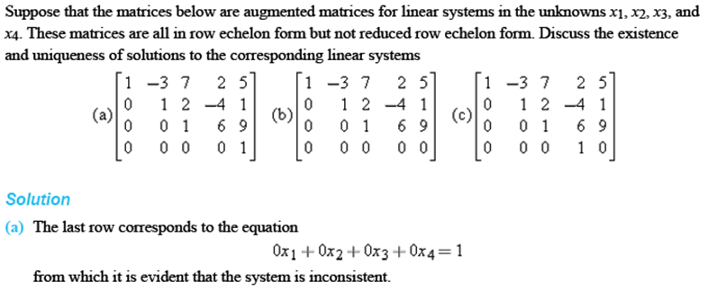
Determining Existence and Uniqueness of Solutions

Slide 45
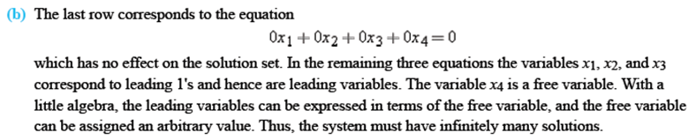
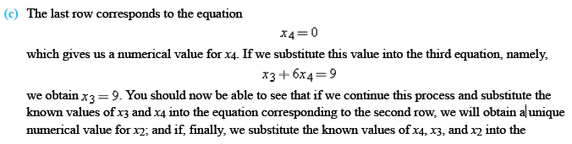
Determining Existence and Uniqueness of Solutions

Slide 46
Some Facts about Echelon Forms
There are three facts about row echelon forms and reduced row echelon forms that are important to know :
Every matrix has a unique reduced row echelon form; that is, regardless of whether you use Gauss-Jordan elimination or some other sequence of elementary row operations, the same reduced row echelon form will result in the end.*
Row echelon forms are not unique; that is, different sequences of elementary row operations can result in different row echelon forms.
Although row echelon forms are not unique, all row echelon forms of a matrix A have the same number of zero rows, and the leading 1's always occur in the same positions in the row echelon forms of A. Those are called the pivot positions of A. A column that contains a pivot position is called a pivot column of A.

Slide 47

Homogeneous System of Linear Equations
A system of linear equations is said to be homogeneous if the constant terms are all zero; that is, the system has the form
Every homogeneous system of linear equations is consistent because all such systems have x₁=0, x₂=0, …, x_{n}=0 as a solution. This solution is called the trivial solution; if there are other solutions, they are called nontrivial solutions.

Slide 48

Homogeneous System of Linear Equations
Because a homogeneous linear system always has the trivial solution, there are only two possibilities for its solutions:
The system has only the trivial solution.
The system has infinitely many solutions in addition to the trivial solution.
In the special case of a homogeneous linear system of two equations in two unknowns, say
the graphs of the equations are lines through the origin, and the trivial solution corresponds to the point of intersection at the origin.

Slide 49
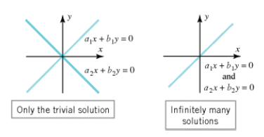
Illustration
There is one case in which a homogeneous system is assured of having nontrivial solutions : whenever the system involves more unknowns than equations.

Slide 50
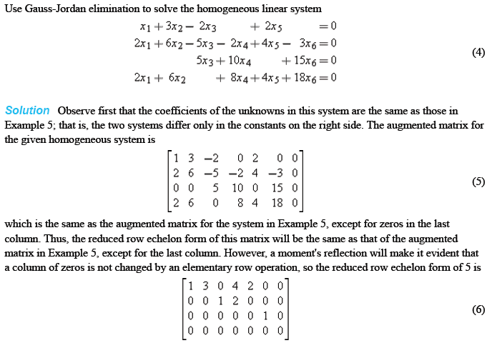
Example

Slide 51
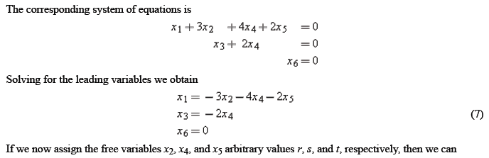

Example (Cont.)

Slide 52
Free Variables
There are two important points about solving homogeneous linear systems:
Elementary row operations do not alter columns of zeros in a matrix, so the reduced row echelon form of the augmented matrix for a homogeneous linear system has a final column of zeros. This implies that the linear system corresponding to the reduced row echelon form is homogeneous, just like the original system.
When we constructed the homogeneous linear system corresponding to augmented matrix, we ignored the row of zeros because the corresponding equation does not impose any conditions on the unknowns. Thus, depending on whether or not the reduced row echelon form of the augmented matrix for a homogeneous linear system has any rows of zero, the linear system corresponding to that reduced row echelon form will either have the same number of equations as the original system or it will have fewer.

Slide 53
Free Variables (Cont.)
Now consider a general homogeneous linear system with n unknowns, and suppose that the reduced row echelon form of the augmented matrix has r nonzero rows. Since each nonzero row has a leading 1, and since each leading 1 corresponds to a leading variable, the homogeneous system corresponding to the reduced row echelon form of the augmented matrix must have r leading variables and free variables.
Theorem about Free Variables of Homogeneous Linear Systems
If a homogeneous linear system has n unknowns, and if the reduced row echelon form of its augmented matrix has r nonzero rows, then the system has n - r free variables.
A homogeneous linear system with more unknowns than equations has infinitely many solutions.

Slide 54
References
Anton, H. and Rorres, C. (2010). Elementary Linear Algebra : Applications Version. 10th Edition. John Wiley & Sons. New Jersey.

