Slide 1
Determinant and Inverse of Matrix
Session 05-07
Course : MATH6030001 - Linear Algebra
Effective Period : February 2016

Slide 2
MATH6162 - Mathematics
Week 5
Determinant and Inverse

Slide 3
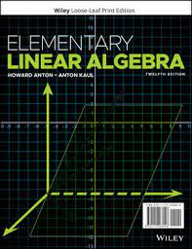
Acknowledgement
These slides have been adapted from:
Anton, Howard, and Chris Rorres. Elementary linear algebra: applications version. John Wiley & Sons, 2019.

Slide 4

LO 3 : Solve Evaluate determinant and inverse of matrix and their applications..
Learning Objectives
Students will be able to evaluate determinant of a matrix and its application.
Students will be able to evaluate inverse of a matrix and its application.

Slide 5
Contents
1
1. Determinant
Methods to solve Determinant
2. Inverse
2
Methods to solve Inverse
3
3. Cramer
Cramer’s Rule
4

Slide 6
Determinant

Slide 7
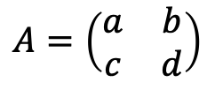

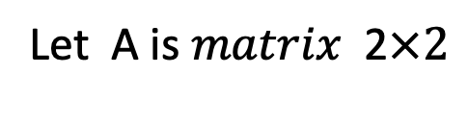

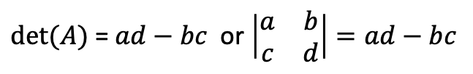
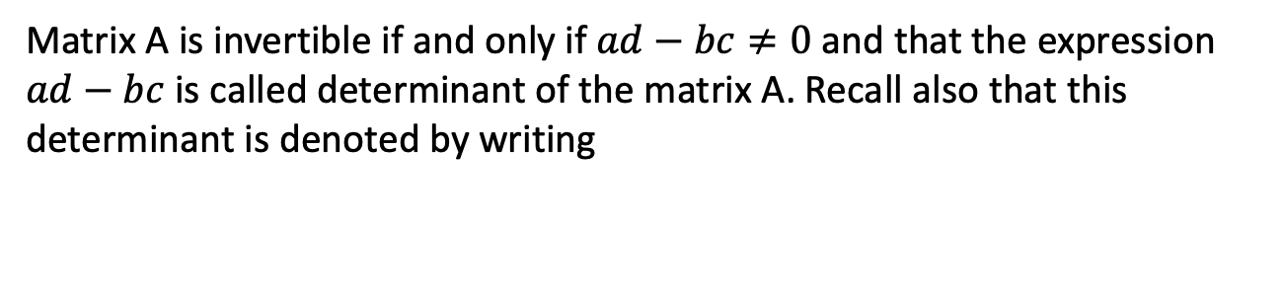
Determinant M$atrix$ 2$×2$
Let A is $matrix$ 2$×2$
$$A=\left(\begin{matrix}a & b \\ c & d\end{matrix}\right)$$
Matrix A is invertible if and only if $ad−bc≠0 \text{and} \text{that} \text{the} \text{expression}$ $ad−bc$ is called determinant of the matrix A. Recall also that this determinant is denoted by writing
$det⁡(A)$ = $ad−bc$ or $\left|\begin{matrix}a & b \\ c & d\end{matrix}\right|=ad−bc$
$Note : det⁡(A)$ is a number, whereas A is a matrix.

Slide 8
Calculating Determinants by Cofactor Ekspansion

Slide 9
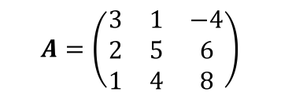
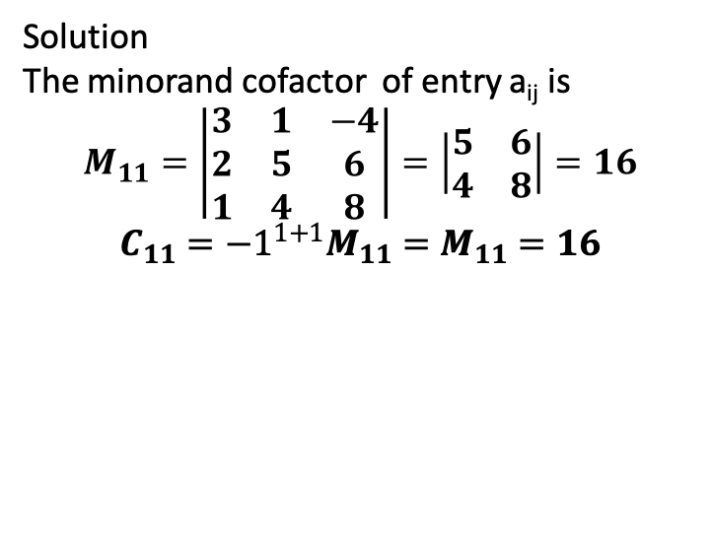
Minor and Cofactor
Definition
If A is a square matrix, then the minor of entry a_{ij} is denoted by M_{ij} and is defined to be the determinant of the submatrix that remains after the ith row and jth column are deleted from A. The number (-1)^{i+j} M_{ij} is denoted by C_{ij} and is called the cofactor of entry a_{ij}
Example : Finding Minors and Cofactors
$$A=\left(\begin{matrix}3 & 1 & −4 \\ 2 & 5 & 6 \\ 1 & 4 & 8\end{matrix}\right)$$
Solution
The minorand cofactor of entry a_{ij} is
$$M_{11}=\left|\begin{matrix}3 & 1 & −4 \\ 2 & 5 & 6 \\ 1 & 4 & 8\end{matrix}\right|=\left|\begin{matrix}5 & 6 \\ 4 & 8\end{matrix}\right|=16$$
$$C_{11}={−1}^{1+1}M_{11}=M_{11}=16$$

Slide 10
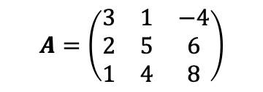
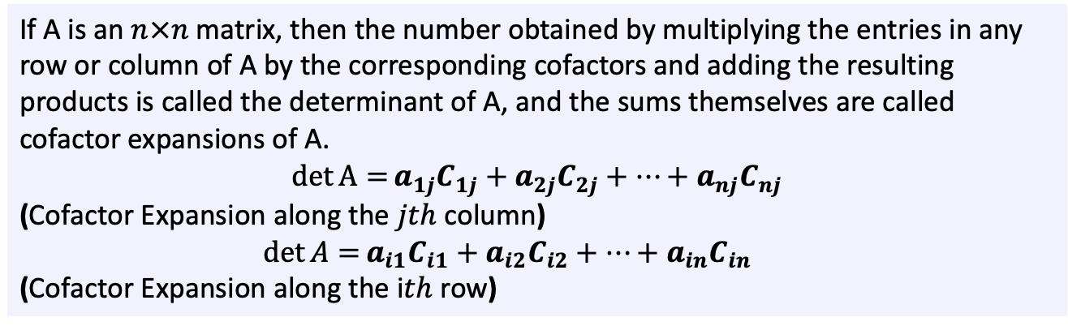
Determinants by Cofactor Expansion
Definition
If A is an $n×n$ matrix, then the number obtained by multiplying the entries in any row or column of A by the corresponding cofactors and adding the resulting products is called the determinant of A, and the sums themselves are called cofactor expansions of A.
$$\det{A=}a_{1j}C_{1j}+a_{2j}C_{2j}+…+a_{nj}C_{nj}$$
(Cofactor Expansion along the $jth$ column)
$\det{A=}a_{i1}C_{i1}+a_{i2}C_{i2}+…+a_{in}C_{in}$
(Cofactor Expansion along the i$th$ row)
Example : Find the determinant of the matrix by cofactor expansion along the first row.
$$A=\left(\begin{matrix}3 & 1 & −4 \\ 2 & 5 & 6 \\ 1 & 4 & 8\end{matrix}\right)$$

Slide 11
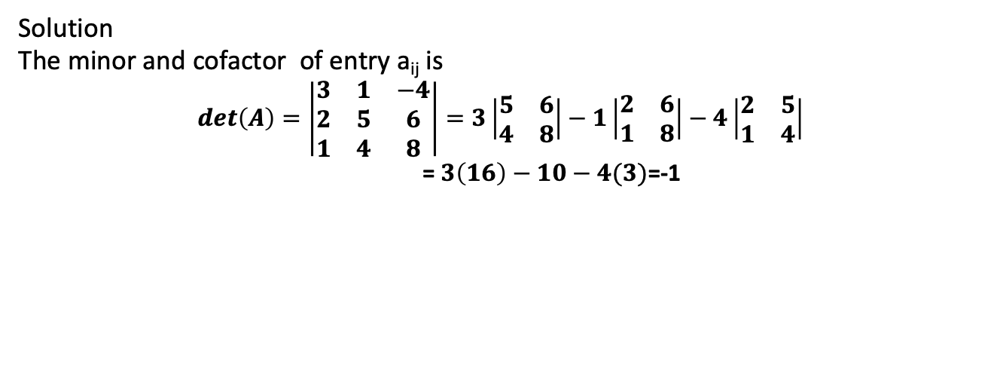
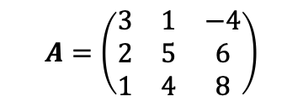
Determinants by Cofactor Expansion
Example : Find the determinant of the matrix by cofactor expansion along the first row.
$$A=\left(\begin{matrix}3 & 1 & −4 \\ 2 & 5 & 6 \\ 1 & 4 & 8\end{matrix}\right)$$
Solution
The minor and cofactor of entry a_{ij} is
$$det\left(A\right)=\left|\begin{matrix}3 & 1 & −4 \\ 2 & 5 & 6 \\ 1 & 4 & 8\end{matrix}\right|=3\left|\begin{matrix}5 & 6 \\ 4 & 8\end{matrix}\right|−1\left|\begin{matrix}2 & 6 \\ 1 & 8\end{matrix}\right|−4\left|\begin{matrix}2 & 5 \\ 1 & 4\end{matrix}\right|$$
= $3\left(16\right)−10−4(3)$=-1

Slide 12
Calculating Determinants by Row Reduction

Slide 13
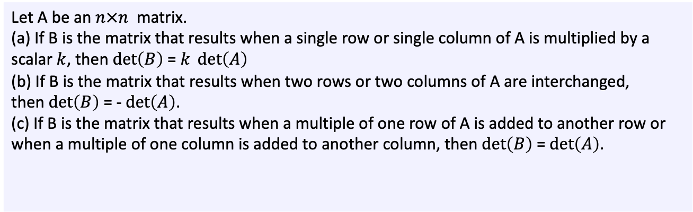
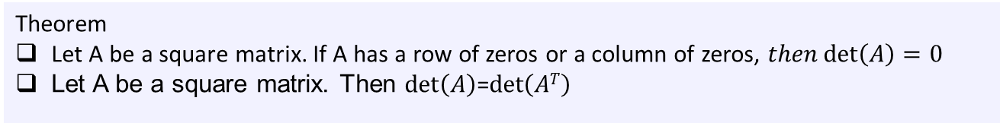
Theorem
Let A be a square matrix. If A has a row of zeros or a column of zeros, $then\det\left(A\right)=0$
Let A be a square matrix. Then $\det\left(A\right)$=$\det\left(AT\right)$
The next theorem shows how an elementary row operation on a square matrix affects
the value of its determinant.
Let A be an $n×n$ matrix.
(a) If B is the matrix that results when a single row or single column of A is multiplied by a scalar $k$, then $\det\left(B\right)$ = $k \det\left(A\right)$
(b) If B is the matrix that results when two rows or two columns of A are interchanged,
then $\det\left(B\right)$ = -$\det\left(A\right)$.
(c) If B is the matrix that results when a multiple of one row of A is added to another row or when a multiple of one column is added to another column, then $\det\left(B\right)$ = $\det\left(A\right)$.

Slide 14
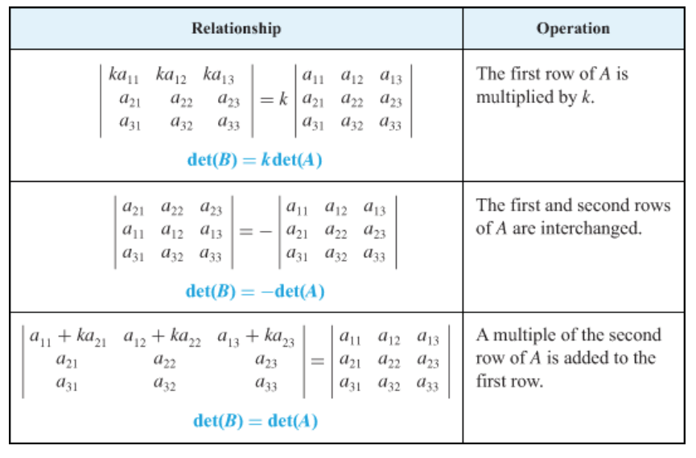

Slide 15
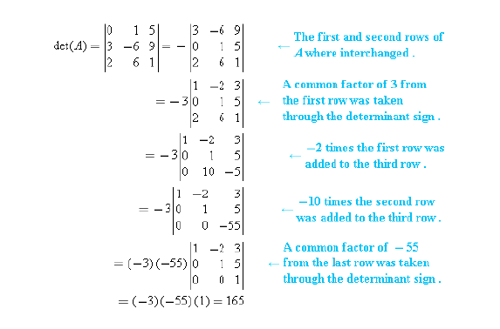
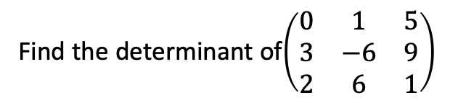
Example
Find the determinant of$\left(\begin{matrix}0 & 1 & 5 \\ 3 & −6 & 9 \\ 2 & 6 & 1\end{matrix}\right)$
Solution

Slide 16
Properties of Determinants
Theorem
Let A be a square matrix.
If A has a row of zeros or a column of zeros, then det(A)=0.
det(A) = det(A^{T}).
Theorem
Suppose that A and B are n x n matrices and k is any scalar. We have the following properties :
det(A.B) = det(A).det(B)
det(k.A) = k^{n}.det(A)
In general, det(A+B) ≠ det(A)+det(B)

Slide 17
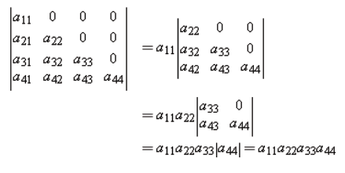
Determinants of
Triangular Matrices
Theorem
If A is an n x n triangular matrix (upper triangular, lower triangular, or diagonal), then det(A) is the product of the entries on the main diagonal of the matrix; that is, det(A) = a₁₁.a₂₂.....a_{nn}.
This is an illustration in 4x4 case :

Slide 18
The Cramer’s Rule

Slide 19
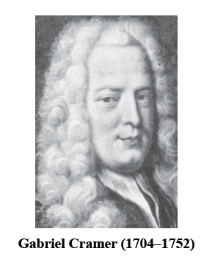
Cramer’s Rule
Our next theorem uses the formula for the inverse of an invertible matrix to produce a formula, called Cramer's rule, for the solution of a linear system A.x = b of n equations in n unknowns in the case where the coefficient matrix A is invertible (or, equivalently, when det(A) ≠ 0).

Slide 20


Cramer’s Rule
Theorem (Cramer’s Rule)
If A.x=b is a system of n linear equations in n unknowns such that det(A) ≠ 0, then the system has a unique solution. This solution is
where A_{j} is the matrix obtained by replacing the entries in the j-th column of A by the entries in the matrix

Slide 21
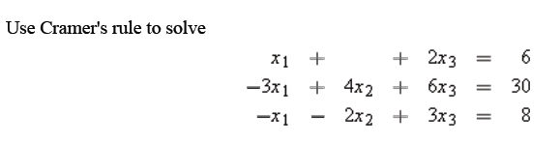
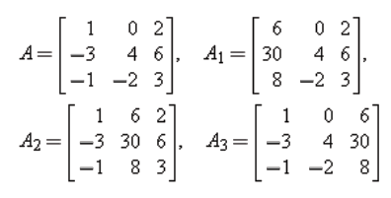
Example

Slide 22
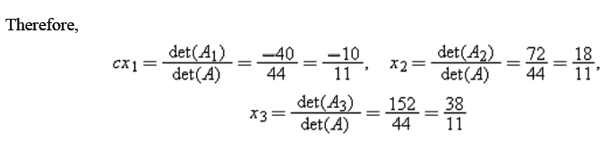
Example
Note : For n > 3, it is usually more efficient to solve a linear system with n equations in n unknowns by Gauss–Jordan elimination than by Cramer's rule. Its main use is for obtaining properties of solutions of a linear system without actually solving the system.

Slide 23
Inverse

Slide 24
Inverse
Definition
If 𝐴 is a square matrix, and if there exists a matrix 𝐵 of the same size for which 𝐴𝐵 = 𝐵𝐴 = 𝐼, then 𝐴 is said to be invertible (or nonsingular) and 𝐵 is called an Inverse of 𝐴. If no such matrix 𝐵 exists, then 𝐴 is said to be singular.

Slide 25
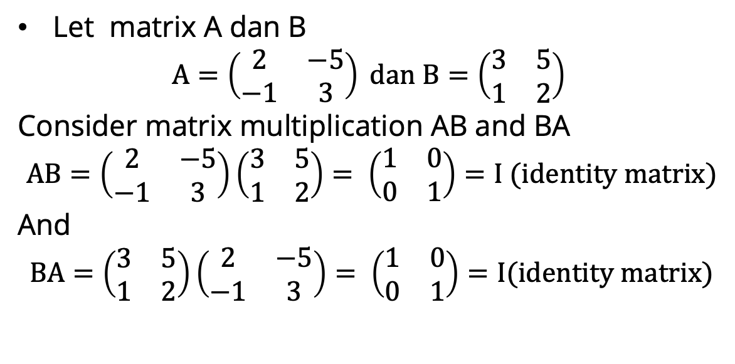
Example
Let matrix A dan B
$$A=\left(\begin{matrix}2 & −5 \\ −1 & 3\end{matrix}\right) dan B=\left(\begin{matrix}3 & 5 \\ 1 & 2\end{matrix}\right)$$
Consider matrix multiplication AB and BA
$$AB=\left(\begin{matrix}2 & −5 \\ −1 & 3\end{matrix}\right)\left(\begin{matrix}3 & 5 \\ 1 & 2\end{matrix}\right)= \left(\begin{matrix}1 & 0 \\ 0 & 1\end{matrix}\right)=I (identity matrix)$$
And
$$BA=\left(\begin{matrix}3 & 5 \\ 1 & 2\end{matrix}\right)\left(\begin{matrix}2 & −5 \\ −1 & 3\end{matrix}\right)= \left(\begin{matrix}1 & 0 \\ 0 & 1\end{matrix}\right)=I(identity matrix)$$

Slide 26
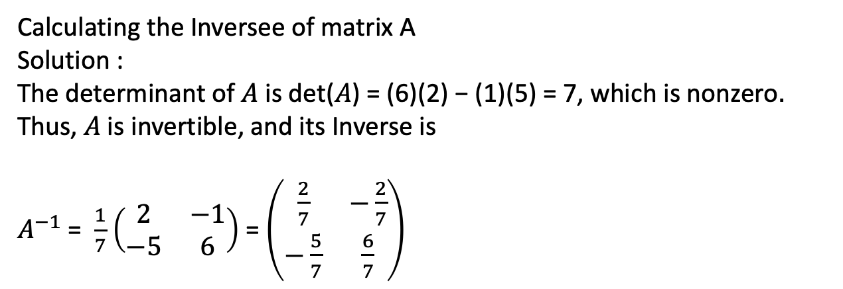
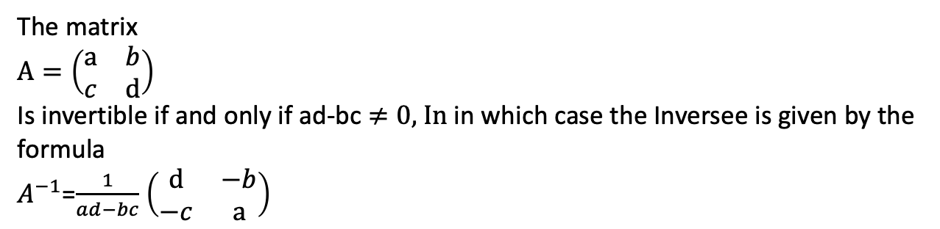
Inverse
Inverse 2 × 2 Matrix
Theorem
The matrix
$A=\left(\begin{matrix}a & b \\ c & d\end{matrix}\right)$
Is invertible if and only if ad-bc $≠0,$ In in which case the Inversee is given by the formula
$A^{−1}$=$\frac{1}{ad−bc}$ $\left(\begin{matrix}d & −b \\ −c & a\end{matrix}\right)$
Calculating the Inversee of matrix A
Solution :
The determinant of 𝐴 is det(𝐴) = (6)(2) − (1)(5) = 7, which is nonzero.
Thus, 𝐴 is invertible, and its Inverse is
$A^{−1}$ = $\frac{1}{7}$ $\left(\begin{matrix}2 & −1 \\ −5 & 6\end{matrix}\right)$ = $\left(\begin{matrix}\frac{2}{7} & −\frac{2}{7} \\ −\frac{5}{7} & \frac{6}{7}\end{matrix}\right)$

Slide 27
Inverse
Theorem
1. If 𝐴 and 𝐵 are invertible matrices with the same size, then 𝐴𝐵 is invertible and
${(AB)}^{−1}=B^{−1}$ $A^{−1}$
2. If 𝐴 is invertible and n is a nonnegative integer, then:
(a) 𝐴⁻¹ is invertible and (𝐴⁻¹)⁻¹ = 𝐴.
(b) 𝐴n is invertible and (𝐴^{n})⁻¹ = 𝐴^{−n} = (𝐴⁻¹)^{n}.
(c) k𝐴 is invertible for any nonzero scalar k, and (k𝐴)⁻¹ = k⁻¹𝐴⁻¹.

Slide 28
A Method for Inverting Matrices
Using Row Operations to Find A⁻¹.
Using the Adjoint to Find an Inversee Matrix

Slide 29
1. Inverse Technique : Inversion Algorithm
To find the inverse of an invertible matrix A, find a sequence of elementary row operations that reduces A to the identity and then perform that same sequence of operations on I_{n} to obtain A⁻¹.
To accomplish this we will adjoin the identity matrix to the right side of A, thereby producing a partitioned matrix of the form
[ A | I ]
Then we will apply row operations to this matrix until the left side is reduced to I; these operations will convert the right side to A⁻¹, so the final matrix will have the form
[ I | A⁻¹ ]

Slide 30
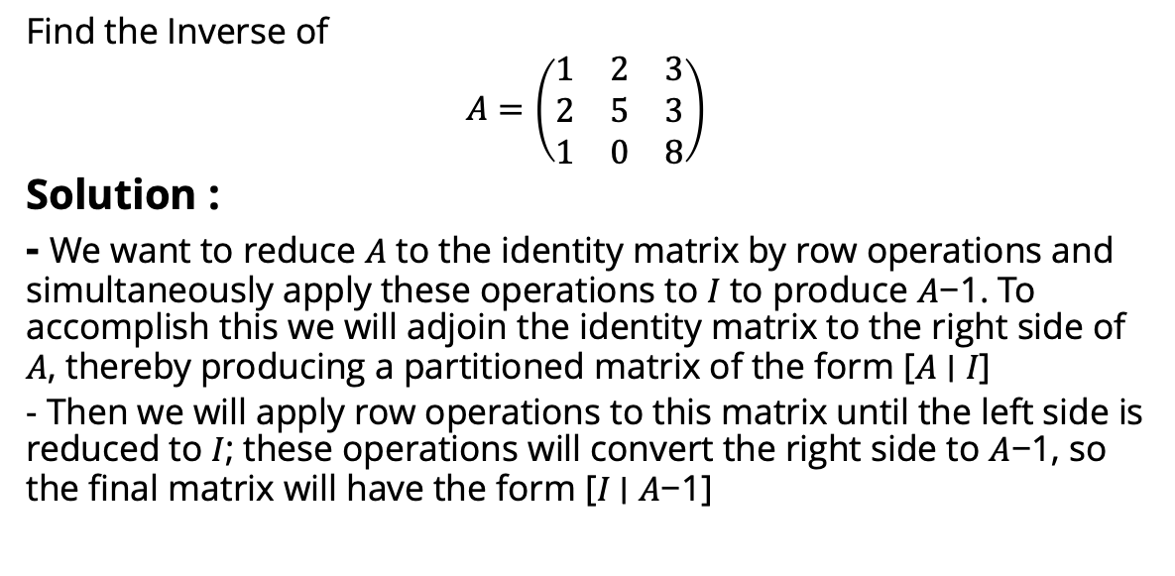
Example :Using Row Operations to Find A⁻¹.
Find the Inverse of
$$A=\left(\begin{matrix}1 & 2 & 3 \\ 2 & 5 & 3 \\ 1 & 0 & 8\end{matrix}\right)$$
Solution :
- We want to reduce 𝐴 to the identity matrix by row operations and simultaneously apply these operations to 𝐼 to produce 𝐴−1. To accomplish this we will adjoin the identity matrix to the right side of 𝐴, thereby producing a partitioned matrix of the form [𝐴 ∣ 𝐼]
- Then we will apply row operations to this matrix until the left side is reduced to 𝐼; these operations will convert the right side to 𝐴−1, so the final matrix will have the form [𝐼 ∣ 𝐴−1]

Slide 31
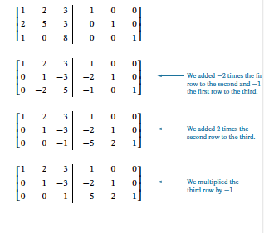
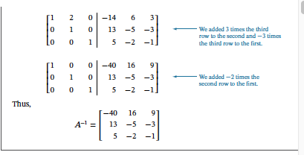
Example
The computations are as follows:

Slide 32
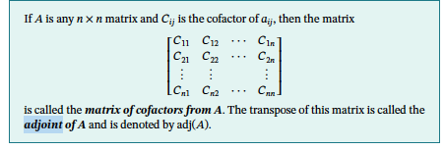
2. Inverse of a Matrix Using Its Adjoint
Definition : Adjoint

Slide 33
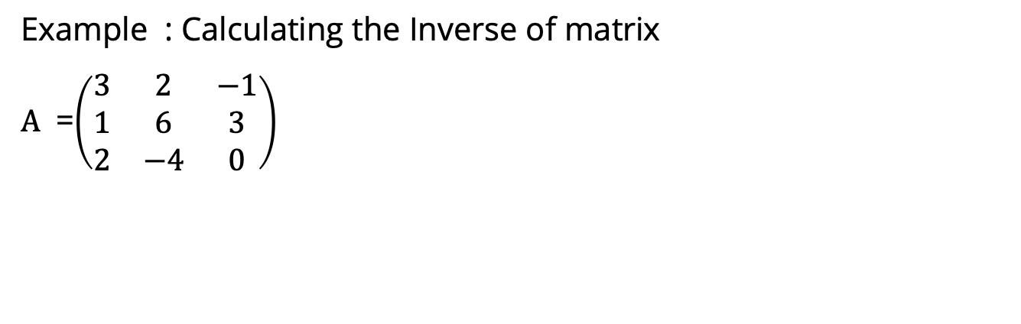
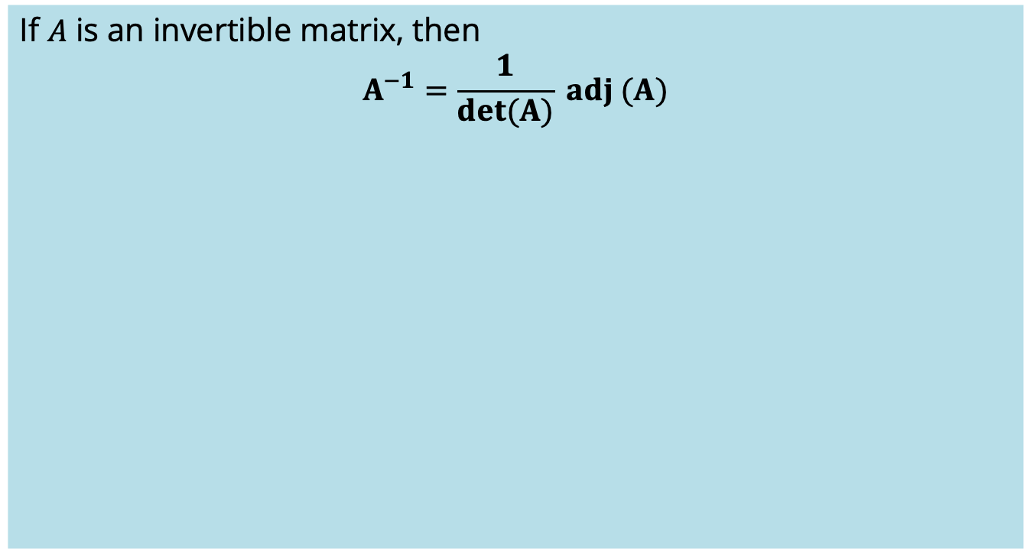
Inverse of a Matrix Using Its Adjoint
If 𝐴 is an invertible matrix, then
$$A^{−1}=\frac{1}{det(A)} adj (A)$$
Example : Calculating the Inverse of matrix
$A$ =$\left(\begin{matrix}3 & 2 & −1 \\ 1 & 6 & 3 \\ 2 & −4 & 0\end{matrix}\right)$

Slide 34
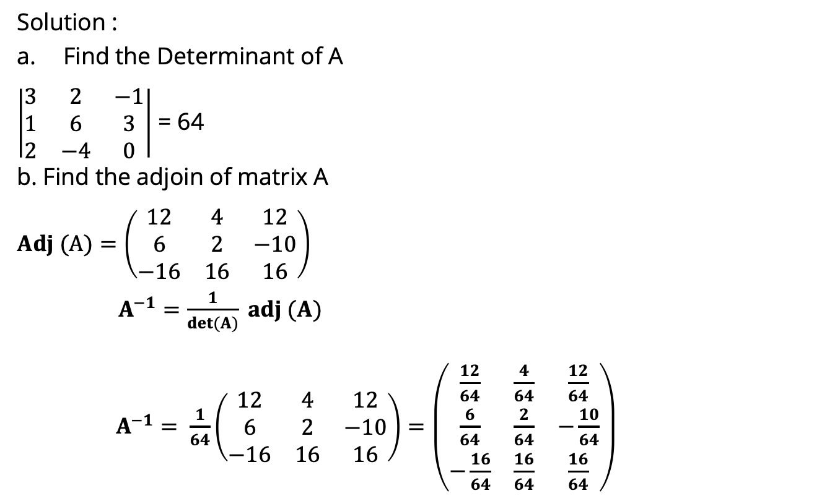
Inverse of a Matrix Using Its Adjoint
Solution :
Find the Determinant of A
$\left|\begin{matrix}3 & 2 & −1 \\ 1 & 6 & 3 \\ 2 & −4 & 0\end{matrix}\right|$ = 64
b. Find the adjoin of matrix A
$Adj (A)=\left(\begin{matrix}12 & 4 & 12 \\ 6 & 2 & −10 \\ −16 & 16 & 16\end{matrix}\right)$
$A^{−1}=\frac{1}{det(A)} adj (A)$
$A^{−1}=$ $\frac{1}{64}\left(\begin{matrix}12 & 4 & 12 \\ 6 & 2 & −10 \\ −16 & 16 & 16\end{matrix}\right)=\left(\begin{matrix}\frac{12}{64} & \frac{4}{64} & \frac{12}{64} \\ \frac{6}{64} & \frac{2}{64} & −\frac{10}{64} \\ −\frac{16}{64} & \frac{16}{64} & \frac{16}{64}\end{matrix}\right)$

Slide 35
Inverse of a Product
Theorem
If A and B are invertible matrices with the same size, then A.B is invertible and
(A.B)⁻¹ = B⁻¹.A⁻¹
Above theorem can be extended to three or more matrices :
A product of any number of invertible matrices is invertible, and the inverse of the product is the product of the inverses in the reverse order.

Slide 36
More Properties of Inverses
Here is some properties of inverses related to exponent and transpose.
Theorem
If A is invertible and n is a nonnegative integer, then:
A⁻¹ is invertible and (A⁻¹)⁻¹ = A.
A^{n} is invertible and (A^{n})⁻¹ = A^{-n} = (A⁻¹)^{n}.
k.A is invertible for any nonzero scalar k, and (k.A)⁻¹ = k⁻¹.A⁻¹.
A^{T} is invertible and (A^{T})⁻¹ = (A⁻¹)^{T}.

Slide 37
Solving Linear Systems by Matrix Inversion
So far we have studied two procedures for solving linear systems : Gauss–Jordan elimination and Gaussian elimination. The following theorem provides an actual formula for the solution of a linear system of n equations in n unknowns in the case where the coefficient matrix is invertible.
Theorem
If A is an invertible n x n matrix, then for each n x 1 matrix b, the system of equations A.x = b has exactly one solution, namely
x = A⁻¹.b.
Above theorem can be proved easily by multiplying each both sides by A⁻¹ from the left.

Slide 38


Example
Consider the system of linear equations
In matrix form this system can be written as A.x = b, where

Slide 39


Example (Cont.)
In previous example we showed that A is invertible and
The solution of the system is
or x₁ = 1, x₂ = -1, x₃ =2.

Slide 40

Thank You

