Slide 1
Linear Algebra
Session 5-7

Slide 2
Determinant and Inverse of Matrix

Slide 3
These slides have been adapted from:
Anton, H. and Rorres, C. (2010). Elementary Linear Algebra : Applications Version. 10th Edition. John Wiley & Sons. New Jersey.
Chapter 2
Acknowledgement

Slide 4
LO 3 : Evaluate determinant and inverse of matrix and their applications.
Learning Objectives
Students will be able to evaluate determinant of a matrix and its application.
Students will be able to evaluate inverse of a matrix and its application.

Slide 5
Determinant and Inverse of Matrix
Contents
Inverse of Matrix
Methods of Finding Inverses
Determinant of Matrix
Methods of Finding Determinants
Cramer’s Rule

Slide 6
Inverse of Matrix

Slide 7
Definition
In real arithmetic every nonzero number a has a reciprocal a⁻¹ = 1/a with the property
a.a⁻¹ = a⁻¹.a = 1.
The number a⁻¹ is sometimes called the multiplicative inverse of a. Analog with this, we can define multiplicative inverse of a matrix.
Definition
If A is a square matrix, and if a matrix B of the same size can be found such that A.B=B.A=I, then A is said to be invertible (or nonsingular) and B is called an inverse of A. If no such matrix B can be found, then A is said to be singular.

Slide 8

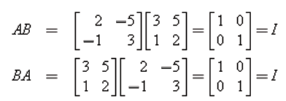
Example
The relationship is not changed by interchanging A and B, so if A is invertible and B is an inverse of A, then it is also true that B is invertible, and A is an inverse of B. Thus, when
A.B = B.A = I
we say that A and B are inverses of one another.
Example
Let
Then
Thus, A and B are invertible and each is an inverse of the other.

Slide 9
Uniqueness of Inverses
Theorem (Uniqueness of Inverse)
If B and C are both inverses of the matrix A, then B=C.
As a consequence of this important result, we can now speak of “the” inverse of an invertible matrix. If A is invertible, then its inverse will be denoted by the symbol A⁻¹. Thus,
A.A⁻¹ = A⁻¹.A = I.
The inverse of A plays much the same role in matrix arithmetic that the reciprocal a⁻¹ plays in the numerical relationships a.a⁻¹=1 and
a⁻ ¹.a =1.

Slide 10



Inverse of 2x2 Matrix
Theorem
The matrix
is invertible if and only if ad – bc ≠ 0, in which case the inverse is given by the formula
Note : The quantity ad – bc in above theorem is called the determinant of the matrix A and is denoted by : det(A) = a.d – b.c, or alternatively by . We will discuss more about
determinant in next section.

Slide 11
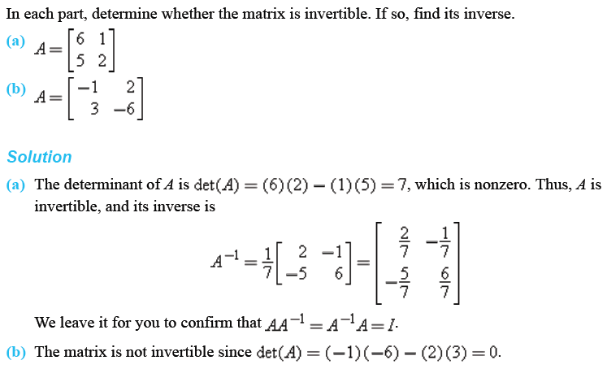
Examples

Slide 12
Inverse of a Product
Theorem
If A and B are invertible matrices with the same size, then A.B is invertible and
(A.B)⁻¹ = B⁻¹.A⁻¹
Above theorem can be extended to three or more matrices :
A product of any number of invertible matrices is invertible, and the inverse of the product is the product of the inverses in the reverse order.

Slide 13



Example
Consider the matrices
We can show that
and also that
Thus, (A.B)⁻¹ = B⁻¹.A⁻¹ as guaranteed by the theorem.

Slide 14
Powers of a Matrix
Definition
If A is a square matrix, then we define the nonnegative integer powers of A to be
A⁰ = I and A^{n} = A.A.....A [n factors]
and if A is invertible, then we define the negative integer powers of A to be
A^{-n} = (A⁻¹)^{n} = A⁻¹.A⁻¹.....A⁻¹ [n factors]
Because these definitions parallel those for real numbers, the usual laws of nonnegative exponents hold; for example,
A^{r}.A^{s} = A^{r+s} and (A^{r})^{s} = A^{r.s}

Slide 15
More Properties of Inverses
Here is some properties of inverses related to exponent and transpose.
Theorem
If A is invertible and n is a nonnegative integer, then:
A⁻¹ is invertible and (A⁻¹)⁻¹ = A.
A^{n} is invertible and (A^{n})⁻¹ = A^{-n} = (A⁻¹)^{n}.
k.A is invertible for any nonzero scalar k, and (k.A)⁻¹ = k⁻¹.A⁻¹.
A^{T} is invertible and (A^{T})⁻¹ = (A⁻¹)^{T}.

Slide 16




Example
  Using matrix A as in previous example :
  Then
  Also
  so, as expected from the theorem :

Slide 17
Methods for Finding Inverses

Slide 18
Finding Inverses using Elementary Row Operations
Theorem
If A is an n x n matrix, then :
A is invertible if and only if the reduced row echelon form of A is I_{n}.
We will develop a procedure (or algorithm) that can be used to tell whether a given matrix is invertible, and if so, produce its inverse. To derive this algorithm, assume for the moment, that A is an invertible nxn matrix.
From above theorem, there is a sequence of row operations that reduce A to I_{n}. If we apply the same sequence of row operations on I_{n}, we will obtain A⁻¹.
Therefore : the same sequence of row operations that reduces A to I_{n} will transform I_{n} to A⁻¹.

Slide 19
Inversion Algorithm
To find the inverse of an invertible matrix A, find a sequence of elementary row operations that reduces A to the identity and then perform that same sequence of operations on I_{n} to obtain A⁻¹.
To accomplish this we will adjoin the identity matrix to the right side of A, thereby producing a partitioned matrix of the form
[ A | I ]
Then we will apply row operations to this matrix until the left side is reduced to I; these operations will convert the right side to A⁻¹, so the final matrix will have the form
[ I | A⁻¹ ]

Slide 20
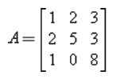
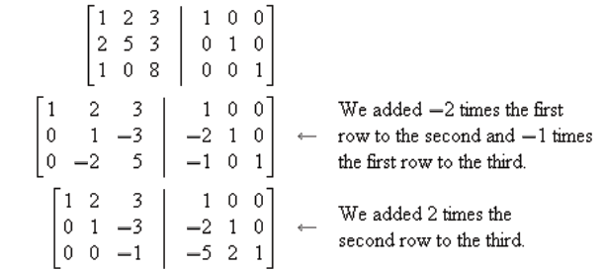
Example
We want to find the inverse of
The computations are as follows :

Slide 21
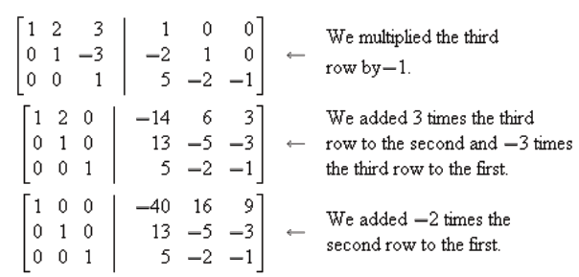
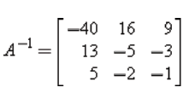
Example (Cont.)
Thus,

Slide 22
Solving Linear Systems by Matrix Inversion
So far we have studied two procedures for solving linear systems : Gauss–Jordan elimination and Gaussian elimination. The following theorem provides an actual formula for the solution of a linear system of n equations in n unknowns in the case where the coefficient matrix is invertible.
Theorem
If A is an invertible n x n matrix, then for each n x 1 matrix b, the system of equations A.x = b has exactly one solution, namely
x = A⁻¹.b.
Above theorem can be proved easily by multiplying each both sides by A⁻¹ from the left.

Slide 23


Example
Consider the system of linear equations
In matrix form this system can be written as A.x = b, where

Slide 24


Example (Cont.)
In previous example we showed that A is invertible and
The solution of the system is
or x₁ = 1, x₂ = -1, x₃ =2.

Slide 25
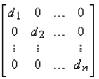
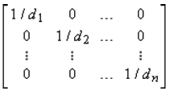
Invertibility of
Some Special Matrices
Theorem
If A is an invertible n x n matrix, then :
If A is a diagonal matrix and
A = ,
then A⁻¹ is also a diagonal matrix and
A⁻¹ = ,
If A is a lower triangular matrix, then A⁻¹ is also lower triangular.
If A is an upper triangular matrix, then A-1 is also upper triangular.
If A is a symmetric matrix, then A⁻¹ is also symmetric.

Slide 26
Determinant of Matrix

Slide 27
Terminologies
In this section we will study “determinants” or, more precisely, “determinant functions.” Determinant functions assign a real number to a matrix variable A.
Determinant of matrix A can be denoted by det(A) or |A| (not to be confused with absolute value in real arithmetic). If the entries of A are known, we can also denotes determinant of A by putting the entries of A inside the “absolute value sign”.
Determinants can be useful for solving very small linear systems (say two or three unknowns). They can also link together with various concepts in linear algebra and provide a useful formula for the inverse of a matrix.

Slide 28


Minors and Cofactors
Determinant can only be defined on a square matrix. Before stating the formula of the determinant, we define the determinant of 2x2 matrix first :
If , then .
To make clearer, we define the determinant of a 1x1 matrix A = [a₁₁] as det(A) = a₁₁.
Definition
If A is a square matrix, then
The minor of entry a_{ij} is denoted by M_{ij} and is defined to be the determinant of the submatrix that remains after the i-th row and j-th column are deleted from A.
The cofactor of entry a_{ij} is denoted by C_{ij} and is defined as
C_{ij} = (-1)^{i+j}.M_{ij}

Slide 29
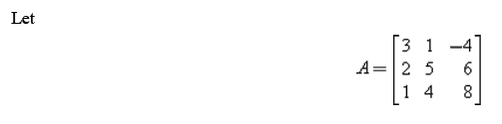
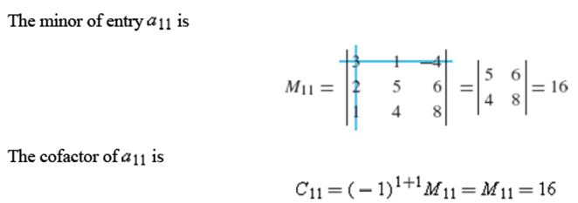
Examples

Slide 30
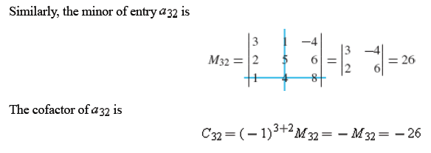
Examples (Cont.)

Slide 31
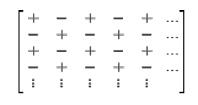
Relation between Minors and Cofactors
Note that a minor M_{ij} and its corresponding cofactor C_{ij} are either the same or negatives of each other and that the relating sign (-1)^{i+j} is either +1 or -1 in accordance with the pattern in the “checkerboard” array
For example, C₁₁ = M₁₁, C₂₁ = -M₂₁, C₂₂ = M₂₂, and so forth.
Thus, it is never really necessary to calculate (-1)^{i+j} to calculate C_{ij} —you can simply compute the minor M_{ij} and then adjust the sign in accordance with the checkerboard pattern.

Slide 32
Methods for Finding Determinants

Slide 33


Cofactor Expansions
Definition
If A is an n x n matrix, then the number obtained by multiplying the entries in any row or column of A by the corresponding cofactors and adding the resulting products is called the determinant of A, and the sums themselves are called cofactor expansions of A. That is,
and

Slide 34
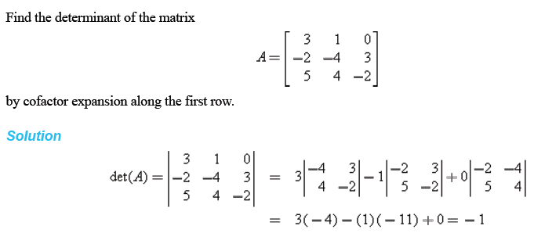
Examples
Cofactor expansion along the first row

Slide 35
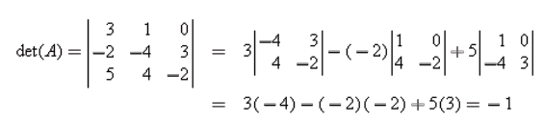
Examples
Cofactor expansion along the first column
A is the same matrix as in the previous example.

Slide 36
Determinant is Well-defined
Theorem
If A is an matrix, then regardless of which row or column of A is chosen, the number obtained by multiplying the entries in that row or column by the corresponding cofactors and adding the resulting products (i.e. the cofactor expansion) is always the same.
Above theorem guaranteed that the value of determinant obtaining from cofactor expansion is well-defined. That is, it can be calculated by cofactor expansion along any row or column of the matrix. Previous examples justify the theorem.

Slide 37
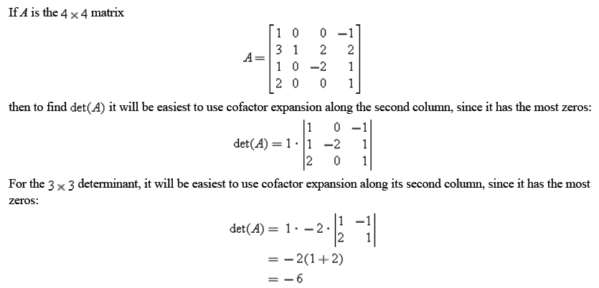
Strategy for Cofactor Expansions
The best strategy for cofactor expansion is to expand along a row or column with the most zeros.
Example

Slide 38
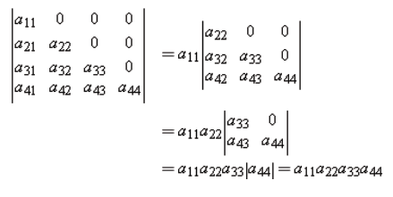
Determinants of
Triangular Matrices
Theorem
If A is an n x n triangular matrix (upper triangular, lower triangular, or diagonal), then det(A) is the product of the entries on the main diagonal of the matrix; that is, det(A) = a₁₁.a₂₂.....a_{nn}.
This is an illustration in 4x4 case :

Slide 39

Sarrus’ Rule
Determinants of 2x2 and 3x3 matrices can be evaluated very efficiently using the pattern suggested below (called Sarrus’ rule):
In the 2x2 case, the determinant can be computed by forming the product of the entries on the rightward arrow and subtracting the product of the entries on the leftward arrow.
In the 3x3 case we first recopy the first and second columns as shown in the figure, after which we can compute the determinant by summing the products of the entries on the rightward arrows and subtracting the products on the leftward arrows. These procedures execute the computations

Slide 40
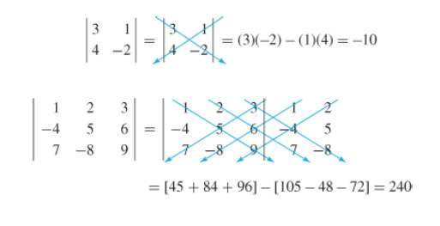
Examples
Warning : This technique only works for 2x2 and 3x3 matrices, and in those cases the result is same with cofactor expansions.

Slide 41
Finding Determinants using Elementary Row Operations
Theorem
Let A be an n x n matrix.
If B is the matrix that results when a single row or single column of A is multiplied by a scalar k, then det(B) = k.det(A).
If B is the matrix that results when two rows or two columns of A are interchanged, then det(B) = - det(A).
If B is the matrix that results when a multiple of one row of A is added to another row or when a multiple of one column is added to another column, then det(B) = det(A).
Note that the three operations mentioned in above theorem are the three kinds of elementary row operations explained in the beginning of this course.

Slide 42
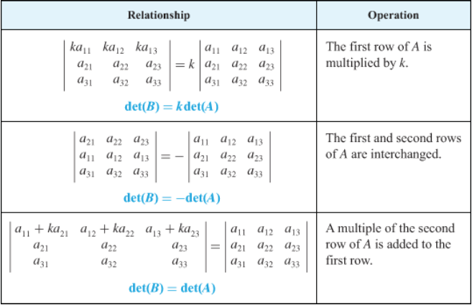
Finding Determinants using Elementary Row Operations
This table explain how the three kinds of elementary row operations on a matrix affect its determinant.

Slide 43

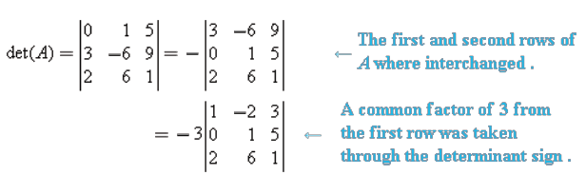
Evaluating Determinants by Row Reduction
Evaluate det(A) where
We will reduce A to row echelon form (which is upper triangular) and then calculate the determinant (easier to do).

Slide 44
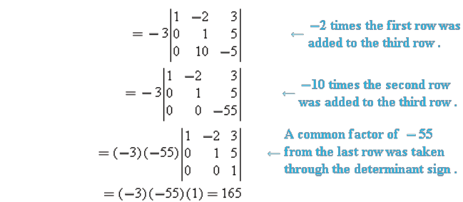
Evaluating Determinants by Row Reduction (Cont.)

Slide 45
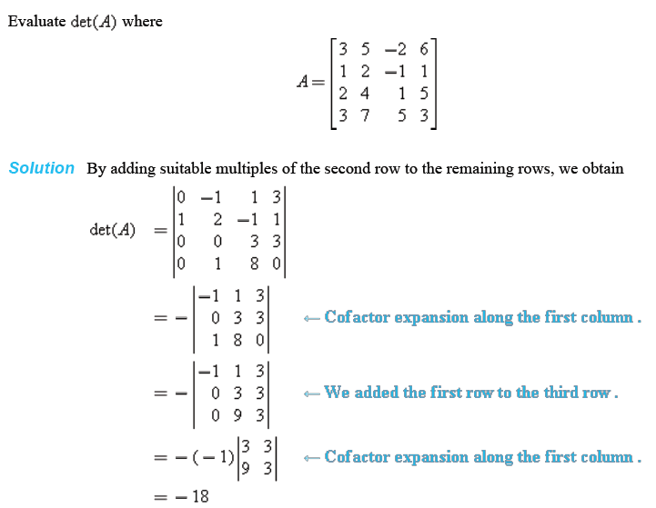
More Examples (1)

Slide 46
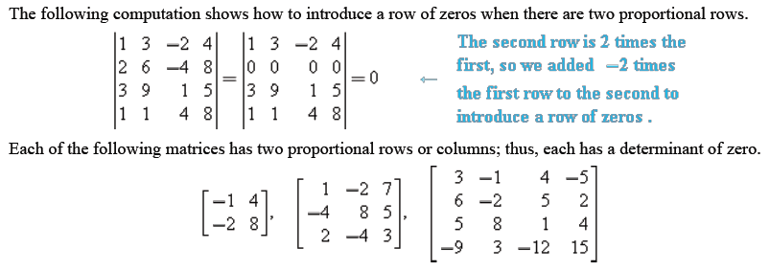
More Examples (2)

Slide 47
Properties of Determinants and
The Cramer’s Rule

Slide 48
Properties of Determinants
Theorem
Let A be a square matrix.
If A has a row of zeros or a column of zeros, then det(A)=0.
det(A) = det(A^{T}).
Theorem
Suppose that A and B are n x n matrices and k is any scalar. We have the following properties :
det(A.B) = det(A).det(B)
det(k.A) = k^{n}.det(A)
In general, det(A+B) ≠ det(A)+det(B)

Slide 49

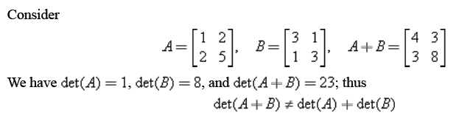
Example
Consider the matrices
We can verify that det(A) = 1, det(B) = -23 and det(A.B) = -23.
Thus, det(A.B) = det(A).det(B), as guaranteed by part (a) of the theorem.
Part (c) of the theorem can be proved using this counter-example:

Slide 50

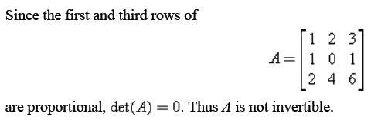
Determinant Test of Invertibility
Theorem
A square matrix A is invertible if and only if det(A) ≠ 0.
If A is invertible, then
Example

Slide 51
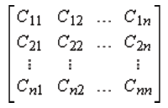
Adjoint of a Matrix
Definition
If A is any n x n matrix and C_{ij} is the cofactor of a_{ij}, then the matrix
is called the matrix of cofactors from A. The transpose of this matrix is called the adjoint of A and is denoted by adj(A).

Slide 52
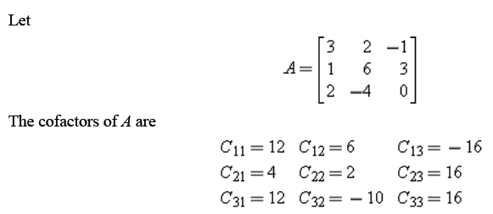
Example

Slide 53
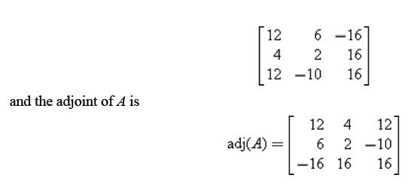
Example (Cont.)

Slide 54

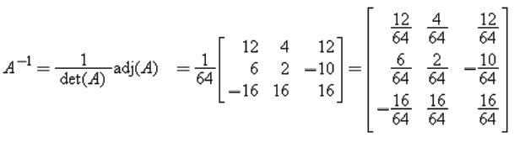
Inverse of Matrix using Adjoint
Theorem
If A is an invertible matrix, then
Example
A is the 3x3 matrix as in previous example. We can check that det(A) = 64. Thus

Slide 55

Cramer’s Rule
Our next theorem uses the formula for the inverse of an invertible matrix to produce a formula, called Cramer's rule, for the solution of a linear system A.x = b of n equations in n unknowns in the case where the coefficient matrix A is invertible (or, equivalently, when det(A) ≠ 0).

Slide 56


Cramer’s Rule
Theorem (Cramer’s Rule)
If A.x=b is a system of n linear equations in n unknowns such that det(A) ≠ 0, then the system has a unique solution. This solution is
where A_{j} is the matrix obtained by replacing the entries in the j-th column of A by the entries in the matrix

Slide 57
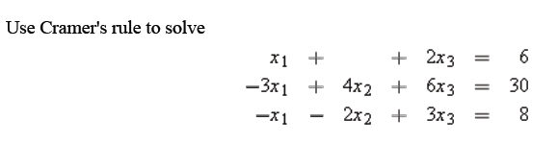
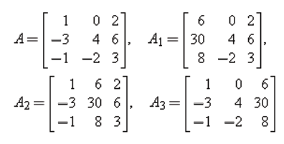
Example

Slide 58
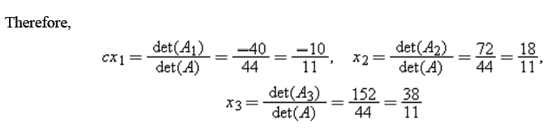
Example
Note : For n > 3, it is usually more efficient to solve a linear system with n equations in n unknowns by Gauss–Jordan elimination than by Cramer's rule. Its main use is for obtaining properties of solutions of a linear system without actually solving the system.

Slide 59
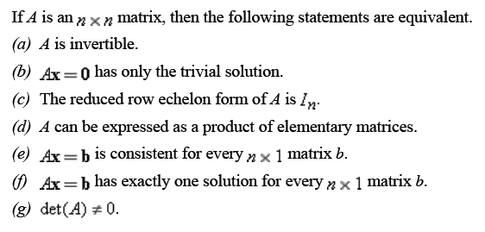
Summary
Theorem

Slide 60
References
Anton, H. and Rorres, C. (2010). Elementary Linear Algebra : Applications Version. 10th Edition. John Wiley & Sons. New Jersey.

