Slide 1
Vectors
Session 08-09
Course : MATH6030001 - Linear Algebra
Effective Period : February 2016

Slide 2
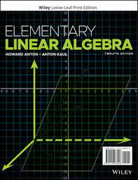
Acknowledgement
These slides have been adapted from:
Anton, Howard, and Chris Rorres. Elementary linear algebra: applications version. John Wiley & Sons, 2019.

Slide 3

LO 4 : Explain vector operations and their geometric interpretations
Learning Objectives
Students will be able to compute various vector operations.
Students will be able to interpret vector operations geometrically.

Slide 4
Contents
1
1
Vectors in 2-Space and 3-Space
2
2
Norm, Dot Product, and Distance in R^{n}
3
3
4
Cross Product
4
Vector Projection

Slide 5
Vectors in 2-Space and 3-Space

Slide 6
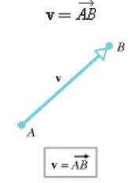
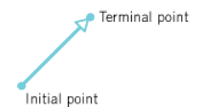
Vectors in 2-Space and 3-Space
Engineers and physicists represent vectors in two dimensions (also called 2-space) or in three dimensions (also called 3-space) by arrows. The direction of the arrowhead specifies the direction of the vector and the length of the arrow specifies the magnitude. Mathematicians call these geometric vectors. The tail of the arrow is called the initial point of the vector and the tip the terminal point.
In this text we will denote vectors in boldface type such as a, b, v, w, and x, and we will denote scalars in lowercase italic type such as a, k, v, w, and x. When we want to indicate that a vector v has initial point A and terminal point B, then we will write :

Slide 7
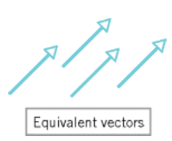
Equivalent Vectors and
Zero Vectors
Vectors with the same length and direction, such as those in figure below, are said to be equivalent. Since we want a vector to be determined solely by its length and direction, equivalent vectors are regarded to be the same vector even though they may be in different positions. Equivalent vectors are also said to be equal, which we indicate by writing v = w.
The vector whose initial and terminal points coincide has length zero, so we call this the zero vector and denote it by 0. The zero vector has no natural direction, so we will agree that it can be assigned any direction that is convenient for the problem at hand.

Slide 8
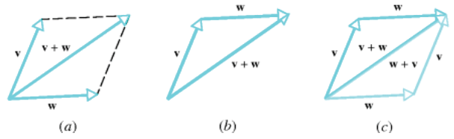
Vector Addition
Parallelogram Rule for Vector Addition
If v and w are vectors in 2-space or 3-space that are positioned so their initial points coincide, then the two vectors form adjacent sides of a parallelogram, and the sum is the vector represented by the arrow from the common initial point of and to the opposite vertex of the parallelogram.

Slide 9
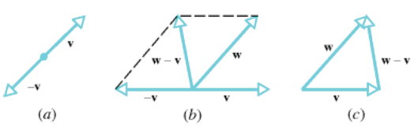
Vector Substraction
In ordinary arithmetic we can write a – b = a + (-b), which expresses subtraction in terms of addition. There is an analogous idea in vector arithmetic :
The negative of a vector v, denoted by -v, is the vector that has the same length as v but is oppositely directed, and the difference of v from w, denoted by w – v, is taken to be the sum
w – v = w + (-v).

Slide 10
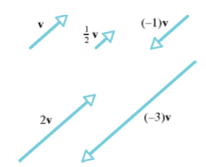
Scalar Multiplication
If is a nonzero vector in 2-space or 3-space, and if k is a nonzero scalar, then we define the scalar product of v by k to be the vector whose length is |k| times the length of v and whose direction is the same as that of v if k is positive and opposite to that of v if k is negative. If k=0 or v=0, then we define k.v to be 0.
Figure below shows the geometric relationship between a vector v and some of its scalar multiples. In particular, observe that (-1).v has the same length as v but is oppositely directed; therefore,
(-1).v = -v

Slide 11
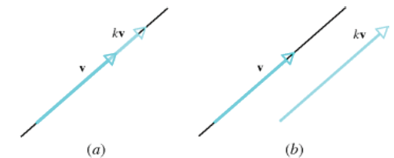
Parallel and Collinear Vectors
Suppose that v and w are vectors in 2-space or 3-space with a common initial point. If one of the vectors is a scalar multiple of the other, then the vectors lie on a common line, so it is reasonable to say that they are collinear (see figure below). However, if we translate one of the vectors, then the vectors are parallel but no longer collinear. This creates a linguistic problem because translating a vector does not change it. The only way to resolve this problem is to agree that the terms parallel and collinear mean the same thing when applied to vectors. Although the vector 0 has no clearly defined direction, we will regard it to be parallel to all vectors when convenient.

Slide 12
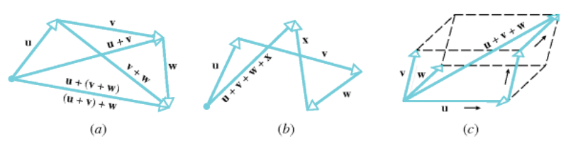
Sum of Three Vectors
Vector addition satisfies the associative law for addition, meaning that when we add three vectors, say u, v, and w, it does not matter which two we add first; that is,
u + (v + w) = (u + v) + w
It follows from this that there is no ambiguity in the expression because the same result is obtained no matter how the vectors are grouped.

Slide 13
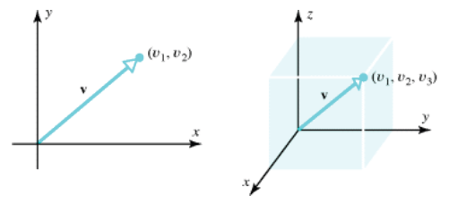
Vectors in Coordinate Systems
If a vector v in 2-space or 3-space is positioned with its initial point at the origin of a rectangular coordinate system, then the vector is completely determined by the coordinates of its terminal point. We call these coordinates the components of v relative to the coordinate system. We will write v = (v₁ ,v₂) to denote a vector v in 2-space with components (v₁, v₂), and v = (v₁, v₂, v₃) to denote a vector in 3-space with components (v₁, v₂, v₃).

Slide 14

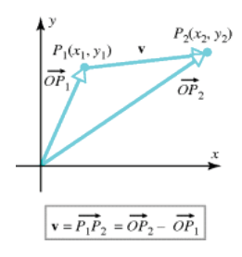


Vectors Whose Initial Points Is Not at the Origin
If denotes the vector in 2-space with initial point P₁(x₁,y₁) and terminal point P₂(x₂,y₂), then the components of this vector are given by the formula
Moreover, the components of a vector in
3-space that has initial point P₁(x₁,y₁,z₁)
and terminal point P₂(x₂,y₂,z₂) are given by
Example :

Slide 15
Vector Operations

Slide 16
Vectors in n-Space
Definition
If n is a positive integer, then an ordered n-tuple is a sequence of n real numbers (v₁,v₂,...,v_{n}). The set of all ordered n-tuples is called n-space and is denoted by R^{n}.
We will denote a vector v in R^{n} using the notation v = (v₁,v₂,...,v_{n}) and we will call 0 = (0,0,...,0) the zero vector.
Definition
Vectors v = (v₁,v₂,...,v_{n}) and w = (w₁,w₂,...,w_{n}) in R^{n} are said to be equivalent (also called equal) if
v₁ = w₁, v₂ = w₂, ..., v_{n} = w_{n}.
We indicate this by writing v = w.

Slide 17
Vector Addition and
Scalar Multiplication
Definition
If v = (v₁,v₂,...,v_{n}) and w = (w₁,w₂,...,w_{n}) are vectors in R^{n}, and if k is any scalar, then we define these operations :
v + w = (v₁+w₁, v₂+w₂, ..., v_{n}+w_{n})
k.v = (k.v₁, k.v₂, ..., k.v_{n})
-v = (-v₁, -v₂, ..., -v_{n})
w – v = (w₁-v₁, w₂-v₂, ..., w_{n}-v_{n})
Example
If v = (1,-3,2) and w = (4,2,1), then
v + w = (5,-1,3), 2v = (2,-6,4),
-w = (-4,-2,-1), v - w = (-3,-5,1).

Slide 18
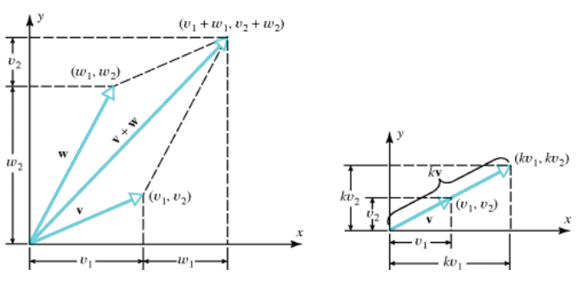
Illustration in 2-Space
Geometric interpretations of vector addition and scalar multiplication in 2-Space (R²) are shown in figure below :

Slide 19
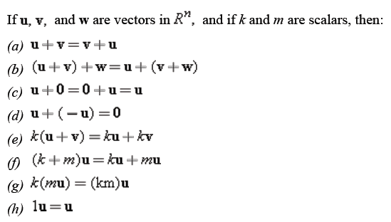
Properties of Vector Addition and Scalar Multiplication
Theorem

Slide 20
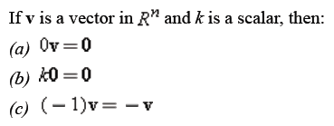
Properties of Vector Addition and Scalar Multiplication
Theorem
Above theorem can be proved easily using some parts of the previous theorem. Be aware to distinguish 0 (scalar) and 0 (zero vector).

Slide 21
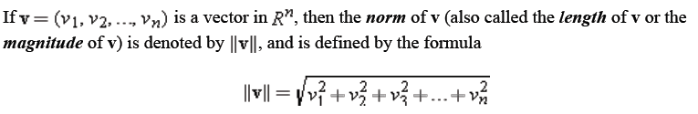

Norm of a Vector
We will denote the length of a vector v by the symbol ||v||, which is read as the norm of v, the length of v, or the magnitude of v (the term “norm” being a common mathematical synonym for length). In general n-Space, the norm of a vector is defined by “extending” the Theorem of Pythagoras.
Definition
Example
Norm of the vector v = (-3,2,1) in R³ is

Slide 22
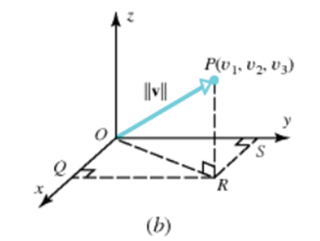
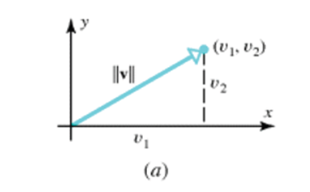
Illustration
These figures illustrate why the Theorem of Pythagoras and its
“extension” are suitable to define norm of a vector in R² and R³.

Slide 23
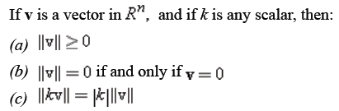
Properties of Norm
There are familiar facts about vectors :
Distances are nonnegative.
The zero vector is the only vector of length zero.
Multiplying a vector by a scalar multiplies its length by the absolute value of that scalar.
Therefore, we can generalize those facts in this theorem.
Theorem

Slide 24
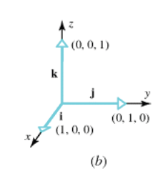
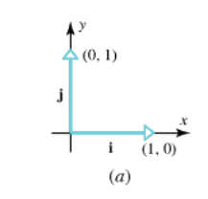
Unit Vectors and
Standard Unit Vectors
A vector of norm 1 is called a unit vector. When a rectangular coordinate system is introduced in R² or R³, the unit vectors in the positive directions of the coordinate axes are called the standard unit vectors. In R² these vectors are denoted by
i = (1,0) and j = (0,1)
and in R³ by
i = (1,0,0), j = (0,1,0) and k = (0,0,1)

Slide 25


Distance between Two Points
Definition
If P₁ and P₂ are points in R² or R³, then the length of the vector
is equal to the distance d between the two points. Specifically, if P₁(x₁,y₁) and P₂(x₂,y₂) are points in R², then
This is the familiar distance formula from analytic geometry. Similarly, the distance between the points P₁(x₁,y₁,z₁) and P₂(x₂,y₂,z₂) in 3-space is
Those formulas can also be generalized in R^{n}, for any natural number n.

Slide 26
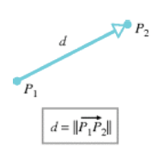
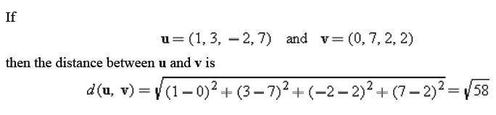
Illustration and Example
Example

Slide 27
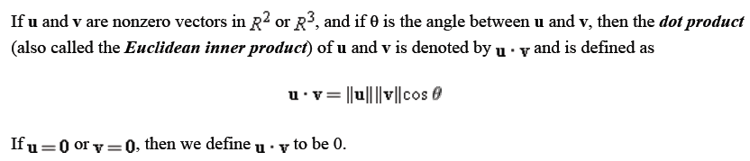
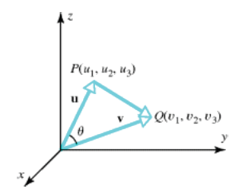
Dot Product
Definition

Slide 28
Dot Product (Cont.)
For computational purposes it is desirable to have a formula that expresses the dot product of two vectors in terms of components.
Definition
If u = (u₁,u₂) and v = (v₁,v₂) are vectors in R², then :
u.v = u₁.v₁ + u₂.v₂
If u = (u₁,u₂,u₃) and v = (v₁,v₂,v₃) are vectors in R³, then :
u.v = u₁.v₁ + u₂.v₂ + u₃.v₃
In general, if u = (u₁,u₂,...,u_{n}) and v = (v₁,v₂,...,v_{n}) are vectors in R^{n}, then the dot product (also called the Euclidean inner product) of u and v is denoted by u.v and is defined by
u.v = u₁.v₁ + u₂.v₂ + ... + u_{n}.v_{n}
Example
Given two vectors in R⁴ : u = (-1,3,5,7) and v = (-3,-4,1,0), then
u.v = (-1).(-3) + 3.(-4) + (5).(1) + (7).(0) = -4.

Slide 29
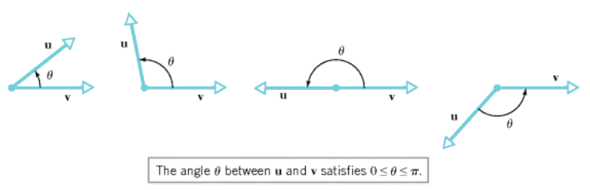

Angles between Two Vectors
Note that the angle θ between u and v is defined as the smallest angle, that is 0 ≤ θ ≤ π.
From the formula , and since 0 ≤ θ ≤ π, it follows from properties of cosine function studied in trigonometry that:
θ is acute if u.v > 0
θ is obtuse if u.v < 0
θ = π/2 acute if u.v = 0

Slide 30
Orthogonal Vectors
Recall from the previous slide that if θ is the angle between two nonzero vectors u and v in R^{n}, then θ = π/2 = 90⁰ if and only if u.v = 0. Thus, we make the following definition about orthogonality.
Definition
Two nonzero vectors u and v in R^{n} are said to be orthogonal (or perpendicular) if u.v = 0. We will also agree that the zero vector in R^{n} is orthogonal to every vector in R^{n}.
A nonempty set of vectors in R^{n} is called an orthogonal set if all pairs of distinct vectors in the set are orthogonal. An orthogonal set of unit vectors is called an orthonormal set.

Slide 31


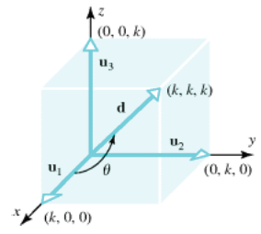
Example
Find the angle between a diagonal of a cube and one of its edges.
Solution Let k be the length of an edge and introduce a coordinate system as shown in figure below. If we let u₁=(k,0,0), u₂=(0,k,0) and u₃=(0,0,k), then the vector d=(k,k,k)=u₁+u₂+u₃ is a diagonal of the cube. It follows from first definition of dot product that the angle θ between d and the edge u₁ satisfies
With the help of a calculator we obtain .

Slide 32

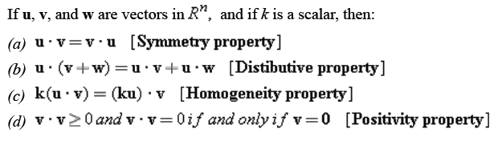
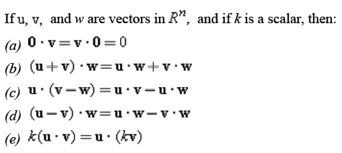
Algebraic Properties of the Dot Product
Note that in special case u = v we have .
Theorem
Theorem

Slide 33
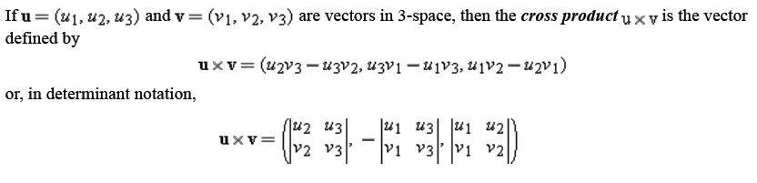
Cross Product
We have defined the dot product of two vectors u and v in n-space. That operation produced a scalar as its result. We will now define a type of vector multiplication that produces a vector as the result but which is applicable only to vectors in 3-space.
Definition

Slide 34

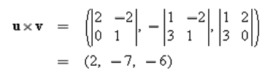

Cross Product (Cont.)
It is also worth (and it will be easier to remember) noting that a cross product can be represented in the determinant form :
where i, j and k are the standard unit vectors in R³.
Example
Find u x v, where u = (1,2,-2) and v = (3,0,1).
or equivalently

Slide 35
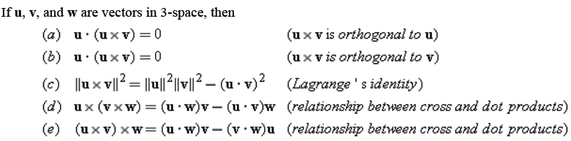
Relationships Involving Cross Product and Dot Product
Theorem
Note that part (a) and (b) of the theorem mean that u x v is orthogonal (or perpendicular) to both u and v.
Example
In previous example, u = (1,2,-2), v = (3,0,1) and we obtain
u x v = (2,-7,-6). Since u.(u x v) = (1)(2) + (2)(-7) + (-2)(-6) = 0 and v.(u x v) = (3)(2) + (0)(-7) + (1)(-6) = 0, u x v is orthogonal to both u and v, as guaranteed by above theorem.

Slide 36
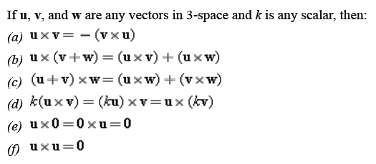
Properties of Cross Product
Theorem
Also note that the cross product is not associative, i.e.
(u x v) x w ≠ u x (v x w).
Therefore we cannot well-define the form u x v x w and need to make sure which operation should be done first.

Slide 37
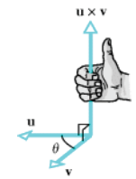

Geometric Interpretation of Cross Product
We have known that u x v is orthogonal to both u and v. If u and v are nonzero vectors, it can be shown that the direction of u x v can be determined using the following “right-hand rule”:
Let θ be the angle between u and v, and suppose u is rotated through the angle θ until it coincides with v. If the fingers of the right hand are cupped so that they point in the direction of rotation, then the thumb indicates (roughly) the direction of u x v.
Also, from Lagrange’s identity, we can obtain that

Slide 38
Vector Projections

Slide 39
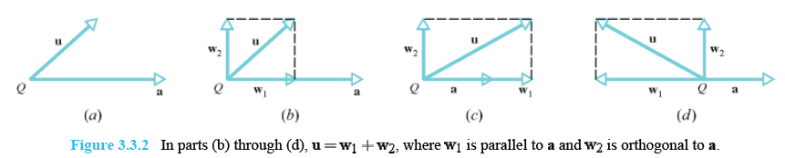
Orthogonal Projection
In many applications it is necessary to “decompose” a vector u into a sum of two terms, one term being a scalar multiple of a specified nonzero vector a and the other term being orthogonal to a. For example, if u and a are vectors in R² that are positioned so their initial points coincide at a point Q, then we can create such a decomposition as follows.
Drop a perpendicular from the tip of u to the line through a.
Construct the vector w₁ from Q to the foot of the perpendicular.
Construct the vector w₂ = u - w₁.

Slide 40
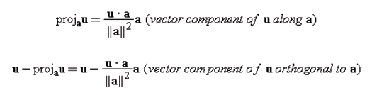
Projection Theorem
Since w₁ + w₂ = w₁ + (u – w₁) = u, we have decomposed u into a sum of two orthogonal vectors, the first term being a scalar multiple of a and the second being orthogonal to a.
Theorem
If u and a are vectors in R^{n} and if a ≠ 0, then u can be expressed in exactly one way in the form u = w₁ + w₂, where w₁ is a scalar multiple of a and w₂ is orthogonal to a.
The vector w₁ is called the orthogonal projection of u on a or sometimes the vector component of u along a, and the vector w₂ is called the vector component of u orthogonal to a. Their formula are :

Slide 41
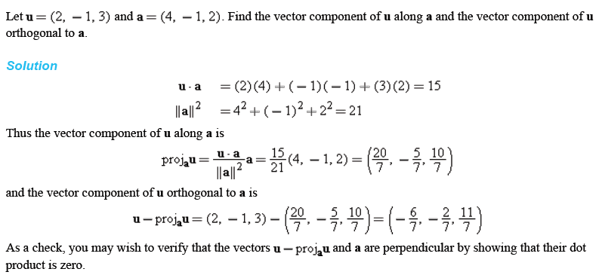
Example

Slide 42
Linear Combinations and Linear Independency of Vectors

Slide 43
Linear Combinations of Vectors
Addition, subtraction, and scalar multiplication are frequently used in combination to form new vectors. For example, if v₁, v₂, and v₃ are vectors in R^{n}, then the vectors
u = 2v₁ + 3v₂ + v₃ and w = 7v₁ – 6v₂ + 8v₃
are formed in this way. In general, we make the following definition.
Definition
If w is a vector in R^{n}, then w is said to be a linear combination of the vectors v₁, v₂, ..., v_{r} in Rn if it can be expressed in the form
w = k₁v₁ + k₂v₂ + ... + k_{r}v_{r}
where k₁, k₂, ..., k_{r} are scalars. These scalars are called the coefficients of the linear combination.

Slide 44
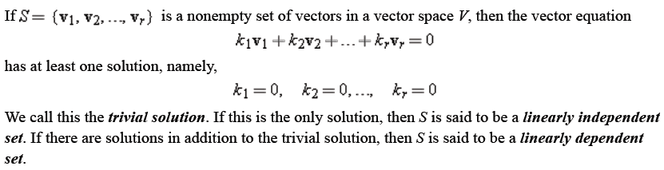
Linear Independence and Dependence
Definition
In other words, a set of vectors S is a linearly independent if and only if linear combination of vectors in S is equal to zero vector implies all of the coefficients are zero.

Slide 45
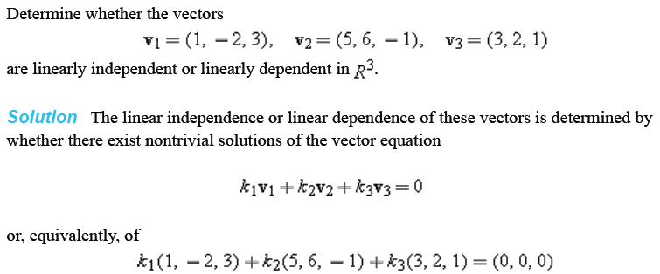
Example

Slide 46
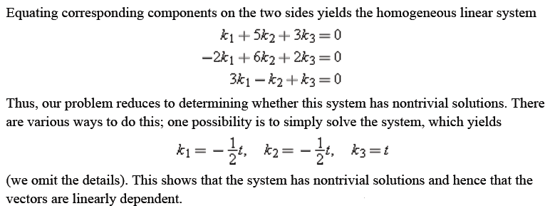
Example (Cont.)

Slide 47

Thank You

