Slide 1

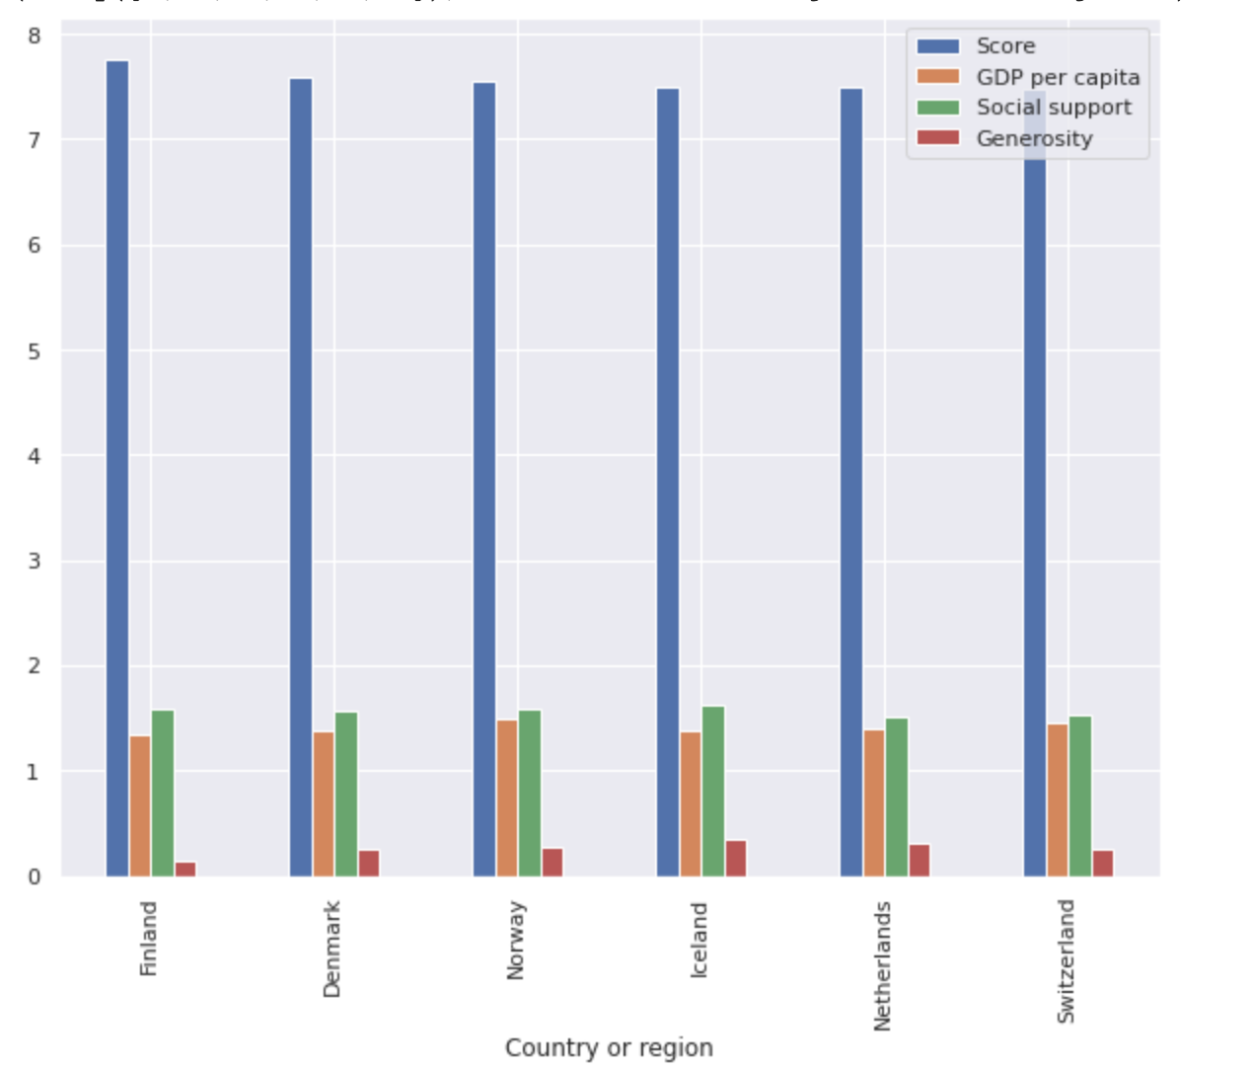
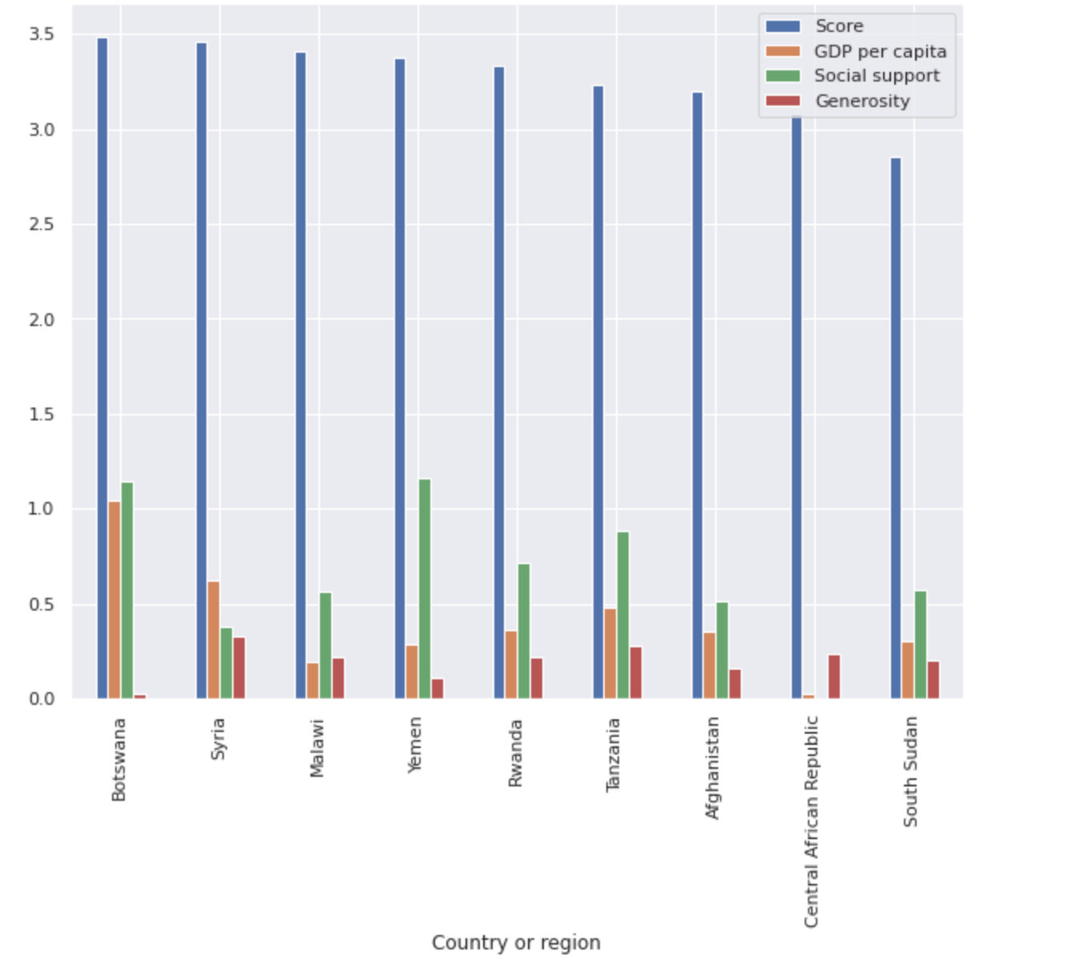
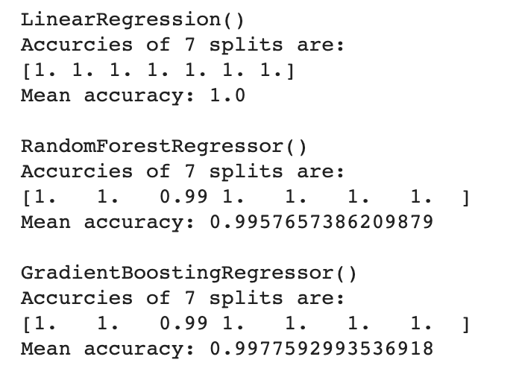
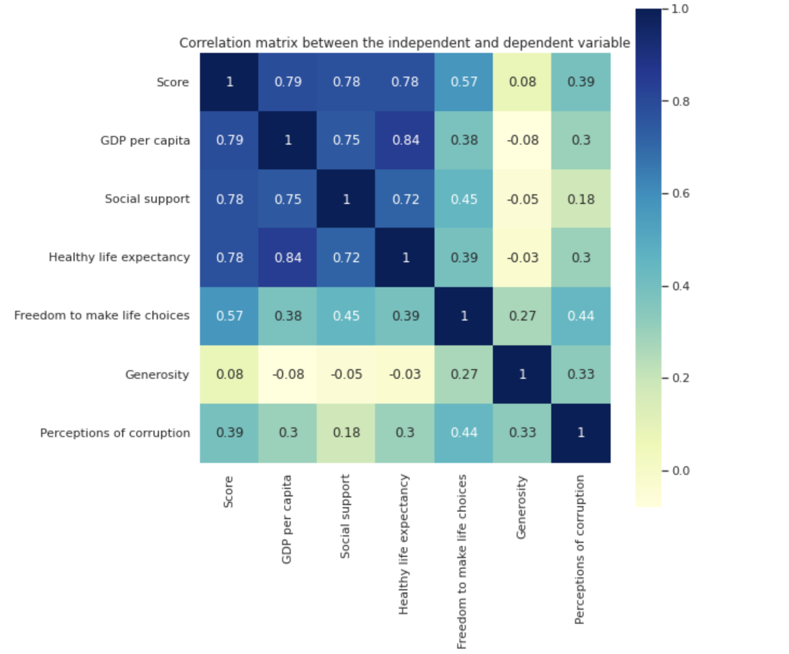
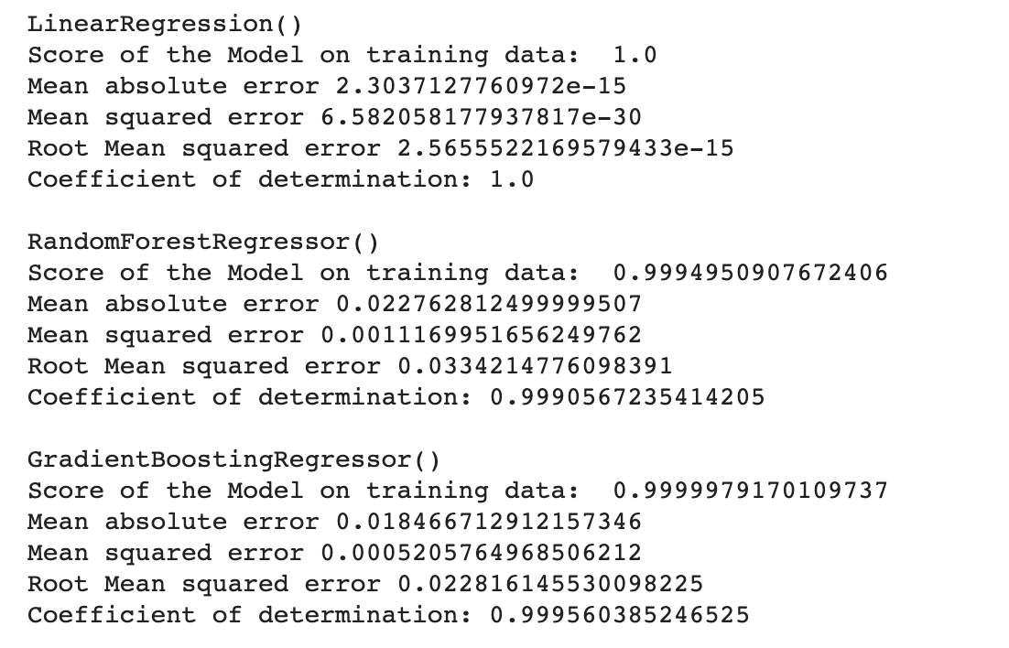
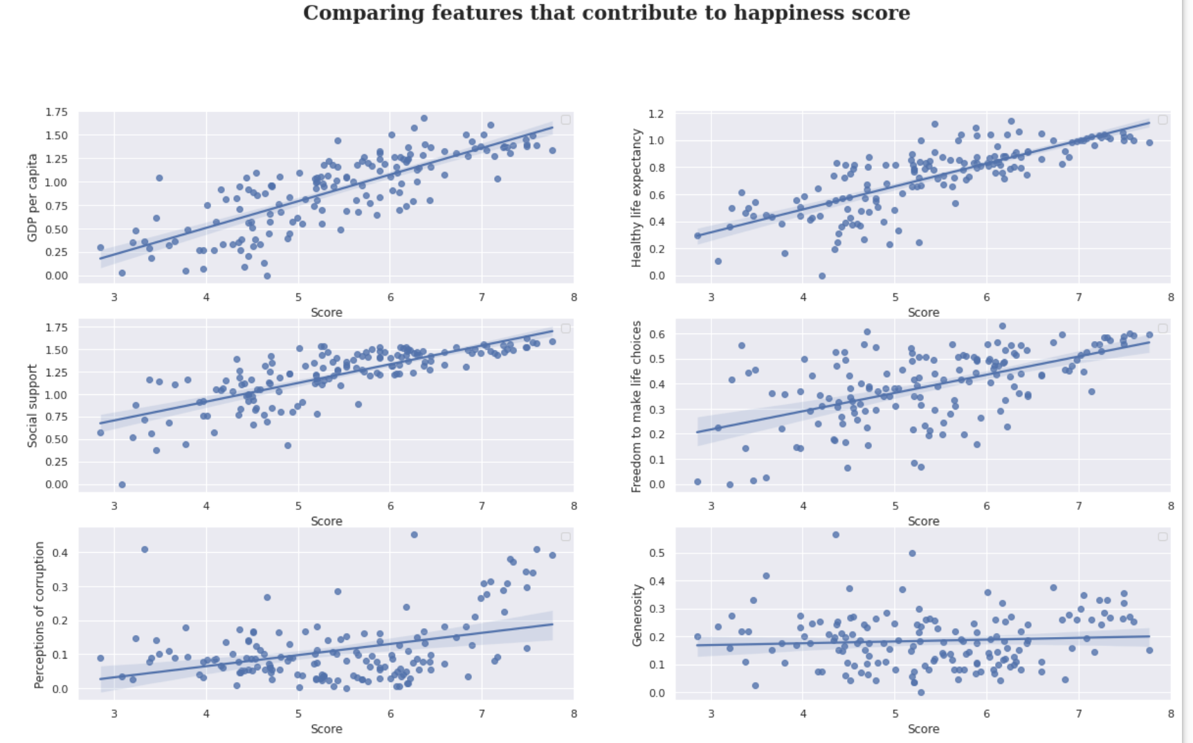
Computer Science Department
Final Project: Project title
Course: Introduction to AI (CS156s4)
Course Instructor: Yulia Newton, Ph.D.
Student Name: Nand Kishore Khuswaha
Introduction/Background
I will have 156 rows and 6 columns. So the shape of my dataset would be (156,7) . I will split my data as 80/20 as we normally do in our assignment. This will split my dataset into (124,7) , (124,) for the training set and (32,7), (32,) for the test set for X and Y values respectively.
From the correlation matrix below, we can observe that GDP per capita, Social support and Healthy life expectancy highly correlates to Happiness Score. On the other hand Generosity and Perception of corruption contributes the least to Happiness score.
Analysis and Results
Countries With Highest Happiness score (>=7.4) vs Countries With Lowest Happiness score (<=3.5)
Happiness is an important part of our well being. There are many factors that contributes to Happiness. We will closely looks at these factors and determine the roles they play in determining the happiness score of a given country. I will use several machine learning algorithms to predict happiness score of various countries. This is an interesting problem to solve because it gives us some insights into major factors that contributes to happiness of people. Happiness is important because it helps us be better people for ourselves, the ones we love, and our community. Happiness has also been linked to better decision-making and improved creativity which can help the growth of a country.
There has been many previous solution for this problem. On Kaggle, a lot of these previous solutions are mostly related to in-depth analysis of the data. Some people have used several different models to train and test their hypotheses to test which model works best on this dataset while some have focused on visualizing the various aspects of the dataset better.
cross-validation results
I have used 7-fold cross validation in my project to get the mean accuracies of each of the model. LinearRegressor seems to perform the best.
Source: Term_project_report.ipynb
As suggested by correlation matrix, we can see from the figures above that countries GDP and Social Support positively impacts happiness score. We can infer from this that a countries need to improve their GDP and provide better social support to improve its happiness score.
Source: Term_project_report.ipynb
Summary/Conclusions
Training and test results
I used the sklearn score metric to check the result for my training dataset. Since my model does really well, I will compare my result based on first five decimal places of accuracies values.
As for the test results, I used Mean absolute error, Root Mean Square error and coefficient of determination to check the performance of my test dataset.
The goal of this project was to compare three ML model performances. We find that even though LinearRegression is a simple model, it seems to perform the best for the given regression task. Model performance is fairly high for the 3 models used, so no improvement needed. It was also interesting to find GradientBooting perform a little better the RandomForest for this task.
If I were to given more time for this project then perhaps I would want to compare and analyze data from last 5 years. It would be interesting to find which countries happiness score improved significantly and the reasons behind it.
Source: Term_project_report.ipynb
Methodology
Algorithm Used
LinerRegression: LinearRegression fits a linear model with coefficients w = (w1, …, wp) to minimize the residual sum of squares between the observed targets in the dataset, and the targets predicted by the linear approximation.
RandomForestRegressor: RFs train each tree independently, using a random sample of the data. This randomness helps to make the model more robust than a single decision tree, and less likely to overfit on the training data [1].
GradientBoostingRegressor GBT build trees one at a time, where each new tree helps to correct errors made by previously trained tree.
I would like to find out which algorithm performs best by comparing root mean squared error and coefficient of determination for each of the algorithm above.
I did not hyper tune any model parameter and just used the default parameter for comparison.
Dataset description
The World Happiness report 2019, ranks 156 countries based on their happiness level.The report primarily uses data from the Gallup World Poll. The dataset can be accessed from Kaggle.
Many of the columns of the dataset represent the factors that contributes to happiness. My independent variable are GDP per capita, social support, healthy life expectancy, freedom to make life choices, generosity and perception of corruption. The happiness score will be the dependent variable or the response variable.
All these variables are numeric in nature. No this variables is not a proxy for our model. This variable is what we will be predicting in this project. This variables suggests that we will be trying to solve a regression problem.
[1] Ravanshad, A. (2019, August 1). Gradient boosting vs Random Forest. Medium, from https://medium.com/@aravanshad/gradient-boosting-versus-random-forest-cfa3fa8f0d80
[2] Term_project_report.ipynb , from
https://colab.research.google.com/drive/1ZyNFK9HP-CWRpou5qfkTYLmUk7tHG2iM#scrollTo=BhSI3FyxZeph
Key References
Acknowledgements
Source: Term_project_report.ipynb
I would like to thank our Professor Newton, who gave us the opportunity to choose a problem that we wanted to research about. I would also like to thank Kaggle for cleaning the data and making it available for anyone to use. Lastly, Google helped find suitable materials for learn and finish the project.
As you can see above, Linear regression have the best performance. Also, Gradient boosting seems to perform slightly better than Random forest regressor.
Source: Term_project_report.ipynb

