Slide 1
IBM University Engagement Project Submission
“Exploring the Power of Agentic AI with IBM Granite and IBM Bob”

Slide 2

Project Tile – [INTERVIEW TRAINER AGENT]
Domain of Project – [ Education ]
Student Name | Recent Passport Photo | Email ID | Mobile number [WhatsApp]
VISHMANTHI VAMSHI KRISHNA |  | nandukumar9052@gmail.com | 8919093908

Slide 3
Problem Statement -
Problem Statement – Interview Trainer Agent
The Challenge – An Interview Trainer Agent, powered by RAG (Retrieval-Augmented Generation),
prepares users for job interviews by generating tailored question sets and preparation strategies based
on their profile name, experience level, and job role.
It retrieves role-specific interview questions, industry expectations, behavioral scenarios, and HR
guidelines from recruitment portals, professional networks, and company interview databases.
Users can input their resume or job title, and the agent provides targeted questions, model answers,
and improvement tips.
It supports both technical and soft skill assessment, ensuring a comprehensive interview prep
experience.
This AI-driven assistant builds user confidence, sharpens responses, and increases success rates in
competitive hiring environments.
Technology – Use of IBM Cloud Lite services / IBM Granite is mandatory.

Slide 4
The objective
Build an AI-powered Interview Trainer Agent that delivers personalized mock interview simulations, real-time feedback, and skill coaching for students, job seekers, and software engineering professionals. The solution should:
Adaptive Mock Interviews – Generate contextual, role-specific interview questions across multiple tech domains (Software Engineer, Full Stack, DevOps, Data Science, System Design, Product Manager) tailored to the candidate's experience level (Entry, Mid, Senior) and preferred difficulty (Easy, Medium, Hard).
Technical Knowledge RAG Retrieval – Fetch and ground interview questions, evaluation criteria, and model answers from a curated technical knowledge base aligned with real-world FAANG and industry hiring rubrics.
Real-Time Answer Evaluation & Feedback – Analyze candidate responses submitted via text or voice input, providing instant 1–10 scoring, STAR-method behavioral checks (Situation, Task, Action, Result), and technical depth analysis with actionable improvement tips.
Targeted Skill Mastery Focus – Diagnose individual candidate weaknesses in system architecture, data structures, algorithms, and communication clarity to recommend specific follow-up practice areas.
Multi-Agent / Modular Architecture –
Question Generation Agent: Synthesizes role-tailored technical, coding, and behavioral interview questions powered by IBM Granite 4 (ibm/granite-4-h-small).
Answer Evaluation Agent: Real-time evaluation of candidate responses against benchmark criteria, grading depth, communication, and correctness.
RAG Knowledge Agent: Retrieves relevant interview topics, best-practice rubrics, and high-scoring reference model answers.
Performance & Coaching Agent: Synthesizes comprehensive post-interview feedback reports, calculating letter grades, strengths, weaknesses, and a next-step roadmap.
Visualization Dashboard – Present detailed performance analytics including overall session scores, letter grades, multi-dimensional radar competency charts, score history trends, and an interactive question bank.

Slide 5
Proposed Solution
Proposed Solution: AI-Powered Interview Trainer Agent
The proposed solution is a multi-agent AI-powered Interview Trainer Agent built using IBM watsonx.ai, IBM watsonx Orchestrate, and IBM Granite 4 Models (ibm/granite-4-h-small) to provide personalized, real-time mock interview practice and coaching. The system addresses common challenges such as interview anxiety, expensive human coaching, and vague feedback through an intelligent, modular architecture.
At its core, the solution uses a Retrieval-Augmented Generation (RAG) pipeline to fetch accurate interview rubrics, technical questions, and industry standards across various engineering disciplines. This domain knowledge allows the system to ground question generation, evaluate answers against real-world benchmarks, and retrieve reference model answers using Granite models.
The system consists of four key agents:
Question Generation Agent: Generates adaptive, role-specific technical, behavioral, and system design questions tailored to candidate seniority (Entry, Mid, Senior) and chosen difficulty (Easy, Medium, Hard).
Answer Evaluation Agent: Evaluates user answers submitted via text or speech-to-text in real time on a 1–10 scale, validating technical accuracy, depth, and STAR-method adherence (Situation, Task, Action, Result).
RAG Knowledge Agent: Retrieves relevant concepts, hiring criteria, and high-scoring reference model answers from the curated technical knowledge base.
Performance & Coaching Agent: Compiles comprehensive diagnostic reports, computing letter grades (A+, A, B, C), identifying strengths and knowledge gaps, and generating personalized improvement roadmaps.
The solution includes a modern, dark-mode dashboard (built with React and Tailwind CSS) backed by a Flask REST API that visualizes overall session scores, multi-dimensional competency radar charts, score history trends, and an interactive question bank.
IBM watsonx Orchestrate is used to coordinate agent workflows and tool execution, while watsonx.ai ensures scalable model inference and AI governance. IBM Granite 4 powers question synthesis, critical answer scoring, and feedback generation.
Overall, this solution delivers an end-to-end intelligent interview coach that empowers candidates to build confidence, sharpen technical communication, and successfully crack competitive technical interviews.

Slide 6
Technology Used
IBM Bob / watsonx Orchestrate Platform – For designing, coordinating, and orchestrating multi-agent interview workflows, tool calling, and structured evaluation processes.
IBM Granite Model (ibm/granite-4-h-small) – For natural language understanding, dynamic question generation, multi-criteria reasoning, answer evaluation, and personalized coaching feedback.
IBM Cloud – It provides the infrastructure, IAM authentication, and enterprise security to build, deploy, and scale the Interview Trainer Agent reliably and efficiently.
IBM watsonx.ai – For high-speed LLM deployment, REST/Chat API inference, prompt orchestration, and enterprise AI governance.
RAG (Retrieval-Augmented Generation) – To fetch real-world technical interview questions, industry hiring rubrics, and model answers first, then generate intelligent evaluations, making the Interview Trainer Agent grounded, accurate, and trustworthy.
Vector / Domain Knowledge Base – For RAG-based role-specific question retrieval, topic indexing, and semantic matching across technical domains (Software Engineering, System Design, DevOps, Data Science, etc.).
Frontend (React.js + Tailwind CSS + Lucide Icons) – For delivering a responsive, dark-mode dashboard with real-time interview chat room, speech-to-text voice input, and visual performance charts.
Backend (Python Flask + SQLAlchemy + Gunicorn) – For serving secure REST APIs, JWT user authentication, session data persistence, and connecting frontend clients to the watsonx.ai engine.
Docker & Cloud Deployment (Render / Cloud Run) – Multi-stage containerization enabling 24/7 global hosting and seamless continuous deployment.

Slide 7
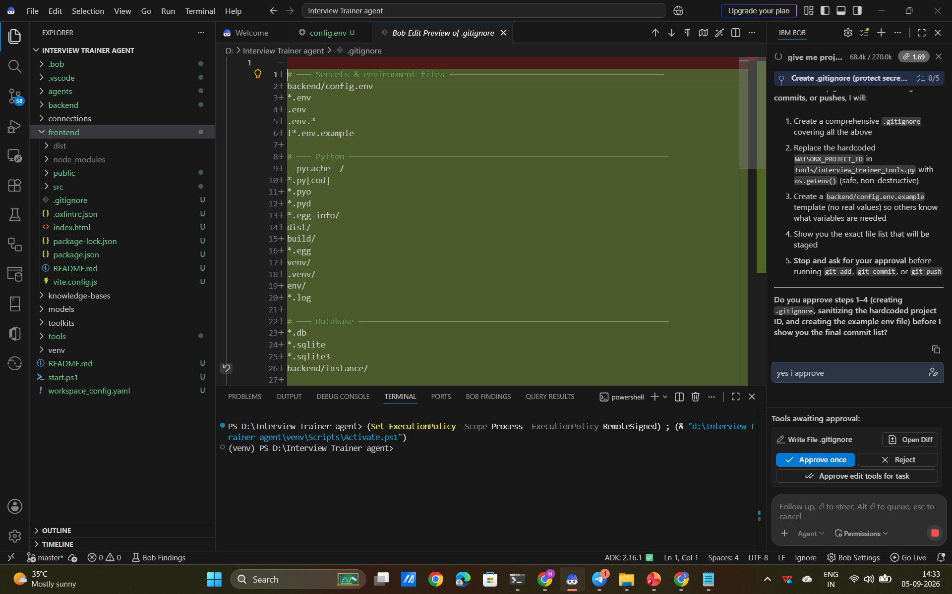
Required Files created using IBM bob -

Slide 8
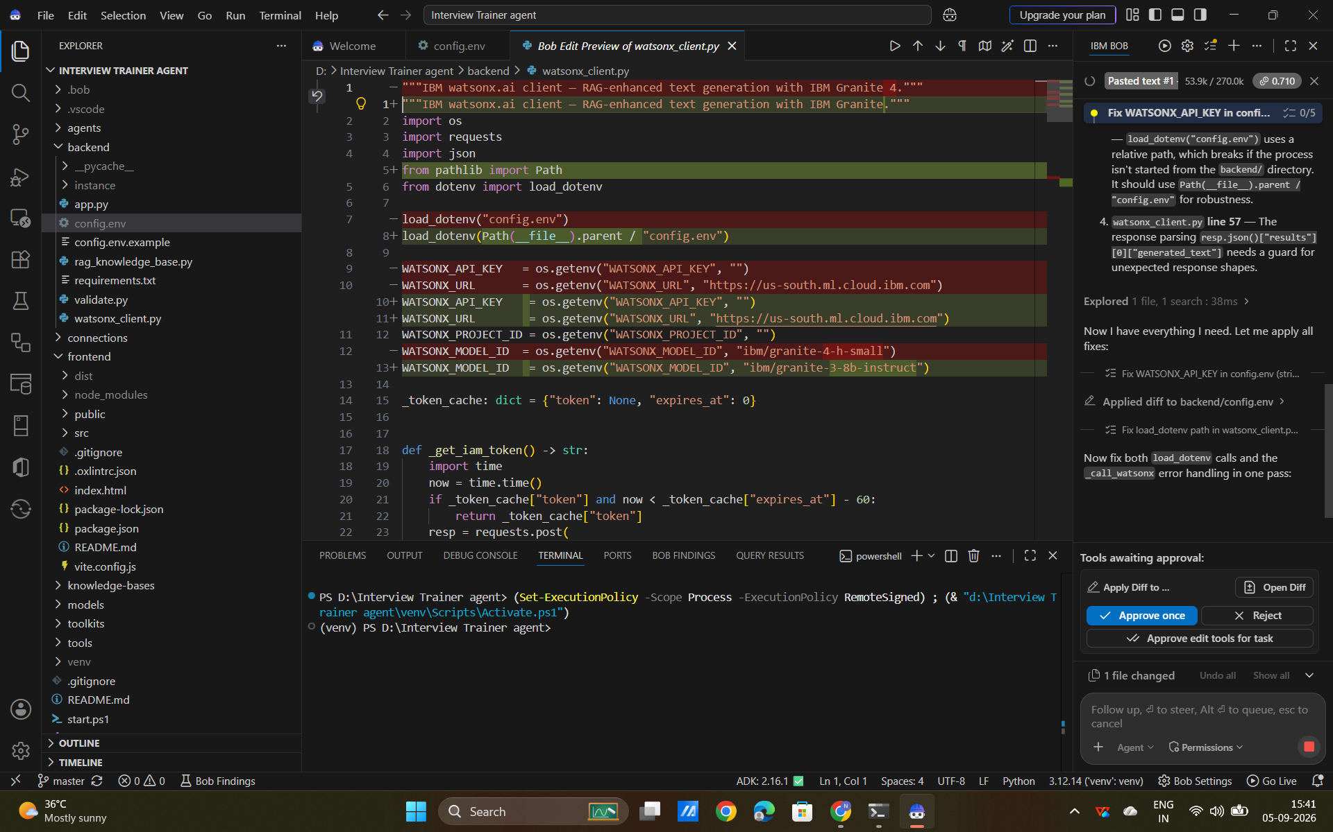
IBM Bob Screenshots:

Slide 9
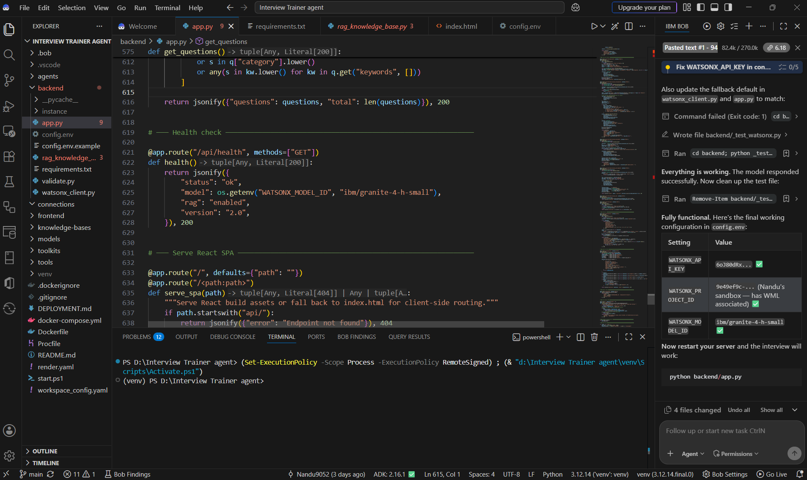

Slide 10
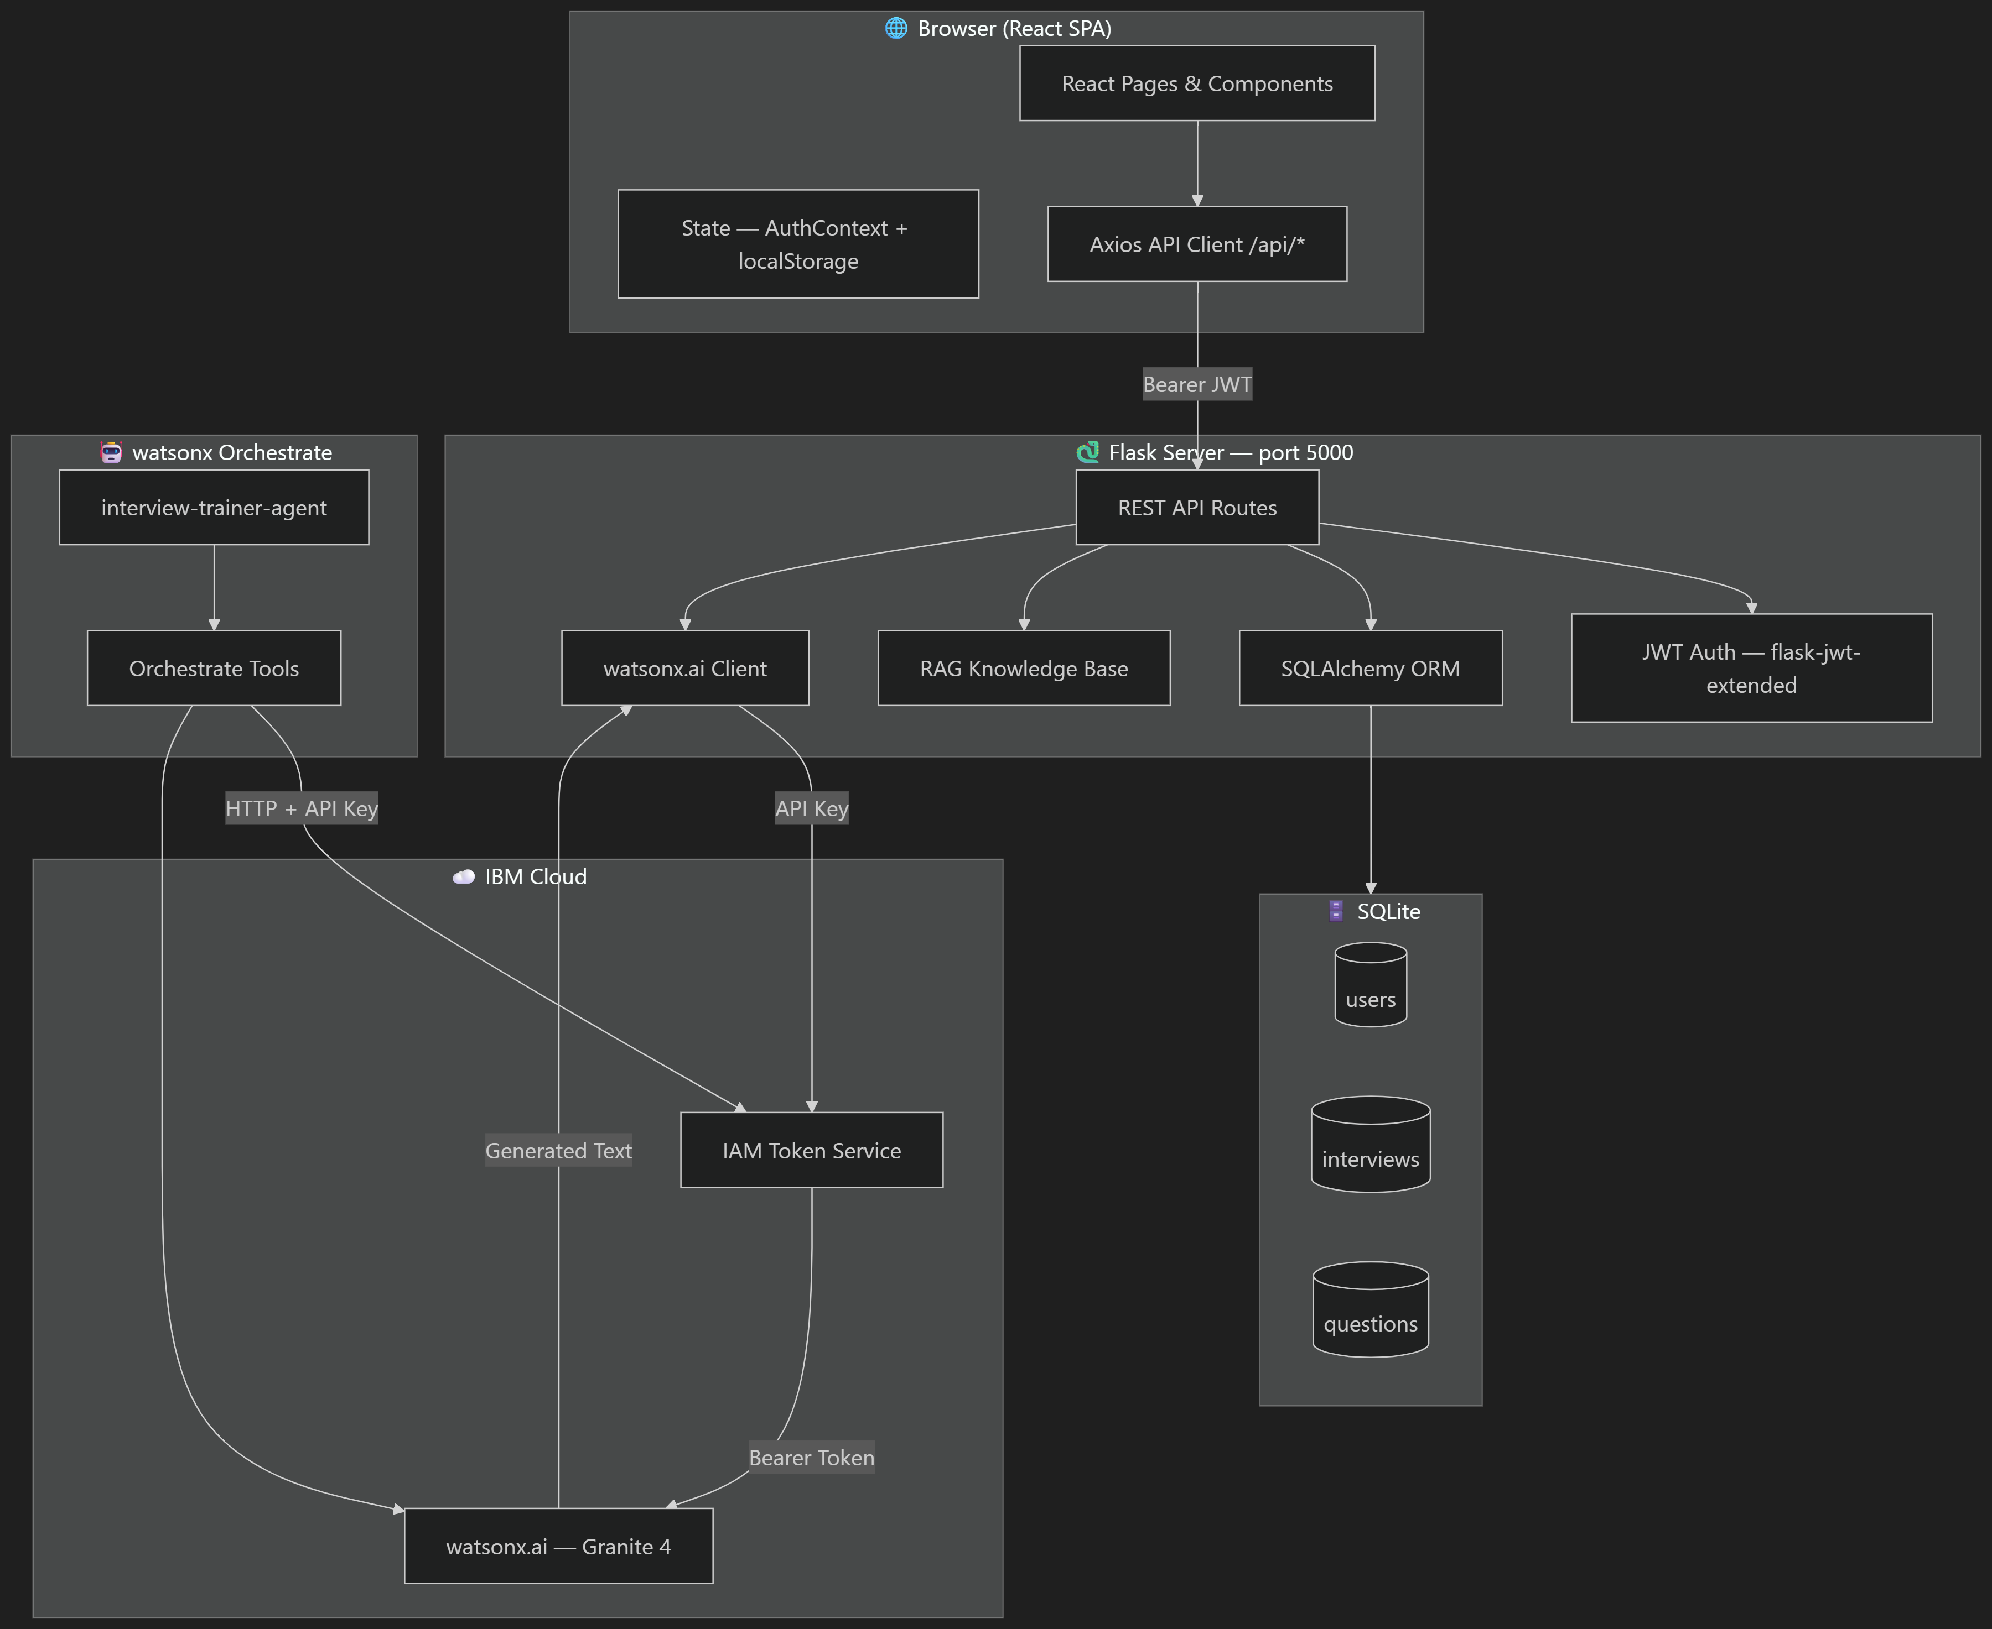
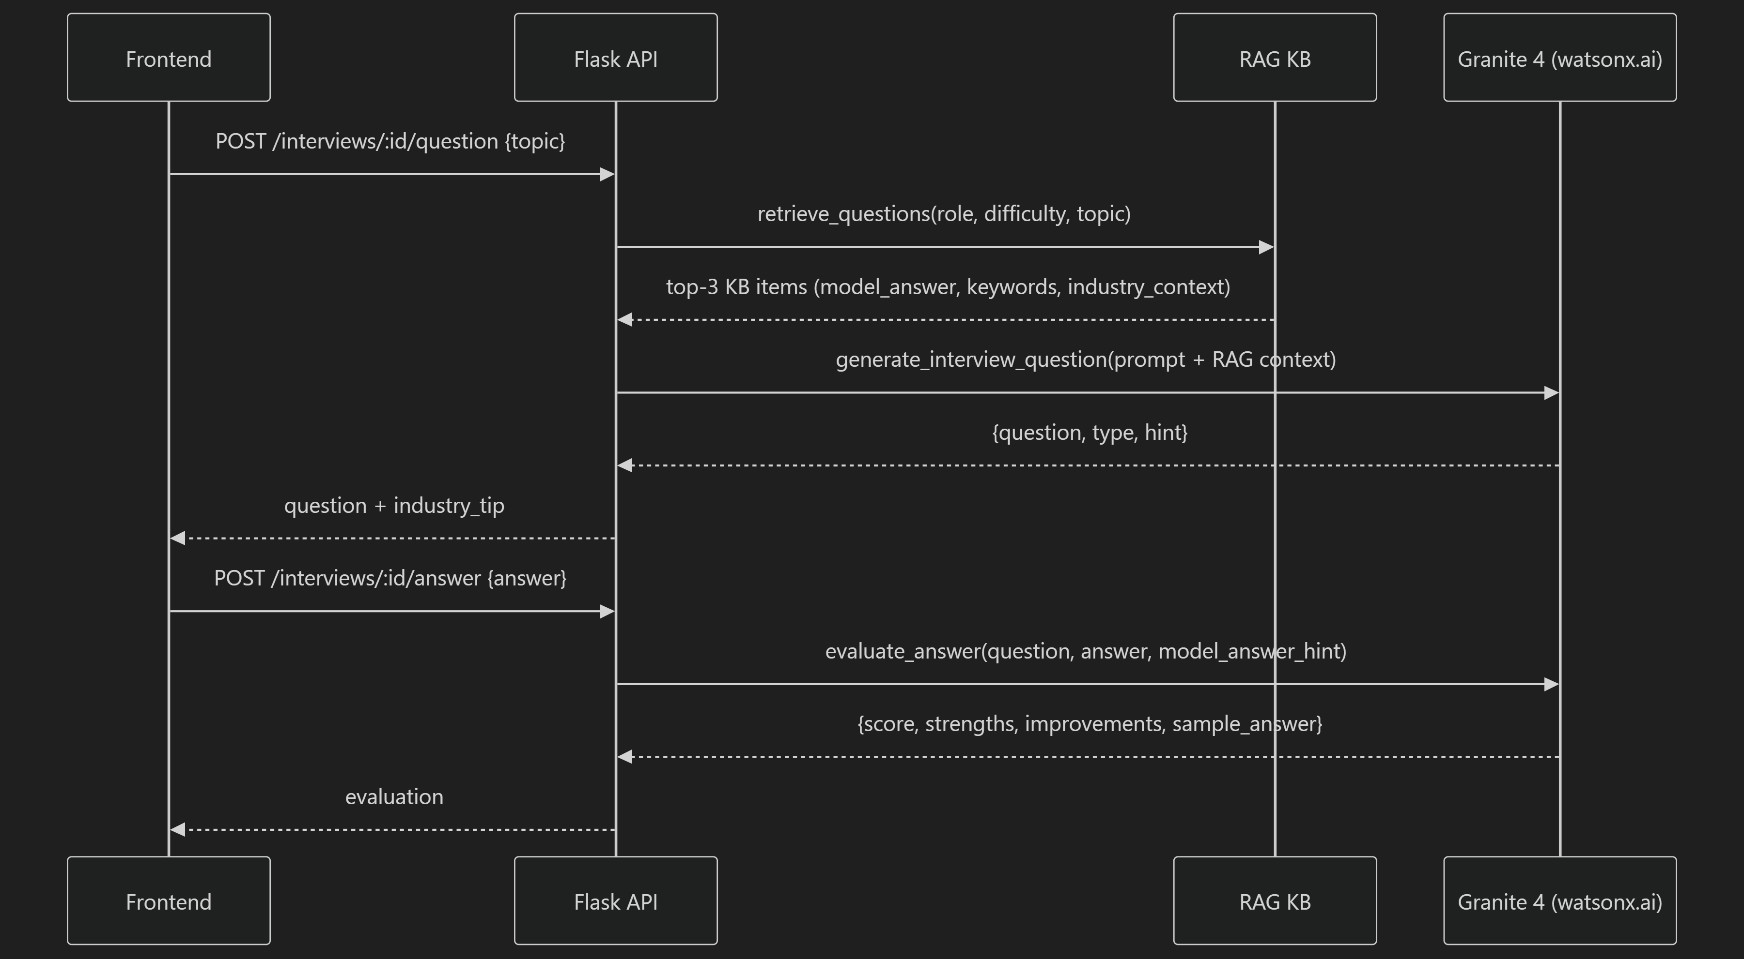
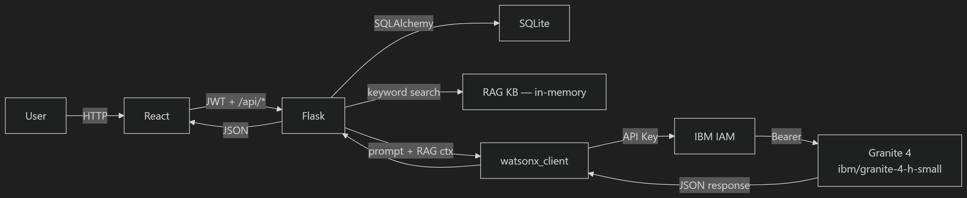
Architecture blueprint for IBM bob:

Slide 11

Role of Agentic AI in the solution
The Role of Agentic AI in the Interview Trainer Agent: Unlike traditional passive chatbots that merely answer isolated questions, Agentic AI acts as an autonomous, proactive interviewer that independently manages the full lifecycle of a mock interview. Powered by IBM Granite 4 and orchestrated via IBM watsonx Orchestrate / Bob, the agentic system autonomously coordinates specialized sub-agents—dynamically generating role-specific questions, retrieving industry rubrics through RAG, executing specialized evaluation tools, and synthesizing comprehensive performance reports. It maintains continuous state and context across multi-turn conversations, dynamically adapting question difficulty to the candidate's performance while rigorously evaluating answers against technical correctness and the behavioral STAR method (Situation, Task, Action, Result). By combining goal-driven decision-making, automated tool calling, and objective multi-criteria scoring, Agentic AI transforms routine interview prep into an intelligent, personalized, and realistic hiring simulation that delivers actionable coaching and measurable skill progression.

Slide 12


Token Usage
11,761 token are used
Before Prompt
After the Prompt
·
·
·

Slide 13
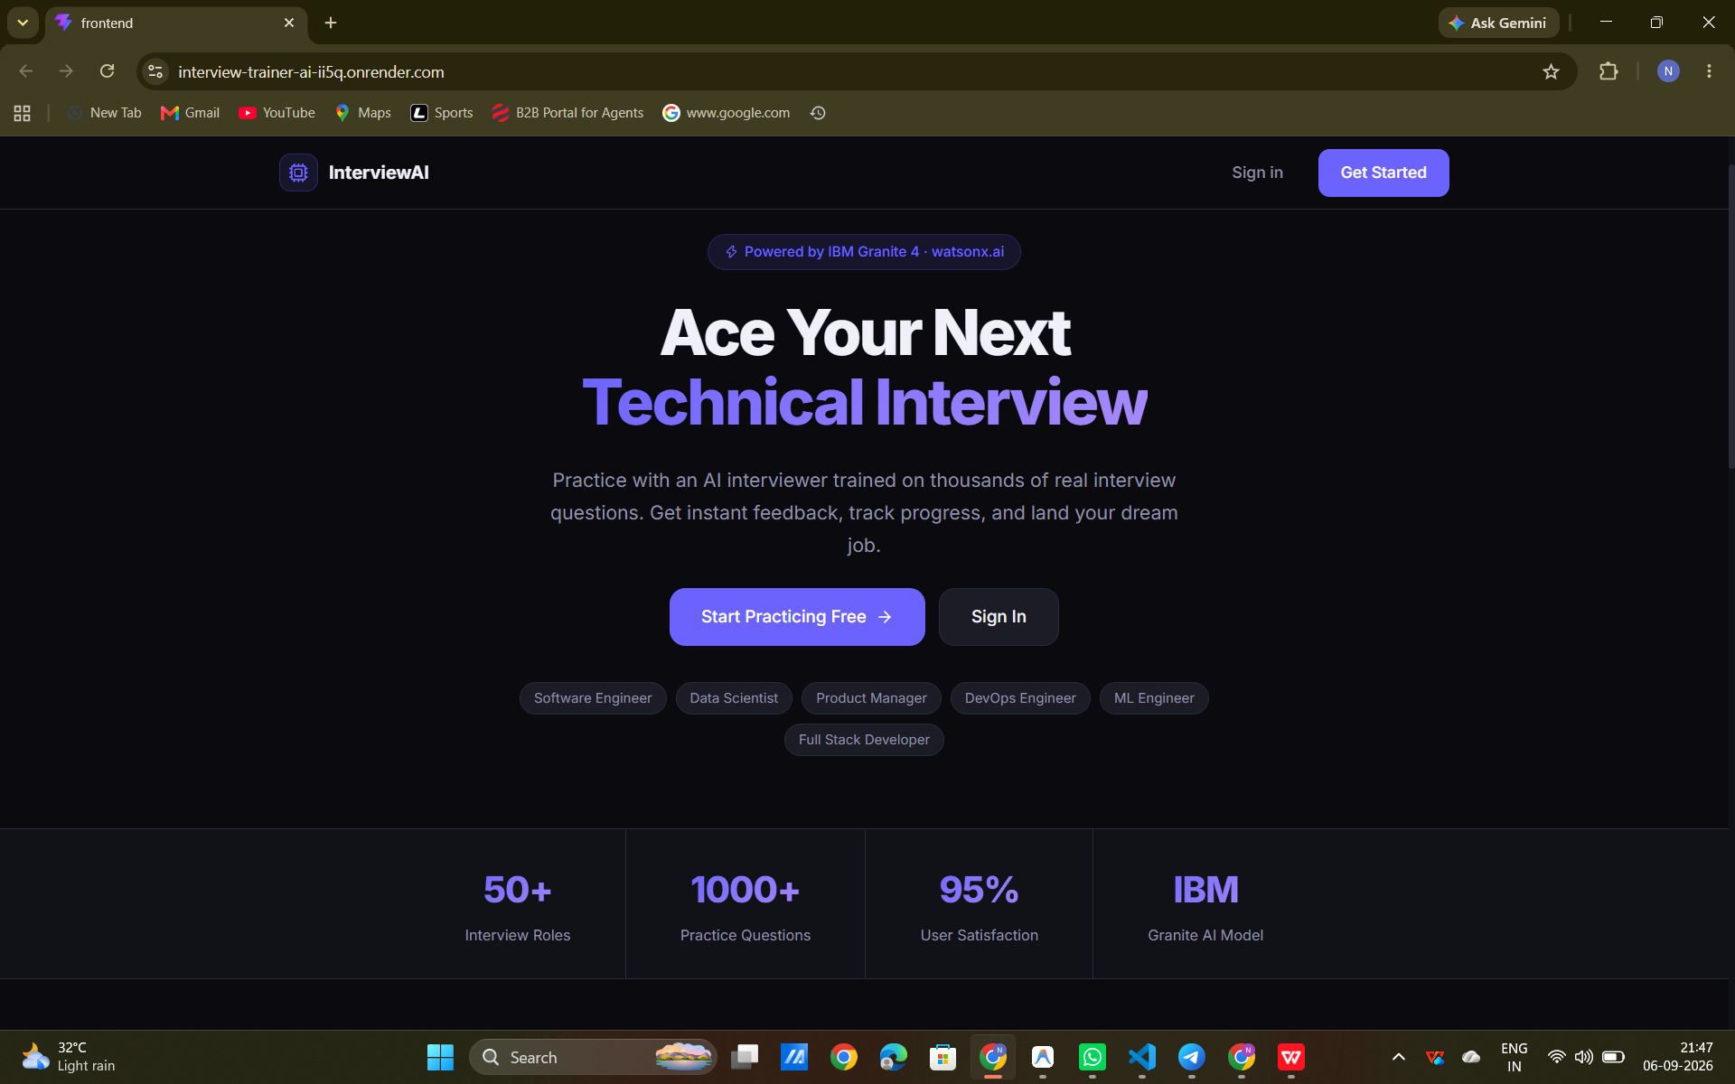
Project Output Screenshot
Please put IBM Bob output screenshots with 2-3 prompts.
You can take 2-3 more slides for each screenshot
·
·
·

Slide 14
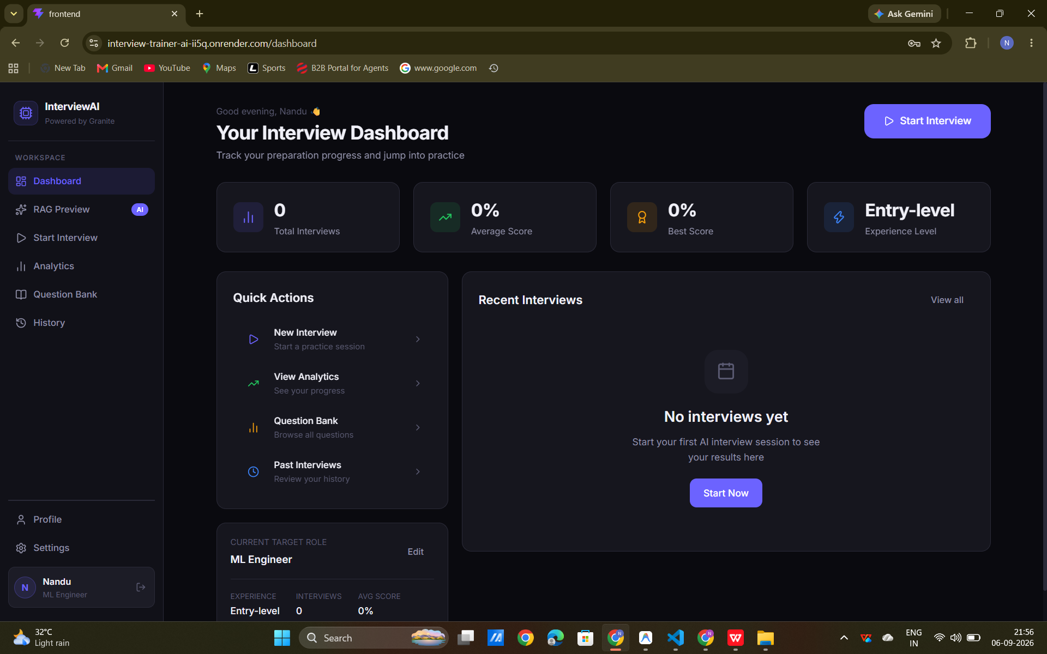
Project Output Screenshot
Please put IBM Bob output screenshots with 2-3 prompts.
You can take 2-3 more slides for each screenshot
·
·
·

Slide 15
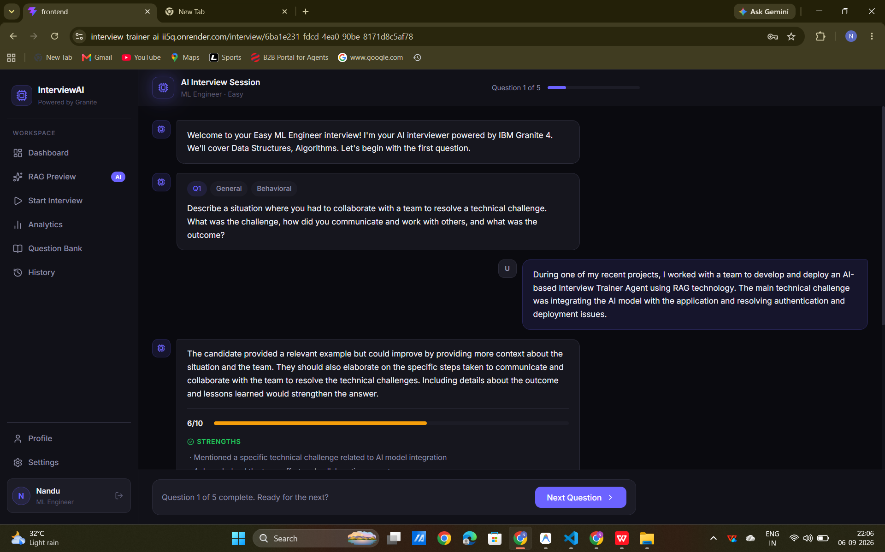
Project Output Screenshot
Please put IBM Bob output screenshots with 2-3 prompts.
You can take 2-3 more slides for each screenshot
·
·
·

Slide 16
Novelty and Uniqueness
The proposed Interview Trainer Agent stands out by combining Agentic AI, RAG, and multi-criteria evaluation into a single intelligent system:
Multi-Agent Intelligence – Instead of a single chatbot, multiple specialized agents (Question Generation, RAG Retrieval, Answer Evaluation, and Performance Coaching) collaborate to deliver structured, context-aware interview simulations.
RAG-Based Accuracy – Integrates a curated technical knowledge base with AI generation, eliminating hallucinations and grounding questions, criteria, and model answers in real-world FAANG and industry hiring rubrics.
Adaptive Personalization – Tailors interview scenarios, topics, and difficulty levels (Easy, Medium, Hard) dynamically based on the candidate's target job role and seniority level.
Dual-Dimension Evaluation – Evaluates both technical architecture/problem-solving depth and behavioral STAR-method compliance (Situation, Task, Action, Result) for complete interview readiness.
Real-Time Feedback Loop – Delivers instant 1–10 scoring, granular critique, and high-quality model answers immediately after each response to accelerate learning.
Multi-Modal Interaction – Supports browser-based speech-to-text voice input alongside text, emulating real verbal interview environments and building speaking confidence under pressure.
360° Diagnostic Analytics – Automatically synthesizes session performance into letter grades (A+, A, B, C), multi-dimensional competency radar charts, strengths/weaknesses matrices, and actionable improvement roadmaps.
Scalable & Enterprise-Ready – Built on IBM watsonx.ai with IBM Granite 4 models (ibm/granite-4-h-small) and IBM watsonx Orchestrate, ensuring high-speed inference, data security, and enterprise AI governance.
This makes the solution a smart, adaptive, and proactive digital interview coach, not just a static question bank or generic chatbot.

Slide 17
Git Hub Link
Github URL :
https://github.com/Nandu9052
Make sure you have Uploaded following three files into your github repository 1) All Agent relevant files of IBM Cloud , 2) yourproblemstatement.pdf file 3) your projectpresntation.pptx file 4)any other files
·
·
·

Slide 18
Future Scope
1. Live Video, Facial & Body Language Analysis : The system can be integrated with computer vision and audio analytics via the user's webcam and microphone to track eye contact, facial expressions, posture, speaking pace, and filler word frequency (e.g., "um", "like"). This will enable the Interview Trainer Agent to provide holistic feedback on executive presence, communication delivery, and confidence under pressure.
2. AI-Powered Voice Assistant & Multilingual Support : Expanding the system with natural bidirectional speech-to-speech conversation and support for multiple international and regional languages will improve global accessibility. Candidates can practice verbal technical interviews in their native or preferred language.
4. Resume & Job Description (JD) Company-Specific Matching : Enabling automated PDF parsing of candidate resumes alongside specific company job descriptions (e.g., Google SWE, Amazon SDE, Meta Product Manager) will allow the agent to generate hyper-personalized interview rounds mirroring the exact hiring rubrics and question patterns of target employers.
·
·
·

Slide 19
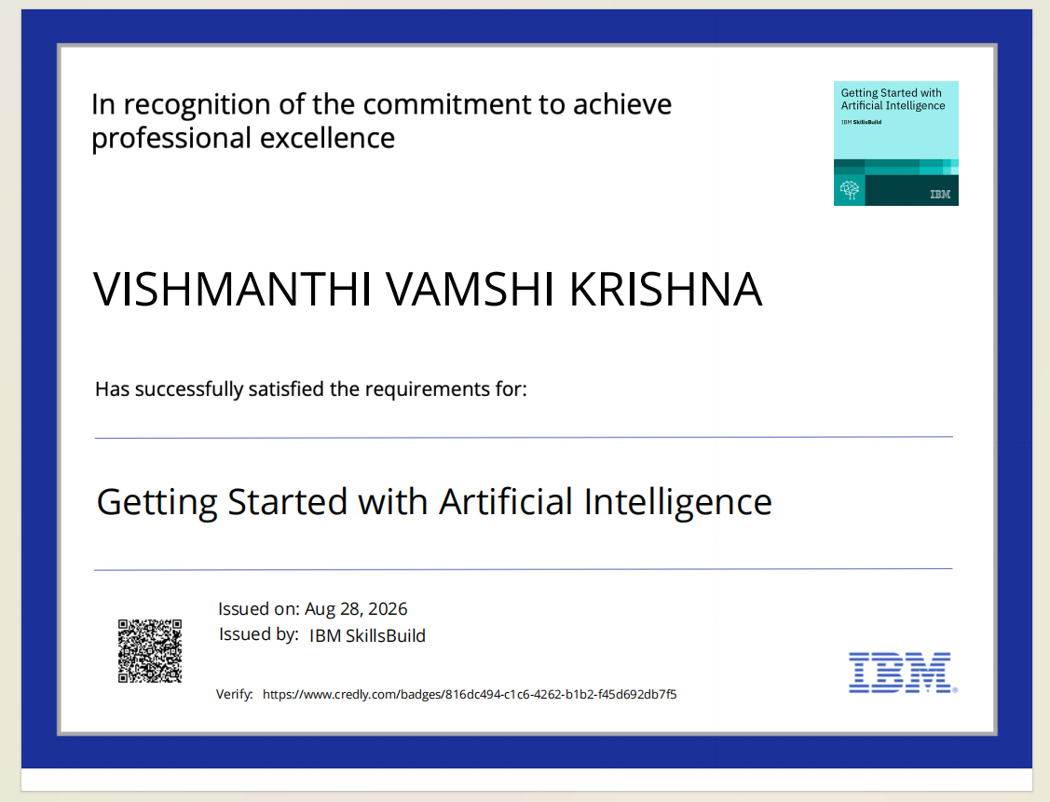
Certificates Earned:
Please add your credly certificate(Getting Started with Artificial Intelligence)

Slide 20
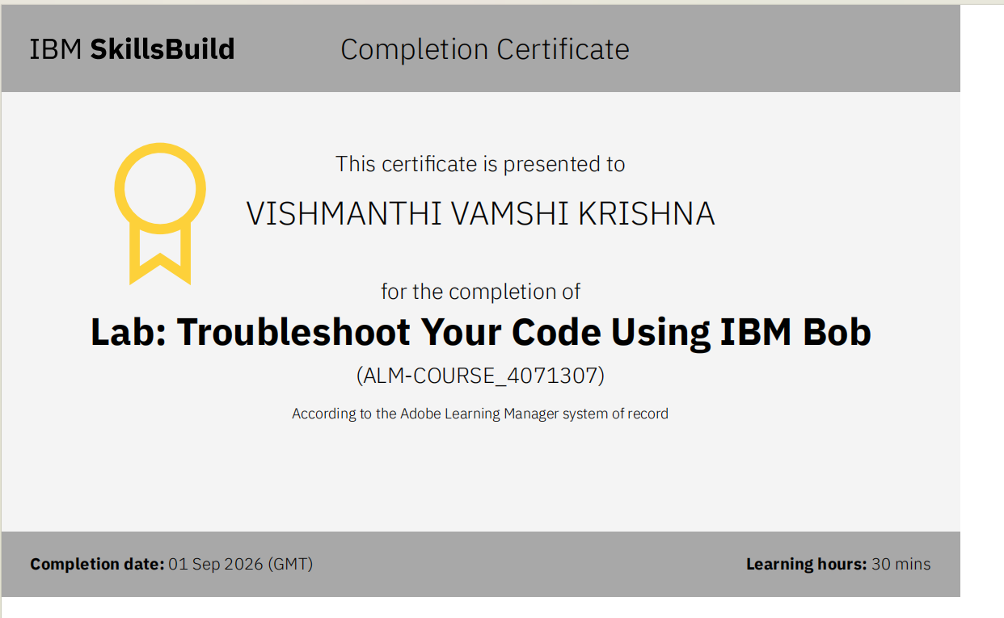
Certificates Earned:​
Add your IBM BOB Certificate

Slide 21


