Slide 1
Insights from Data
Submitted By:
Dara Nanda Gopala Krishna
Jaypee Institute of Information Technology
Enroll.No: 16104056
Phone No: 9643543470
Email: nandudara3105@gmail.com

Slide 2
Data Preprocessing:
There are 10,000 observations and 49 total number of attributes in the given dataset.
The dataset has empty values in it. So all the empty values in the data are replaced by the ‘NA’ values.
The target attribute in the dataset is ‘Good_Bad’ which is replaced by ‘target’ for ease. And also it will be more convenient if it is of numeric type. So further ‘target’ is converted into numerical form and named as ‘Target’ with ‘Good’ and ‘Bad’ changed to ‘2’ and ‘1’ respectively.
The next attribute which requires preprocessing and one hot encoding is ‘LOCATIONNAME’. It has ‘NA’ values and also some numeric values like ‘8’, ‘6’ etc., in some observations. So the observations with these type ambiguity are removed from the dataset. Also this attribute is converted to numeric type and named ‘Location’ for further process.
Another technique of removing ambiguity in dataset is replacing the irrelevant values in the attribute with mean value or most repeating value of that particular attribute.
The above mentioned preprocessing in implemented in ‘Preprocessing.r’ file.

Slide 3
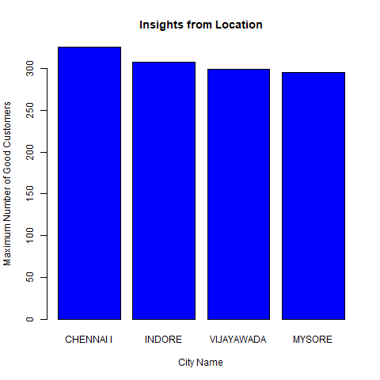
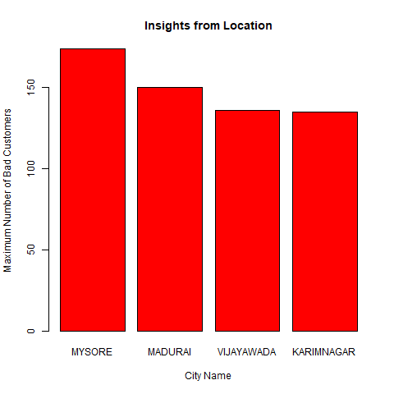
Insights from Location:
The first approach of extracting Insights from Location attribute leads to, city ‘CHENNAI I’ has more good customers with count of ‘326’, city ‘INDORE’ has good customers with count of ‘308’, and so on.
The first approach of extracting Insights from Location attribute leads to, city ‘MYSORE’ has more bad customers with count of ‘174’, city ‘MADURAI’ has bad customers with count of ‘150’, and so on.

Slide 4
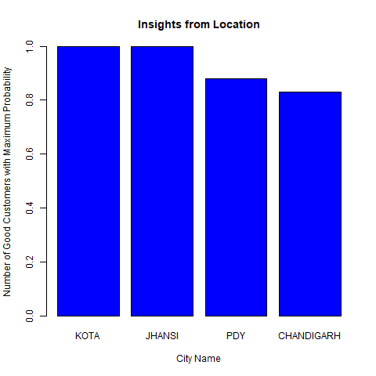
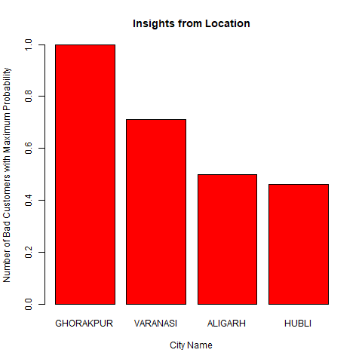
The Second approach of extracting Insights from Location attribute leads to, city ‘KOTA’ has more good customers with maximum probability of ‘1’, city ‘JHANSI’ has good customers with probability of ‘1’, and so on.
The Second approach of extracting Insights from Location attribute leads to, city ‘GHORAKPUR’ has more bad customers with maximum probability of ‘1’, city ‘VARANASI’ has bad customers with probability of ‘0.71’, and so on.

Slide 5
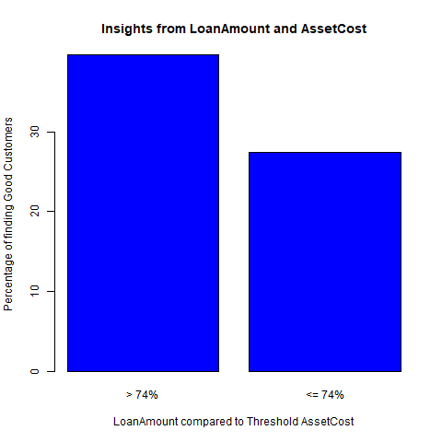
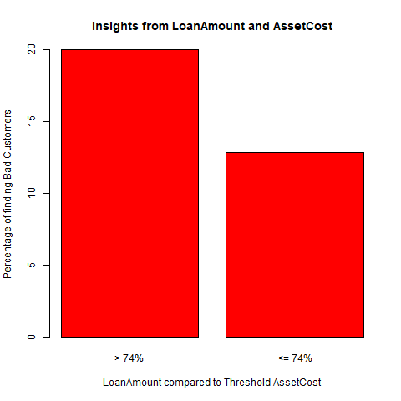
Insights from Loan Amount:
If the loan amount given is greater than 74% of asset cost then number of finding the good customers in this case is 39.71% but If the loan amount given is less than or equal to 74% of asset cost then number of finding the good customers in this case is 27.44%.
If the loan amount given is greater than 74% of asset cost then number of finding the bad customers in this case is 20.02% but If the loan amount given is less than or equal to 74% of asset cost then number of finding the bad customers in this case is 12.83%.

Slide 6
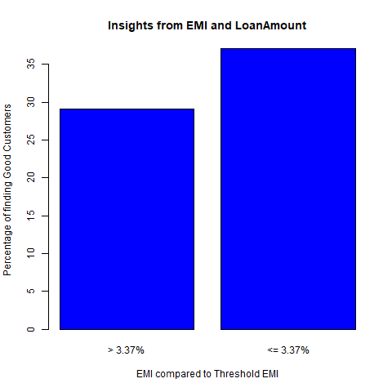
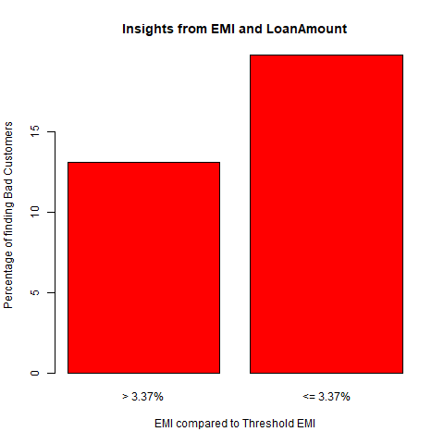
Insights from EMI:
If the loan amount given at EMI greater than 3.37% then the percentage of good customers found is 29.12% but if the loan amount given at EMI is less than or equal to 3.37% then the percentage of good customers found is 37.12%.
If the loan amount given at EMI greater than 3.37% then the percentage of bad customers found is 13.08% but if the loan amount given at EMI is less than or equal to 3.37% then the percentage of bad customers found is 19.77%.

Slide 7
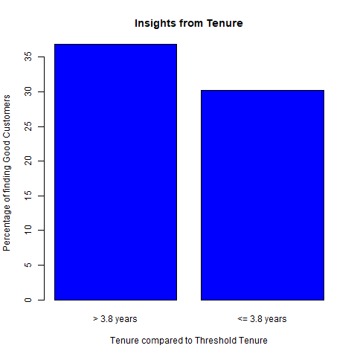
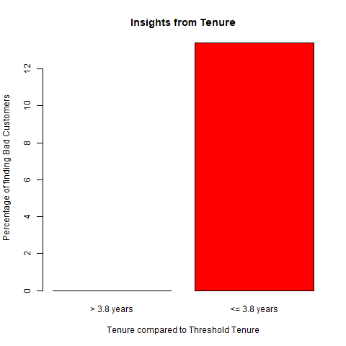
Insights from Tenure:
If the tenure time given is greater than 3.8 years then the percentage of good customers found is 36.92% but if the tenure time given is less than or equal to 3.8 years then the percentage of finding good customers is 30.23%.
If the tenure time given is greater than 3.8 years then the percentage of bad customers found is 0% but if the tenure time given is less than or equal to 3.8 years then the percentage of finding bad customers is 13.43%.

Slide 8
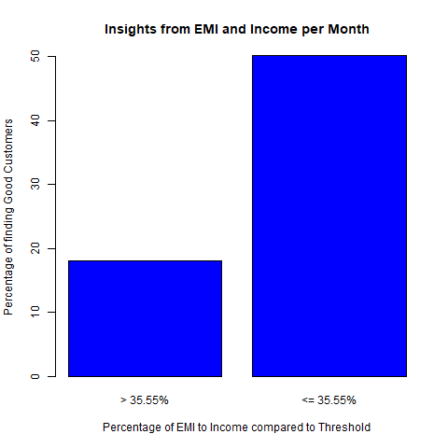
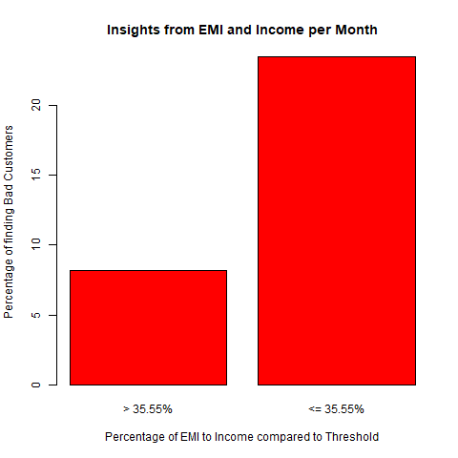
Insights from Income:
If the interest given by person having monthly income greater than 35.55% then percentage of good customers found is 18.1% and if the interest given by person having monthly income less than or equal to 35.55% then percentage of good customers is 50.21%.
If the interest given by person having monthly income greater than 35.55% then percentage of bad customers found is 8.15% and if the interest given by person having monthly income less than or equal to 35.55% then percentage of bad customers is 23.54%.

Slide 9
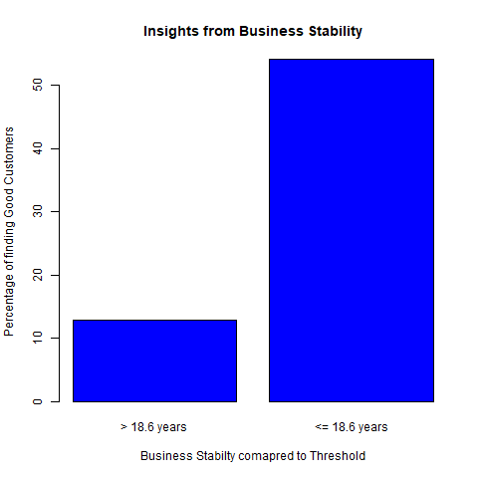
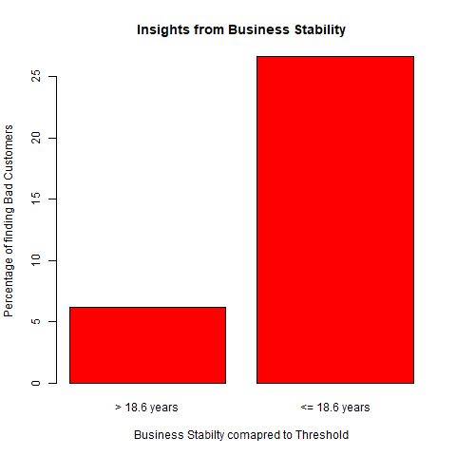
Insights from Business Stability:
If the current stability in business is greater than 18.6 years then percentage of good customers found is 12.89% but If the current stability in business is less than or equal to 18.6 years then percentage of good customers found is 54.21%.
If the current stability in business is greater than 18.6 years then percentage of bad customers found is 6.21% but If the current stability in business is less than or equal to 18.6 years then percentage of bad customers found is 26.69%.

Slide 10
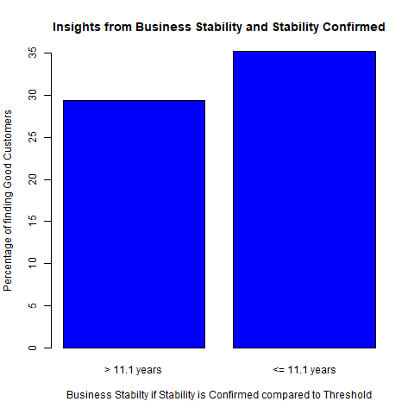
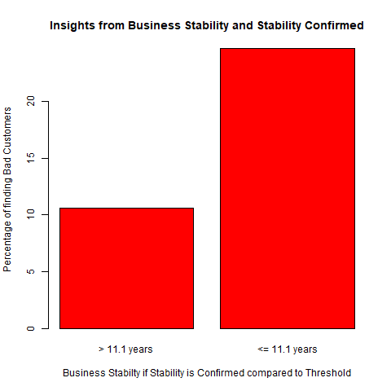
If the stability is confirmed and current stability in business is greater than 11.1 years then percentage of good customers found is 29.41% but if the stability is confirmed and current stability in business is less than or equal to 11.1 years then percentage of good customers found is 35.29%.
If the stability is confirmed and current stability in business is greater than 11.1 years then percentage of good customers found is 10.59% but if the stability is confirmed and current stability in business is less than or equal to 11.1 years then percentage of good customers found is 24.71%.

Slide 11
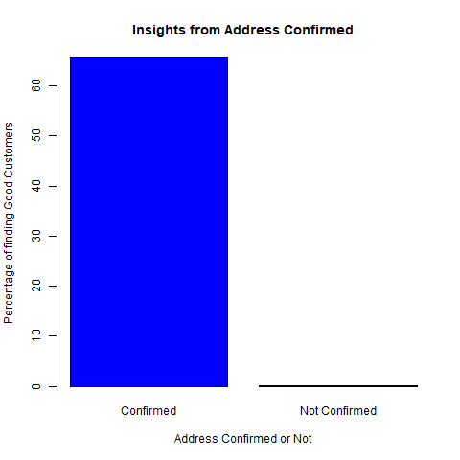
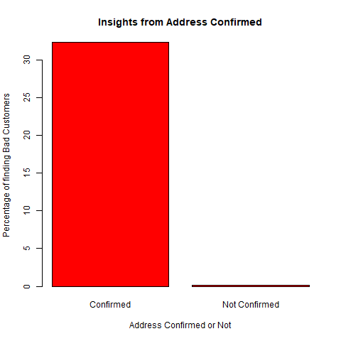
Insights from Address Confirmed:
If the address is confirmed then percentage of good customers found is 65.86% but if the address is not confirmed then the percentage of good customers found is 0.21%.
If the address is confirmed then percentage of bad customers found is 32.37% but if the address is not confirmed then the percentage of bas customers found is 0.11%.

Slide 12
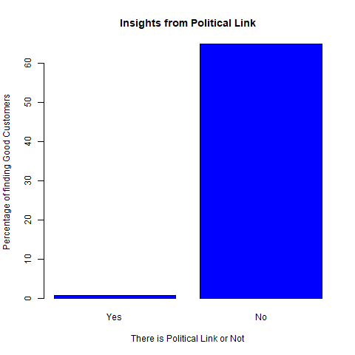
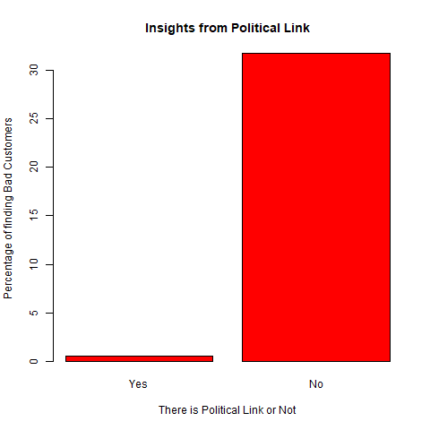
Insights from Political Link:
If there is political link then percentage of good customers found is 0.71% but if there is no political link then the percentage of good customers found is 64.91%.
If there is political link then percentage of bad customers found is 0.56% but if there is no political link then the percentage of bad customers found is 31.83%.

Slide 13
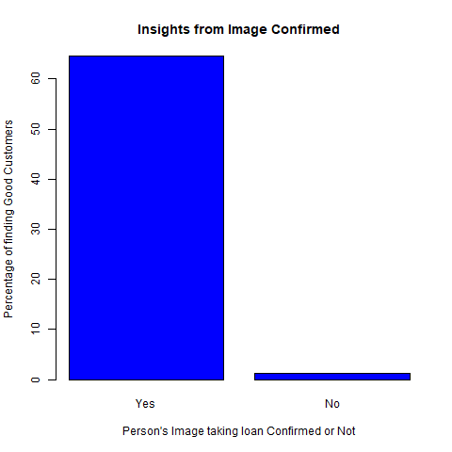
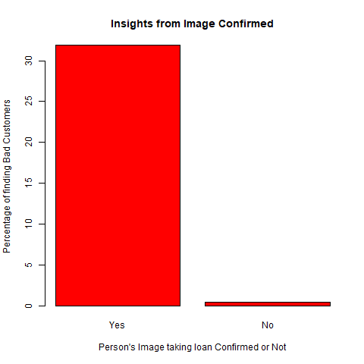
Insights from Image Confirmed:
If the image of person taking loan is confirmed then percentage of good customers found is 64.67% but if the image of person taking loan is not confirmed then percentage of good customers found is 1.31%.
If the image of person taking loan is confirmed then percentage of bad customers found is 31.95% but if the image of person taking loan is not confirmed then percentage of bad customers found is 0.45%.

