Slide 1
FAILED BANKING TRANSACTION ANALYSIS
Presented By : E. Nandi Vardhan Reddy

Slide 2
Project Overview
This project aims to analyze failed banking transactions across multiple cities and branches.
The analysis pipeline involves data ingestion from multiple CSV files, data cleaning, processing using PySpark, and visualization using GCP services.

Slide 3
Data Ingestion
Daily transaction CSVs are collected from 3 cities (5 branches each)
Each file contains 7 days of transaction data
Files are uploaded to a GCS bucket using gsutil
Uniform naming convention ensures traceability

Slide 4
Data Processing with PySpark
Dataproc single-node cluster is used for distributed processing
All CSV files are read into PySpark DataFrames
Null and blank rows are removed
Cleaned data is merged into one unified CSV file

Slide 5
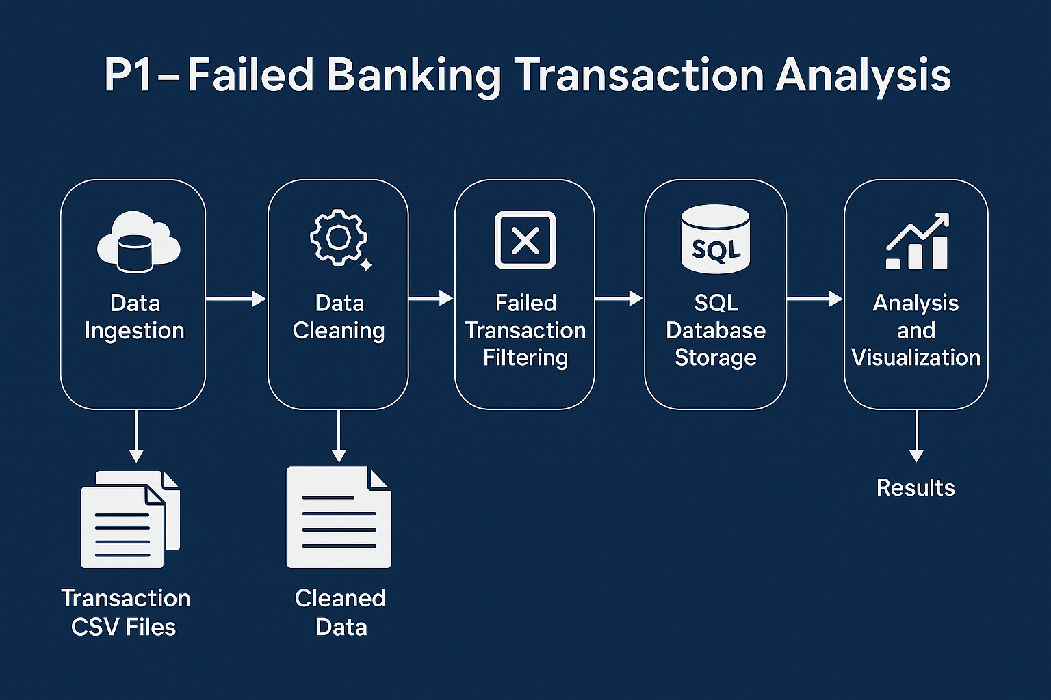
Flow Chart

Slide 6
Filtering Failed Transactions
The unified CSV is analyzed to filter only failed transactions
Criteria: Status column indicating 'FAILED' or similar markers
Resulting DataFrame is stored into a Cloud SQL (MySQL) table for further processing.

Slide 7
Cloud SQL Integration
A Cloud SQL (MySQL) instance hosts a table for failed transactions
Data is written using PySpark JDBC connector
Table schema is optimized for analytics (indexes, types, etc.)

Slide 8
Visualization Using BigQuery
Cloud SQL table is federated with BigQuery
Analysts use BigQuery to run SQL queries
Dashboards are created for failure trends, branch comparison, etc.
Potential to integrate with Looker Studio

Slide 9
Challenges and Solutions
Challenge: Handling large files – Solution: PySpark parallelism
Challenge: Data consistency – Solution: Pre-ingestion validation
Challenge: GCP cost control – Solution: Scheduled Dataproc jobs

Slide 10
Conclusion
Successfully created a scalable pipeline for banking transaction analysis
Enabled tracking of failure patterns per branch and city
Future Scope: Fraud detection using ML models, alerting systems, anomaly detection

