Slide 1
House Price Prediction Model
Data Science EL Project
Nabendu Das
1RV22MC053
Ashish Garg
1RV22MC016

Slide 2
Topics
Problem definition
Description of the dataset
Requirement analysis
Literature Survey
Proposed solution

Slide 3
House Price Prediction
Problem Statement
Need to predict the price of houses, flat room or any other real estate.
Prediction through different parameters through a house, building or area.

Slide 4
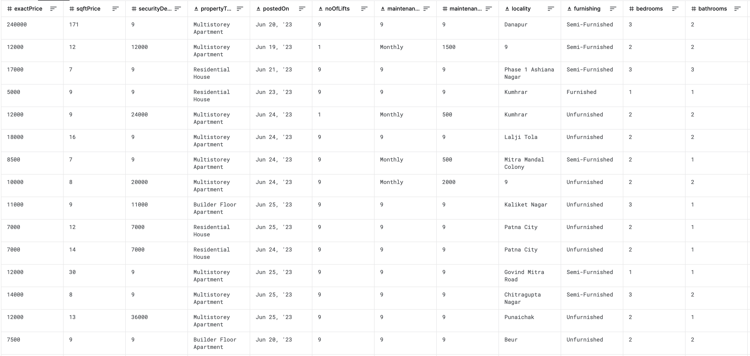
Dataset Description
House Prices Data in India 2023

Slide 5



01 Cleaning Data & Analysis
02 Building Supervised Learning Model
Clean the data based on useful parameters and clean the records for more accurate data analysis and analysis different graphs
Since the data has highly corr-related parameters, so planning for linear regression model
03 Deploy Model on a Real Estate Website
After building the model, deploy the model on a real estate price calculating website.

Slide 6
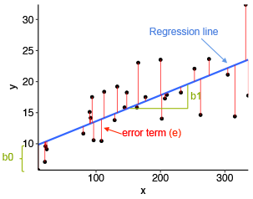
About Linear Regression Solution
Finding the best parameters for prediction the price and make a regression classification based on the parameters
In the deployed website, user can find the price of the house or area based on the model.

Slide 7
Thank You

