Slide 1

BOTNET DETECTION
STOP.THINK.CONNECT

Slide 2

Detecting and Mitigating Botnet Attacks in Software-Defined Networks Using Deep Learning Techniques
PRESENTED BY:
CHERUPALLI NANESH
GUIDED BY:
Mr. CH. G.V.N PRASAD
(H.O.D)

Slide 3
ABSTRACT
Software-Defined Networking (SDN) is an emerging architecture that enables flexible and easy management and communication of large-scale networks. It offers programmable and centralized interfaces for making complex network decisions dynamically and seamlessly. However, SDN provides opportunities for businesses and individuals to build network applications based on their demands and improve their services. In contrast, it started to face a new array of security and privacy challenges and simultaneously introduced the threats of a single point of failure. Usually, attackers launch malicious attacks such as botnets and Distributed Denial of Service (DDoS) to the controller through Open Flow switches. Deep learning (DL)-based security applications are trending, effectively detecting and mitigating potential threats with fast response. In this article, we analyze and show the performance of the DL methods to detect botnet-based DDoS attacks in an SDN-supported environment. A newly self-generated dataset is used for the evaluation.

Slide 4
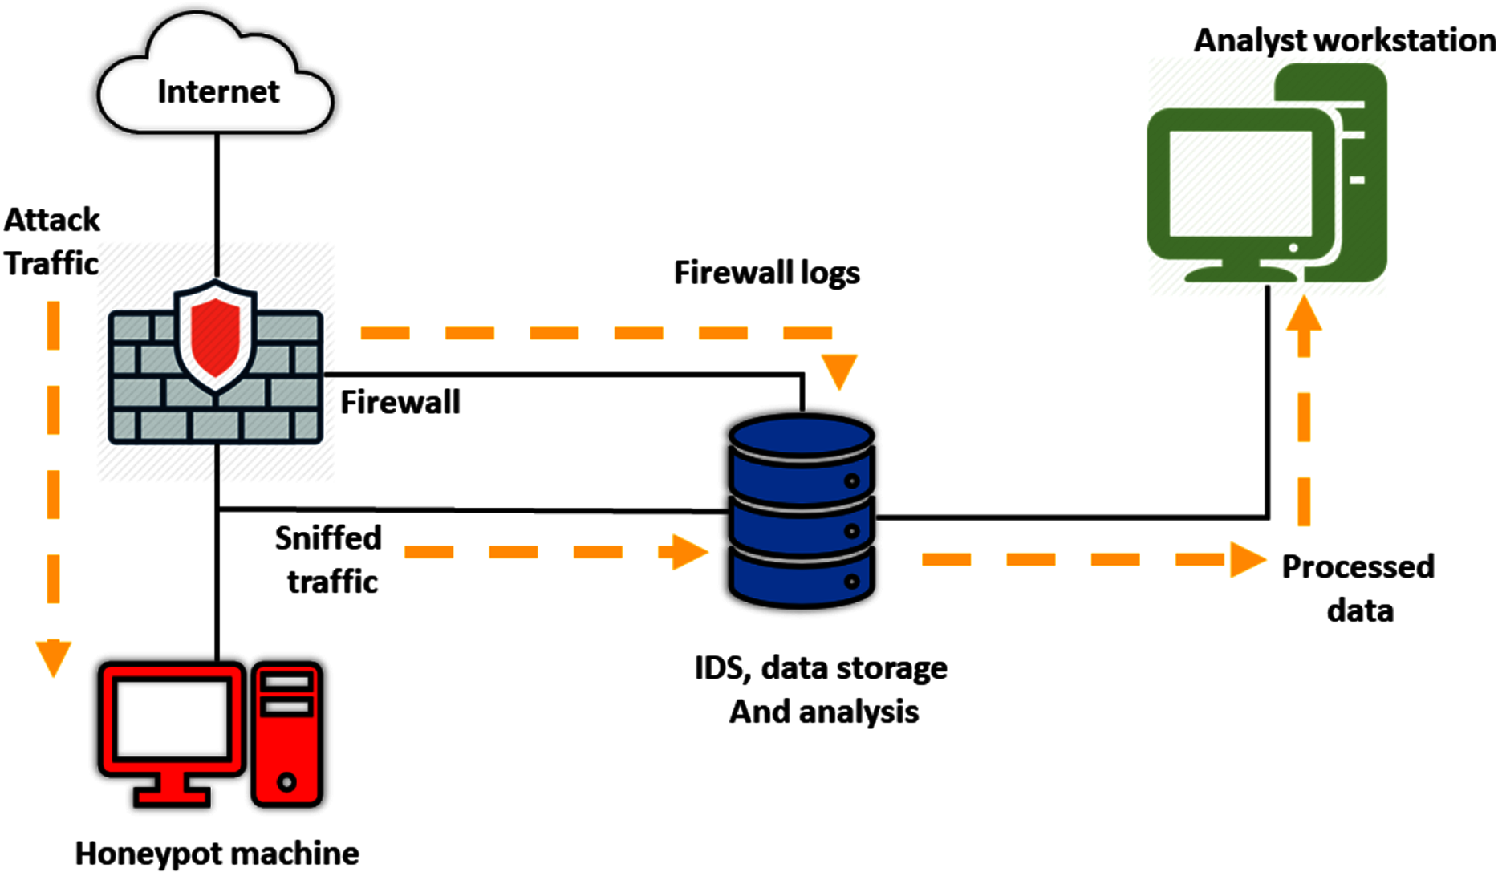
INTRODUCTION
Botnets are networks of compromised devices that can be controlled remotely to perform coordinated attacks. The rise of IoT devices has exacerbated this issue, making traditional detection methods inadequate.
Key Objectives:
To analyze network traffic and detect anomalies indicative of botnet activity.
To implement deep learning models that can learn from historical data and adapt to new threats.
To develop mitigation strategies that can be deployed in real-time to counteract detected threats.

Slide 5

SYSTEM ANALYSIS
EXISTING SYSTEM:
Various machine learning (ML) and deep learning (DL) methods used for detecting botnet and DDoS attacks, particularly in IoT environments. Researchers have explored different hybrid approaches to improve detection accuracy, reduce processing time, and optimize feature selection. Techniques include combining ML/DL algorithms like CNN, RNN, SVM, and optimization methods (e.g., Grey Wolf, Particle Swarm) to enhance botnet and DDoS attack detection. Notable contributions involve feature extraction, dimensionality reduction, and hyperparameter optimization to minimize false positives and speed up detection. These methods show promise in distinguishing normal from malicious traffic, even in complex IoT ecosystems.
In this method, the dual address entropy is first used to extract the features from the flow table, and then SVM classifies the traffic as normal or attack. This method helps to detect the attack at the preliminary stage and restore the usual communication in time

Slide 6
EXISTING SYSTEM:
Current botnet detection systems in SDNs primarily rely on traditional methods such as:
Signature-Based Detection: This approach uses predefined signatures of known threats, which limits its effectiveness against new or evolving botnets.
Anomaly Detection: While some systems utilize statistical methods to identify deviations from normal traffic patterns, they often struggle with high false positive rates and may not adapt quickly to new attack vectors
DISADVANTAGES:
The complexity of data: Most of the existing machine learning models must be able to accurately interpret large and complex datasets to detect Botnet Attacks.
Data availability: Most machine learning models require large amounts of data to create accurate predictions. If data is unavailable in sufficient quantities, then model accuracy may suffer.
Incorrect labeling: The existing machine learning models are only as accurate as the data trained using the input dataset. If the data has been incorrectly labeled, the model cannot make accurate predictions.

Slide 7
SYSTEM ANALYSIS
PROPOSED SYSTEM:
The proposed work aims to conduct a comparative study on deep learning methods with optimized feature selection from network traffic flow to detect the botnet-based DDoS attack in an SDN environment. The selection of optimal features can improve DL methods’ detection performance and accuracy and can help to reduce the SDN controller’s overhead.
As we know, botnet attacks can hijack the controller and launch malicious activities. So, DL-based techniques and dedicated bot management are optimal solutions for SDN to deal with botnet traffic. The progressive development in security measures of SDN has motivated us to develop a DL method named ‘‘DepBot’’ to detect and mitigate botnet-based DDoS.

Slide 8
PROPOSED SYSTEM:
ADVANTAGES:
Optimal Features: Identifying and compressing critical features from network traffic to enhance detection performance.
Factor Analysis: Using feature weighting and threshold techniques to create five subsets of optimal features.
DL Methods: Evaluation of five DL methods—RNN, CNN, MLP, LSTM, and DNN—commonly used in network intrusion detection, leveraging time-series approaches.
Performance Evaluation: The methods are tested using accuracy, precision, detection rate, and F1-score, with good results on a specific feature subset.
Mitigation: A flow deletion strategy using graph theory helps mitigate the detected attacks.

Slide 9

System requirements
Functional Requirements:
Data Collection
Anomaly Detection
Response Mechanism
User Interface
Reporting

Slide 10
System requirements Non-Functional Requirements:
SOFTWARE REQUIREMENTS:-
Operating system : Windows 7 Ultimate.
Coding Language : Python.
Front-End : Python.
Back-End : Django-ORM
Designing : Html, CSS, JavaScript.
Data Base : MySQL (WAMP Server).
HARDWARE REQUIREMENTS:-
Processor : Pentium –IV
RAM : 4 GB (min)
Hard Disk : 20 GB
Key Board : Standard Windows Keyboard
Mouse : Two or Three Button Mouse
Monitor : SVGA

Slide 11
IMPLEMENTATION
The implementation phase involves several critical steps:
Data Collection:
Gather network traffic data from various sources, including benign and malicious traffic.
Utilize public datasets like CTU-13 for training deep learning models.
Model Selection:
Experiment with various deep learning architectures such as CNNs and LSTMs to determine the most effective model for botnet detection.
Training and Evaluation:
Train models on labeled datasets, optimizing for metrics such as accuracy, precision, recall, and F1-score.
Conduct cross-validation to ensure model robustness.
Deployment:
Integrate the trained model into the SDN controller for real-time traffic analysis and anomaly detection.

Slide 12

System architecture
Operations
User
Application
MODULES
User- User, will execute the project and perform all the operations

Slide 13
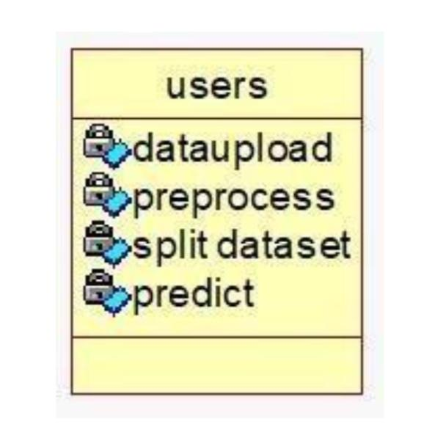
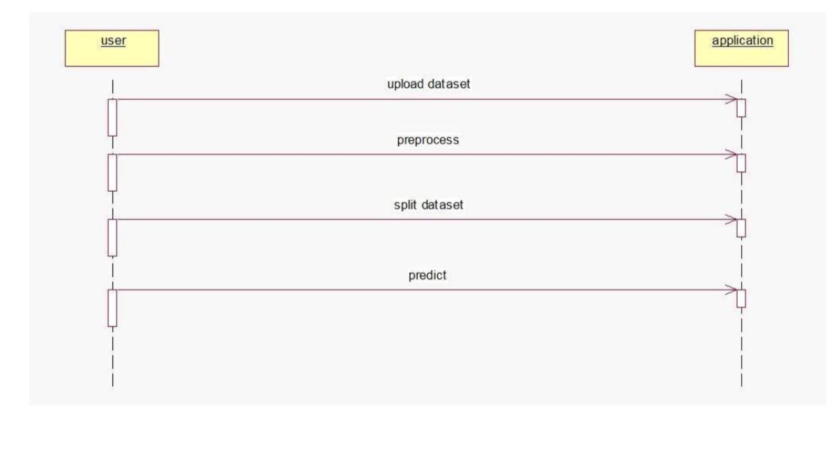
UML DIAGRAMS
CLASS DIAGRAM
SEQUENCE DIAGRAM

Slide 14
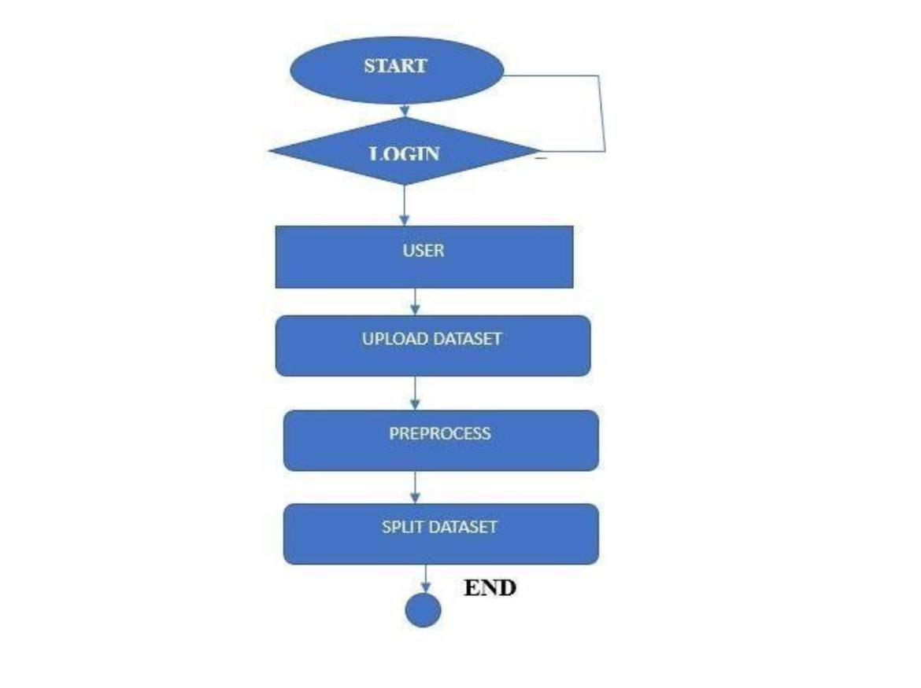
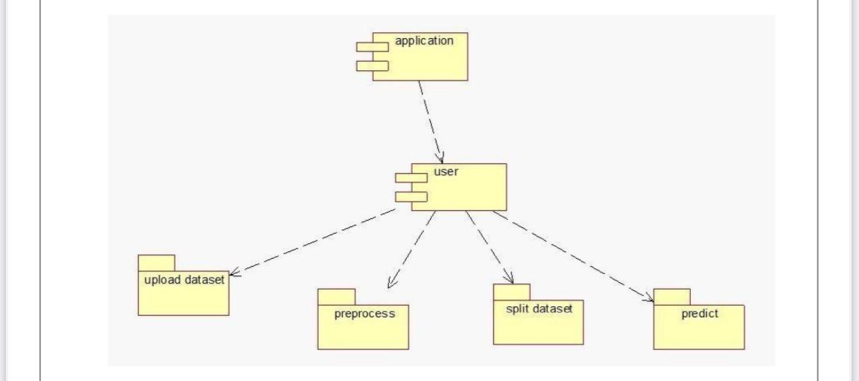
ACTIVITY DIAGRAM:
COMPONENT DIAGRAM:

Slide 15
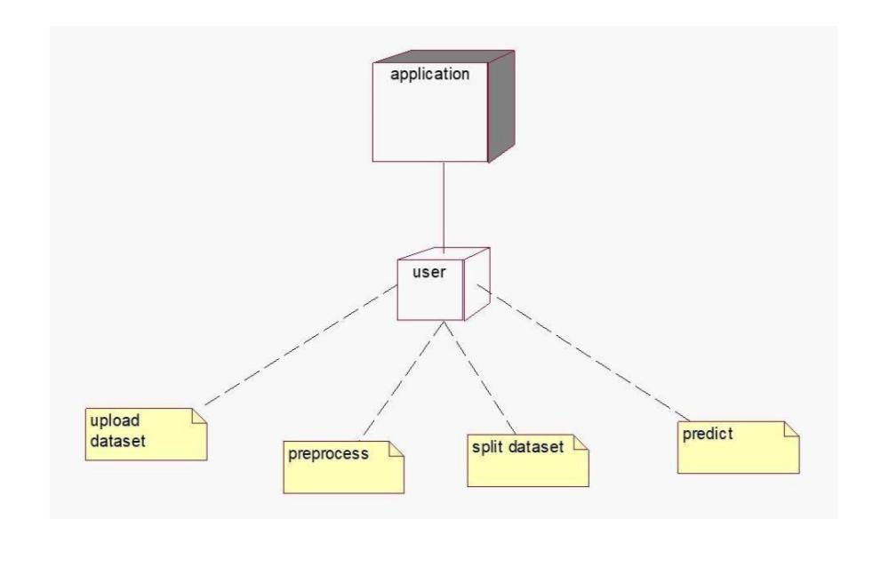
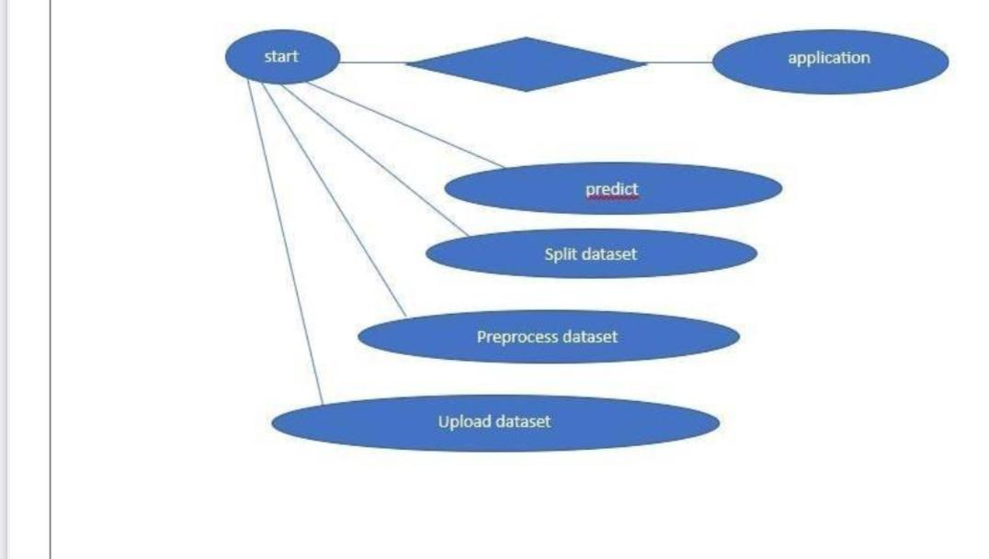
DEPLOYMENT DIAGRAM:
ER DIAGRAM:

Slide 16
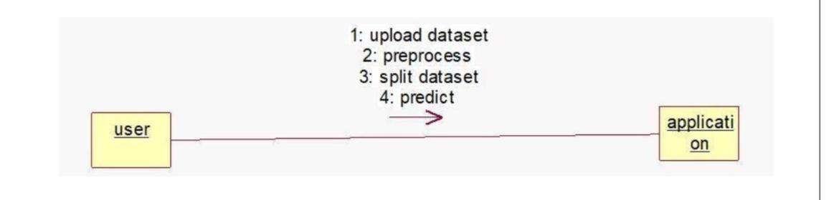
COLLABORATION DIAGRAM:

Slide 17
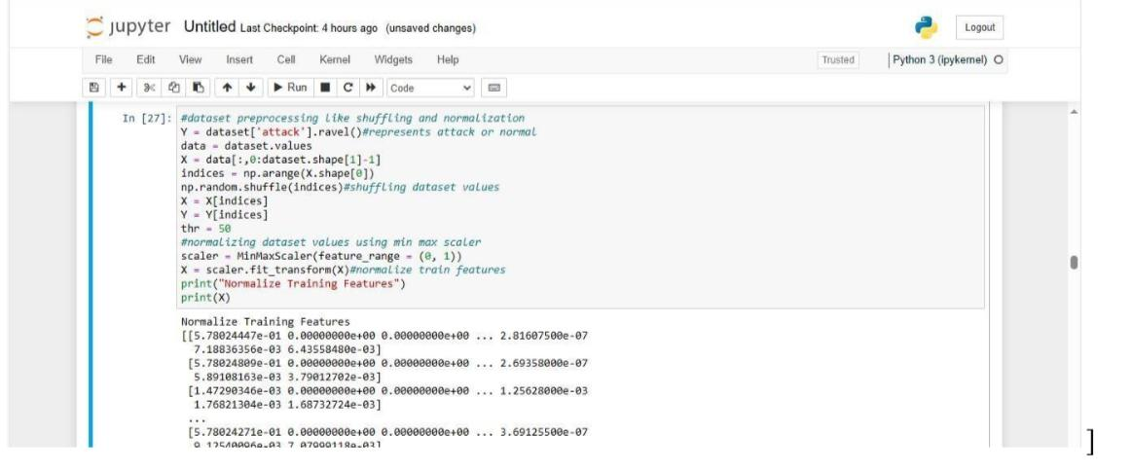
INPUT AND OUTPUT SCREENSHOTS:

Slide 18
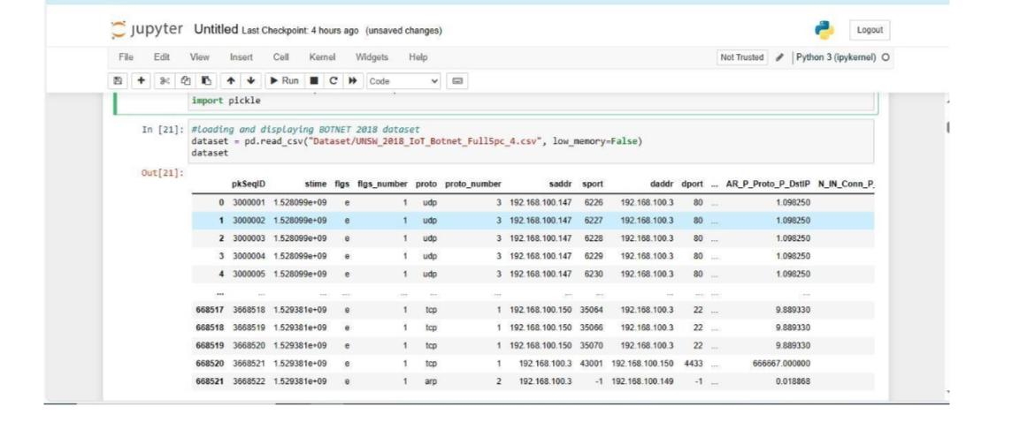

Slide 19
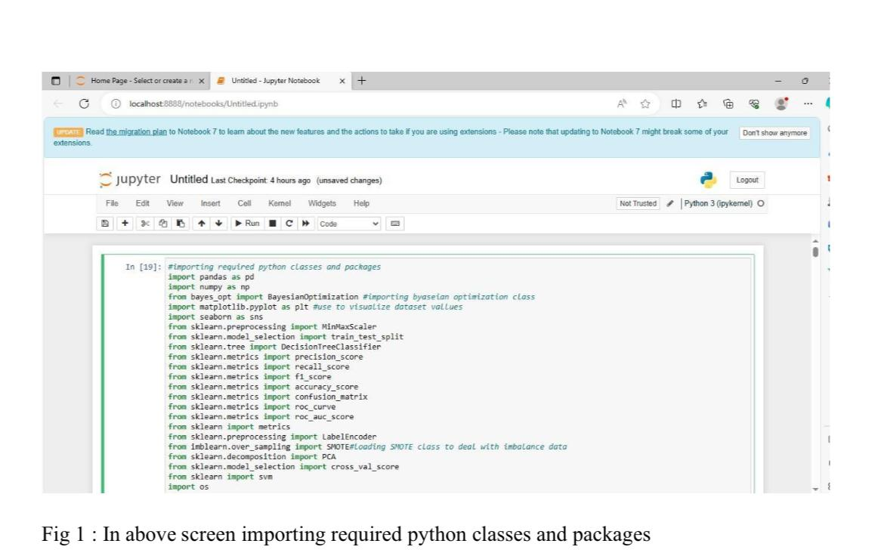

Slide 20
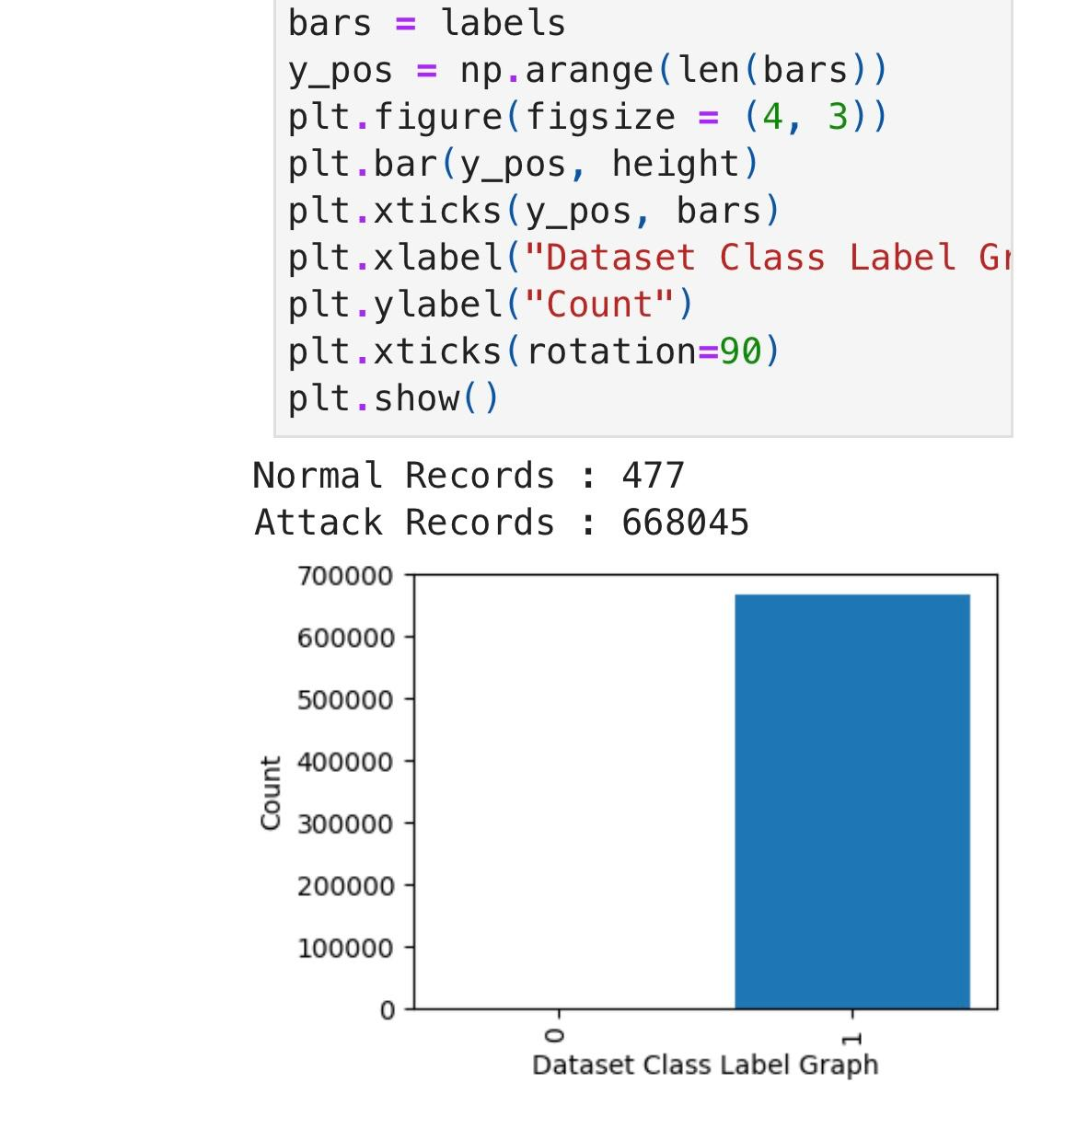
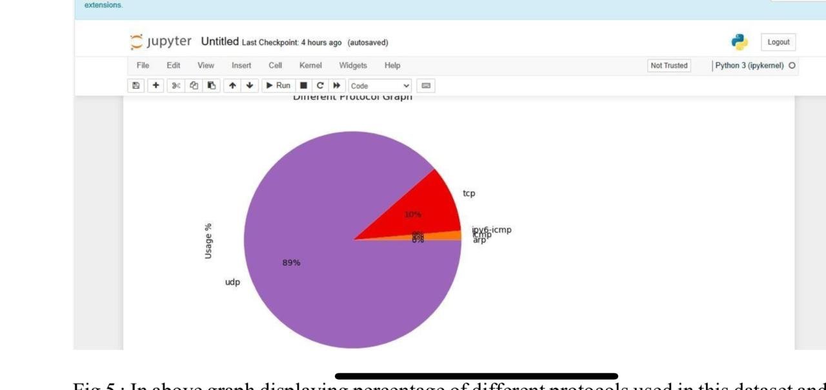

Slide 21
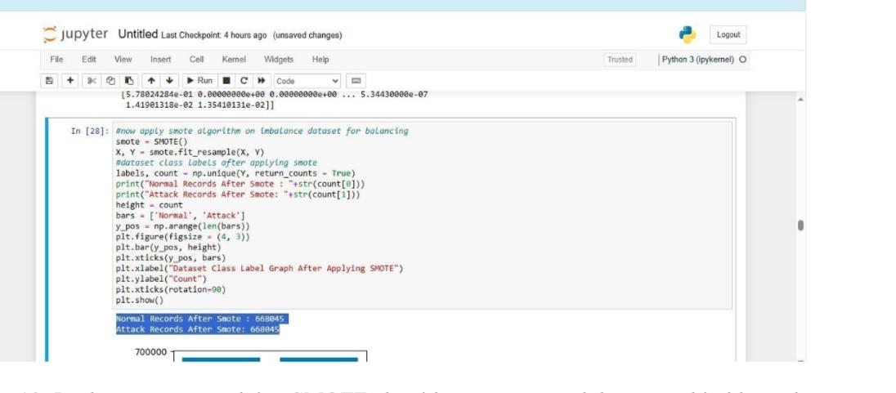
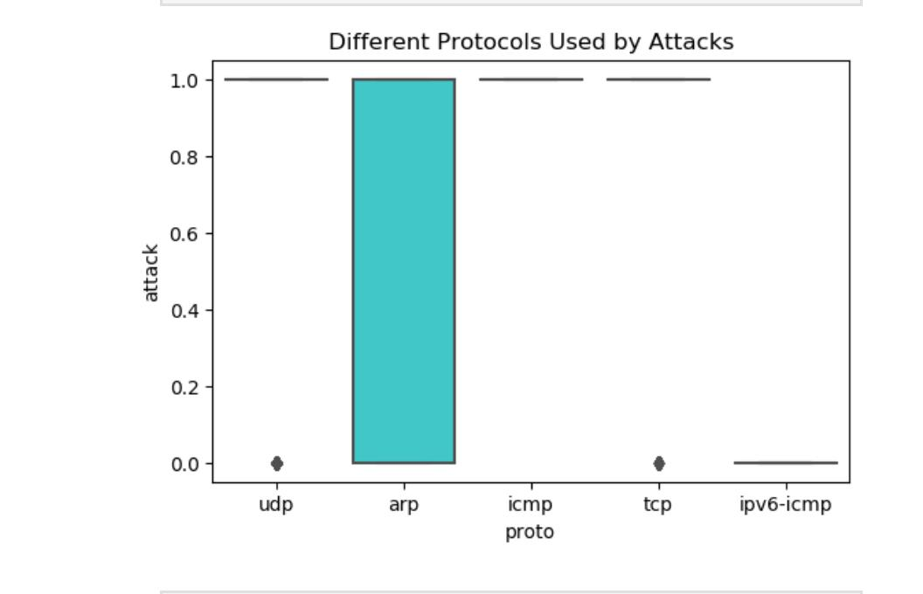

Slide 22
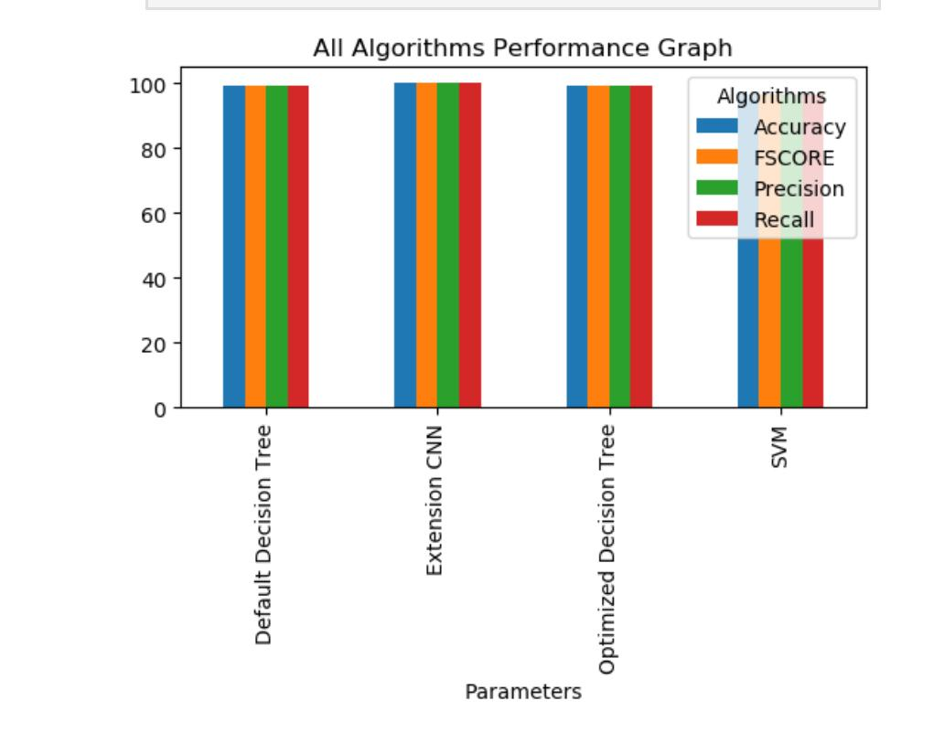
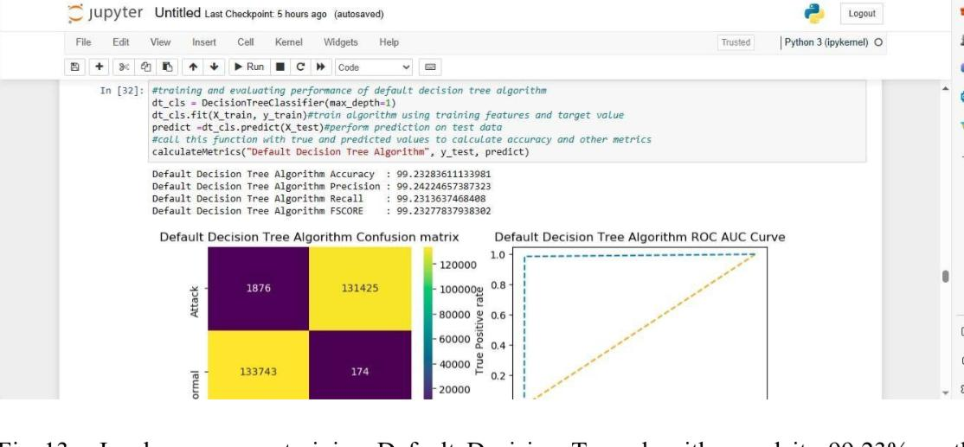

Slide 23
CONCLUSION
The proposed framework for detecting and mitigating botnet attacks in Software-Defined Networks using deep learning techniques represents a significant advancement in network security. By leveraging modern machine learning capabilities, this approach not only enhances detection accuracy but also enables proactive responses to emerging threats. Future work will focus on refining model performance through continuous learning from new data and adapting to evolving botnet strategies. This updated presentation now includes both functional requirements (what the system should do) and non-functional requirements (how well the system performs) within the System Requirements section. This addition provides a comprehensive overview of what is necessary for implementing the proposed solution effectively while ensuring it meets performance expectations.

Slide 24


