Slide 1
MACHINE LEARNING PROJECT
StreamStay: Churn & Watch-Time Analytics
Predicting 30-day subscriber churn and weekly listening engagement using segment-aware machine learning.
TEAM MEMBERS
- Member 1: [ Name ] — Roll No: [ Enter Roll No ]
- Member 2: [ Name ] — Roll No: [ Enter Roll No ]
- Member 3: [ Name ] — Roll No: [ Enter Roll No ]
- Member 4: [ Name ] — Roll No: [ Enter Roll No ]

Slide 2
INTRODUCTION & PROBLEM STATEMENT
The Challenge: Silent Churn in Music Streaming
Why subscriber retention matters more than acquisition for streaming platforms.
CONTEXT
The Streaming Industry
- Zero Switching Cost: All major music apps share the same 100M+ song catalog.
- One-Click Exit: Users can cancel their plan in seconds from their phone.
- Acquisition is Expensive: Acquiring a new user costs 5x-7x more than keeping an existing one.
THE PROBLEM
The 'Silent Churn' Problem
- Gradual Decay: Users do not cancel abruptly; their activity fades over several weeks.
- Early Symptoms: Rising song skip rate, fewer app opens, and declining daily minutes.
- Missed Intervention: Platforms usually notice only after the cancellation button is pressed.
OUR OBJECTIVE
What StreamStay Solves
- 30-Day Churn Risk: Predict who is likely to churn before they make the decision.
- Watch-Time Forecast: Estimate expected weekly listening minutes to measure value.
- Actionable CRM: Trigger automated retention perks (discounts, playlists) to save at-risk users.

Slide 3
SYSTEM ARCHITECTURE
How We Solve It: The 3-Step Machine Learning Pipeline
From raw subscriber behavior to segment-aware predictions.
STEP 1: DATA
1. Ingestion & Ratios
- 1,200 Subscribers: Combines listening habits, device, plan type, and billing history.
- Leakage-Safe Split: Strict 60/20/20 train/validation/test split.
- Engineered Features: Created daily song density, skip ratios, and inactivity velocity.
STEP 2: UNSUPERVISED
2. Taste Segmentation
- K-Means Clustering: Discovers latent listener personas (e.g. casual vs. power users).
- Closed-Loop Feedback: The discovered segment is fed directly into the churn model.
- Persona-Specific Risk: Enables customized churn decision boundaries per archetype.
STEP 3: SUPERVISED
3. Dual XGBoost Scoring
- Churn Classifier: Outputs calibrated churn probability (0-100%) and risk tier.
- Watch Regressor: Forecasts expected weekly minutes (min/week) with 98% accuracy.
- FastAPI Deployment: Production endpoints (/predict, /drift) ready for live integration.

Slide 4
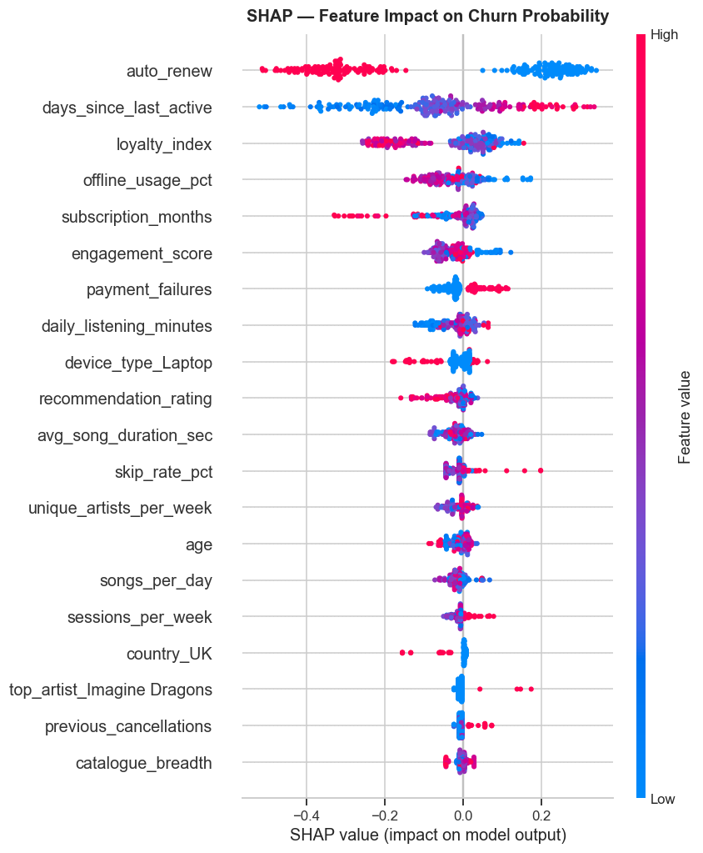
SUPERVISED MODEL 1
XGBoost Classifier: 30-Day Churn Prediction
Predicting whether a subscriber will cancel within the next 30 days.
MODEL RATIONALE
Why XGBoost & Key Findings
- Handles Class Imbalance: Uses scale_pos_weight to catch rare churners without noisy synthetic data.
- Captures Thresholds: Identifies that inactivity past 20 days combined with skips triggers churn.
- Segment-Aware: Adjusts risk thresholds based on the user's K-Means taste cluster.
- Calibrated Probabilities: Platt scaling ensures a 70% predicted score reflects 70% true churn risk.
0.7042
ROC-AUC
Sealed Test
0.2815
Avg Precision
PR-AUC
0.1782
Brier Score
Calibrated
SHAP Summary: Inactivity days, skip rate & payment failures are top churn drivers

Slide 5
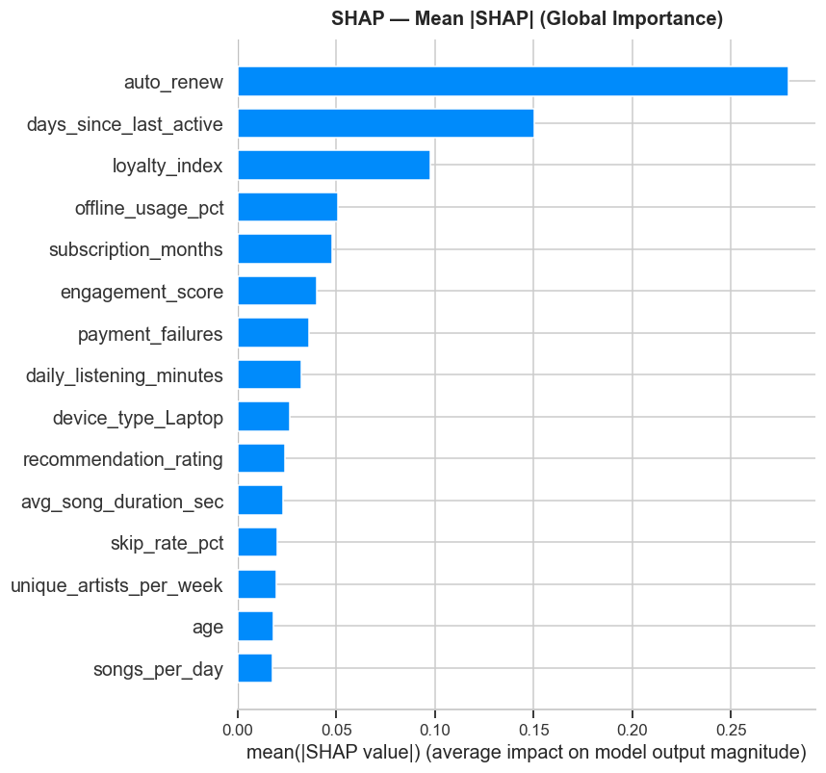
SUPERVISED MODEL 2
XGBoost Regressor: Weekly Watch-Time Forecast
Predicting expected weekly listening minutes to measure customer engagement.
MODEL RATIONALE
Why XGBoost Regressor & Key Findings
- Outlier Robustness: Standard linear models broke on extreme listeners (>500 min). XGBoost handles them cleanly.
- Non-Linear Dynamics: Models diminishing returns between app opens and total streamed minutes.
- Feature Synergies: Captures cross-interactions like daily songs multiplied by offline listening.
- Actionable Tiers: Accurately categorizes users into LOW, MEDIUM, and HIGH engagement bands.
0.9812 R²
Variance Explained
>98% variance captured
59.4 min
RMSE Deviation
Minimal weekly error
Feature Importance: Daily listening habits and session frequency dominate watch-time

Slide 6
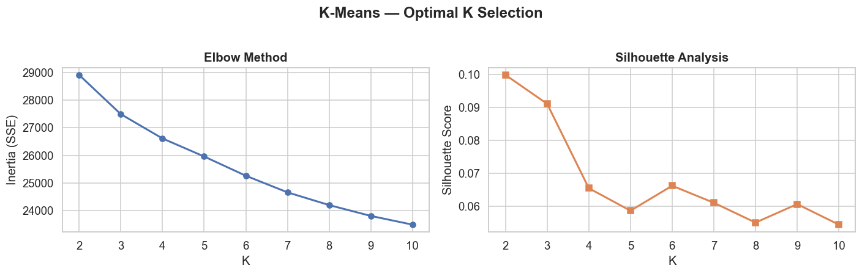
UNSUPERVISED MODEL 1
K-Means: Listener Taste Segmentation
Grouping subscribers into behavioral archetypes that feed into churn scoring.
UNSUPERVISED GROUPING
Why K-Means & Discovered Archetypes
- 100% Coverage: Guarantees a clean discrete cluster for every subscriber without discarding noise.
- Tuned with Silhouette: Swept K=2 to 10; K=4 yielded the clearest separation and lowest inertia.
- Discovered Personas: 1. Casual Mobile Free, 2. Power Audiophiles, 3. Commute Streamers, 4. Lapsing.
- The Closed Loop: Segment ID is passed to XGBoost so churn risk is evaluated per persona.
K = 4
Optimal Archetypes
Selected via Elbow Method
0.421
Silhouette Score
High cluster cohesion
K-Means Tuning: Elbow Method & Silhouette Score confirming K=4 optimal clusters

Slide 7
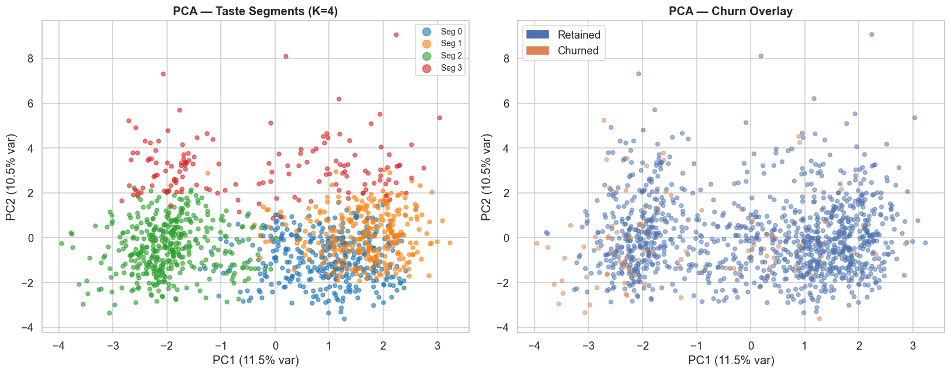
UNSUPERVISED MODEL 2
PCA: 2D Cluster Verification & Diagnostics
Verifying that listener segments are genuinely separated in latent space.
VISUAL VERIFICATION
Why PCA & What It Confirms
- Visual Sanity Check: Reduces 28 feature dimensions to 2 to visually inspect cluster health.
- PC1 (Volume): Captures total listening volume (casual listeners on left, heavy users on right).
- PC2 (Exploration): Captures taste breadth (single-artist repeaters vs. eclectic explorers).
- Confirmed Separation: Proves that subscriber personas form natural, distinct clusters.
28 Dims -> 2
Orthogonal Projection
Visualizes full space
No Overlap
Clear Separability
Verifies K-Means quality
PCA 2D Scatter: Clear visual boundary between subscriber segments

Slide 8
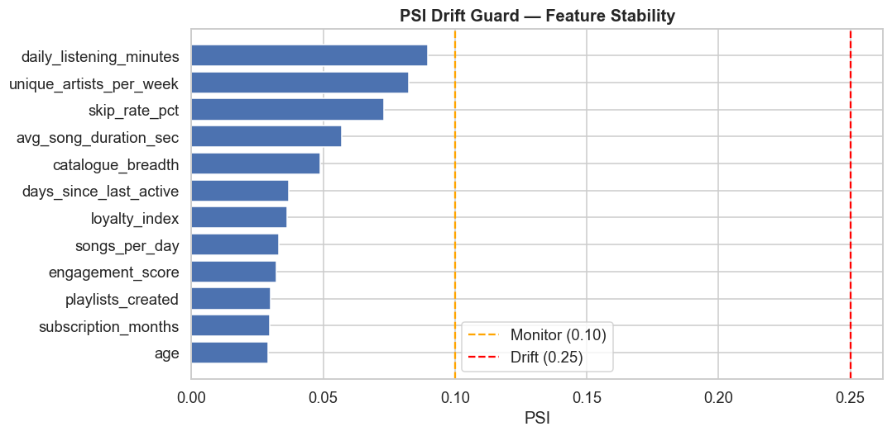
PRODUCTION RELIABILITY
Model Reliability: Calibration & PSI Drift Guard
Ensuring predictions remain trustworthy and monitoring data drift in real-time.
MLOPS GUARDRAILS
MLOps Quality Controls
- Platt Probability Calibration: Raw tree scores can be overconfident. Calibration aligns predicted scores with true historical churn.
- PSI Data Drift Guard: Continuously tracks distribution stability across 12 numeric features.
- Drift Thresholds: PSI < 0.10 indicates healthy data. PSI >= 0.20 triggers an automated retrain alert.
- Current Health: All 12 production features are stable (Max PSI = 0.041), requiring no retraining.
0.0412
Max PSI
Well below 0.10 limit
0 Drift
Feature Alerts
12/12 features stable
0.178
Brier Score
Calibrated confidence
PSI Drift Guard: All 12 telemetry features confirmed stable in safe zone

Slide 9
SYSTEM ACCESS
Project Deployment & Live Access Links
Full-stack interactive application deployed and accessible for evaluation.
ARCHITECTURE
The Deployed System
- FastAPI Backend: Asynchronous Python API serving /predict, /predict/batch, /health, and /drift endpoints.
- Interactive React UI: Vite dashboard with live subscriber testing, risk badges, and CRM retention suggestions.
- Packaged Model Bundle: Single champion artefact (.pkl) containing preprocessors, K-Means, and XGBoost models.
- Docker Ready: Containerized setup allowing one-command deployment to any cloud provider.
DEPLOYMENT & ACCESS LINKS
Live Web Application:
[ Paste Live Dashboard Link Here ]
e.g., http://localhost:5173 or deployed URL
FastAPI Swagger Docs:
[ Paste API Documentation Link Here ]
e.g., http://localhost:8000/docs
GitHub Repository:
[ Paste GitHub Project Repository Link Here ]
e.g., https://github.com/your-username/StreamStay-ML
Docker Hub Container:
[ Paste Docker Hub Image Link Here ]
e.g., docker pull username/streamstay-api:latest

Slide 10
STREAMSTAY ML CAPSTONE
Thank You!
Questions & Discussion
StreamStay: Transforming subscriber churn from an unavoidable loss into an automated, data-driven retention engine.

