Slide 1

Chapter 5
IPv4 Addresses
Copyright © The McGraw-Hill Companies, Inc. Permission required for reproduction or display.

Slide 2
OBJECTIVES:
To introduce the concept of an address space in general and the address space of IPv4 in particular.
To discuss the classful architecture and the blocks of addresses available in each class.
To discuss the idea of hierarchical addressing and how it has been implemented in classful addressing.
To explain subnetting and supernetting for classful architecture.
To discuss classless addressing, that has been devised to solve the problems in classful addressing.
To discuss some special blocks and some special addresses in each block.
To discuss NAT technology and show how it can be used to alleviate of address depletion.

Slide 3
Chapter
Outline
5.1 Introduction
5.2 Classful Addressing
5.3 Classless Addressing
5.4 Special Addresses
5.5 NAT

Slide 4
5-1 INTRODUCTION
The identifier used in the IP layer of the TCP/IP protocol suite to identify each device connected to the Internet is called the Internet address or IP address. An IPv4 address is a 32-bit address that uniquely and universally defines the connection of a host or a router to the Internet; an IP address is the address of the interface.

Slide 5
Topics Discussed in the Section
Notation
Range of Addresses
Operations

Slide 6

Note
An IPv4 address is 32 bits long.
Note
The IPv4 addresses are unique
and universal.

Slide 7
Note
The address space of IPv4 is
2³² or 4,294,967,296.
Note
Numbers in base 2, 16, and 256 are discussed in Appendix B.

Slide 8
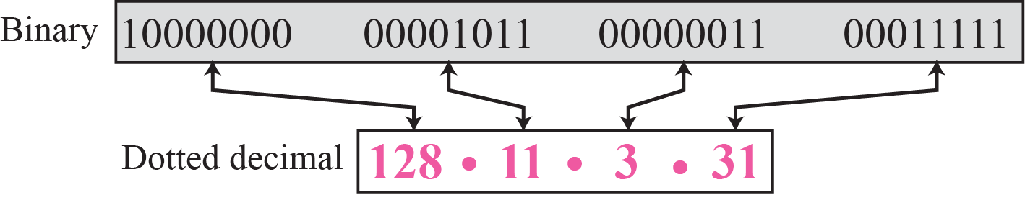
Figure 5.1 Dotted-decimal notation

Slide 9
Example 5.1
Change the following IPv4 addresses from binary notation to dotted-decimal notation.
a. 10000001 00001011 00001011 11101111
b. 11000001 10000011 00011011 11111111
c. 11100111 11011011 10001011 01101111
d. 11111001 10011011 11111011 00001111
Solution
We replace each group of 8 bits with its equivalent decimal number (see Appendix B) and add dots for separation:
a. 129.11.11.239
b. 193.131.27.255
c. 231.219.139.111
d. 249.155.251.15

Slide 10
Example 5.2
Change the following IPv4 addresses from dotted-decimal notation to binary notation.
a. 111.56.45.78
b. 221.34.7.82
c. 241.8.56.12
d. 75.45.34.78
Solution
We replace each decimal number with its binary equivalent:
a. 01101111 00111000 00101101 01001110
b. 11011101 00100010 00000111 01010010
c. 11110001 00001000 00111000 00001100
d. 01001011 00101101 00100010 01001110

Slide 11
Example 5.3
Find the error, if any, in the following IPv4 addresses:
a. 111.56.045.78
b. 221.34.7.8.20
c. 75.45.301.14
d. 11100010.23.14.67
Solution
a. There should be no leading zeroes (045).
b. We may not have more than 4 bytes in an IPv4 address.
c. Each byte should be less than or equal to 255.
d. A mixture of binary notation and dotted-decimal notation.

Slide 12
Example 5.4
Change the following IPv4 addresses from binary notation to hexadecimal notation.
a. 10000001 00001011 00001011 11101111
b. 11000001 10000011 00011011 11111111
Solution
We replace each group of 4 bits with its hexadecimal equivalent. Note that 0X (or 0x) is added at the beginning or the subscript 16 at the end.
a. 0X810B0BEF or 810B0BEF₁₆
b. 0XC1831BFF or C1831BFF₁₆

Slide 13
Example 5.5
Find the number of addresses in a range if the first address is 146.102.29.0 and the last address is 146.102.32.255.
Solution
We can subtract the first address from the last address in base 256 (see Appendix B). The result is 0.0.3.255 in this base. To find the number of addresses in the range (in decimal), we convert this number to base 10 and add 1 to the result..

Slide 14
Example 5.6
The first address in a range of addresses is 14.11.45.96. If the number of addresses in the range is 32, what is the last address?
Solution
We convert the number of addresses minus 1 to base 256, which is 0.0.0.31. We then add it to the first address to get the last address. Addition is in base 256.

Slide 15
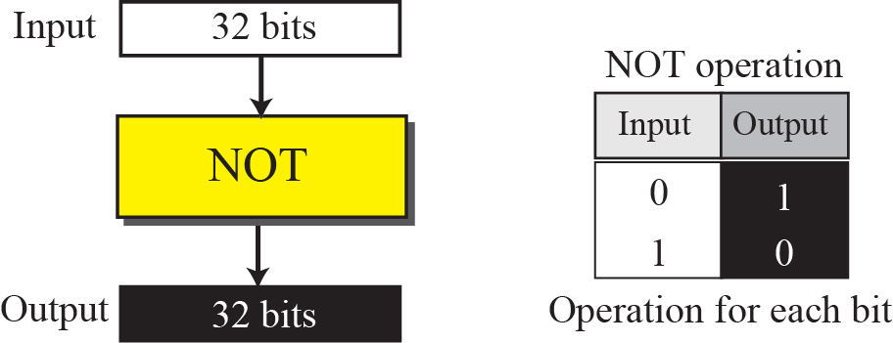
Figure 5.2 Bitwise NOT operation

Slide 16
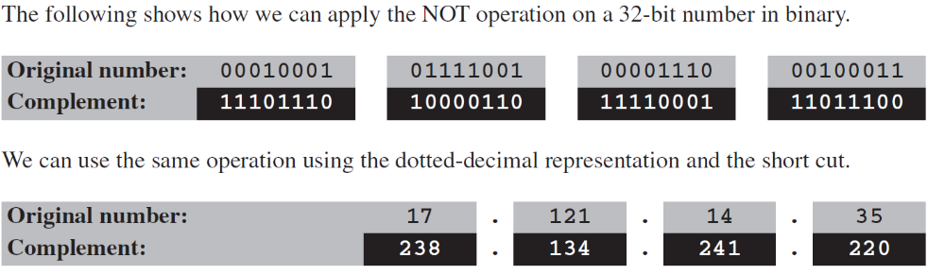
Example 5.7

Slide 17
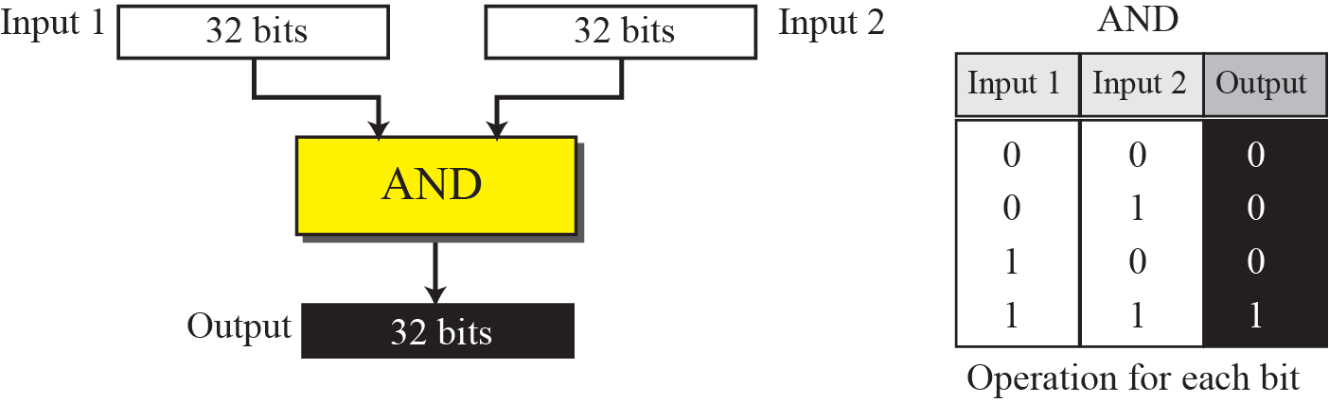
Figure 5.3 Bitwise AND operation

Slide 18
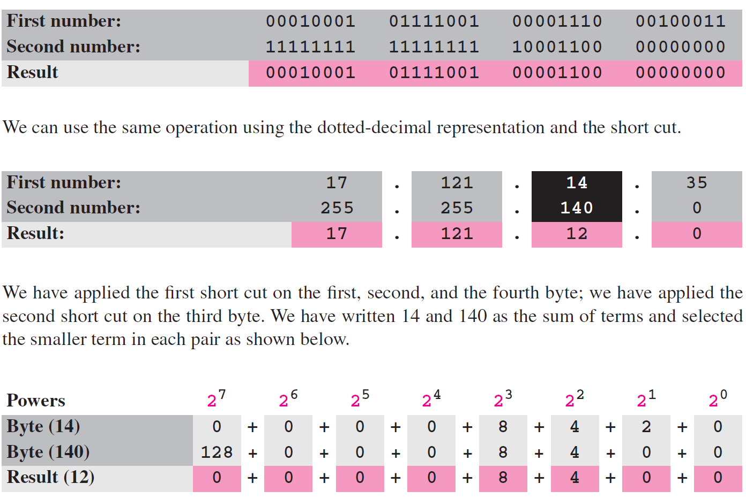
Example 5.8

Slide 19
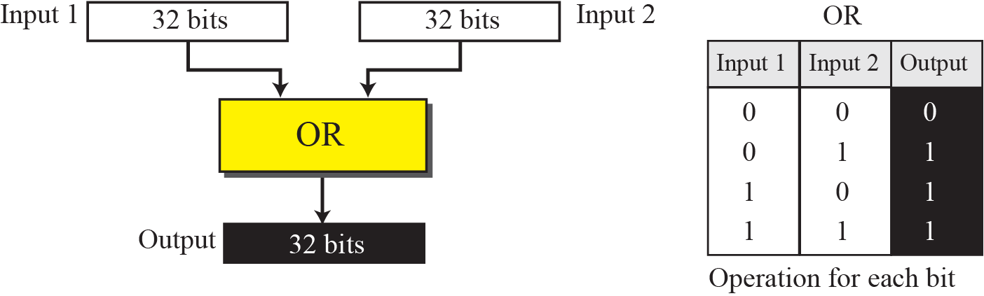
Figure 5.4 Bitwise OR operation

Slide 20
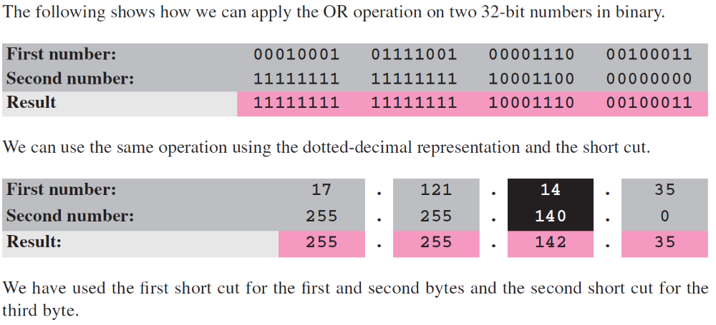
Example 5.9

Slide 21
5-2 CLASSFUL ADDRESSING
IP addresses, when started a few decades ago, used the concept of classes. This architecture is called classful addressing. In the mid-1990s, a new architecture, called classless addressing, was introduced that supersedes the original architecture. In this section, we introduce classful addressing because it paves the way for understanding classless addressing and justifies the rationale for moving to the new architecture. Classless addressing is discussed in the next section.

Slide 22
Topics Discussed in the Section
Classes
Classes and Blocks
Two-Level Addressing
Three-Level Addressing: Subnetting
Supernetting

Slide 23
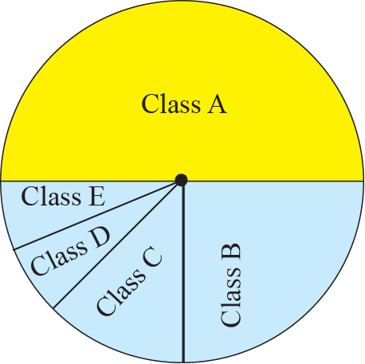
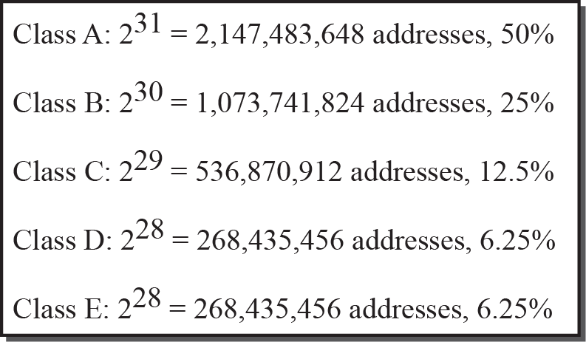
Figure 5.5 Occupation of address space

Slide 24
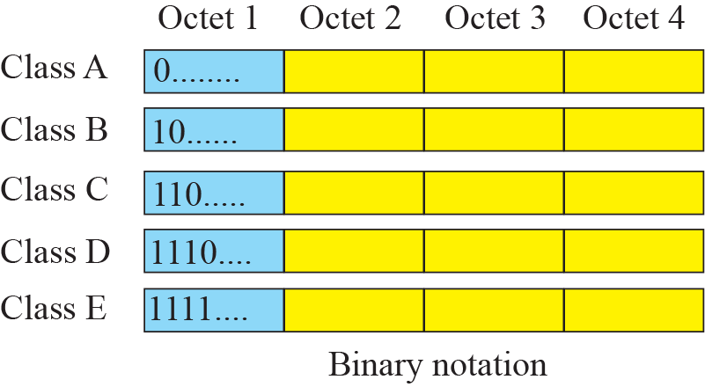
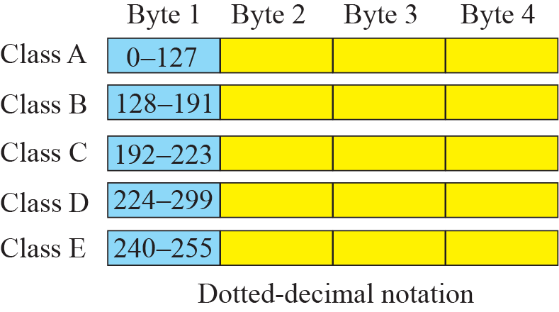
Figure 5.6 Finding the class of address

Slide 25
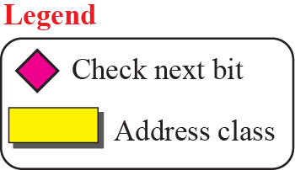
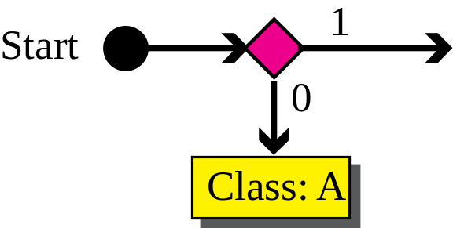
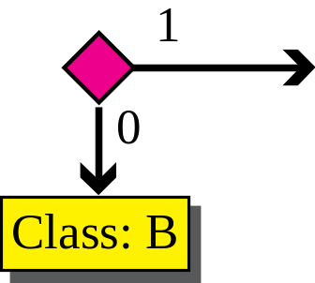
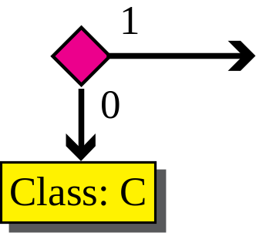
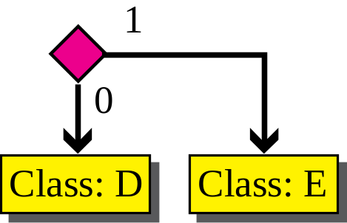
Figure 5.7 Finding the class of an address using continuous checking
Notes:
Start0Class: A1Start0Class: AClass: C01

Slide 26
Example 5.10
Find the class of each address:
a. 00000001 00001011 00001011 11101111
b. 11000001 10000011 00011011 11111111
c. 10100111 11011011 10001011 01101111
d. 11110011 10011011 11111011 00001111
Solution
See the procedure in Figure 5.7.
a. The first bit is 0. This is a class A address.
b. The first 2 bits are 1; the third bit is 0. This is a class C address.
c. The first bit is 1; the second bit is 0. This is a class B address.
d. The first 4 bits are 1s. This is a class E address.

Slide 27
Example 5.11
Find the class of each address:
a. 227.12.14.87
b. 193.14.56.22
c. 14.23.120.8
d. 252.5.15.111
Solution
a. The first byte is 227 (between 224 and 239); the class is D.
b. The first byte is 193 (between 192 and 223); the class is C.
c. The first byte is 14 (between 0 and 127); the class is A.
d. The first byte is 252 (between 240 and 255); the class is E.

Slide 28
Figure 5.8 Netid and hostid

Slide 29
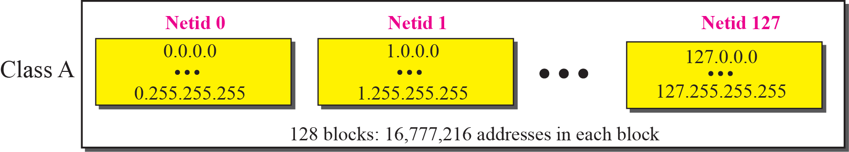
Figure 5.9 Blocks in Class A

Slide 30
Note
Millions of class A addresses
are wasted.

Slide 31
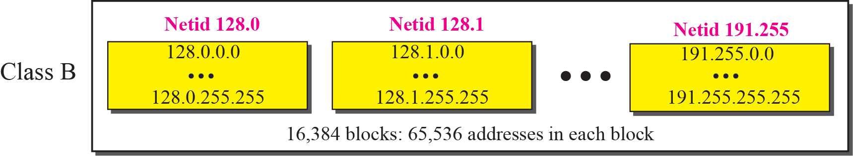
Figure 5.10 Blocks in Class B

Slide 32
Note
Many class B addresses are wasted.

Slide 33
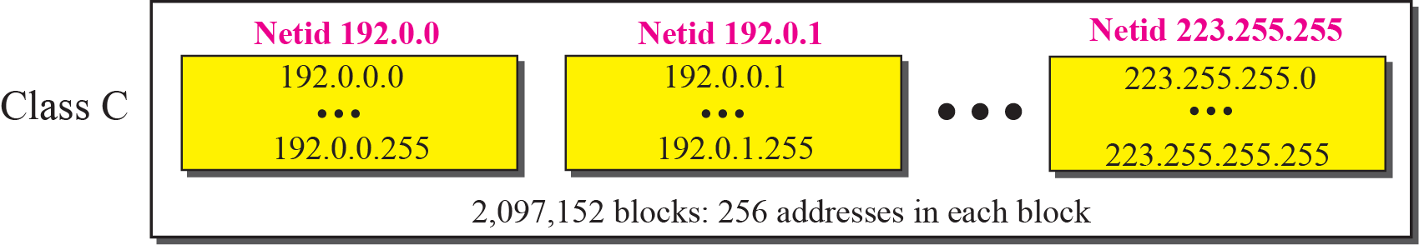
Figure 5.11 Blocks in Class C

Slide 34
Note
Not so many organizations are so small to have a class C block.

Slide 35
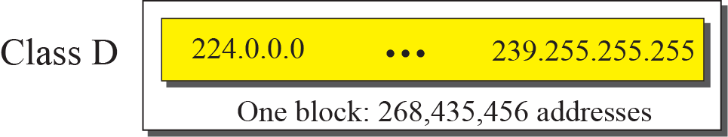
Figure 5.12 The single block in Class D

Slide 36
Note
Class D addresses are made of one block, used for multicasting.

Slide 37
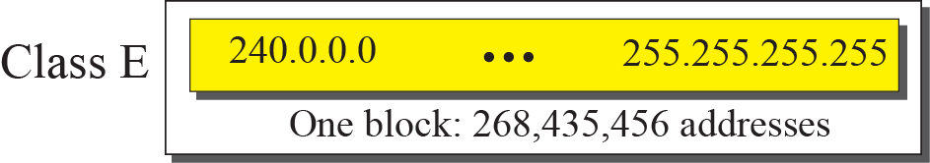
Figure 5.13 The single block in Class E

Slide 38
Note
The only block of class E addresses was reserved for future purposes.

Slide 39
Note
The range of addresses allocated to an organization in classful addressing
was a block of addresses in
Class A, B, or C.

Slide 40
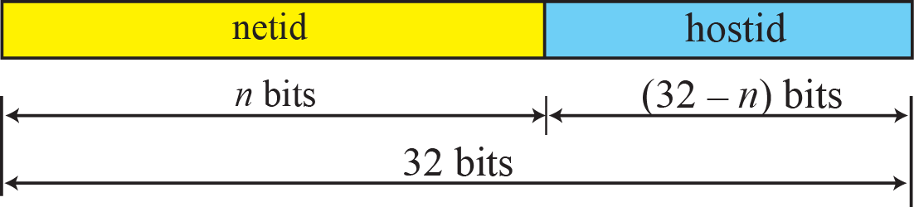
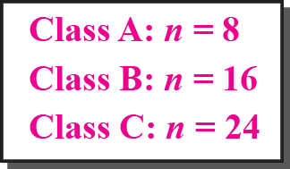
Figure 5.14 Two-level addressing in classful addressing

Slide 41
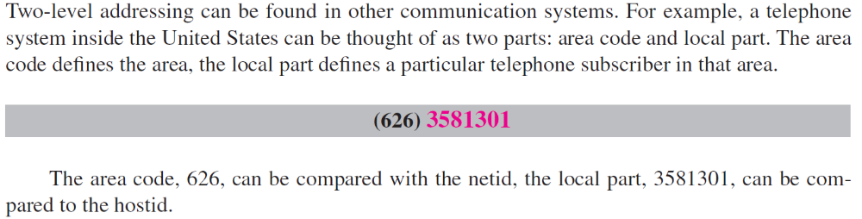
Example 5.12

Slide 42
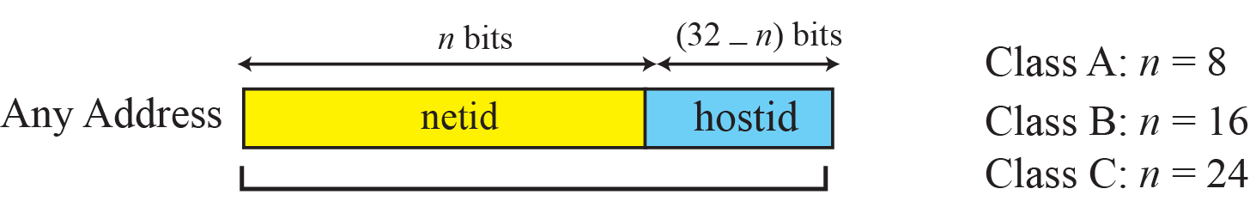
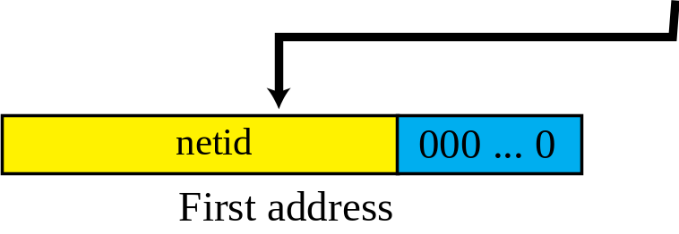
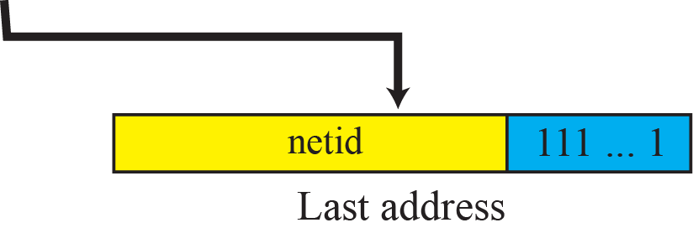
Figure 5.15 Information extraction in classful addressing

Slide 43
Example 5.13
An address in a block is given as 73.22.17.25. Find the number of addresses in the block, the first address, and the last address.
Solution
Figure 5.16 shows a possible configuration of the network that uses this block.
1. The number of addresses in this block is N = 2^{32−n} = 16,777,216.
2. To find the first address, we keep the leftmost 8 bits and set the rightmost 24 bits all to 0s. The first address is 73.0.0.0/8, in which 8 is the value of n.
3. To find the last address, we keep the leftmost 8 bits and set the rightmost 24 bits all to 1s. The last address is 73.255.255.255.

Slide 44
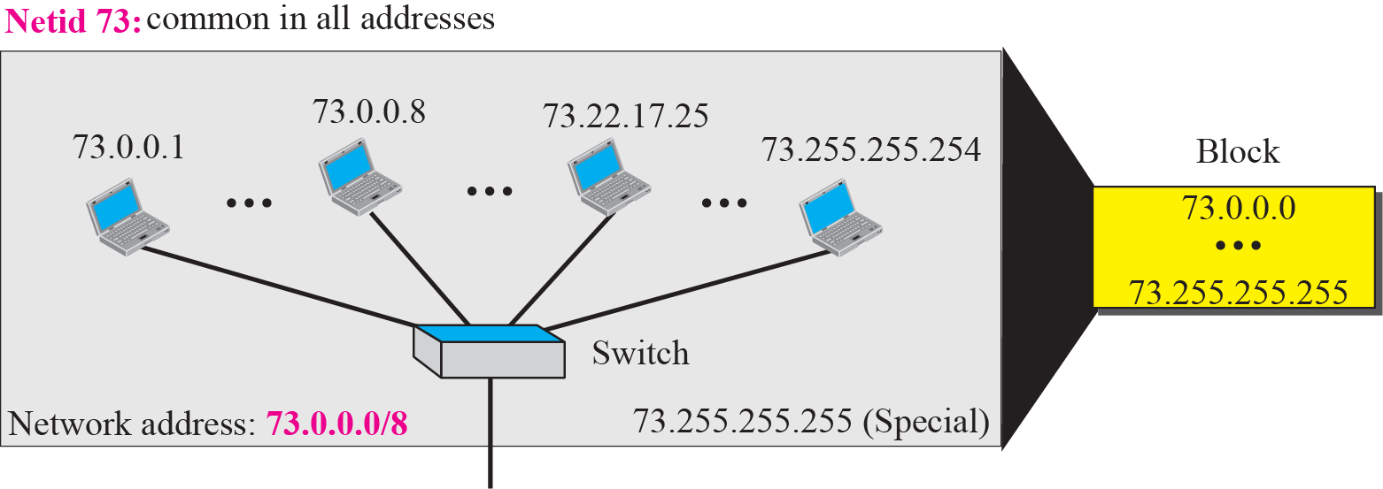
Figure 5.16 Solution to Example 5.13

Slide 45
Example 5.14
An address in a block is given as 180.8.17.9. Find the number of addresses in the block, the first address, and the last address.
Solution
Figure 5.17 shows a possible configuration of the network that uses this block.
1. The number of addresses in this block is N = 2^{32−n} = 65,536.
2. To find the first address, we keep the leftmost 16 bits and set the rightmost 16 bits all to 0s. The first address is 18.8.0.0/16, in which 16 is the value of n.
3. To find the last address, we keep the leftmost 16 bits and set the rightmost 16 bits all to 1s. The last address is
18.8.255.255.

Slide 46
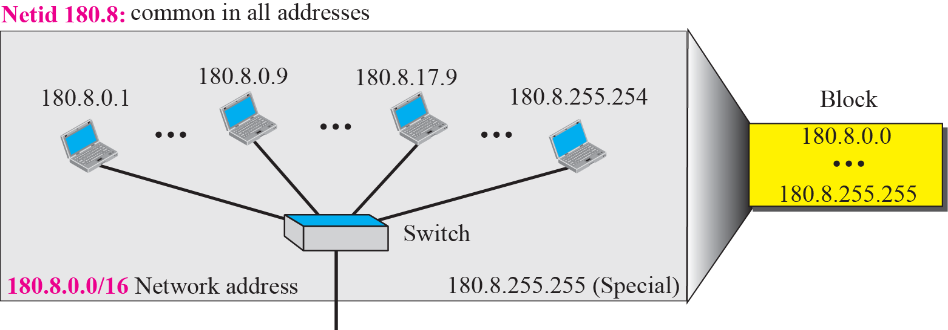
Figure 5.17 Solution to Example 5.14

Slide 47
Example 5.15
An address in a block is given as 200.11.8.45. Find the number of addresses in the block, the first address, and the last address.
Solution
Figure 5.17 shows a possible configuration of the network that uses this block.
1. The number of addresses in this block is N = 2^{32−n} = 256.
2. To find the first address, we keep the leftmost 24 bits and set the rightmost 8 bits all to 0s. The first address is
200.11.8.0/16, in which 24 is the value of n.
3. To find the last address, we keep the leftmost 24 bits and set the rightmost 8 bits all to 1s. The last address is
200.11.8.255/16.

Slide 48
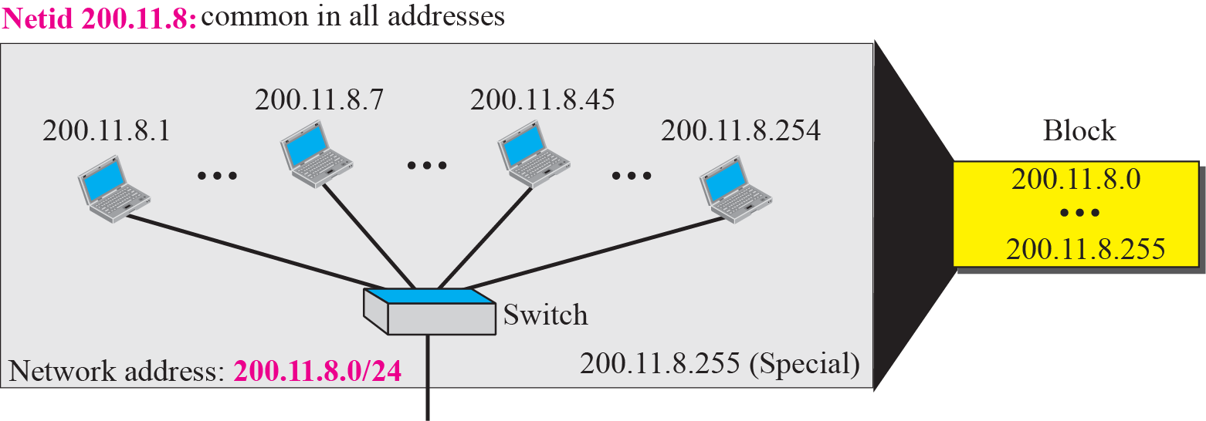
Figure 5.18 Solution to Example 5.15

Slide 49
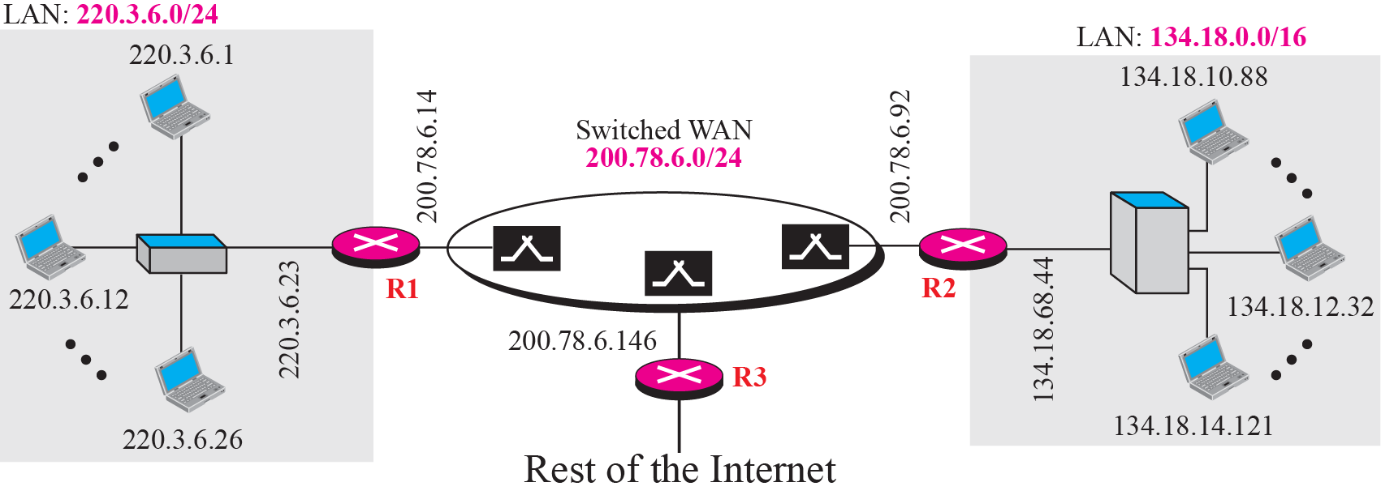
Figure 5.19 Sample Internet

Slide 50
Note
The network address is the identifier of a network.

Slide 51
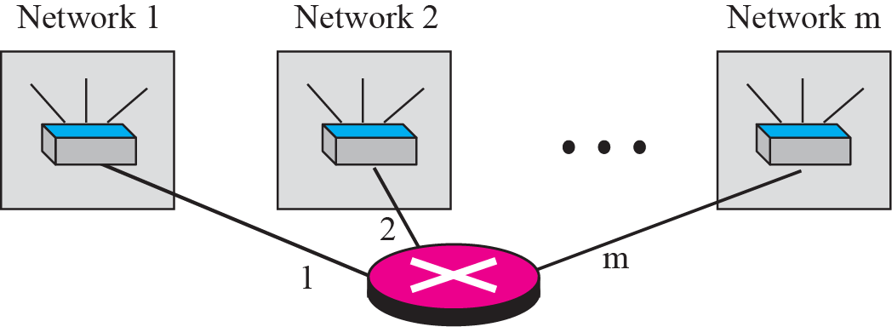
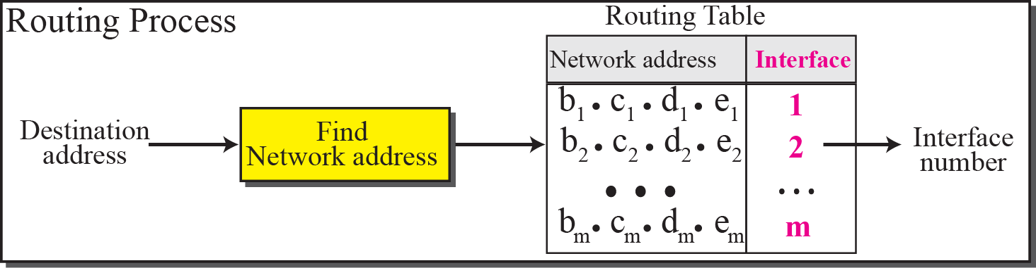
Figure 5.20 Network addresses

Slide 52
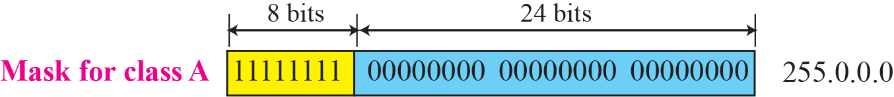
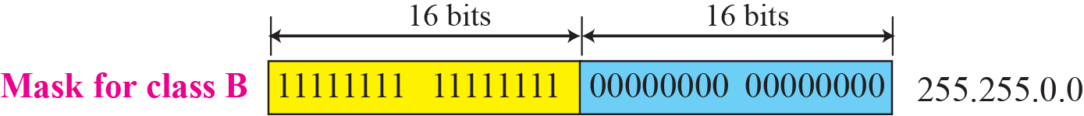
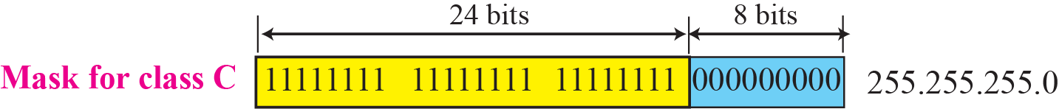
Figure 5.21 Network mask

Slide 53
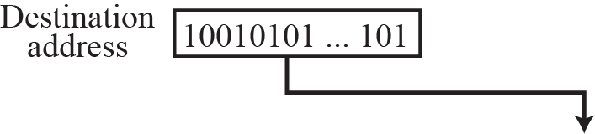
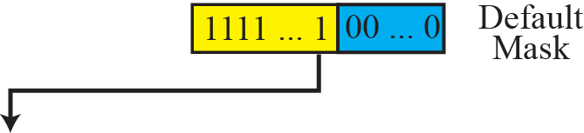
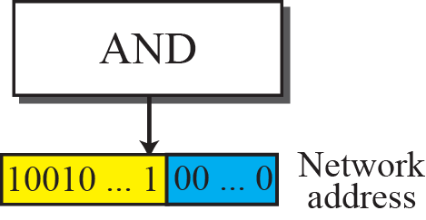
Figure 5.22 Finding a network address using the default mask

Slide 54
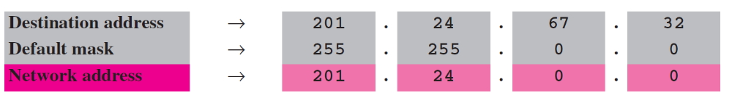
Example 5.16
A router receives a packet with the destination address 201.24.67.32. Show how the router finds the network address of the packet.
Solution
Since the class of the address is B, we assume that the router applies the default mask for class B, 255.255.0.0 to find the network address.

Slide 55

Example 5.17
Three-level addressing can be found in the telephone system if we think about the local part of a telephone number as an exchange and a subscriber connection:
in which 626 is the area code, 358 is the exchange, and 1301 is the subscriber connection.

Slide 56
Example 5.18
Figure 5.23 shows a network using class B addresses before subnetting. We have just one network with almost 216 hosts. The whole network is connected, through one single connection, to one of the routers in the Internet. Note that we have shown /16 to show the length of the netid (class B).

Slide 57
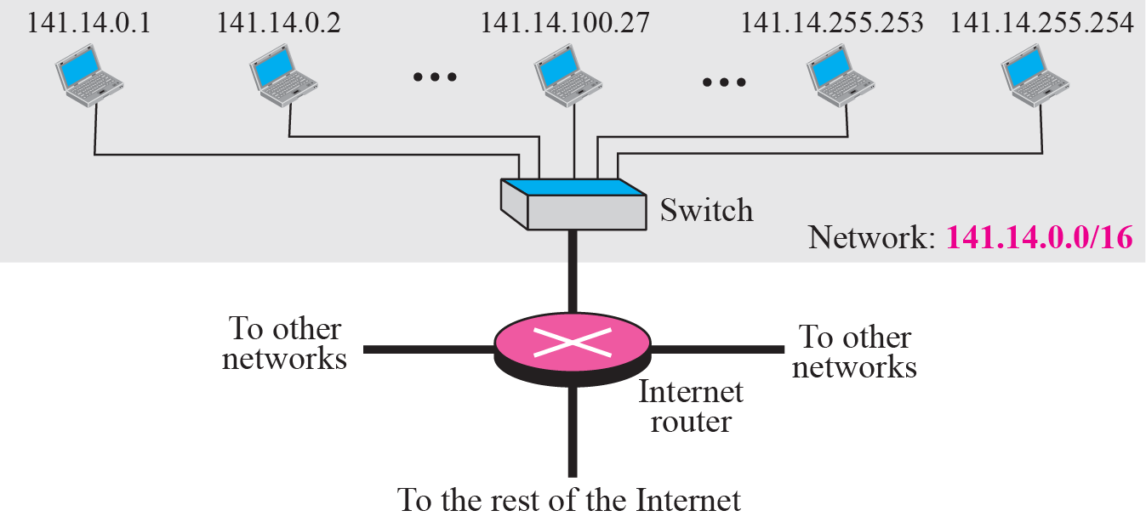
Figure 5.23 Example 5.18

Slide 58
Example 5.19
Figure 5.24 shows the same network in Figure 5.23 after subnetting. The whole network is still connected to the Internet through the same router. However, the network has used a private router to divide the network into four subnetworks. The rest of the Internet still sees only one network; internally the network is made of four subnetworks. Each subnetwork can now have almost 214 hosts. The network can belong to a university campus with four different schools (buildings). After subnetting, each school has its own subnetworks, but still the whole campus is one network for the rest of the Internet. Note that /16 and /18 show the length of the netid and subnetids.

Slide 59
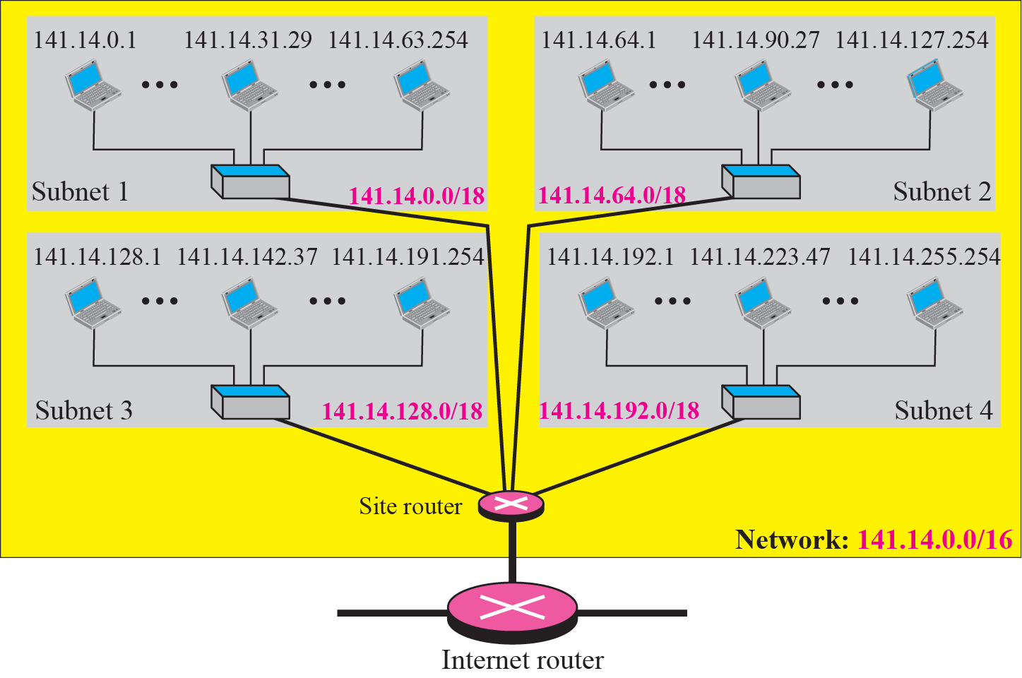
Figure 5.24 Example 5.19

Slide 60
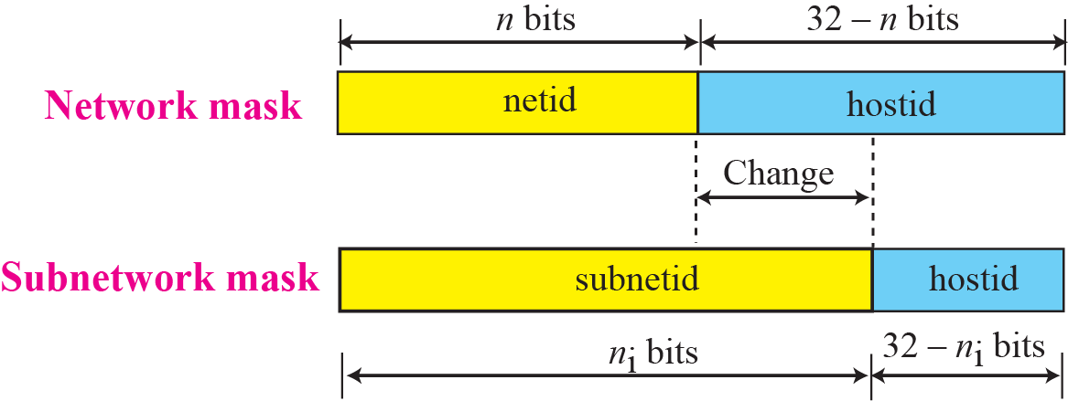
Figure 5.25 Network mask and subnetwork mask

Slide 61
Example 5.20
In Example 5.19, we divided a class B network into four subnetworks. The value of n = 16 and the value of
n₁ = n₂ = n₃ = n₄ = 16 + log₂4 = 18.
This means that the subnet mask has eighteen 1s
and fourteen 0s. In other words, the subnet mask is 255.255.192.0 which is different from the network mask for class B (255.255.0.0).

Slide 62
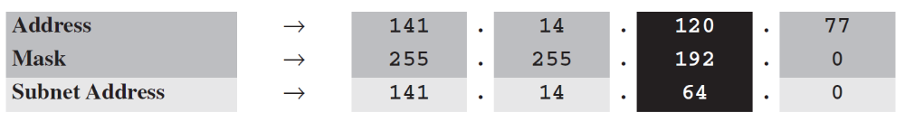
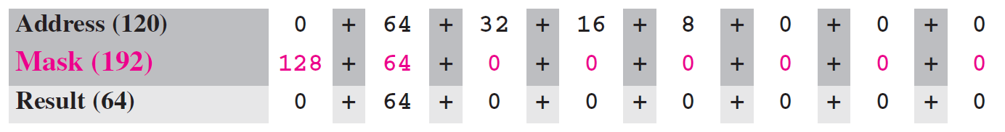
Example 5.21
In Example 5.19, we show that a network is divided into four subnets. Since one of the addresses in subnet 2 is 141.14.120.77, we can find the subnet address as:
The values of the first, second, and fourth bytes are calculated using the first short cut for AND operation. The value of the third byte is calculated using the second short cut for the AND operation.

Slide 63
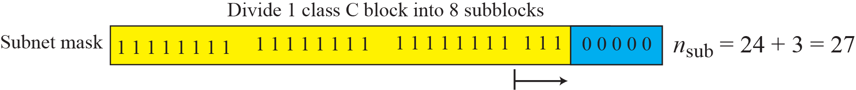
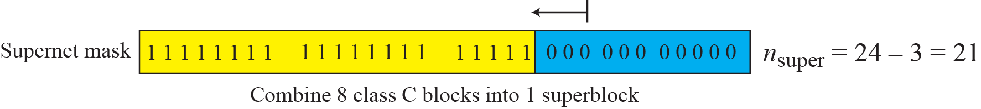
Figure 5.26 Comparison of subnet, default, and supernet mask

Slide 64
5-3 CLASSLESS ADDRESSING
Subnetting and supernetting in classful addressing did not really solve the address depletion problem. With the growth of the Internet, it was clear that a larger address space was needed as a long-term solution. Although the long-range solution has already been devised and is called IPv6, a short-term solution was also devised to use the same address space but to change the distribution of addresses to provide a fair share to each organization. The short-term solution still uses IPv4 addresses, but it is called classless addressing.

Slide 65
Topics Discussed in the Section
Variable –Length Blocks
Two-Level Addressing
Block Allocation
Subnetting

Slide 66
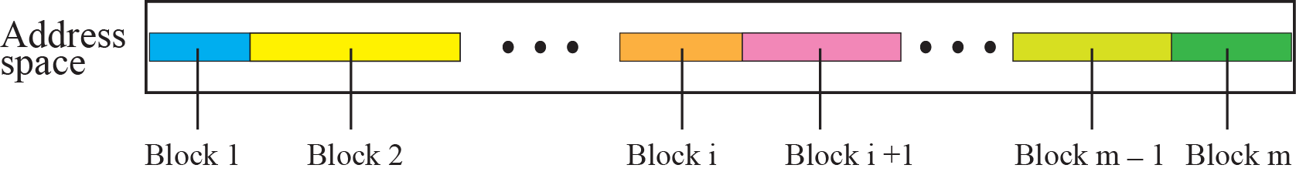
Figure 5.27 Variable-length blocks in classless addressing

Slide 67
Note
In classless addressing, the prefix defines the network and the suffix
defines the host.

Slide 68
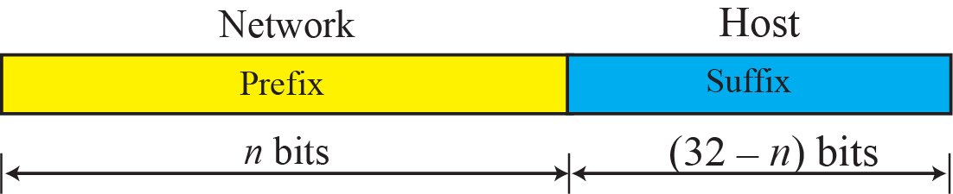
Figure 5.28 Prefix and suffix

Slide 69
Note
The prefix length in classless addressing can be 1 to 32.

Slide 70
Example 5.22
What is the prefix length and suffix length if the whole Internet is considered as one single block with 4,294,967,296 addresses?
Solution
In this case, the prefix length is 0 and the suffix length is 32. All 32 bits vary to define 232 = 4,294,967,296 hosts in this single block.

Slide 71
Example 5.23
What is the prefix length and suffix length if the Internet is divided into 4,294,967,296 blocks and each block has one single address?
Solution
In this case, the prefix length for each block is 32 and the suffix length is 0. All 32 bits are needed to define 232 = 4,294,967,296 blocks. The only address in each block is defined by the block itself.

Slide 72
Example 5.24
The number of addresses in a block is inversely related to the value of the prefix length, n. A small n means a larger block; a large n means a small block.

Slide 73
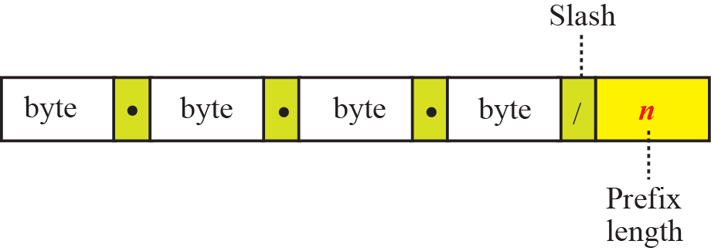
Figure 5.29 Slash notation

Slide 74
Note
In classless addressing, we need to know one of the addresses in the block
and the prefix length to define the block.

Slide 75

Example 5.25
In classless addressing, an address cannot per se define the block the address belongs to. For example, the address 230.8.24.56 can belong to many blocks some of them are shown below with the value of the prefix associated with that block:

Slide 76
Example 5.26
The following addresses are defined using slash notations.
a. In the address 12.23.24.78/8, the network mask is 255.0.0.0. The mask has eight 1s and twenty-four 0s. The prefix length is 8; the suffix length is 24.
b. In the address 130.11.232.156/16, the network mask is 255.255.0.0. The mask has sixteen 1s and sixteen 0s.The prefix length is 16; the suffix length is 16.
c. In the address 167.199.170.82/27, the network mask is 255.255.255.224. The mask has twenty-seven 1s and five 0s. The prefix length is 27; the suffix length is 5.

Slide 77

Example 5.27
One of the addresses in a block is 167.199.170.82/27. Find the number of addresses in the network, the first address, and the last address.
Solution
The value of n is 27. The network mask has twenty-seven 1s and five 0s. It is 255.255.255.240.
a. The number of addresses in the network is 2^{32 − n} = 32.
b. We use the AND operation to find the first address (network address). The first address is 167.199.170.64/27.

Slide 78

Example 5.27 Continued
c. To find the last address, we first find the complement of the network mask and then OR it with the given address: The last address is 167.199.170.95/27.

Slide 79

Example 5.28
One of the addresses in a block is 17.63.110.114/24. Find the number of addresses, the first address, and the last address in the block.
Solution
The network mask is 255.255.255.0.
a. The number of addresses in the network is 2³² ⁻ ²⁴ = 256.
b. To find the first address, we use the short cut methods
discussed early in the chapter. The first address is
17.63.110.0/24.

Slide 80
Example 5.28 Continued
c. To find the last address, we use the complement of the network mask and the first short cut method we discussed before. The last address is 17.63.110.255/24.

Slide 81

Example 5.29
One of the addresses in a block is 110.23.120.14/20. Find the number of addresses, the first address, and the last address in the block.
Solution
The network mask is 255.255.240.0.
a. The number of addresses in the network is 2³² ⁻ ²⁰ = 4096.
b. To find the first address, we apply the first short cut to bytes 1, 2, and 4 and the second short cut to byte 3. The first address is 110.23.112.0/20.

Slide 82

Example 5.29 Continued
c. To find the last address, we apply the first short cut to bytes 1, 2, and 4 and the second short cut to byte 3. The OR operation is applied to the complement of the mask. The last address is 110.23.127.255/20.

Slide 83
Example 5.30
An ISP has requested a block of 1000 addresses. The following block is granted.
a. Since 1000 is not a power of 2, 1024 addresses are granted (1024 = 210).
b. The prefix length for the block is calculated as n = 32 −
log21024 = 22.
c. The beginning address is chosen as 18.14.12.0 (which is
divisible by 1024).
The granted block is 18.14.12.0/22. The first address is 18.14.12.0/22 and the last address is 18.14.15.255/22.

Slide 84


Slide 85
Example 5.31
Assume an organization has given a class A block as 73.0.0.0 in the past. If the block is not revoked by the authority, the classless architecture assumes that the organization has a block 73.0.0.0/8 in classless addressing.

Slide 86
Note
The restrictions applied in allocating addresses for a subnetwork are
parallel to the ones used to allocate addresses for a network.

Slide 87

Example 5.32
An organization is granted the block 130.34.12.64/26. The organization needs four subnetworks, each with an equal number of hosts. Design the subnetworks and find the information about each network.
Solution
The number of addresses for the whole network can be found as N = 2³² ⁻ ²⁶ = 64. The first address in the network is 130.34.12.64/26 and the last address is 130.34.12.127/26. We now design the subnetworks:
1. We grant 16 addresses for each subnetwork to meet the first requirement (64/16 is a power of 2).
2. The subnetwork mask for each subnetwork is:

Slide 88
Example 5.32 Continued
3. We grant 16 addresses to each subnet starting from the first available address. Figure 5.30 shows the subblock for each subnet. Note that the starting address in each subnetwork is divisible by the number of addresses in that subnetwork.

Slide 89


Figure 5.30 Solution to Example 5.32

Slide 90
Example 5.33
An organization is granted a block of addresses with the beginning address 14.24.74.0/24. The organization needs to have 3 subblocks of addresses to use in its three subnets as shown below:
❑ One subblock of 120 addresses.
❑ One subblock of 60 addresses.
❑ One subblock of 10 addresses.
Solution
There are 2³² ⁻ ²⁴ = 256 addresses in this block. The first address is 14.24.74.0/24; the last address is 14.24.74.255/24.
a. The number of addresses in the first subblock is not a power of 2. We allocate 128 addresses. The subnet
mask is 25. The first address is 14.24.74.0/25; the last
address is 14.24.74.127/25.

Slide 91
Example 5.33 Continued
b. The number of addresses in the second subblock is not a power of 2 either. We allocate 64 addresses. The subnet mask is 26. The first address in this block is 14.24.74.128/26; the last address is 14.24.74.191/26.
c. The number of addresses in the third subblock is not a power of 2 either. We allocate 16 addresses. The subnet mask is 28. The first address in this block is 14.24.74.192/28; the last address is 14.24.74.207/28.
d. If we add all addresses in the previous subblocks, the result is 208 addresses, which means 48 addresses are left in reserve. The first address in this range is 14.24.74.209. The last address is 14.24.74.255.
e. Figure 5.31 shows the configuration of blocks. We have shown the first address in each block.

Slide 92


Figure 5.31 Solution to Example 5.33

Slide 93
Example 5.34
Assume a company has three offices: Central, East, and West. The Central office is connected to the East and West offices via private, WAN lines. The company is granted a block of 64 addresses with the beginning address 70.12.100.128/26. The management has decided to allocate 32 addresses for the Central office and divides the rest of addresses between the two other offices.
1. The number of addresses are assigned as follows:
2. We can find the prefix length for each subnetwork:

Slide 94
Example 5.34 Continued
3. Figure 5.32 shows the configuration designed by the management. The Central office uses addresses 70.12.100.128/27 to 70.12.100.159/27. The company has used three of these addresses for the routers and has reserved the last address in the subblock. The East office
uses the addresses 70.12.100.160/28 to 70.12.100.175/28. One of these addresses is used for the router and the company has reserved the last address in the subblock. The West office uses the addresses 70.12.100.160/28 to 70.12.100.175/28. One of these addresses is used for the router and the company has reserved the last address in the subblock. The company uses no address for the point-to-point connections in WANs.

Slide 95

Figure 5.32 Example 5.34

Slide 96
Example 5.35
An ISP is granted a block of addresses starting with 190.100.0.0/16 (65,536 addresses). The ISP needs to distribute these addresses to three groups of customers as follows:
❑ The first group has 64 customers; each needs approximately 256 addresses.
❑ The second group has 128 customers; each needs
approximately 128 addresses.
❑ The third group has 128 customers; each needs approximately 64 addresses.
We design the subblocks and find out how many addresses are still available after these allocations.

Slide 97

Example 5.35 Continued
Solution
Let us solve the problem in two steps. In the first step, we allocate a subblock of addresses to each group. The total number of addresses allocated to each group and the prefix length for each subblock can found as
Figure 5.33 shows the design for the first hierarchical level. Figure 5.34 shows the second level of the hierarchy. Note that we have used the first address for each customer as the subnet address and have reserved the last address as a special address.

Slide 98

Figure 5.33 Solution to Example 5.35: first step

Slide 99



Figure 5.34 Solution to Example 5.35: second step

Slide 100
5-4 SPECIAL ADDRESSES
In classful addressing some addresses were reserved for special purposes. The classless addressing scheme inherits some of these special addresses from classful addressing.

Slide 101
Topics Discussed in the Section
Special Blocks
Special Addresses in each Block

Slide 102


Figure 5.35 Example of using the all-zero address

Slide 103



Figure 5.36 Example of limited broadcast address

Slide 104


Figure 5.37 Example of loopback address

Slide 105


Slide 106



Figure 5.38 Example of a directed broadcast address

Slide 107
5-5 NAT
The distribution of addresses through ISPs has created a new problem. If the business grows or the household needs a larger range, the ISP may not be able to grant the demand because the addresses before and after the range may have already been allocated to other networks. In most situations, however, only a portion of computers in a small network need access to the Internet simultaneously. A technology that can help in this cases is network address translation (NAT).

Slide 108
Topics Discussed in the Section
Address Translation
Translation Table

Slide 109

Figure 5.39 NAT

Slide 110





Figure 5.40 Address resolution

Slide 111

Figure 5.41 Translation

Slide 112


