Slide 1

Chapter 6
Delivery and
Forwarding of
IP Packets
ΤΧΠ/ΙΠ Προτοχολ Συιτε
<νυμβερ>
Copyright © The McGraw-Hill Companies, Inc. Permission required for reproduction or display.

Slide 2
OBJECTIVES:
To discuss the delivery of packets in the network layer and distinguish between direct and indirect delivery.
To discuss the forwarding of packets in the network layer and distinguish between destination-address–based forwarding and label-based forwarding.
To discuss different forwarding techniques, including next-hop, network-specific, host-specific, and default.
To discuss the contents of routing tables in classful and classless addressing and some algorithms used to search the tables.
To introduce MPLS technology and show how it can achieve label based forwarding.
To list the components of a router and explain the purpose of each component and their relations to other components.
ΤΧΠ/ΙΠ Προτοχολ Συιτε
<νυμβερ>

Slide 3
Chapter
Outline
6.1 Delivery
6.2 Forwarding
6.3 Structure of a Router
ΤΧΠ/ΙΠ Προτοχολ Συιτε
<νυμβερ>

Slide 4
6-1 DELIVERY
The network layer supervises the handling of the packets by the underlying physical networks. We define this handling as the delivery of a packet. The delivery of a packet to its final destination is accomplished using two different methods of delivery: direct and indirect.
ΤΧΠ/ΙΠ Προτοχολ Συιτε
<νυμβερ>

Slide 5
Topics Discussed in the Section
Direct Delivery
Indirect Delivery
ΤΧΠ/ΙΠ Προτοχολ Συιτε
<νυμβερ>

Slide 6
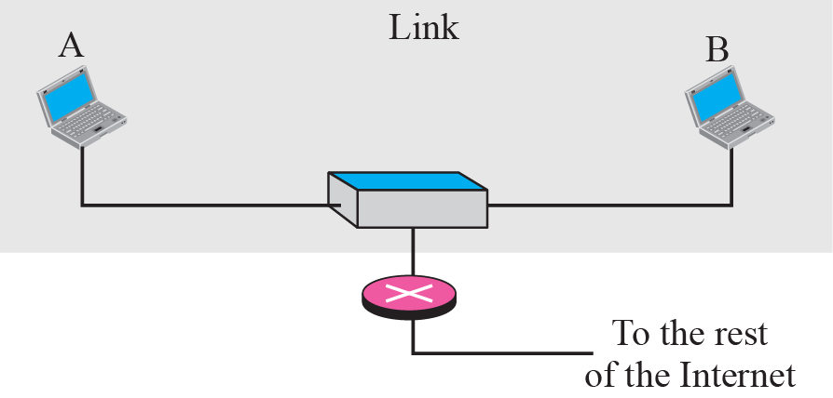
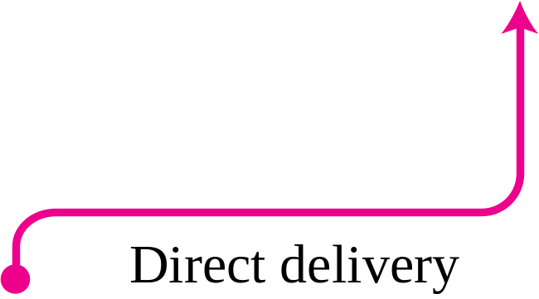
Figure 6.1 Direct delivery
ΤΧΠ/ΙΠ Προτοχολ Συιτε
<νυμβερ>

Slide 7
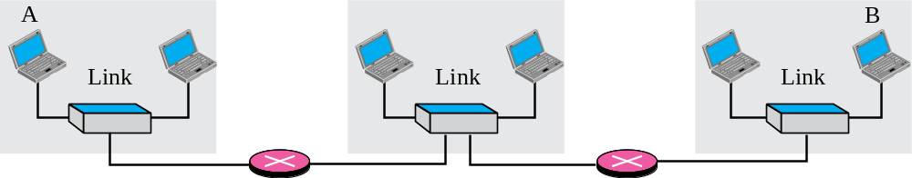
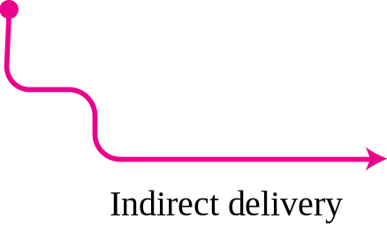
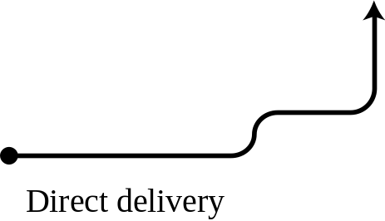

Figure 6.2 Indirect delivery
ΤΧΠ/ΙΠ Προτοχολ Συιτε
<νυμβερ>

Slide 8
6-2 FORWARDING
Forwarding means to place the packet in its route to its destination. Since the Internet today is made of a combination of links (networks), forwarding means to deliver the packet to the next hop (which can be the final destination or the intermediate connecting device). Although the IP protocol was originally designed as a connectionless protocol, today the tendency is to use IP as a connection-oriented protocol.
ΤΧΠ/ΙΠ Προτοχολ Συιτε
<νυμβερ>

Slide 9
Topics Discussed in the Section
Forwarding Based on Destination Address
Forwarding Based on Label
ΤΧΠ/ΙΠ Προτοχολ Συιτε
<νυμβερ>

Slide 10
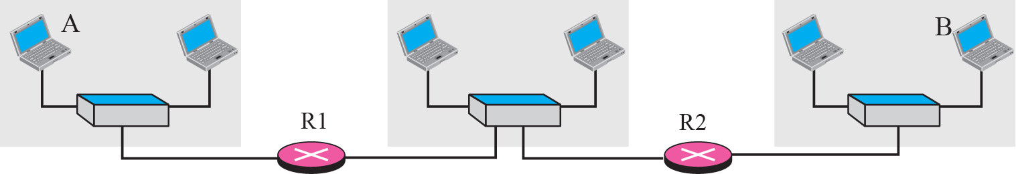
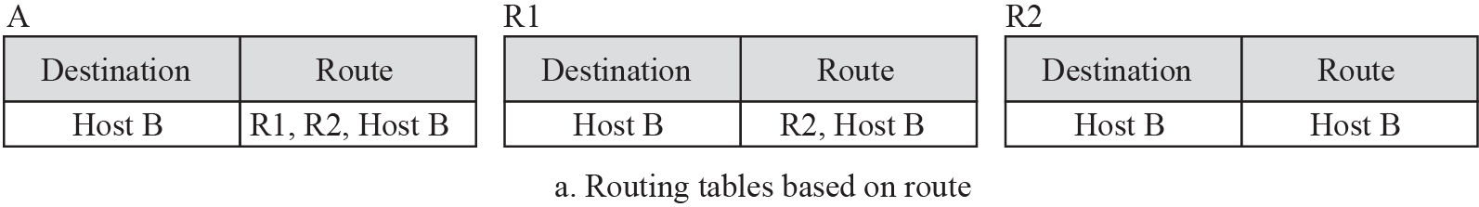
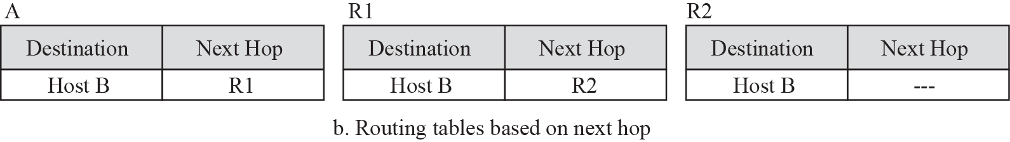
Figure 6.3 Next-hop method
ΤΧΠ/ΙΠ Προτοχολ Συιτε
<νυμβερ>

Slide 11
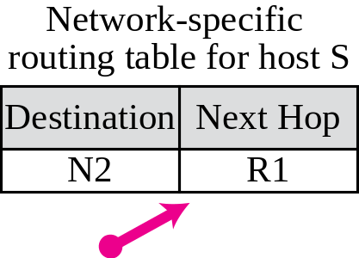
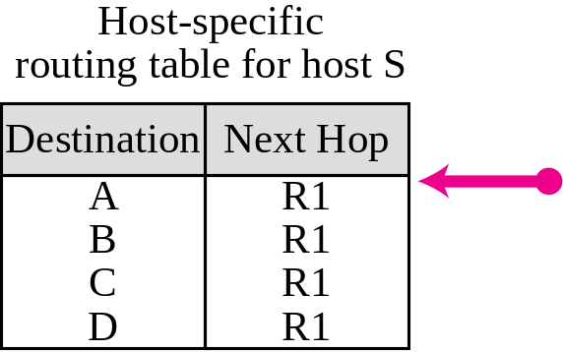
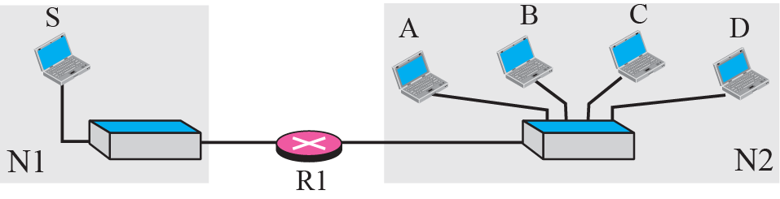
Figure 6.4 Network-specific method
ΤΧΠ/ΙΠ Προτοχολ Συιτε
<νυμβερ>
Notes:
Host-specific
routing table for host SNext HopR1
R1
R1
R1DestinationA
B
C

Slide 12
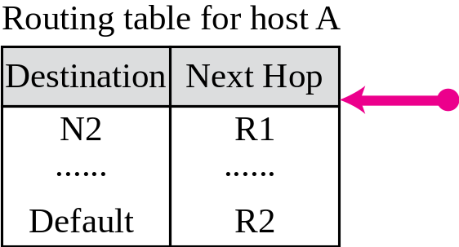
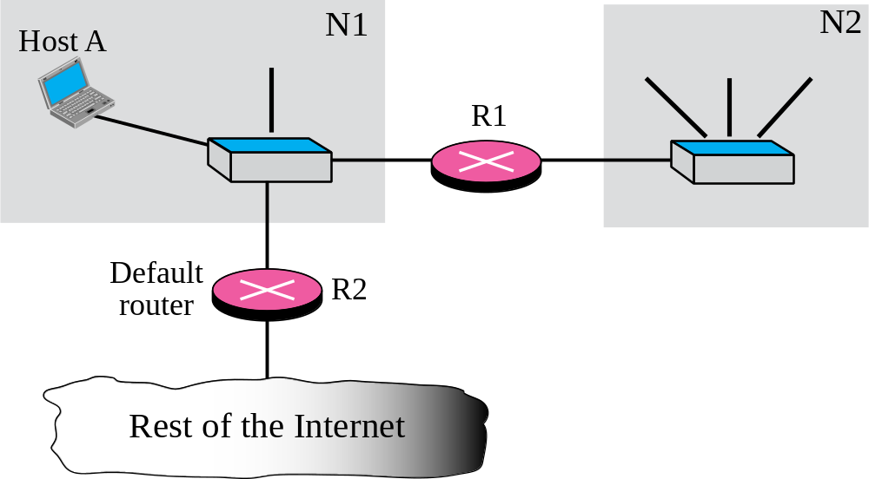
Figure 6.6 Default routing
ΤΧΠ/ΙΠ Προτοχολ Συιτε
<νυμβερ>

Slide 13

Note
In classful addressing we can have a routing table with three columns;
in classless addressing,
we need at least four columns.
ΤΧΠ/ΙΠ Προτοχολ Συιτε
<νυμβερ>

Slide 14
6-3 STRUCTURE OF A ROUTER
In our discussion of forwarding and routing, we represented a router as a black box that accepts incoming packets from one of the input ports (interfaces), uses a routing table to find the output port from which the packet departs, and sends the packet from this output port. In this section we open the black box and look inside. However, our discussion won’t be very detailed; entire books have been written about routers. We just give an overview to the reader.
ΤΧΠ/ΙΠ Προτοχολ Συιτε
<νυμβερ>

Slide 15
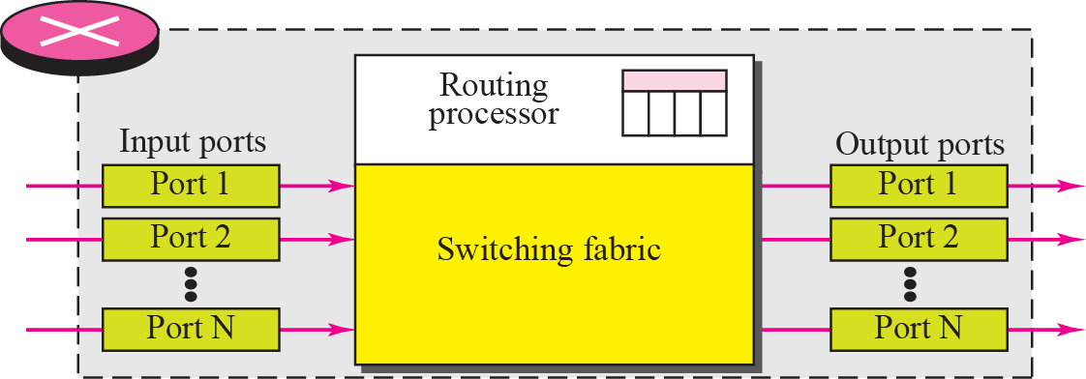
Figure 6.22 Router components
ΤΧΠ/ΙΠ Προτοχολ Συιτε
<νυμβερ>

Slide 16
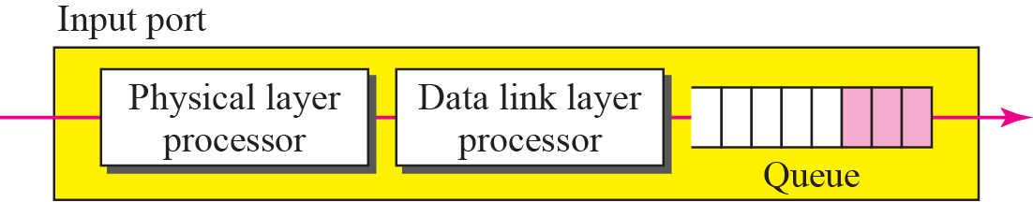
Figure 6.23 Input port
ΤΧΠ/ΙΠ Προτοχολ Συιτε
<νυμβερ>

Slide 17
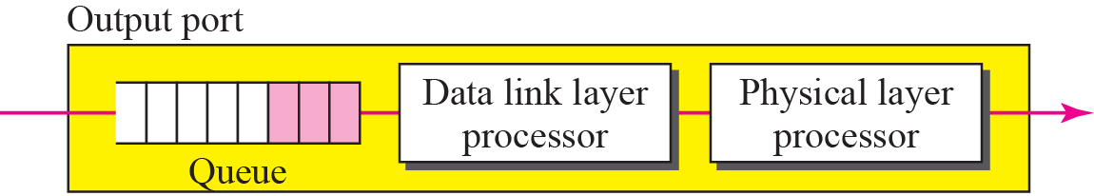
Figure 6.24 Output port
ΤΧΠ/ΙΠ Προτοχολ Συιτε
<νυμβερ>

