Slide 1

Chapter 7
Internet Protocol Version4
(IPv4)
Copyright © The McGraw-Hill Companies, Inc. Permission required for reproduction or display.

Slide 2
OBJECTIVES:
To explain the general idea behind the IP protocol and the position of IP in TCP/IP protocol suite.
To show the general format of an IPv4 datagram.
To discuss fragmentation and reassembly of datagrams.
To discuss several options that can be in an IPv4 datagram and their applications.
To show how a checksum is calculated for the header of an IPv4 datagram at the sending site and how the checksum is checked at the receiver site.
To discuss IP over ATM and compare it with IP over LANs and/or point-to-point WANs.
To show a simplified version of the IP package and give the pseudocode for some modules.

Slide 3
Chapter Outline
7.1 Introduction
7.2 Datagrams
7.3 Fragmentation
7.4 Options
7.5 Checksum
7.6 IP over ATM
7.7 Security
7.8 IP Package

Slide 4
7-1 INTRODUCTION
The Internet Protocol (IP) is the transmission mechanism used by the TCP/IP protocols at the network layer.

Slide 5
Topics Discussed in the Section
Relationship of IP to the rest of the TCP/IP Suite
IP is an unreliable and connectionless datagram protocol—a best-effort delivery service. The term best-effort means that IP packets can be corrupted, lost, arrive out of order, or delayed and may create congestion for the network.
If reliability is important, IP must be paired with a reliable protocol such as TCP.
IP is also a connectionless protocol for a packet switching network that uses the datagram approach (see Chapter 4). This means that each datagram is handled independently, and each datagram can follow a different route to the destination. This implies that datagrams sent by the same source to the same destination could arrive out of order. Also, some could be lost or corrupted during transmission. Again, IP relies on a higher-level protocol to take care of all these problems.

Slide 6
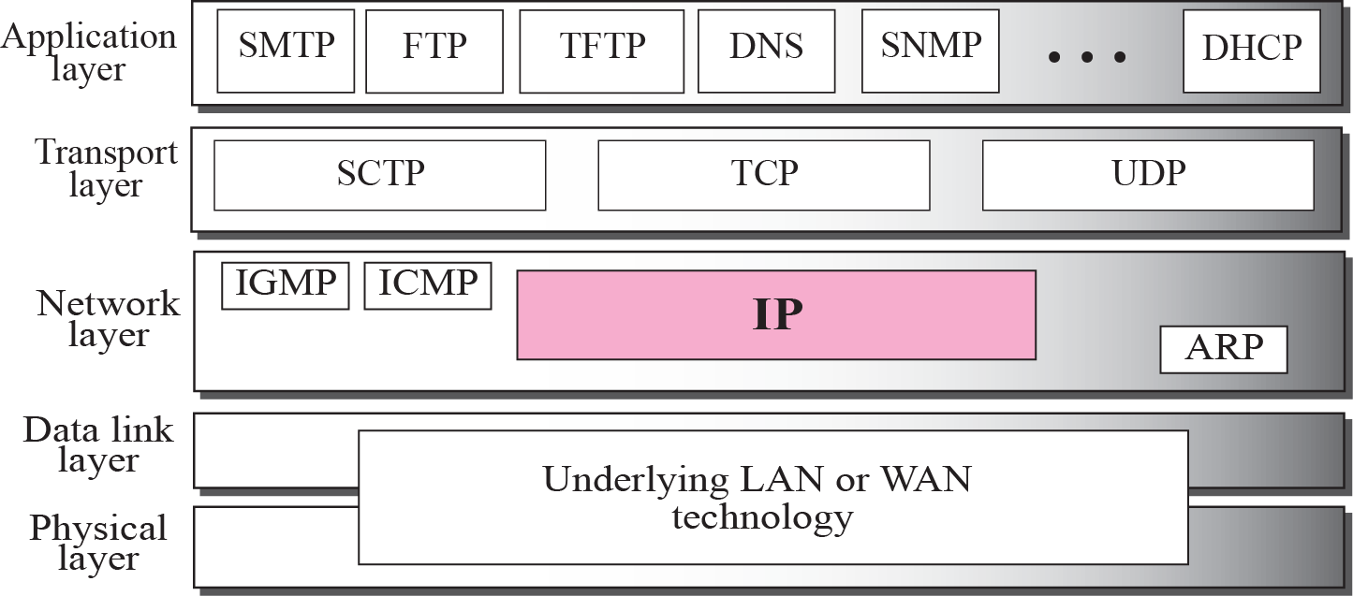
Figure 7.1 Position of IP in TCP/IP protocol suite

Slide 7
7-2 DATAGRAMS
Packets in the network (internet) layer are called datagrams. A datagram is a variable-length packet consisting of two parts: header and data. The header is 20 to 60 bytes in length and contains information essential to routing and delivery. It is customary in TCP/IP to show the header in 4-byte sections. A brief description of each field is in order.

Slide 8
Topics Discussed in the Section
Format of the datagram packet
Some examples

Slide 9
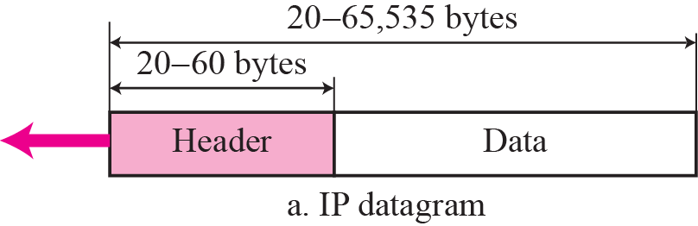
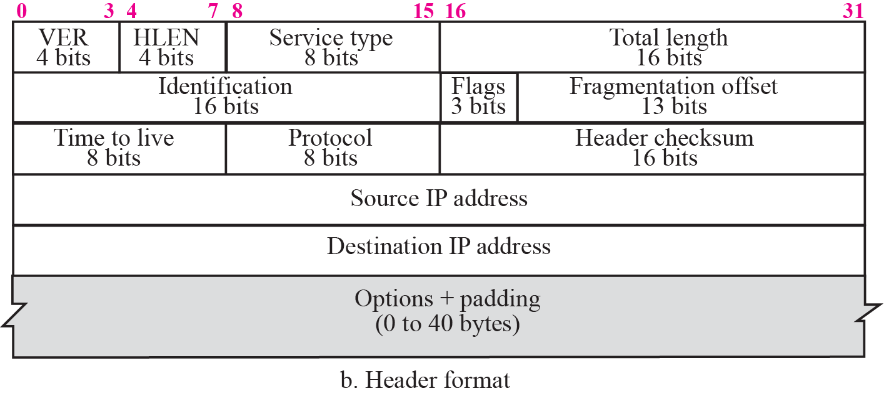
Figure 7.2 IP datagram

Slide 10
IP Datagram Fields
❑ Version (VER). This 4-bit field defines the version of the IP protocol.
❑ Header length (HLEN). This 4-bit field defines the total length of the datagram header in 4-byte words
❑ Service type. In the original design of IP header, this field was referred to as type of service (TOS), which defined how the datagram should be handled.
❑ Total length. This is a 16-bit field that defines the total length (header plus data) of the IP datagram in bytes. To find the length of the data coming from the upper layer, subtract the header length from the total length.
❑ Identification. This field is used in fragmentation (discussed in the next section).
❑ Flags. This field is used in fragmentation (discussed in the next section).

Slide 11
IP Datagram Fields – cont.
❑ Fragmentation offset. This field is used in fragmentation (discussed in the next section).
❑ Time to live. A datagram has a limited lifetime in its travel through an internet. This field was originally designed to hold a timestamp, which was decremented by each visited router. The datagram was discarded when the value became zero.
❑ Protocol. This 8-bit field defines the higher-level protocol that uses the services of the IP layer.
❑ Checksum. The checksum concept and its calculation are discussed later in this chapter.
❑ Source address. This 32-bit field defines the IP address of the source. This field must remain unchanged during the time the IP datagram travels from the source host to the destination host.
❑ Destination address. This 32-bit field defines the IP address of the destination. This field must remain unchanged during the time the IP datagram travels from the source host to the destination host.

Slide 12
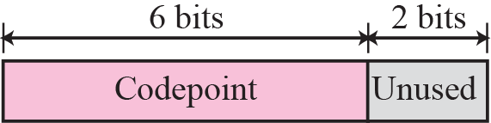
Figure 7.3 Service type

Slide 13
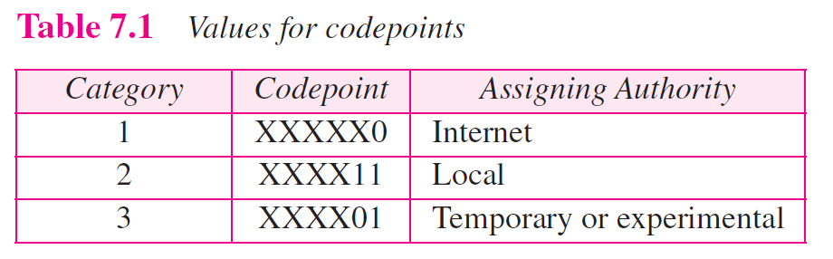

Slide 14

Note
The total length field defines the total length of the datagram including the header.

Slide 15

Figure 7.4 Encapsulation of a small datagram in an Ethernet frame

Slide 16
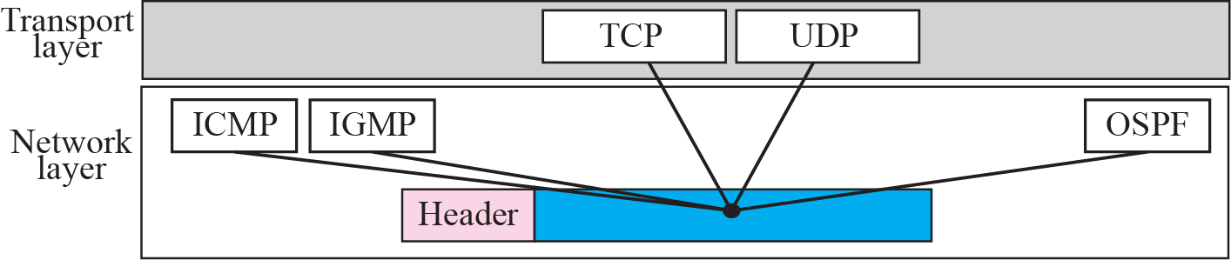
Figure 7.5 Multiplexing

Slide 18
Example 7.1
An IP packet has arrived with the first 8 bits as shown:
The receiver discards the packet. Why?
Solution
There is an error in this packet. The 4 left-most bits (0100) show the version, which is correct. The next 4 bits (0010) show the wrong header length (2 × 4 = 8). The minimum number of bytes in the header must be 20. The packet has been corrupted in transmission.

Slide 19
Example 7.2
In an IP packet, the value of HLEN is 1000 in binary. How many bytes of options are being carried by this packet?
Solution
The HLEN value is 8, which means the total number of bytes in the header is 8 × 4 or 32 bytes. The first 20 bytes are the base header, the next 12 bytes are the options.

Slide 20
Example 7.3
In an IP packet, the value of HLEN is 5₁₆ and the value of the total length field is 0028₁₆. How many bytes of data are being carried by this packet?
Solution
The HLEN value is 5, which means the total number of bytes in the header is 5 × 4 or 20 bytes (no options). The total length is 40 bytes, which means the packet is carrying 20 bytes of data (40 − 20).
Example: HLEN = 6 and Total Length filed is 0028₁₆
Answer: Header = 6 x4 = 24 bytes, options= 24-20 = 4,
Data = 40 – 24=26 bytes

Slide 21
Example 7.4
An IP packet has arrived with the first few hexadecimal digits as shown below:
How many hops can this packet travel before being dropped? The data belong to what upper layer protocol?
Solution
To find the time-to-live field, we skip 8 bytes (16 hexadecimal digits). The time-to-live field is the ninth byte, which is 01. This means the packet can travel only one hop. The protocol field is the next byte (02), which means that the upper layer protocol is IGMP (see Table 7.2)

Slide 22
7-3 FRAGMENTATION
A datagram can travel through different networks. Each router decapsulates the IP datagram from the frame it receives, processes it, and then encapsulates it in another frame. The format and size of the received frame depend on the protocol used by the physical network through which the frame has just traveled. The format and size of the sent frame depend on the protocol used by the physical network through which the frame is going to travel.

Slide 23
Topics Discussed in the Section
Maximum Transfer Unit (MTU)
Fields Related to Fragmentation

Slide 24
Maximum Transfer Unit (MTU)
Each data link layer protocol has its own frame format in most protocols. One of the fields defined in the format is the maximum size of the data field. In other words, when a datagram is encapsulated in a frame, the total size of the datagram must be less than this maximum size, which is defined by the restrictions imposed by the hardware and software used in the network.
The source usually does not fragment the IP packet. The transport layer will instead segment the data into a size that can be accommodated by IP and the data link layer in use.
When a datagram is fragmented, each fragment has its own header with most of the fields repeated, but some changed. A fragmented datagram may itself be fragmented if it encounters a network with an even smaller MTU. In other words, a datagram can be fragmented several times before it reaches the final destination.

Slide 25
Maximum Transfer Unit (MTU)-cont.
A datagram can be fragmented by the source host or any router in the path. When a datagram is fragmented, required parts of the header must be copied by all Fragments.
When a datagram is fragmented, required parts of the header must be copied by all fragments.

Slide 26

Figure 7.6 MTU

Slide 27
Note
Only data in a datagram is fragmented.

Slide 28
Fields Related to Fragmentation
❑ Identification. This 16-bit field identifies a datagram originating from the source host. The combination of the identification and source IP address must uniquely define a datagram as it leaves the source host. To guarantee uniqueness, the IP protocol uses a counter to label the datagrams.
❑ Flags. This is a three-bit field. The first bit is reserved (not used). The second bit is called the do not fragment bit. If its value is 1, the machine must not fragment thedatagram. If it cannot pass the datagram through any available physical network, it discards the datagram and sends an ICMP error message to the source host (see Chapter 9). If its value is 0, the datagram can be fragmented if necessary. The third bit is called the more fragment bit. If its value is 1, it means the datagram is not the last fragment; there are more fragments after this one. If its value is 0, it means this is the last or only fragment (see Figure 7.7).

Slide 29

Figure 7.7 Flags field

Slide 30
Fields Related to Fragmentation-Cont.
❑ Fragmentation offset. This 13-bit field shows the relative position of this fragment with respect to the whole datagram. It is the offset of the data in the original datagram measured in units of 8 bytes. Figure 7.8 shows a datagram with a data size of 4000 bytes fragmented into three fragments. The bytes in the original datagram are numbered 0 to 3999. The first fragment carries bytes 0 to 1399. The offset for this datagram is 0/8 = 0. The second fragment carries bytes 1400 to 2799; the offset value for this fragment is 1400/8 = 175. Finally, the third fragment carries bytes 2800 to 3999. The offset value for this fragment is 2800/8 = 350.

Slide 31
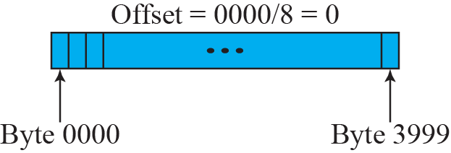
Figure 7.8 Fragmentation example

Slide 32
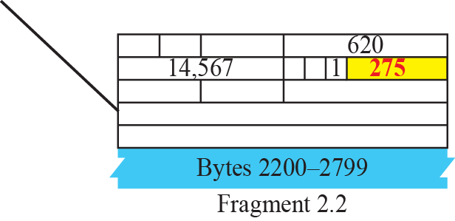
Figure 7.9 Detailed fragmentation example
The figure shows what happens if a fragment itself is fragmented. In this case the value of the offset field is always relative to the original datagram.

Slide 33
Example 7.5
A packet has arrived with an M bit value of 0. Is this the first fragment, the last fragment, or a middle fragment? Do we know if the packet was fragmented?
Solution
If the M bit is 0, it means that there are no more fragments; the fragment is the last one. However, we cannot say if the original packet was fragmented or not. A nonfragmented packet is considered the last fragment.

Slide 34
Example 7.6
A packet has arrived with an M bit value of 1. Is this the first fragment, the last fragment, or a middle fragment? Do we know if the packet was fragmented?
Solution
If the M bit is 1, it means that there is at least one more fragment. This fragment can be the first one or a middle one, but not the last one. We don’t know if it is the first one or a middle one; we need more information (the value of the fragmentation offset). See also the next example.

Slide 35
Example 7.7
A packet has arrived with an M bit value of 1 and a fragmentation offset value of zero. Is this the first fragment, the last fragment, or a middle fragment?
Solution
Because the M bit is 1, it is either the first fragment or a middle one. Because the offset value is 0, it is the first fragment.

Slide 36
Example 7.8
A packet has arrived in which the offset value is 100. What is the number of the first byte? Do we know the number of the last byte?
Solution
To find the number of the first byte, we multiply the offset value by 8. This means that the first byte number is 800. We cannot determine the number of the last byte unless we know the length of the data.

Slide 37
Example 7.9
A packet has arrived in which the offset value is 100, the value of HLEN is 5 and the value of the total length field is 100. What is the number of the first byte and the last byte?
Solution
The first byte number is 100 × 8 = 800. The total length is 100 bytes and the header length is 20 bytes (5 × 4), which means that there are 80 bytes in this datagram. If the first byte number is 800, the last byte number must be 879.

Slide 38
Practice Set Q15 (Try by yourself and will continue at 4:30
An IP datagram has arrived with the following information in the header (in hexadecimal):
45 00 00 54 00 03 00 00 20 06 00 00 7C 4E 03 02 B4 0E 0F 02
a. Are there any options?
b. Is the packet fragmented?
c. What is the size of the data?
d. Is a checksum used?
e. How many more routers can the packet travel to?
f. What is the identification number of the packet?
g. What is the type of service?
4 | 5 | 00 | 0054
0003 |  |  | 0 | 000
20 |  | 06 | 0000
7C4E0302
B40E0F02

Slide 39
Practice Set Q15 - Answer
a. There are no options.
b. The packet is not fragmented.
c. The packet carries 64 bytes of data.
d. The header is 20 bytes long.
e. The checksum is not used.
f. The packet may visit up to 32 more routers.
g. The identification number of the packet is 3 (decimal). The type of service is

Slide 40
7-4 OPTIONS
The header of the IP datagram is made of two parts: a fixed part and a variable part. The fixed part is 20 bytes long and was discussed in the previous section. The variable part comprises the options, which can be a maximum of 40 bytes.
Options, as the name implies, are not required for a datagram. They can be used for network testing and debugging. Although options are not a required part of the IP header, option processing is required of the IP software.

Slide 41
7-5 CHECKSUM
The error detection method used by most TCP/IP protocols is called the checksum. The checksum protects against the corruption that may occur during the transmission of a packet. It is redundant information added to the packet. The checksum is calculated at the sender and the value obtained is sent with the packet. The receiver repeats the same calculation on the whole packet including the checksum. If the result is satisfactory (see below), the packet is accepted; otherwise, it is rejected.

Slide 42
Topics Discussed in the Section
Checksum Calculation at the Sender
Checksum Calculation at the Receiver
Checksum in the Packet

Slide 43
Checksum Calculation at the Sender
❑ The packet is divided into k sections, each of n bits.
❑ All sections are added together using one’s complement arithmetic.
❑ The final result is complemented to make the checksum.

Slide 44
Checksum Calculation at the Receiver
The receiver divides the received packet into k sections and adds all sections. It then complements the result. If the final result is 0, the packet is accepted; otherwise, it is rejected. Figure 7.22 shows graphically what happens at the sender and the receiver.

Slide 45
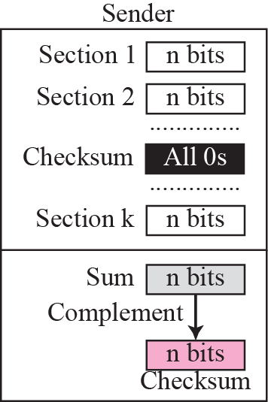
Figure 7.22 Checksum concept

Slide 46
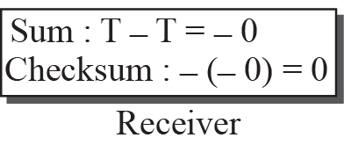
Figure 7.23 Checksum in one’s complement arithmetic

Slide 47
Checksum in the IP Packet
The implementation of the checksum in the IP packet follows the same principles discussed above.
First, the value of the checksum field is set to 0.
Then, the entire header is divided into 16-bit sections and added together.
Add carry to Sum.
The result after carry added (sum) is complemented and inserted into the checksum field.
The checksum in the IP packet covers only the header, not the data.

Slide 48
Calculating the IPv4 header checksum
Take the following truncated excerpt of an IPv4 packet. The header is shown in bold and the checksum is underlined. 4500 0073 0000 4000 4011 b861 c0a8 0001 c0a8 00c7 0035 e97c 005f 279f 1e4b 8180
For one's complement addition, each time a carry occurs, we must add a 1 to the sum. A carry check and correction can be performed with each addition or as a post-process after all additions. If another carry is generated by the correction, another 1 is added to the sum.
To calculate the checksum, we can first calculate the sum of each 16 bit value within the header, skipping only the checksum field itself. Note that these values are in hexadecimal notation. 4500 + 0073 + 0000 + 4000 + 4011 + c0a8 + 0001 + c0a8 + 00c7 = 2479C The first digit is the carry count and is added to the sum: 2 + 479C = 479E (if another carry is generated by this addition, another 1 must be added to the sum) To obtain the checksum we take the one's complement of this result: B861 (as shown underlined in the original IP packet header).

Slide 49
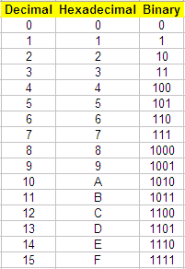
Calculating the IPv4 header checksum (using Binary)
4500 + 0073 + 0000 + 4000 + 4011 + c0a8 + 0001 + c0a8 + 00c7
0100 0101 0000 0000
0000 0000 0111 0011
0000 0000 0000 0000
0100 0000 0000 0000
0100 0000 0001 0001
1100 0000 1010 1000
0000 0000 0000 0001
1100 0000 1010 1000
0000 0000 1100 0111
10 0100 0111 1001 1100 = 2 479C (sum)
Add carry 10
0100 0111 1001 1110 (need find 1’s complement)
1’ 1011 1000 0110 0001 (checksum) = B861
The first digit is the carry count and is added to the sum: 2 + 479C = 479E (if another carry is generated by this addition, another 1 must be added to the sum) To obtain the checksum we take the one's complement of this result: B861.

Slide 50
Calculating checksum
4500 + 0073 + 0000 + 4000 + 4011 + c0a8 + 0001 + c0a8 + 00c7
0100 0101 0000 0000 (4500h)
0000 0000 0111 0011 (0073h)
Sum 0100 0101 0111 0011
0000 0000 0000 0000 (0000h)
Sum 0100 0101 0111 0011
0100 0000 0000 0000 (4000h)
Sum 1000 0101 0111 0011
0100 0000 0001 0001 (4011h)
Sum 1100 0101 1000 0100
1100 0000 1010 1000 (C0A8h)
Sum 1 1000 0110 0010 1100
Carry 1
1000 0110 0010 1101
0000 0000 0000 0001 (0001h)
Sum 1000 0110 0010 1110
1100 0000 1010 1000 (C0A8h)
Sum 1 0100 0110 1101 0110
Carry 1
0100 0110 1101 0111
0000 0000 1100 0111 (00C7h)
Sum 0100 0111 1001 1110 (479Eh)
The carry count is added to the sum: To obtain the checksum we take the one's complement of this result: B861.

Slide 51
Verifying the IPv4 header checksum
When verifying a checksum, the same procedure is used as above, except that the original header checksum is not omitted.
4500 + 0073 + 0000 + 4000 + 4011 + b861 + c0a8 + 0001 + c0a8 + 00c7 = 2fffd
Add the carry bits:
fffd + 2 = ffff
Taking the ones' complement (flipping every bit) yields 0000, which indicates that no error is detected. IP header checksum does not check for the correct order of 16 bit values within the header.

Slide 52
Note
Checksum in IP covers only the header, not the data.

Slide 53
Example 7.17
Figure 7.24 shows an example of a checksum calculation at the sender site for an IP header without options. The header is divided into 16-bit sections. All the sections are added and the sum is complemented. The result is inserted in the checksum field.

Slide 54
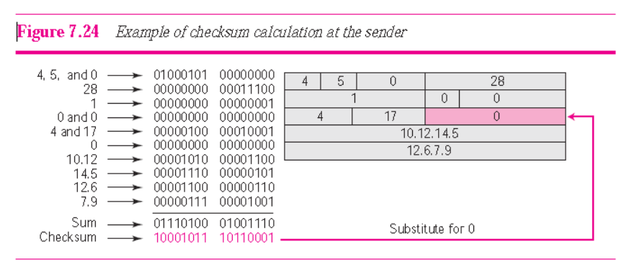
Figure 7.24 Example of checksum calculation at the sender
45 00 00 54 00 03 00 00 20 06 00 00 7C 4E 03 02 B4 0E 0F 02
Notes:
Substitute for 012.6.7.917015010.12.14.50028Substitute for 012.6.7.917015010.12.14.50028Substitute for 0Substitute for 0

Slide 55
Example 7.18
Figure 7.25 shows the checking of checksum calculation at the receiver site (or intermediate router) assuming that no errors occurred in the header. The header is divided into 16-bit sections. All the sections are added and the sum is complemented. Since the result is 16 0s, the packet is accepted.

Slide 56
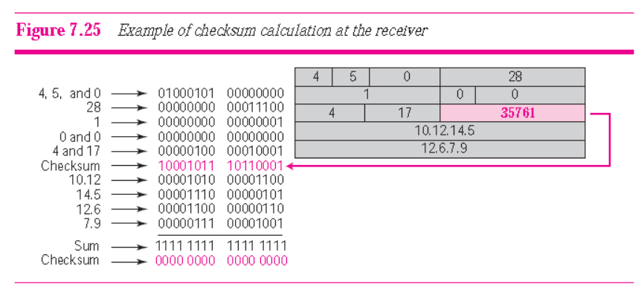
Figure 7.25 Example of checksum calculation at the receiver

Slide 57
Note
Appendix D gives an algorithm for checksum calculation.

Slide 58
7-7 SECURITY
The IPv4 protocol, as well as the whole Internet, was started when the Internet users trusted each other. No security was provided for the IPv4 protocol. Today, however, the situation is different; the Internet is not secure any more. Although we discuss network security in general and IP security in particular in Chapters 29 and 30, we give a brief idea about the security issues in IP protocol and the solution.

