Slide 1

Chapter 8
Address
Resolution
Protocol
(ARP)
TCP/IP Protocol Suite
Copyright © The McGraw-Hill Companies, Inc. Permission required for reproduction or display.

Slide 2
OBJECTIVES:
To make a distinction between logical address (IP address) and physical address (MAC address).
To describe how the mapping of a logical address to a physical address can be static or dynamic.
To show how the address resolution protocol (ARP) is used to dynamically map a logical address to a physical address.
To show that the proxy ARP can be used to create a subnetting effect.
To discuss ATMARP, which maps the IP addresses when the underlying network is an ATM WAN.
To show that an ARP software package can be made of five components.
To show the pseudocode for each module used in the ARP software package.
TCP/IP Protocol Suite

Slide 3


Chapter
Outline
8.1 Address Mapping
8.2 The ARP Protocol
TCP/IP Protocol Suite

Slide 4
8-1 ADDRESS MAPPING
The delivery of a packet to a host or a router requires two levels of addressing: logical and physical. We need to be able to map a logical address to its corresponding physical address and vice versa. These can be done using either static or
dynamic mapping.
TCP/IP Protocol Suite

Slide 5
Topics Discussed in the Section
Static Mapping
  means creating a table that associates a logical address with a physical address. This table is stored in each machine on the network. This has some limitations because physical addresses may change
Dynamic Mapping
  each time a machine knows the logical address of another machine, it can use a protocol to find the physical address. Two protocols have been designed to perform dynamic mapping: Address Resolution Protocol (ARP) and Reverse Address Resolution Protocol (RARP). ARP maps a logical address to a physical address.
TCP/IP Protocol Suite

Slide 6
8-2 ARP PROTOCOL
Anytime a host or a router has an IP datagram to send to another host or router, it has the logical (IP) address of the receiver. But the IP datagram must be encapsulated in a frame to be able to pass through the physical network. This means that the sender needs the physical address of the receiver. A mapping corresponds a logical address to a physical address. ARP accepts a logical address from the IP protocol, maps the address to the corresponding physical address and pass it to the data link layer.
Anytime a host, or a router, needs to find the physical address of another host or router on its network, it sends an ARP query packet.
Every host or router on the network receives and processes the ARP query packet, but only the intended recipient recognizes its IP address and sends back an ARP response packet.
TCP/IP Protocol Suite

Slide 7
Topics Discussed in the Section
Packet Format
Encapsulation
Operation
Proxy ARP
TCP/IP Protocol Suite

Slide 8
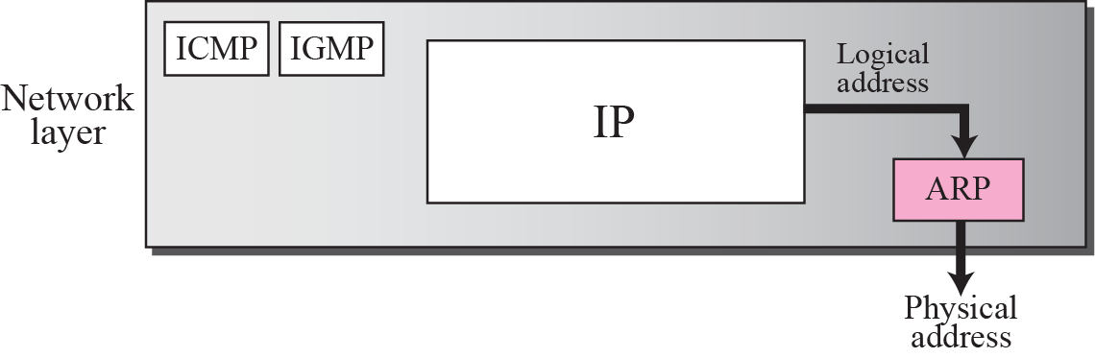
Figure 8.1 Position of ARP in TCP/IP protocol suite
TCP/IP Protocol Suite

Slide 9
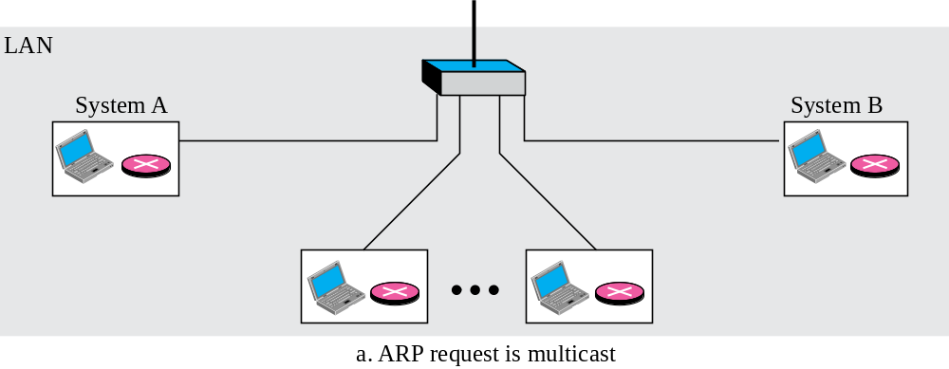
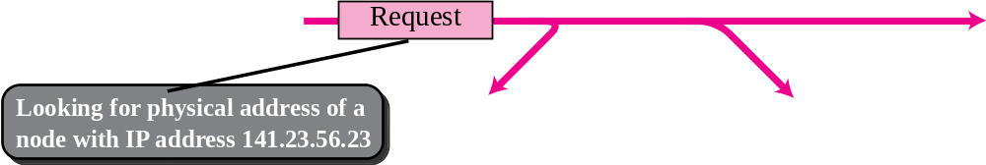
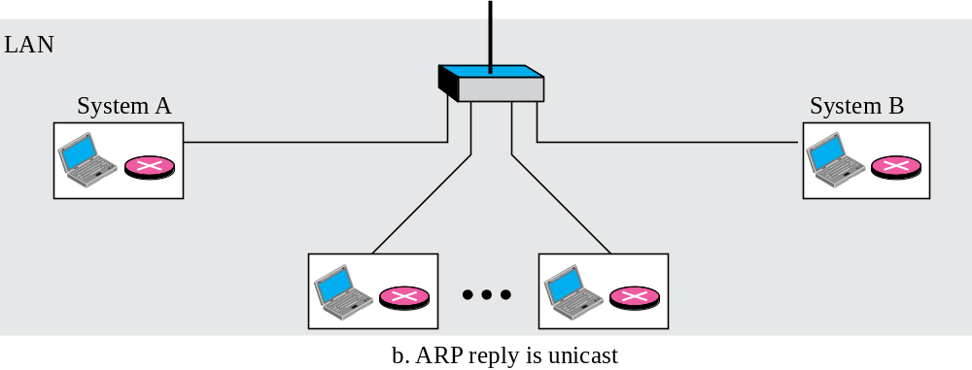
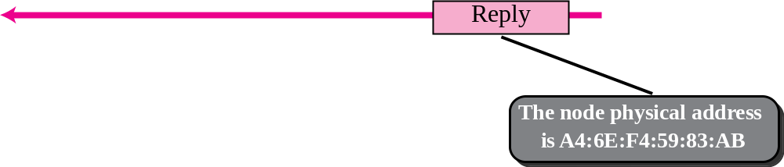
Figure 8.2 ARP operation
TCP/IP Protocol Suite

Slide 10
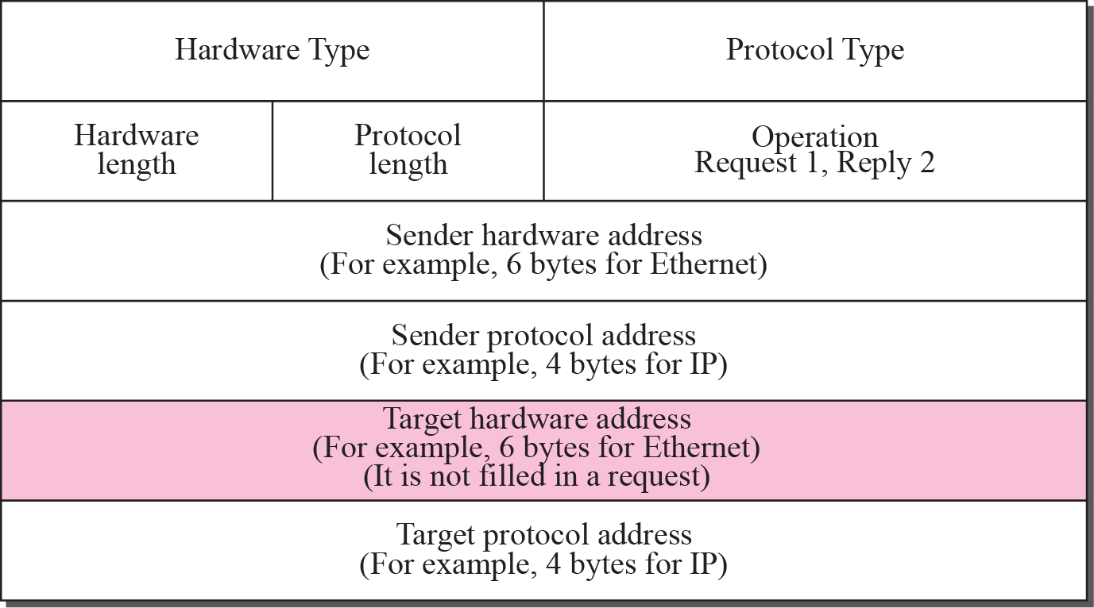
Figure 8.3 ARP packet
TCP/IP Protocol Suite

Slide 11
Packet Format
❑ Hardware type. This is a 16-bit field defining the type of the network on which ARP is running. Each LAN has been assigned an integer based on its type. For example, Ethernet is given the type 1. ARP can be used on any physical network.
❑ Protocol type. This is a 16-bit field defining the protocol. For example, the value of this field for the IPv4 protocol is 080016. ARP can be used with any higher-level protocol.
❑ Hardware length. This is an 8-bit field defining the length of the physical address in bytes. For example, for Ethernet the value is 6.
❑ Protocol length. This is an 8-bit field defining the length of the logical address in bytes. For example, for the IPv4 protocol the value is 4.
TCP/IP Protocol Suite

Slide 12
Packet Format-cont.
❑ Operation. This is a 16-bit field defining the type of packet. Two packet types are defined: ARP request (1), ARP reply (2).
❑ Sender hardware address. This is a variable-length field defining the physical address of the sender. For example, for Ethernet this field is 6 bytes long.
❑ Sender protocol address. This is a variable-length field defining the logical (for example, IP) address of the sender. For the IP protocol, this field is 4 bytes long.
❑ Target hardware address. This is a variable-length field defining the physical address of the target. For example, for Ethernet this field is 6 bytes long. For an ARP request message, this field is all 0s because the sender does not know the physical address of the target.
❑ Target protocol address. This is a variable-length field defining the logical (for example, IP) address of the target. For the IPv4 protocol, this field is 4 bytes long.
TCP/IP Protocol Suite

Slide 13
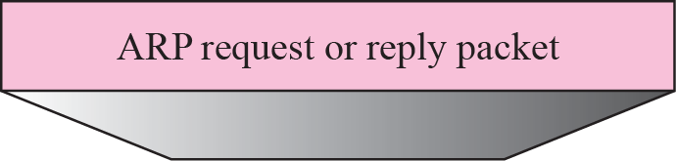
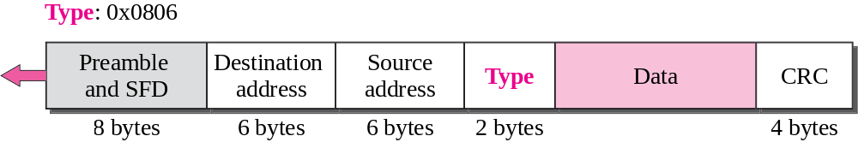
Figure 8.4 Encapsulation of ARP packet
An ARP packet is encapsulated directly into a data link frame. For example, in Figure 8.4 an ARP packet is encapsulated in an Ethernet frame. Note that the type field indicates that the data carried by the frame is an ARP packet.
TCP/IP Protocol Suite

Slide 14
APR OPERATION STEPS
1. The sender knows the IP address of the target. We will see how the sender obtains this shortly.
2. IP asks ARP to create an ARP request message, filling in the sender physical address, the sender IP address, and the target IP address. The target physical address field is filled with 0s.
3. The message is passed to the data link layer where it is encapsulated in a frame using the physical address of the sender as the source address and the physical broadcast address as the destination address.
4. Every host or router receives the frame. Because the frame contains a broadcast destination address, all stations remove the message and pass it to ARP. All machines except the one targeted drop the packet. The target machine recognizes the IP address.
5. The target machine replies with an ARP reply message that contains its physical address. The message is unicast.
6. The sender receives the reply message. It now knows the physical address of the target machine.
7. The IP datagram, which carries data for the target machine, is now encapsulated in a frame and is unicast to the destination.
TCP/IP Protocol Suite

Slide 15

Note
An ARP request is broadcast;
an ARP reply is unicast.
TCP/IP Protocol Suite

Slide 16
Four cases using ARP
❑ Case 1: The sender is a host and wants to send a packet to another host on the same network. In this case, the logical address that must be mapped to a physical address is the destination IP address in the datagram header.
❑ Case 2: The sender is a host and wants to send a packet to another host on another network. In this case, the host looks at its routing table and finds the IP address of the next hop (router) for this destination. If it does not have a routing table, it looks for the IP address of the default router. The IP address of the router becomes the logical address that must be mapped to a physical address.
❑ Case 3: The sender is a router that has received a datagram destined for a host on another network. It checks its routing table and finds the IP address of the next router. The IP address of the next router becomes the logical address that must be mapped to a physical address.
❑ Case 4: The sender is a router that has received a datagram destined for a host in the same network. The destination IP address of the datagram becomes the logical address that must be mapped to a physical address.
TCP/IP Protocol Suite

Slide 17
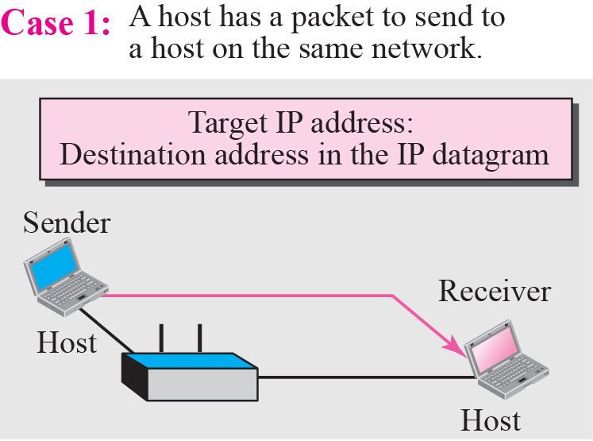
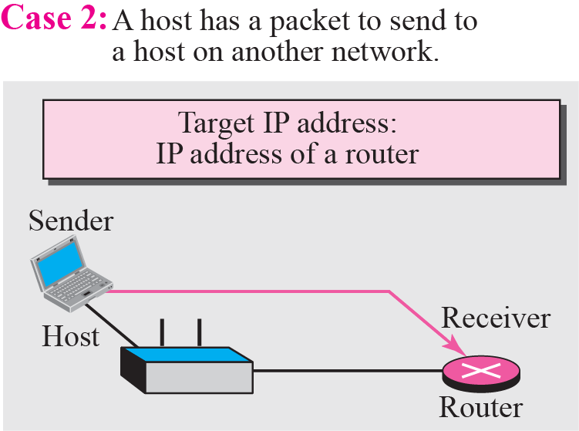
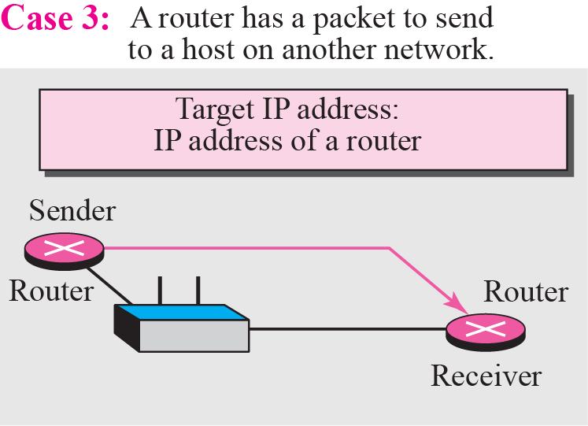
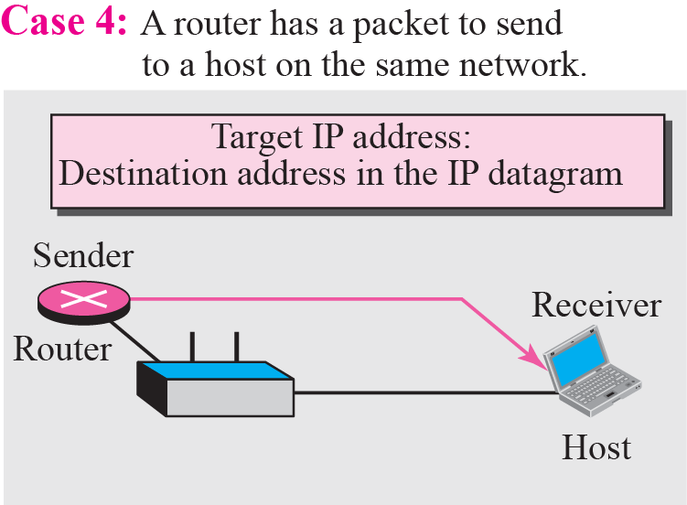
Figure 8.5 Four cases using ARP
TCP/IP Protocol Suite

Slide 18
Example 8.1
A host with IP address 130.23.43.20 and physical address B2:34:55:10:22:10 has a packet to send to another host with IP address 130.23.43.25 and physical address A4:6E:F4:59:83:AB. The two hosts are on the same Ethernet network. Show the ARP request and reply packets encapsulated in Ethernet frames.
Solution
Figure 8.6 shows the ARP request and reply packets. Note that the ARP data field in this case is 28 bytes, and that the individual addresses do not fit in the 4-byte boundary. That is why we do not show the regular 4-byte boundaries for these addresses. Also note that the IP addresses are shown in hexadecimal.
TCP/IP Protocol Suite

Slide 19
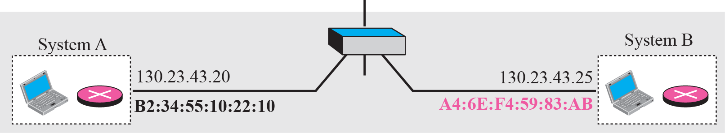
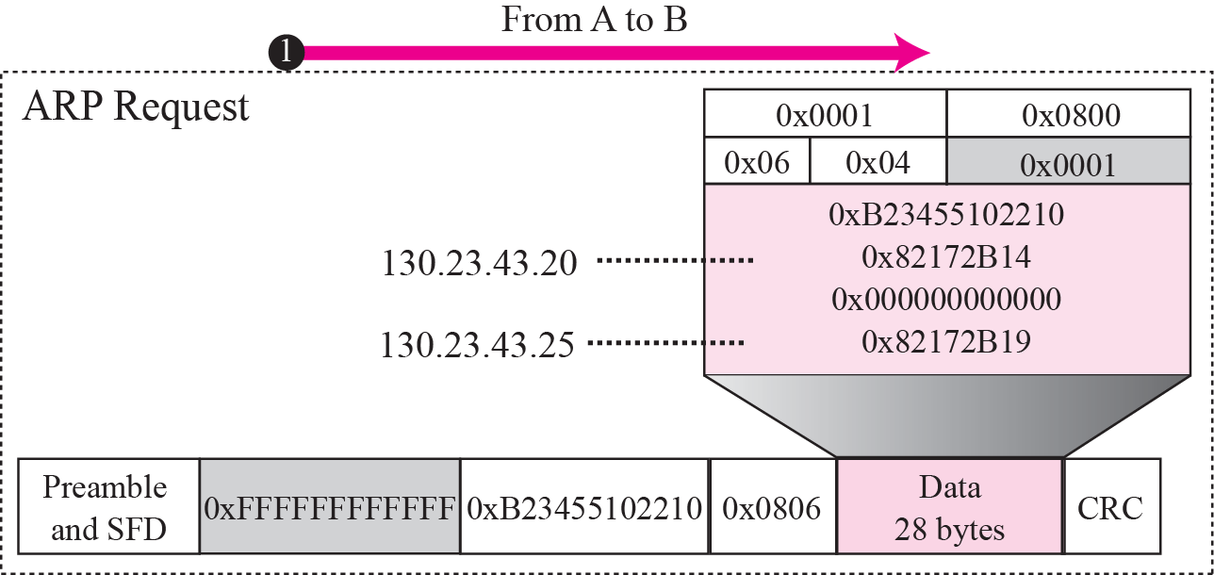
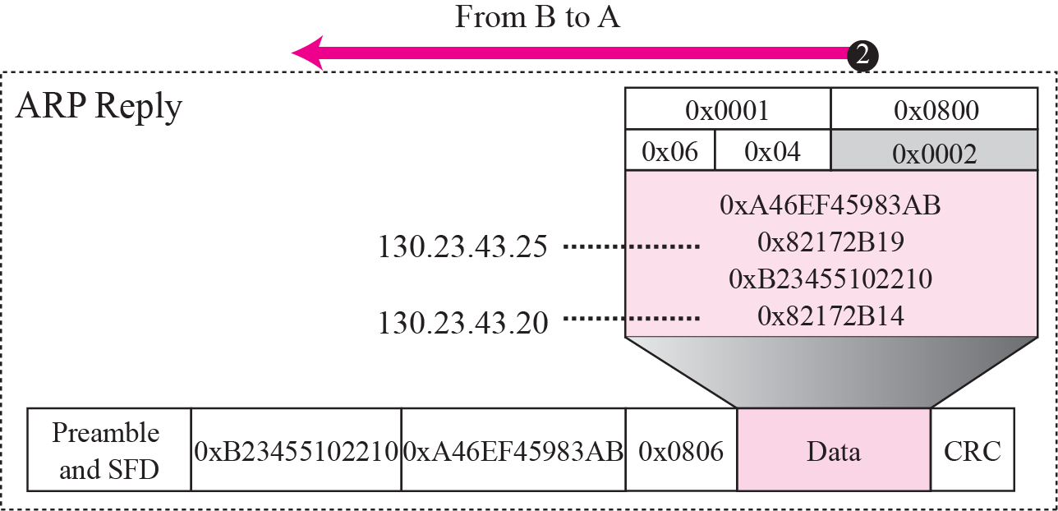
Figure 8.6 Example 8.1
TCP/IP Protocol Suite

Slide 20
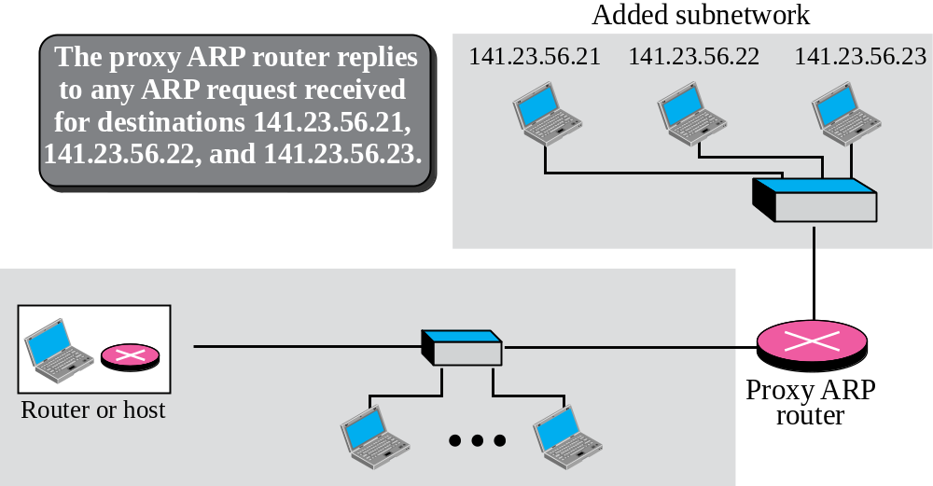
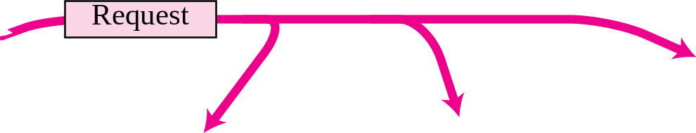
Figure 8.7 Proxy ARP
TCP/IP Protocol Suite

Slide 21
Quiz
A router with IP address 125.45.23.12 and Ethernet physical address 23:45:AB:4F:67:CD has received a packet for a host destination with IP address 125.11.78.10 and Ethernet physical address AA:BB:A2:4F:67:CD.
Show the entries in the ARP request packet sent by the router. Assume no subnetting.
Show the entries in the ARP packet sent in response to part a.
Encapsulate the packet made in part a in a data link frame. Fill in all the ﬁelds.
Encapsulate the packet part b in a data link frame. Fill in all the ﬁelds.
TCP/IP Protocol Suite

Slide 22
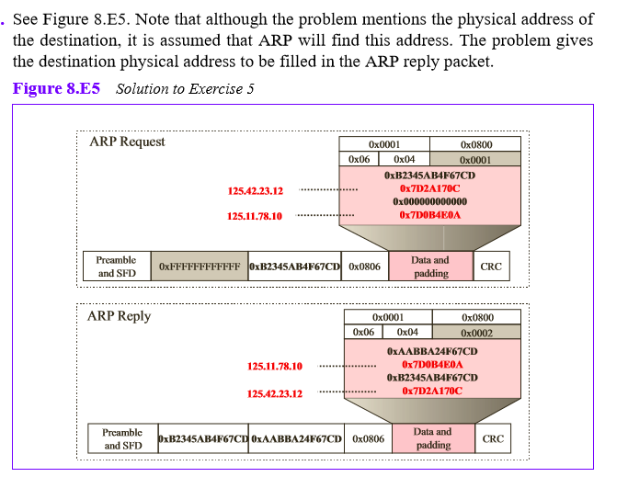
Answer
TCP/IP Protocol Suite

Slide 23
8-3 ATM ARP
We discussed IP over ATM in Chapter 7. When IP packet are moving through an ATMWAN, a mechanism protocol is needed to find (map) the physical address of the exiting-point router in the ATM WAN given the IP address of the router. This is the same task performed by ARP on a LAN. However, there is a difference between a LAN and an ATM network. A LAN is a broadcast network (at the data link layer); ARP uses the broadcasting capability of a LAN to send (broadcast) an ARP request.
TCP/IP Protocol Suite

Slide 24
Topics Discussed in the Section
Packet Format
ATMARP Operation
Logical IP Subnet (LIS)
TCP/IP Protocol Suite

Slide 25
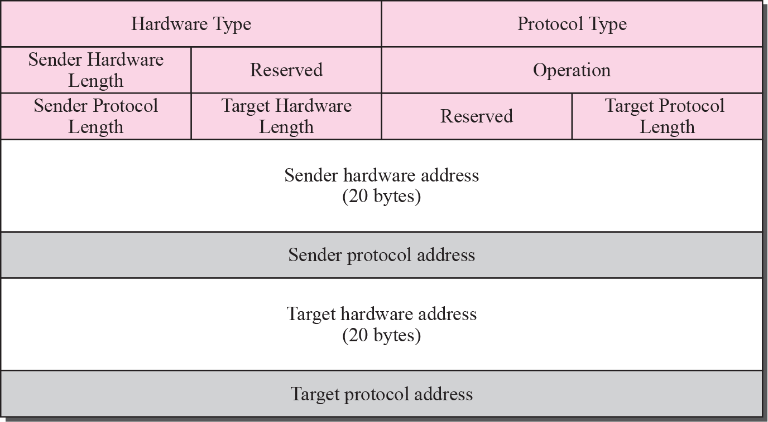
Figure 8.8 ATMARP packet
TCP/IP Protocol Suite

Slide 26
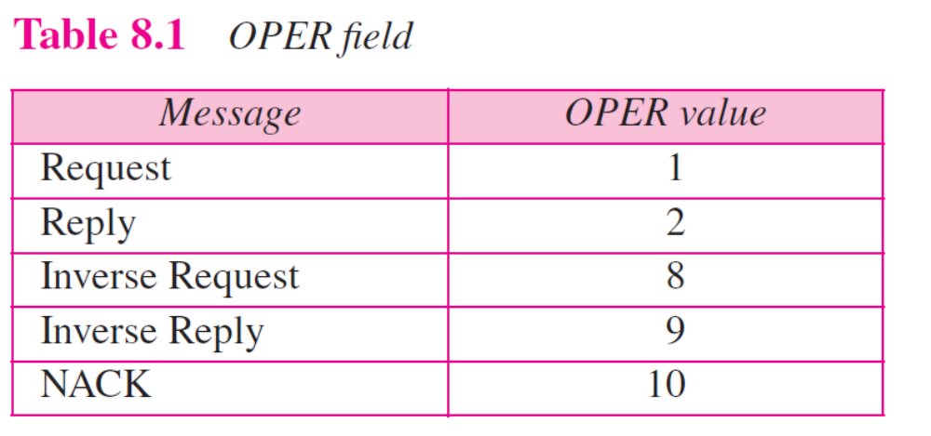
TCP/IP Protocol Suite

Slide 27
Note
The inverse request and inverse
reply messages can bind the
physical address to an IP
address in a PVC situation.
TCP/IP Protocol Suite

Slide 28
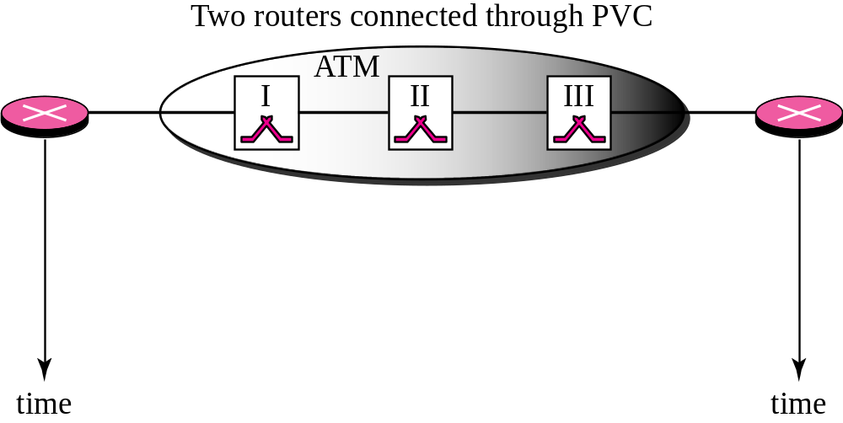
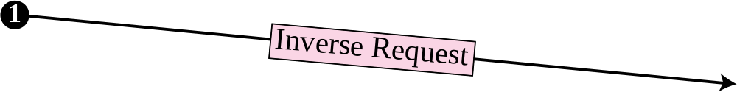
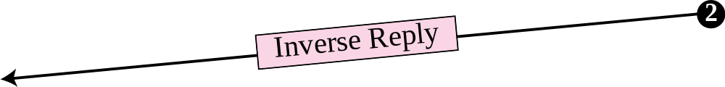
Figure 8.9 Binding with PVC
TCP/IP Protocol Suite

Slide 29
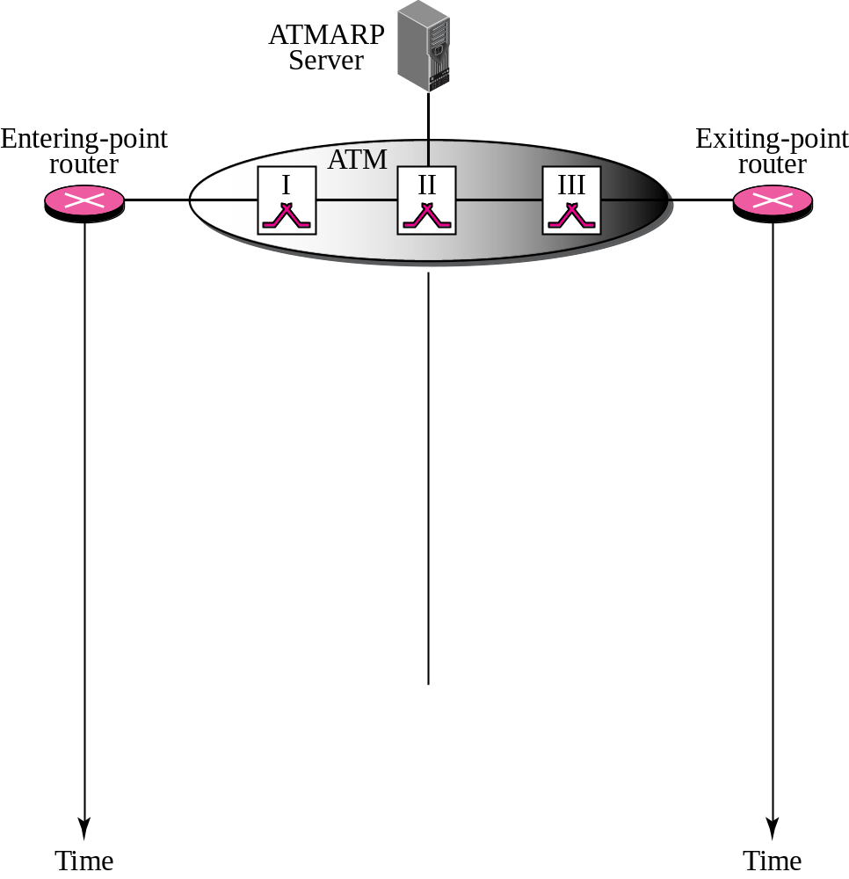



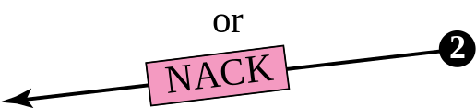

Figure 8.10 Binding with ATMARP
Finding physical
address
TCP/IP Protocol Suite

Slide 30
Note
The request and reply message can be used to bind a physical address to an
IP address in an SVC situation.
TCP/IP Protocol Suite

Slide 31
Note
The inverse request and inverse reply can also be used to build the
server’s mapping table.
TCP/IP Protocol Suite

Slide 32
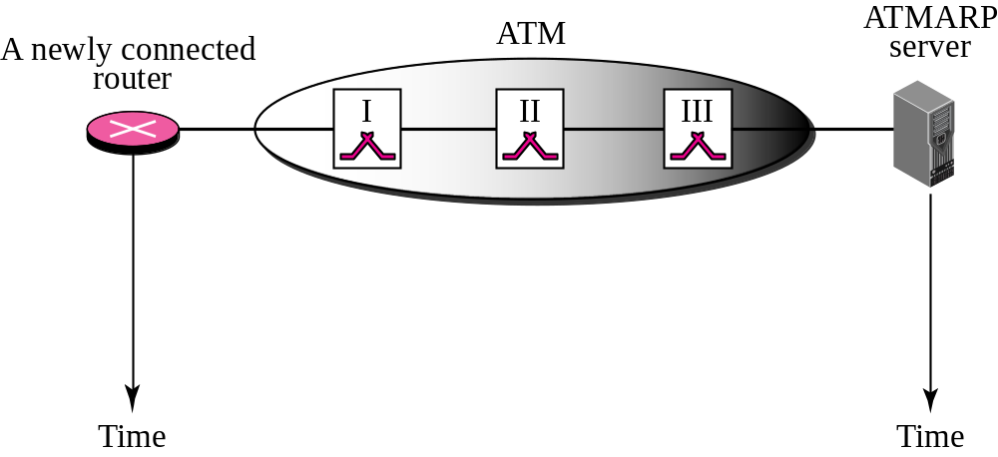
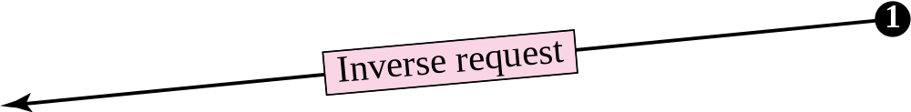
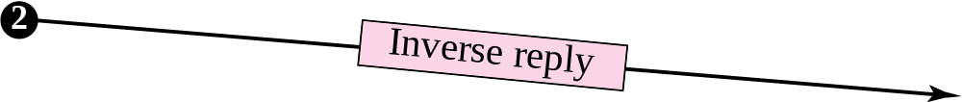
Figure 8.11 Building a table
TCP/IP Protocol Suite

Slide 33
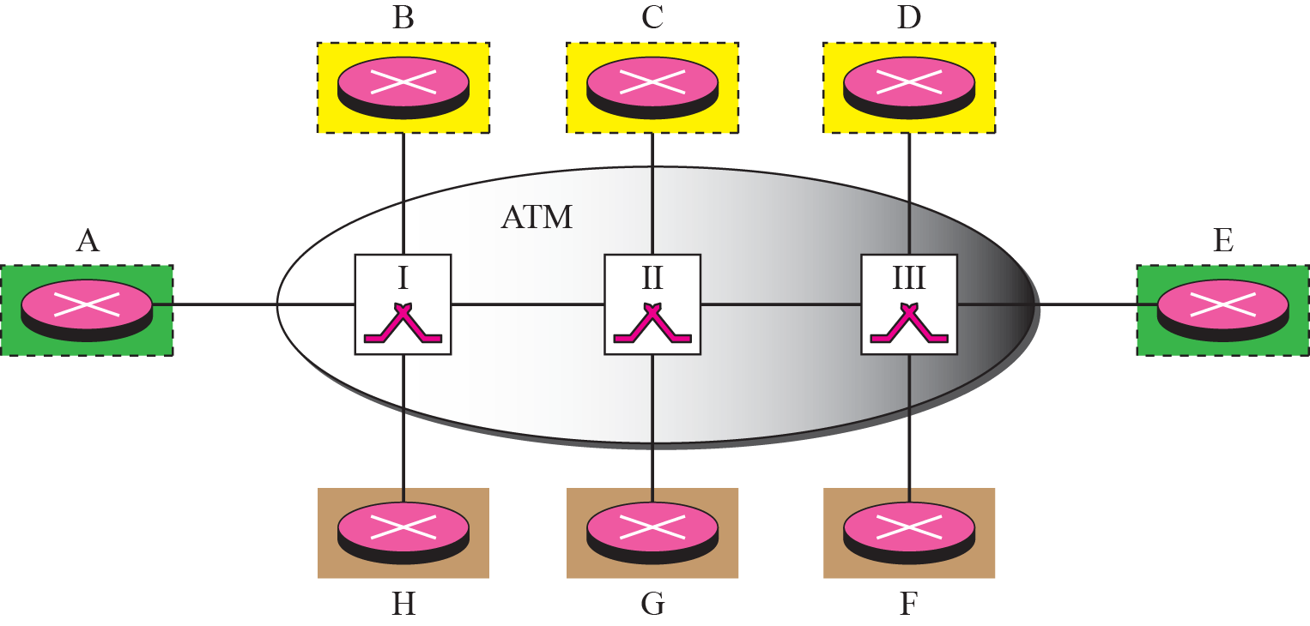
Figure 8.12 LIS
TCP/IP Protocol Suite

Slide 34
Note
LIS allows an ATM network to be divided into several logical subnets.
To use ATMARP, we need a separate server for each subnet.
TCP/IP Protocol Suite

