Slide 1

Chapter 9
Internet Control Message Protocol Version 4 (ICMPv4)
TCP/IP Protocol Suite
Copyright © The McGraw-Hill Companies, Inc. Permission required for reproduction or display.

Slide 2
OBJECTIVES:
To discuss the rationale for the existence of ICMP.
To show how ICMP messages are divided into two categories: error reporting and query messages.
To discuss the purpose and format of error-reporting messages.
To discuss the purpose and format of query messages.
To show how the checksum is calculated for an ICMP message.
To show how debugging tools using the ICMP protocol.
To show how a simple software package that implements ICMP is organized.
TCP/IP Protocol Suite

Slide 3

Chapter
Outline
9.1 Introduction
9.2 Messages
9.3 Debugging Tools
TCP/IP Protocol Suite

Slide 4
9-1 INTRODUCTION
The IP protocol has no error-reporting or error correcting mechanism. What happens if something goes wrong? What happens if a router must discard a datagram because it cannot find a router to the final destination, or because the time-to-live field has a zero value? These are examples of situations where an error has occurred and the IP protocol has no built-in mechanism to notify the original host.
The Internet Control Message Protocol (ICMP) has been designed to compensate for the above two deficiencies.
TCP/IP Protocol Suite

Slide 5
Topics Discussed in the Section
The position of ICMP in the TCP/IP suite
Encapsulation of ICMP Packets
TCP/IP Protocol Suite

Slide 6
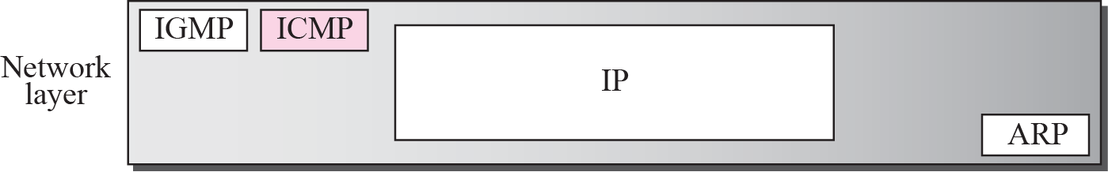
Figure 9.1 Position of ICMP in the network layer
TCP/IP Protocol Suite

Slide 7
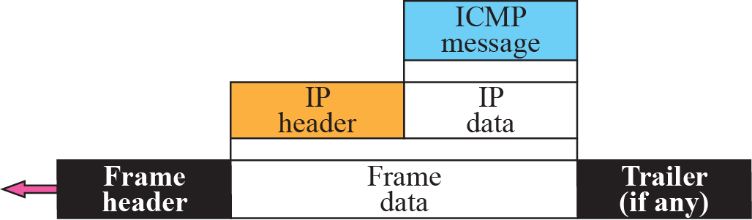
Figure 9.2 ICMP encapsulation
ICMP itself is a network layer protocol. However, its messages are not passed directly to the data link layer as would be expected. Instead, the messages are first encapsulated inside IP datagrams before going to the lower layer (see Figure 9.2).
TCP/IP Protocol Suite

Slide 8
9-2 MESSAGES
ICMP messages are divided into two broad categories: error-reporting messages and query messages. The error-reporting messages report problems that a router or a host (destination) may encounter when it processes an IP packet. The query messages, which occur in pairs, help a host or a network manager get specific information from a router or another host. Also, hosts can discover and learn about routers on their network and routers can help a node redirect its messages.
TCP/IP Protocol Suite

Slide 9
Topics Discussed in the Section
Message Format
Error Reporting Messages
Query Messages
Checksum
TCP/IP Protocol Suite

Slide 10
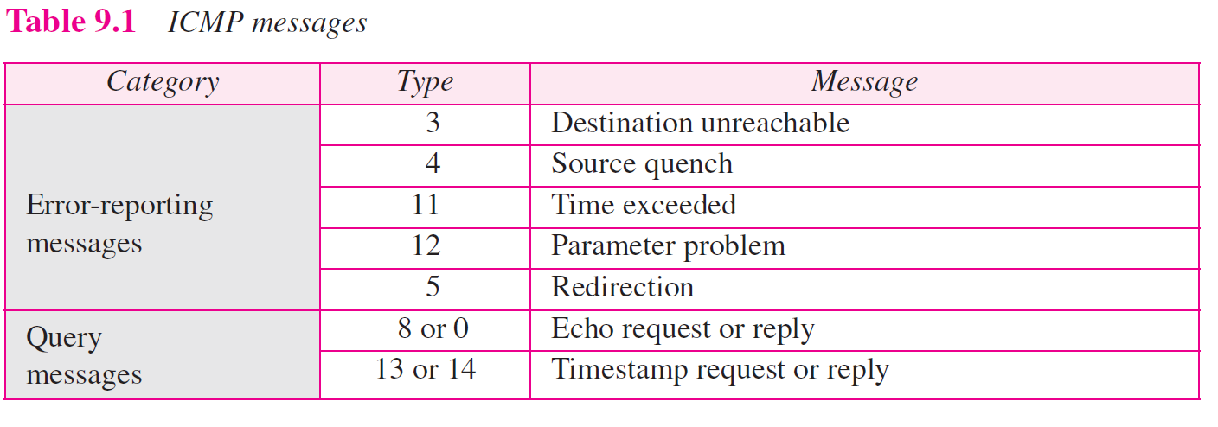
TCP/IP Protocol Suite

Slide 11
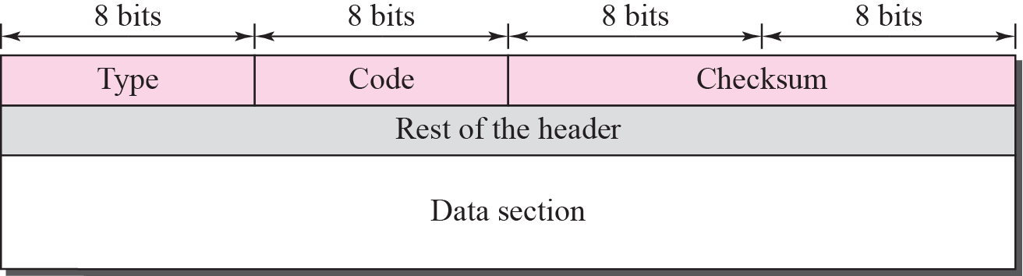
Figure 9.3 General format of ICMP messages
An ICMP message has an 8-byte header and a variable-size data section. Although the general format of the header is different for each message type, the first 4 bytes are common to all. As Figure 9.3 shows, the first field, ICMP type, defines the type of the message. The code field specifies the reason for the particular message type. The last common field is the checksum field (to be discussed later in the chapter). The rest of the
header is specific for each message type.
The data section in error messages carries information for finding the original packet that had the error. In query messages, the data section carries extra information based on the type of the query.
TCP/IP Protocol Suite

Slide 12

Note
ICMP does not correct errors, it simply reports them. Error correction is left to the higher-level protocols.
ICMP always reports error messages to the original source.
TCP/IP Protocol Suite

Slide 13
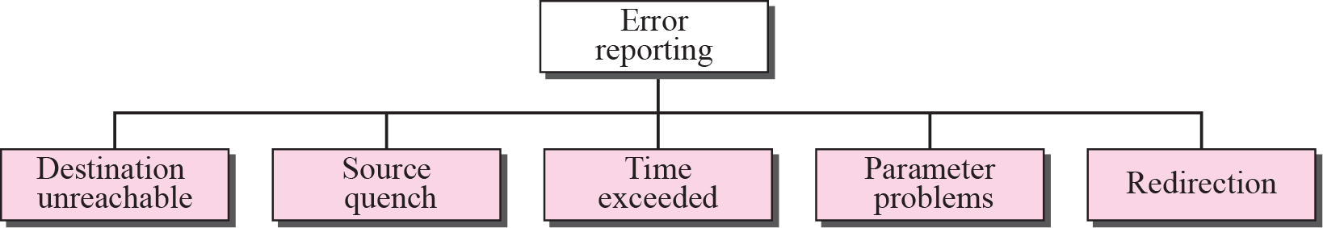
Figure 9.4 Error-reporting messages
TCP/IP Protocol Suite

Slide 14
IMPORTANT POINTS ABOUT ICMP ERROR MESSAGES
❑ No ICMP error message will be generated in response to a datagram carrying an ICMP error message.
❑ No ICMP error message will be generated for a fragmented datagram that is not the first fragment.
❑ No ICMP error message will be generated for a datagram having a multicast address.
❑ No ICMP error message will be generated for a datagram having a special address such as 127.0.0.0 or 0.0.0.0.
TCP/IP Protocol Suite

Slide 15
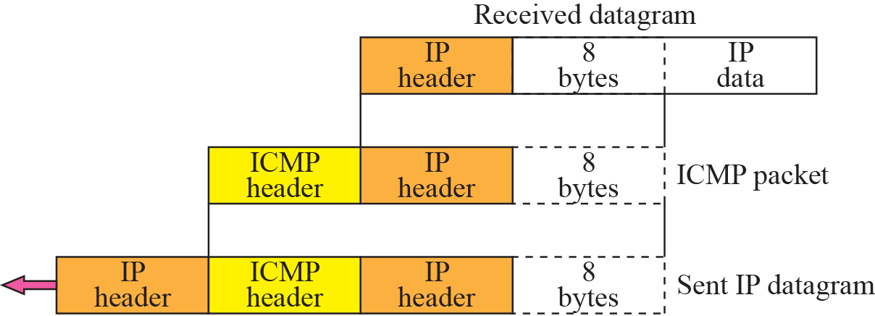
Figure 9.5 Contents of data field for the error message
All error messages contain a data section that includes the IP header of the original datagram plus the first 8 bytes of data in that datagram. The original datagram header is added to give the original source, which receives the error message, information about the datagram itself. The 8 bytes of data are included because, as we will see in Chapters 14 and 15 on UDP and TCP protocols, the first 8 bytes provide information about the port numbers (UDP and TCP) and sequence number (TCP). This information is needed so the source can inform the protocols (TCP or UDP) about the error. ICMP forms an error packet, which is then encapsulated in an IP datagram (see igure 9.5).
TCP/IP Protocol Suite

Slide 16
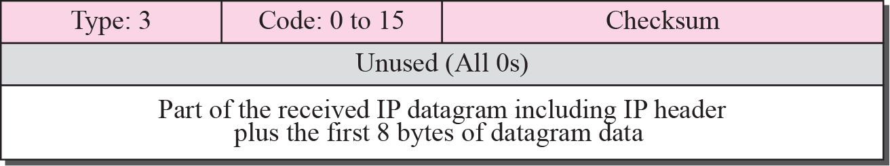
Figure 9.6 Destination-unreachable format
When a router cannot route a datagram or a host cannot deliver a datagram, the datagram is discarded and the router or the host sends a destination-unreachable message back to the source host that initiated the datagram. Figure 9.6 shows the format of the destination-unreachable message.
TCP/IP Protocol Suite

Slide 17
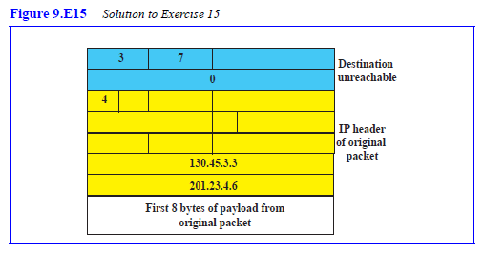
Practice Set Q15
A router receives an IP packet with source IP address 130.45.3.3 and destination IP address 201.23.4.6. The router cannot find the destination IP address in its routing table. Fill in the fields (as much as you can) for the ICMP message sent.
TCP/IP Protocol Suite

Slide 18
CODE FIELD
❑ Code 0. The network is unreachable, possibly due to hardware failure.
❑ Code 1. The host is unreachable. This can also be due to hardware failure.
❑ Code 2. The protocol is unreachable. An IP datagram can carry data belonging to higher-level protocols such as UDP, TCP, and OSPF. If the destination host receives a datagram that must be delivered, for example, to the TCP protocol, but the TCP protocol is not running at the moment, a code 2 message is sent.
❑ Code 3. The port is unreachable. The application program (process) that the datagram is destined for is not running at the moment.
❑ Code 4. Fragmentation is required, but the DF (do not fragment) field of the datagram has been set. In other words, the sender of the datagram has specified that the datagram not be fragmented, but routing is impossible without fragmentation.
❑ Code 5. Source routing cannot be accomplished. In other words, one or more routers defined in the source routing option cannot be visited.
❑ Code 6. The destination network is unknown. This is different from code 0. In code 0, the router knows that the destination network exists, but it is unreachable at the moment. For code 6, the router has no information about the destination network.
❑ Code 7. The destination host is unknown. This is different from code 1. In code 1, the router knows that the destination host exists, but it is unreachable at the moment. For code 7, the router is unaware of the existence of the destination host.
TCP/IP Protocol Suite

Slide 19
CODE FIELD-cont.
❑ Code 8. The source host is isolated.
❑ Code 9. Communication with the destination network is administratively
prohibited.
❑ Code 10. Communication with the destination host is administratively prohibited.
❑ Code 11. The network is unreachable for the specified type of service. This is different from code 0. Here the router can route the datagram if the source had requested an available type of service.
❑ Code 12. The host is unreachable for the specified type of service. This is different from code 1. Here the router can route the datagram if the source had requested an available type of service.
❑ Code 13. The host is unreachable because the administrator has put a filter on it.
❑ Code 14. The host is unreachable because the host precedence is violated. The
message is sent by a router to indicate that the requested precedence is not permitted for the destination.
❑ Code 15. The host is unreachable because its precedence was cut off. This message is generated when the network operators have imposed a minimum level of precedence for the operation of the network, but the datagram was sent with a precedence below this level.
TCP/IP Protocol Suite

Slide 20
Note
Destination-unreachable messages with codes 2 or 3 can be created only by the
destination host.
Other destination-unreachable messages can be created only by routers.
TCP/IP Protocol Suite

Slide 21
Note
A router cannot detect all problems that prevent the delivery of a packet.
TCP/IP Protocol Suite

Slide 22
Note
The IP protocol is a connectionless protocol. There is no communication between the source host, which produces the datagram, the routers, which forward it, and the destination
host, which processes it.
There is no flow-control or congestion-control mechanism in the IP protocol.
TCP/IP Protocol Suite

Slide 23
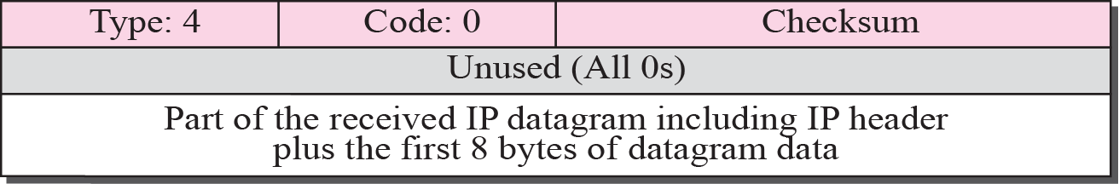
Figure 9.7 Source-quench format
The source-quench message in ICMP was designed to add a kind of flow control and congestion control to the IP. When a router or host discards a datagram due to congestion, it sends a source-quench message to the sender of the datagram.
This message has two purposes.
It informs the source that the datagram has been discarded.
It warns the source that there is congestion somewhere in the path and that the source should slow down (quench) the sending process.
The source-quench format is shown in Figure 9.7.
TCP/IP Protocol Suite

Slide 24
Note
A source-quench message informs the source that a datagram has been discarded due to congestion in
a router or the destination host.
The source must slow down the sending of datagrams until the congestion is relieved.
TCP/IP Protocol Suite

Slide 25
More Explanation
First, the router or destination host that has experienced the congestion sends one source-quench message for each discarded datagram to the source host. Second, there is no mechanism to tell the source that the congestion has been relieved and the source can resume sending datagrams at its previous rate. The source continues to lower the rate until no more source-quench messages are received. Third, the congestion can be created either by a one-to-one or many-to-one communication. In a one-to-one communication, a single high-speed host could create datagrams faster than a router or the destination host can handle. In this case, source-quench messages can be helpful. They tell the source to slow down. In a many-to-one communication, many sources create datagrams that must be handled by a router or the destination host. In this case, each source can be sending datagrams at different speeds, some of them at a low rate, others at a high rate. Here, the source-quench message may not be very useful. The router or the destination host has no clue which source is responsible for the congestion. It may drop a datagram from a very slow source instead of dropping the datagram from the source that has actually created the congestion.
TCP/IP Protocol Suite

Slide 26
Note
One source-quench message is sent for each datagram that is discarded due
to congestion.
TCP/IP Protocol Suite

Slide 27
Note
Whenever a router decrements a datagram with a time-to-live value to zero, it discards the datagram and
sends a time-exceeded message to the original source.
TCP/IP Protocol Suite

Slide 28
Note
When the final destination does not receive all of the fragments in a
set time, it discards the received fragments and sends a
time-exceeded message to
the original source.
TCP/IP Protocol Suite

Slide 29
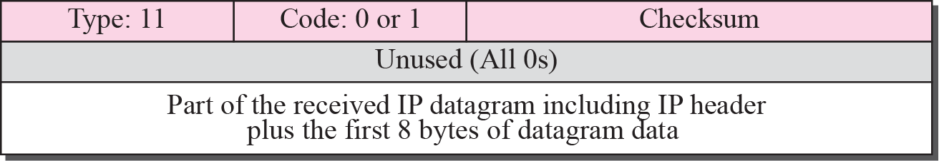
Figure 9.8 Time-exceeded message format
TCP/IP Protocol Suite

Slide 30
Note
In a time-exceeded message,
Code 0 is used only by routers to show that the value of the time-to-live field is zero.
Code 1 is used only by the destination host to show that not all of
the fragments have arrived
within a set time.
TCP/IP Protocol Suite

Slide 31
Note
A parameter-problem message can be created by a router or the destination host.
TCP/IP Protocol Suite

Slide 32
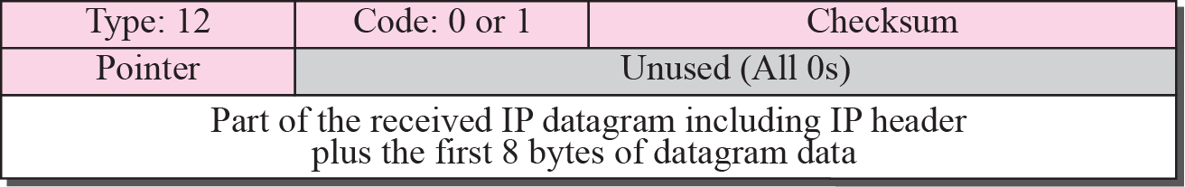
Figure 9.9 Parameter-problem message format
in this case specifies the reason for discarding the datagram:
❑ Code 0. There is an error or ambiguity in one of the header fields. In this case, the value in the pointer field points to the byte with the problem. For example, if the value is zero, then the first byte is not a valid field.
❑ Code 1. The required part of an option is missing. In this case, the pointer is not used.
TCP/IP Protocol Suite

Slide 33
Redirection
When a router needs to send a packet destined for another network, it must know the IP address of the next appropriate router. The same is true if the sender is a host. Both routers and hosts then must have a routing table to find the address of the router or the next router.
However, for efficiency, hosts do not take part in the routing update process because there are many more hosts in an internet than routers. Updating the routing tables of hosts dynamically produces unacceptable traffic. The hosts usually use static routing. When a host comes up, its routing table has a limited number of entries. It usually knows only the IP address of one router, the default router. For this reason, the host may send a datagram, which is destined for another network, to the wrong router. In this case, the router that receives the datagram will forward the datagram to the correct router. However, to update the routing table of the host, it sends a redirection message to the host.
TCP/IP Protocol Suite

Slide 34
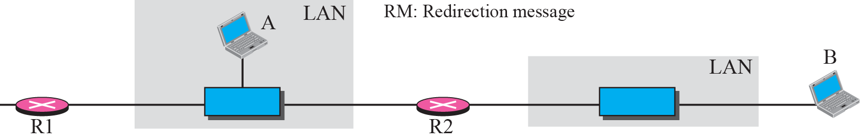
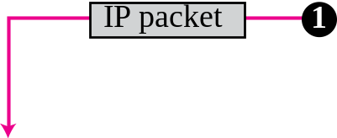

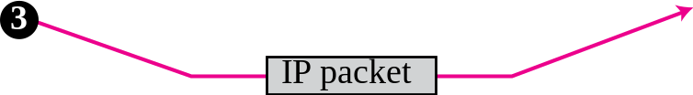
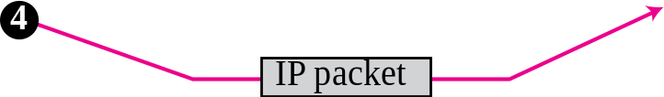
Figure 9.10 Redirection concept
TCP/IP Protocol Suite

Slide 35
Note
A host usually starts with a small routing table that is gradually augmented and updated.
One of the tools to accomplish this
is the redirection message.
TCP/IP Protocol Suite

Slide 36
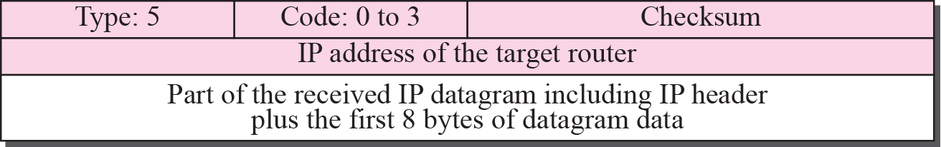
Figure 9.11 Redirection message format
The code field for the redirection message narrows down the redirection:
❑ Code 0. Redirection for a network-specific route.
❑ Code 1. Redirection for a host-specific route.
❑ Code 2. Redirection for a network-specific route based on a specified type of service.
❑ Code 3. Redirection for a host-specific route based on a pecified type of service.
TCP/IP Protocol Suite

Slide 37
Note
A redirection message is sent from a router to a host on the same local network.
TCP/IP Protocol Suite

Slide 38
Echo Request and Reply
The echo-request and echo-reply messages are designed for diagnostic purposes. Network managers and users utilize this pair of messages to identify network problems. The combination of echo-request and echo-reply messages determines whether two systems (hosts or routers) can communicate with each other.
TCP/IP Protocol Suite

Slide 39
Note
An echo-request message can be sent by a host or router.
An echo-reply message is sent
by the host or router that receives
an echo-request message.
TCP/IP Protocol Suite

Slide 40
Note
Echo-request and echo-reply messages can be used by network managers to check the operation of the IP protocol.
TCP/IP Protocol Suite

Slide 41
Note
Echo-request and echo-reply messages can test the reachability of a host.
This is usually
done by invoking the ping command.
TCP/IP Protocol Suite

Slide 42
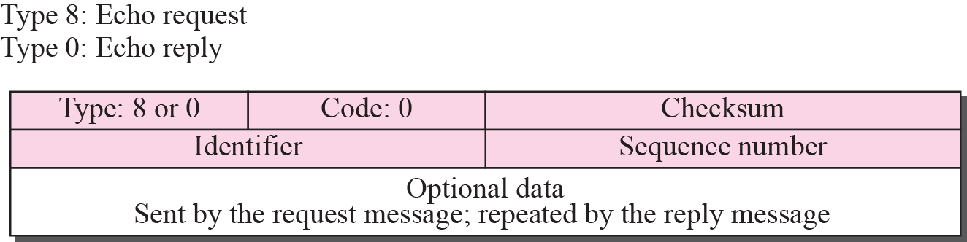
Figure 9.12 Echo-request and echo-reply message
Echo request, together with echo reply, can determine whether or not a node is functioning properly. The node to be tested is sent an echo-request message. The optional data field contains a message that must be repeated exactly by the responding node in its echo-reply message. Figure 9.12 shows the format of the echo-reply and echo-request message. The identifier and sequence number fields are not formally defined by the protocol and can be used arbitrarily by the sender. The identifier is often the same as the process ID.
TCP/IP Protocol Suite

Slide 43
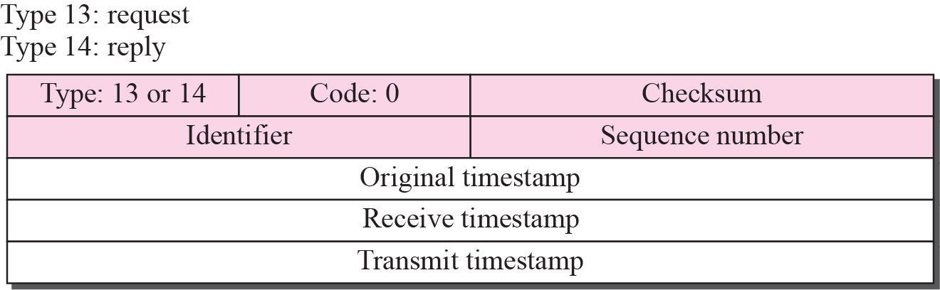
Figure 9.13 Timestamp-request and timestamp-reply message format
Two machines (hosts or routers) can use the timestamp-request and timestamp-reply messages to determine the round-trip time needed for an IP datagram to travel between them. It can also be used to synchronize the clocks in two machines. The format of these two messages is shown in Figure 9.13.
TCP/IP Protocol Suite

Slide 44
Formulas for Times
sending time = receive timestamp − original timestamp
receiving time = returned time − transmit timestamp
round-trip time = sending time + receiving time
TCP/IP Protocol Suite

Slide 45
Note
Timestamp-request and timestamp-reply messages can be used to calculate the
round-trip time between a source and a destination machine even if their
clocks are not synchronized.
TCP/IP Protocol Suite

Slide 46
Note
The timestamp-request and timestamp-reply messages can be used to synchronize two clocks in two
machines if the exact one-way
time duration is known.
TCP/IP Protocol Suite

Slide 47
Example 9.1
Figure 9.14 shows an example of checksum calculation for a simple echo-request message (see Figure 9.12). We randomly chose the identifier to be 1 and the sequence number to be 9. The message is divided into 16-bit (2-byte) words. The words are added together and the sum is complemented. Now the sender can put this value in the checksum field.
TCP/IP Protocol Suite

Slide 48
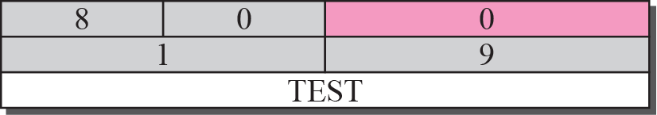

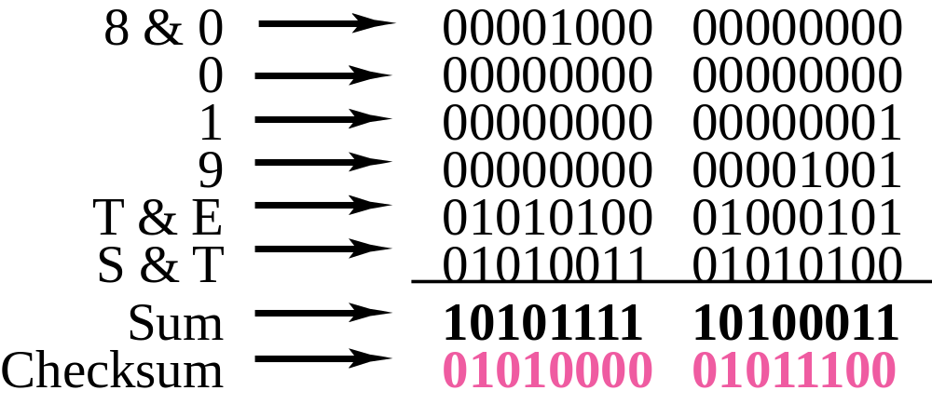
Figure 9.14 Example of checksum calculation
TCP/IP Protocol Suite

Slide 49
9-3 DEBUGGING TOOLS
There are several tools that can be used in the Internet for debugging. We can find if a host or router is alive and running. We can trace the route of a packet. We introduce two tools that use ICMP for debugging: ping and traceroute. We will introduce more tools in future chapters after we have discussed the corresponding protocols.
TCP/IP Protocol Suite

Slide 50
Topics Discussed in the Section
Ping: to find if a host is alive and responding.
Traceroute or tracert: to trace the route of a packet from the source to the destination.
TCP/IP Protocol Suite

Slide 51
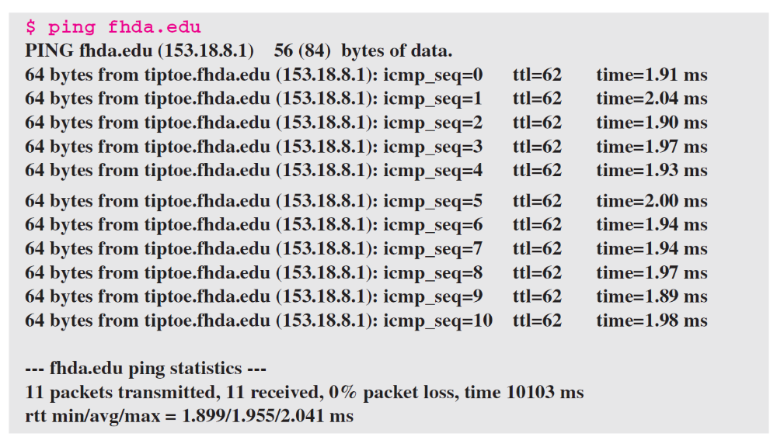
Example 9.2
We use the ping program to test the server fhda.edu. The result is shown below:
TCP/IP Protocol Suite

Slide 52
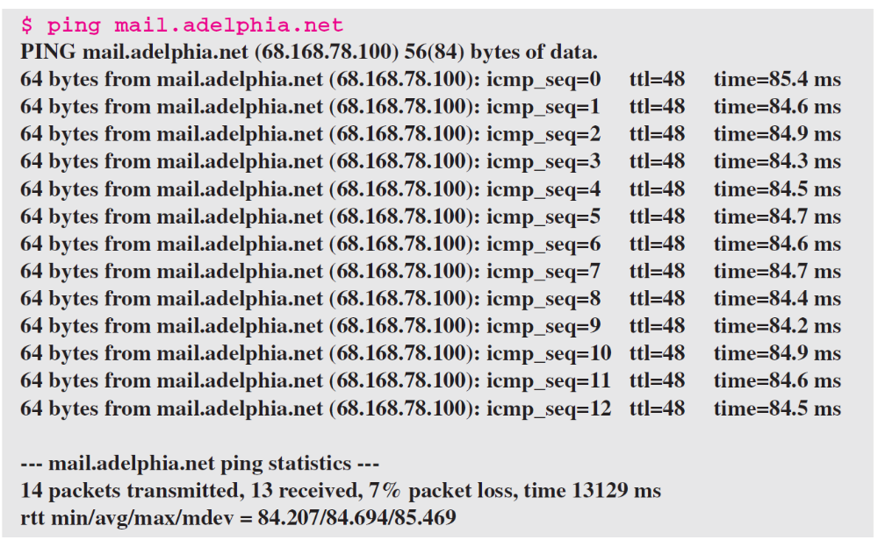
Example 9.3
For the second example, we want to know if the adelphia.net mail server is alive and running. The result is shown below: Note that in this case, we sent 14 packets, but only 13 have been returned. We may have interrupted the program before the last packet, with sequence number 13, was returned.
TCP/IP Protocol Suite

Slide 53
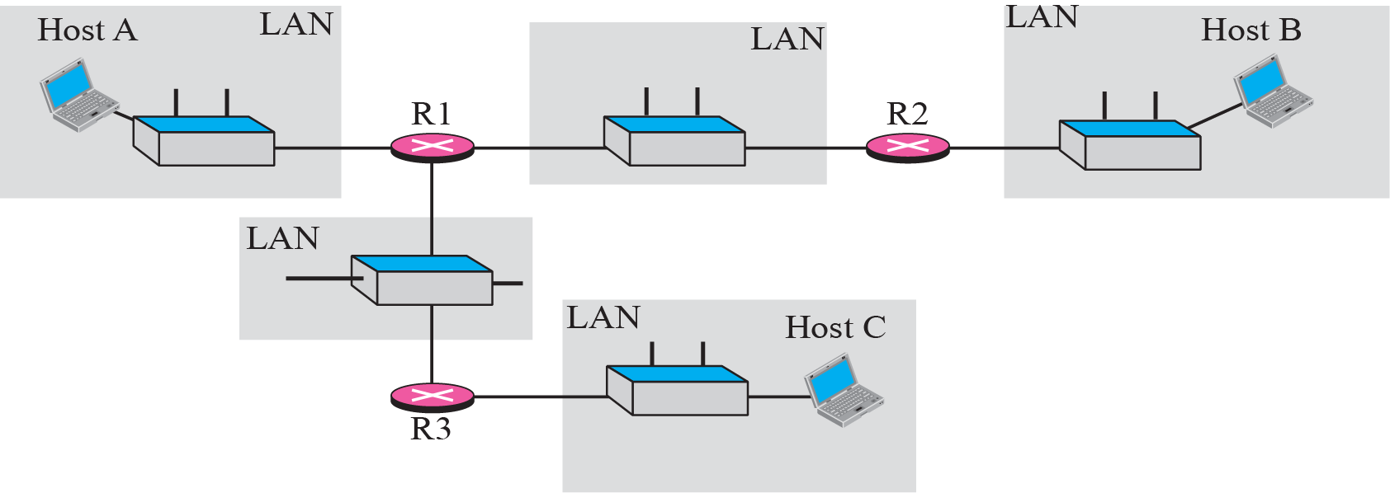
Figure 9.15 The traceroute program operation
TCP/IP Protocol Suite

Slide 54
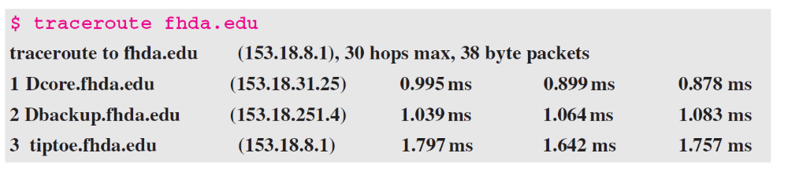
Example 9.4
We use the traceroute program to find the route from the computer voyager.deanza.edu to the server fhda.edu. The following shows the result.
TCP/IP Protocol Suite

Slide 55
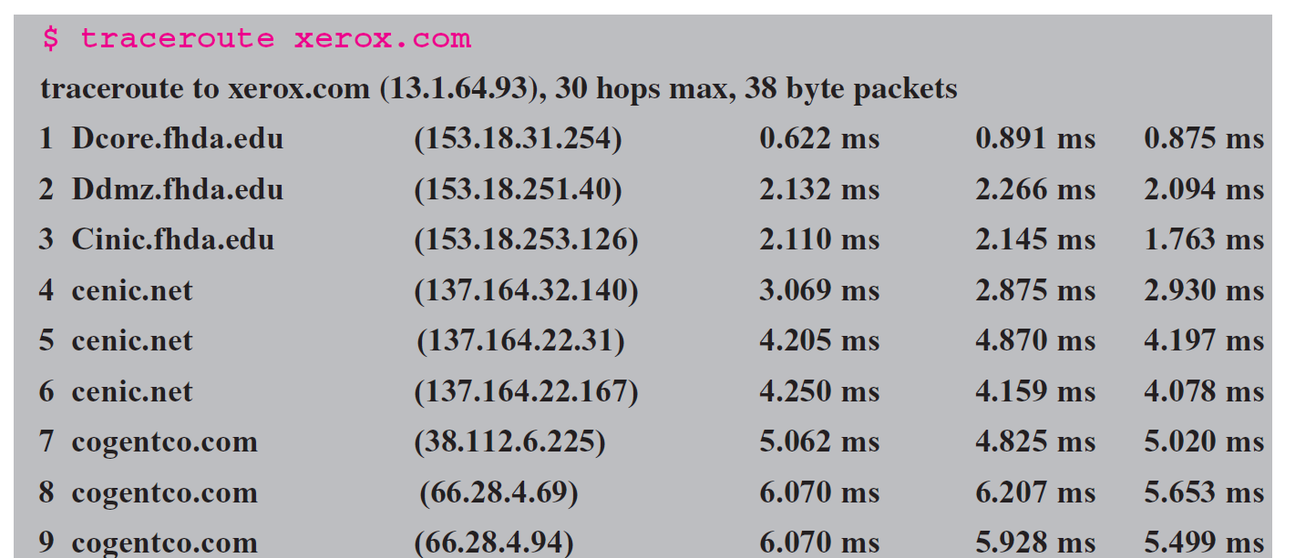
Example 9.5
In this example, we trace a longer route, the route to xerox.com. The following is a partial listing.
TCP/IP Protocol Suite

Slide 56
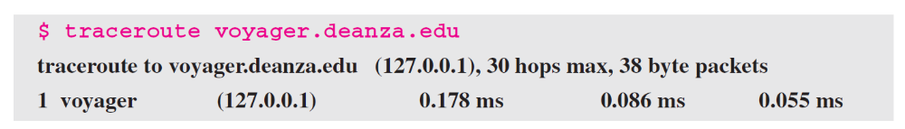
Example 9.6
An interesting point is that a host can send a traceroute packet to itself. This can be done by specifying the host as the destination. The packet goes to the loopback address as we expect.
TCP/IP Protocol Suite

Slide 57
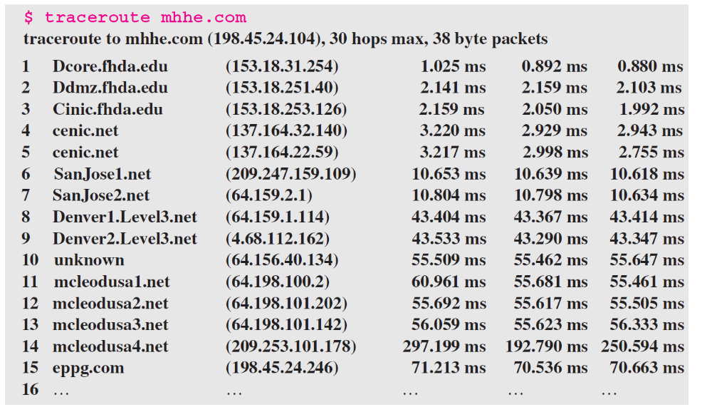
Example 9.7
Finally, we use the traceroute program to find the route between fhda.edu and mhhe.com (McGraw-Hill server). We notice that we cannot find the whole route. When traceroute does not receive a response within 5 seconds, it prints an asterisk to signify a problem (not the case in this example), and then tries the next hop.
TCP/IP Protocol Suite

