Slide 1

Chapter 10
Mobile
IP
TCP/IP Protocol Suite
Copyright © The McGraw-Hill Companies, Inc. Permission required for reproduction or display.

Slide 2
OBJECTIVES:
To discuss addressing issues related to a mobile host and the need for a care-of address.
To discuss two agents involved in mobile IP communication, the home agent and the foreign agent, and how they communicate.
To explain three phases of communication between a mobile host and a remote host: agent discovery, registration, and data transfer.
To mention inefficiency of mobile IP in two cases, double crossing and triangular routing, and a possible solution.
TCP/IP Protocol Suite

Slide 3
Chapter
Outline
10.1 Addressing
10.2 Agents
10.3 Three Phases
10.4 Inefficiency in Mobile IP
TCP/IP Protocol Suite

Slide 4
10-1 ADDRESSING
The main problem that must be solved in providing mobile communication using the IP protocol is addressing.
TCP/IP Protocol Suite

Slide 5
Topics Discussed in the Section
Stationary Host
  The original IP addressing was based on the assumption that a host is stationary, attached to one specific network. A router uses an IP address to route an IP datagram.
  The address is valid only when the host is attached to the network. If the network changes, the address is no longer valid.
Mobile Host
  When a host moves from one network to another, the IP addressing structure needs to be modified.
  One simple solution is to let the mobile host change its address as it goes to the new
  network. This approach has several drawbacks. First, the configuration files would need to be changed. Second, each time the computer moves from one network to another, it must be rebooted. Third, the DNS tables (see Chapter 19) need to be revised so that every other host in the Internet is aware of the change. Fourth, if the host roams from one network to another during a transmission, the data exchange will be interrupted.
TCP/IP Protocol Suite

Slide 6

Note
The IP addresses are designed to work with stationary hosts because part
of the address defines the network to which the host is attached.
TCP/IP Protocol Suite

Slide 7
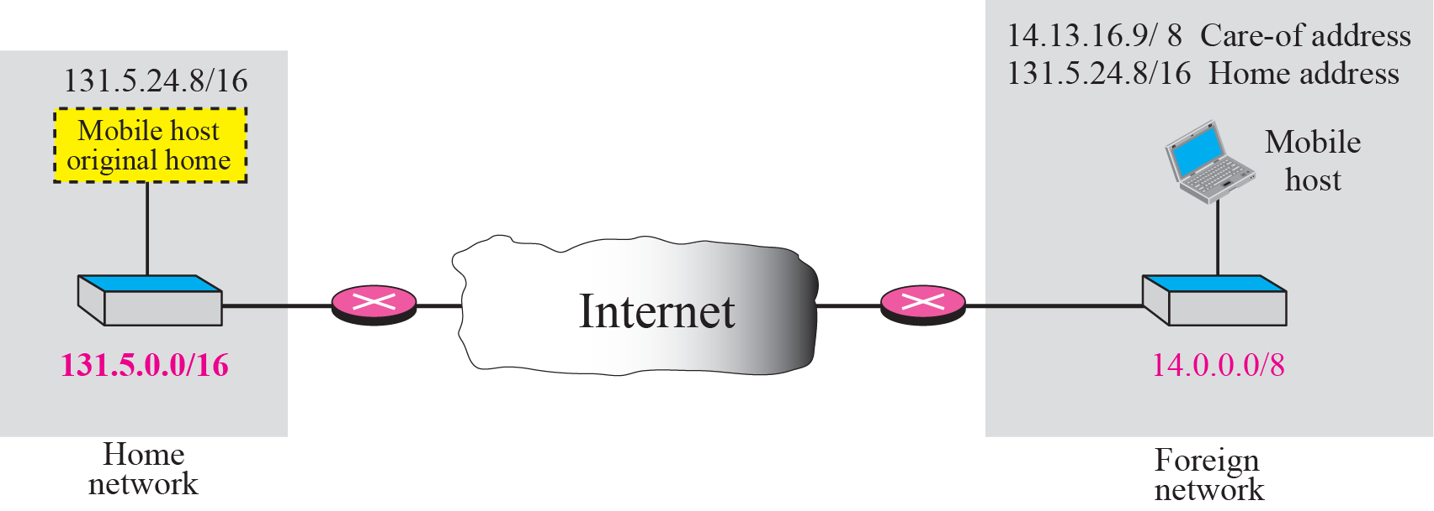
Figure 10.1 Home address and care-of address
TCP/IP Protocol Suite

Slide 8
Note
Mobile IP has two addresses for a mobile host:
one home address and
one care-of address.
The home address is permanent;
the care-of address changes as the
mobile host moves from one
network to another.
When a mobile host visits a foreign network, it receives its care-of address during the agent discovery and registration phase described later.
TCP/IP Protocol Suite

Slide 9
10-2 AGENTS
To make the change of address transparent to the rest of the Internet requires a home agent and a foreign agent.
TCP/IP Protocol Suite

Slide 10
Topics Discussed in the Section
Home Agent
  The home agent is usually a router attached to the home network of the mobile host. The home agent acts on behalf of the mobile host when a remote host sends a packet to the mobile host. The home agent receives the packet and sends it to the foreign agent.
Foreign Agent
  The foreign agent is usually a router attached to the foreign network. The foreign agent receives and delivers packets sent by the home agent to the mobile host.
TCP/IP Protocol Suite

Slide 11
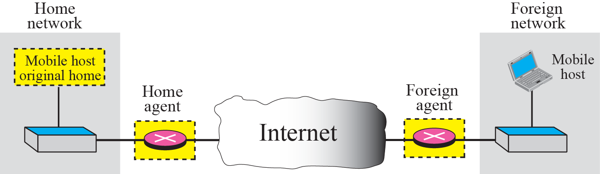
Figure 10.2 Home agent and foreign agent
The mobile host needs the necessary software to allow it to communicate with the home agent and to have two addresses: its home address and its care-of address.
TCP/IP Protocol Suite

Slide 12
Note
When the mobile host and the foreign agent are the same, the care-of
address is called a colocated
care-of address.
The advantage of using a colocated care-of address is that the mobile host can move to any network without worrying about the availability of a foreign agent. The disadvantage is that the mobile host needs extra software to act as its own foreign agent.
TCP/IP Protocol Suite

Slide 13
10-3 THREE PHASES
To communicate with a remote host, a mobile host goes through three phases: agent discovery, registration, and data transfer.
The first phase, agent discovery, involves the mobile host, the foreign agent, and the home agent. The second phase, registration, also involves the mobile host and the two agents. Finally, in the third phase, the remote host is also involved. We discuss each phase separately.
TCP/IP Protocol Suite

Slide 14
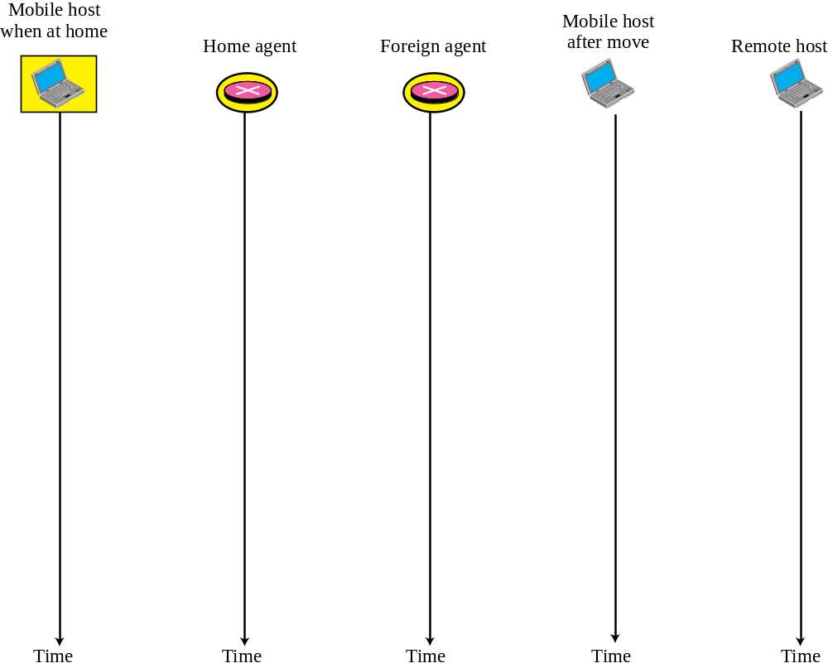

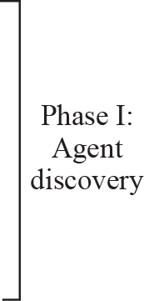
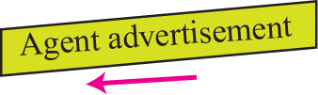


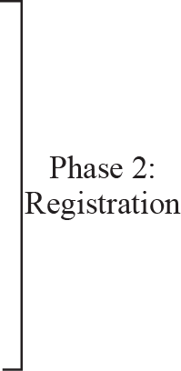




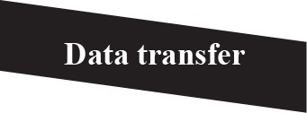
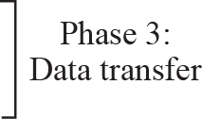
Figure 10.3 Remote host and mobile host configuration
TCP/IP Protocol Suite

Slide 15
Topics Discussed in the Section
Agent Discovery
Registration
Data Transfer
TCP/IP Protocol Suite

Slide 16
Phase 1: Agent Discovery
Consists of two sub-phases.
A mobile host must discover (learn the address of) a home agent before it leaves its home network.
A mobile host must discover a foreign agent after it has moved to a foreign network. This discovery consists of learning the care-of address as well as the foreign agent’s address. The discovery involves two types of messages: advertisement and solicitation.
TCP/IP Protocol Suite

Slide 17
Figure 10.3 Remote host and mobile host configuration
TCP/IP Protocol Suite

Slide 18
Agent Advertisement
When a router advertises its presence on a network using an ICMP router advertisement, it can append an agent advertisement to the packet if it acts as an agent.
TCP/IP Protocol Suite

Slide 19
Note
Mobile IP does not use a new packet type for agent advertisement; it uses
the router advertisement packet
of ICMP, and appends an agent advertisement message.
TCP/IP Protocol Suite

Slide 20
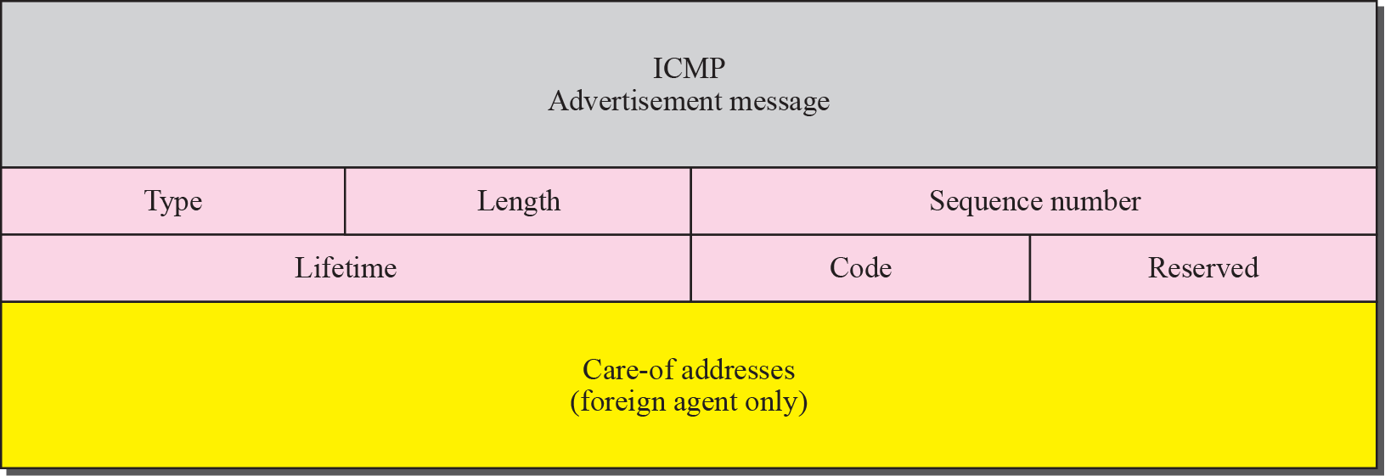
Figure 10.4 Agent advertisement
TCP/IP Protocol Suite

Slide 21
Agent Advertisement Packet
❑ Type. The 8-bit type field is set to 16.
❑ Length. The 8-bit length field defines the total length of the extension message (not the length of the ICMP advertisement message).
❑ Sequence number. The 16-bit sequence number field holds the message number. The recipient can use the sequence number to determine if a message is lost.
❑ Lifetime. The lifetime field defines the number of seconds that the agent will accept requests. If the value is a string of 1s, the lifetime is infinite.
❑ Code. The code field is an 8-bit flag in which each bit is set (1) or unset (0). The meanings of the bits are shown in Table 10.1.
❑ Care-of Addresses. This field contains a list of addresses available for use as care of addresses. The mobile host can choose one of these addresses. The selection of this care-of address is announced in the registration request. Note that this field is used only by a foreign agent.
TCP/IP Protocol Suite

Slide 22
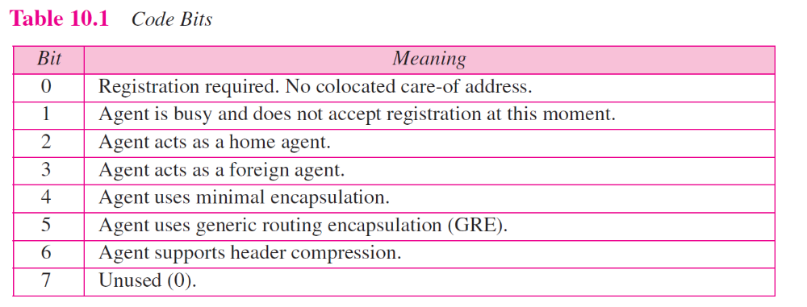
TCP/IP Protocol Suite

Slide 23
Agent Solicitation
When a mobile host has moved to a new network and has not received agent advertisements, it can initiate an agent solicitation. It can use the ICMP solicitation message to inform an agent that it needs assistance.
TCP/IP Protocol Suite

Slide 24
Note
Mobile IP does not use a new packet type for agent solicitation;
it uses the router solicitation
packet of ICMP.
TCP/IP Protocol Suite

Slide 25
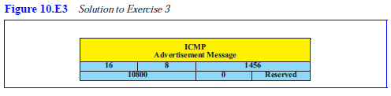
Practice Set Question 3
Create a home agent advertisement message using 1456 as the sequence number and a lifetime of 3 hours. Select your own values for the bits in the code field. Calculate and insert the value for the length field.
TCP/IP Protocol Suite

Slide 26
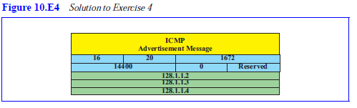
Practice Set Question 4
Create a foreign agent advertisement message using 1672 as the sequence number and a lifetime of 4 hours. Select your own values for the bits in the code field. Use at least three care-of addresses of your choice. Calculate and insert the value for the length field.
TCP/IP Protocol Suite

Slide 27
Phase II: Registration
After a mobile host has moved to a foreign network and discovered the foreign agent, it must register. There are four aspects of registration:
1. The mobile host must register itself with the foreign agent.
2. The mobile host must register itself with its home agent. This is normally done by the foreign agent on behalf of the mobile host.
3. The mobile host must renew registration if it has expired.
4. The mobile host must cancel its registration (deregistration) when it returns home.
TCP/IP Protocol Suite

Slide 28
Figure 10.3 Remote host and mobile host configuration
TCP/IP Protocol Suite

Slide 29
Registration Request
A registration request is sent from the mobile host to the foreign agent to register its care-of address and also to announce its home address and home agent address. The foreign agent, after receiving and registering the request, relays the message to the home agent. Note that the home agent now knows the address of the foreign agent because the IP packet that is used for relaying has the IP address of the foreign agent as the source address.
Figure 10.5 shows the format of the registration request.
TCP/IP Protocol Suite

Slide 30
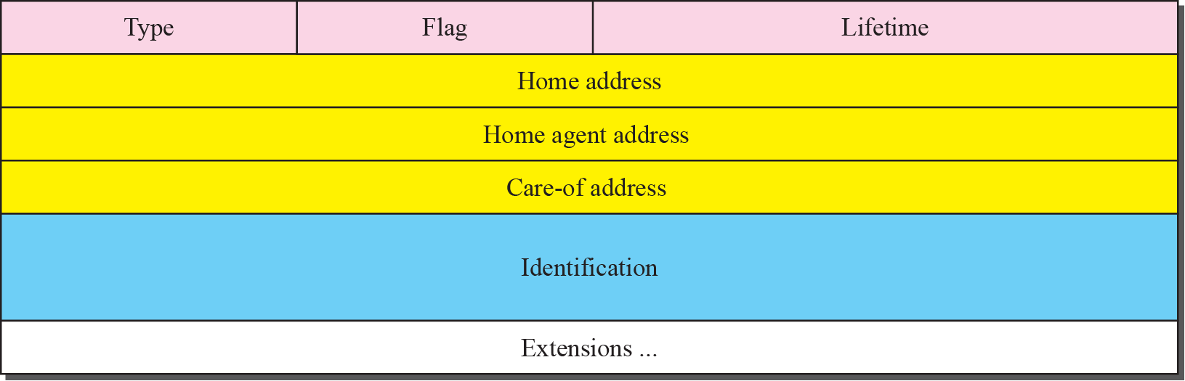
Figure 10.5 Registration request format
TCP/IP Protocol Suite

Slide 31
Registration request format
❑ Type. The 8-bit type field defines the type of the message. For a request message the value of this field is 1.
❑ Flag. The 8-bit flag field defines forwarding information. The value of each bit can be set or unset. The meaning of each bit is given in Table 10.2.
❑ Lifetime. This field defines the number of seconds the registration is valid. If the field is a string of 0s, the request message is asking for deregistration. If the field is a string of 1s, the lifetime is infinite.
❑ Home address. This field contains the permanent (first) address of the mobile host.
❑ Home agent address. This field contains the address of the home agent.
❑ Care-of address. This field is the temporary (second) address of the mobile host.
❑ Identification. This field contains a 64-bit number that is inserted into the request by the mobile host and repeated in the reply message. It matches a request with a reply.
❑ Extensions. Variable length extensions are used for authentication. They allow a home agent to authenticate the mobile agent. We discuss authentication in Chapter 29.
TCP/IP Protocol Suite

Slide 32
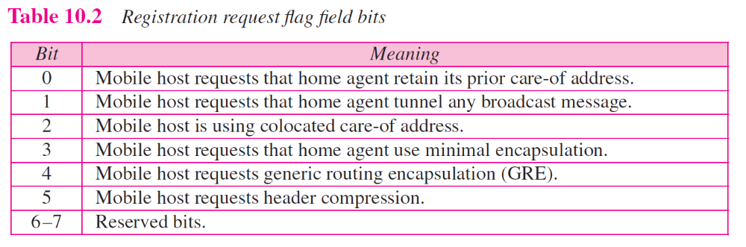
TCP/IP Protocol Suite

Slide 33
Registration Reply
A registration reply is sent from the home agent to the foreign agent and then relayed to the mobile host. The reply confirms or denies the registration request.
TCP/IP Protocol Suite

Slide 34
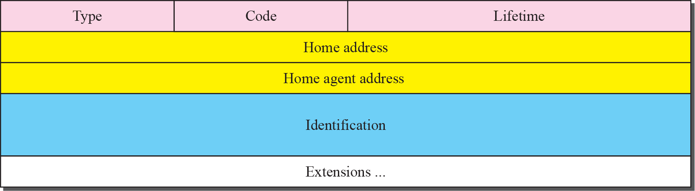
Figure 10.6 Registration reply format
Figure 10.6 shows the format of the registration reply. The fields are similar to those of the registration request with the following exceptions. The value of the type field is 3. The code field replaces the flag field and shows the result of the registration request (acceptance or denial). The care-of address field is not needed.
TCP/IP Protocol Suite

Slide 35
Note
A registration request or reply is sent by UDP using the well-known port 434.
TCP/IP Protocol Suite

Slide 36
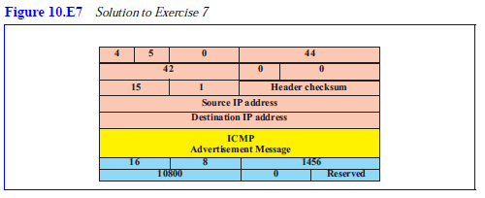
Practice Set Question 7
Show the encapsulation of the advertisement message in Exercise 3 in an IP datagram. What is the value for the protocol field?
TCP/IP Protocol Suite

Slide 37
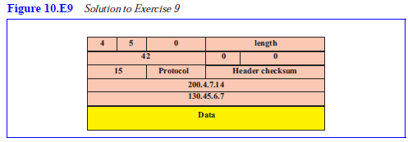
Practice Set Question 9
We have the following information shown below. Show the contents of the IP datagram header sent from the remote host to the home agent.
  Mobile host home address: 130.45.6.7/16
  Mobile host care-of address: 14.56.8.9/8
  Remote host address: 200.4.7.14/24
  Home agent address: 130.45.10.20/16
  Foreign agent address: 14.67.34.6/8
TCP/IP Protocol Suite

Slide 38
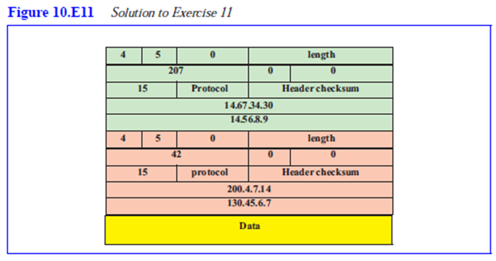
Practice Set Question 11
Using the information in Exercise 9, show the contents of the IP datagram sent by the foreign agent to the mobile host.
TCP/IP Protocol Suite

Slide 39
Figure 10.3 Remote host and mobile host configuration
TCP/IP Protocol Suite

Slide 40
Phase III: Data Transfer
After agent discovery and registration, a mobile host can communicate with a remote host. Figure 10.7 shows the idea.
TCP/IP Protocol Suite

Slide 41
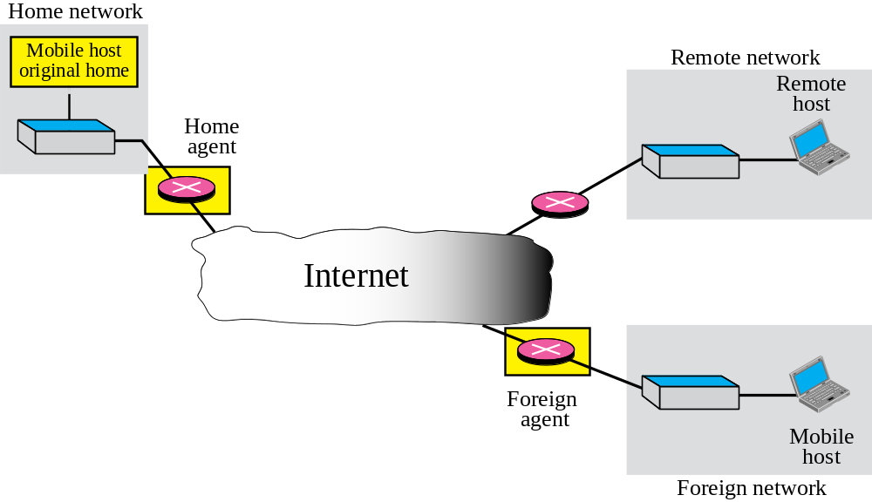
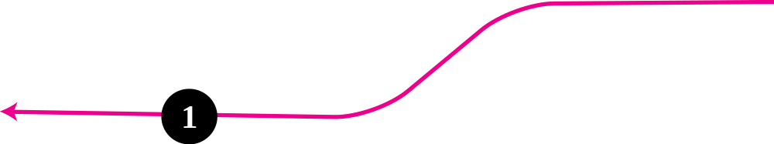
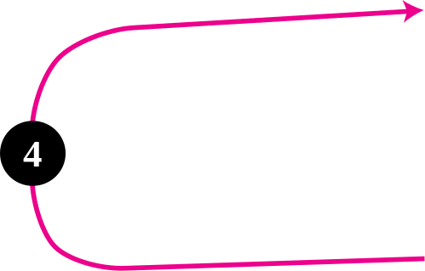
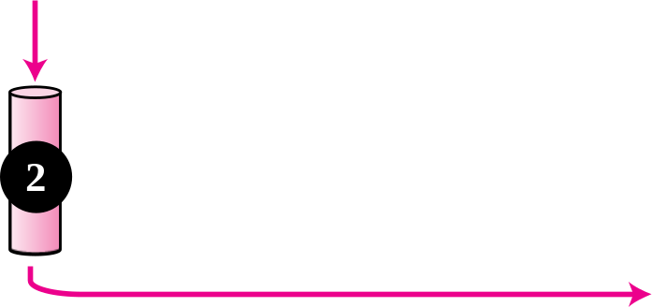

Figure 10.7 Data transfer
TCP/IP Protocol Suite

Slide 42
From Home Agent to Foreign Agent
After receiving the packet, the home agent sends the packet to the foreign agent using the tunneling concept discussed in Chapter 30. The home agent encapsulates the whole IP packet inside another IP packet using its address as the source and the foreign agent’s address as the destination. Path 2 of Figure 10.7 shows this step.
TCP/IP Protocol Suite

Slide 43
From Foreign Agent to Mobile Host
When the foreign agent receives the packet, it removes the original packet. However, since the destination address is the home address of the mobile host, the foreign agent consults a registry table to find the care-of address of the mobile host. (Otherwise, the packet would just be sent back to the home network.) The packet is then sent to the care-of address. Path 3 of Figure 10.7 shows this step.
TCP/IP Protocol Suite

Slide 44
From Mobile Host to Remote Host
When a mobile host wants to send a packet to a remote host (for example, a response to the packet it has received), it sends as it does normally. The mobile host prepares a packet with its home address as the source, and the address of the remote host as the destination. Although the packet comes from the foreign network, it has the home address of the mobile host. Path 4 of Figure 10.7 shows this step.
TCP/IP Protocol Suite

Slide 45
Transparency
In this data transfer process, the remote host is unaware of any movement by the mobile host. The remote host sends packets using the home address of the mobile host as the destination address; it receives packets that have the home address of the mobile host as the source address. The movement is totally transparent. The rest of the Internet is not aware of the mobility of the moving host.
TCP/IP Protocol Suite

Slide 46
Note
The movement of the mobile host is transparent to the rest of the Internet.
TCP/IP Protocol Suite

Slide 47
10-4 INEFFICIENCY IN MOBILE IP
Communication involving mobile IP can be inefficient. The inefficiency can be severe or moderate. The severe case is called double crossing or 2X . The moderate case is called triangle routing or dog-leg routing.
TCP/IP Protocol Suite

Slide 48
Topics Discussed in the Section
Double Crossing
Triangle Routing
Solution
TCP/IP Protocol Suite

Slide 49
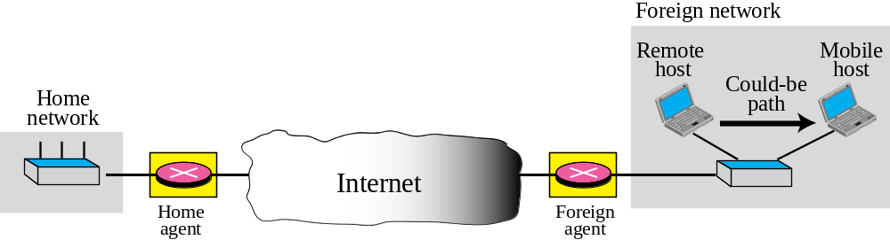
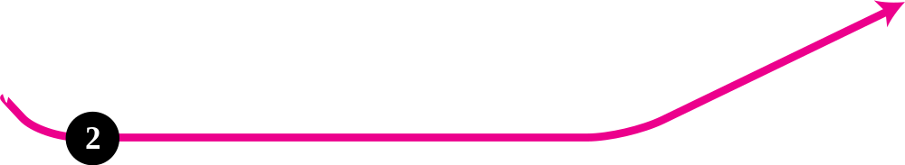
Figure 10.8 Double crossing
Double crossing occurs when a remote host communicates with a mobile host that has moved to the same network (or site) as the remote host
When the mobile host sends a packet to the remote host, there is no inefficiency; the communication is local. However, when the remote host sends a packet to the mobile host, the packet crosses the Internet twice.
Since a computer usually communicates with other local computers (principle of locality), the inefficiency from double crossing is significant.
TCP/IP Protocol Suite

Slide 50
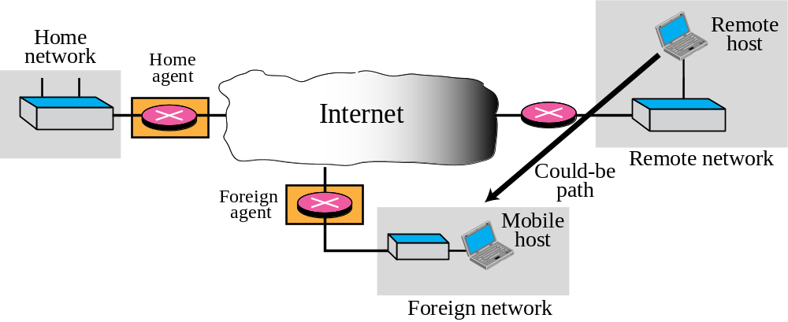



Figure 10.9 Triangle routing
Triangle routing, the less severe case, occurs when the remote host communicates
with a mobile host that is not attached to the same network (or site) as the mobile host. When the mobile host sends a packet to the remote host, there is no inefficiency. However, when the remote host sends a packet to the mobile host, the packet goes from the remote host to the home agent and then to the mobile host. The packet travels the two sides of a triangle, instead of just one side.
TCP/IP Protocol Suite

Slide 51
Solution
One solution to inefficiency is for the remote host to bind the care-of address to the home address of a mobile host. For example, when a home agent receives the first packet for a mobile host, it forwards the packet to the foreign agent; it could also send an update binding packet to the remote host so that future packets to this host could be sent to the care-of address. The remote host can keep this information in a cache.
The problem with this strategy is that the cache entry becomes outdated once the mobile host moves. In this case the home agent needs to send a warning packet to the remote host to inform it of the change.
TCP/IP Protocol Suite

