Slide 1

Chapter 12
Multicasting
And
Multicast
Routing
Protocols
TCP/IP Protocol Suite
Copyright © The McGraw-Hill Companies, Inc. Permission required for reproduction or display.

Slide 2
OBJECTIVES:
To compare and contrast unicasting, multicasting, and broadcasting communication.
To define multicast addressing space in IPv4 and show the division of the space into several blocks.
To discuss the IGMP protocol, which is responsible for collecting group membership information in a network.
To discuss the general idea behind multicast routing protocols and their division into two categories based on the creation of the shortest path trees.
To discuss multicast link state routing in general and its implementation in the Internet: a protocol named MOSPF.
TCP/IP Protocol Suite

Slide 3
OBJECTIVES (continued):
To discuss multicast distance vector routing in general and its implementation in the Internet: a protocol named DVMRP.
To discuss core-based protocol (CBT) and briefly discuss two independent multicast protocols PIM-DM and PIM-SM.
To discuss multicast backbone (MBONE) that shows how to create a tunnel when the multicast messages need to pass through an area with no multicast routers.
TCP/IP Protocol Suite

Slide 4

Chapter
Outline
12.1 Introduction
12.2 Multicast Addresses
12.3 IGMP
12.4 Multicast Routing
12.5 Routing Protocols
TCP/IP Protocol Suite

Slide 5
12-1 INTRODUCTION
We have learned that forwarding a datagram is normally based on the prefix of the destination address in the datagram. Address aggregation mechanism may combine several datagrams to be delivered to an ISP and then separate them to be delivered to their final destination networks, but the principle does not change.
Understanding the above forwarding principle, we can now define unicasting, multicasting, and broadcasting. Let us clarify these terms as they relate to the Internet.
TCP/IP Protocol Suite

Slide 6
Topics Discussed in the Section
Unicasting
Multicasting
Broadcasting
TCP/IP Protocol Suite

Slide 7
Unicasting
In unicasting, there is one source and one destination network. The relationship between the source and the destination network is one to one. Each router in the path of the datagram tries to forward the packet to one and only one of its interfaces.
TCP/IP Protocol Suite

Slide 8
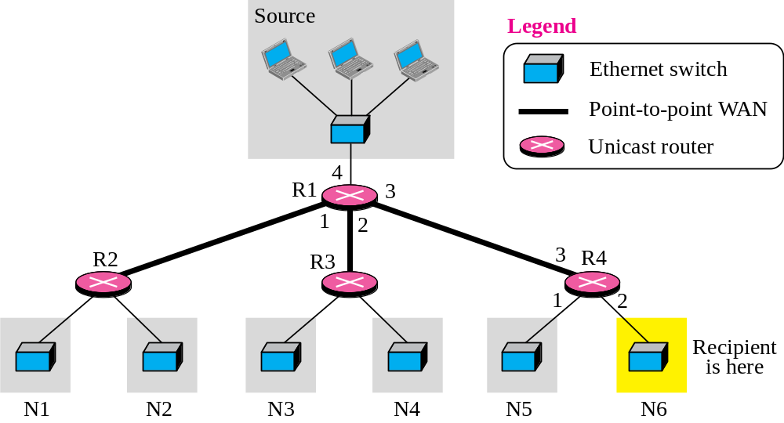
Figure 12.1 Unicasting
TCP/IP Protocol Suite

Slide 9

Note
In unicasting, the router forwards the received datagram through
only one of its interfaces.
TCP/IP Protocol Suite

Slide 10
Multicasting
In multicasting, there is one source and a group of destinations. The relationship is one to many. In this type of communication, the source address is a unicast address, but the destination address is a group address, a group of one or more destination networks in which there is at least one member of the group that is interested in receiving the multicast datagram.
In multicasting, a multicast router may have to send out copies of the same datagram through more than one interface. In Figure 12.2, router R1 needs to send out the datagram through interfaces 2 and 3. Similarly, router R4 needs to send out the datagram through both its interfaces. Router R3, however, knows that there is no member belonging to this group in the area reached by interface 2; it only sends out the datagram through interface 1.
TCP/IP Protocol Suite

Slide 11
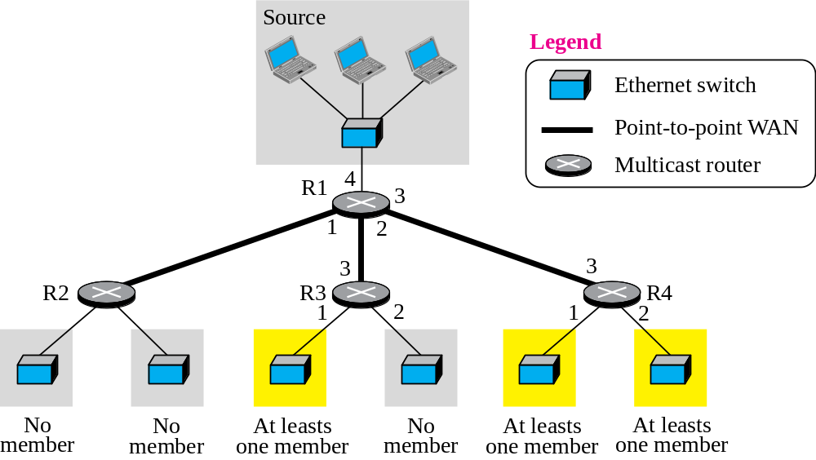
Figure 12.2 Multicasting
TCP/IP Protocol Suite

Slide 12
Note
In multicasting, the router may
forward the received datagram
through several of its interfaces.
TCP/IP Protocol Suite

Slide 13
Multicasting versus Multiple Unicasting
Multicasting starts with one single packet from the source that is duplicated by the routers. The destination address in each packet is the same for all duplicates. Note that only one single copy of the packet travels between any two routers.
In multiple unicasting, several packets start from the source. If there are four destinations, for example, the source sends four packets, each with a different unicast destination address. Note that there may be multiple copies traveling between two routers.
TCP/IP Protocol Suite

Slide 14
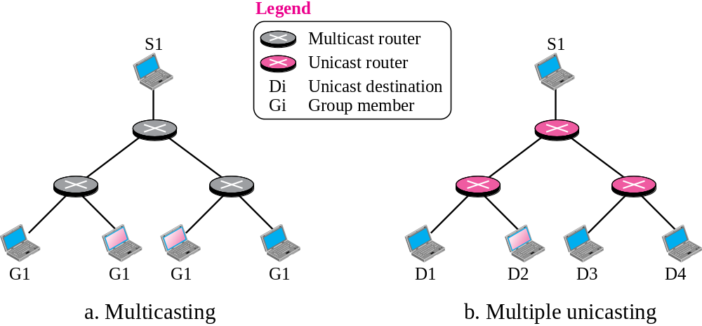


Figure 12.3 Multicasting versus multiple unicasting
TCP/IP Protocol Suite

Slide 15
Emulation of Multicasting with Unicasting
You might wonder why we have a separate mechanism for multicasting, when it can be emulated with unicasting. There are several reasons for this; two are obvious:
1. Multicasting is more efficient than multiple unicasting. In Figure 12.3, we can see how multicasting requires less bandwidth than multiple unicasting. In multiple unicasting, some of the links must handle several copies.
2. In multiple unicasting, the packets are created by the source with a relative delay between packets. If there are 1,000 destinations, the delay between the first and the last packet may be unacceptable. In multicasting, there is no delay because only one packet is created by the source.
TCP/IP Protocol Suite

Slide 16
Note
Emulation of multicasting through multiple unicasting is not
efficient and may create
long delays, particularly
with a large group.
TCP/IP Protocol Suite

Slide 17
Multicast Applications
Multicasting has many applications today such as access to distributed databases, information dissemination, teleconferencing, and distance learning.
TCP/IP Protocol Suite

Slide 18
Broadcasting
In broadcast communication, the relationship between the source and the destination is one to all. There is only one source, but all of the other hosts are the destinations. The Internet does not explicitly support broadcasting because of the huge amount of traffic it would create and because of the bandwidth it would need. Imagine the traffic generated in the Internet if one person wanted to send a message to everyone else connected to the Internet.
TCP/IP Protocol Suite

Slide 19
12-2 MULTICAST ADDRESSES
A multicast address is a destination address for a group of hosts that have joined a multicast group. A packet that uses a multicast address as a destination can reach all members of the group unless there are some filtering restriction by the receiver.
TCP/IP Protocol Suite

Slide 20
Topics Discussed in the Section
Multicast Addresses in IPv4
Selecting Multicast Addresses
Delivery of Multicast Packets at Data Link Layer
TCP/IP Protocol Suite

Slide 21
Multicast Addresses in IPv4
In classful addressing, multicast addresses occupied the only single block in class D.
In classless addressing the same block has been used for this purpose. In other words, the block assigned for multicasting is 224.0.0.0/4. This means that the block has 228 = 268,435,456 addresses (224.0.0.0 to 239,255.255.255). This large block, or the multicast address space as sometimes it is referred to, is divided into some smaller ranges, as shown in Table 12.1, based on RFC 3171.
TCP/IP Protocol Suite

Slide 22
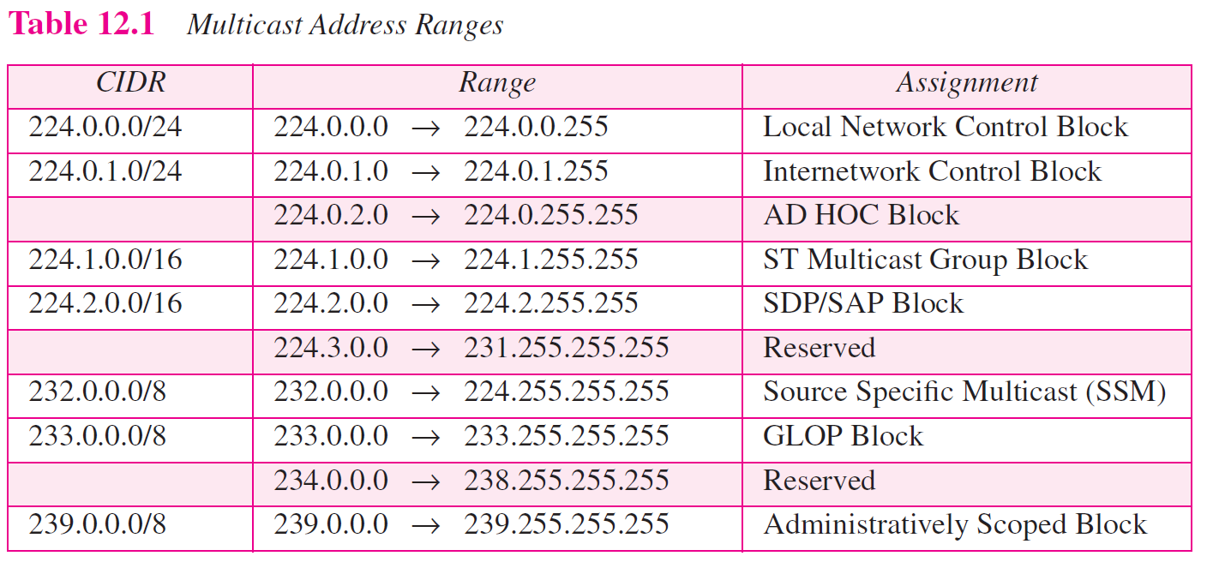
TCP/IP Protocol Suite

Slide 23
Local Network Control Block
The first block is called local network control block (224.0.0.1/24). The addresses in this block are used for protocol control traffic. In other words, they are not used for general multicast communication. Some multicast or multicast-related protocols use these addresses. The IP packet with the destination address in this range needs to have the value of TTL set to 1, which means that the routers are not allowed to forward these packets. The packet remains in the network, which means two or more networks can use the same address at the same time, a sense of privacy. Table 12.2 shows the assignment of some of these addresses.
TCP/IP Protocol Suite

Slide 24
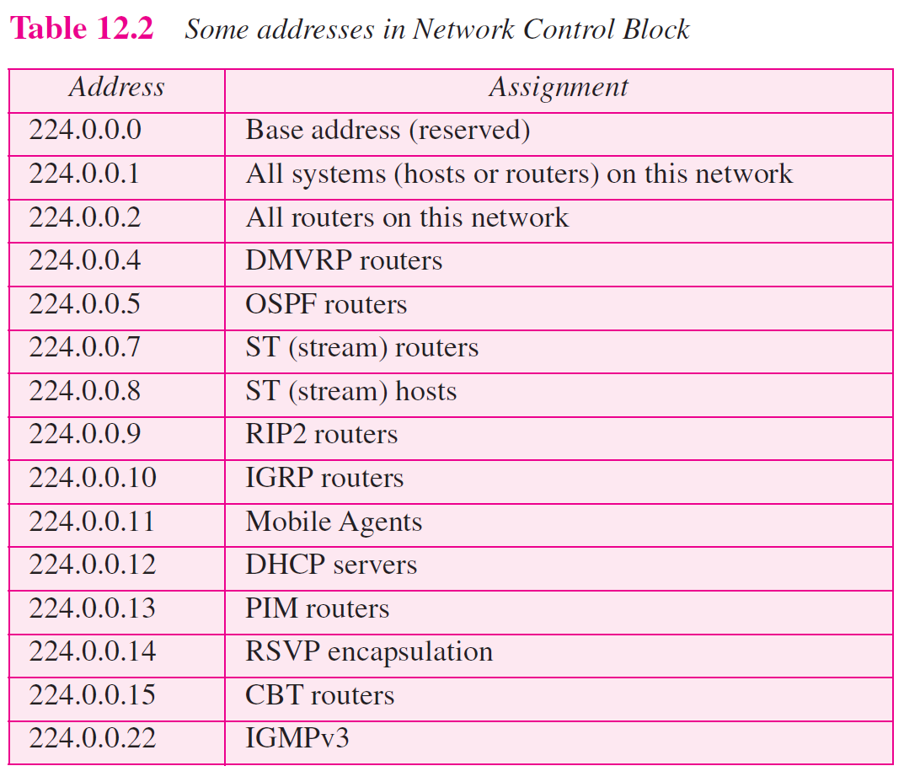
TCP/IP Protocol Suite

Slide 25
Internetwork Control Block
The block 224.0.1/24 is called the Internetwork Control Block. The addresses in this block are also used for protocol control traffic, but the IP packets with one of these addresses as destination can be forwarded by router thought the whole Internet. For example, the address 224.0.1.1 is used by the NTP protocol.
TCP/IP Protocol Suite

Slide 26
AD-HOC Block
The block 224.0.2.0 to 224.0.255.0 is called AD-HOC Block by IANA. This block was traditionally assigned to some applications that do not fit in the first or second block discussed above. For example, the block 224.0.18/24 is assigned to Dow Jones. Note that the range of this block has two unusual features. First, the last address should be 224.2.255.255. Second, the whole block cannot be represented in CIDR notation.
TCP/IP Protocol Suite

Slide 27
Stream Multicast Group Block
The block 224.1.0.0/16 is called Stream Multicast Group Block and is allocated for stream multimedia.
TCP/IP Protocol Suite

Slide 28
SAP/SDP Block
The block 224.2.0.0/16 is used for Session Announcement Protocol and Session Directory Protocol (RFC 2974).
TCP/IP Protocol Suite

Slide 29
SSM Block
The block 232.0.0.0/8 is used for Source Specific Multicasting. We discuss SSS later in the chapter, when we introduce IGMPv3.
TCP/IP Protocol Suite

Slide 30
GLOP Block
The block 233.0.0.0/8 is called the GLOP block (not an acronym nor an abbreviation). This block defines a range of globally assigned addresses that can be use inside an autonomous system (AS). As we learned in Chapter 11, each autonomous system is assigned a 16-bit number. One can insert the AS number as the two middle octet in the block to create a range of 256 multicast addresses (233.x.y.0 to 233.x.y.255), in which x.y is the AS number.
TCP/IP Protocol Suite

Slide 31
Administratively Scoped Block
The block 239.0.0.0/8 is called the Administratively Scoped Block. The addresses in this block are used in a particular area of the Internet. The packet whose destination address belongs to this range is not supposed to leave the area. In other words, an address in this block is restricted to an organization.
TCP/IP Protocol Suite

Slide 32
Netstat Utility
The netstat utility can be used to find the multicast addresses supported by an interface.
TCP/IP Protocol Suite

Slide 33
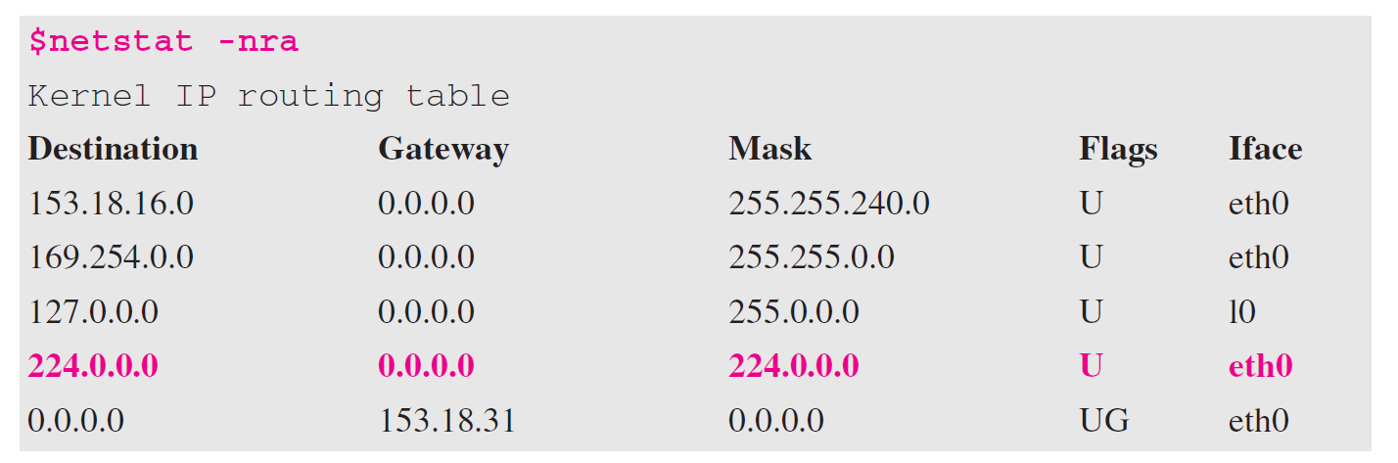
Example 12.1
We use netstat with three options, -n, -r, and -a. The -n option gives the numeric versions of IP addresses, the -r option gives the routing table, and the -a option gives all addresses (unicast and multicast). Note that we show only the fields relative to our discussion. The multicast address is shown in color.
TCP/IP Protocol Suite

Slide 34
Selecting Multicast Address
Limited Group: The administrator can use the AS number (x.y) and choose an address between 239.x.y.0 and 239.x.y.255 (Administratively Scoped Block) that is not used by any other group as the multicast address for that particular group.
Larger Group: If the group is spread beyond an AS territory, the previous solution does not work. The group needs to choose an address from the SSM block (232.0.0.0/8). There is no need to get permission to use an address in this block, because the packets in source-specific multicasting are routed based on the group and the source address; they are unique.
TCP/IP Protocol Suite

Slide 35
Network with Multicast Support
Most LANs support physical multicast addressing. Ethernet is one of them. An Ethernet physical address (MAC address) is six octets (48 bits) long. If the first 25 bits in an Ethernet address are 00000001 00000000 01011110 0, this identifies a physical multicast address for the TCP/IP protocol. The remaining 23 bits can be used to define a group. To convert an IP multicast address into an Ethernet address, the multicast router extracts the least significant 23 bits of a multicast IP address and inserts them into a multicast Ethernet physical address (see Figure 12.4).
TCP/IP Protocol Suite

Slide 36
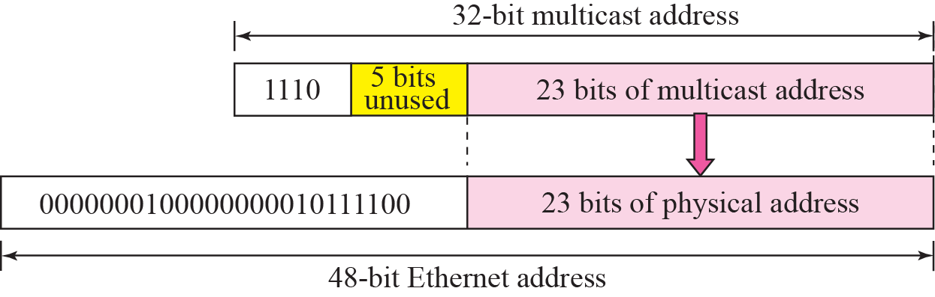
Figure 12.4 Mapping class D to Ethernet physical address
The group identifier of a multicast address block in IPv4 address is 28 bits long, which implies that 5 bits are not used. This means that 32 (25) multicast addresses at the IP level are mapped to a single multicast address. In other words, the mapping is many to one instead of one to one. If the 5 leftmost bits of the group identifier of a multicast address are not all zeros, a host may receive packets that do not really belong to the group in which it is involved. For this reason, the host must check the IP address and discard any packets that do not belong to it.
TCP/IP Protocol Suite

Slide 37
Note
An Ethernet multicast physical
address is in the range
0000 0001 0000 0000 0101 1110 0000 0000 0000 0000 0000 0000
01:00:5E:00:00:00
to
0000 0001 0000 0000 0101 1110 0111 1111 1111 1111 1111 1111
01:00:5E:7F:FF:FF.
TCP/IP Protocol Suite

Slide 38
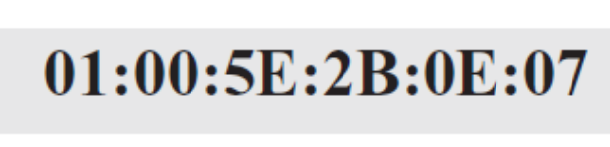
Example 12.2
Change the multicast IP address 232.43.14.7 to an Ethernet multicast physical address.
Solution
We can do this in two steps:
a. We write the rightmost 23 bits of the IP address in
hexadecimal. This can be done by changing the rightmost 3 bytes to hexadecimal and then subtracting 8 from the leftmost digit if it is greater than or equal to 8. In our example the result is 2B:0E:07.
b. We add the result of part a to the starting Ethernet multicast address, which is 01:00:5E:00:00:00. The result is
232 = 1110 1000
43 = 0010 1011
14 = 0000 1110
7 = 0000 0111
0000 0001 0000 0000 0101 1100 0
1110 1000 0010 1011 0000 1110 0000 0111
0000 0001 0000 0000 0101 1110 0010 1011 0000 1110 0000 0111
0 1 0 0 5 E 2 B 0 E 0 7
TCP/IP Protocol Suite

Slide 39
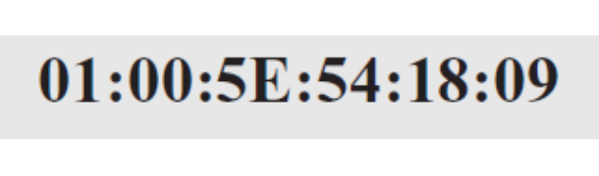
Example 12.3
Change the multicast IP address 238.212.24.9 to an Ethernet multicast address.
Solution
We can do this in two steps:
a. The rightmost 3 bytes in hexadecimal are D4:18:09. We need to subtract 8 from the leftmost digit, resulting in 54:18:09.
We add the result of part a to the Ethernet multicast starting address. The result is
238 = 1110 1110
212 = 1101 0100
24 = 0001 1000
9 = 0000 1001
0000 0001 0000 0000 0101 1100 0
1110 1110 1101 0100 0001 1000 0000 1001
0000 0001 0000 0000 0101 1110 0101 0100 0001 1000 0000 1001
0 1 0 0 5 E 5 4 1 8 0 9
TCP/IP Protocol Suite

Slide 40
Network with No Multicast Support
Most WANs do not support physical multicast addressing. To send a multicast packet through these networks, a process called tunneling is used. In tunneling, the multicast packet is encapsulated in a unicast packet and sent through the network, where it emerges from the other side as a multicast packet (see Figure 12.5).
TCP/IP Protocol Suite

Slide 41
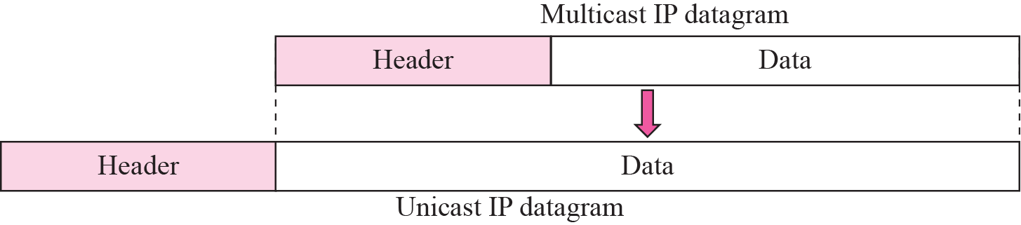
Figure 12.5 Tunneling
TCP/IP Protocol Suite

Slide 42
12-3 IGMP
Multicast communication means that a sender sends a message to a group of recipients that are members of the same group. Each multicast router needs to know the list of groups that have at least one loyal member related to each interface. Collection of this type of information is done at two levels: locally and globally. The first task is done by the IGMP protocol; the second task is done by the multicast routing protocols.
TCP/IP Protocol Suite

Slide 43
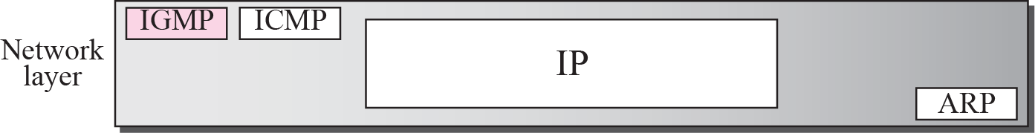
Figure 12.6 Position of IGMP in the network layer
TCP/IP Protocol Suite

Slide 44
Topics Discussed in the Section
Group Management
IGMP Messages
IGMP Protocol Applied to host
IGMP Protocol Applied to Router
Role of IGMP in Forwarding
Variables and Timers
Encapsulation
Compatibility with other Versions
TCP/IP Protocol Suite

Slide 45
Group Management
IGMP is not a multicasting routing protocol; it is a protocol that manages group membership. In any network, there are one or more multicast routers that distribute multicast packets to hosts or other routers. The IGMP protocol gives the multicast routers information about the membership status of hosts (routers) connected to the network.
A multicast router may receive thousands of multicast packets every day for different groups. If a router has no knowledge about the membership status of the hosts, it must forward all of these packets. This creates a lot of traffic and consumes bandwidth. A better solution is to keep a list of groups in the network for which there is at least one loyal member. IGMP helps the multicast router create and update this list.
TCP/IP Protocol Suite

Slide 46
Note
IGMP is a group management protocol. It helps a multicast router create and update a list of loyal members related
to each router interface.
TCP/IP Protocol Suite

Slide 47
IGMP Versions
IGMP has gone through three versions. Versions 1 and 2 provide what is called anysource multicast (ASM), which means that the group members receive a multicast message no matter where it comes from. The IGMP version 3 provides what is called sourcespecific multicast (SSM), which means that the recipient can choose to receive multicast messages coming from a list of predefined sources.
TCP/IP Protocol Suite

Slide 48
IGMP v3 Messages
IGMPv3 has two types of messages: membership query message and membership report message.
The first type can be used in three different formats: general, group specific, and group-and-source-specific, as shown in Figure 12.7.
TCP/IP Protocol Suite

Slide 49
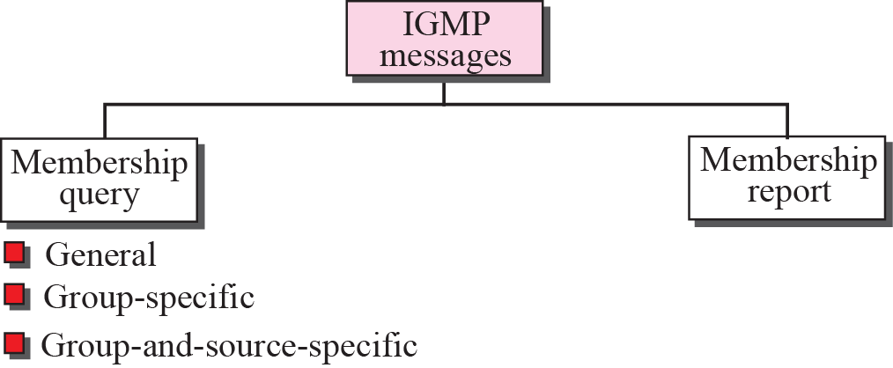
Figure 12.7 IGMP messages
TCP/IP Protocol Suite

Slide 50
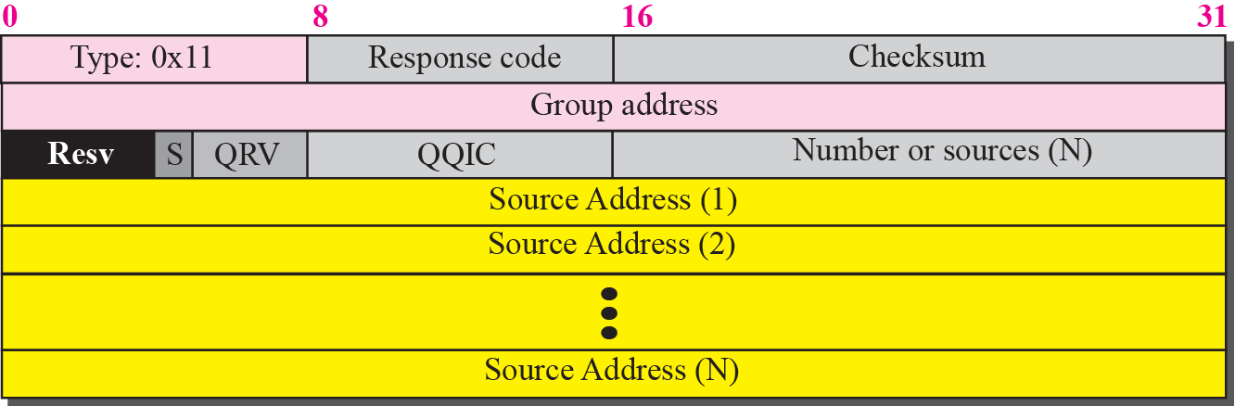
Figure 12.8 Membership query message format
A membership query message is sent by a router to find active group members in the network. Figure 12.8 shows the format of this message.
TCP/IP Protocol Suite

Slide 51
Membership query message
❑ Type. This 8-bit field defines the type of the message. The value is 0X11 for a membership query message.
❑ Maximum Response Code. This 8-bit field is used to define the response time of a recipient of the query as we will show shortly.
❑ Checksum. This is a 16-bit field holding the checksum. The checksum is calculated over the whole IGMP message.
❑ Group Address. This 32-bit field is set to 0 in a general query message; it is set to IP multicast being queried when sending a group-specific or group-and-sourcespecific query message.
❑ Resv. This 4-bit field is reserved for the future and it is not used.
❑ S. This is a 1-bit suppress flag. When this field is set to 1, it means that the receivers of the query message should suppress the normal timer updates.
❑ QRV. This 3-bit field is called querier’s robustness variable. It is used to monitor the robustness in the network.
❑ QQIC. This 8-bit field is called querier’s query interval code. This is used to calculate the querier’s query interval (QQI), as we will show shortly.
❑ Number of sources (N). This 16-bit field defines the number of 32-bit unicast source addresses attached to the query. The value of this field is zero for the general query and the group-specific query, and nonzero in the group-and-source-specific query.
❑ Source Addresses. These multiple 32-bit fields list the N source addresses, the origin of multicast messages. The value of N is defined in the previous field.

Slide 52
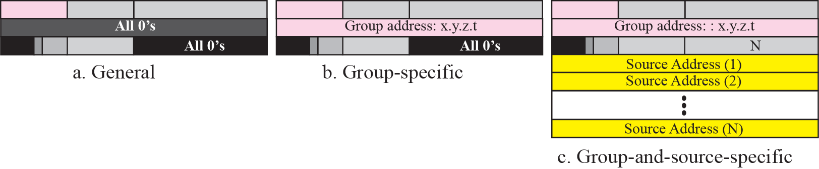
Figure 12.9 Three forms of query messages
In a general query message, the querier router probes each neighbor to report the whole list of its group membership (interest in any multicast group).
In a group-specific query message, the querier router probes each neighbor to report if it is still interested in a specific multicast group. The multicast group address is defined as x.y.z.t in the group address field of the query.
In a group-and-source-specific query message, the querier router probes each neighbor to report if it is still in a specific multicast group, x.y.z.t, coming from any of the N sources whose unicast addresses are defined in this packet.
TCP/IP Protocol Suite

Slide 53
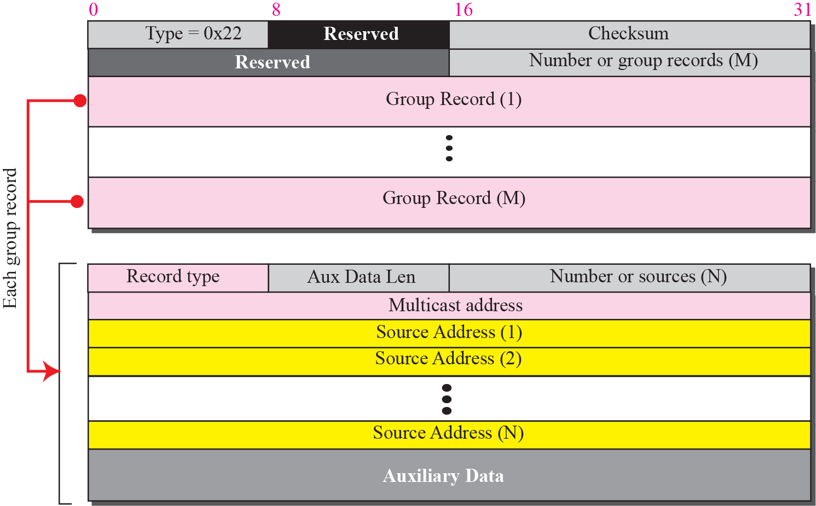
Figure 12.10 Membership report message format
TCP/IP Protocol Suite

Slide 54
Membership Report Message
❑ Type. This 8-bit field with the value 0x22 defines the type of the message.
❑ Checksum. This is a 16-bit field carrying the checksum. The checksum is calculated over the entire IGMP message.
❑ Number of Group Records (M). This 16-bit field defines the number of group records carried by the packet.
❑ Number of Group Records. There can be zero or more group records of variable length. The fields of each group record will be explained below.
TCP/IP Protocol Suite

Slide 55
Group Record
❑ Record Type. Currently there are six record types as shown in Table 12.3. We learn about their applications shortly.
❑ Aux Data Len. This 8-bit field defines the length of the auxiliary data included in each group record. If the value of this field is zero, it means there is no auxiliary data included in the packet. If the value is nonzero, it specifies the length of auxiliary data in words of 32 bits.
❑ Number of Sources (N). This 16-bit field defines the number of 32-bit multicast source addresses attached to the report.
❑ Source Addresses. These multiple 32-bit fields list the M source addresses. The value of M is defined in the previous field.
❑ Aux Data. This field contains any auxiliary data that may be included in the report message. The IGMP has not yet defined any auxiliary data, but it may be added to the protocol in the future.
TCP/IP Protocol Suite

Slide 56
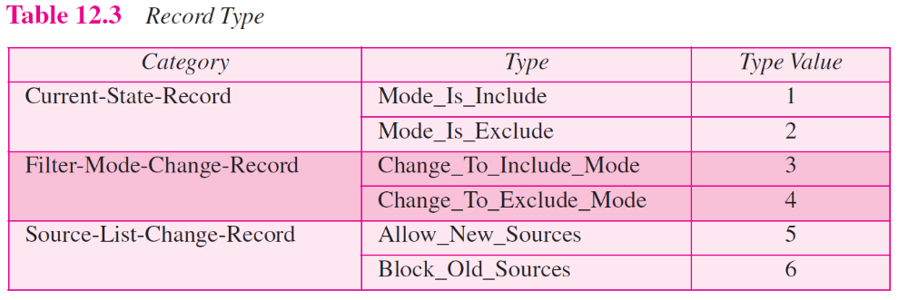
TCP/IP Protocol Suite

Slide 57
IGMP Protocol Applied to Host
Socket State: The management of groups starts with the processes (running application programs) on a host connected to an interface. The record also shows one of the two modes: include mode or exclude mode. If the record is in include mode, it lists the unicast source addresses from which the socket accepts the group messages. If the record is in exclude mode, it lists the unicast source addresses that the socket will not accept the group messages.
Interface State: To be efficient, group management requires that the interface connecting the host to the network also keep an interface state. The interface state is originally empty, but it will build up when socket records are changed (creation in this sense also means change). However, the interface state keeps only one record for each multicast group. If new socket records are created for the same multicast group, the corresponding interface will changed to reflect the new change.
TCP/IP Protocol Suite

Slide 58
Example 12.4
Figure 12.11 shows a host with three processes: S1, S2, and S3. The first process has only one record; the second and the third processes each have two records. We have used lowercase alphabet to show the source address.
TCP/IP Protocol Suite

Slide 59
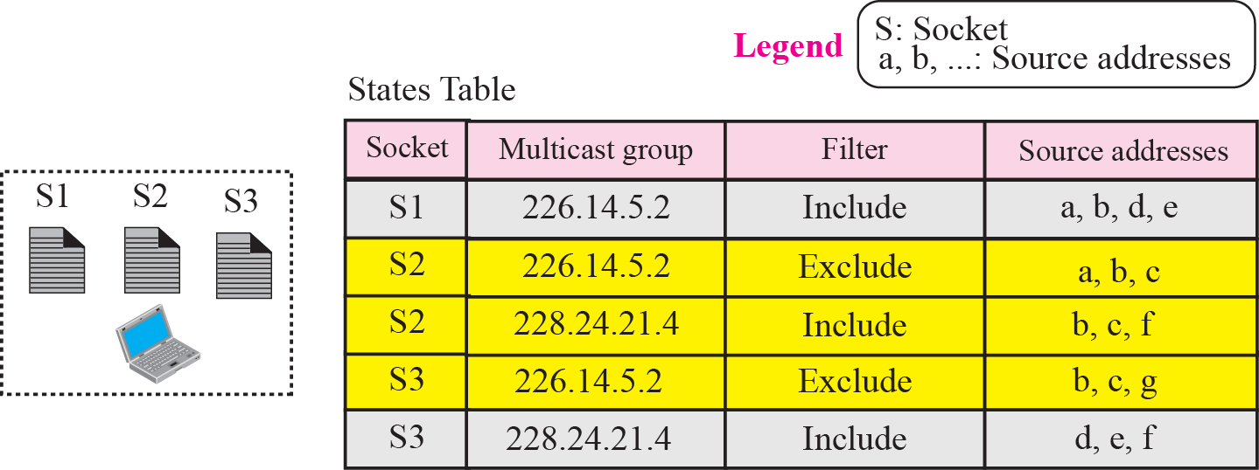
Figure 12.11 Socket state
TCP/IP Protocol Suite

Slide 60
Note
Each time there is a change in any socket record, the interface state
will change using the
above-mentioned rules.
TCP/IP Protocol Suite

Slide 61
Example 12.5
We use the two rules described above to create the interface state for the host in Example 12.4. First we found the list of source address for each multicast group.
a. Multicast group 226.14.5.2 has two exclude lists and one include list. The result is an exclude list as calculated below. a, b, c, d, e, f, g
b. Multicast group: 228.24.21.4 has two include lists. The result is an include list as calculated below. We use the plus sign for the union operation. a, b, c, d, e, f
Figure 12.12 shows the interface state.
TCP/IP Protocol Suite

Slide 62
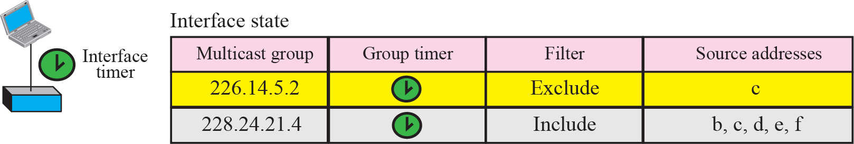
Figure 12.12 Interface state
TCP/IP Protocol Suite

Slide 63
Sending Change-State Reports
If there is any change in the interface state, the host needs to immediately send a membership report message for that group, using the appropriate group record(s). As Figure 12.13 shows, four different cases may occur in the change, based on the old-state filter and the new state filter. We have shown only the group records, not the whole report.
TCP/IP Protocol Suite

Slide 64
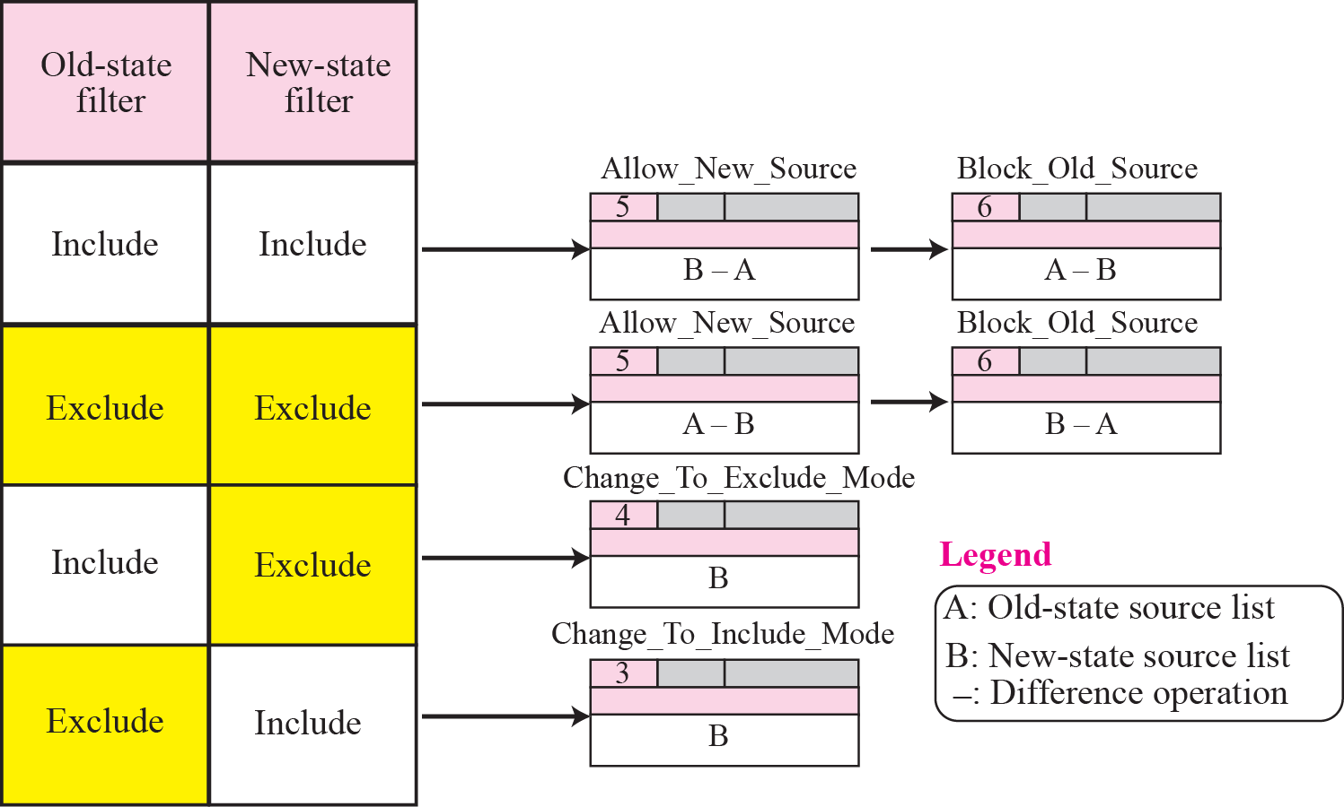
Figure 12.13 Sending change state reports
TCP/IP Protocol Suite

Slide 65
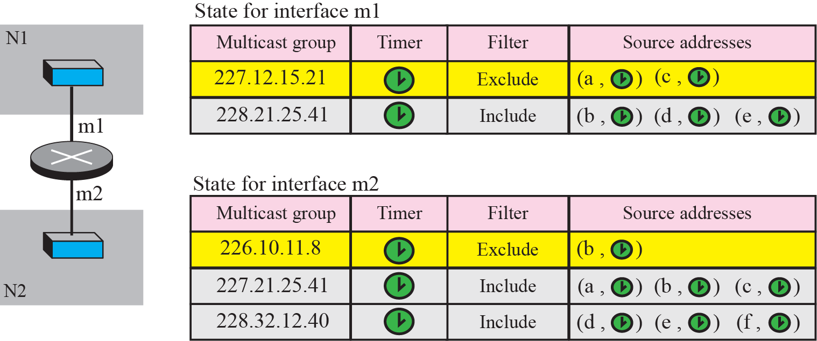
Figure 12.14 Router States
Figure 12.14 shows an example of a multicast router and its two state tables, one related to interface m1 and the other to interface m2.
TCP/IP Protocol Suite

Slide 66
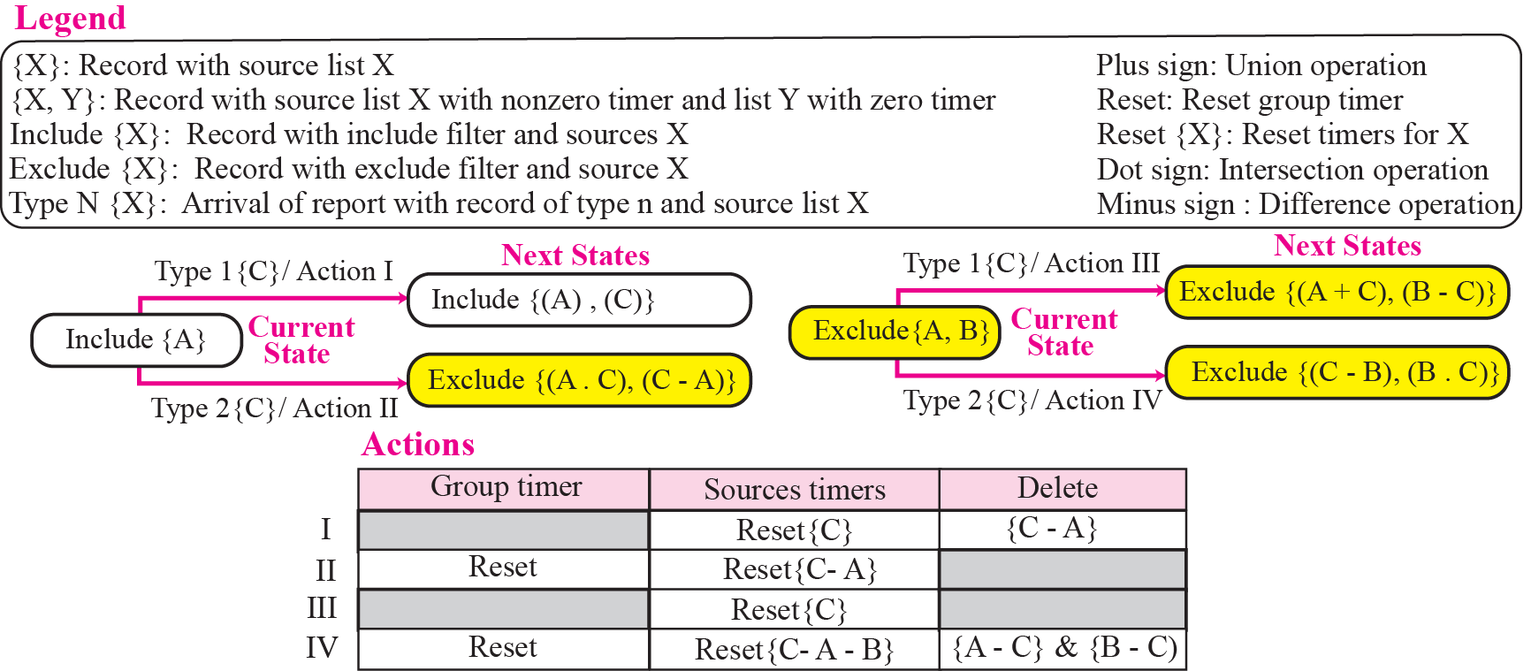
Figure 12.15 Change of state related to general query report
The figure shows the state of each record in the router based on the current state and the record arrived in the report. In other words, the figure is a state transition diagram. When a record is extracted from an arrived report, it changes the state of the corresponding record (with the same group address) and invokes some actions. We have shown the four different sets of actions separately, one set for each change of state.
TCP/IP Protocol Suite

Slide 67
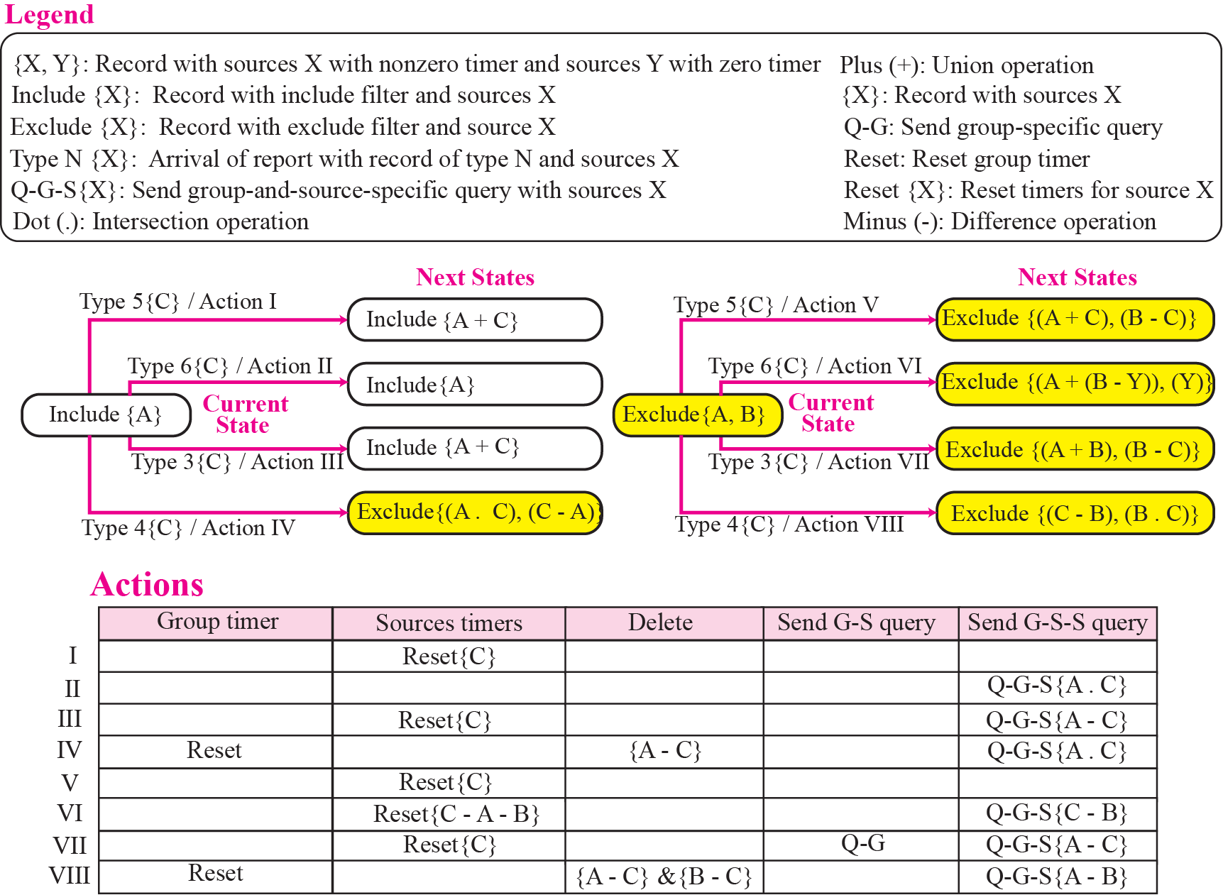
Figure 12.16 Change of state related to other report types
TCP/IP Protocol Suite

Slide 68
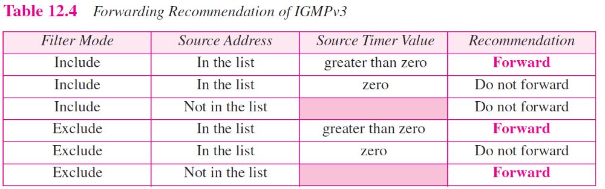
TCP/IP Protocol Suite

Slide 69
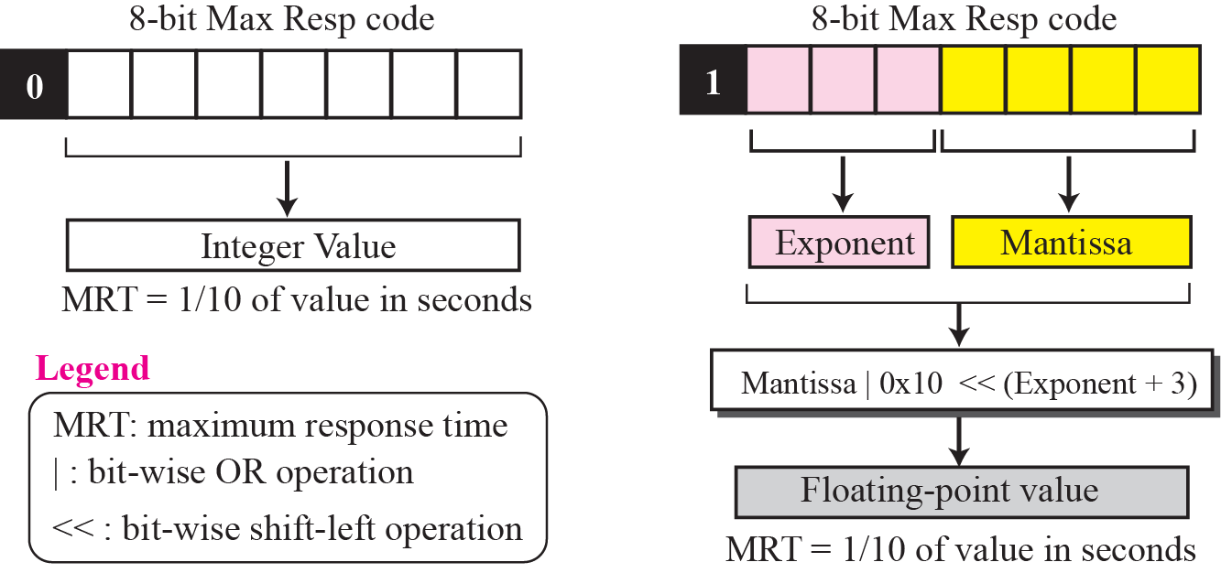
Figure 12.17 Calculation of maximum response time
TCP/IP Protocol Suite

Slide 70
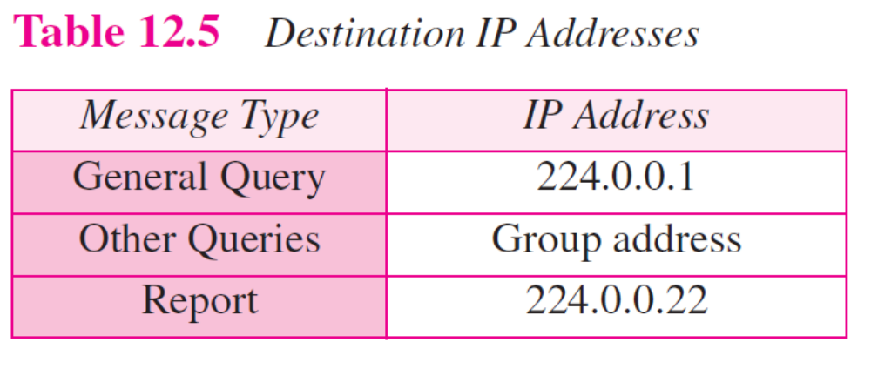
TCP/IP Protocol Suite

Slide 71
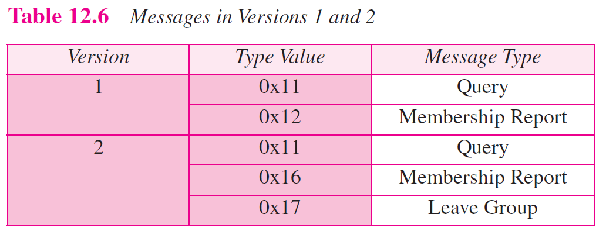
TCP/IP Protocol Suite

Slide 72
12-4 MULTICAST ROUTING
Now we show how information collected by IGMP is disseminated to other routers using multicast routing protocols. However, we first discuss the idea of optimal routing, common in all multicast protocols. We then give an overview of multicast routing protocols.
TCP/IP Protocol Suite

Slide 73
Topics Discussed in the Section
Optimal Routing: Shortest Path Trees
TCP/IP Protocol Suite

Slide 74
Note
In unicast routing, each router in the domain has a table that defines a shortest path tree to possible destinations.
TCP/IP Protocol Suite

Slide 75
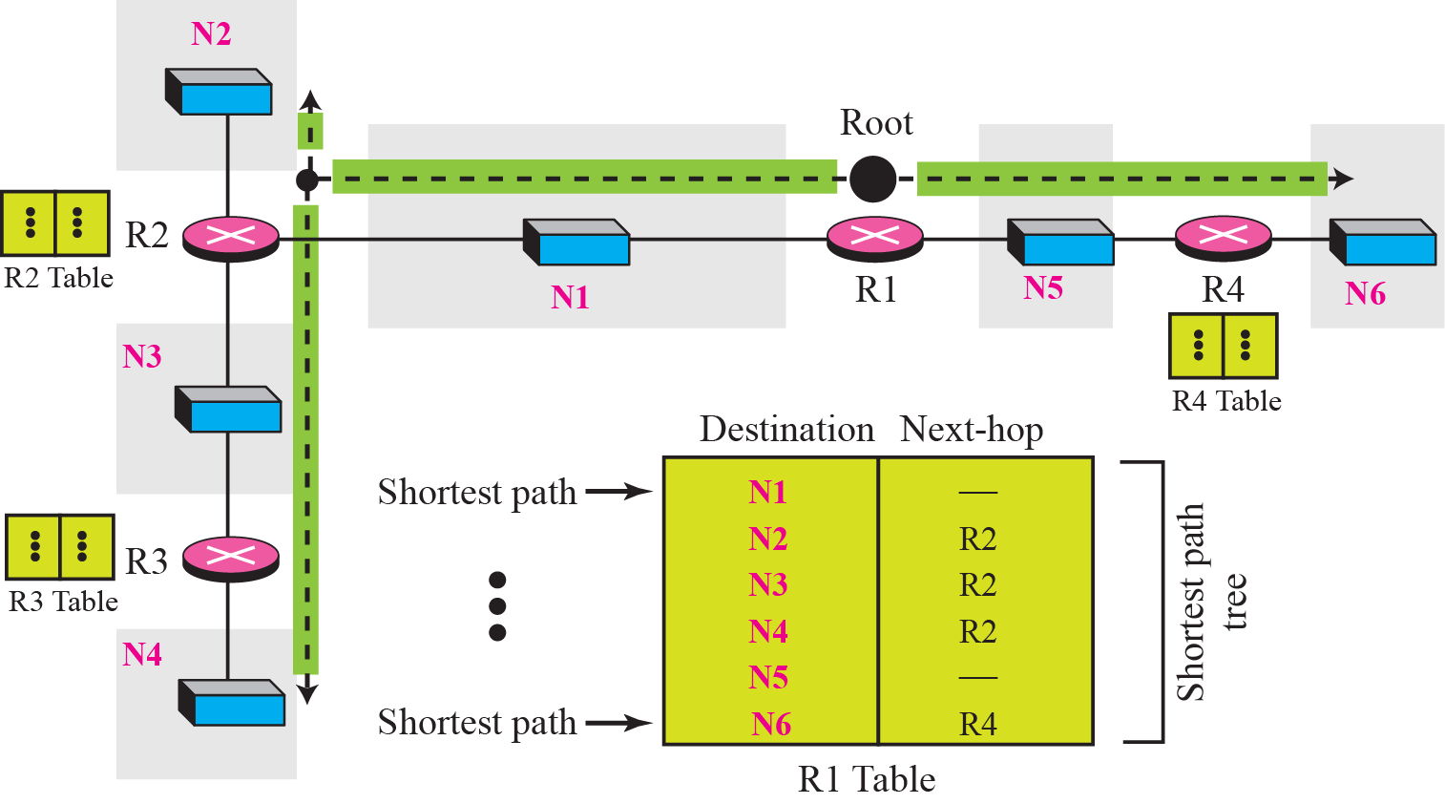
Figure 12.18 Shortest path tree in multicast routing
TCP/IP Protocol Suite

Slide 76
Note
In multicast routing, each involved router needs to construct a shortest
path tree for each group.
TCP/IP Protocol Suite

Slide 77
Note
In the source-based tree approach, each router needs to have one shortest path tree for each group.
TCP/IP Protocol Suite

Slide 78
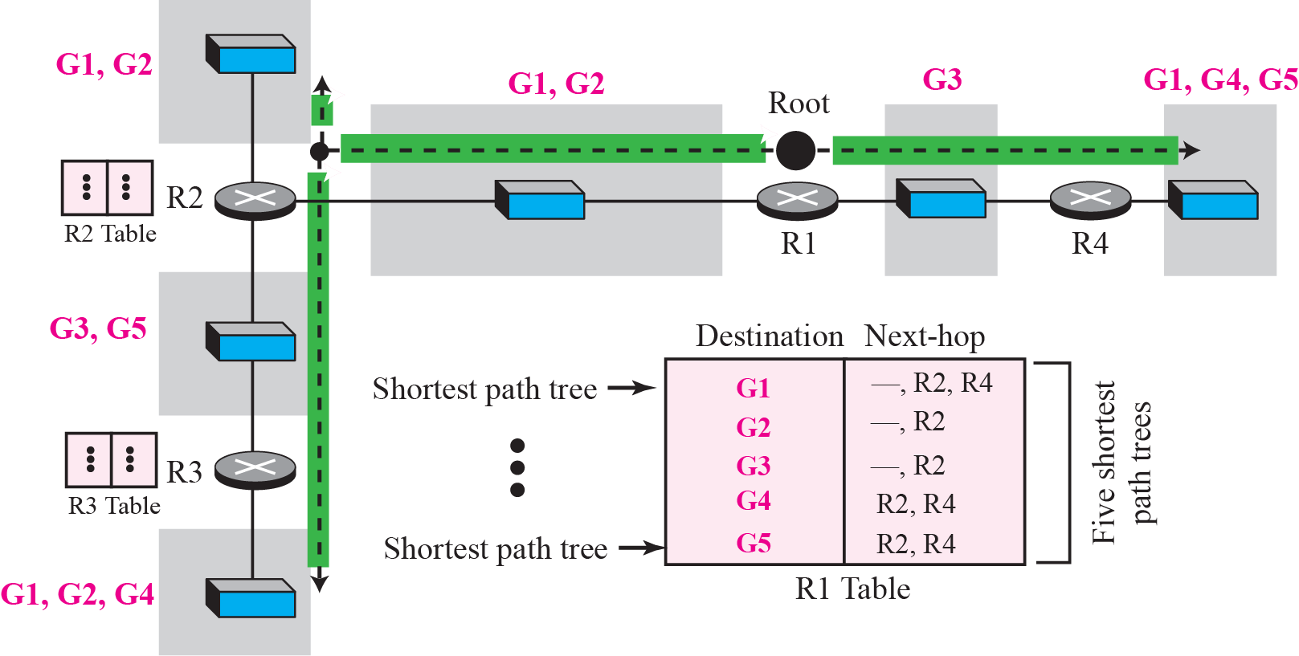
Figure 12.19 Source-based tree approach
TCP/IP Protocol Suite

Slide 79
Note
In the group-shared tree approach, only the core router, which has a shortest path tree for each group, is involved
in multicasting.
TCP/IP Protocol Suite

Slide 80
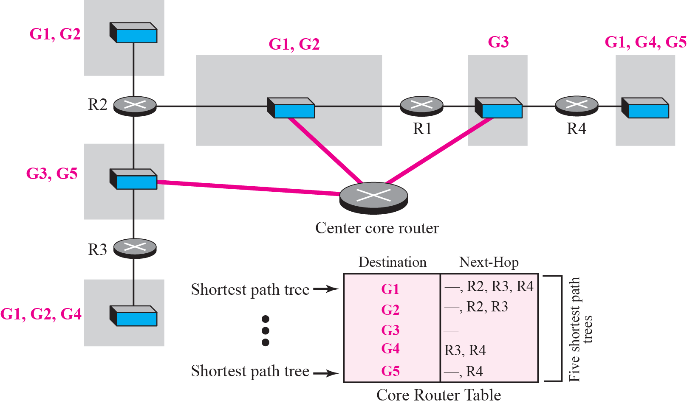
Figure 12.20 Group-shared tree approach
TCP/IP Protocol Suite

Slide 81
12-5 ROUTING PROTOCOLS
During the last few decades, several multicast routing protocols have emerged. Some of these protocols are extensions of unicast routing protocols; some are totally new. We discuss these protocols in the remainder of this chapter. Figure 12.21 shows the taxonomy of these protocols.
TCP/IP Protocol Suite

Slide 82
Topics Discussed in the Section
Multicast Link State Routing: MOSPF
Multicast Distance Vector: DVMRP
Core-Based Tree: CBT
Protocol Independent Multicast: PIM
TCP/IP Protocol Suite

Slide 83
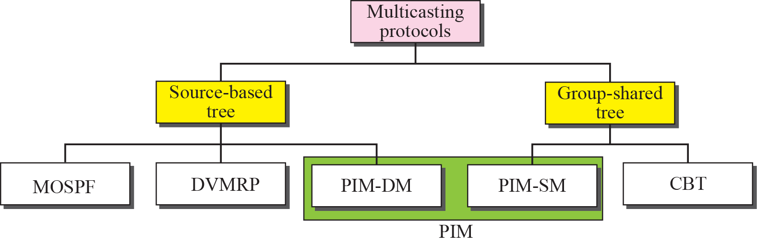
Figure 12.21 Taxonomy of common multicast protocols
TCP/IP Protocol Suite

Slide 84
Note
Multicast link state routing uses the source-based tree approach.
TCP/IP Protocol Suite

Slide 85
Note
Flooding broadcasts packets, but creates loops in the systems.
TCP/IP Protocol Suite

Slide 86
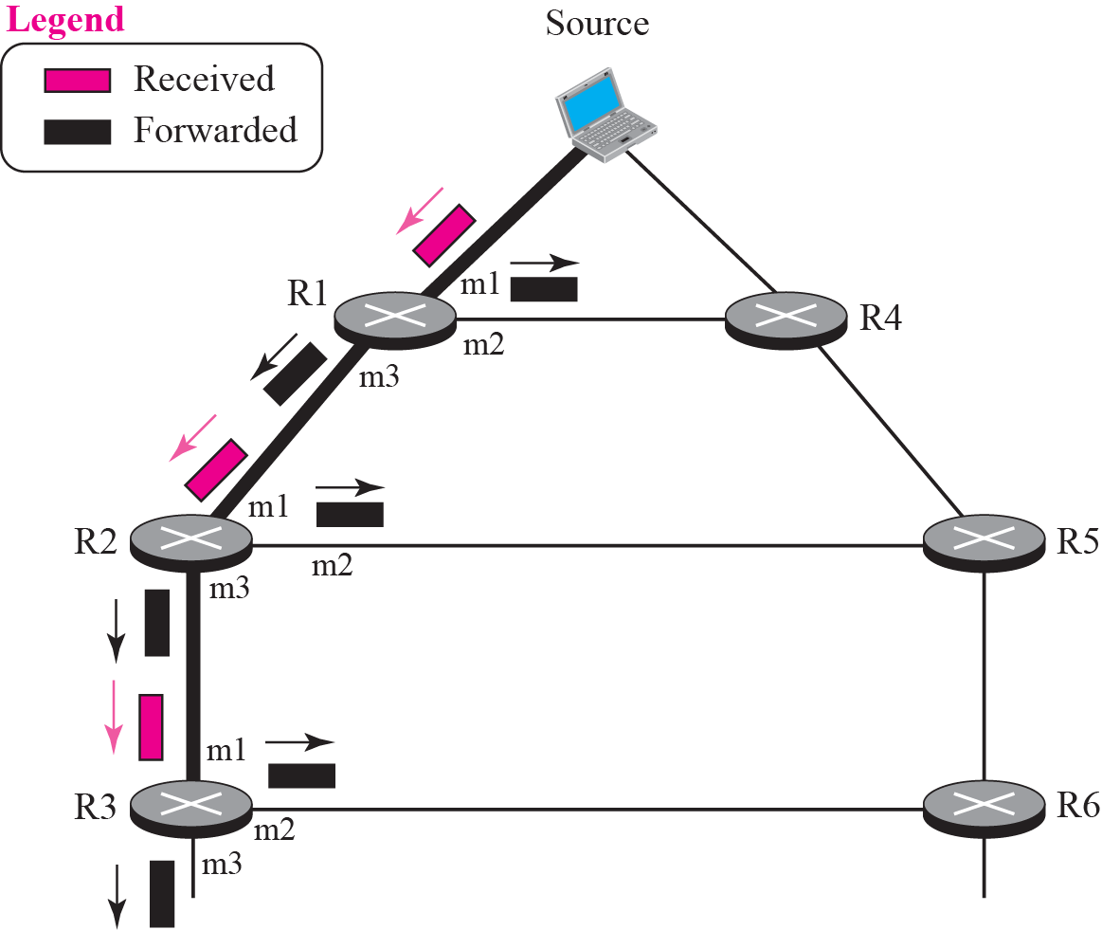
Figure 12.22 RPF
TCP/IP Protocol Suite

Slide 87
Note
RPF eliminates the loop in the
flooding process.
TCP/IP Protocol Suite

Slide 88
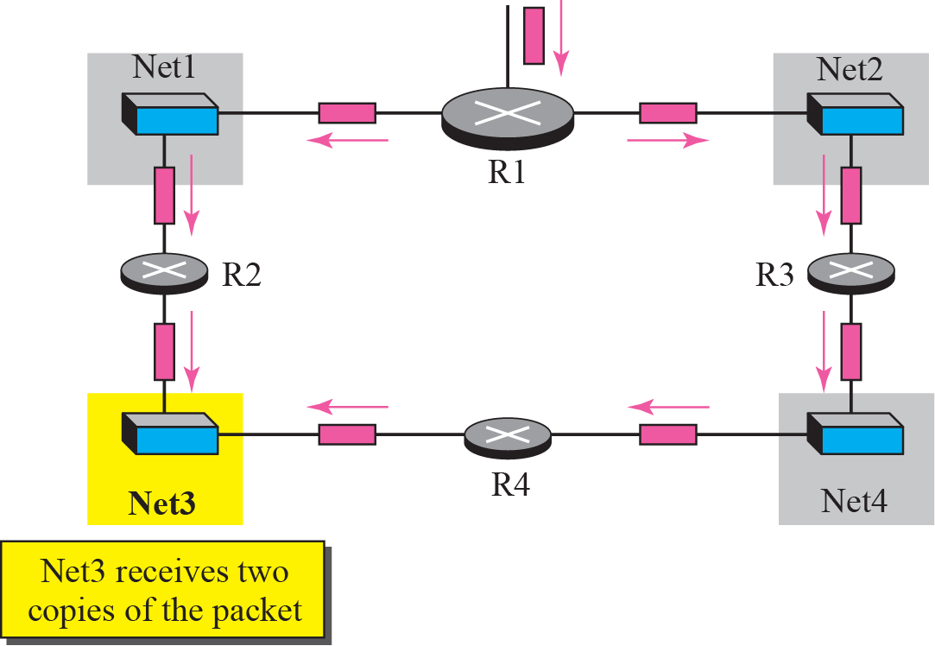
Figure 12.23 Problem with RPF
TCP/IP Protocol Suite

Slide 89
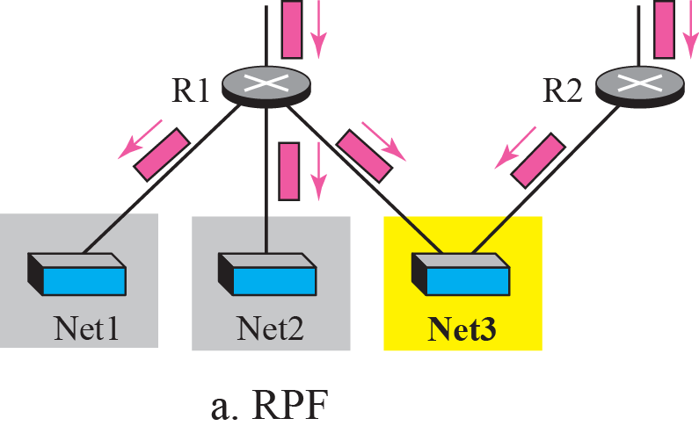
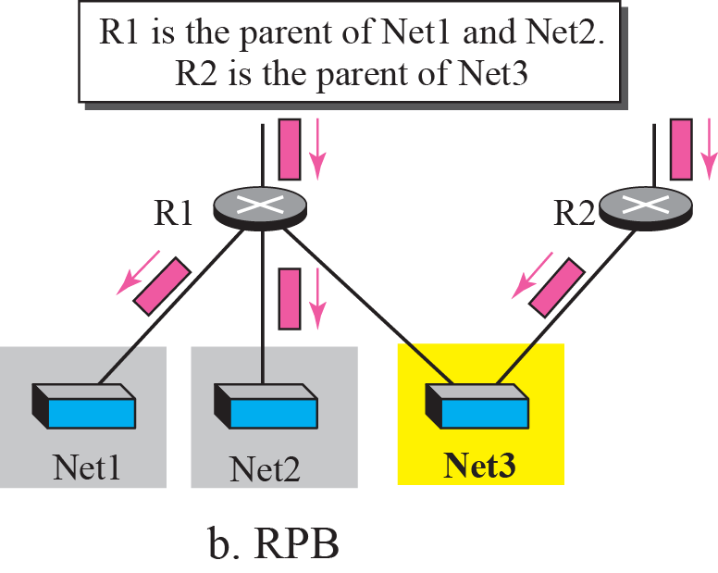
Figure 12.24 RPM versus RPB
TCP/IP Protocol Suite

Slide 90
Note
RPB creates a shortest path broadcast tree from the source to each destination.
It guarantees that each destination receives one and only one copy
of the packet.
TCP/IP Protocol Suite

Slide 91
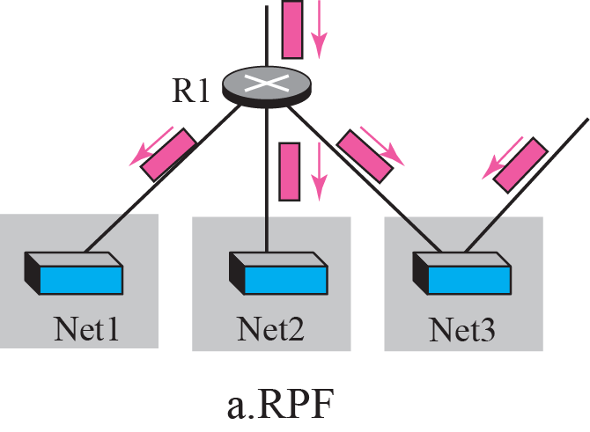
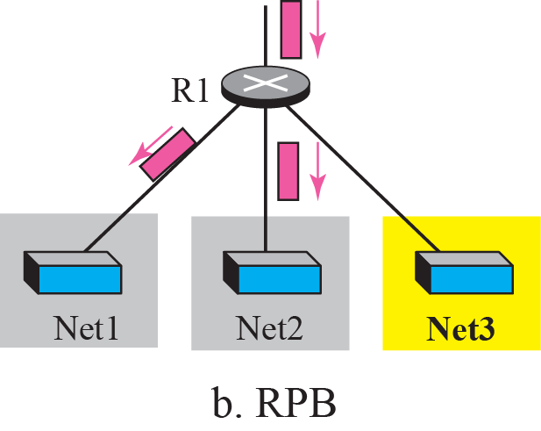
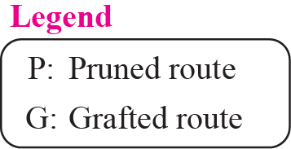
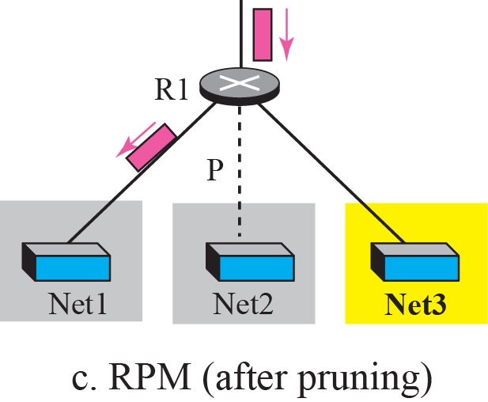
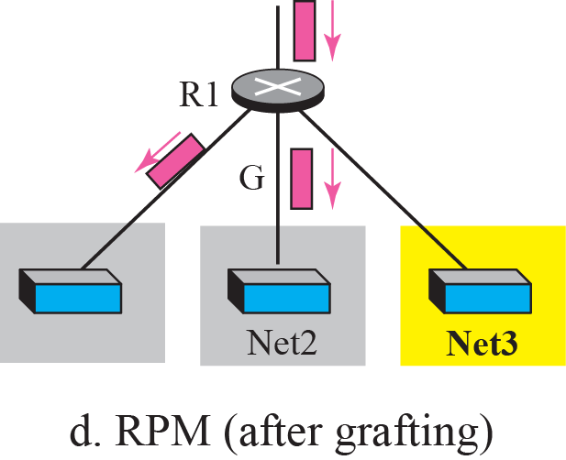
Figure 12.25 RPF, RPB, and RPM
TCP/IP Protocol Suite

Slide 92
Note
RPM adds pruning and grafting to RPB to create a multicast shortest path tree that supports dynamic membership changes.
TCP/IP Protocol Suite

Slide 93
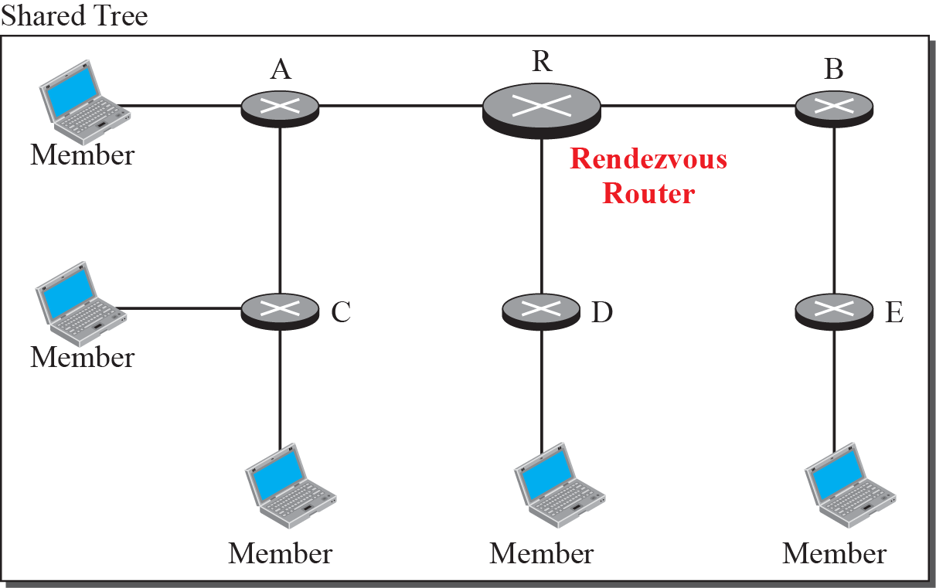
Figure 12.26 Group-shared tree with rendezvous router
TCP/IP Protocol Suite

Slide 94
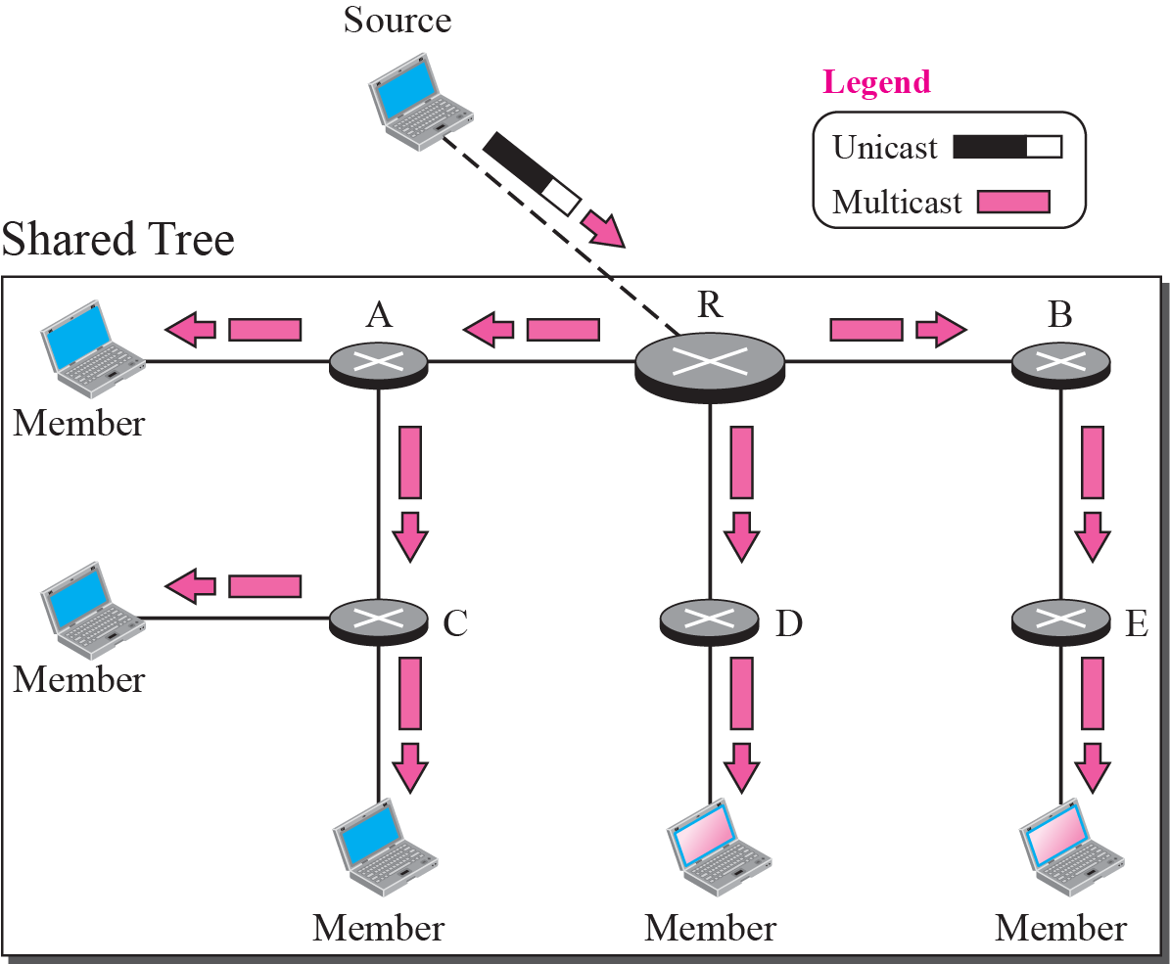
Figure 12.27 Sending a multicast packet to the rendezvous router
TCP/IP Protocol Suite

Slide 95
Note
In CBT, the source sends the multicast packet (encapsulated in a unicast packet) to the core router. The core router decapsulates the packet and forwards it to all interested
interfaces.
TCP/IP Protocol Suite

Slide 96
Note
PIM-DM is used in a dense multicast environment, such as a LAN.
TCP/IP Protocol Suite

Slide 97
Note
PIM-DM uses RPF and pruning/grafting strategies to handle multicasting.
However, it is independent from the underlying unicast protocol.
TCP/IP Protocol Suite

Slide 98
Note
PIM-SM is used in a sparse multicast environment such as a WAN.
TCP/IP Protocol Suite

Slide 99
Note
PIM-SM is similar to CBT but uses a simpler procedure.
TCP/IP Protocol Suite

