Slide 1

SCRAPING THE WEBSITE USING PYTHON
Project Guide : Dr.Jemshia Miriam
Name of the Student: Rajulapati Nithin
Register Number: 39110831
9 April 2022
Department of CSE

Slide 2
Presentation Outline
Course Certificate
Introduction
Objectives
Module Implementation
Project Snapshots
Results and Discussions
Conclusion & Future work
References
9 April 2022
Department of CSE

Slide 3
Course Certificate

Slide 4
Introduction
Web scraping is the process of collecting and parsing raw data from the Web, and the Python community has come up with some pretty powerful web scraping tools.
The Internet hosts perhaps the greatest source of information and misinformation on the planet. Many disciplines, such as data science, business intelligence, and investigative reporting, can benefit enormously from collecting and analyzing data from websites.
Collecting data from websites using an automated process is known as web scraping. Some websites explicitly forbid users from scraping their data with automated tools. Websites do this for two possible reasons:
The site has a good reason to protect its data. For instance, Google Maps doesn’t let you request too many results too quickly.
Making many repeated requests to a website’s server may use up bandwidth, slowing down the website for other users and potentially overloading the server such that the website stops responding entirely.
9 April 2022
Department of CSE

Slide 5
Problem Statement
* To scrap a known website with the permissions and rules given by the website and collect the data from the HTML and JSON forms of the website and organise the bulk data into the accurate manner of .CSV format like a dataset.
* Before Scrapping (Have to check):
1. Whether the website allows the people to scrap their data or not.
2. Check the rules of the website and also the legal notices given by the website.
3. If the website allows you to scrap, then you can proceed with the further process.
9 April 2022
Department of CSE

Slide 6
Objectives
The main goal of this website scraping is to extract the data in different formats using python and organise it in the beautiful manner(understandable).
In this project I am going to use a “GitHub.com” which contains huge number of data and able to scrap the data what we want.
In this project I am going to import packages from python like Beautiful-soup, Requests, Pandas. Using these modules we can extract the data and also organise it in the CSV format.
9 April 2022
Department of CSE

Slide 7
Project Implementation
Requests, Beautiful_soup and Pandas are the modules which are imported in this project.
REQUESTS: Requests library is used for making HTTP requests to a specific URL and returns the response. Python requests provide inbuilt functionalities for managing both the request and response.
BEAUTIFUL SOUP: It is a Python library for pulling data out of HTML and XML files. It works with your favourite parser to provide idiomatic ways of navigating, searching, and modifying the parse tree. It commonly saves programmers hours or days of work.
Pandas : It is an open-source Python Library providing high-performance data manipulation and analysis tool using its powerful data structures.
9 April 2022
Department of CSE

Slide 8
SOFTWARE AND HARDWARE REQUIREMENTS
Hardware requirements:
Computer or pc with latest processor.
Ram: 4gb
Software requirements:
Jupyter Notebook(Anaconda 3)
Python installed in system
Modules installed from python.
In order to extract the data from the website we need a website which allows us to scrap the data only for the education purpose.
We have to convert that bulk data into the CSV format using pandas.
9 April 2022
Department of CSE

Slide 9
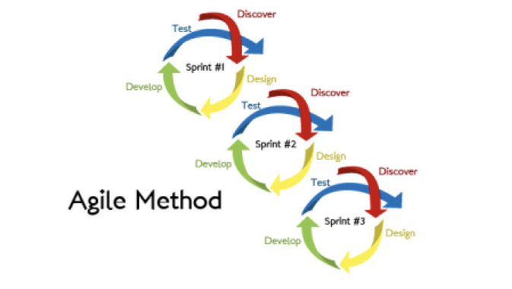
Methodology
Agile Methodology
* The agile methodology is used when the requirements may change during the development of a project. Projects using agile development are broken up into sprints, each with their own analysis, design, implementation and testing phases.
* These sprints begin with a meeting, detailing the work to be done in the sprint with daily meetings to keep the project on target.
* Essentially, this breaks the project into smaller segments with each segment having its own development phase, then at the end, the segments are combined to form the finished product. Below figure shows the agile method as a series of sprints with their own development life cycles.
9 April 2022
Department of CSE

Slide 10
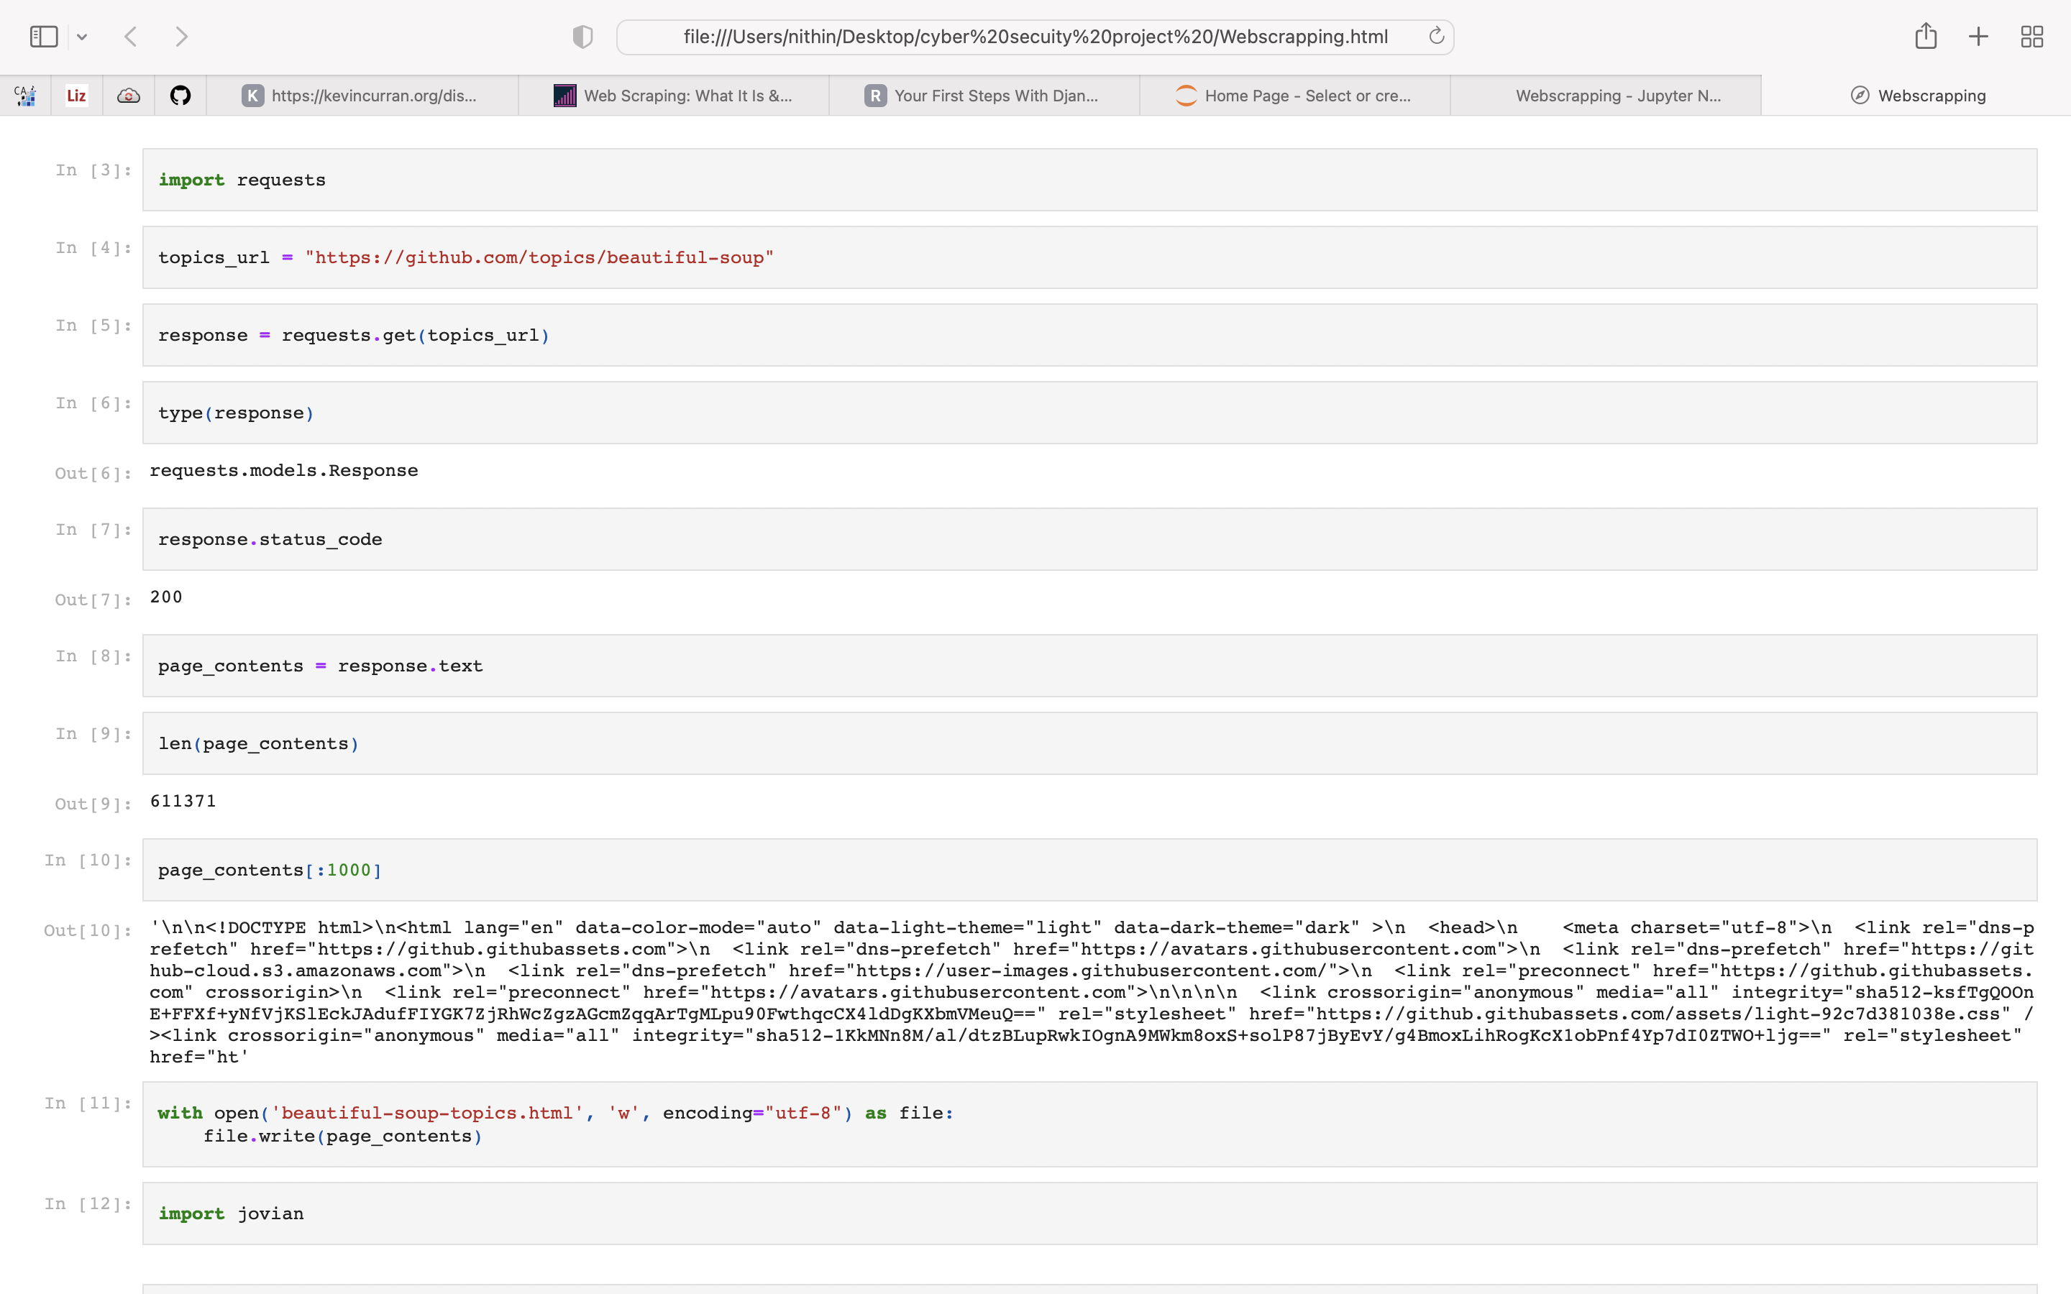
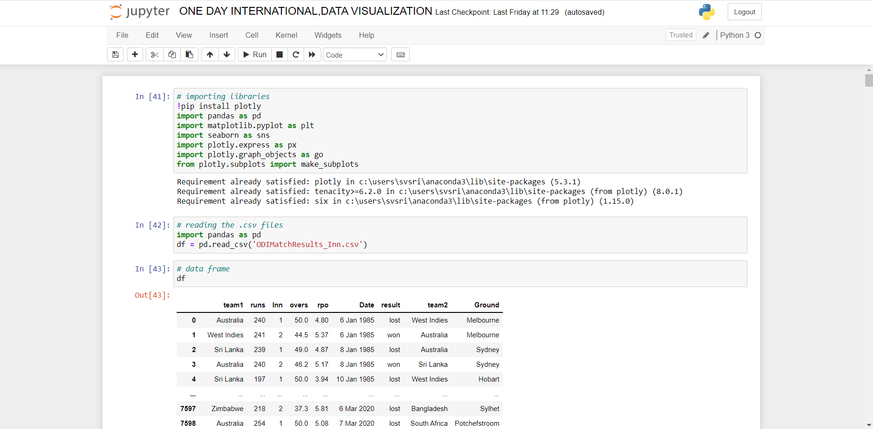
Application Snapshots
Jupyter Interface
9 April 2022
Department of CSE

Slide 11
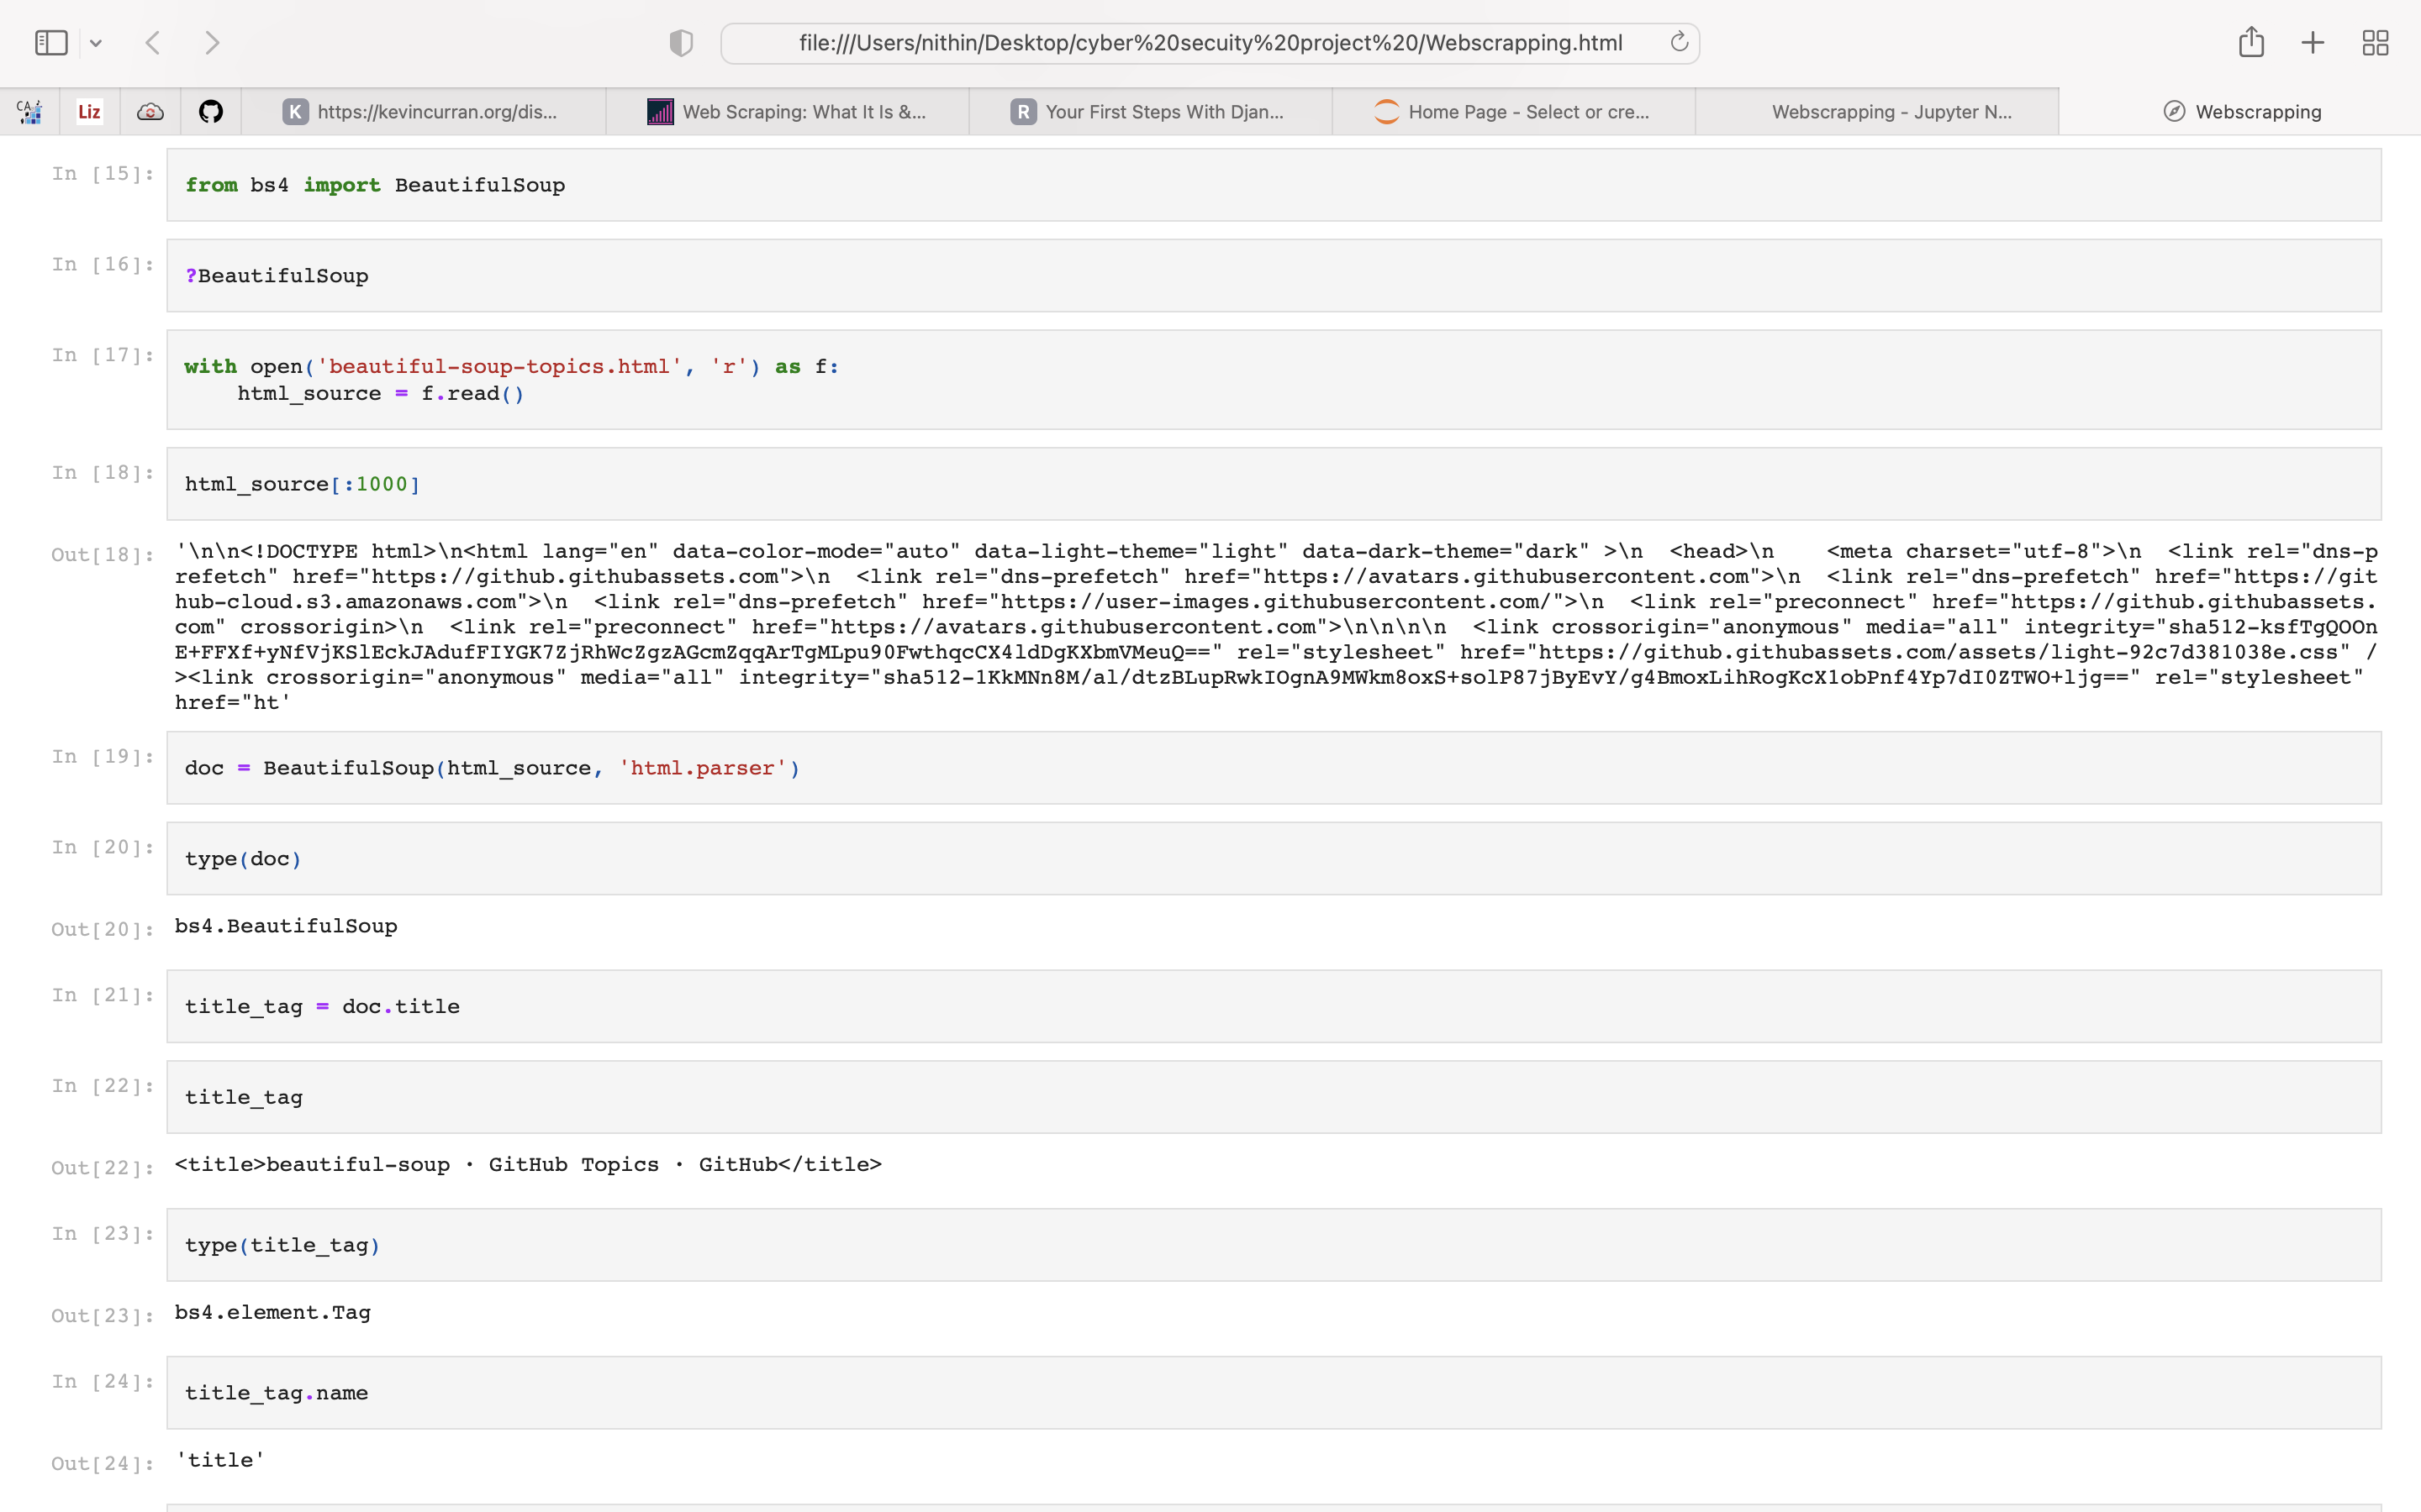
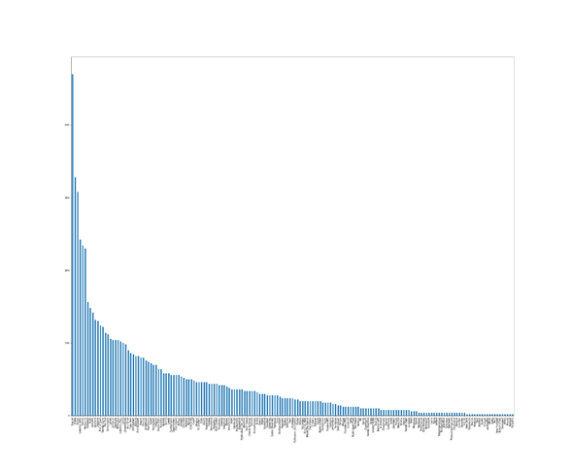
Extraction
9 April 2022
Department of CSE

Slide 12
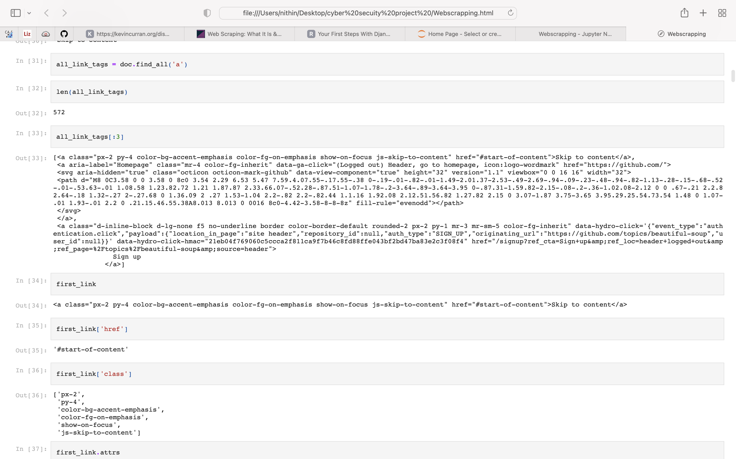
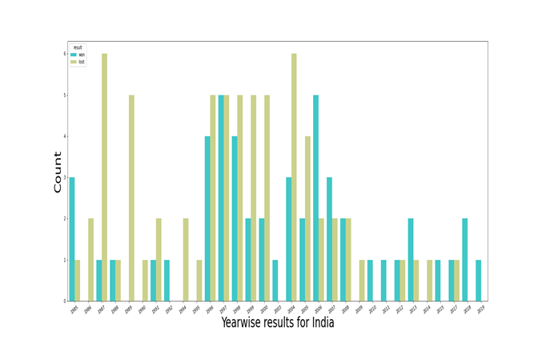
Snap shots
9 April 2022
Department of CSE

Slide 13
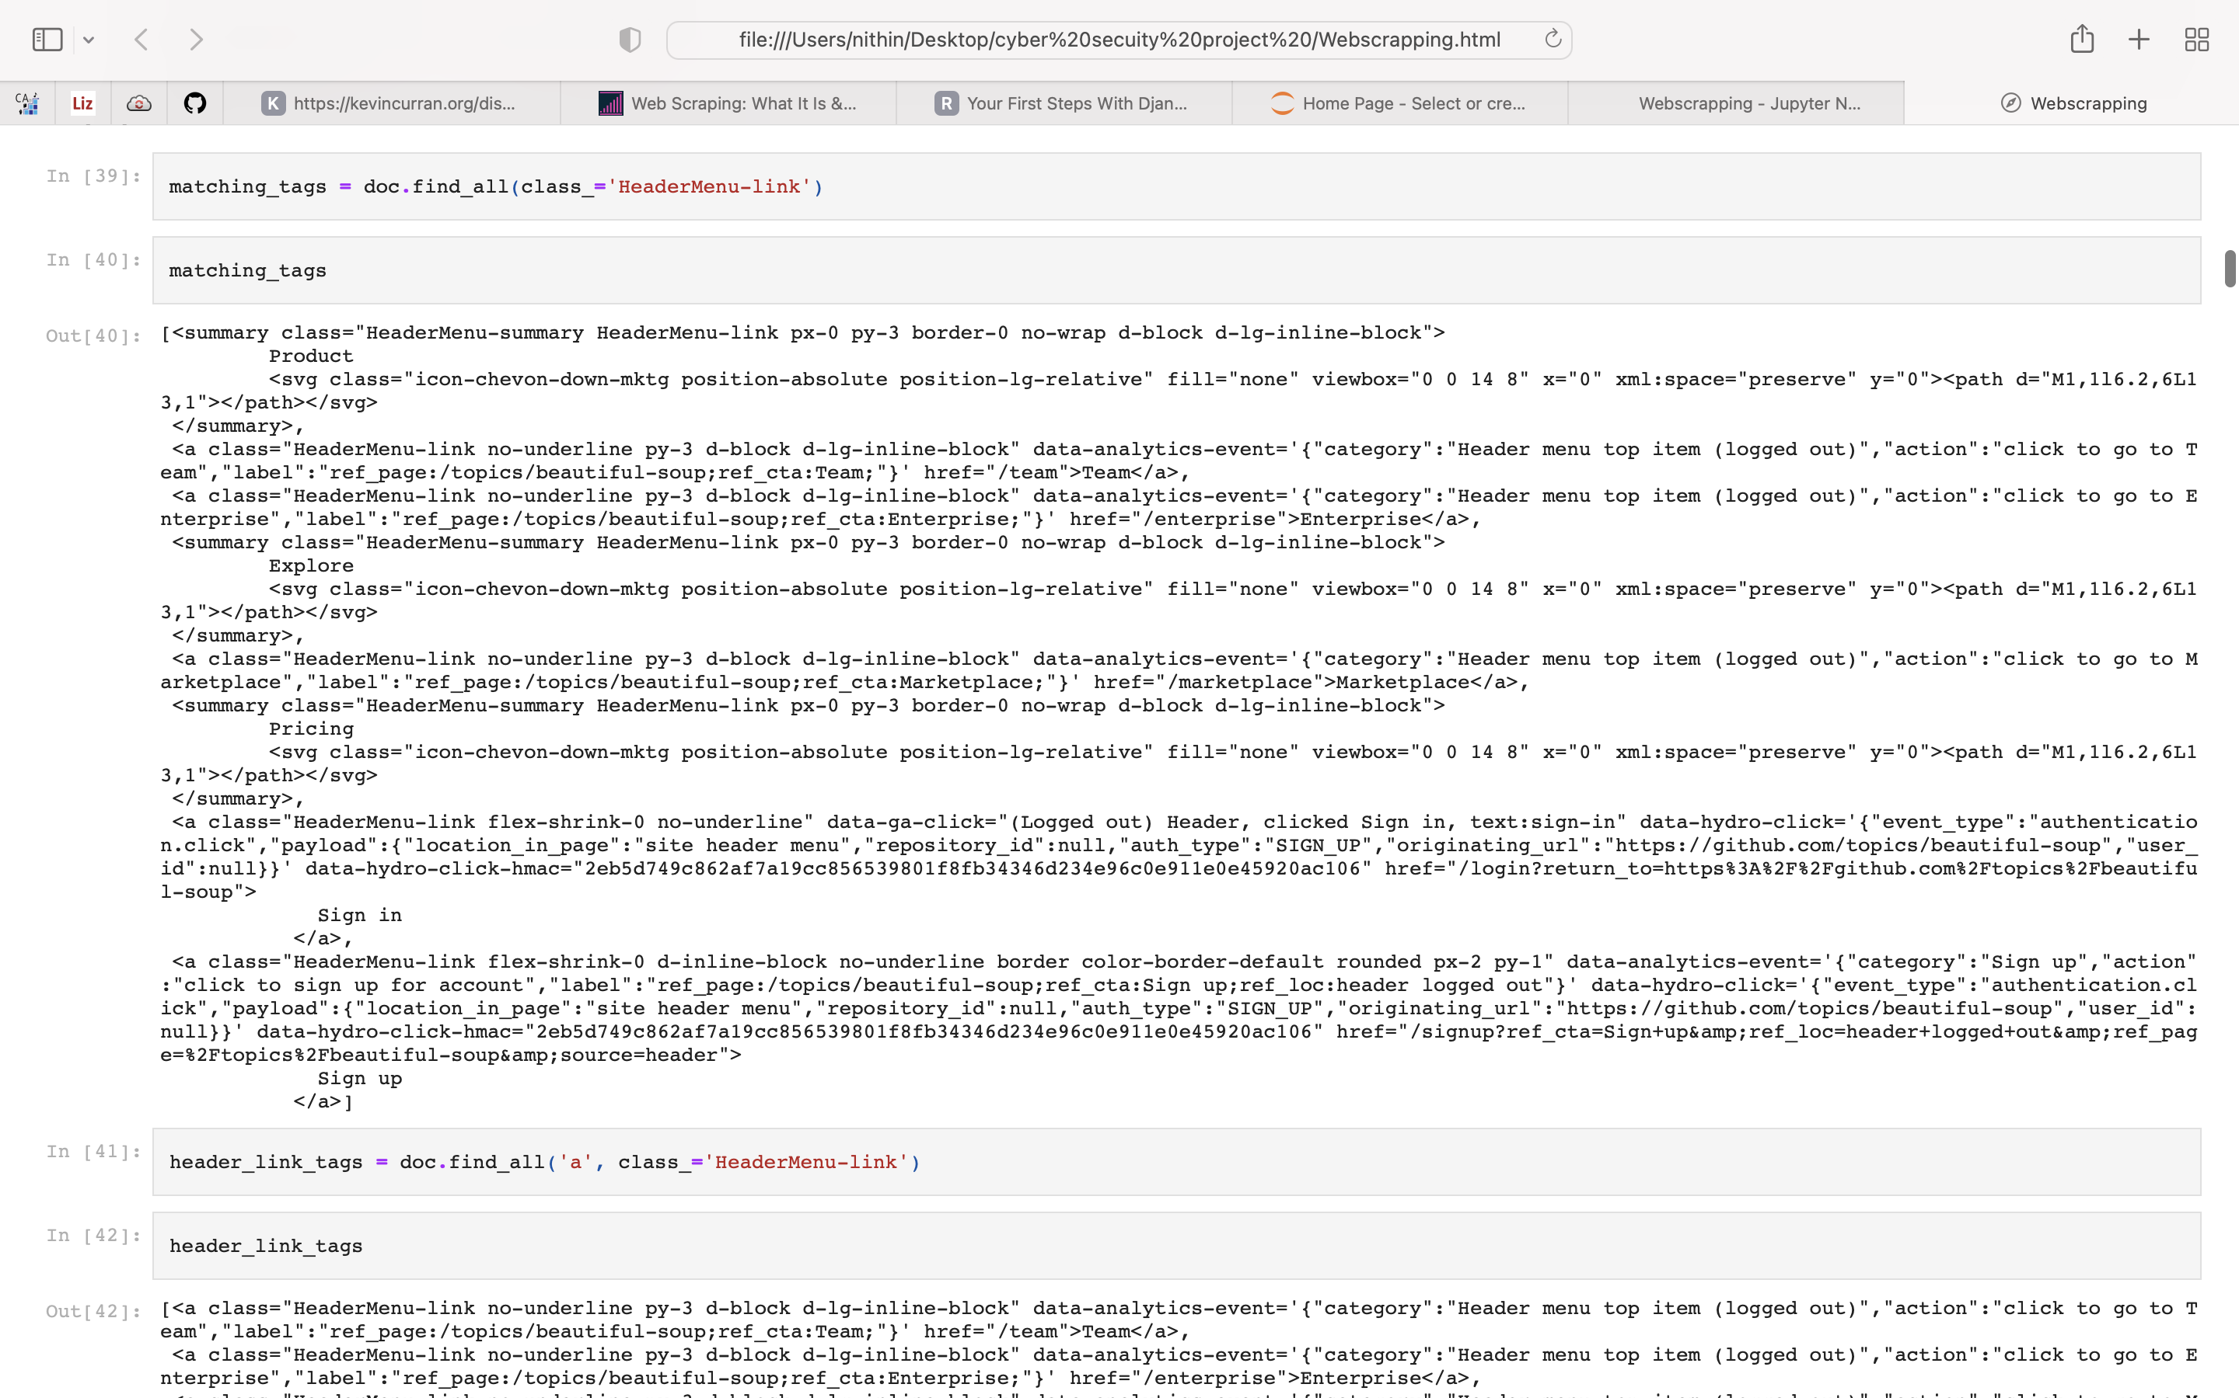
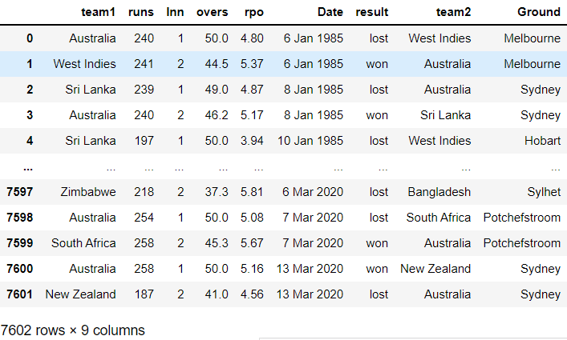
Extracted data from website
Data frame of all the teams
9 April 2022
Department of CSE

Slide 14
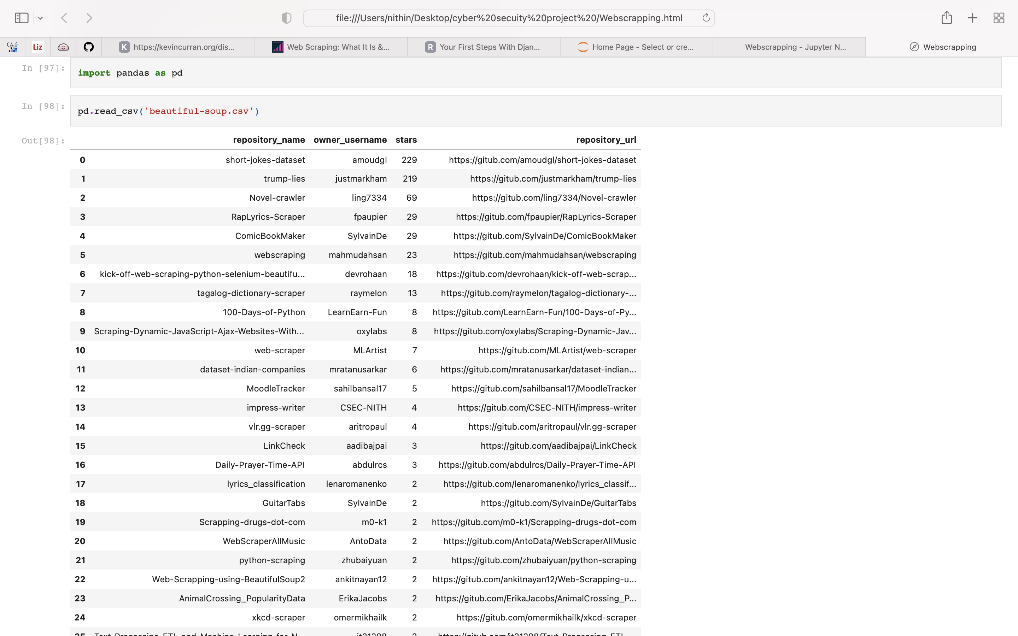
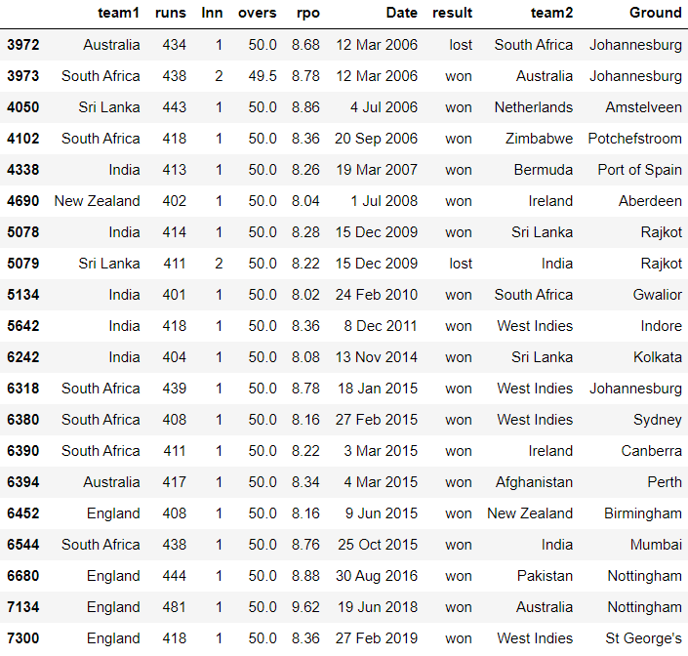
Converted data into CSV file
CSV format
9 April 2022
Department of CSE

Slide 15
Conclusion
From this project we can conclude that all the different types of data like HTML, JSON and CSS are extracted successfully and organised in a beautiful format that a user can easily understand everything in the dataset.
We have extracted the data from the GitHub.com and organised the data in the understandable way (.csv format).
We can use this type of data for knowing what are all the links and mail id’s available with the website and also the repositories which are similar to our search.
9 April 2022
Department of CSE

Slide 16
References
[1] | github.com Scraped data from https://github.com/topics/beautiful-soup
[2] | python.org This is for downloading the python.
[3] | anaconda.org For installation of Jupyter.
[4] | Requests, Beautiful soup, Pandas are the modules.
9 April 2022
Department of CSE

