Slide 1
Introduction to Software Engineering
Xiaoying Bai
Department of Computer Science and Technology
Tsinghua University, Beijing, China
September 22, 2016

Slide 2
Outline
What is software?
Why software engineering?
What is software engineering?
SE Body of Knowledge
SE Code of Ethics

Slide 3
Outline
What is software?
Why software engineering?
What is software engineering?
SE Body of Knowledge
SE Code of Ethics

Slide 4
What is Software?
In-the
-small
In-the
-Large
“In the coming decade, it will evolve into an integral extension not only of our senses and bodies but our minds.”
-- Kevin Kelly, Wired, Aug. 2005
In-the
-World
In-
Every
-where

Slide 5
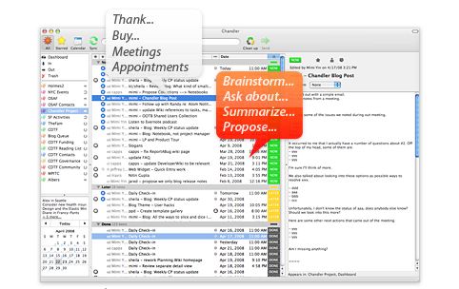
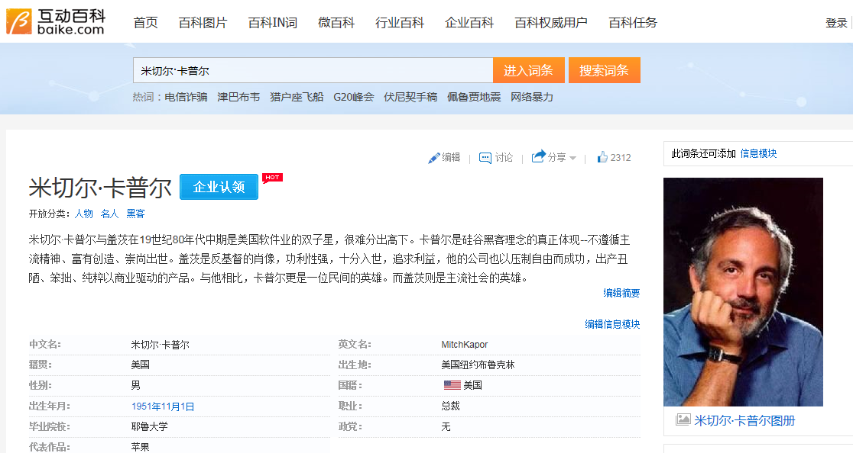
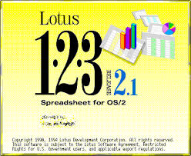

How to develop Software?

Slide 6


Dreaming in Code:
Two Dozen Programmers, Three Years, 4,732 Bugs, and One Quest for Transcendent Software
(January 16, 2007)
“标靶移来移去，目的忽上忽下，计划不切实际，期限一拖再拖，预算膨胀超值，绝望不已，混乱不堪。”
梦萦代码
“这里躺着一个野心勃勃的开源项目。它曾立志超越Outlook，最后却无疾而终。慷慨的Mitch Kapor带给它生命，又把命脉从它身上取走。许多程序员以心血养育它，惜乎全不见成效。它是温室中的花儿，有过绚烂的梦想，还未绽放即已枯萎。那软件的花园中，还有多少会渐次凋零呢？”
Scott Rosenberg

Slide 7

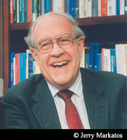
Grand Challenges
F. P. Brooks, The Mythical Man-Month
Published 1975, Republished 1995
Experience managing the development of OS/360
Issues in software development, US Government Accounting 1979
28.8% Software never delivered
47.3% Delivered but never used
19.2% Major modification, re-work or abandon
3% Minor modification
2% Used as delivered
Brooks' project, OS/360:
was late (over 5000 person year, 61-64)
cost many times more than estimate (over $500M)

Slide 8

Essential Difficulties
Complexity
Conformity
Changeability
Invisibility
“No Silver Bullet – Essence and Accident in Software Engineering”,
F. P. Brooks, 1986

Slide 9
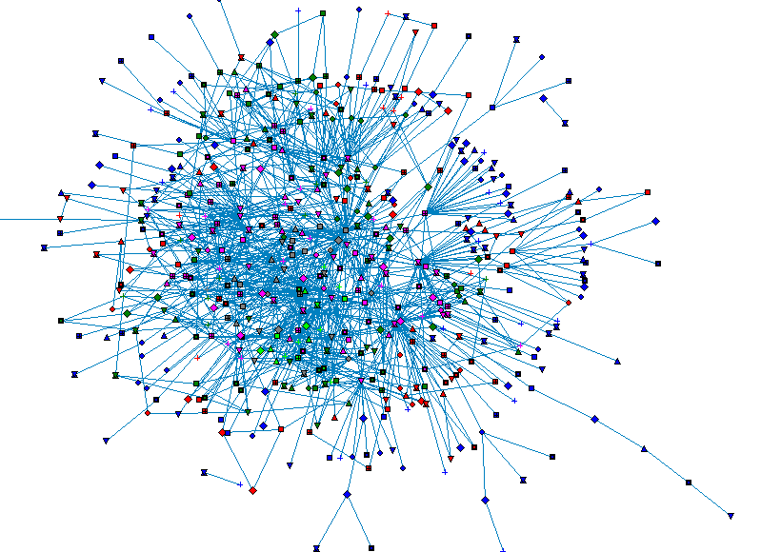
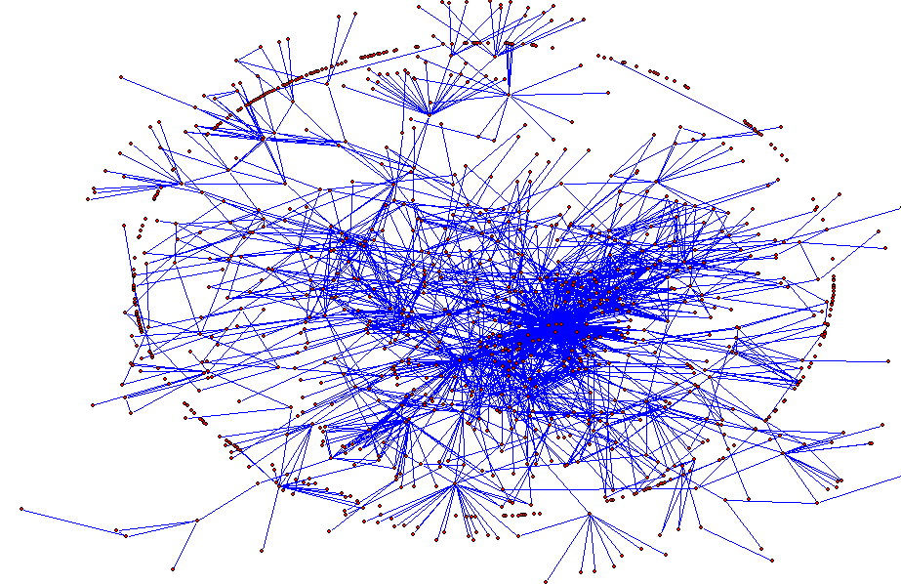
Linux内核有630个函数，存在1841个函数调用。图中将函数表示为节点，调用关系表示为边
应用服务器支撑软件Tomcat，含1019个类，类与类之间有2109个继承或聚合关系。图中将类表示为节点，关系表示为边

Slide 10
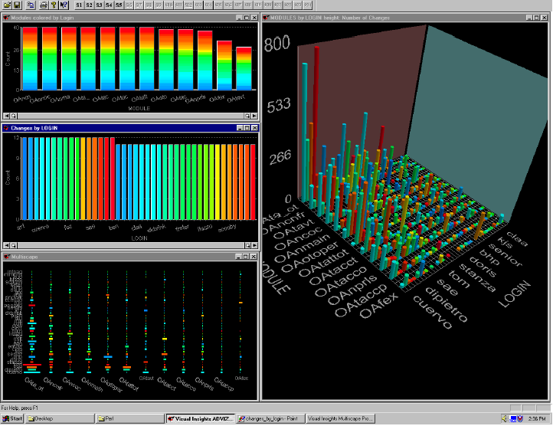
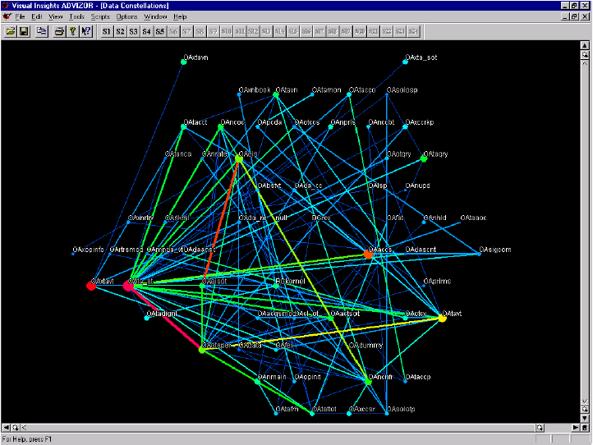
Relationships Between Files Based on IMR Linkages. Nodes are files, and linkage is defined by the relative frequency of ﬁles being changed as part of the same IMR. Link color shows the strength of this relationship.
Number of Changes Indexed by Developer and Module. Barcharts: Changes by module (top)and by developer(bottom),with color encoding developer. Matrix view and Cityscape view: number of changes indexed by developer (columns) and module(rows).
[Eick00]

Slide 11
“软件人员太像皇帝新衣故事中的裁缝了。当我来检查时软件开发工作时，所得到的回答好象对我说：我们正忙于编织这件带有魔法的织物。只要等一会儿，你就会看到这件织物是及其美丽的。但是我什么也看不到，什么也摸不到，也说不出任何一个有关的数字，没有任何办法得到一些信息说明事情确实进行得非常顺利，而且我已经知道许多人最终已经编织了一大堆昂贵的废物而离去，还有不少人最终什么也没有做出来。”
-- F.D. Brooks, Manager of OS/360
“The Mythical Man-Month”, 1974

Slide 12
“…没有别的场景比巨兽在焦油坑中垂死挣扎的场面更令人震撼…它们挣扎得越是猛烈，焦油纠缠得越紧，没有任何猛兽足够强壮或具有足够的技巧，能够挣脱束缚，它们最后都沉到了坑底。
过去几十年的大型系统开发就犹如这样一个焦油坑，很多大型和强壮的动物在其中剧烈地挣扎…各种团队 ，大型的和小型的，庞杂的和精干的，一个接一个淹没在了焦油坑中…”
-- F.D. Brooks, Manager of OS/360
“The Mythical Man-Month”, 1974

Slide 13
Expensive Bugs
Child Support Woes (2004)
Cost
£539,000,000 and counting
Disaster
Business services giant EDS developed a software system for U.K.’s Child Support Agency (CSA) .
The system accidentally overpaid 1,900,000 people, underpaid another 700,000, had £3,500,000,000 in uncollected child support payments, a backlog of 239,000 cases, and 36,000 new cases “stuck” in the system.
Cause
The system had a large number of bugs
It still has 500 documented bugs
It is a large, complex software system, improperly designed, implemented, and tested
FBI’s Trilogy Terminated (2005)
Cost
$105,000,000 and counting
Disaster
FBI scrapped its computer systems overhaul after four years of effort
The Virtual Case File project was a massive, integrated software system for agents to share case files and other information
Cause
A long-term project was built on technology that was outdated before the project completed
Resulted in a complex and unusable system
Software errors cost the U.S. economy $60,000,000,000 annually

Slide 14
Software Engineering
Software Engineering is the establishment & use of sound engineering principles in order to obtain economically software that is reliable & work efficiently on real machines.
--- Fritz Bauer, 1969, NATO
“The application of a systematic, disciplined, quantifiable approach to the development, operation, and maintenance of software; that is, the application of engineering to software.”
--- “IEEE Standard Glossary of Software Engineering Terminology”,
IEEE, Piscataway, NJ std 610.12-1990, 1990.

Slide 15
Software Engineering
Engineering discipline
Systematic
Economic
High quality
All aspects of software production
from the early stages of system specification through to maintaining the system after it has gone to use
Requirements: Identify, analyze and specify users’ needs
Design: Define how the system should be constructed to meet the requirements
Coding: Program the software
Testing: Verify and Validate the system
Maintenance: Maintain the software during operation

Slide 16
A Layered Technology
Tools
Methods
Process
Quality Focus

Slide 17
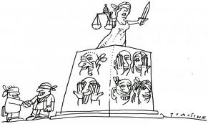
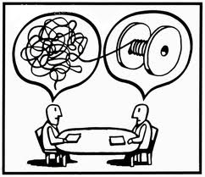
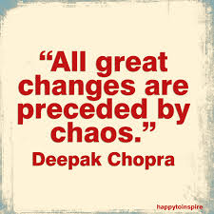
Order and Chaos
“The basic rule of software status reporting can be summarized in a single phrase: No surprises.”
Capers Jones

Slide 18
“We have the tendency to think that order is the ideal state of nature. This could be a mistake. Research …. Supports the theory that operation away from equilibrium generates creativity, self-organized processes, and increasing returns. Absolute order means the absence of variability, which could be an advantage under unpredictable environments. Change occurs when there is some structure so that the change can be organized, but not so rigid that is cannot occur. Too much chaos, on the other hand, can make coordination and coherence impossible. Lack of structure does not always mean disorder. ”
J. Nogueira, et. al., “Surfing the Edge of Chaos: Application to Software Engineering”, Command and Control Research and Technology Symposium, 2000.

Slide 19
Outline
What is software?
Why software engineering?
What is software engineering?
SE Body of Knowledge
SE Code of Ethics

Slide 20
SE Boy of Knowledge
15 SWEBOK key areas
Software Requirements
Software Design
Software Construction
Software Testing
Software Maintenance
Software Configuration Management
Software Engineering Management
Software Engineering Process
Software Engineering Models and Methods
Software Quality
Software Engineering Professional Practice
Software Engineering Economics
Computing Foundations
Mathematical Foundations
Engineering Foundations

Slide 21
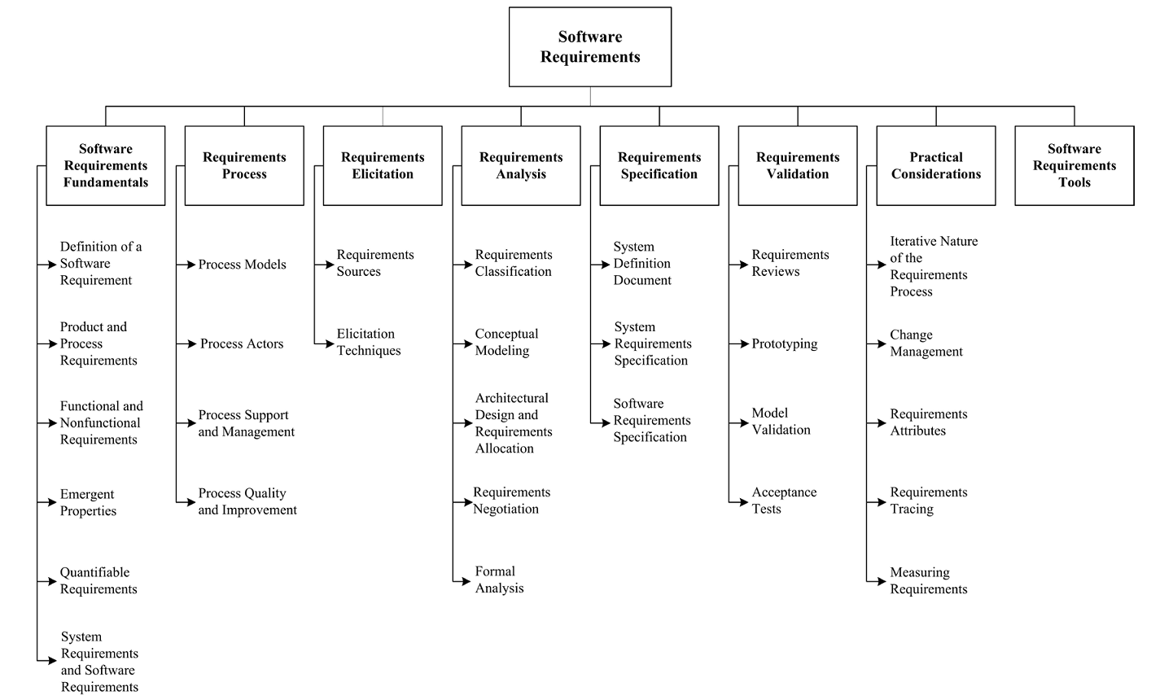
Software Requirements

Slide 22
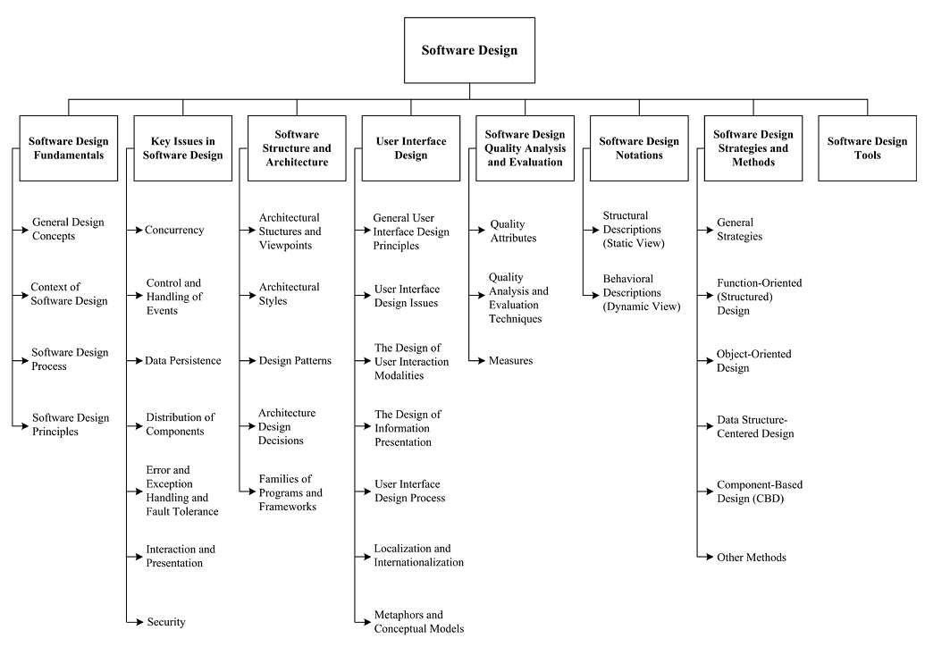
Software Design

Slide 23
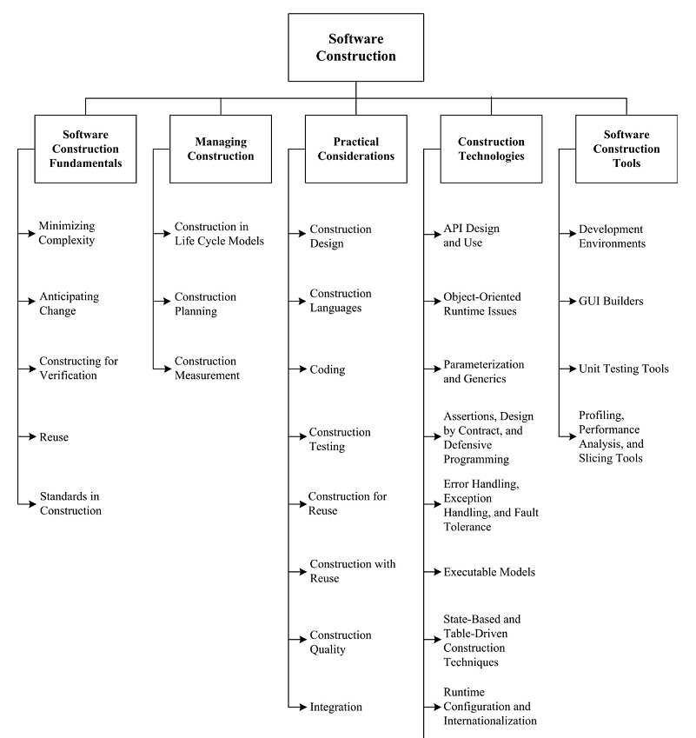
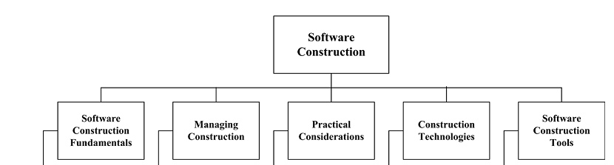
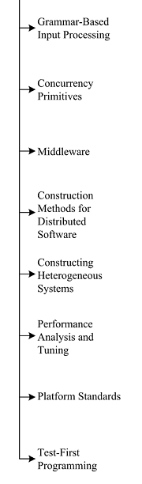
Software Construction

Slide 24
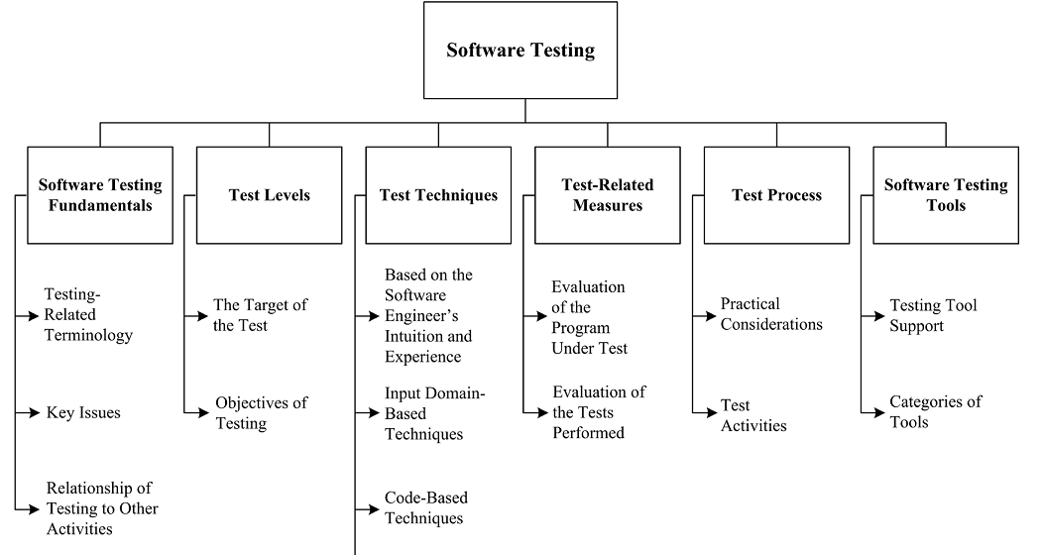
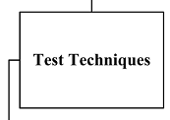
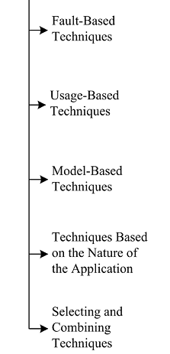
Software Testing

Slide 25
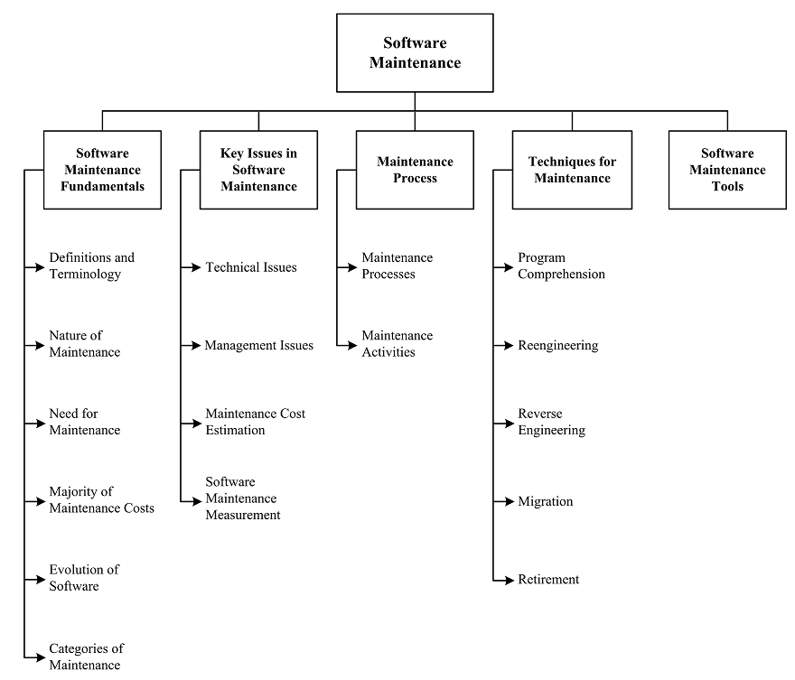
Software Maintenance

Slide 26
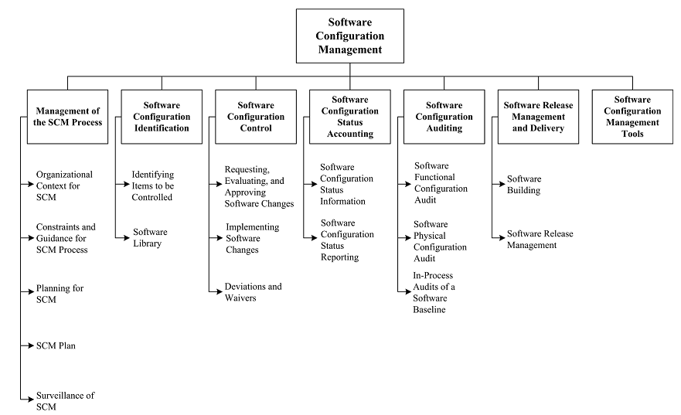
Configuration Management

Slide 27
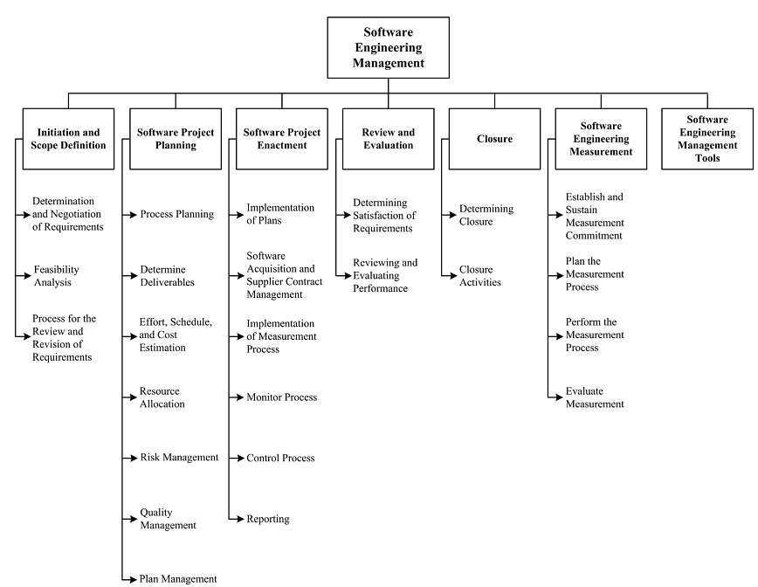
Management

Slide 28
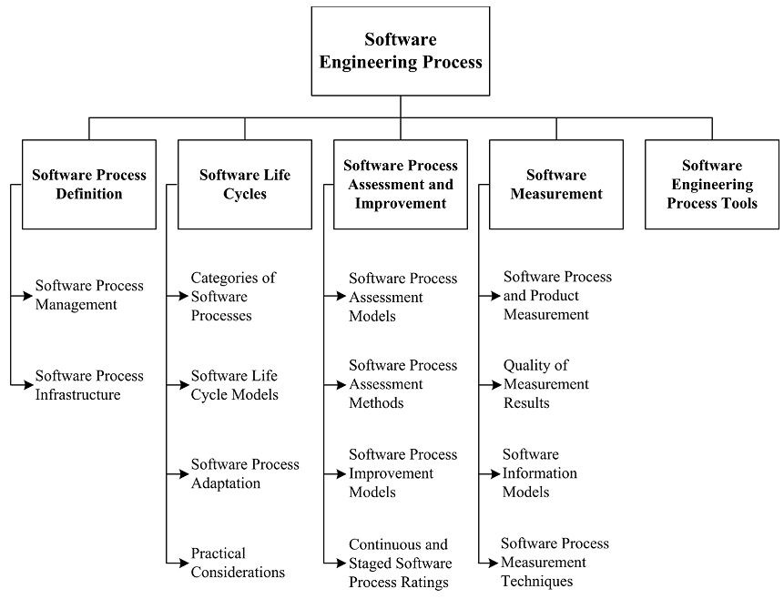
Software Engineering Process

Slide 29
Software Myths
Practitioner Myths
Myth: Once we write the program and get it to work, our job is done.
Reality: Someone once said that the sooner you begin writing code, the longer it’ll take you to get done. Industry data indicate that between 60 and 80 percent of all effort expended on software will be expended after it is delivered to the customer for the first time.

Slide 30
Software Myths
Practitioner Myths
Myth: Until I get the program running, I have no way to assessing its quality.
Reality: One of the most effective software quality assurance mechanisms can be applied from the inception of a project – the formal technical review. Software reviews are a “quality filter” that have been found to be more effective than testing for finding certain classes of software errors.

Slide 31
Software Myths
Practitioner Myths
Myth: The only deliverable work product for a successful project is the working program.
Reality: A working program is only one part of a software configuration that includes many elements. Documentation provides a foundation for successful engineering and, more importantly, guidance for software support.

Slide 32
Software Myths
Practitioner Myths
Myth: Software engineering will make us create voluminous and unnecessary documentation and will invariably slow us down.
Reality: Software engineering is not about crating documents. It is about crating quality. Better quality leads to reduces rework. And reduced rework results in faster delivery times.

Slide 33
Software Myths
Customer Myths
Myth: A general statement of objectives is sufficient to begin writing programs – we can fill in the details later.
Reality: Although a comprehensive and stable statement of requirements is not always possible, an ambiguous statement of objectives is a recipe for disaster. Unambiguous requirements (usually derived iteratively) are developed only through effective and continuous communication between customer and developer.

Slide 34
Software Myths
Customer Myths
Myth: Project requirements continually change, but change can be easily accommodated because software is flexible.
Reality: It is true that software requirements change, but the impact of change varies with the time at which it is introduces. When requirement changes are requested early (before design or code has been started), cost impact is relatively small. However, as time passes, cost impact grows rapidly – resources have been committed, a design framework has been established, and change can cause upheaval that requires additional resources and major design modification.

Slide 35
Software Myths
Management Myths
Myth: We already have a book that’s full of standards and procedures for building software. Won’t that provide my people with everything they need to know?
Reality: The book of standards may very well exist, but is it used? Are software practitioners aware of its existence? Does it reflect modern software engineering practice? Is it complete? Is it adaptable? Is it streamlined to improve time to delivery while still maintaining a focus on quality? In many cases, the answer to all of these questions is no.

Slide 36
Software Myths
Management Myths
Myth: If we get behind schedule, we can add more programmers and catch up (sometimes called the Mongolian horde concept).
Reality: Software development is not a mechanistic process like manufacturing. In the words of Brooks: “Adding people ot a late software project makes it later.” As new people are added, people who were working must spend time educating the newcomers, thereby reducing the amount of time spent on productive development effort. People can be added but only in a planned and well-coordinated manner.

Slide 37
Software Myths
Management Myths
Myth: If we decide to outsource the software project to a third party, I can just relax and let that firm build it.
Reality: If an organization does not understand how to manage and control software projects internally, it will invariably struggle when it out-sources software projects.

Slide 38
Professional and Ethical Responsibility
Software engineering involves wider responsibilities than simply the application of technical skills
Software engineers must behave in an honest and ethically responsible way if they are to be respected as professionals
Ethical behaviour is more than simply upholding the law.

Slide 39
Professional Responsibility
Confidentiality
Engineers should normally respect the confidentiality of their employers or clients irrespective of whether or not a formal confidentiality agreement has been signed.
Competence
Engineers should not misrepresent their level of competence. They should not knowingly accept work which is outwith their competence.

Slide 40
Professional Responsibility
Intellectual property rights
Engineers should be aware of local laws governing the use of intellectual property such as patents, copyright, etc. They should be careful to ensure that the intellectual property of employers and clients is protected.
Computer misuse
Software engineers should not use their technical skills to misuse other people’s computers. Computer misuse ranges from relatively trivial (game playing on an employer’s machine, say) to extremely serious (dissemination of viruses).

Slide 41
Code of Ethics
Preamble
Software engineers shall commit themselves to making the analysis, specification, design, development, testing and maintenance of software a beneficial and respected profession. In accordance with their commitment to the health, safety and welfare of the public, software engineers shall adhere to the following eight principles:

Slide 42
Code of Ethics
PUBLIC
Software engineers shall act consistently with the public interest.
CLIEMT AND EMPLOYER
Software engineers shall act in a manner that is in the best interests of their client and employer consistent with the public interest.
PRODUCT
Software engineers shall ensure that their products and related modifications meet the highest professional standards possible.
JUDGMENT
Software engineers shall maintain integrity and independence in their professional judgment

Slide 43
Code of Ethics
MANAGEMENT
Software engineering managers and leaders shall subscribe to and promote an ethical approach to the management of software development of maintenance.
PROFESSION
Software engineers shall advance the integrity and reputation of the profession consistent with the public interest.
COLLEAGUES
Software engineers shall be fair to the supportive of their colleagues.
SELF
Software engineers shall participate in lifelong learning regarding the practice of their profession and shall promote an ethical approach to the practice of the profession.

Slide 44
Summary
“Computer software continues to be the single most important technology on the world stage” [Pressman 09]
Software and the way we build software change a lot throughout these years.
Software engineering is an engineering discipline which is concerned with all aspects of software production.
Software engineering is a layered architecture and the body of knowledge defines 10 areas of engineering activities for developing software.
Software engineers have responsibilities to the engineering profession and society. They should not simply be concerned with technical issues.

Slide 45
Reading
“The Mythical Man-Month: Essays on Software Engineering”,
(2nd Edition), Frederick P. Brooks, 1995
Addison Wesley Longman,
影印版，中国电力出版社，2003，ISBN 7-5083-1303-8
“Software Engineering Body of Knowledge (SWBOK) v3.0”, 2014 IEEE.
D. Gotterbarn, K. Miller, and S. Rogenon, “Software Engineering Code of Ethics, Version 3.0”, IEEE Computer, Vol. 30, No. 10, Oct. 1997, pp. 88-92.
F. P. Brooks, “No Silver Bullet: Essence and Accidents of Software Engineering”, IEEE Computer, Vol. 20, No. 4, Apr. 1987, pp. 10-19.

Slide 46

Thank you!
Xiaoying Bai
Ph.D, Associate Professor
Dept. DS&T, INLIST
Tsinghua University
Beijing, China, 100084
Phone: 86-10-62794935
Email: baixy@tsinghua.edu.cn

