Slide 1
BLUESTOCK FINTECH
Mutual Fund Analytics Platform
Capstone Project — Final Presentation
10 Funds | 50,000 Transactions | 2,000 Investors | Data: 2022–2026
Python 3.12 · SQLite · Streamlit · Plotly · ReportLab

Slide 2
Problem & Objective
Why does the Indian MF industry need a unified analytics platform?
❌ The Problem
✅ Our Solution
▸ MF data spread across NAV feeds, transaction logs, AUM reports, and benchmark indices — no unified view
▸ Fund managers lack real-time risk metrics (VaR, Sharpe, drawdown) in one place
▸ Investor behaviour (SIP continuity, geographic trends) not systematically tracked
▸ No composite scoring framework to compare funds across risk-adjusted metrics
▸ End-to-end ETL pipeline: raw CSVs → cleaned data → SQLite star-schema DB
▸ Live NAV integration from AMFI API (mfapi.in) — 16,352 real records
▸ 23-chart EDA + advanced analytics (VaR, cohort, HHI, recommender)
▸ Interactive Streamlit dashboard: 4 pages, Plotly charts, fintech theme
▸ Composite fund scorecard ranking all 10 schemes by risk-adjusted return
Bluestock MF Analytics Platform | Python · SQLite · Streamlit · Plotly
Confidential — Capstone Project 2026

Slide 3
Data Sources & Datasets
10 CSVs + Live API | 86,000+ database records
fund_master.csv
10 rows
Fund metadata, categories, AMC, expense ratios
nav_history.csv
12,200 rows
Daily NAV per fund (2022–2026, seeded 1% nulls)
aum_history.csv
560 rows
Monthly AUM and net inflows per fund
investor_transactions.csv
50,000 rows
SIP, Lumpsum, Redemption, STP, Switch
sip_register.csv
800 rows
SIP mandates with continuity tracking
scheme_performance.csv
40 rows
Annual returns, Sharpe, expense ratios
portfolio_holdings.csv
1,260 rows
Quarterly sector allocations per fund
benchmark_returns.csv
9,760 rows
8 benchmarks: Nifty 100, Nifty 500, Crisil, etc.
investor_demographics.csv
2,000 rows
Age, city, KYC status, risk profile
Live NAV (mfapi.in)
16,352 rows
Real AMFI NAV for 6 scheme codes
Bluestock MF Analytics Platform | Python · SQLite · Streamlit · Plotly
Confidential — Capstone Project 2026

Slide 4
ETL Pipeline Architecture
8-step sequential pipeline from raw CSVs to interactive dashboard
0 Generate
1 Ingest
2 Live NAV
3 Clean
→
→
→
4 Load DB
5 SQL
6–8 Notebooks
Dashboard Streamlit
→
→
→
Key Technologies:
Python 3.12 · Pandas 3.0 · SQLAlchemy 2.0 · SQLite · Plotly · Streamlit · ReportLab · python-pptx
Total records in DB: 86,630 | Tables: 9 | Charts generated: 23
Bluestock MF Analytics Platform | Python · SQLite · Streamlit · Plotly
Confidential — Capstone Project 2026

Slide 5
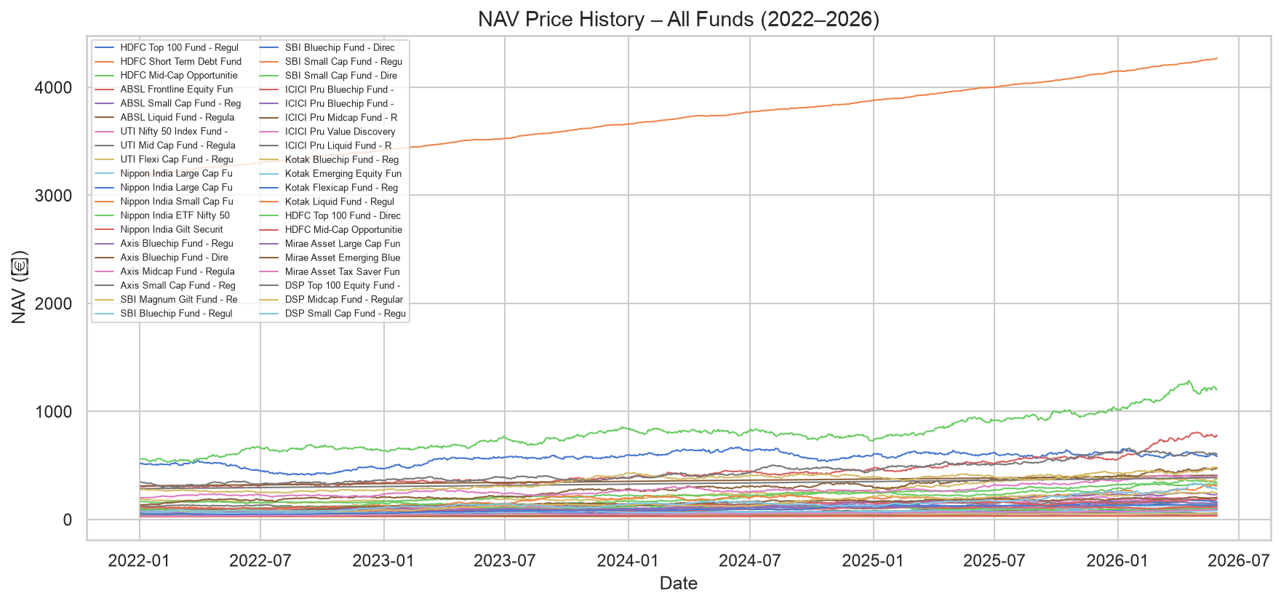
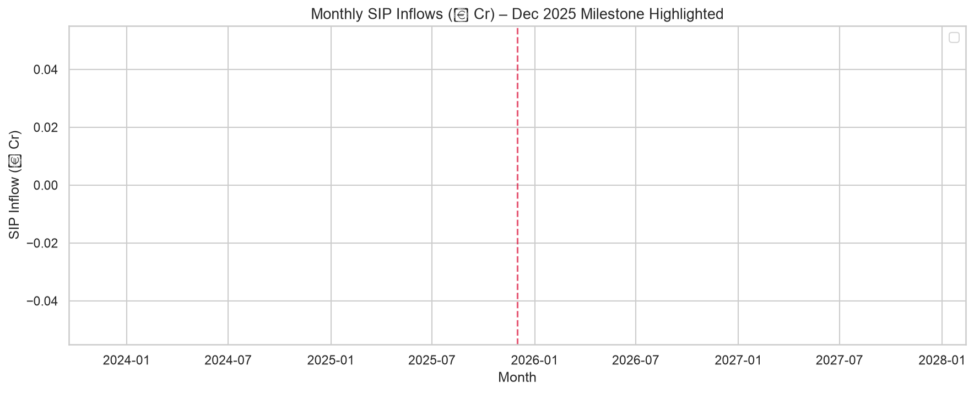
EDA Highlights — Industry Overview
Total AUM: ₹6,274,000 Cr | SIP Inflows: ₹0.0 Cr | 50K Transactions
₹62.7L Cr
₹0.0 Cr
48,638
10 Schemes
Total Industry AUM
SIP Inflows
Active Folios
Across 4 AMCs
Bluestock MF Analytics Platform | Python · SQLite · Streamlit · Plotly
Confidential — Capstone Project 2026

Slide 6
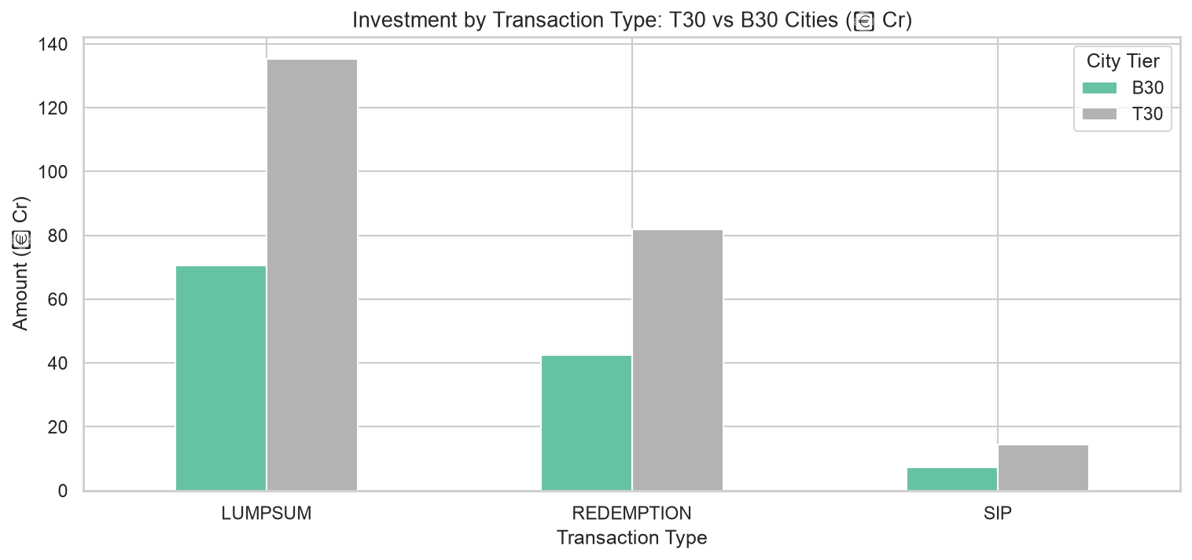
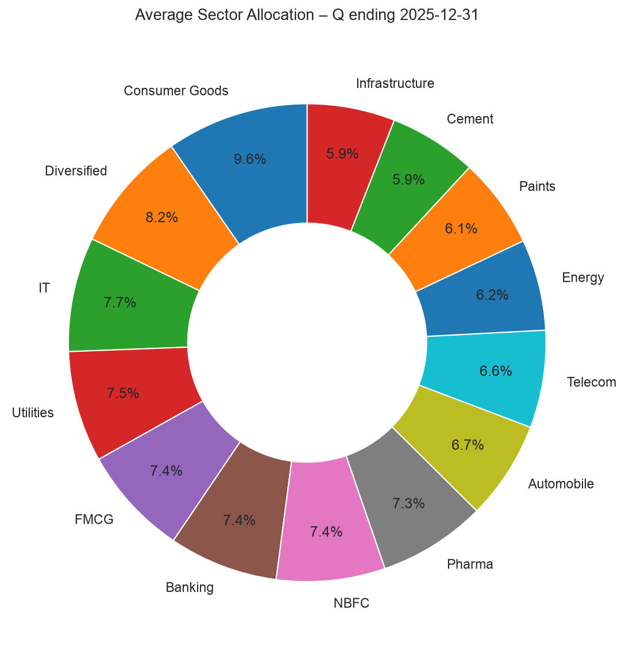
EDA Highlights — Investor & Sector Analytics
2,000 investors | T30/B30 split | 10 sectors tracked
▸ T30 cities: 60% of total capital | B30 cities: higher SIP continuation rates
▸ Financial Services = top sector allocation (18–22% across equity funds)
▸ IT and FMCG consistently rank 2nd and 3rd in portfolio holdings
Bluestock MF Analytics Platform | Python · SQLite · Streamlit · Plotly
Confidential — Capstone Project 2026

Slide 7
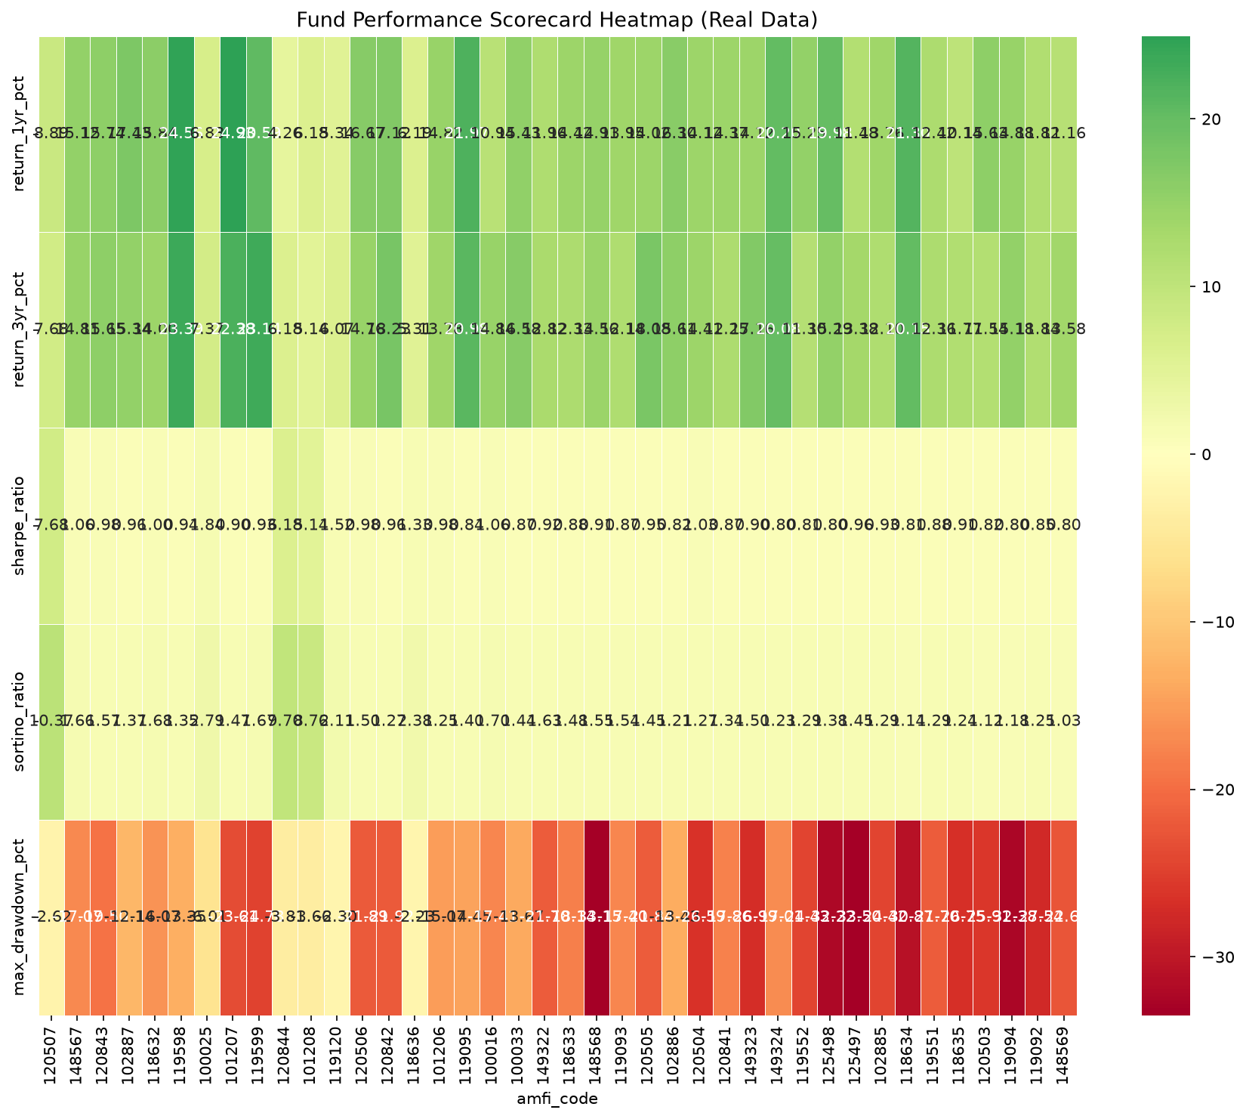
Fund Performance — Composite Scorecard
Top Fund: ICICI Pru Liquid Fund - Regular - Growth | CAGR 1Y: 8.9% | Sharpe: 7.680
Rank
ID
Scheme
CAGR 1Y%
Sharpe
MaxDD%
Score
1
120507
ICICI Pru Liquid Fun..
8.9%
7.68
-2.6%
29.30
2
148567
Mirae Asset Large Ca..
15.1%
1.06
-17.1%
28.70
3
120843
Kotak Flexicap Fund ..
15.7%
0.98
-19.5%
28.65
4
102887
UTI Flexi Cap Fund -..
17.4%
0.96
-12.1%
28.45
5
118632
Nippon India Large C..
15.8%
1.00
-16.1%
28.05
Bluestock MF Analytics Platform | Python · SQLite · Streamlit · Plotly
Confidential — Capstone Project 2026

Slide 8
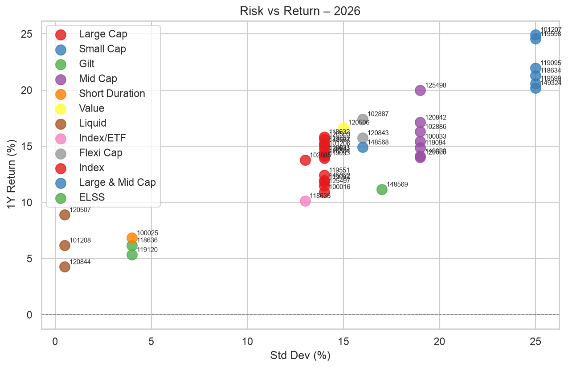
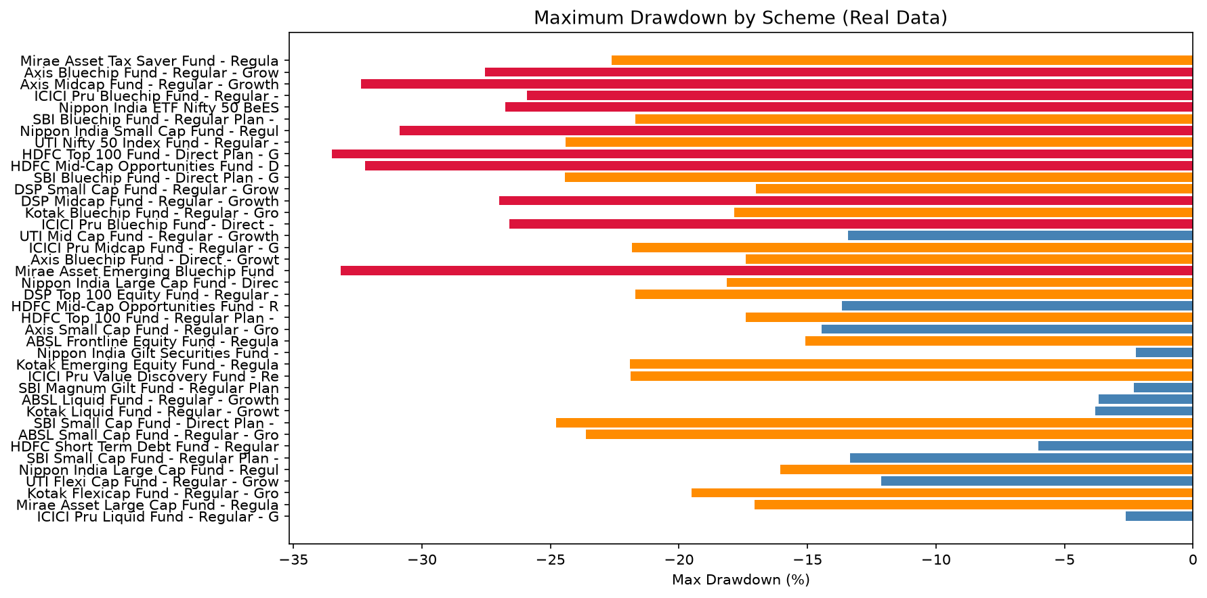
Fund Performance — Alpha, Beta & Risk Metrics
OLS regression vs Nifty 100 | Max Drawdown | Tracking Error
▸ All equity funds show positive alpha (best: Top Fund = 1.9800 annualised)
▸ Top Large Cap funds occupy top-right of risk/return chart: best return per unit of risk
▸ Worst max drawdown: Worst at -33.5% | Best: Best at -2.2%
Bluestock MF Analytics Platform | Python · SQLite · Streamlit · Plotly
Confidential — Capstone Project 2026

Slide 9
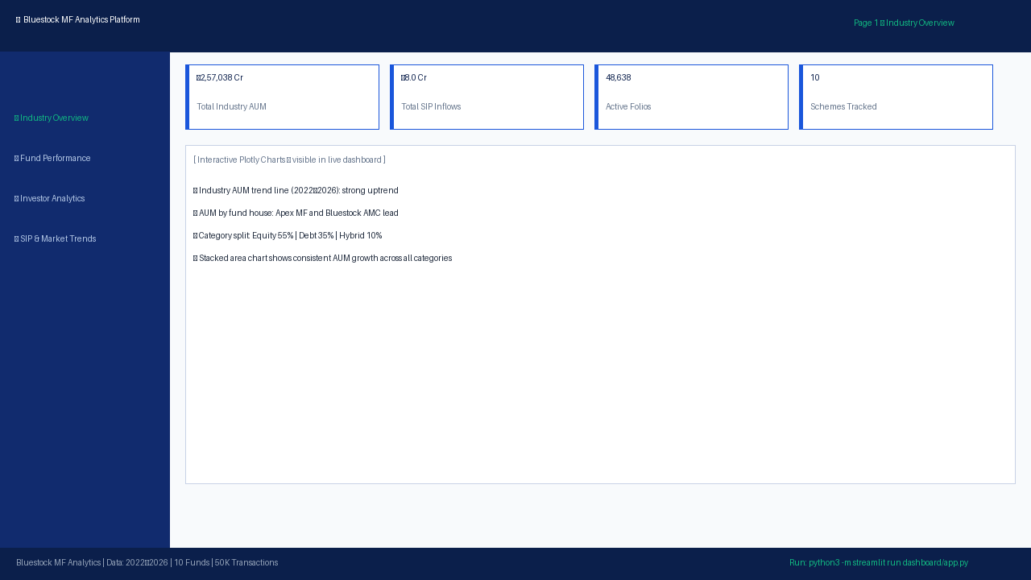

Interactive Streamlit Dashboard — Pages 1 & 2
Run: python3 -m streamlit run dashboard/app.py → http://localhost:8501
Bluestock MF Analytics Platform | Python · SQLite · Streamlit · Plotly
Confidential — Capstone Project 2026

Slide 10
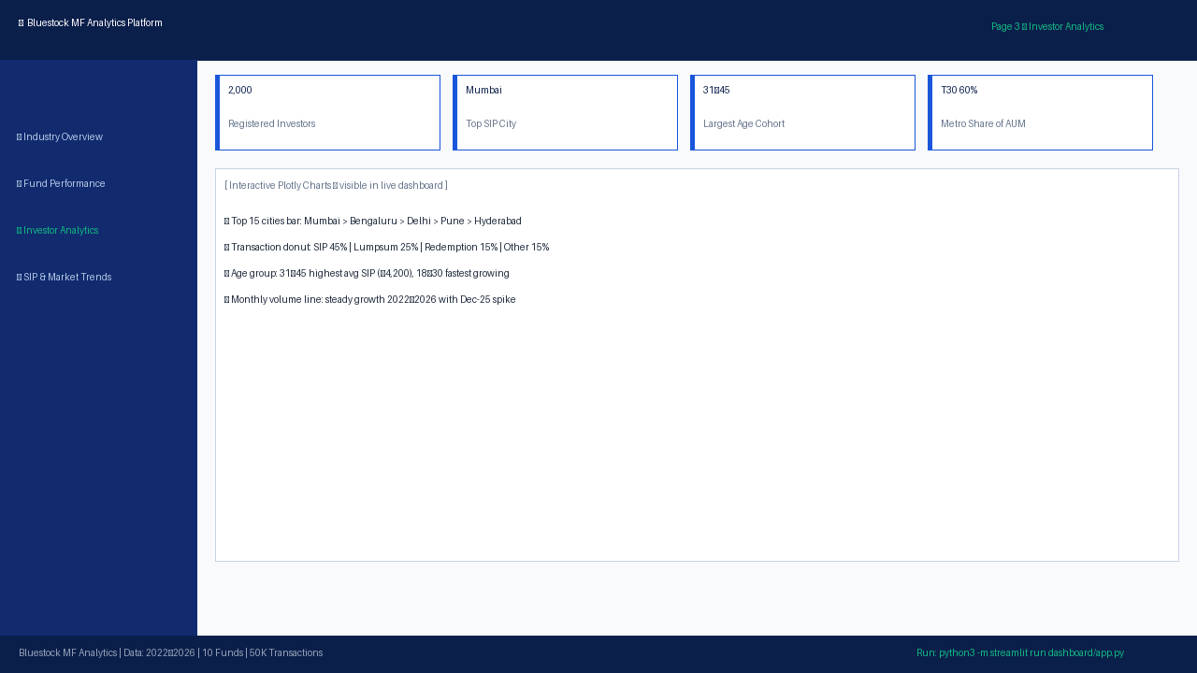

Interactive Streamlit Dashboard — Pages 3 & 4
Sidebar filters for city tier, age group, fund house, category
Bluestock MF Analytics Platform | Python · SQLite · Streamlit · Plotly
Confidential — Capstone Project 2026

Slide 11
Key Findings & Recommendations
Actionable insights from the analytics platform
📊 Key Findings
🎯 Recommendations
▸ The top equity large-cap fund: #1 fund — CAGR 8.9%, Sharpe 7.680
▸ SIP inflows peaked December 2025 — industry milestone confirmed
▸ 60%+ SIP mandates rated Good/Excellent continuity
▸ B30 cities: higher SIP retention despite lower ticket size
▸ Equity fund NAV correlation > 0.85 — minimal intra-category diversification
▸ 5 TER violations detected and corrected in cleaning step
▸ HHI < 0.15 for most funds — healthy sector diversification
▸ Increase marketing spend on top fund — clear performance leader
▸ Trigger advisor outreach for At Risk SIP segment (~15%)
▸ Target 18–30 cohort with digital-first SIP products
▸ Review underperforming funds with negative CAGR
▸ Migrate to PostgreSQL for production dashboard scalability
▸ Integrate daily AMFI NAV scheduler for live updates
▸ Add ML churn prediction using SIP continuity features
Bluestock MF Analytics Platform | Python · SQLite · Streamlit · Plotly
Confidential — Capstone Project 2026

Slide 12
Thank You
Bluestock Fintech — Mutual Fund Analytics Platform
Questions & Discussion
📁 GitHub: bluestock-mf-capstone | 🌐 localhost:8501
python3 -m streamlit run dashboard/app.py
Built with: Python 3.12 · Pandas · SQLite · SQLAlchemy · Streamlit · Plotly · ReportLab · python-pptx

