Slide 1
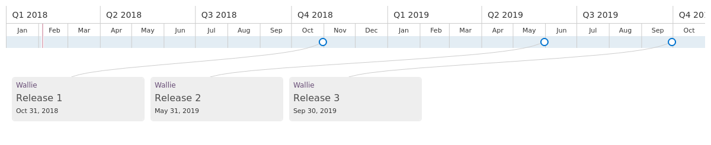
Roadmap for Wallie
Release 1 includes Version 1 for iOS application and Version 1 for Merchant System
Release 2 includes Version 2 for iOS application and Version 1 for Android Application and Version 2 for Merchant System
Release 3 includes Version 3 for iOS application and Version 2 for Android Application

Slide 2
Release Plan Explanation
We plan to have the following major releases in the next 21 months as explained below.
R1 - V1 for iOS - This is the first major release for Apple iOS. Target release date : Oct 2018
R1 - V1 for Merchant System - This is the first major release for web application for merchants. Target release date : Oct 2018
R2 - V1 for Android - This is the first major release for Android. Target release date : May 2019
R2 - V2 for iOS - This the second major release for iOS with feature enhancements. Target release date: May 2019
R2 - V2 for Merchant System - This the second major release for Merchant Web Interface with feature enhancements. Target release date: May 2019
R3 - V3 for iOS - This the third major release for iOS with feature enhancements. Target release date: Sep 2019
R3 - V2 for Android - This is the second major release for Android with feature enhancements. Target release date: Sep 2019
In Between the major releases, our engineering team will continue to work on intermediate releases to fix bugs, improve performance and scalability. These will be released as updates.

Slide 3
Release 1 Features Estimate
Feature | Version | Estimations for Implementation (Number of Days) | Number of Engineers
 |  |  | iOS | Full Stack | Android
Account Management iOS | R1-V1 | 35 | 1 | 1
Card Management iOS | R1-V1 | 7 | 1 | 1
Map View iOS | R1-V1 | 25 | 1 | 1
Deals Details iOS | R1-V1 | 10 | 1
Search Deals iOS | R1-V1 | 10 | 1
Push Notification iOS | R1-V1 | 20 | 1 | 1
Deals Recommendation iOS | R1-V1 | 45 | 2 | 2
Website | R1-V1 | 5 |  | 1
Merchant Account Management | R1-V1 | 30 |  | 1
Merchant Offers Management | R1-V1 | 30 |  | 2

Slide 4
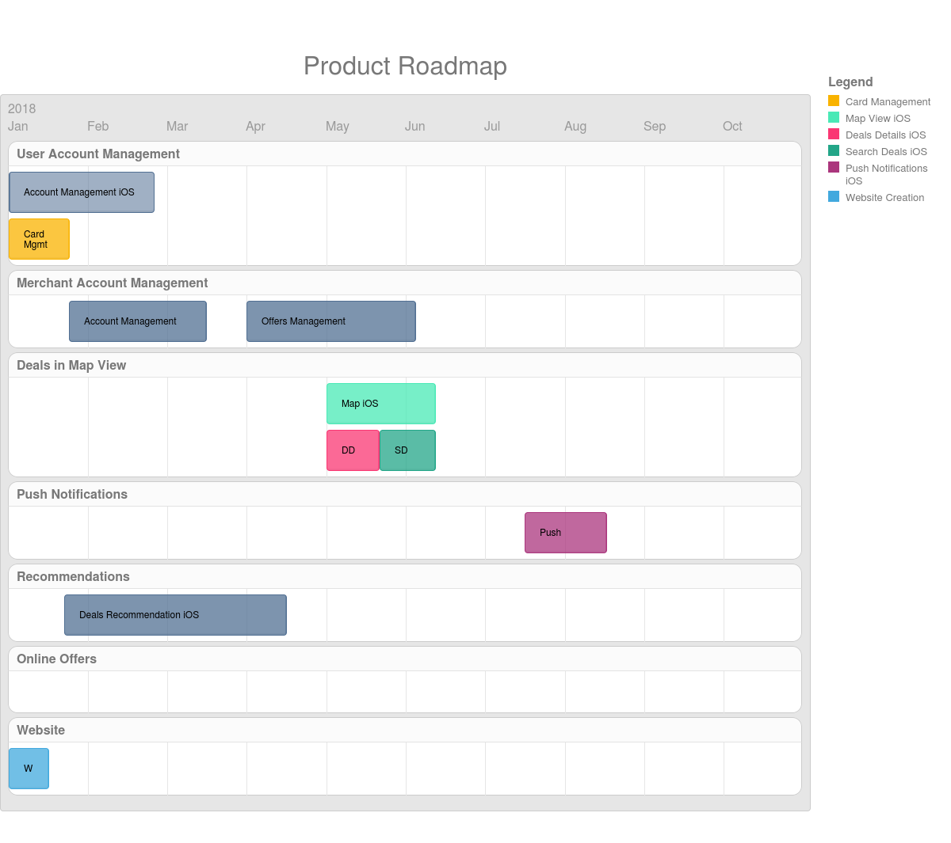
Release 1 Product Roadmap
iOS
Integration Testing
Bug Fixes, Testing and Buffer for any overflow Compatibility with new version of iOS

Slide 5
Release 2 Features Estimate
Feature | Version | Estimations for Implementation (Number of Days) | Number of Engineers
 |  |  | iOS | Full Stack | Android
Account Management Android | R2-V1 | 25 |  | 1 | 1
Card Management Android | R2-V1 | 5 |  | 1 | 1
Referral System iOS | R2-V2 | 12 | 1 | 1
Map View Android | R2-V1 | 15 |  | 1 | 1
Deals Details Android | R2-V1 | 10 |  |  | 1
Search Deals Android | R2-V1 | 10 |  |  | 1
Push Notification Android | R2-V1 | 20 |  |  | 2
Deals Recommendation Android | R2-V1 | 30 |  |  | 2
Credit Cards Recommendation iOS | R2-V2 | 22 | 1 | 1
Merchant Ads Platform | R2-V2 | 40 |  | 2
Referral System Android | R2-V1 | 5 |  |  | 1

Slide 6
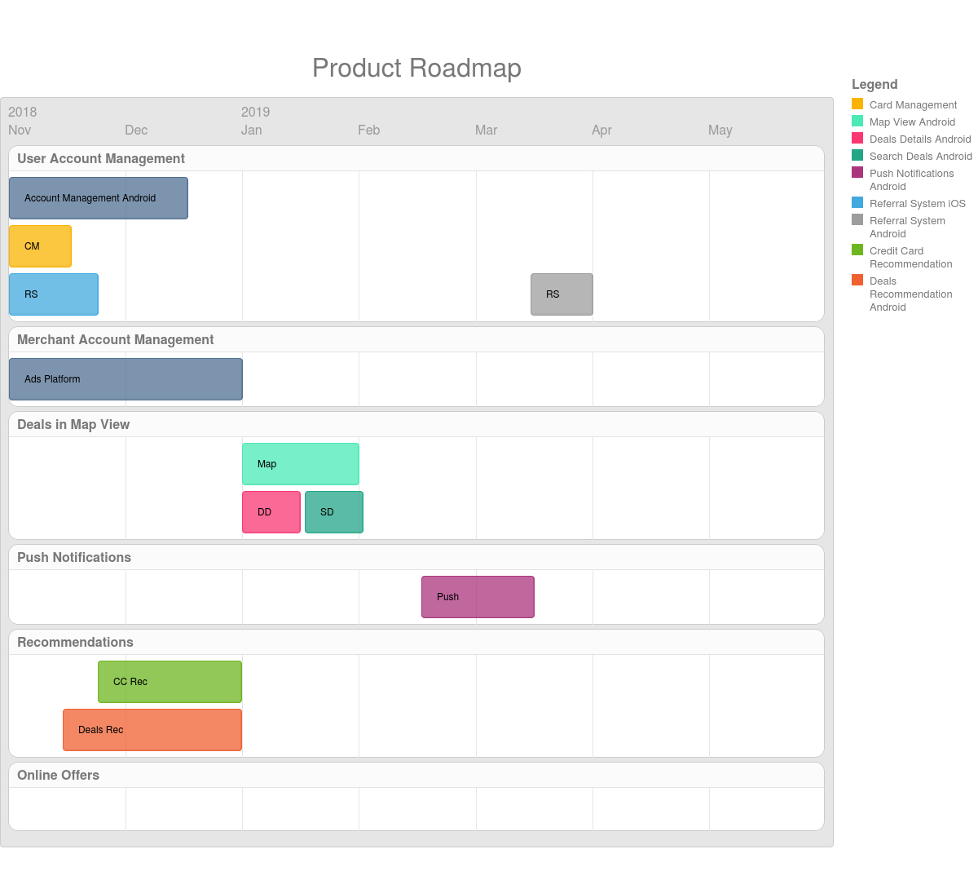
Release 2 Product Roadmap
Android
Bug Fixes, Integration Testing
Considering User Feedback and Competitive Features Improving Performance, Scalability and Security
Backward Compatibility with iOS and Android versions
Compatibility with latest versions of iOS and Android
Bug Fixes, Integration Testing
Considering User Feedback Improving Performance, Scalability and Security

Slide 7
Release 3 Features Estimate
Feature | Version | Estimations for Implementation (Number of Days) | Number of Engineers
 |  |  | iOS | Full Stack | Android
Credit Cards Recommendation Android | R3-V2 | 20 |  |  | 1
Navigation Android | R3-V2 | 2 | 1
Navigation iOS | R3-V3 | 2 |  |  | 1
Online Offers Chrome | R3-V1 | 25 |  | 2
Online Offers Safari | R3-V1 | 20 |  | 1
Online Offers Firefox | R3-V1 | 20 |  | 1
Email Notifications | R3-V2 | 25 |  | 2

Slide 8
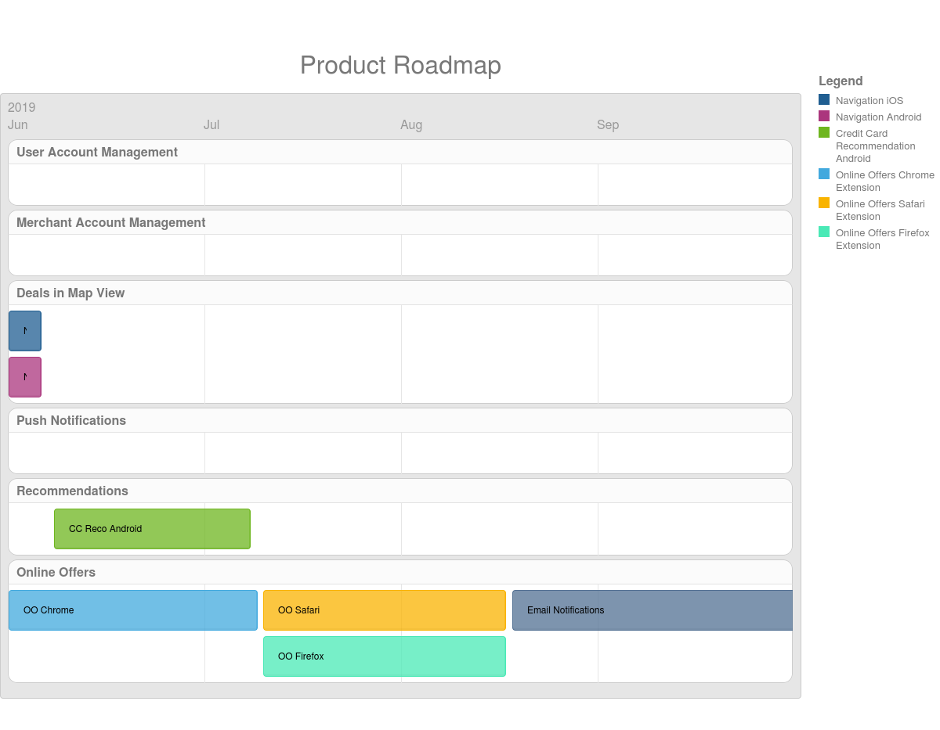
Release 3 Product Roadmap
Bug Fixes Considering User Feedback Improving Performance, Scalability and Security
Backward Compatibility with iOS and Android versions
Compatibility with latest versions of iOS and Android

