Slide 1

Beautiful KPU
Log In
MunDongSeon PyeonJiYong ParkGyeongJae

Slide 2
Login..

Slide 3









w
Logout
Beautiful KPU
홈
Smart
Beautiful

Slide 4
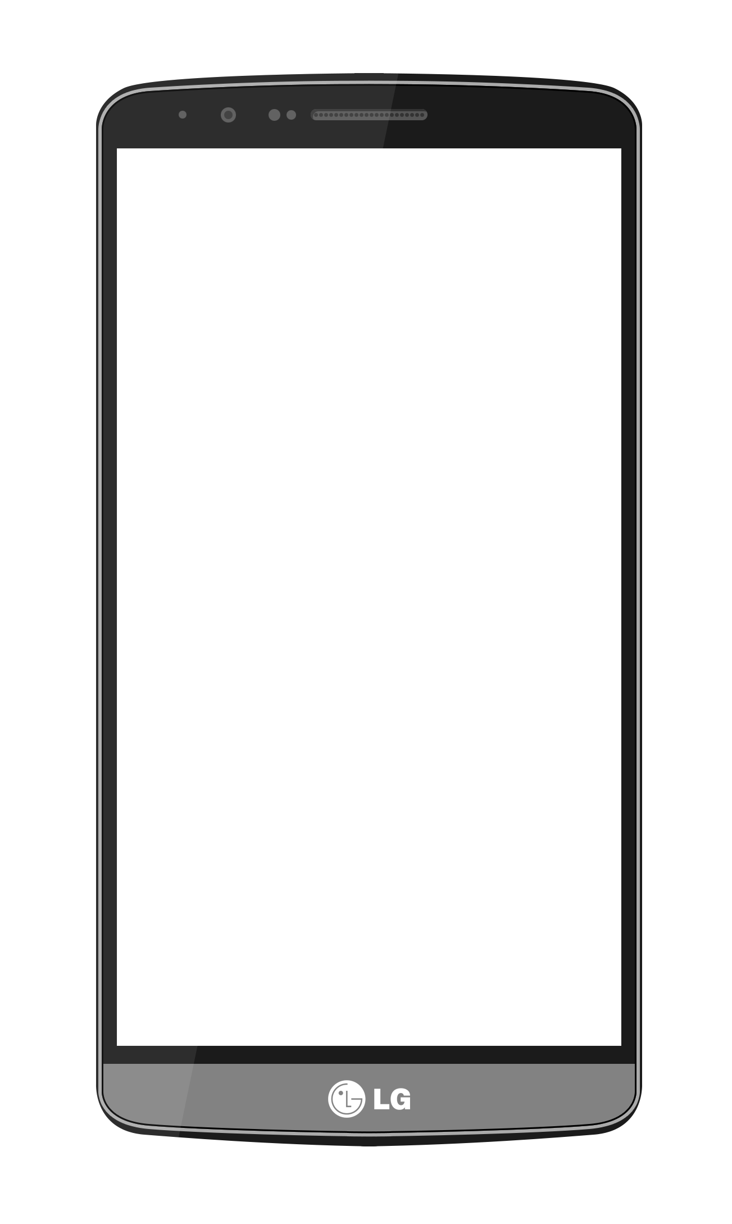
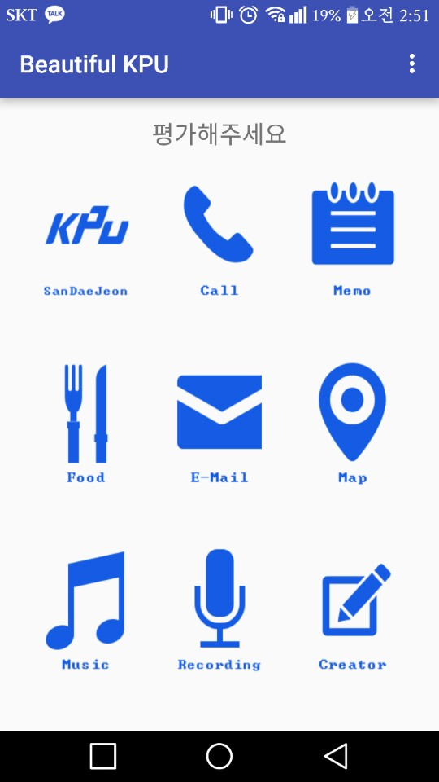






w
Logout
Beautiful KPU
홈

Slide 5
w
Logout
Beautiful KPU
홈

Slide 6
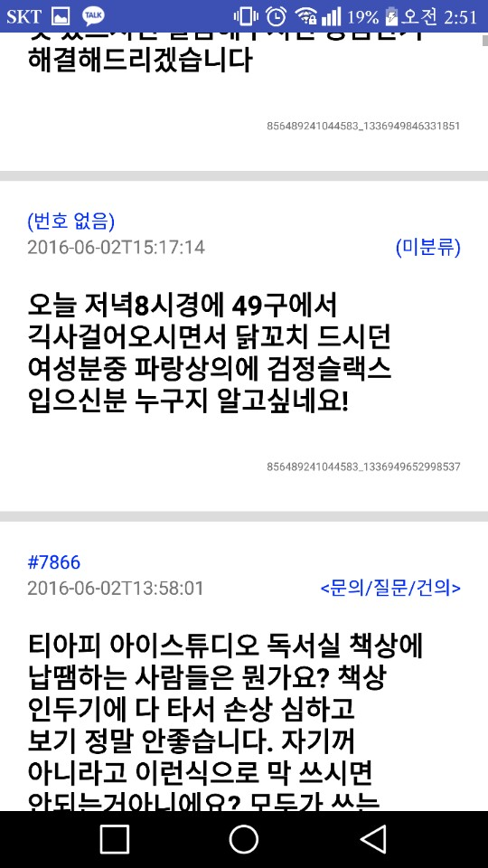
w
Logout
Beautiful KPU
홈

Slide 7
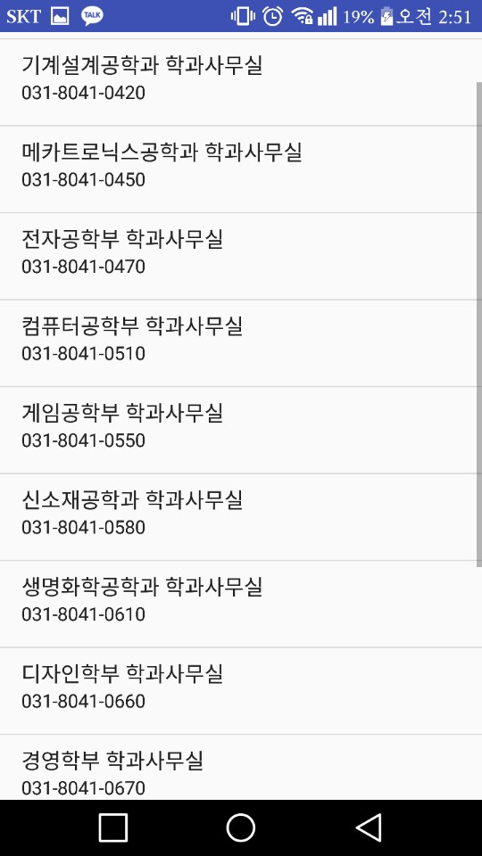
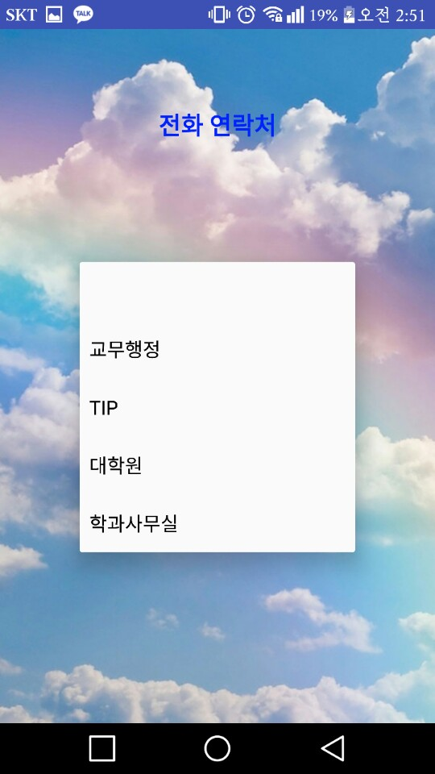
w
Logout
Beautiful KPU
홈

Slide 8
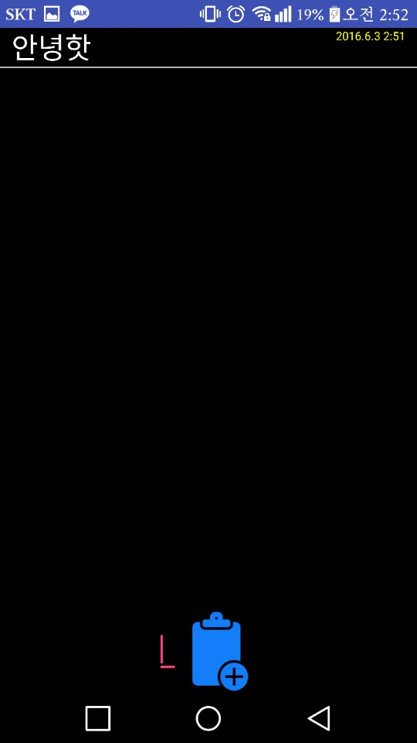
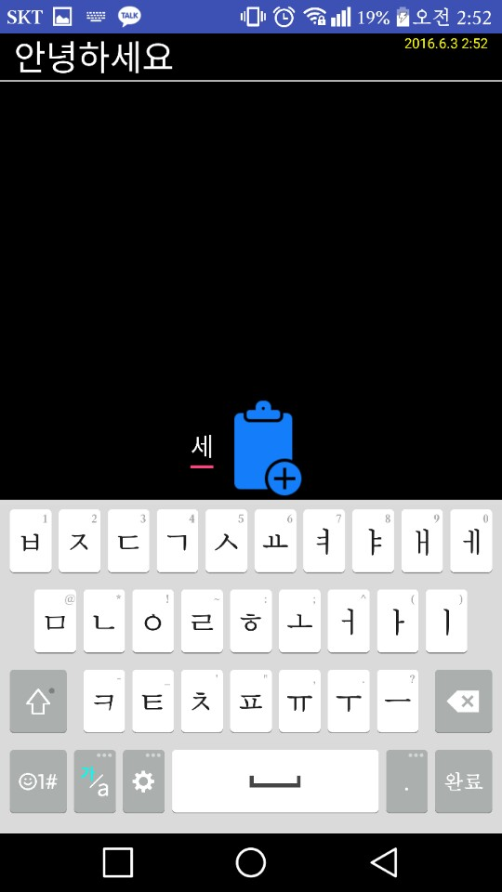
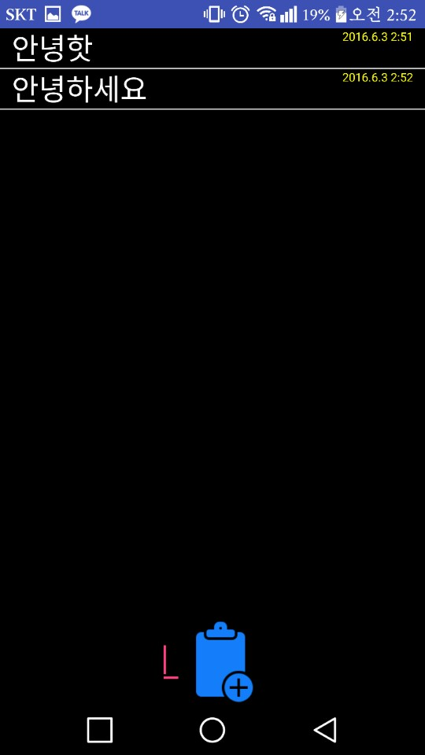
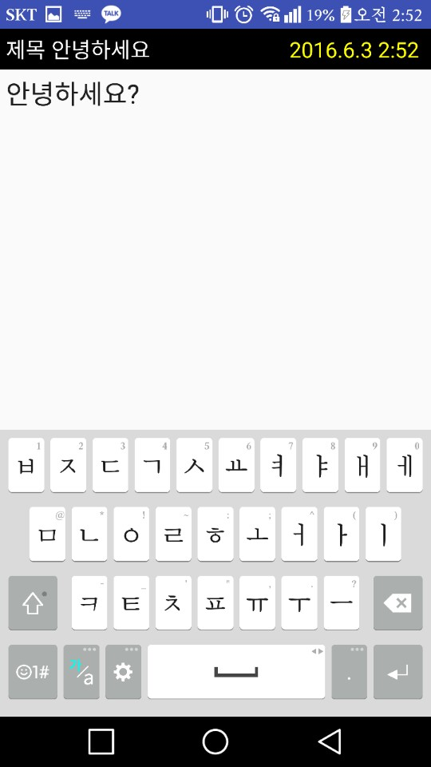
w
Logout
Beautiful KPU
홈

Slide 9
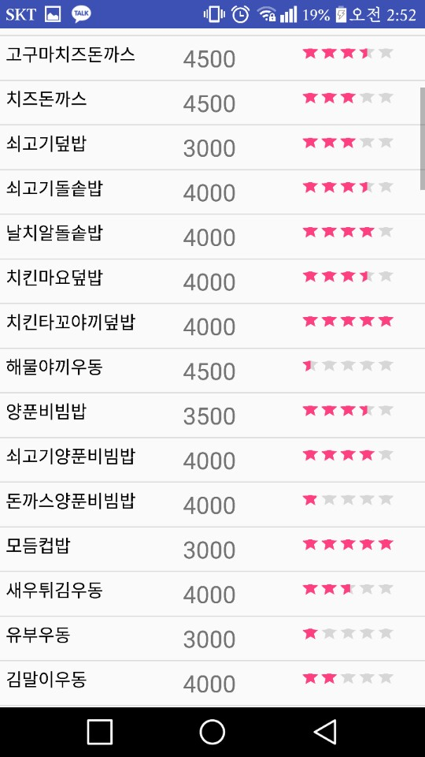
w
Logout
Beautiful KPU
홈

Slide 10
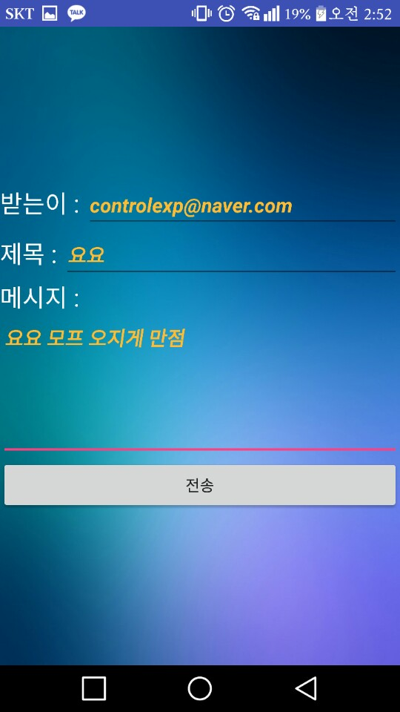
w
Logout
Beautiful KPU
홈

Slide 11
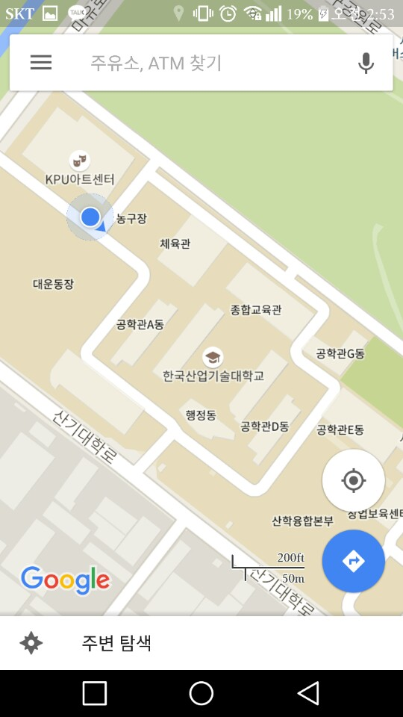
w
Logout
Beautiful KPU
홈

Slide 12
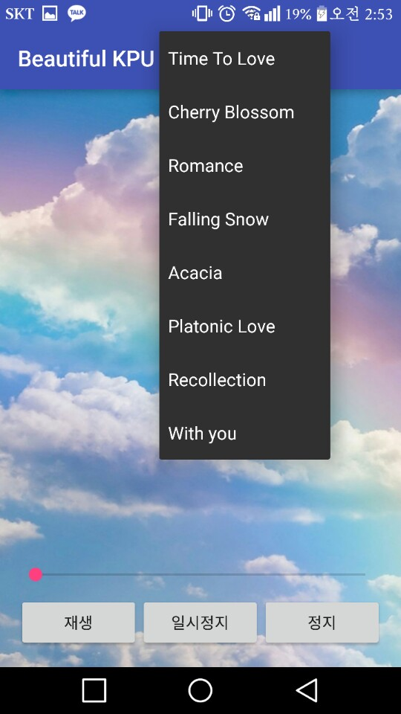
w
Logout
Beautiful KPU
홈

Slide 13
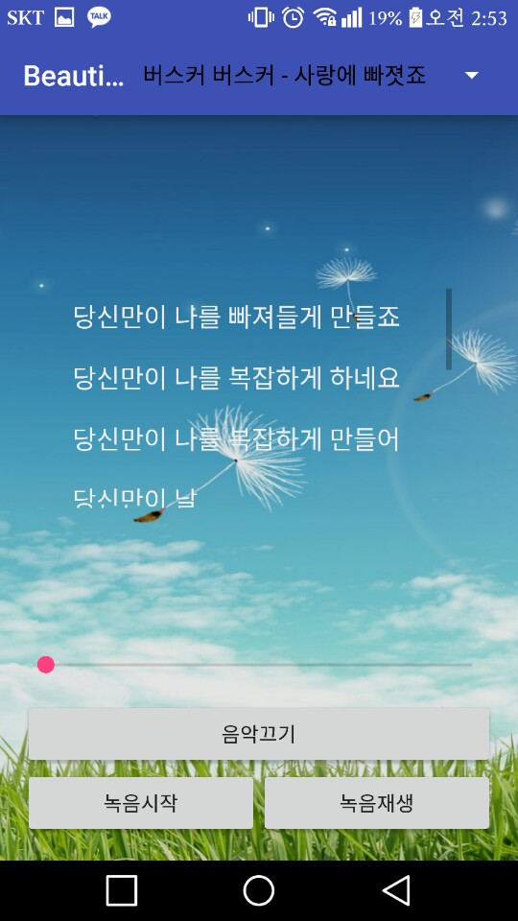
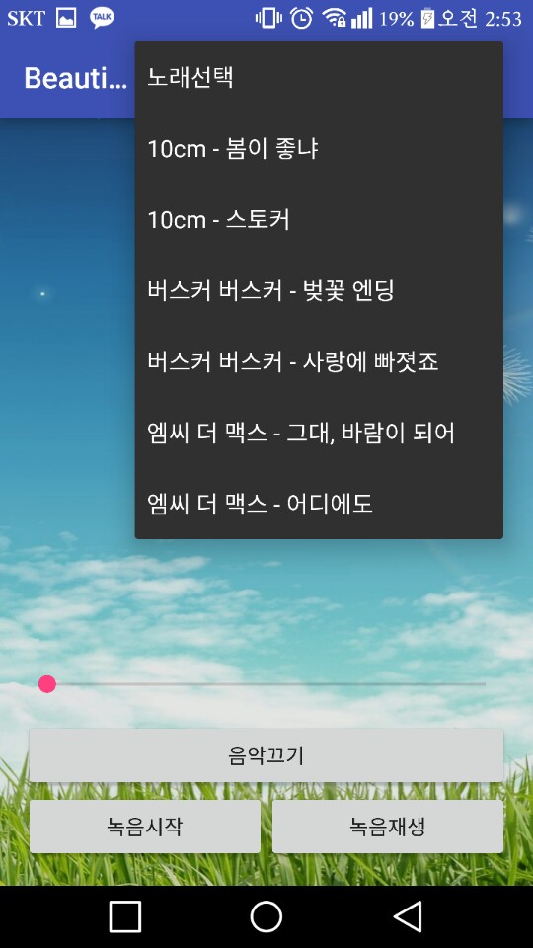
w
Logout
Beautiful KPU
홈

Slide 14

w
Logout
Beautiful KPU
홈

Slide 15
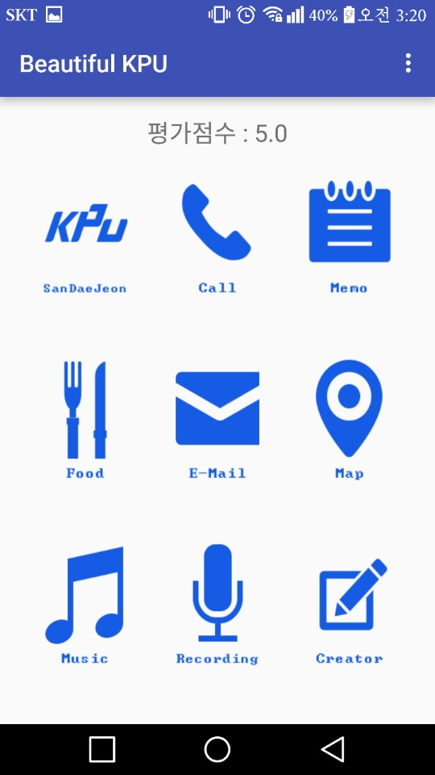
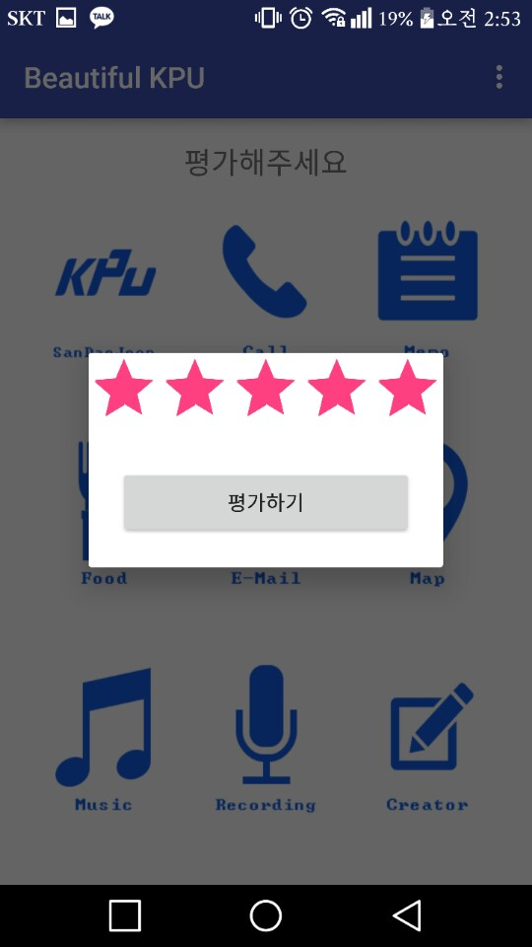
w
Logout
Beautiful KPU
홈

Slide 16
Logout..

