Slide 1
FULL STACK WEB DEVELOPMENT | COURSE-BASED PROJECT
Flash Sale E-commerce Page
with Countdown & Stock Counter
DROP: a responsive frontend with a simulated shopping flow
Review 1 Presentation
Team No: 18
Section: to be confirmed
M Nanith Reddy - 1602-24-733-091
Sukka Bhuvaneshwar - 1602-24-733-070
P William - 1602-24-733-130
Notes:
Team 18 Review 1. Current delivery is a frontend-only React demo with browser-local data. Backend integration and shared database behavior are future work. Faculty dates and individual roles await confirmation. Verification previously completed: 15 frontend tests, ESLint and Vite production build.

Slide 2
1
Problem statement
The problem
Who is affected
Flash-sale shoppers need to see when an offer ends and how much stock remains.
A static page cannot demonstrate changing availability or a complete purchase journey.
This project brings the countdown, product stock and shopping bag into one responsive interface.
Shoppers browsing short-duration offers on mobile and desktop.
Students learning frontend state, persistence and user feedback.
Why it matters
Clear availability reduces confusing purchase attempts.
The demo makes time, quantity limits and checkout outcomes visible.
Notes:
Team 18 Review 1. Current delivery is a frontend-only React demo with browser-local data. Backend integration and shared database behavior are future work. Faculty dates and individual roles await confirmation. Verification previously completed: 15 frontend tests, ESLint and Vite production build.

Slide 3
2
Objectives
Display a persistent countdown and stop demo purchases after expiry.
1
Show stock for 8 demo products and block sold-out or excessive quantities.
2
Support browsing, bag review and a confirmed simulated order.
3
Verify responsive behavior, keyboard access, 15 tests, lint and build.
4
Notes:
Team 18 Review 1. Current delivery is a frontend-only React demo with browser-local data. Backend integration and shared database behavior are future work. Faculty dates and individual roles await confirmation. Verification previously completed: 15 frontend tests, ESLint and Vite production build.

Slide 4
3
Users and scope
Target users
In scope
Out of scope
Shoppers discovering limited offers.
Mobile and desktop users.
Reviewers following the complete frontend flow.
Countdown and stock display.
Product details, search and filters.
Bag, favorites and simulated checkout.
Browser-local persistence.
Real payments or shipping.
Accounts and seller tools.
Shared inventory or a deployed API.
Backend integration is a future phase.
Notes:
Team 18 Review 1. Current delivery is a frontend-only React demo with browser-local data. Backend integration and shared database behavior are future work. Faculty dates and individual roles await confirmation. Verification previously completed: 15 frontend tests, ESLint and Vite production build.

Slide 5
4
Ideation
Static sale banner
Single-product timer
Curated sale collection
Fast and simple.
Rejected: no changing stock or purchase journey.
A clear timing demo.
Rejected: limited browsing and component reuse.
Combines time, stock and a bag.
Chosen: complete frontend flow within a manageable scope.
Final idea chosen and why
DROP combines a small collection with visible availability and a demo checkout. A full marketplace adds accounts, sellers and payments beyond the current phase.
Notes:
Team 18 Review 1. Current delivery is a frontend-only React demo with browser-local data. Backend integration and shared database behavior are future work. Faculty dates and individual roles await confirmation. Verification previously completed: 15 frontend tests, ESLint and Vite production build.

Slide 6
5
Key features
Must-have: timestamp-derived countdown with clear expired-sale feedback.
1
Must-have: product prices, stock counters and sold-out states.
2
Must-have: quantity controls, bag totals and simulated order confirmation.
3
Good-to-have: search, category filters, sorting and saved finds.
4
Notes:
Team 18 Review 1. Current delivery is a frontend-only React demo with browser-local data. Backend integration and shared database behavior are future work. Faculty dates and individual roles await confirmation. Verification previously completed: 15 frontend tests, ESLint and Vite production build.

Slide 7
6
Similar existing solutions
Existing solution | What it offers | How this project differs
Amazon Lightning Deals | Limited-duration product offers | Small educational catalog; no real payment
Flipkart Offers Store | Sale offers and promotional collections | Focused countdown, stock and bag demo
Xiaomi Flash Sale | Scheduled purchase offers | Illustrative multi-category frontend
Notes:
Reference examples, accessed 26 October 2026: https://www.aboutamazon.in/news/retail/how-to-find-amazon-lightning-deals ; https://www.flipkart.com/offers-store ; https://www.mi.com/in/flashsale/openbuy/index.html . The comparison describes scope, not claims that competitors lack stock or countdown features.

Slide 8
7
Tech stack chosen
Front end
Back end
Database
React + Vite
JavaScript + CSS
Reusable interface
Planned only
Node + Express
Validated API
localStorage now
PostgreSQL later
Prisma planned
Hosting
Tools
Frontend is implemented.
Browser data simulates the sale.
Backend and shared database are deferred.
Local preview
Vite on port 5174
No deployment
Git + GitHub
Vitest + ESLint
Taste + Impeccable
Notes:
Team 18 Review 1. Current delivery is a frontend-only React demo with browser-local data. Backend integration and shared database behavior are future work. Faculty dates and individual roles await confirmation. Verification previously completed: 15 frontend tests, ESLint and Vite production build.

Slide 9
8
Architecture overview
Current frontend architecture. Future phase: React frontend, Express API, Prisma and PostgreSQL.
React interface
Components + hooks
Demo adapter
Async JavaScript
Browser data
Catalog + localStorage
Notes:
Team 18 Review 1. Current delivery is a frontend-only React demo with browser-local data. Backend integration and shared database behavior are future work. Faculty dates and individual roles await confirmation. Verification previously completed: 15 frontend tests, ESLint and Vite production build.

Slide 10
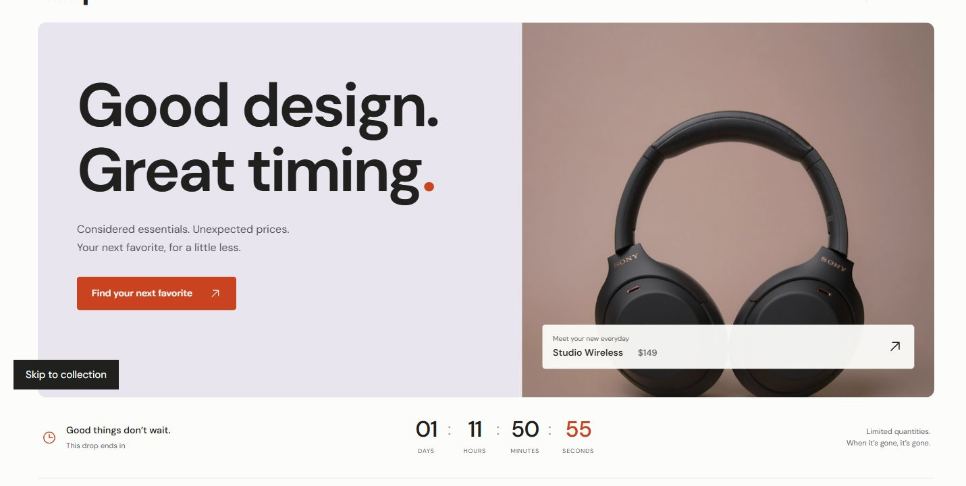
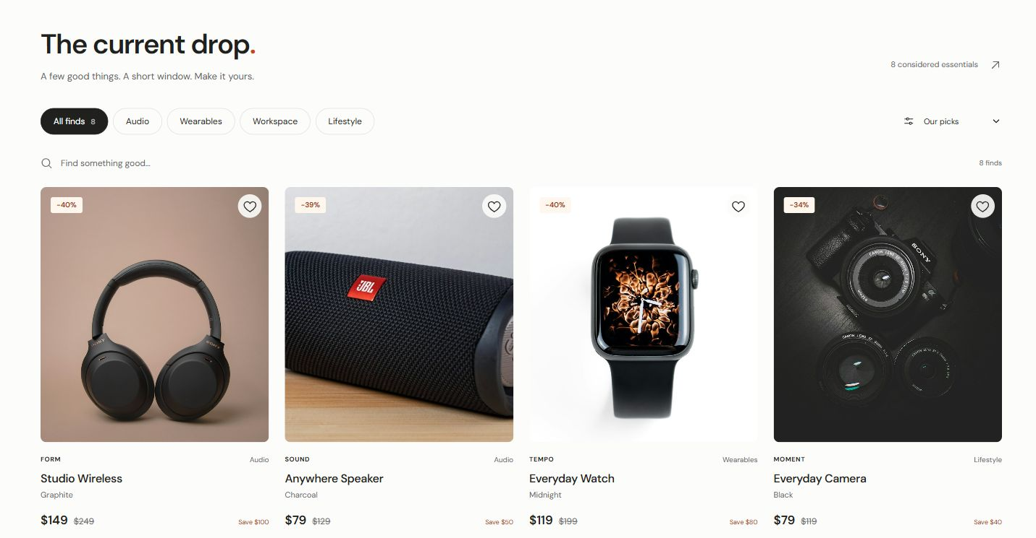
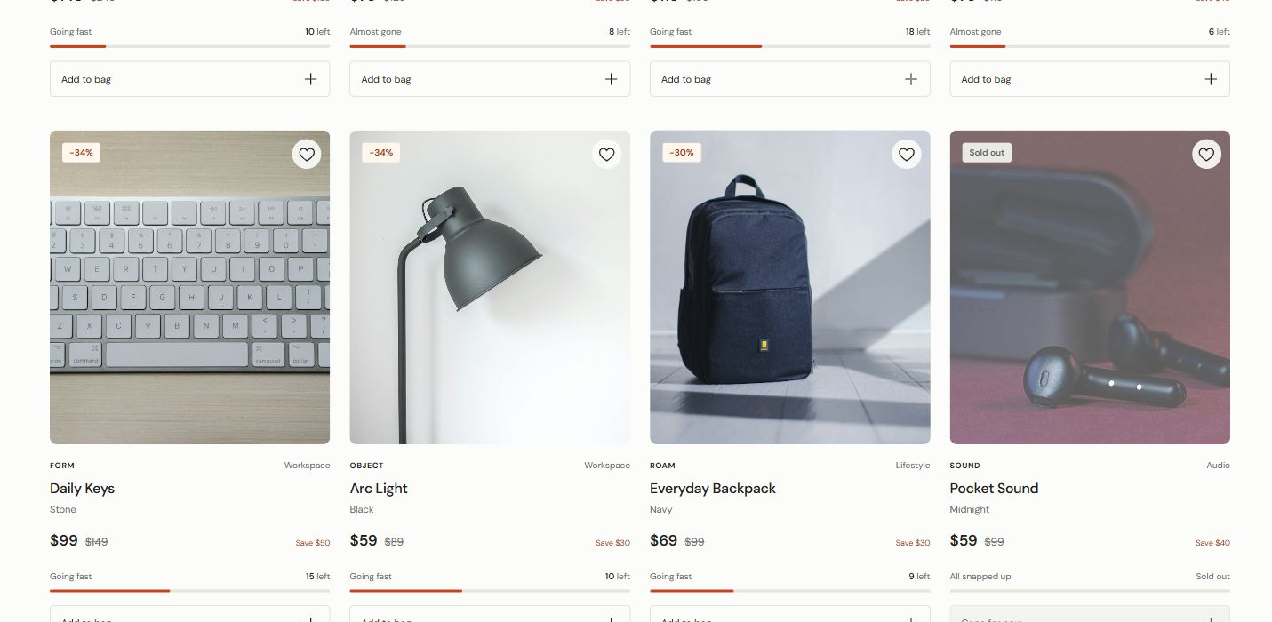
9
Implemented frontend screens
Sale landing
Product collection
Availability states
Hero and sale countdown
Filters, prices and stock
Low stock and sold-out items
Notes:
Screenshots are cropped from the existing DROP frontend screenshot in docs/screenshots/storefront.png. They show illustrative products and browser-local demo stock. No generated UI mockups or real payment flow are shown.

Slide 11
10
Work plan and milestones
Milestone | Target date | Responsible member
Review 2: UI/UX and frontend | Faculty date pending | Team 18
Review 3: backend and integration | Future phase; date pending | Proposed: Bhuvaneshwar + team
Final presentation | Faculty date pending | All team members
Frontend ready for review. Next: confirm the backend scope, faculty dates and role allocation.
Notes:
Team 18 Review 1. Current delivery is a frontend-only React demo with browser-local data. Backend integration and shared database behavior are future work. Faculty dates and individual roles await confirmation. Verification previously completed: 15 frontend tests, ESLint and Vite production build.

Slide 12
11
Team roles and risks
Nanith Reddy
Bhuvaneshwar
P William
Risks
Proposed role
Layout and shared React components.
Frontend integration.
Proposed role
Catalog, countdown and stock state.
Future API planning.
Proposed role
Bag and checkout tests.
Accessibility and review material.
Timer drift: derive time from timestamps.
Stale stock: validate quantities.
Regressions: test, lint and build.
Expected outcome
A responsive, accessible frontend demonstration covering sale timing, stock, bag review and simulated checkout.
Notes:
Team 18 Review 1. Current delivery is a frontend-only React demo with browser-local data. Backend integration and shared database behavior are future work. Faculty dates and individual roles await confirmation. Verification previously completed: 15 frontend tests, ESLint and Vite production build.

Slide 13
12
Thank you | Questions
GitHub repository
https://github.com/Nanith-tech/flash-sale-ecommerce-team18
Design and review material
Included in the repository. No external Google Drive or Figma link was provided.
Team
Team 18
M Nanith Reddy, Sukka Bhuvaneshwar and P William
Notes:
Team 18 Review 1. Current delivery is a frontend-only React demo with browser-local data. Backend integration and shared database behavior are future work. Faculty dates and individual roles await confirmation. Verification previously completed: 15 frontend tests, ESLint and Vite production build.

