Slide 1

2025 Academic Year
Mai Ja Yang College
Department of Computer Science
Title : Color Voting System
Subject : Cloud Computing & DevOps
Date : 7/11/2025
Group-2
3Cs-9 Marip Yaw Htung Nan
3Cs-10 Maru La Htoi
3Cs-12 Mwihpu Naw San
3Cs-13 Myitung Bawm Yaw
3Cs-14 Myitung Naw Li
3Cs-15 Nan Thi Thi Hein
3Cs-20 Woisu Sut Ding Awng

Slide 2
Content
Introduction
Objective
Architecture Diagram
Data Flow Diagram
Design Justification
Cost Estimate
Scalability & Reliability
Advantages
Conclusion

Slide 3
Introduction
Color voting System (Web app)
Cloud-Native Web Application Deployment on AWS
Tools: Flask, Docker, Kubernetes (EKS), Redis, Terraform, AWS

Slide 4
Objective
Build a fully automated cloud-deployed web app.
Demonstrate automation, scalability, and reliability using DevOps tools.

Slide 5
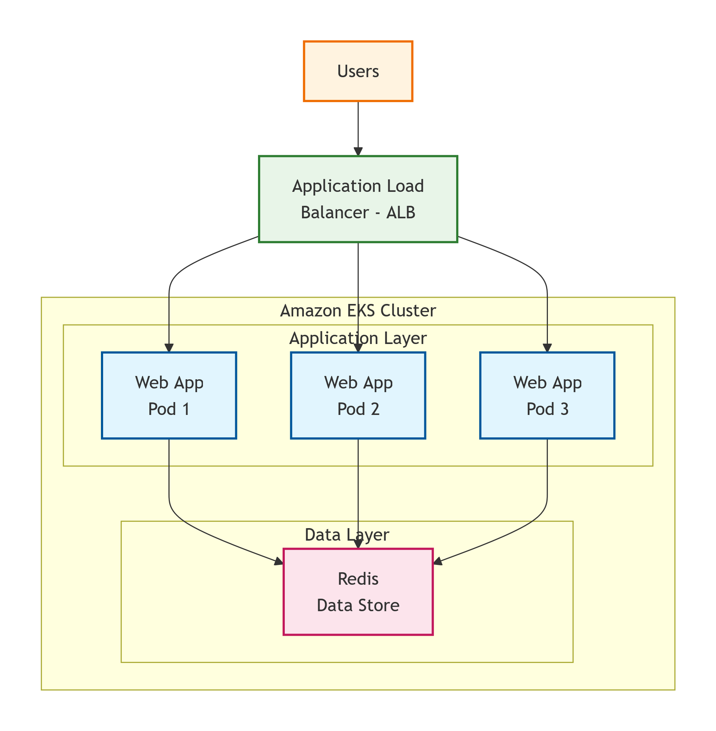
Architecture Diagram

Slide 6
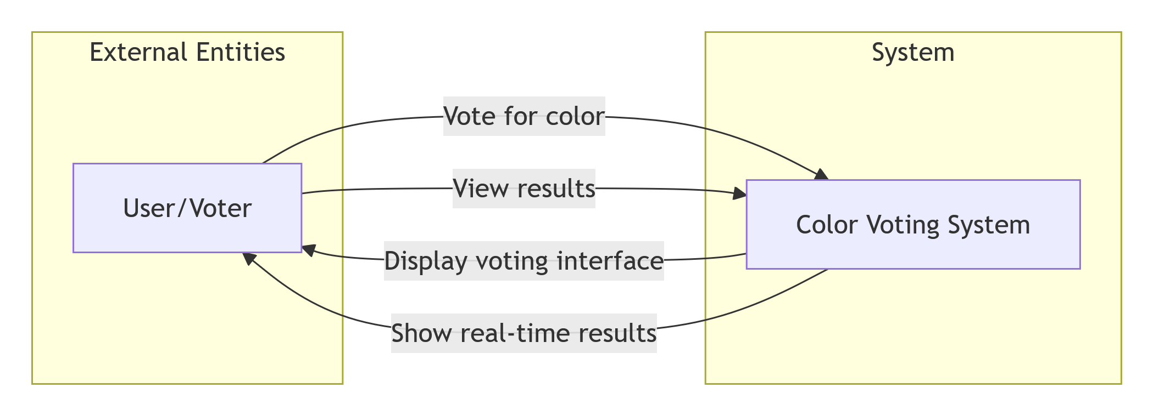
Data Flow Diagram

Slide 7
Design Justification
EKS: Auto-healing, auto-scaling, rolling updates
Terraform: Reproducible, version-controlled infrastructure
Redis: High-speed caching and session management
Docker: Ensures consistent environments across stages

Slide 8
Cost Estimation
EKS Cluster (t3.medium x 2): $70
ALB: $20
Redis: $15
Storage (S3/EBS): $10
Monitoring (Terraform + CloudWatch): $5
Total ≈ $120/month

Slide 9
Scalability & Reliability
Horizontal Pod Autoscaler adjusts pods automatically.
Cluster Autoscaler scales nodes based on demand.
AWS Backup automates snapshots.
CloudWatch monitors performance and uptime.

Slide 10
Implementation Roadmap
1. Develop Flask app
2. Containerize with Docker
3. Deploy infrastructure via Terraform
4. Deploy app & Redis on EKS
5. Configure monitoring & autoscaling

Slide 11
Advantages
Automated deployment and rollback
High availability and fault tolerance
Efficient cost scaling with load
Fast response via Redis caching
Code-defined infrastructure with Terraform

Slide 12
Conclusion
Complete DevOps pipeline from IaC to autoscaling.
AWS, Terraform, Docker, and Kubernetes integration ensures:
- Scalability
- Reliability
- Cost-efficiency
- Real-world production readiness

