Slide 1


Hands-on ML monitoring flow with NannyML
by Wojtek Kuberski

Slide 2
Agenda
ML Monitoring Flow
Performance Monitoring
1
2
4
3
Issue Resolution
Root Cause Analysis

Slide 3
The ML Monitoring flow
1

Slide 4
ML Monitoring Flow
The goals
1. Maintain the business impact of the model
2. Reduce risk of the model
3. Increase visibility of the model

Slide 5
ML Monitoring Flow
The process
Performance Monitoring
Root Cause Analysis
Issue
Resolution

Slide 6
Performance Monitoring
2

Slide 7
ML Monitoring Flow
The process
Performance Monitoring
Root Cause Analysis
Issue
Resolution

Slide 8
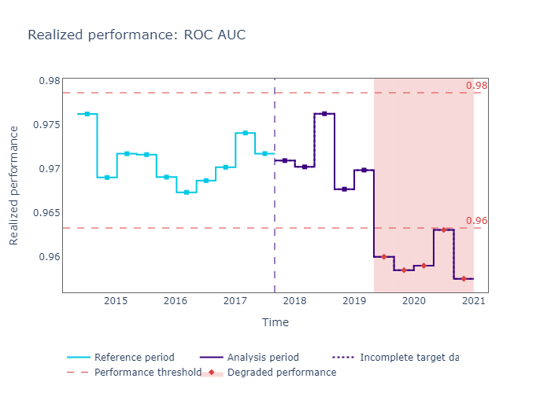
Performance Monitoring
A crucial step in the flow
Proxy for Business Impact
Identifies potential issues
Trigger for Root Cause Analysis
However
Not easily possible without target data
Performance Estimation
is a viable alternative

Slide 9
Performance Monitoring
Availability of Ground Truth
Performance Monitoring
Performance Estimation
Is Ground Truth Available?
No
Yes
What type of model?
Performance Calculation
DLE
CBPE
Regression
Classification

Slide 10
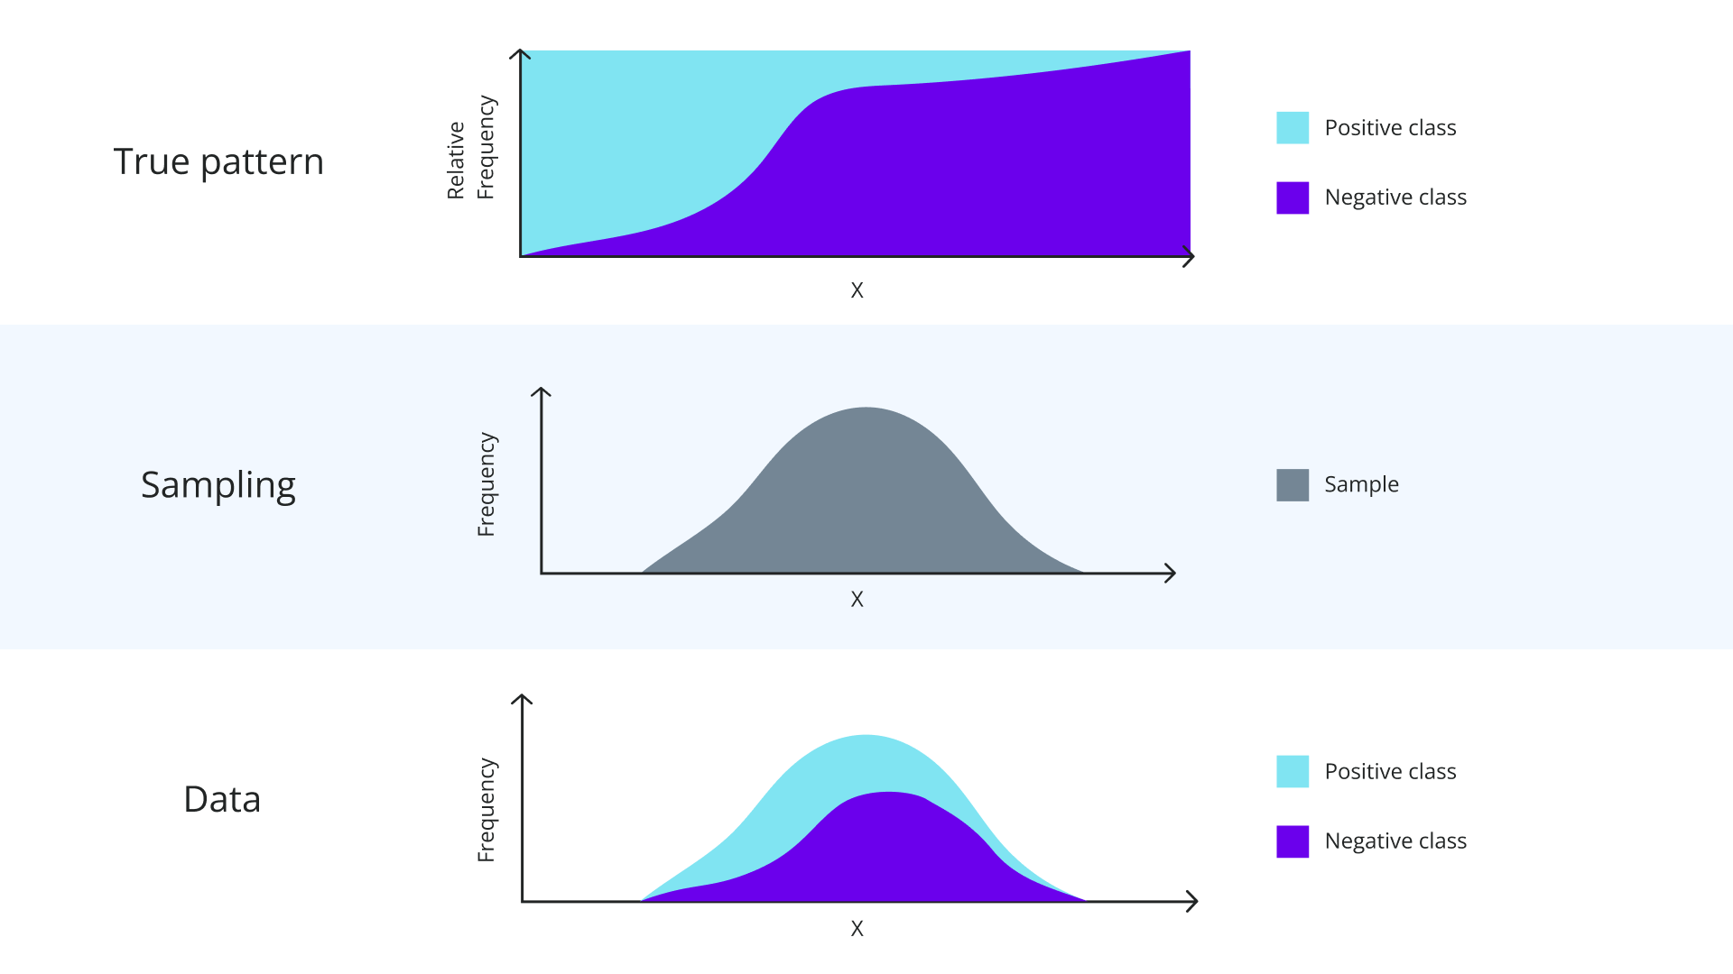
The two causes of silent model failure
The basics
Notes:
Population -> underlying concept
The mapping / the relationship

Slide 11
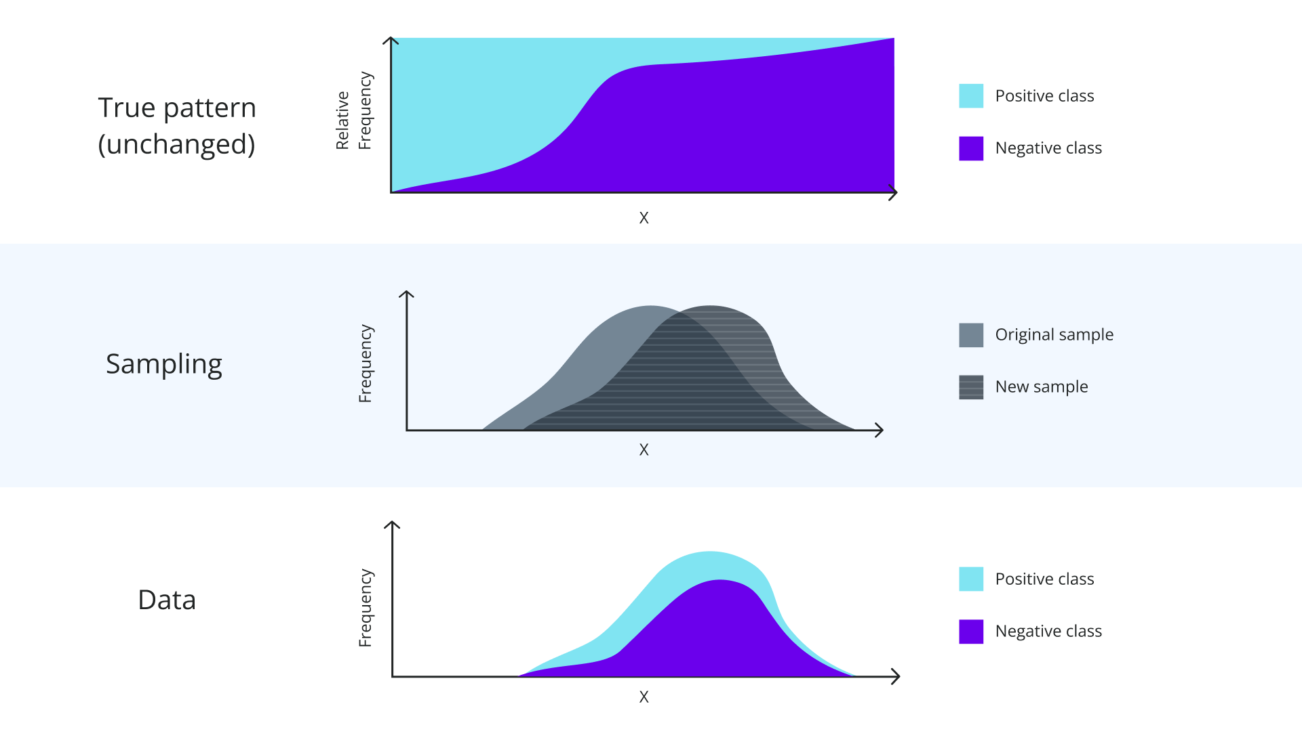
The two causes of silent model failure
Covariate shift

Slide 12
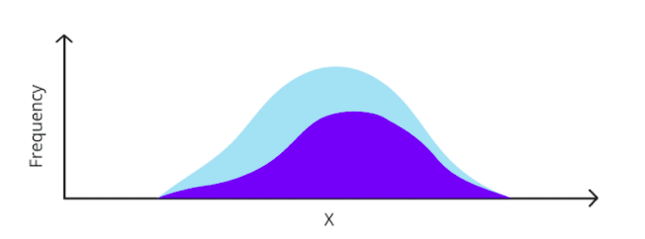
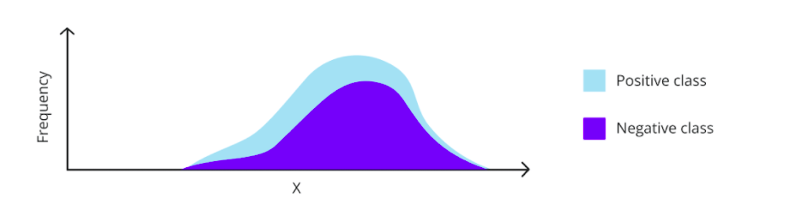
The two causes of silent model failure
Covariate shift
Change in the joint model input distribution - P(X)

Slide 13
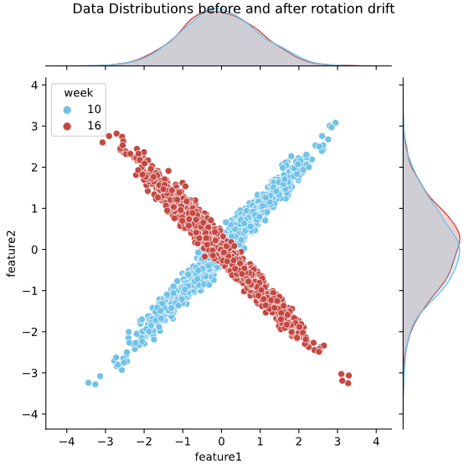
The two causes of silent model failure
Covariate shift: Multivariate example

Slide 14
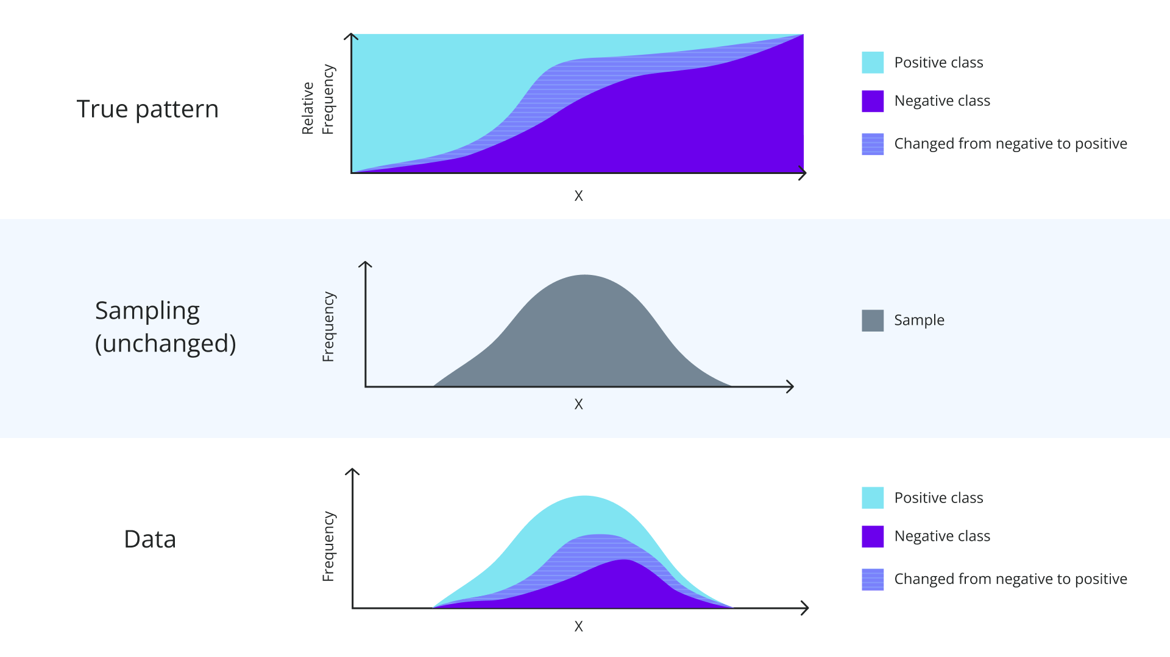
The two causes of silent model failure
Concept drift
Notes:
add concept drift - in the legend.
Take is MUCH slower.

Slide 15
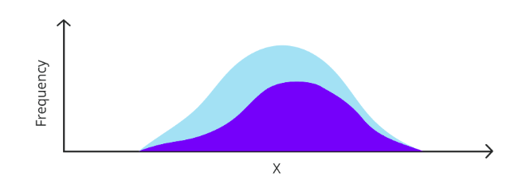
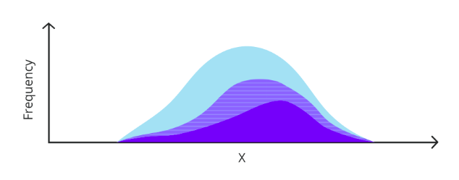
The two causes of silent model failure
Concept drift
Change in the relationship between the target and the model inputs - P(y|X)

Slide 16
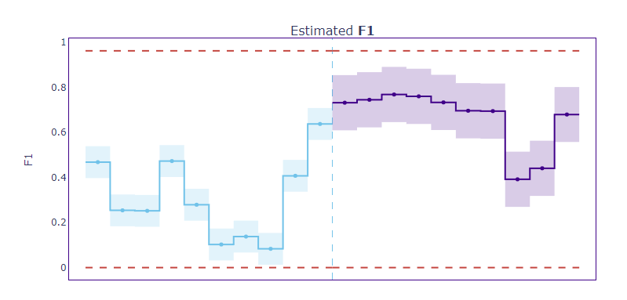
Performance Estimation for Classification
CBPE: What can we calculate?
Confusion Matrix
Precision, Recall, Accuracy, Specificity, F1…
ROC AUC

Slide 17
Performance Estimation for Classification
CBPE: What does it do?
Captures the full impact of covariate shift on performance
Assumes no concept drift
Assumes there is no covariate shift to previously unseen regions

Slide 18
Performance Estimation for Classification
CBPE: Inputs
estimator = nml.CBPE(
y_pred_proba = 'y_pred_proba',
y_pred = 'y_pred',
y_true = 'target',
metrics = ['roc_auc', 'f1'],
problem_type = 'classification_binary'
)
Model scores (predicted probabilities)
Model predictions
Ground truth / target (fitting only)

Slide 19
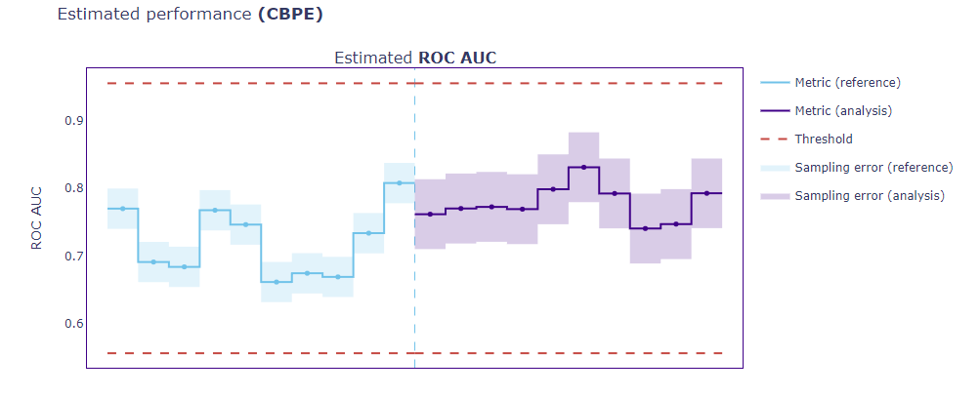
Performance Estimation for Classification
CBPE: Results
Estimated metric
Confidence bands
Thresholds

Slide 20
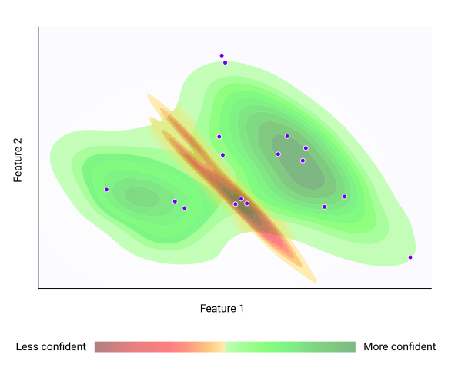

Performance Estimation for Classification
CBPE: Intuition
Test data
Production data

Slide 21
Performance Estimation for Classification
CBPE: Algorithm
Calibrate probabilities
Choose a threshold
Find expected confusion matrix for every point
Get aggregate confusion matrix
Compute a metric

Slide 22
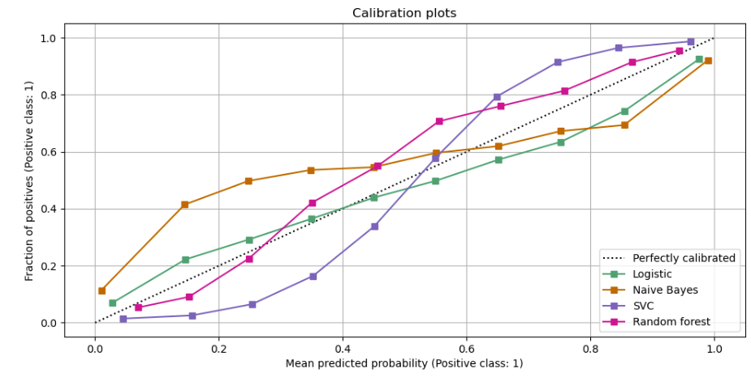
Classification with CBPE
Calibrate Probabilities

Slide 23
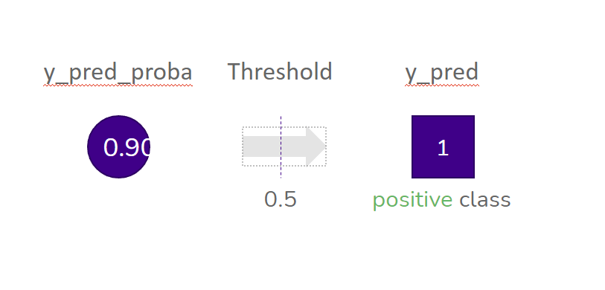
Classification with CBPE
Choose a threshold
0.90

Slide 24
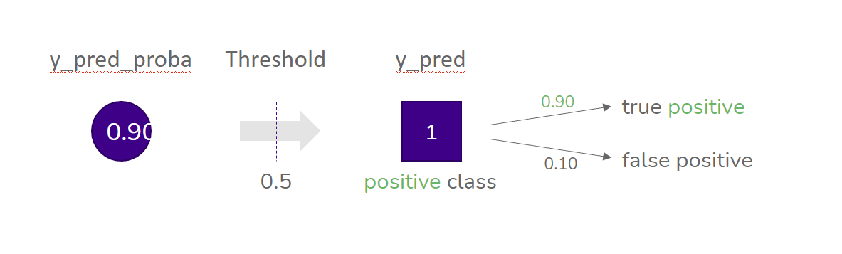
Classification with CBPE
Find expected confusion matrix for every point
0.90

Slide 25
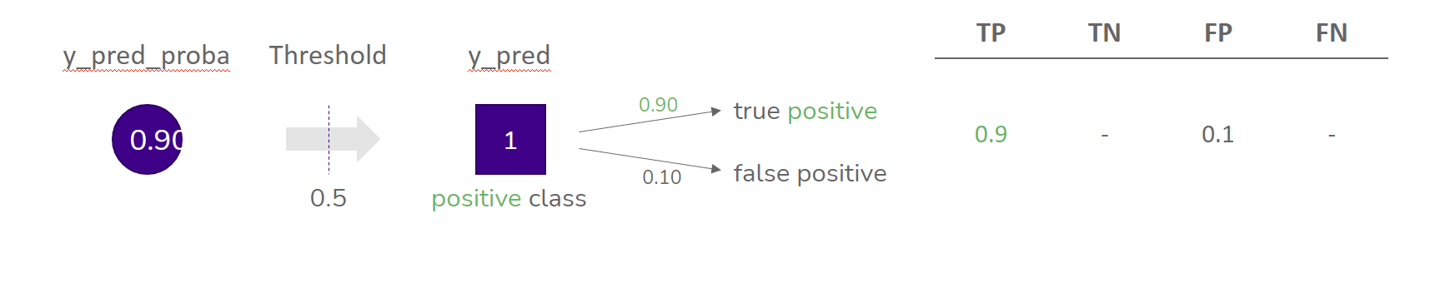
Classification with CBPE
Find expected confusion matrix for every point
0.90

Slide 26
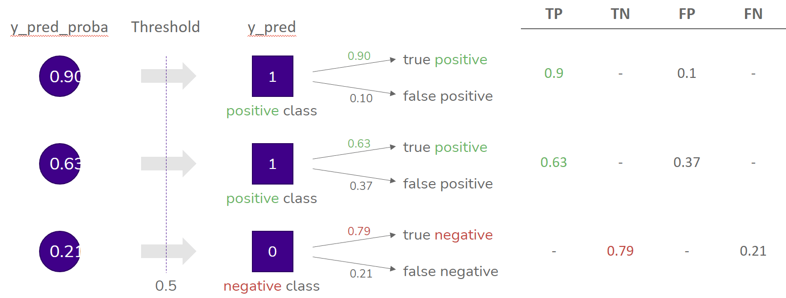
Classification with CBPE
Find expected confusion matrix for every point
0.90
0.63
0.21

Slide 27
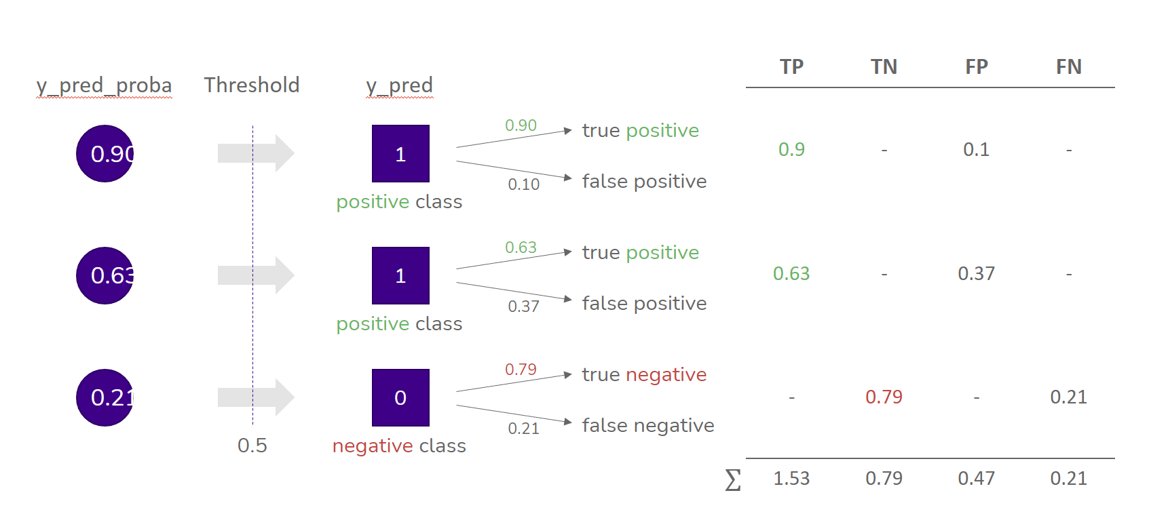
Classification with CBPE
Find expected confusion matrix for every point
0.90
0.63
0.21

Slide 28
Root Cause Analysis
3

Slide 29
Root Cause Analysis
The second step in the monitoring flow
Performance Monitoring
Root Cause Analysis
Issue
Resolution

Slide 30
Root Cause Analysis
The framework
Run drift detection and data quality monitoring
Correlate with Performance
Use domain knowledge to determine the root cause

Slide 31
Root Cause Analysis
Drift Detection and Data Quality Monitoring
Run drift detection and data quality monitoring
Univariate Drift Detection
Multivariate Drift Detection
Data Quality
Categorical Methods
Continuous Methods
Unseen Data
Missing Data

Slide 32
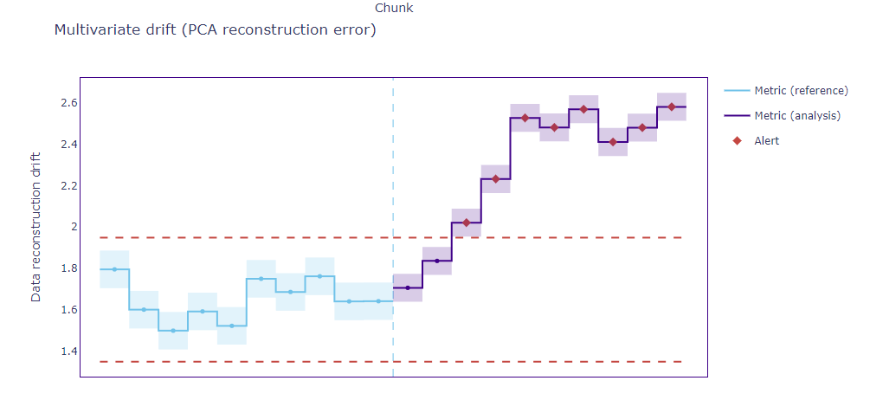
Multivariate Drift Detection
Results
Reconstruction error
Confidence bands
Thresholds

Slide 33
Multivariate Drift Detection
Characteristics
Captures any linear change in relationship between features
Captures changes in single feature distributions
Requires at least 2 features to work
Not easily interpretable

Slide 34
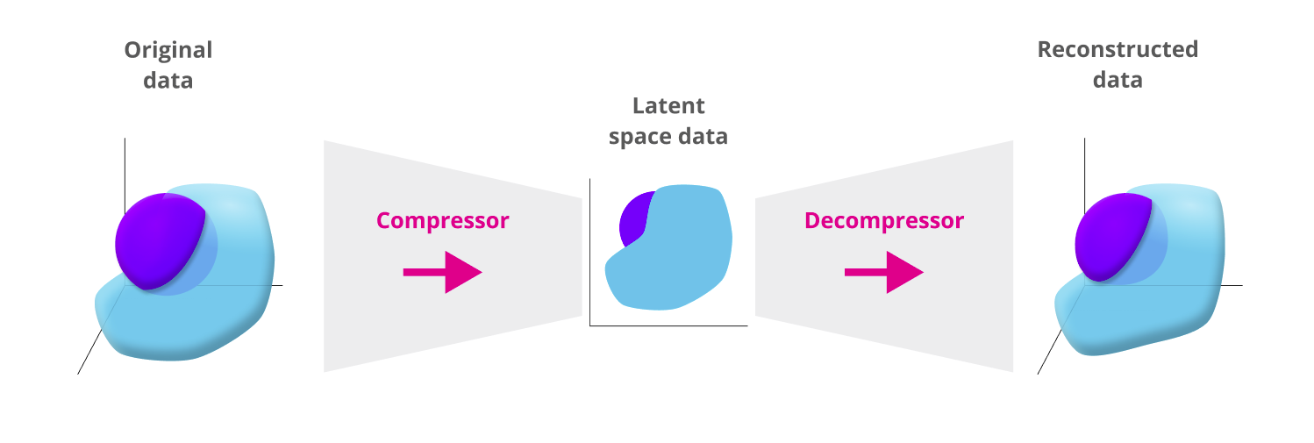
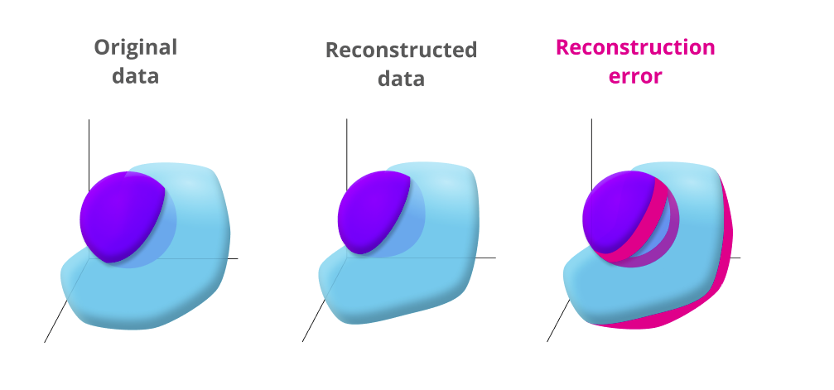
Multivariate Drift Detection
Intuition

Slide 35
Multivariate Drift Detection
Algorithm training
Prepare the data: impute missing values, encode categorical features, scale the data
Train PCA on reference data
Compress and decompress the reference data using trained PCA
Compute the distance between original and reconstructed points
Compute the reconstruction error: the average of those distances

Slide 36
Multivariate Drift Detection
Algorithm drift detection
Compress and decompress the analysis data using trained PCA
Compute the distance between original and reconstructed points
Compute the reconstruction error: the average of those distances
Compare this reconstruction error with the reconstruction error we got on the reference data

Slide 37
Univariate Drift Detection
At-a-glance comparison
Name | Categorical | Continuous | Range
Jensen-Shannon Distance | Yes | Yes | [0,1]
Hellinger | Yes | Yes | [0,1]
Wasserstein | No | Yes | [0,+inf]
L-Infinity | Yes | No | [0,1]
Kolmogorov- Smirnov | No | Yes | [0,1]
Chi-squared | Yes | No | [0,+inf]
2

Slide 38
Univariate Drift Detection
Structure of the Overview
Basics: what the method is
Intuition: how the method works
Results: example results on the same dataset

Slide 39
Univariate Drift Detection
Jensen-Shannon distance: Basics
Data Type | Intuition | Range
continuous and categorical | Based on KL-divergence | [0,1]

Slide 40
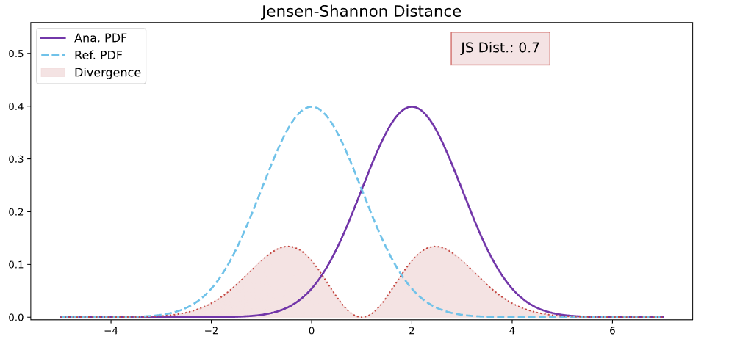
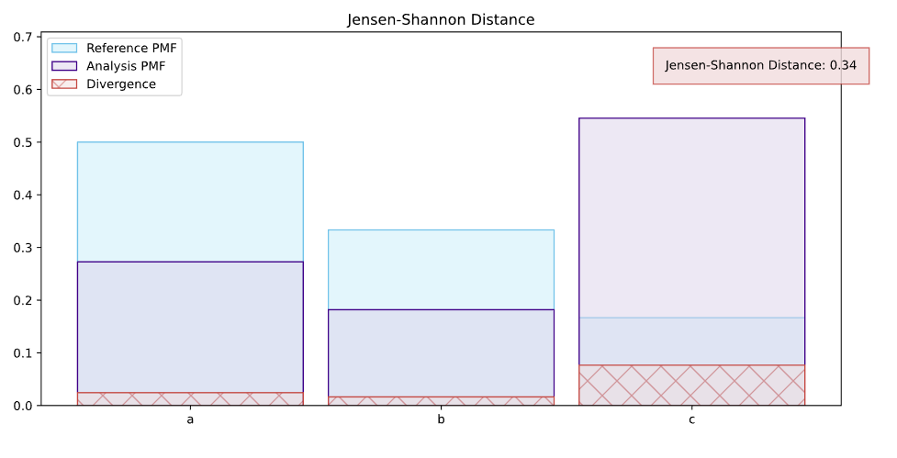
Univariate Drift Detection
Jensen-Shannon distance: Intuition
Captures the “amount of overlap”
“bi-directional” KL divergence
Categorical: an average of all changes in relative frequencies of categories

Slide 41
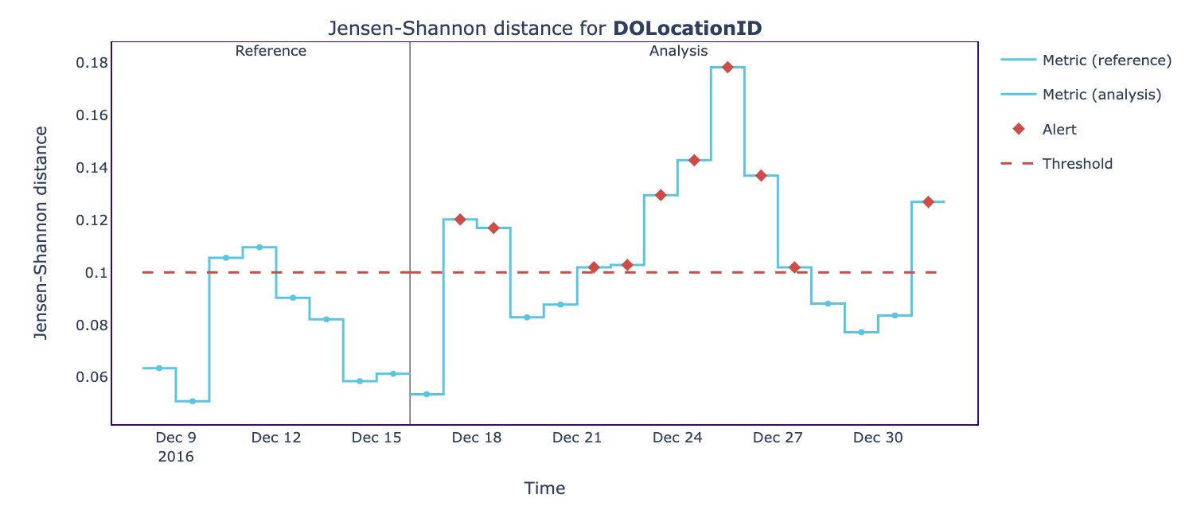
Univariate Drift Detection
Jensen-Shannon distance: Results

Slide 42

Univariate Drift Detection
Hellinger distance: Basics
Data Type | Intuition | Range
continuous and categorical | Similar to Bhattacharyya Coefficient | [0,1]

Slide 43
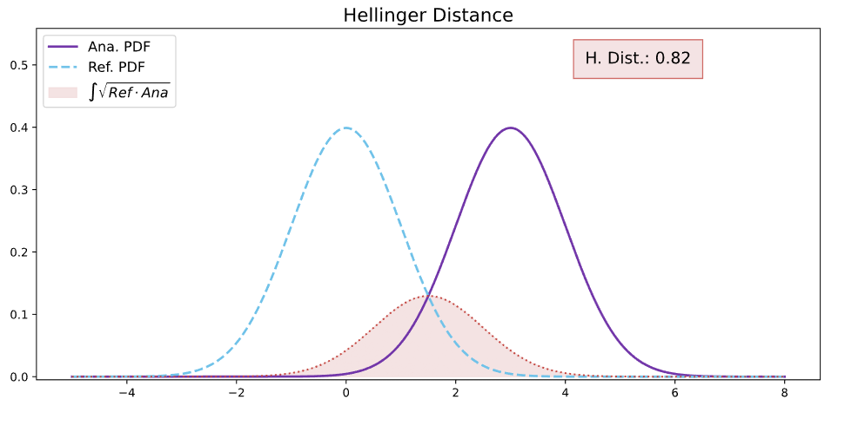
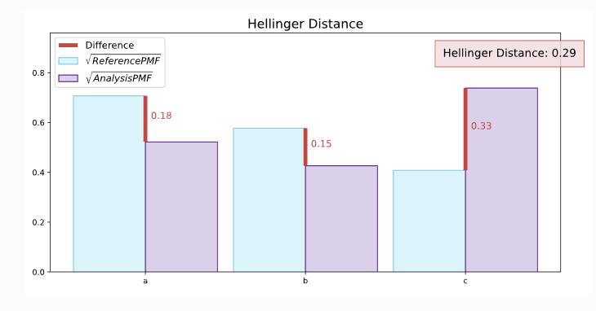
Univariate Drift Detection
Hellinger distance: Intuition
Overlap between the probabilities assigned to the same event by two distributions
Doesn’t differentiate between very strong shifts
Qualitatively similar to Jensen-Shannon

Slide 44
Univariate Drift Detection
Wasserstein distance: Basics
Data Type | Intuition | Range
continuous | Also known as earth mover distance | [0,+inf]

Slide 45
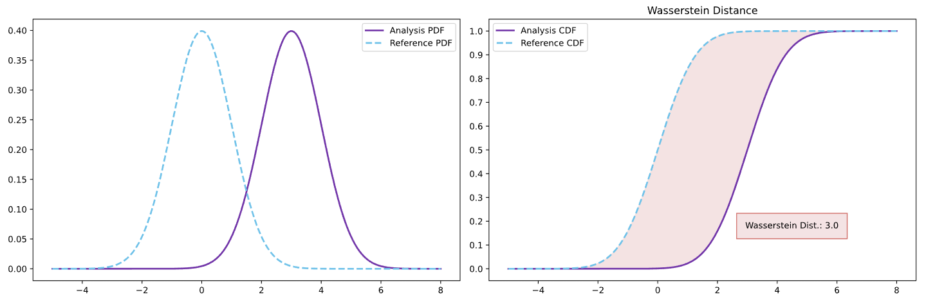
Univariate Drift Detection
Wasserstein distance: Intuition
Amount of work needed to transform one distribution into the other
Area between cumulative distribution functions (CDFs)
Sensitive to outliers

Slide 46
Univariate Drift Detection
Kolmogorov-Smirnov Test: Basics
Data Type | Intuition | Range
continuous | Statistical measure, not a distance | [0,1]

Slide 47
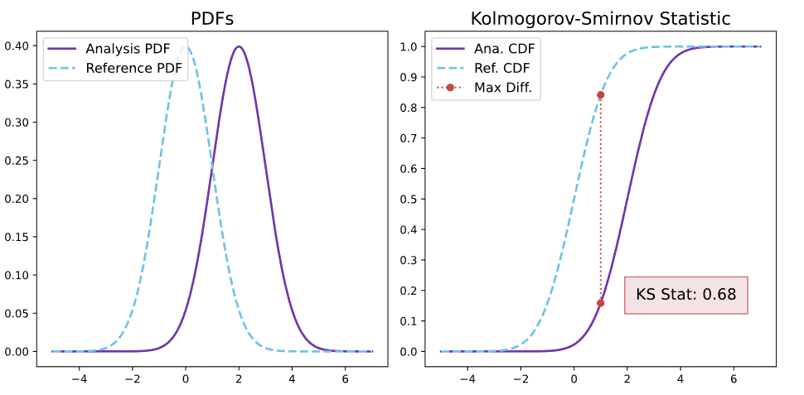
Univariate Drift Detection
Kolmogorov-Smirnov Test: Intuition
Maximum distance of the cumulative distribution functions (CDFs)
Prone to false positives, especially in bigger samples
Outputs d-statistic and p-value

Slide 48
Univariate Drift Detection
Chi-squared Test: Basics
Data Type | Intuition | Range
categorical | Statistical measure, not a distance | [0,+inf]

Slide 49
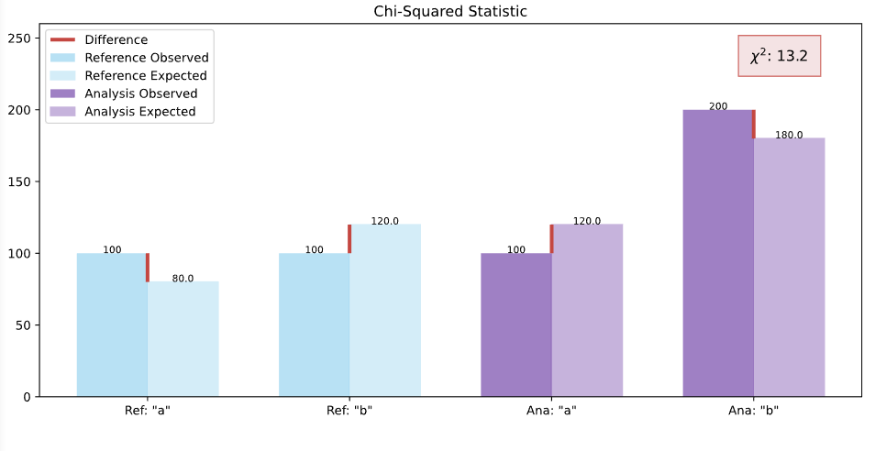
Univariate Drift Detection
Chi-squared Test: Intuition
Sample size influences the statistic for the same drift magnitude
Sensitive to changes in low-frequency categories
Outputs chi-squared statistic and p-value

Slide 50
Univariate Drift Detection
L-Infinity Distance: Basics
Data Type | Intuition | Range
categorical | Similar to Euclidean Distance | [0,1]

Slide 51
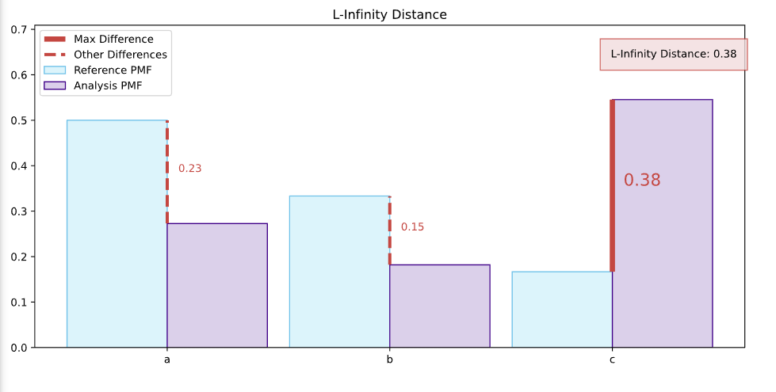
Univariate Drift Detection
L-Infinity Distance: Intuition
Maximum of the absolute difference between the relative frequencies
Robust to noise in features with many categories
Sensitive to changes to just one category

Slide 52
Univariate Drift Detection
At-a-glance comparison
Name | Categorical | Continuous | Range | Distance | Recommended use | Characteristics
Jensen-Shannon Distance | Yes | Yes | [0,1] | Yes | Versatile | Doesn’t differentiate between very strong and extreme drifts
Hellinger | Yes | Yes | [0,1] | Yes | Medium-strength shifts | Breaks down in extreme shifts
Wasserstein | No | Yes | [0,+inf] | Yes | Work as a shift measure is relevant | Sensitive to outliers
L-Infinity | Yes | No | [0,1] | Yes | Works well with many categories | Sensitive to big changes to one category
Kolmogorov-Smirnov | No | Yes | [0,1] | Statistical Test | Statistical significance | False positives, insensitive to changes in tails
Chi-squared | Yes | No | [0,+inf] | Statistical Test | Statistical significance | False positives, function of sample size
2

Slide 53
Issue resolution
4

Slide 54
Issue Resolution
The final step in the monitoring flow
Performance Monitoring
Root Cause Analysis
Issue
Resolution

Slide 55





Issue Resolution
5 possible solutions
Retrain
the model
Adjust downstream processes
Revert to a
previous model
Refactor
the use case
Do
nothing

Slide 56
Issue Resolution
Comparison of methods
MOSTLY USED
WORKS WHEN
BE MINDFUL
Retrain the model
Default first step
There is no concept drift
Will not resolve problems due to covariate shift.
Might make matters worse if root cause is data quality issue.
Adjust downstream processes
To minimize business impact of the performance drop
Performance degradation cannot be fixed
Generally involves human checks or adjustments to actions done based on predictions
Revert to a
previous model
If you automatically retrain models
Need quick fix that works well enough
Check if the previous model is still performant
Refactor
the use case
Last-resort, due to cost
In most cases
Ideally more labelled data should be gathered
Might not work if the main cause was covariate shift
Do nothing
Important to consider it a real option
Fixing costs higher than leaving the problem as is
Sometimes it’s not possible to fix issues due to covariate shift
Important to consider it a real option

Slide 57
ML Monitoring Flow
Key Takeaways
3-step monitoring flow ensures continued performance of your models
Performance monitoring and estimation are crucial and cannot be replaced with just data drift detection
Data Drift detection is mainly a root cause analysis tool
Retraining won’t always fix your problems and can even be a source of an issue

Slide 58
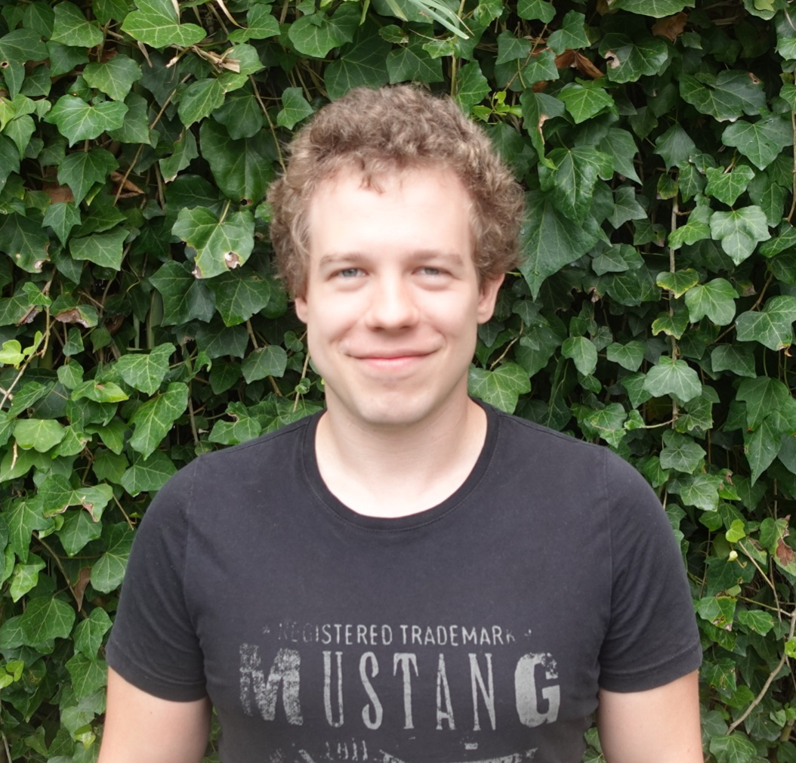

Thanks for Listening!
Give NannyML a try (and a star): https://github.com/NannyML/nannyml

