Slide 1

SMART CITY MOBILITY INTELLIGENCE PLATFORM
Urban Pulse
Integrated analytics for transit, ride-hailing, cycling, weather, and demographic data — unified into one urban mobility decision-support platform.

Slide 2

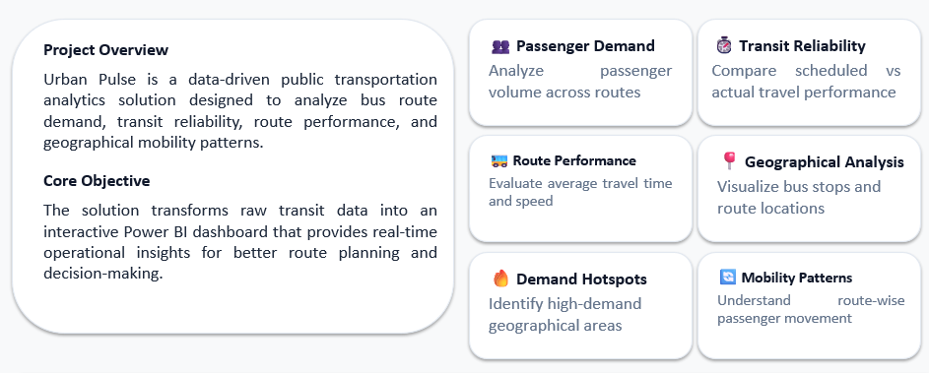
Project Statement
THE PROBLEM
URBAN PULSE
02

Slide 3

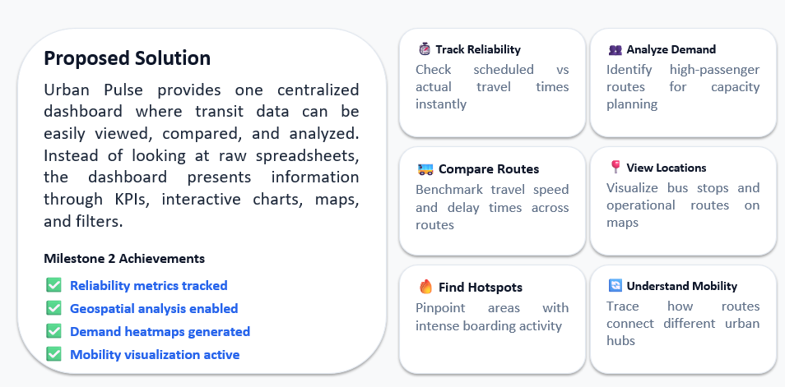
THE SOLUTION

Slide 4
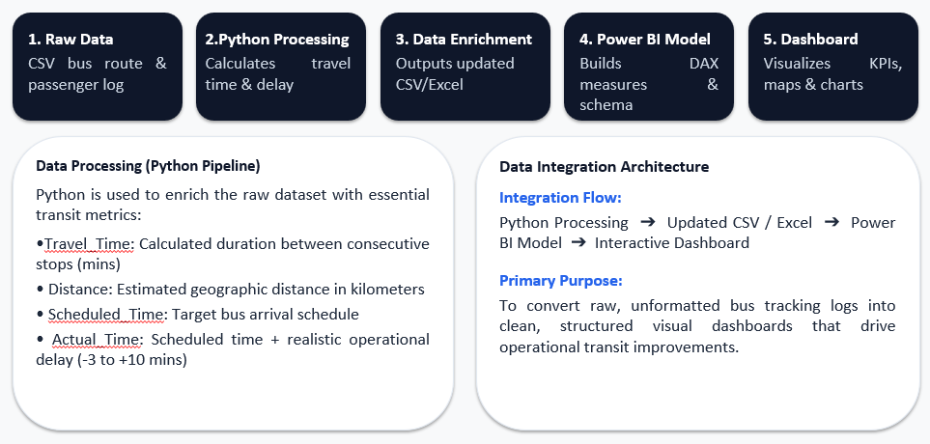
WORKFLOW & DATA INTEGRATION PIPELINE

Slide 5
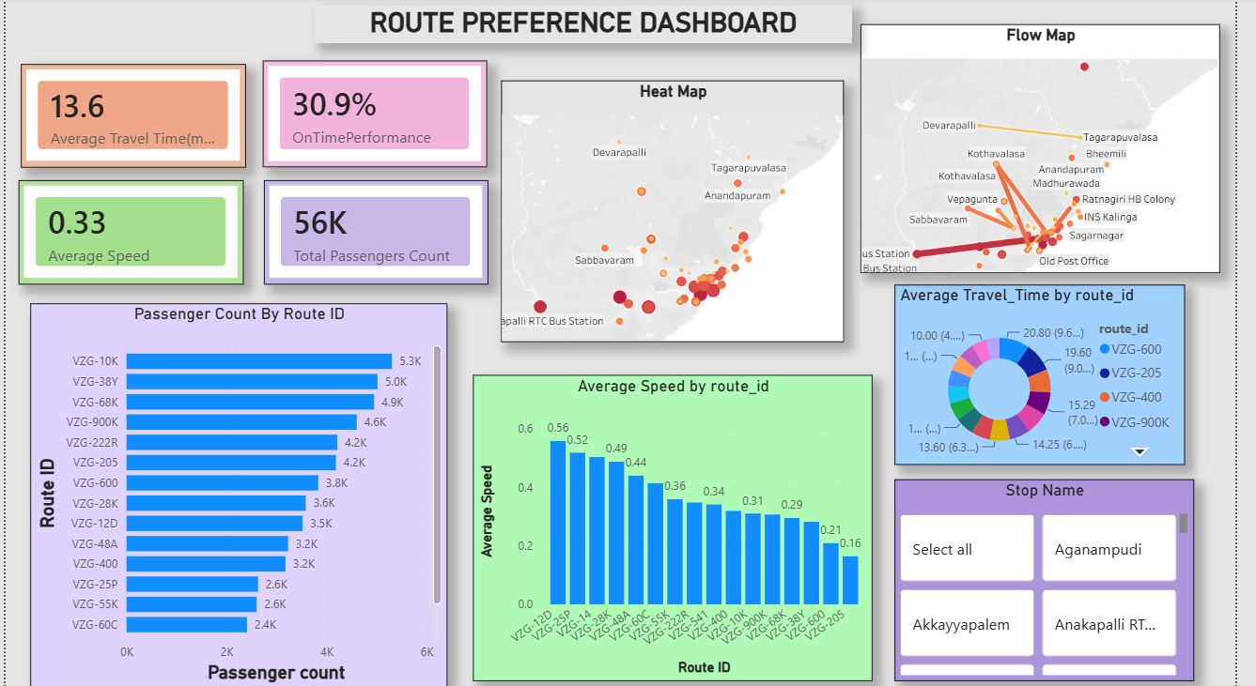
Urban Pulse — Power BI Dashboard

Slide 6
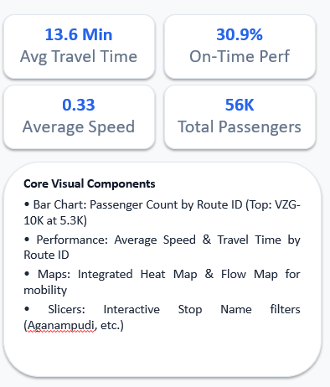
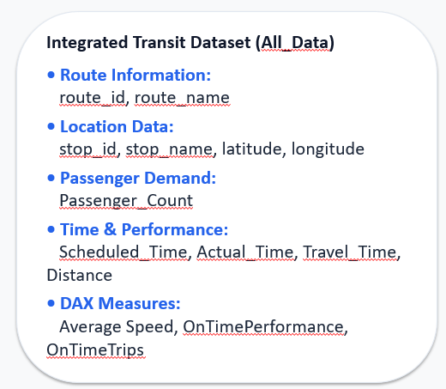
Urban Pulse — Database Schema

Slide 7
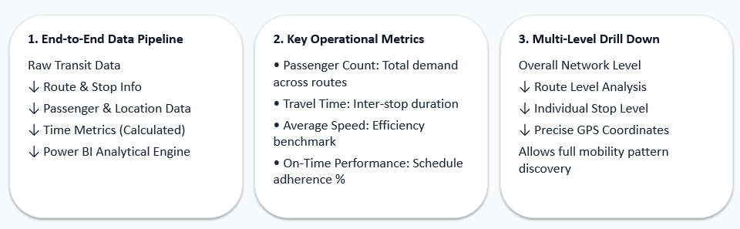
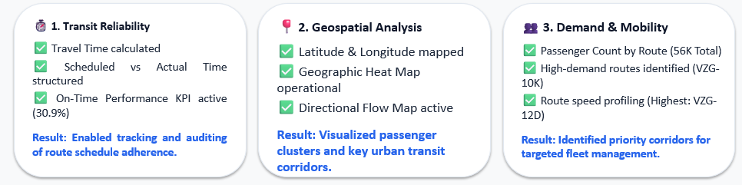
DATA MODELING & METRICS ARCHITECTURE

Slide 8

THANK YOU
URBAN PULSE

