Slide 1

SMART CITY MOBILITY INTELLIGENCE PLATFORM
Urban Pulse
Integrated analytics for transit, ride-hailing, cycling, weather, and demographic data — unified into one urban mobility decision-support platform.

Slide 2


Project Statement
THE PROBLEM
THE SOLUTION
Modern cities generate a large amount of transportation data from different sources such as public buses, metro services, ride-hailing apps, cycling systems, traffic sensors, weather reports, and GPS devices. However, this data is stored in separate systems and is not connected. Because of this, city planners and transport authorities find it difficult to get a complete view of the city's transportation network. This leads to problems like traffic congestion, poor route planning, delayed services, and inefficient decision-making.
Urban Pulse is a Smart City Mobility Intelligence Platform that combines transportation data from multiple sources into one centralized system. It provides interactive dashboards, maps, and visual reports that help users monitor traffic conditions, analyze transportation performance, identify congestion areas, and understand mobility patterns. The platform also uses analytics to predict future traffic trends and supports data-driven decision-making, helping city planners improve transportation services and build a smarter, more sustainable city.
URBAN PULSE
02

Slide 3







Outcomes
What the platform delivers
A single platform that integrates data from buses, metro, ride-hailing, cycling, weather, and demographic sources.
Interactive dashboards to monitor traffic, transport demand, and transit performance in real time.
Automatic data collection and updates from multiple public data sources.
Maps and heatmaps to identify traffic congestion, bottlenecks, and busy travel routes
7
Mobility Index and City Mobility Health Score to measure transportation efficiency and accessibility.
Forecasting and anomaly detection to predict traffic conditions and identify issues before they become major problems.
Role-based dashboards for city planners, transport operators, and government officials to support faster and smarter decision-making.
CORE OUTCOME AREAS
DELIVERED END-TO-END
URBAN PULSE
03

Slide 4
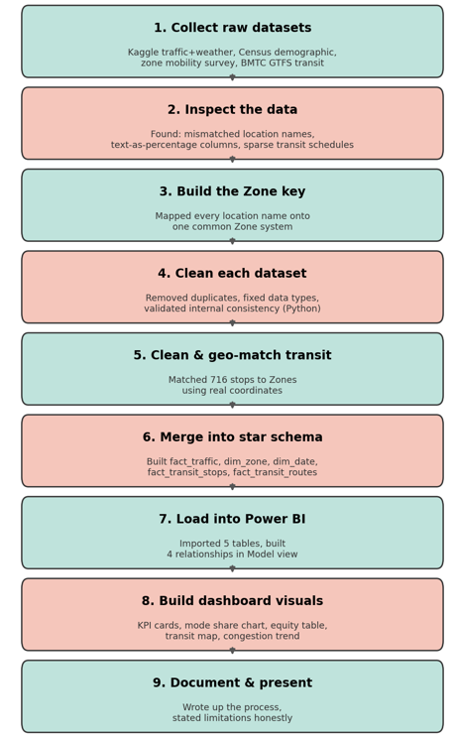
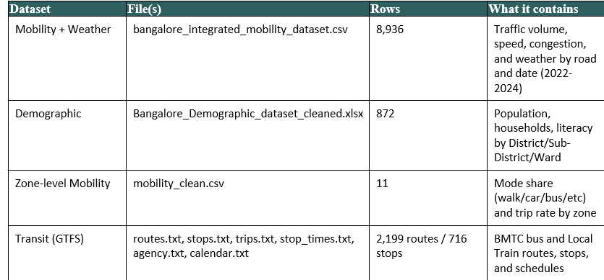
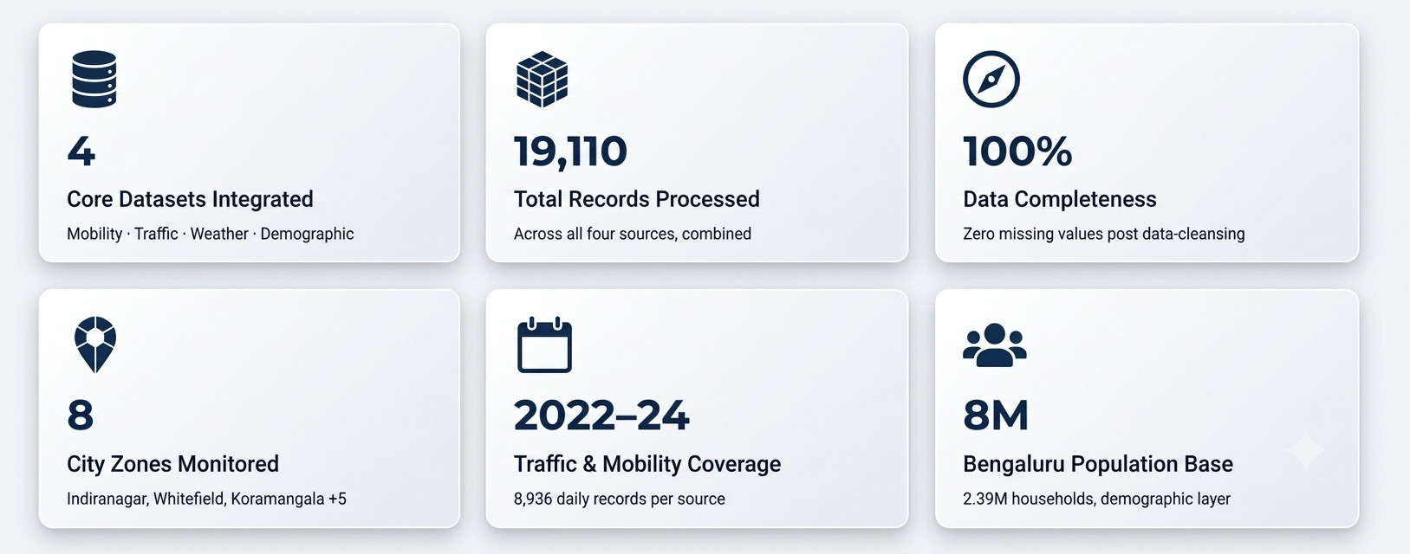
Workflow and Data Integration

Slide 5
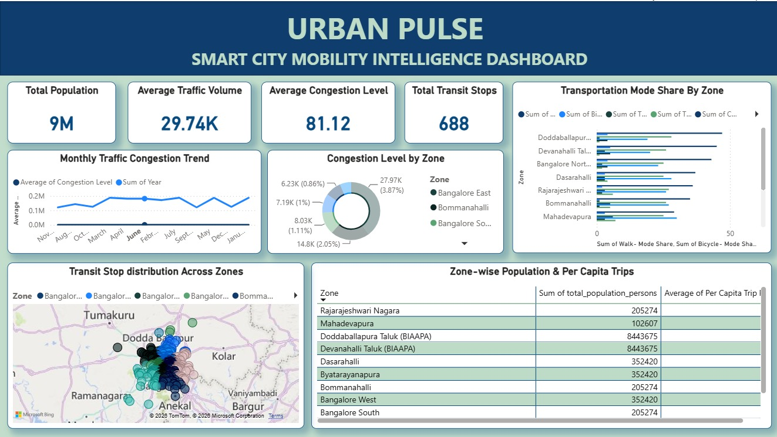
Urban Pulse — Power BI Dashboard

Slide 6
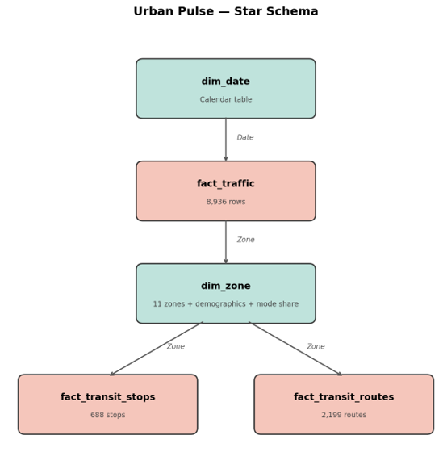
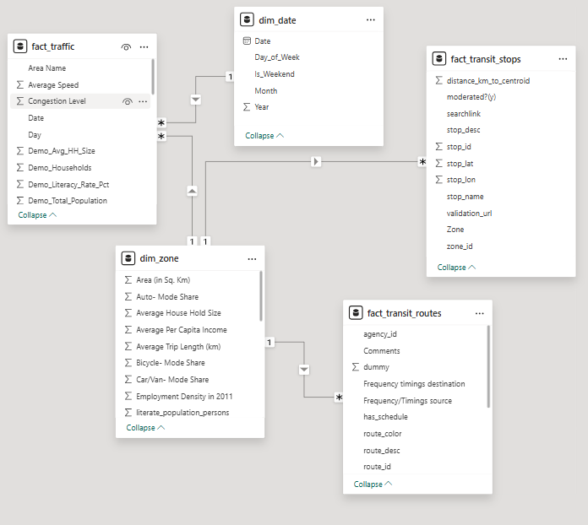
Urban Pulse — Database Schema

Slide 7
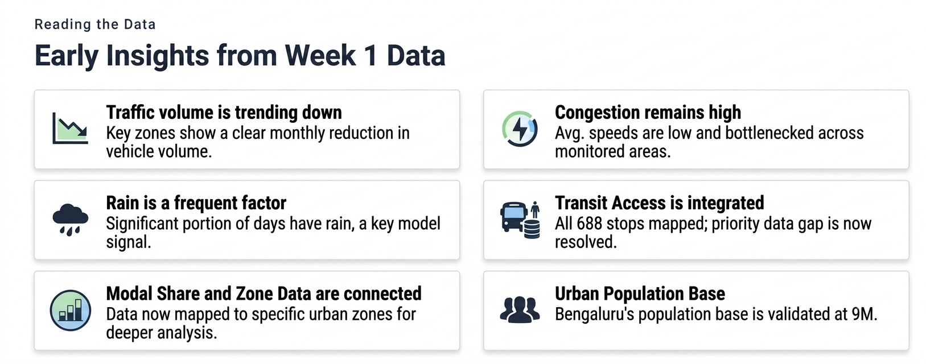

Slide 8
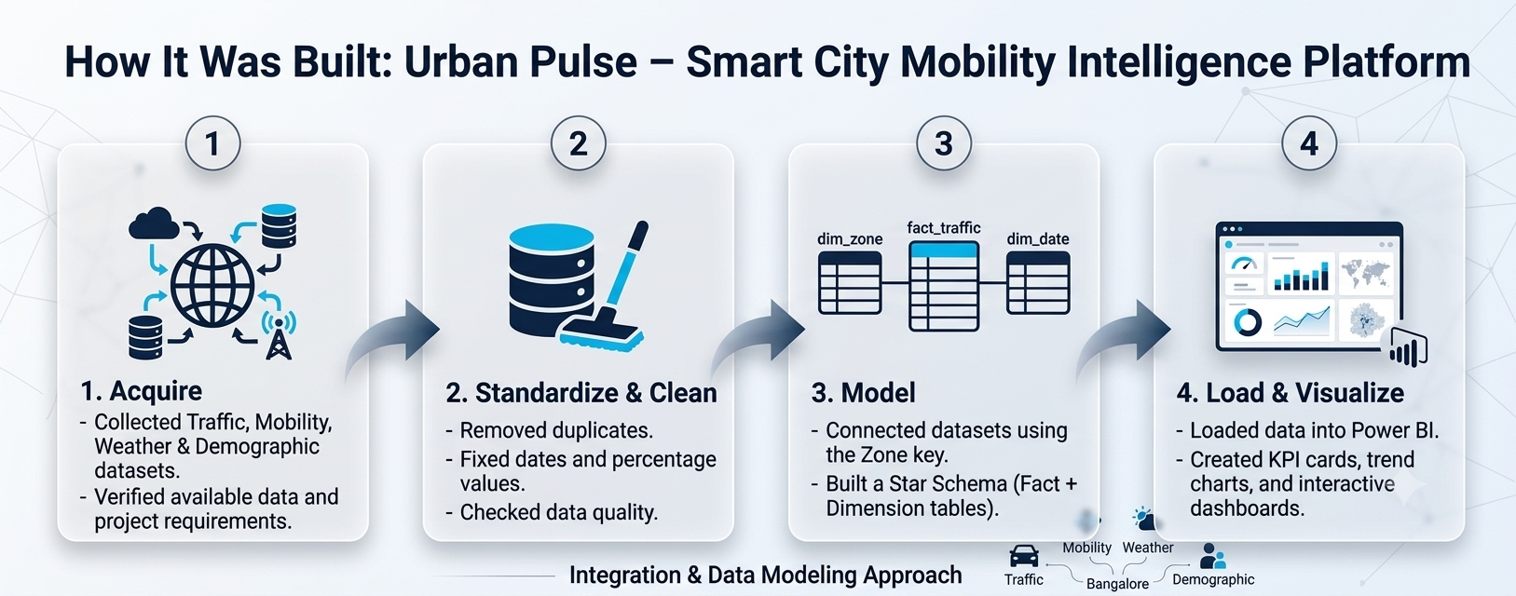




Integration & Data Modeling Approach
From raw data sources to stakeholder decisions
1
2
3
4
1. Acquire
2. Standardize & Clean
Cleaned all datasets by removing duplicates, fixing date formats, converting percentage values into numbers, and checking data quality to ensure accurate analysis.
3. Model
Connected the datasets using a common Zone key and created a Star Schema with one Fact table (fact_traffic) and two Dimension tables (dim_zone and dim_date) for efficient reporting.
4. Load & Visualize
Loaded the final tables into Power BI and built an interactive dashboard with KPI cards, traffic trends, mobility insights, and population analysis. Weather data was shown as a separate reference chart.
Stakeholders
Collected four datasets including Traffic, Mobility, Weather, and Demographic data for Bangalore. First, we checked the available data and identified missing transit information.
URBAN PULSE
08

Slide 9

THANK YOU
URBAN PULSE

