Slide 1
Review From Last Section and Misc Notes
Slides and other things available at
https://github.com/NanoDataCenter/nano_data_center/tree/master/presentations/session_3

Slide 2
Miscellaneous Notes
Why Avocado’s are grown on hills

Slide 3
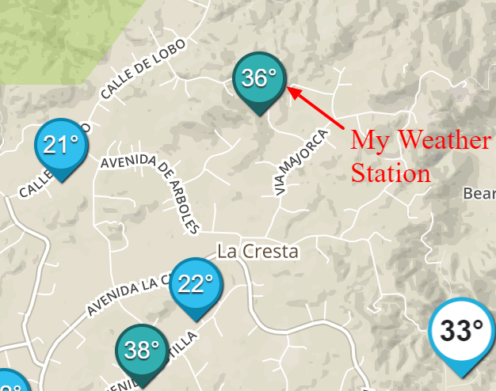
Why Avocados Are Grown on Hills

Slide 4
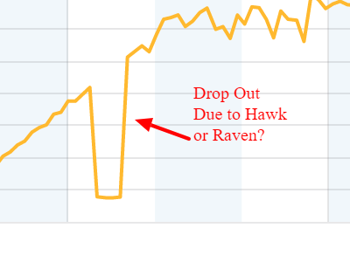
Birds Landing On Weather Station Blocking Light Sensor And Solar Recharge Cell

Slide 5
Recap Last Week Part 1 Use of Redis In Raspberry PI
Redis as data store
Status information
Shared by multiple processes
Redis as a Job Queue
Send Requests to Irrigation Controller
Redis as Data Logging Service
Use Trimmed Lists
Use Streams
Redis as a RPC Mechanism
Send and Receive Information from I/O Server
Redis as a Message Broker
Publish / Subscribe
Streams

Slide 6
Some Clarification from last week
Mission Criticial Data is Backed up by files:
Irrigation Schedules
ETO valve Setups
Irrigation Limits
Most of the logging data is for diagnostics analysis.
At most 200 data packets/day are added to the system.
Largest packet is less than 10K/packet
Potential Data Traffic Going back to Cloud would be 2 Meg bytes/day

Slide 7
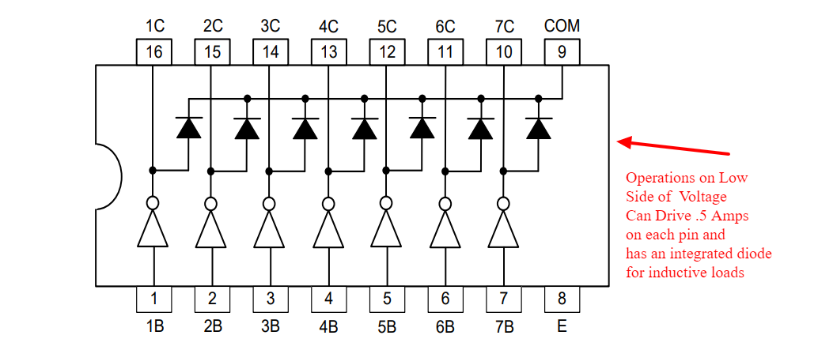
Hardware Section
Introduced a TI report on using 3.3 Volt Systems on 5.0 Volt Systems
Two Useful Hardware Chips in these situations
Comparator
ULN2003A

Slide 8
Hardware Section Water Turbine
Many Agriculture Sites do not have electrical power and never will have electrical power.
Solar Power is one answer.
However most sites have high pressure water and moderate to high water flows.
Water turbines attached to the irrigation lines can generate significant power
A $10.00 , 10 Watt power generator is shown on next page

Slide 9
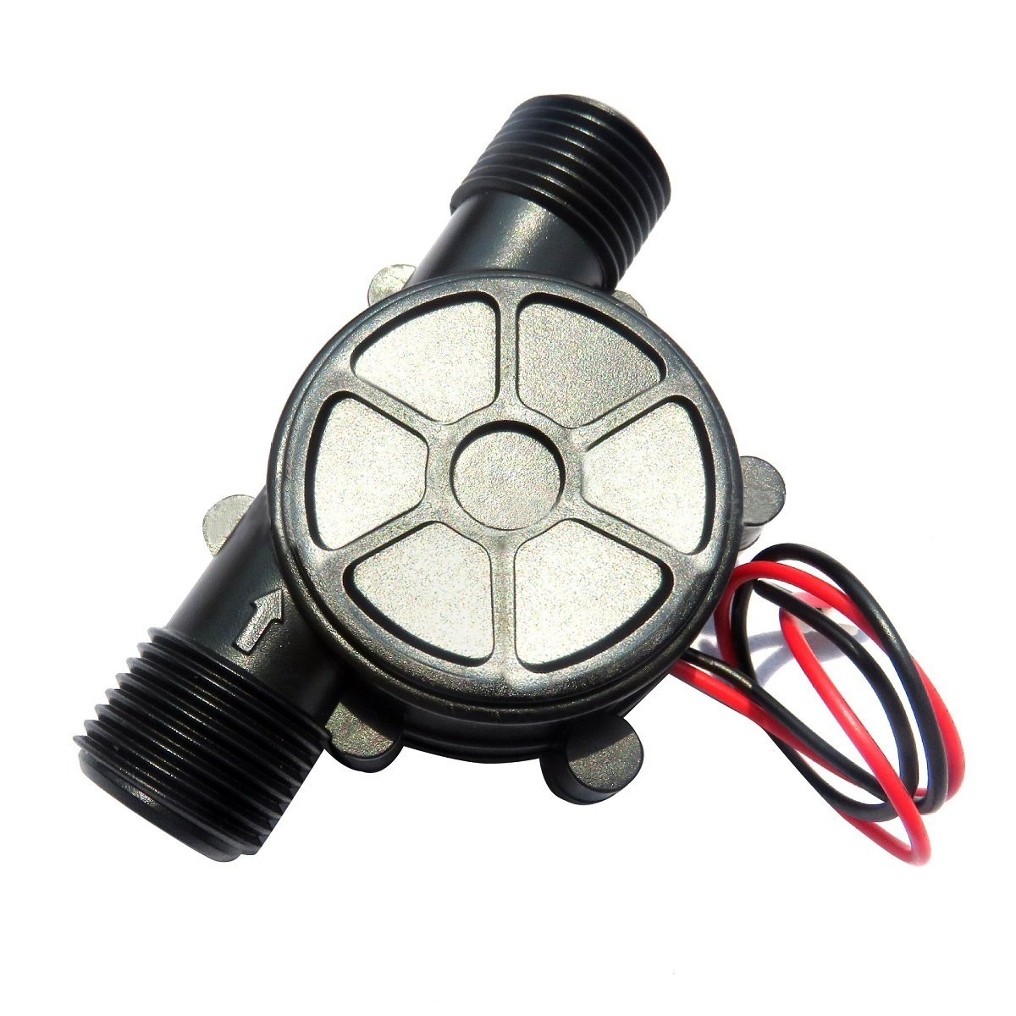
Low Cost Generators Available??
10 W various voltages
.25 inlet
$10.00
Need to up scale or fit multiple units
Into the system

Slide 10
Topics For Today
Redis with Elastic Search Capability
Irrigation Hardware Part 1
Next Few Weeks
Feb 27 Redis Graph part 1 / Irrigation Hardware Part 2
March 6 Redis Graph part 2 / Hardware for Vending Machine
March 13 Python Application Support / Hardware ?
March 20 Docker Setup / Hardware ?
March 27 Web Design / Hardware ?
April 3 Alexa Integration / Hardware ?

