Slide 1
Atmospheric pressure

Slide 2
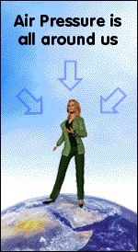

Slide 3
What causes atmospheric pressure?
The atmosphere is made up of a mixture of gases
It is like a deep sea of air which surrounds the Earth
The moving particles in air exert pressure in all directions

Slide 4
Does the atmosphere change?
The atmosphere is a gas which can be squashed.
The air closest to the Earth is more squashed and so is more dense
At higher levels the air becomes less dense, and therefore the pressure it exerts is also reduced

Slide 5
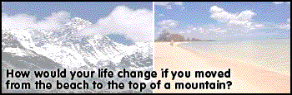
Living at different altitudes
This leads to increased lung capacity
Down at sea level atmospheric pressure is about 100 000 Pa (pressure is sometimes measured in Atmospheres or mmHg)
As you increase in altitude the air becomes less dense and the atmospheric pressure decreases

Slide 6
The effects of high altitude on breathing
Athletes train at high altitudes because of the effects on their lungs
At lower pressures gas exchange in the lungs is not as easy as at high pressure.
There is less oxygen so they have to breath in a greater volume of air
Another effect is that the red blood cell count increases in order to transport the oxygen more efficiently through the body

Slide 7
Question
If atmospheric pressure is 100 000 N/m², what force is exerted on a wall with an area of 10m²?

Slide 8
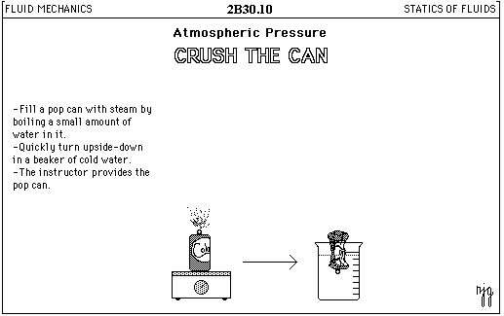
Can you explain how this experiment works?

Slide 9
This powerpoint was kindly donated to www.worldofteaching.com
http://www.worldofteaching.com is home to over a thousand powerpoints submitted by teachers. This is a completely free site and requires no registration. Please visit and I hope it will help in your teaching.

